Slide 1
All-to-all communication
Gorums

Slide 2
Distributed systems
Benefits:
Scalability
Availability
Performance
Modularity
Challenges:
Coordination
Communication
Fault-tolerance
Complexity
Gorums should offer the benefits and mitigate the challenges.
source

Slide 3
Preliminary
It is assumed that all nodes know about each other in advance
Request-response (QuorumCall) ← Currently uses this
Push (Multicast)
Proposition:
Use QuorumCall for Client to Server communication
Use Multicast for Server to Server communication

Slide 4
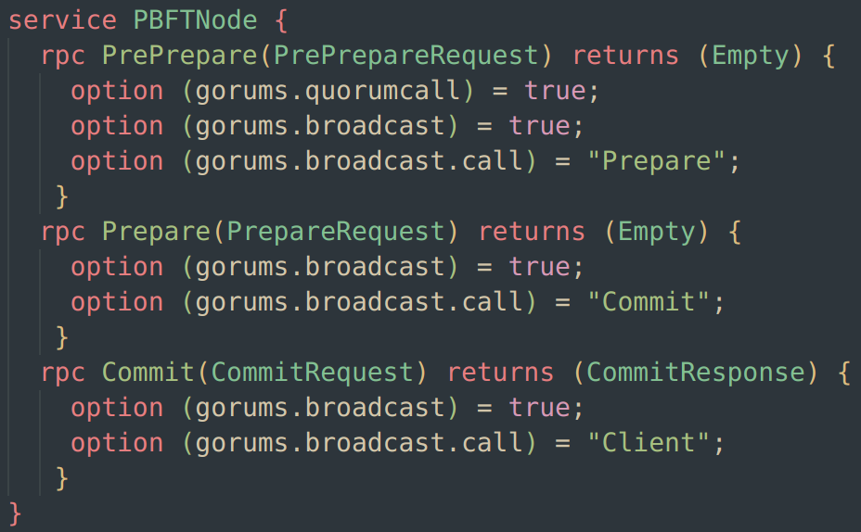
Code

Slide 5
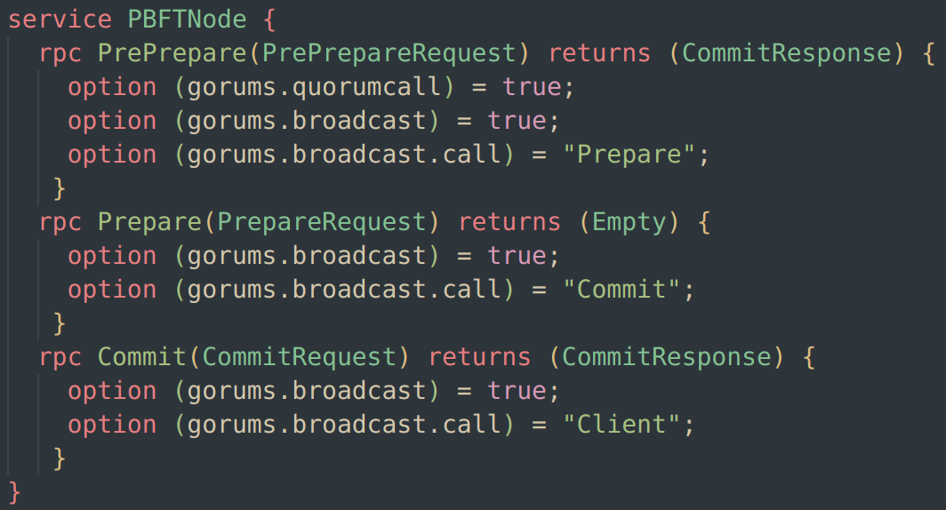
Code

Slide 6
Code

Slide 7
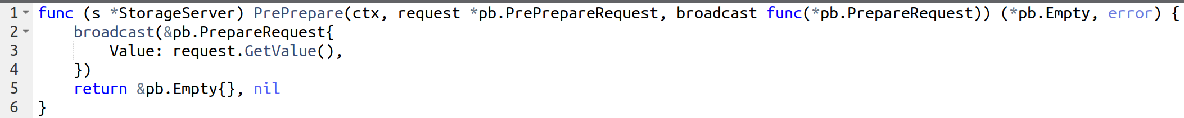
Code

Slide 8
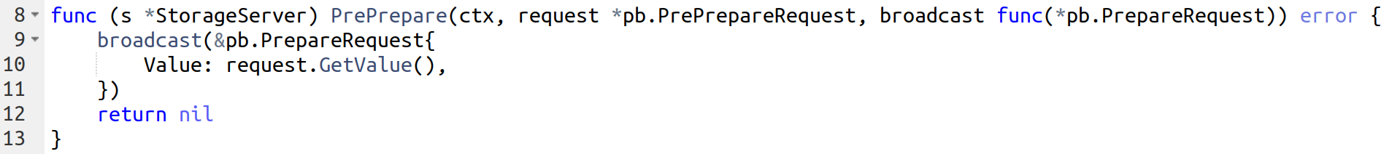
Code
Is this function signature better when the response is not needed?

Slide 9
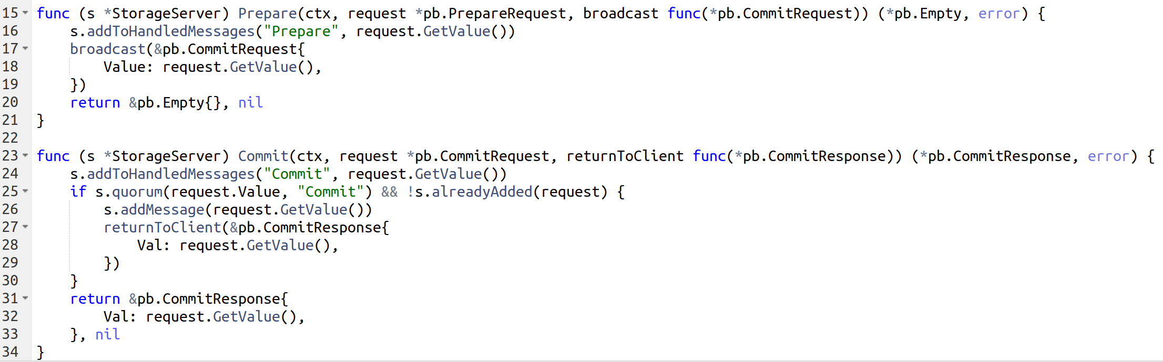
Code

Slide 10
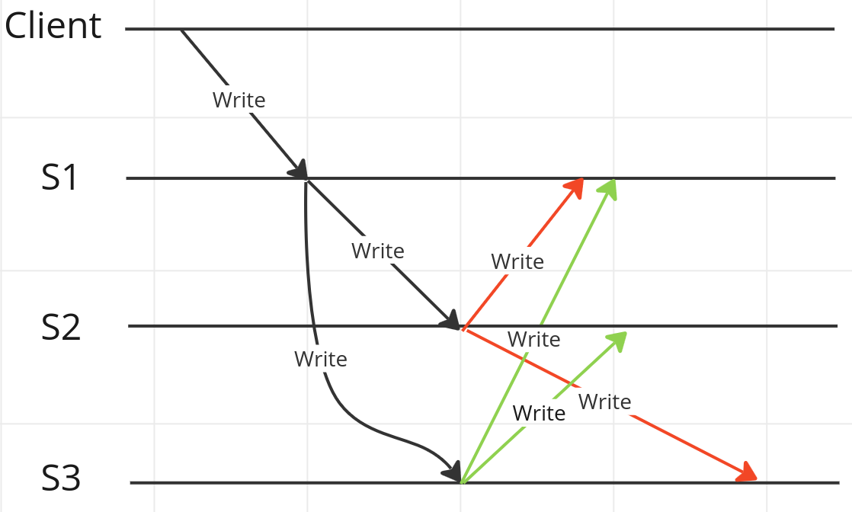
All-to-all invoking same method

Slide 11
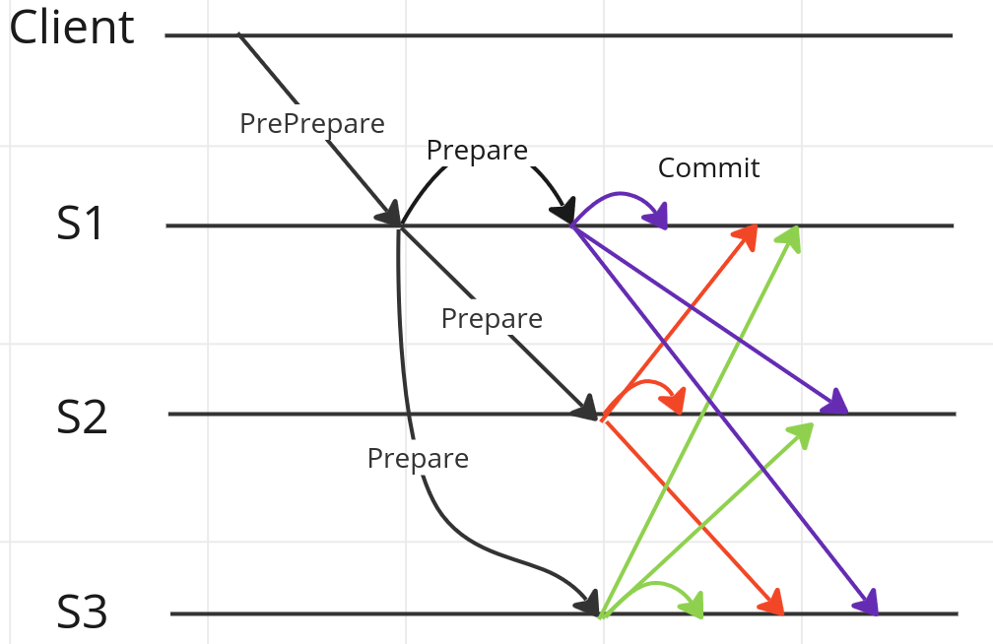
All-to-all invoking another method

Slide 12
All-to-all invoking another function
Note: Server broadcasting to itself

Slide 13
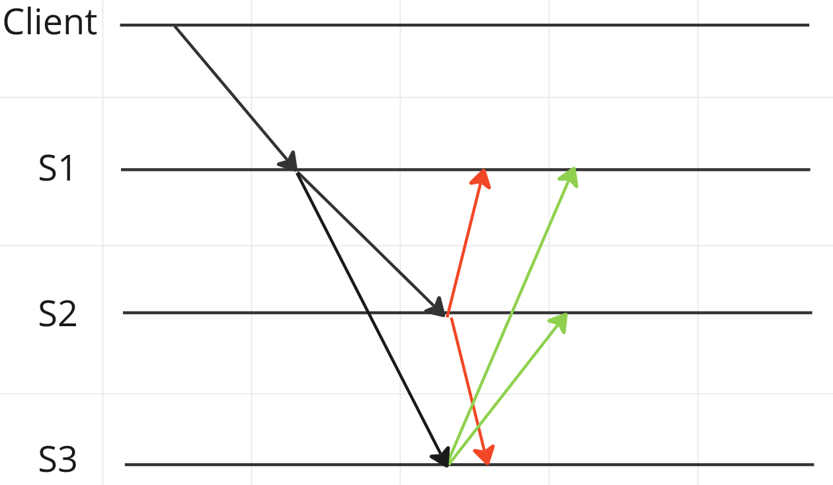
Guarantee that a node broadcasts only once

Slide 14
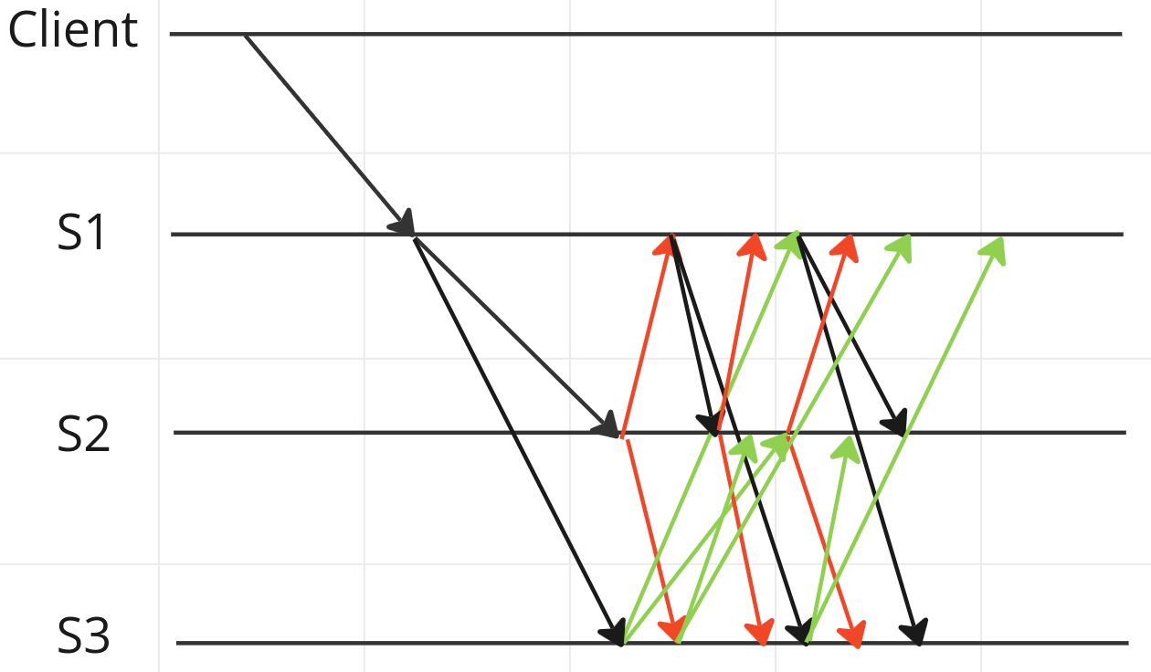
We don’t want this

Slide 15
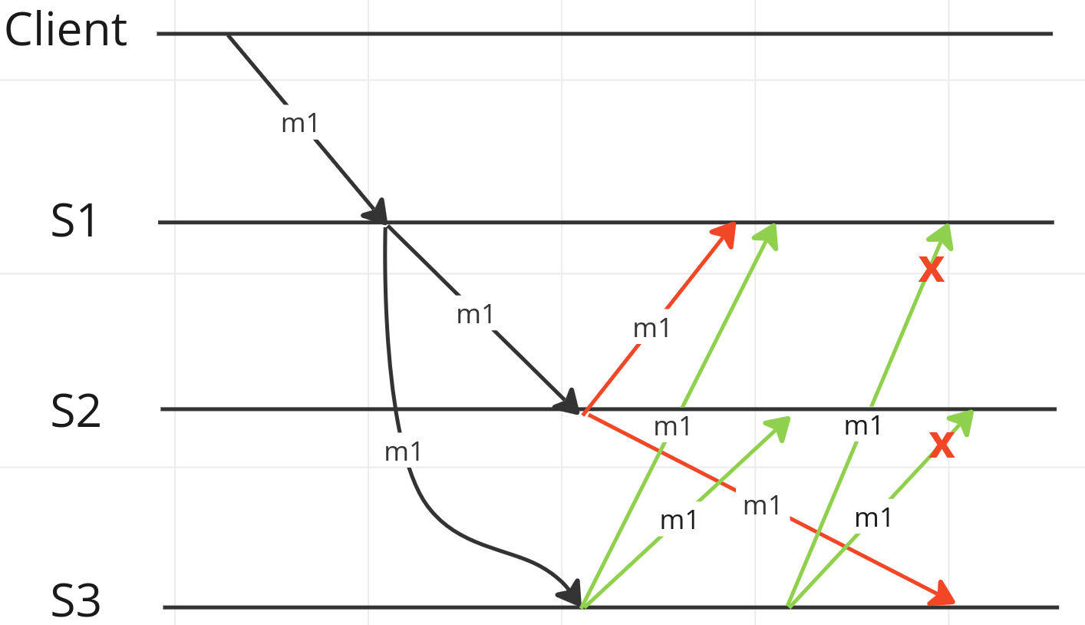
Guarantee that a request is unique (duplicates are dropped at the receiver)

Slide 16
Guarantee that a request is unique
Note:
m1 != message 1
m1 = gRPC method 1
A request is defined as following:
A client issues a gRPC call with a message request
This message request is tagged with a unique ID
All following broadcast messages will contain this ID
Hence, all broadcasts can be seen as part of the initial client request
This way, subsequent gRPC calls to the same method won’t be dropped

Slide 17
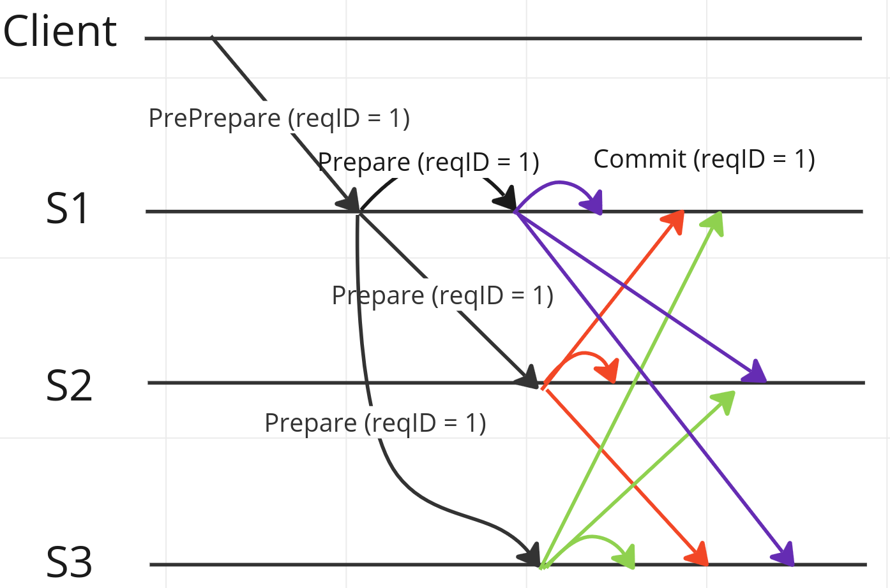
Guarantee that a request is unique

Slide 18
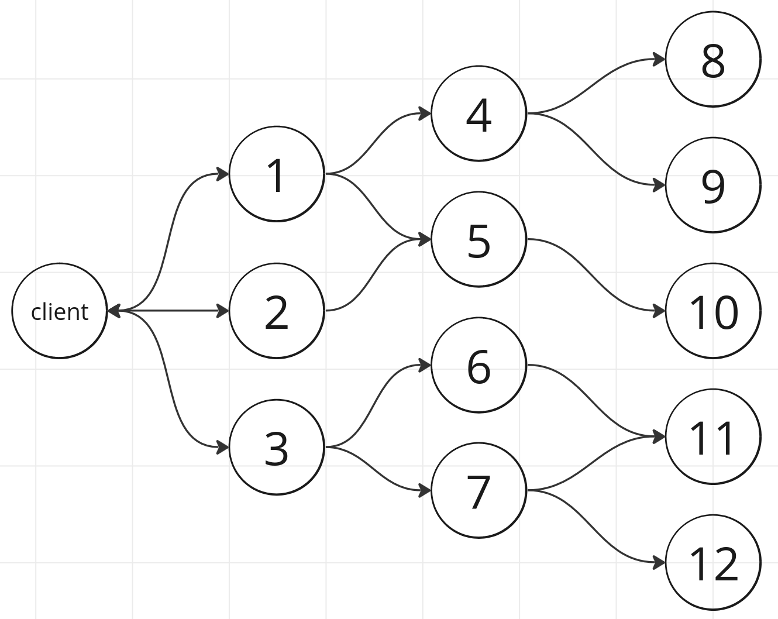
Client time outs

Slide 19
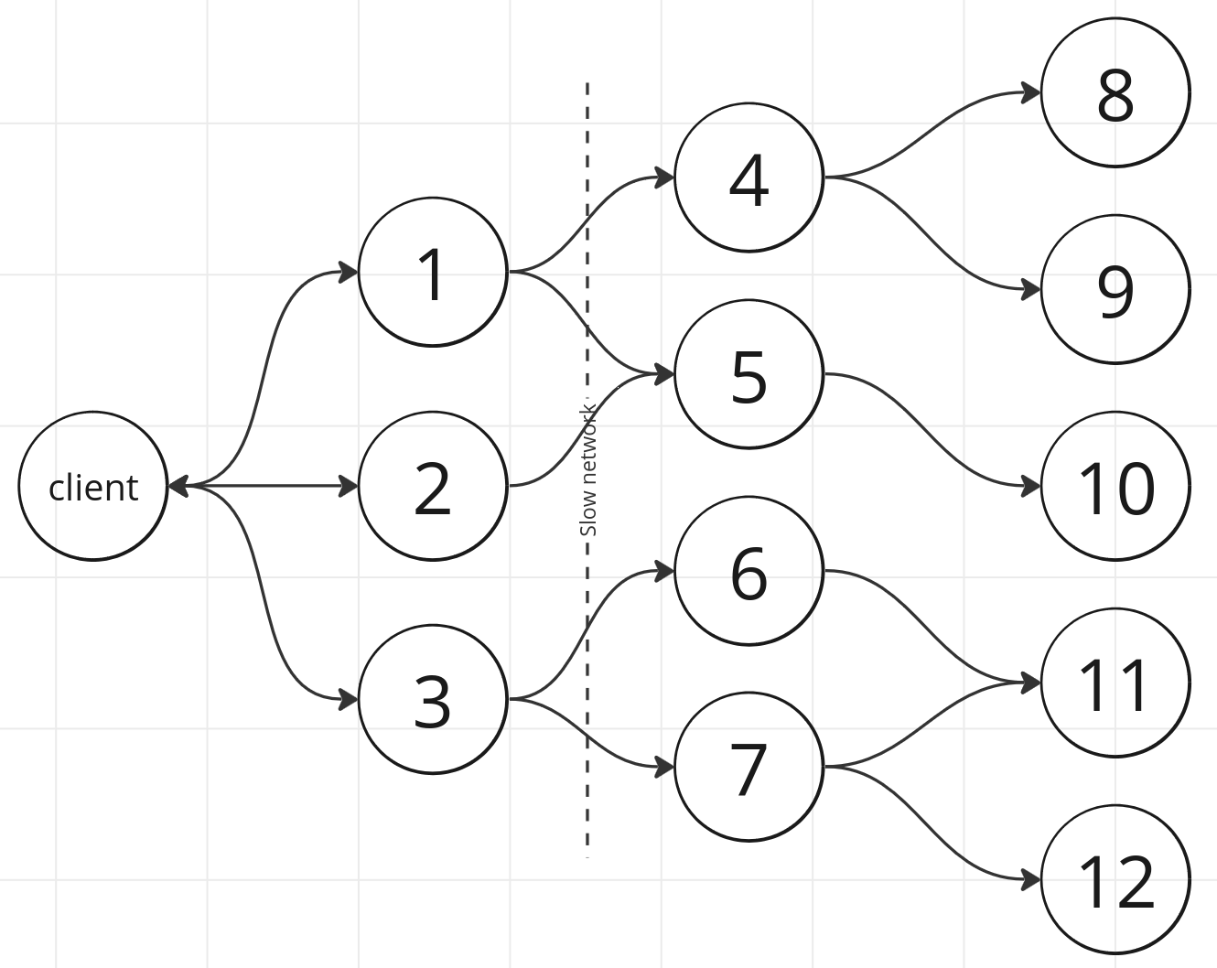
Client time outs

Slide 20
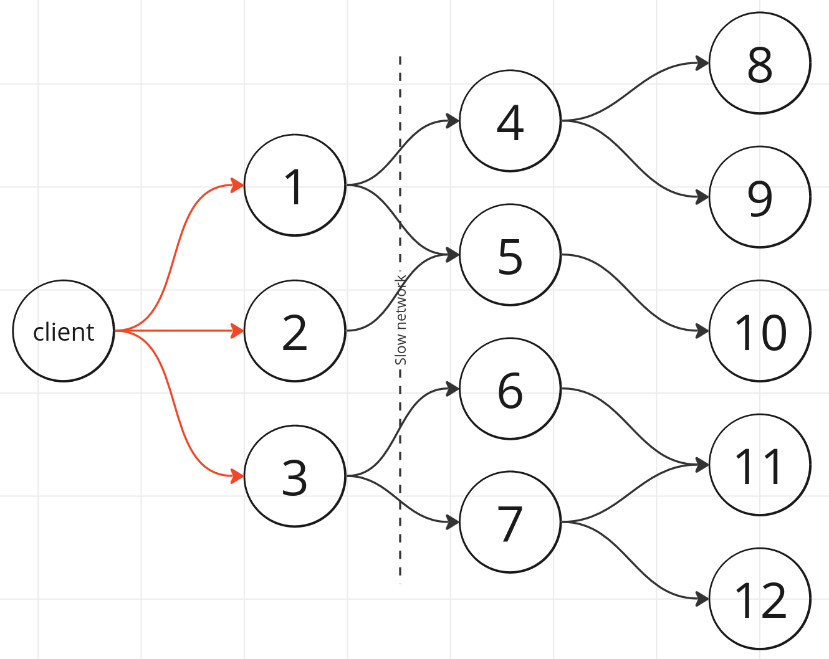
Client time outs

Slide 21
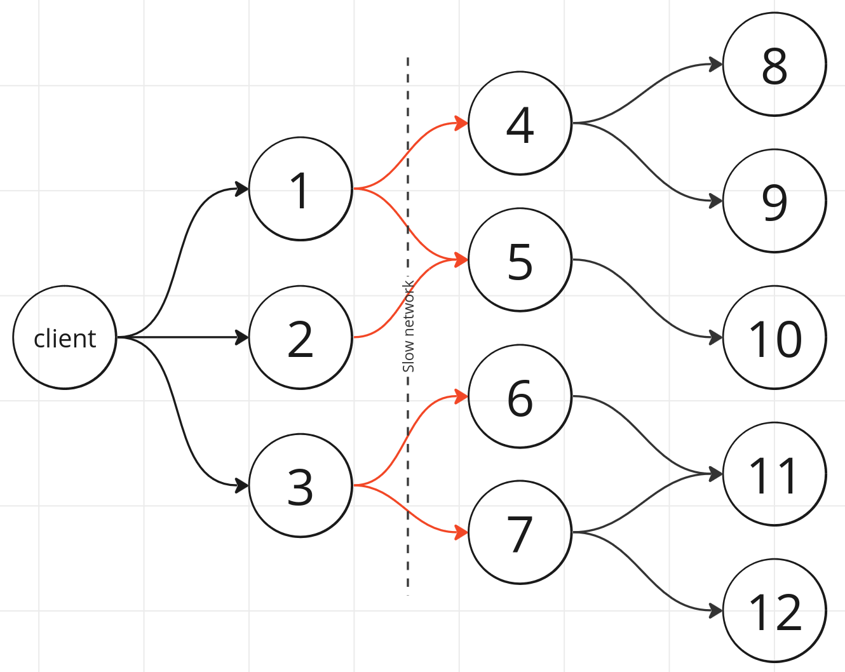
Client time outs

Slide 22
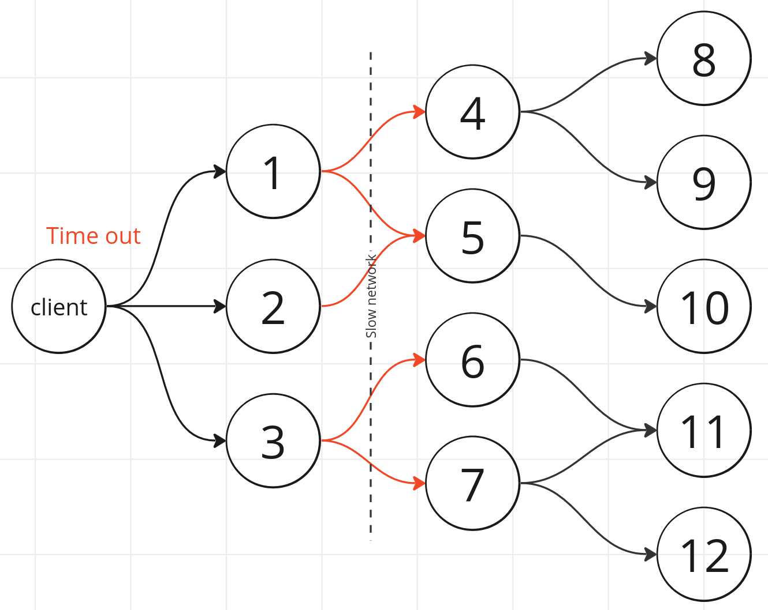
Client time outs

Slide 23
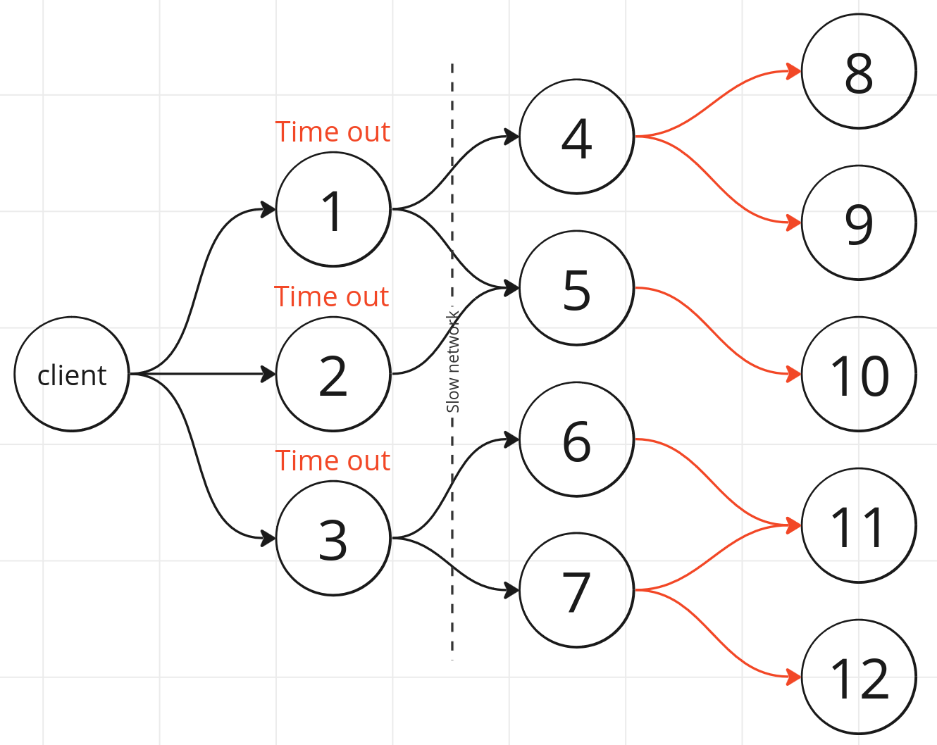
Client time outs

Slide 24
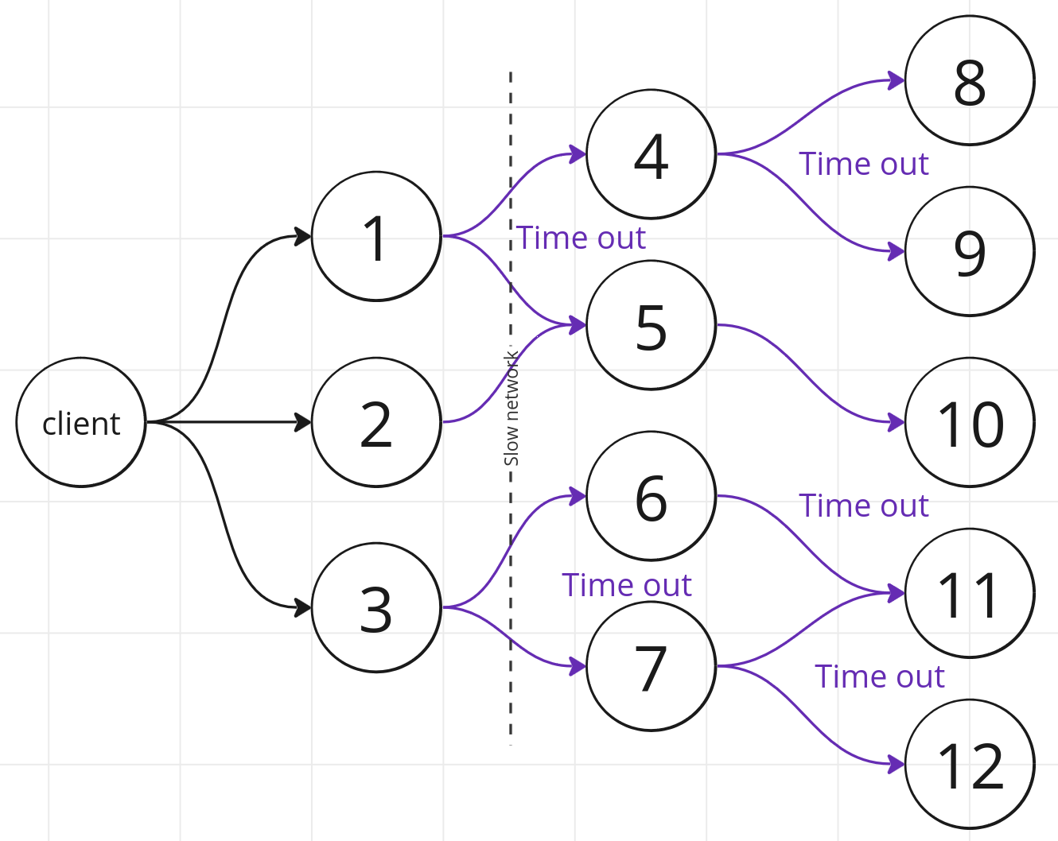
Client time outs

Slide 25
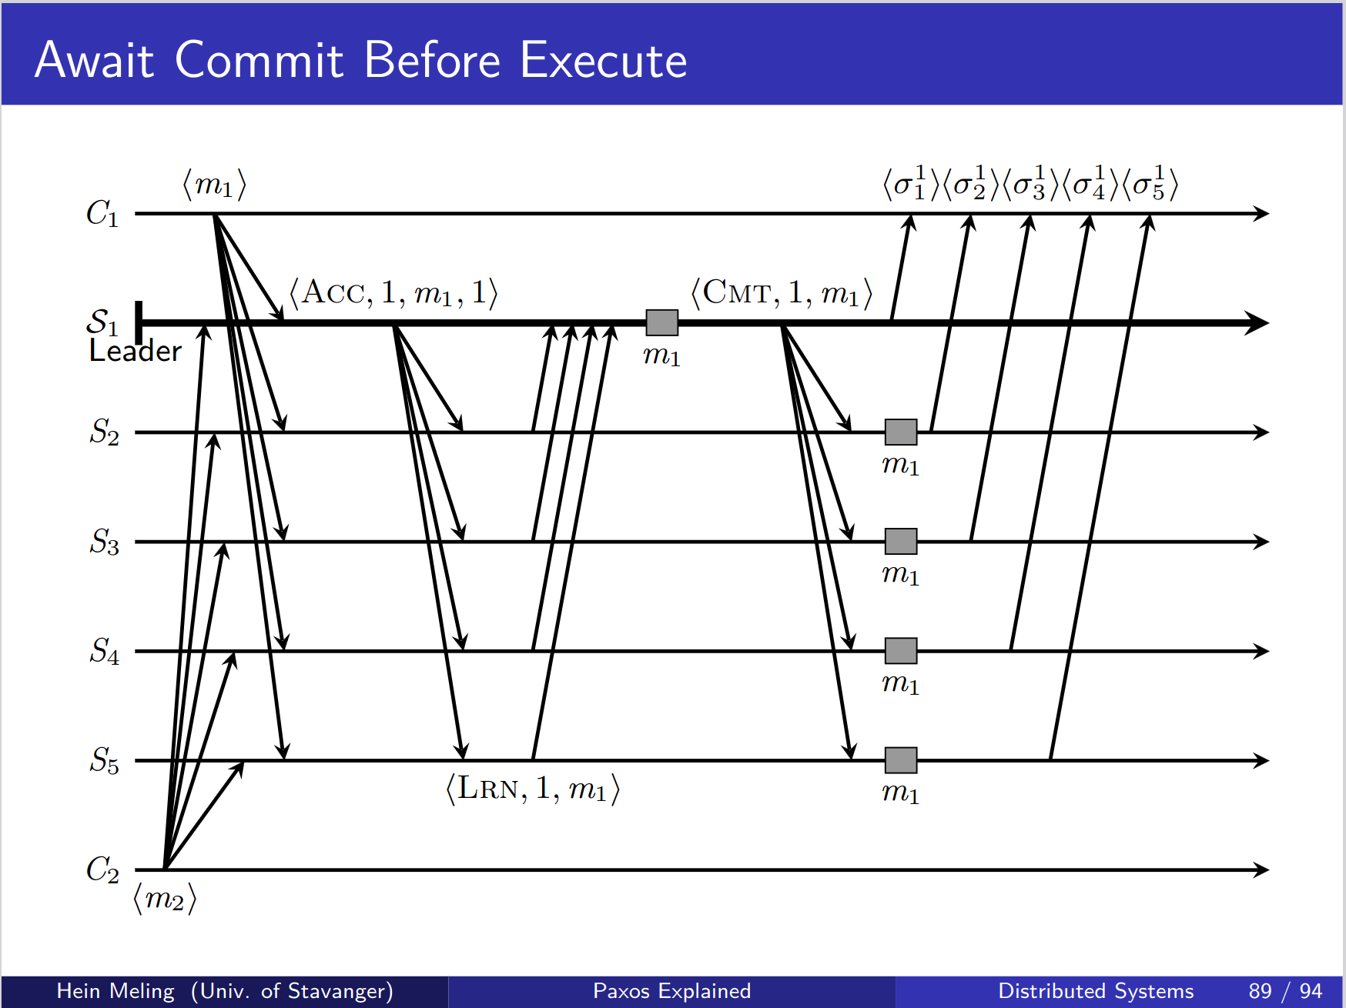
Paxos without all-to-all

Slide 26
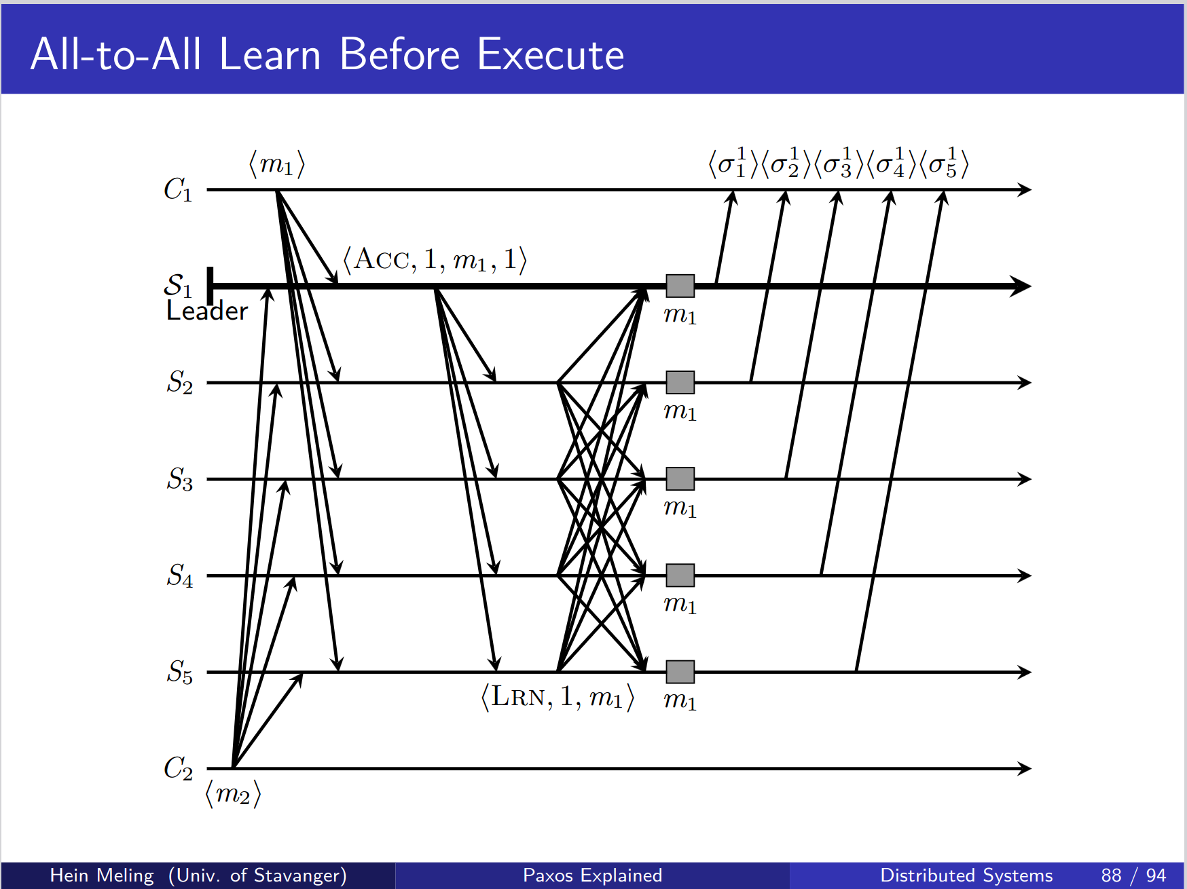
Paxos with all-to-all

Slide 27
Paxos with all-to-all
One less communication step needed (Commit)

Slide 28
Response
Client to server: Return a response based upon a criteria
Some default criteria can be provided:
Immediately
Quorum
Majority
All
User defined function:
Do you have any suggestions for use cases?
Server to server:
Responses are ignored. Are there use cases for this?

Slide 29
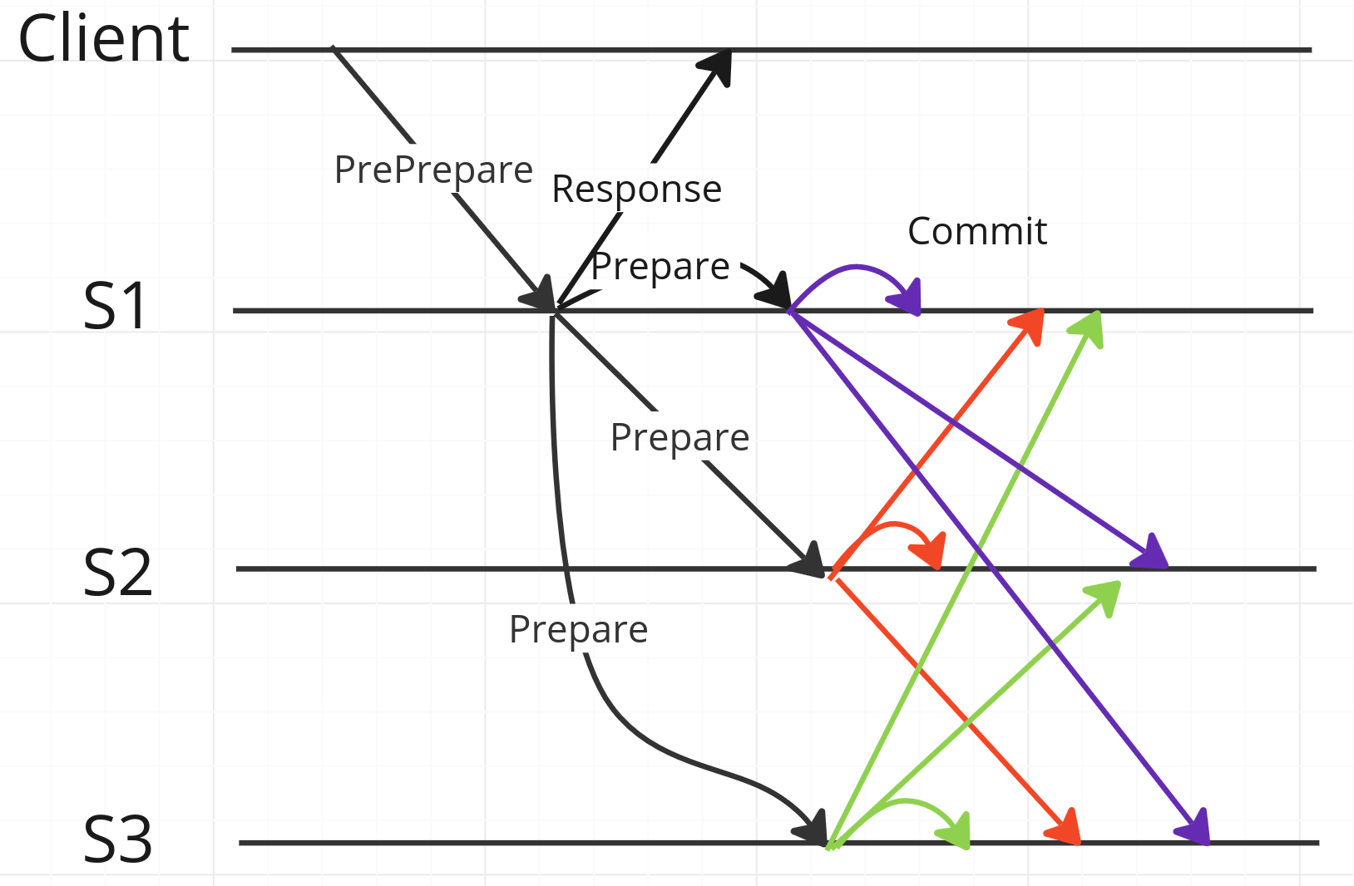
Response – Return (immediately)

Slide 30
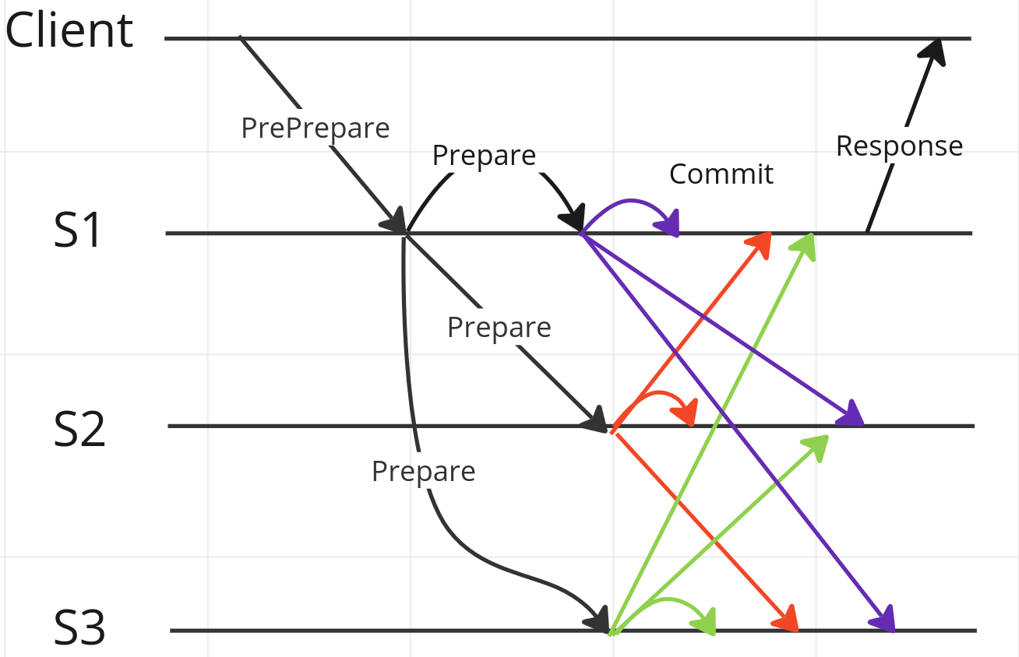
Response – Return (criteria)

Slide 31
Miscellaneous
Support streaming? Use cases?
Authentication?
Is it possible to hijack a gRPC stream?
Server to server streams could be setup at the start with auth
Subsequent communication can be trusted because a stream is already setup? Or is it necessary to verify all communication?

Slide 32
Library functions
Implement a set of broadcast functions?
Best effort broadcast
Reliable broadcast
Uniform broadcast
Implement leader election?
Failure detector
Leader election
Others suggestions?

Slide 33
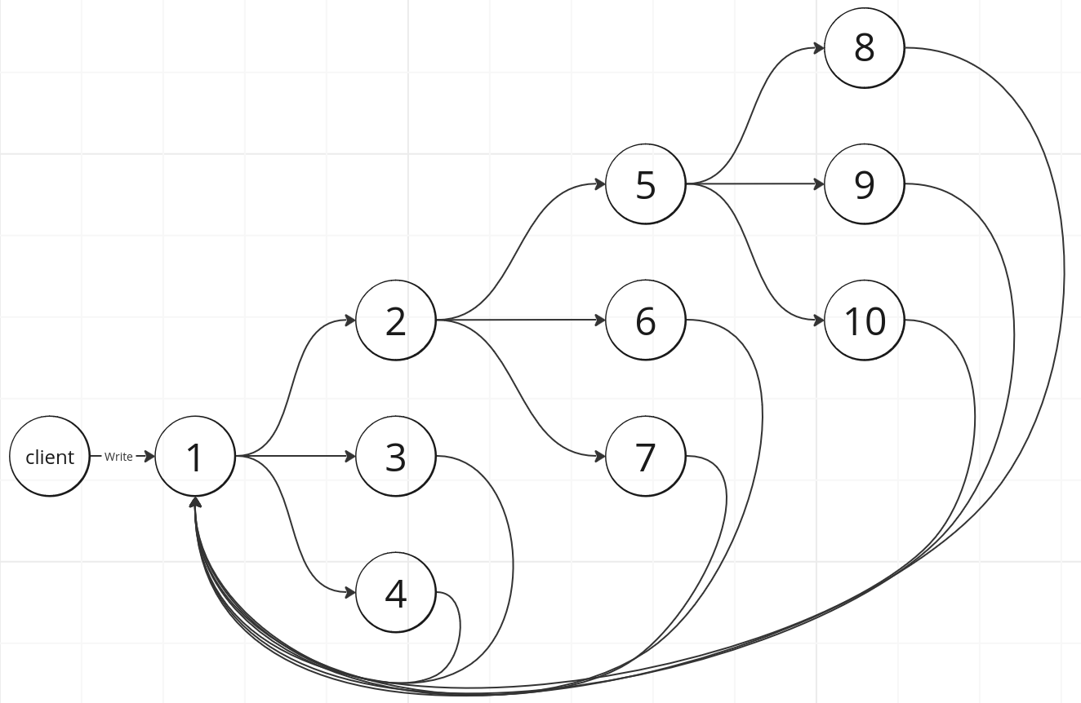
Gossiping

Slide 34
“A distributed system is one in which the failure of a computer you did not even know existed can render your own computer unusable.” - Leslie Lamport

