Slide 1
Input/Output
File reading and writing
Gradle
CSV reading and writing

Slide 2
In the Java API, a source from which one can read bytes is called an input stream. The bytes can come from a file, a network connection, or an array in memory.
Similarly, a destination for bytes is an output stream.
In contrast, readers and writers consume and produce sequences of characters.

Slide 3
Input/Output Streams (bytes processing)
InputStream
abstract int read();
OutputStream
abstract void write(int b)
How to create:
InputStream in = Files.newInputStream(path); OutputStream out = Files.newOutputStream(path);

Slide 4
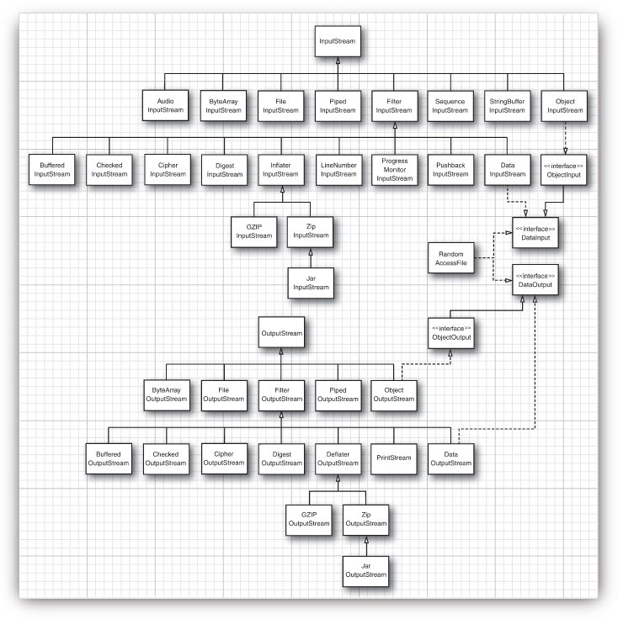

Slide 5
Input/Output Streams operate on simple bytes.
To read and write strings and numbers, you need more capable subclasses.
DataInputStream and DataOutputStream let you read and write all the primitive Java types in binary format.
ZipInputStream and ZipOutputStream let you read and write files in the familiar ZIP compression format.
FileInputStream and FileOutputStream give you input and output streams attached to a disk file. You need to pass the file name or full path name of the file to the constructor.
FileInputStream fin = new FileInputStream("employee.dat");

Slide 6
Different InputStreams can be combined
FileInputStream fin = new FileInputStream("employee.dat");
DataInputStream din = new DataInputStream(fin);
double x = din.readDouble();
DataInputStream din = new DataInputStream(
new BufferedInputStream(
new FileInputStream("employee.dat")));

Slide 7
import java.io.BufferedInputStream;
import java.io.IOException;
import java.io.InputStream;
import java.net.URL;
public class Input {
public static void main(String[] args) throws IOException {
URL url = new URL("http://google.com");
InputStreamReader urlIn = new InputStreamReader (url.openStream());
BufferedReader in = new BufferedReader(urlIn);
String inputLine;
while ((inputLine = in.readLine()) != null)
System.out.println(inputLine);
in.close(); }
}

Slide 8
Reader/Writer (text processing)
Reader
abstract int read()
Writer
abstract void write(int c)

Slide 9
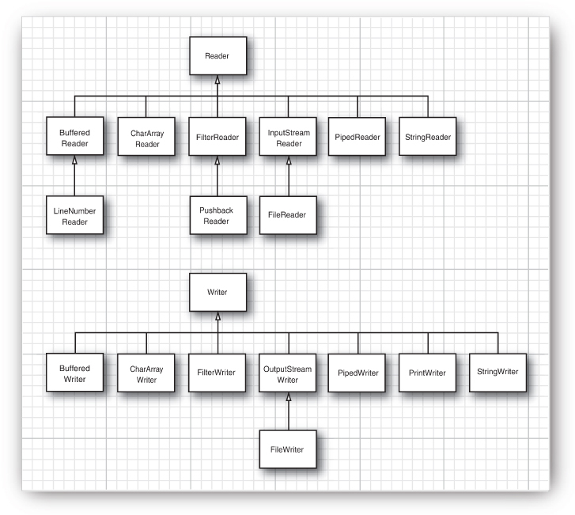

Slide 10
Writing to text file
PrintWriter out = new PrintWriter("file.txt");
String name = "Harry Hacker";
double salary = 75000;
out.print(name);
out.print(" ");
out.println(salary);
out.flush();

Slide 11
Read from text file
BufferedReader objReader = new BufferedReader(new FileReader("file.txt")); List<String> lines = new ArrayList<>;
String strCurrentLine; while ((strCurrentLine = objReader.readLine()) != null) { lines.add(strCurrentLine); } // or shorter way List<String> lines = Files.readAllLines(Paths.get(PATH));

Slide 12
Working with files
Files
createDirectory
copy
move
delete
list

Slide 13
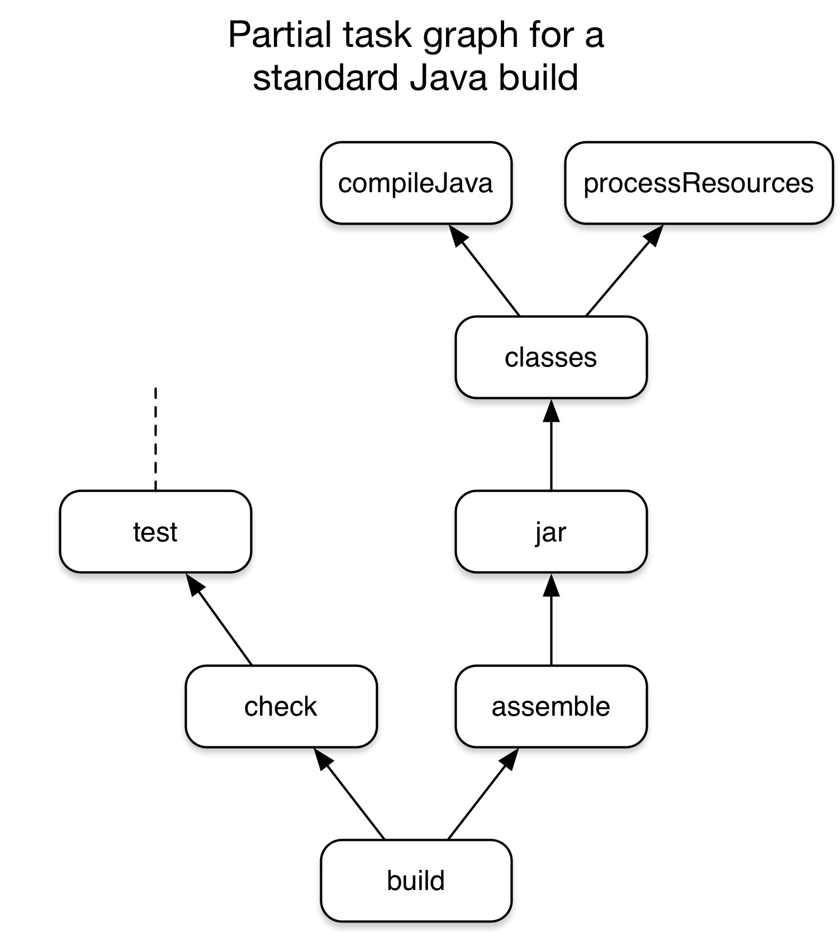
Gradle
Gradle is an open-source build automation tool that is designed to be flexible enough to build almost any type of software.
Dependency Management
Software projects rarely work in isolation. In most cases, a project relies on reusable functionality in the form of libraries or is broken up into individual components to compose a modularized system. Dependency management is a technique for declaring, resolving and using dependencies required by the project in an automated fashion.

Slide 14
build.gradle
plugins {
id 'java'
}
group 'com.wit.codered.csv'
version '1.0'
sourceCompatibility = 1.8
repositories {
mavenCentral()
}
dependencies {
compile group: 'org.apache.commons', name: 'commons-csv', version: '1.7'
testCompile group: 'junit', name: 'junit', version: '4.12'
}

Slide 15
package com.wit.codered.csv;
public class User {
private final String name;
private final String email;
public User(String name, String email, String phone, String country) {
this.name = name;
this.email = email;
this.phone = phone;
this.country = country;
}
@Override
public String toString() {
return String.format("User{name='%s', email='%s'}", name, email); }
}

Slide 16
package com.ubs.wit.codered.csv; import org.apache.commons.csv.CSVFormat; import org.apache.commons.csv.CSVParser; import org.apache.commons.csv.CSVPrinter; import org.apache.commons.csv.CSVRecord; import java.io.IOException; import java.io.Reader; import java.io.Writer; import java.nio.file.Files; import java.nio.file.Paths; import java.util.ArrayList; import java.util.List; public class UserCsvApplication { public static void main(String[] args) throws IOException { Reader fileReader = Files.newBufferedReader(Paths.get("users.csv")); CSVFormat csvFormat = CSVFormat.DEFAULT.withFirstRecordAsHeader().withTrim(); CSVParser csvParser = new CSVParser(fileReader, csvFormat); List<User> users = new ArrayList<>(); List<CSVRecord> records = csvParser.getRecords(); for (CSVRecord record : records) { User u = new User(record.get("Name"), record.get("Email")); users.add(u); } for (User user : users) { System.out.println(user); } users.add(new User("George Bush", "g.bush@example.com")); Writer writer = Files.newBufferedWriter(Paths.get("users-updated.csv")); CSVFormat csvWriteFormat = CSVFormat.DEFAULT.withHeader("Name", "Email").withTrim(); CSVPrinter printer = new CSVPrinter(writer, csvWriteFormat); for (User user : users) { printer.printRecord(user.getName(), user.getMail()); } printer.flush(); } }

Slide 17
package com.wit.codered.csv;
import org.apache.commons.csv.CSVFormat;
import org.apache.commons.csv.CSVPrinter;
import java.io.BufferedWriter;
import java.io.IOException;
import java.nio.file.Files;
import java.nio.file.Paths;
import java.util.Arrays;
public class UserCsvWriter {
private static final String SAMPLE_CSV_FILE = "sample.csv";
public static void main(String[] args) throws IOException {
BufferedWriter writer = Files.newBufferedWriter(Paths.get(SAMPLE_CSV_FILE));
CSVFormat format = CSVFormat.DEFAULT.withHeader("Name", "Email", "Phone", "Country");
CSVPrinter csvPrinter = new CSVPrinter(writer, format);
csvPrinter.printRecord("Anna Nowak", "anna.nowak@onet.pl", "112", "Poland");
csvPrinter.printRecord("John Smith", "john.smith11@gmail.com", "112", "UK");
csvPrinter.flush();
}
}

Slide 18
users.csv
Name,Email
Barak Obama,barak.obama@example.com
Donald Trump,donald.trump@example.com

