Slide 1
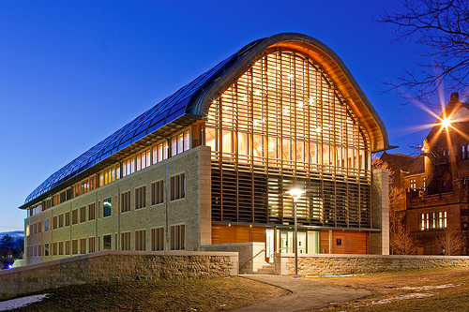
Kroon Hall
Designed by Hopkins Architects (Michael Taylor, Sophy Twohig, Henry Kong, Tom Jenkins, Thomas Corrie, Andrew Stanforth, Nathaniel Moore) in 2009, with Centerbook Architects as Executive Architects. It houses Yale School of Forestry and Environmental Studies and has offices, classrooms, a library and an auditorium. It is notable for being a very sustainable and energy efficient building, which coincides with the goals of Environmental Studies.
Aleksandra Zakrzewska

Slide 2
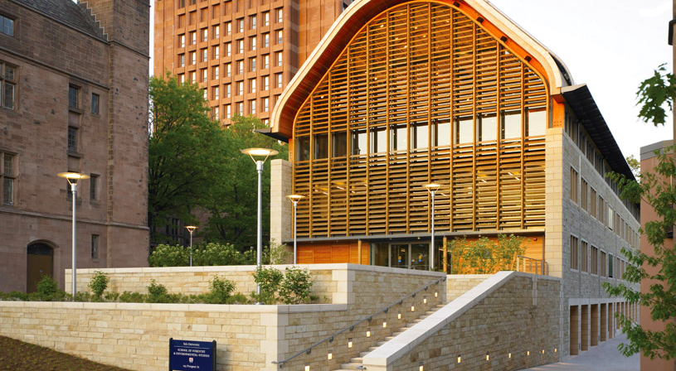
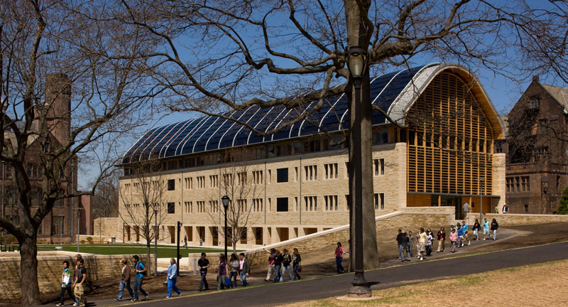
Curve of roof continues seamlessly into stone sides
Plants coexist with nature theme of wooden framework and welcome up the stairs
Large front and back windows let in a lot of natural light, but wooden lines provide warm, natural feel, instead of stern reflections
Roof covered entirely in solar panels makes them integral to design, giving smooth black finish
Front and back design is same, lending simplicity and continuity
Smooth curve of roof allows solar panels to have better angles to sun, while also softening the shape from standard point
Stone side is much more enclosed and feels less welcoming than front
Entrance on second floor allows building to work smoothly with the contours of the ground and draws people towards the building

