Slide 1

Sistemas Inteligentes Aprendizagem não Supervisionada Incremental
Docente
Luís Seabra Lopes
Autores
José Horácio Fradique Duarte, Mec. 62406
Fernando José Fradique Duarte, Mec. 48257
Mestrado em Engenharia Informática, 2016/2017

Slide 2
Tecnologies Used
PCL - Point Cloud Library Version 1.7.2
C++98
PCL Class|Paremeters | Usage | Application Module
VoxelGrid voxel size = 0.015 | Point cloud downsampling and Key points extraction. | FeatureExtractor
SpinImageEstimation window width = 8 support length = 0.1m support angle = 90º min points neighbors = 0 | Object views key points representation. | FeatureExtractor
KdTreeFLANN nearestKSearch(...) radiusSearch(...) search radius = 0.065 | Computation of distance between object views. | Searcher Memory
Notes: The parameters values, except for search radius, follow from the ones used in [4].
PCL Documentation, API, tutorials, etc. can be found at [3], [5] and [6].

Slide 3
DataSet I of II
We used the Washington RGB-D Object Dataset [7] [8] containing:
Views of 300 physically distinct everyday objects.
Organized into 51 categories arranged using WordNet [9].
Each view is a 3d point cloud in the PCD format.
Each point is stored with 6 fields:
3d coordinates (x, y, z)
color packed into 24 bits with 8 bits per channel (RGB)
image coordinates of the point (imX, imY).
Note: We assumed that the views were already cleaned up and we did not use a ConditionalRemoval filter to remove outliers, as in [4].

Slide 4
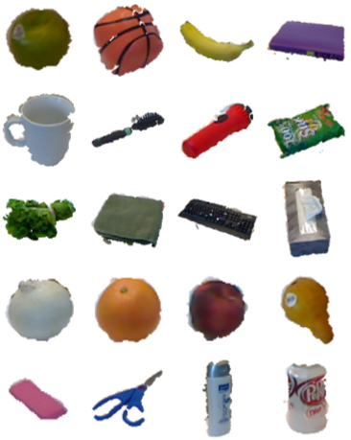
DataSet II of II
Fig 1: Some objects from the Washington RGB-D Object Dataset [10].

Slide 5
Architecture
Views Repository
Mem
ObjectViewRepository
Object View
Object View Point Cloud
Class
Memory
Keypoints/Features from Object View
FeatureExtractor
Object View Features and the Current Categories and Clusters
CategoryRecognizer
Features In
Memory
Object View Category Assigment Result
kmeans

Slide 6
Processing New Seen Features
Action
Keypoints/Features from New Object View
Add Features to Memory
Assign Features to some Cluster
Assign Features to some Category
Check Features for Redundancy

Slide 7
Applying Memory Decay
Action
Apply Memory Decay To Features in Memory
Process New Seen Features

Slide 8
Forgetting Features
Key Points/Features from New Object View
Key Point/Feature To Forget
Action
Check Feature Redundancy
Redistribute Global Weights
Key Points/Features in Memory
Global Weight <= Memory Decay Threshold
Key Point/Feature To Forget
Redistribute Local Weights
Remove Feature From Memory
Update Cluster Centroid

Slide 9
Assigning Features to Clusters and Cluster Quality Checks
Key Points/Features
From new Object View
Action
Assign Features to Nearest Cluster
Compute WSS for All Clusters
Check Split Conditions
Conditions not Meet
Conditions Meet
Check Merge Conditions
Split Cluster
Conditions Meet
Merge Cluster

Slide 10
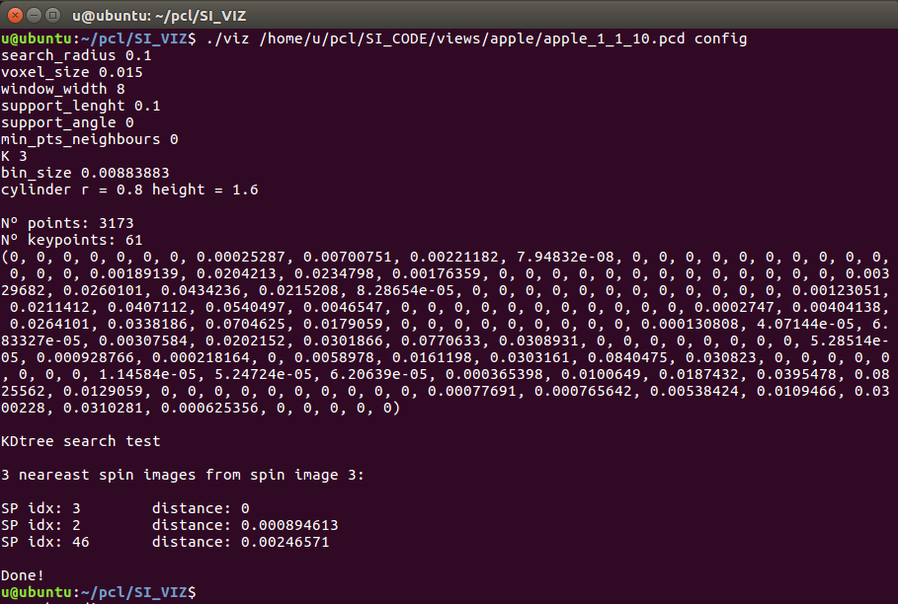
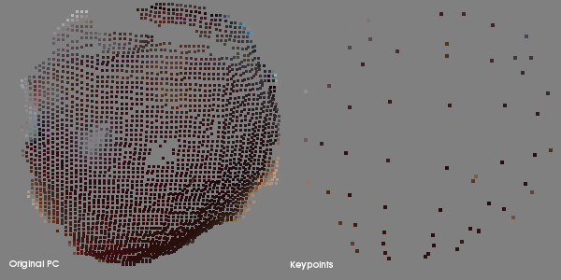
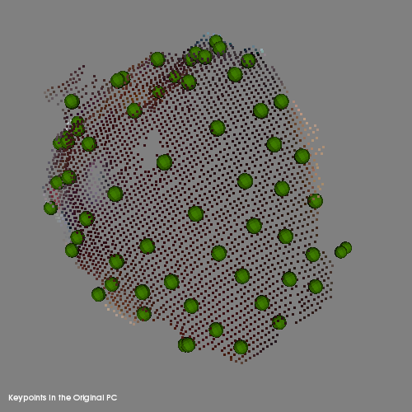
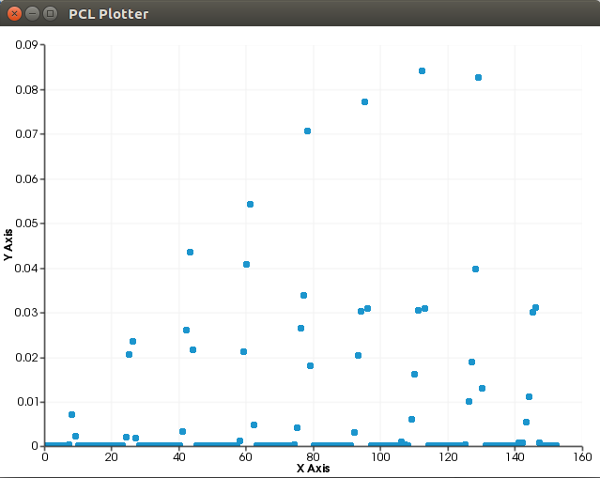
Viz Application
1
2
3
4
Fig 2: 1 - Viz console output. 2 - The original point cloud and the Key points. 3 - The key points on the original point cloud. 4 - Spin image histogram.

Slide 11
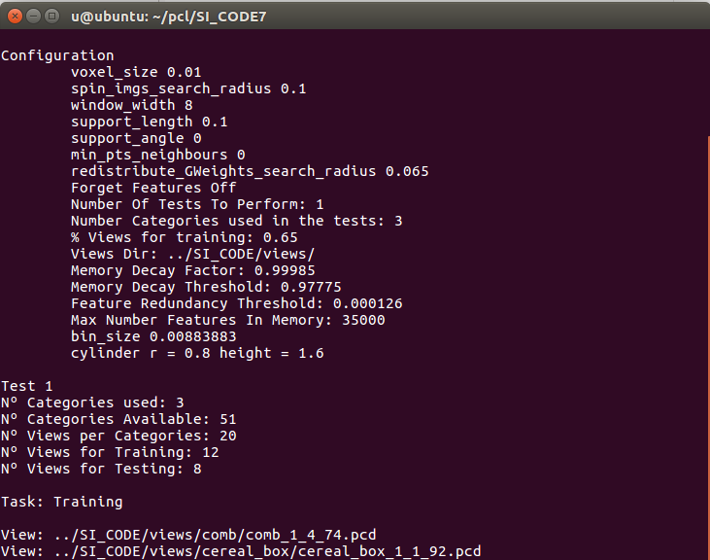
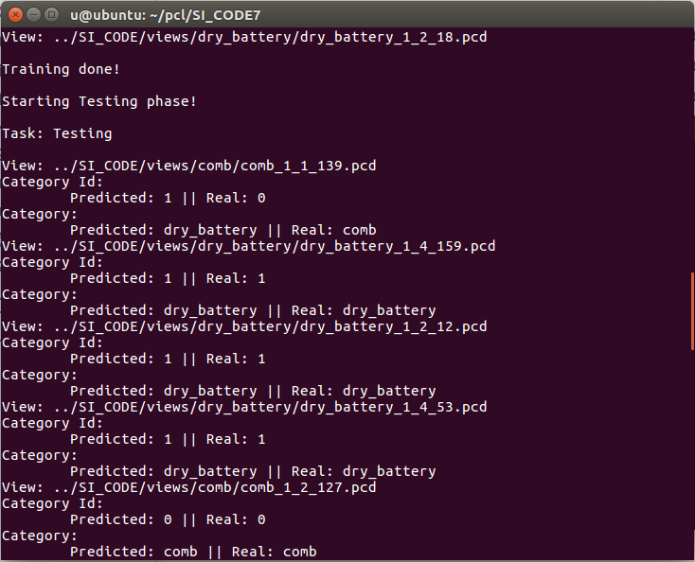
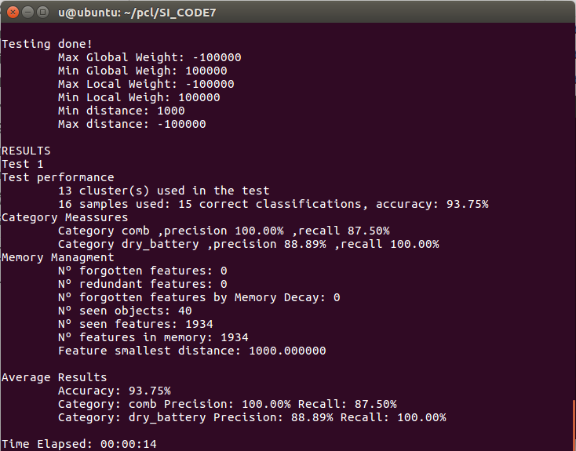
Main Application
1
2
3
3
Fig 3: 1 - Settings and training phase. 2 - Test phase. 3 - Results.

Slide 12
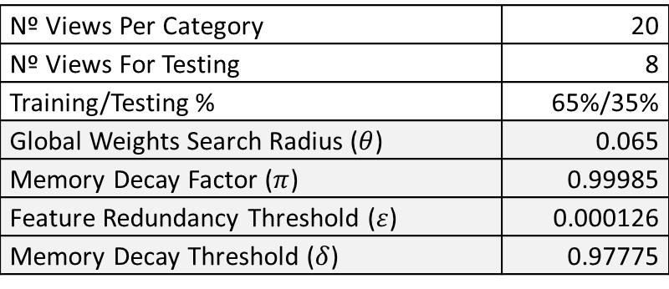
Tests Setup
The application was tested in a VMware virtual machine stored in an external HD. | RAM 4 Gb Nº Processors 1 Intel® Core™ i7-4510U CPU @ 2.00GHz HD 40 Gb OS Ubuntu 16.04 LTS 32-bit
Host machine | RAM 8 Gb Nº Processors 1 Intel® Core™ i7-4510U CPU @ 2.00GHz HD SSD OS Windows 8.1 64-bit
PCL | Version 1.7.2
K-means Paremeters
Nº Views Per Category | 20
Nº Views For Testing | 8
Training/Testing % | 65%/35%
Global Weights Search Radius ($θ$) | 0.065
Memory Decay Factor ($π$) | 0.99985
Feature Redundancy Threshold ($ε$) | 0.000126
Memory Decay Threshold ($δ$) | 0.97775
maxCheckIters 1
wssThreshForSplit 0.12
minSplitClusterSize 50
degenerateClusterSize 20
wssThreshForMerge 0.07
maxSplitClusterSize 500
bssThreshForMerge 0.14

Slide 13
Test Results Without Forgetting Features
Categories | Smashed Categories | Clusters | Accuracy | Features In Memory | Objects | Time
5 | None | 21 | 90.00% | 23864 | 100 | 04:59
10 | water_bottle | 23 | 76.25% | 41008 | 200 | 07:33
15 | water_bottle toothpaste | 25 | 65.00% | 56432 | 300 | 09:13
20 | Pliers water_bottle toothpaste | 38 | 65.00% | 65110 | 400 | 12:53
30 | water_bottle flashlight ball camera toothpaste | 29 | 58.75% | 119473 | 600 | 22:24
51 | Lot of smashed categories | 50 | 40.20% | 220136 | 1020 | 01:15:01*

Slide 14
Test Results While Forgetting Features
Categories | Smashed Categories | Clusters | Accuracy | Features In Memory | Objects | Time
5 | None | 28 | 87.50% | M: 20271 F: 3593 | 100 | 28:19 09:59
10 | water_bottle | 79 | 72.50% | M: 33615 F: 7393 R: 3702 D: 3691 | 200 | 01:17:32* 41:32
16 | water_bottle peach | 82 | 70.31% | M: 45736 F: 13149 R: 3890 D: 9259 | 320 | 01:00:00+
20 | pliers | 108 | 68.12% | M: 48312 F: 16798 R: 3882 D: 12916 | 400 | 01:00:00+

Slide 15
Test Results While Forgetting Features
Categories | Smashed Categories | Clusters | Accuracy | Features In Memory | Objects | Time
15 | None | 73 | 72.50% | M: 44664 F: 11768 R: 3862 D: 7906 | 300 | 01:10:12

Slide 16
Performance Issues and Optimization
The application does not scale well.
Two optimization fronts: the forgetting features mechanism and Kmeans.
Main reason: too many point cloud copies.
And cluster explosion :))
Too many thresholds, makes it difficult to find the most appropriate values. Need some data analysis techniques?

Slide 17
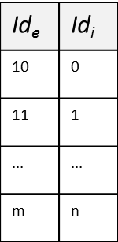
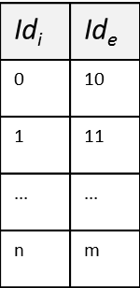
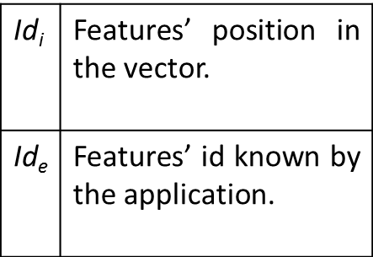
Data structure implemented using an unordered_map.
A New Architecture?
Data structure implemented using a std::vector<PointT>. This is a PCL point cloud.
Id$\text{i}$ | Id$\text{e}$
0 | 10
1 | 11
... | ...
n | m
ClassX
Point Cloud
Point Cloud With All Features in Memory
ClassY
Class
Lookup Table
Get/insert/delete Features
Id$\text{e}$ | Id$\text{i}$
10 | 0
11 | 1
... | ...
m | n
Manage Lookup Table
The Memory data structure stores: the categories, the cLusters, the features’ metadata and the point cloud of features.
Id$\text{i}$ | Features’ position in the vector.
Id$\text{e}$ | Features’ id known by the application.
PointCloudManager

Slide 18
Issues and Future Work
Optimize the application: improve performance, etc.
Define appropriate values for the forgetting features mechanism:
Memory Decay Threshold,
Memory Decay Factor,
Feature Redundancy Threshold, etc.
Define appropriate values for Kmeans:
Cluster Merge Threshold,
Cluster Split Threshold,
etc.
Test the application with more categories.

Slide 19
Bibliography And References
[1] Andrew E. Johnson, Martial Hebert (1998). Using Spin-Images for Efﬁcient Object Recognition in Cluttered 3-D Scenes. IEEE Transactions on Pattern Analysis and Machine Intelligence.
[2] S. Nene and S Nayar. Closest point search in high dimensions. Proc. Computer Vision and Pattern Recognition (CVPR ‘96), 1996.
[3] Marius Muja, Julius Kammerl July 1, 2011. PCL Tutorial at RSS 2011 PCL::Search. http://www.pointclouds.org/media/rss2011.html.
[4] Miguel Oliveira et. Al. (2016). 3D object perception and perceptual learning in the RACE project. Robotics and Autonomous Systems 75 (2016) 614–626. http://dx.doi.org/10.1016/j.robot.2015.09.019
[5] PCL Documentation: http://pointclouds.org/documentation/
[6] PCL API: http://docs.pointclouds.org/1.7.2/
[7] Washington RGB-D Object Dataset : http://rgbd-dataset.cs.washington.edu/dataset/rgbd-dataset_pcd_ascii/
http://www.cs.washington.edu/rgbd-dataset/
[8] A Large-Scale Hierarchical Multi-View RGB-D Object Dataset Kevin Lai, Liefeng Bo, Xiaofeng Ren, and Dieter Fox IEEE International Conference on Robotics and Automation (ICRA), May 2011.
[9] L. Bo, X. Ren, and D. Fox. Unsupervised Feature Learning for RGB-D Based Object Recognition
[10] Sílvio Filipe, Luís A. Alexandre. A Comparative Evaluation of 3D Keypoint Detectors in a RGB-D Object Dataset.

