Slide 1
Aleks website

Slide 2
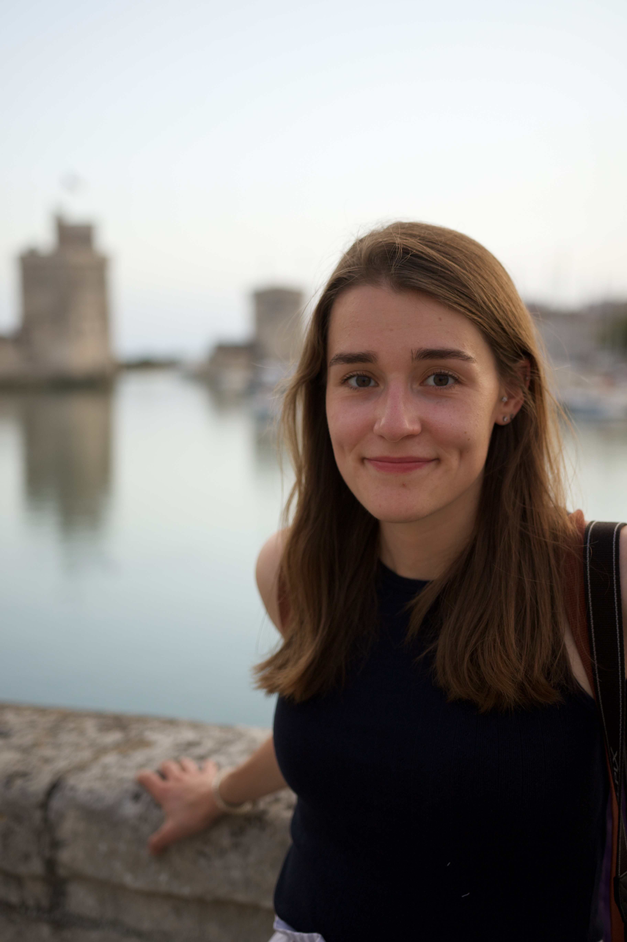

Slide 3
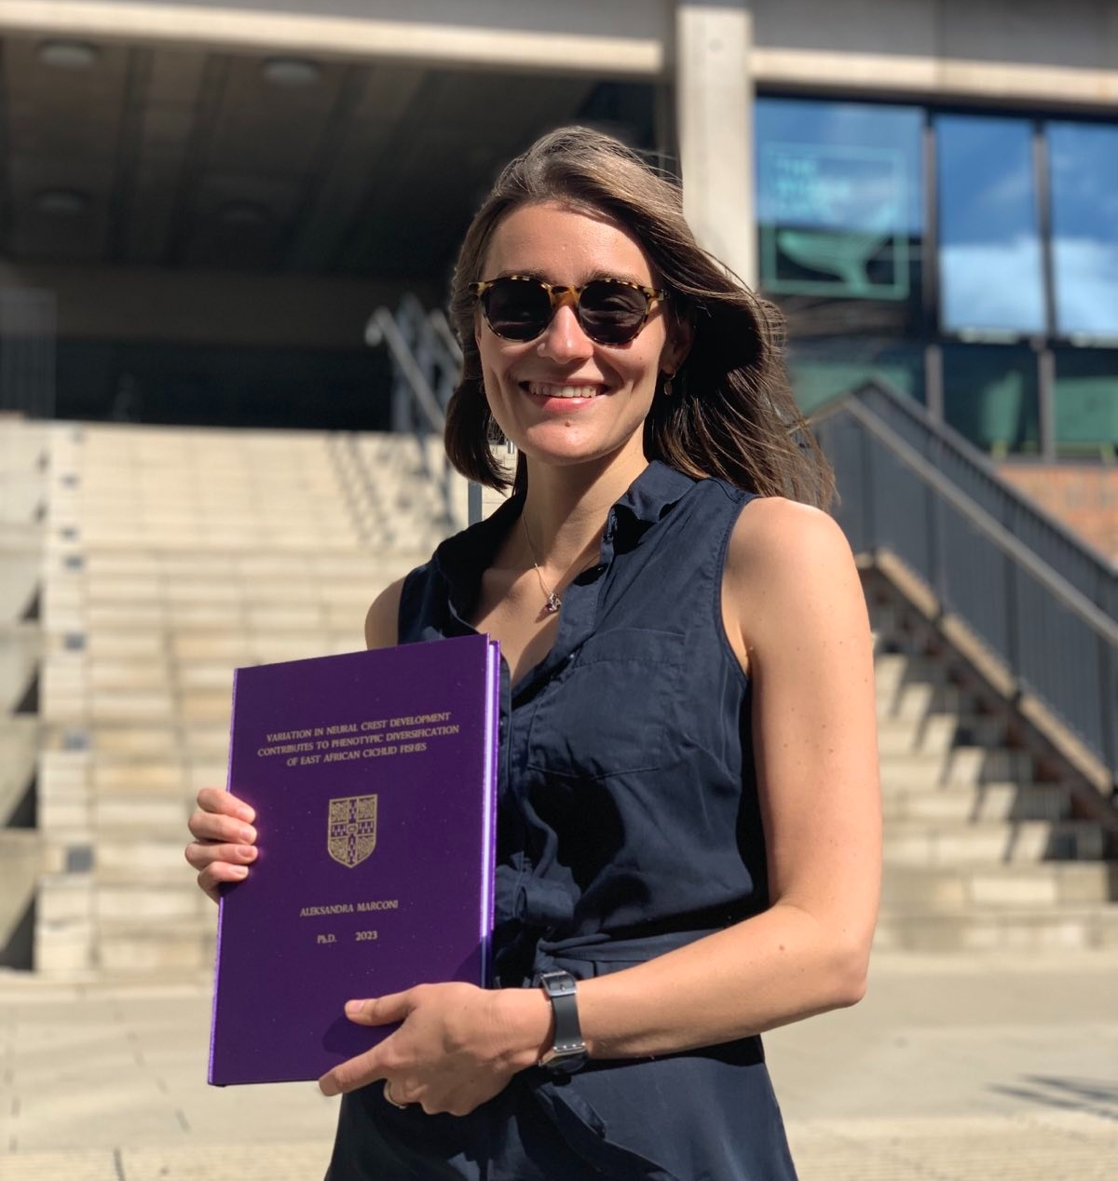

Slide 4
