Slide 1
Model-Based Estimation of Functional Connectivity using Whole-Brain Multifiber Implant Calcium Dynamics in Behaving Mice

Slide 2
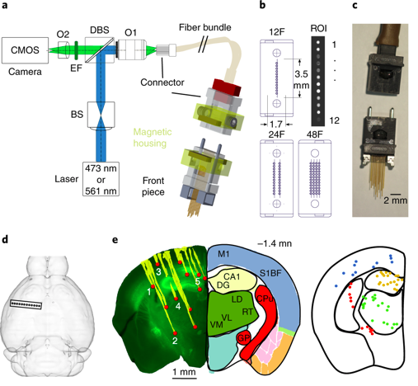
Experiment - Optics
GCaMP6m - Decay constant ~0.5s
Fiber diameter ~0.1mm, so ~1000 neurons
Hypothesize representative average over a given brain region
Have data for mice with 12 or 48 fiber implants
Sych et al 2019

Slide 3
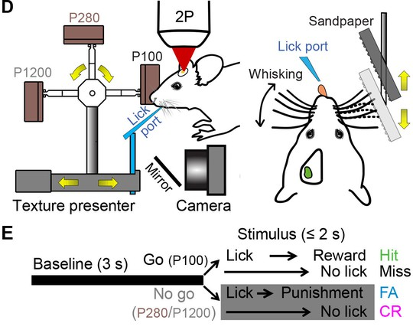
Experiment - Task
Each trial lasts 10s
~400 trials per day
~2 weeks of trials per mouse
16 mice total
Mouse is presented a tone then one of two textures, then it may choose to lick at the water port
If it licks for texture P100 it will get a water reward, if for P1200, it will get a white noise punishment
Performance, behaviour and neuronal activity recorded for each trial
Chen et al 2016

Slide 4
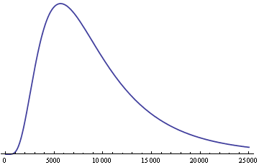
External Observables
~250ms
~200ms
Auditory Cue
Texture Distance
Paw Movement
window-avg abs diff from whisking angle
Whisk Velocity
U_{CUE1}(t)
U_{CUE2}(t)
U_{PAW}(t)
U_{WHISK}(t)
U_{WHISK}(t)*U_{TEX}(t)
U_{LICK}(t)
U_{REWARD}(t)
Lick Rate
First touch
U(t) =
First lick
AKA Reaction time
Reward
0 1 2 3 4 5 6 7 8

Slide 5
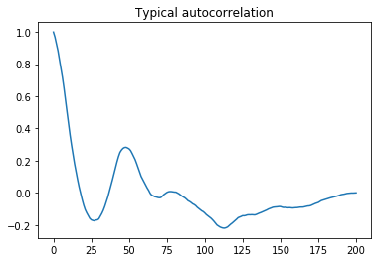
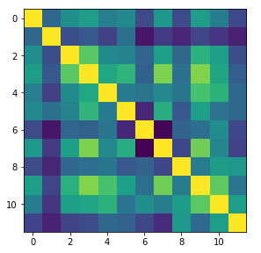
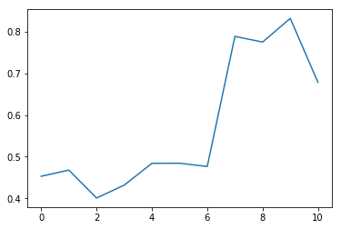
Preliminary investigation
Autocorrelation in time
Cross-correlation in channels
Super-synchronization with learning in some mice
Typical cross-correlation
Synchronization by days

Slide 6
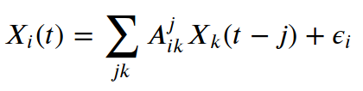

1.1 Multivariate Autoregression (MAR) - Naive MLE
Upsides
Can use multiple orders
Can use external input
Optimized over all trials
Downsides
MLE - overfitting
No good fitness criterion
A can be negative

Slide 7
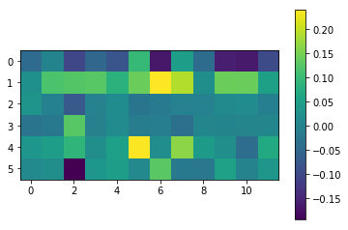
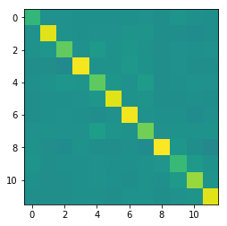
Parameter Estimates
With Behaviour
Without Behaviour

Slide 8
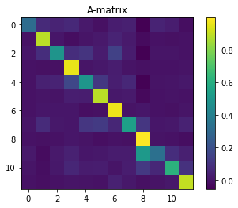
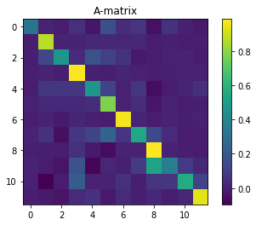
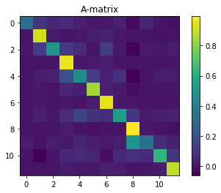
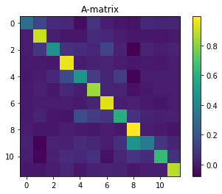
Parameter Estimation - by performance
GO
MISS
NOGO
FA

Slide 9
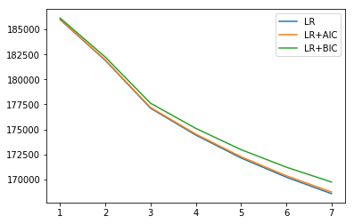
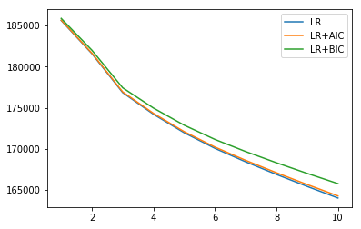
Fitness improvement from including behaviour
Without behaviour
With behaviour

Slide 10
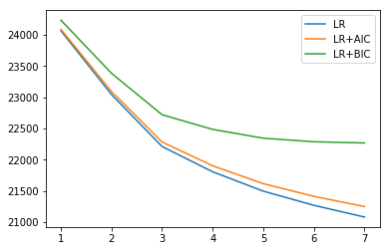
Problems - Estimating Info Criteria
Raw data
Z-Scored by channel
AIC & BIC depend on prior knowledge of Variance

Slide 11

1.2 MAR - regularized
Upsides
A forced to be non-negative
L1 forces many entries to be 0
Optimized over all trials
Downsides
No good fitness criterion
Can use external input (yet)
Can use multiple orders (yet)

Slide 12
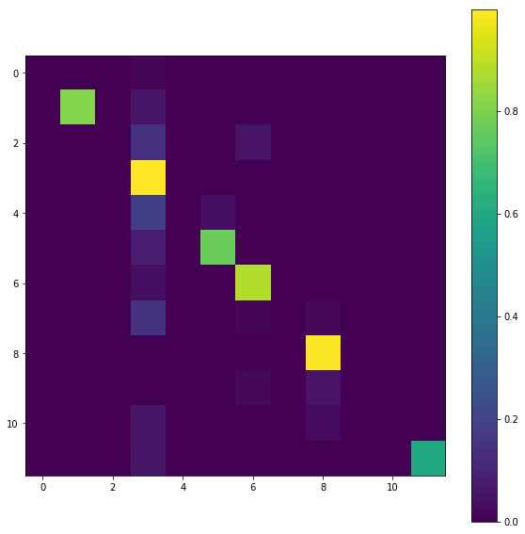
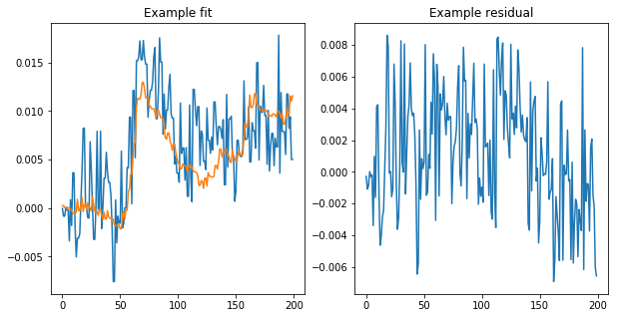
Parameter estimates

Slide 13
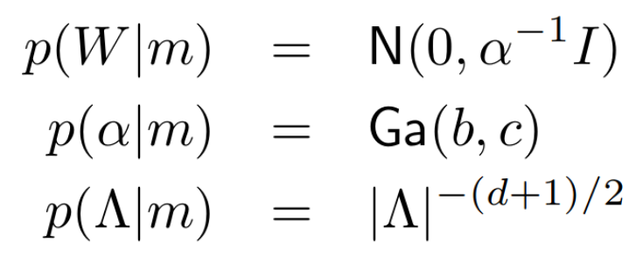
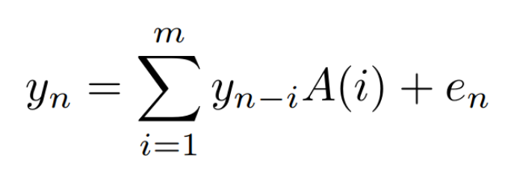
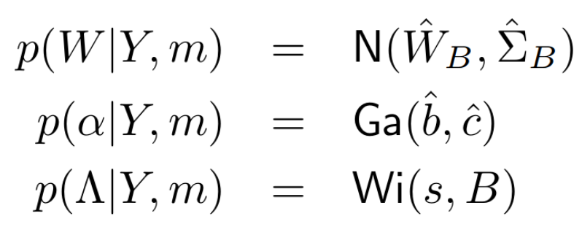
1.3 Multivariate Autoregression (MAR) - Bayesian
Upsides
BMS via Model Evidence estimate
Can use multiple orders
Downsides
A may be negative (fixable by prior)
Not optimized over all trials
Can’t use external input (yet)
Penny2002, Penny2006, Penny2008

Slide 14
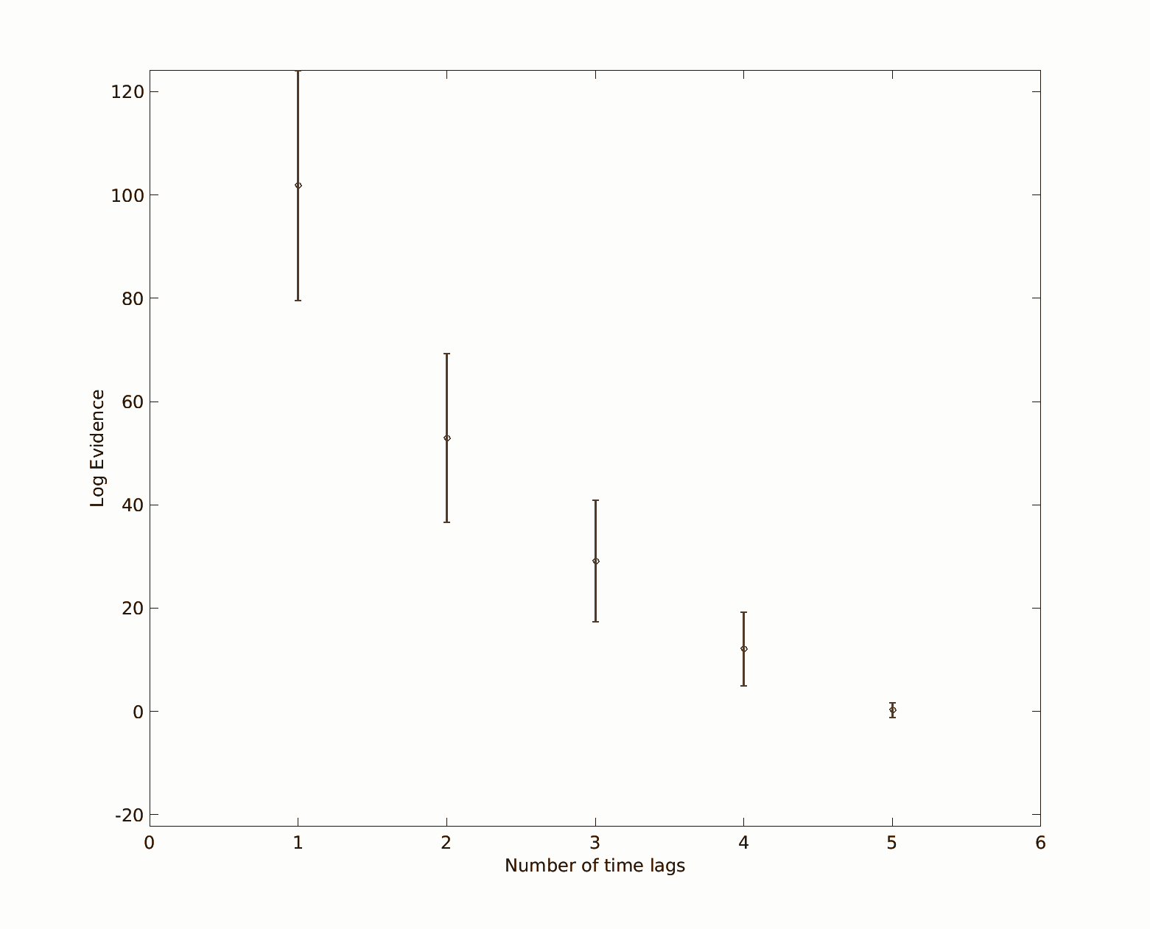
Model Evidence

Slide 15
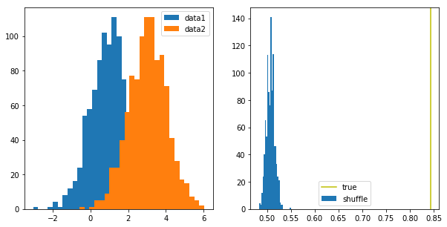
2.0 Classifiability
Null Hypothesis: Labels (Hit, Miss, CR, FA) are random
Labelled data
CLF accuracy

Slide 16
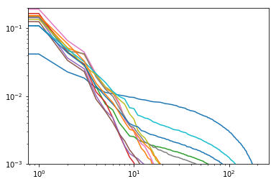
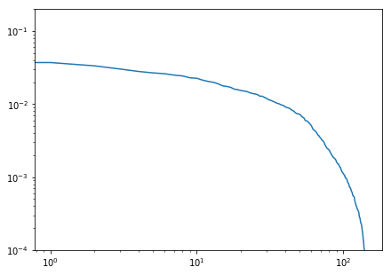
Dimensionality Reduction via PCA
Eigenvalues by channel
Eigenvalues of AR(1) matrix

Slide 17
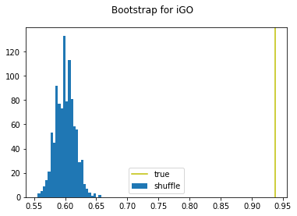
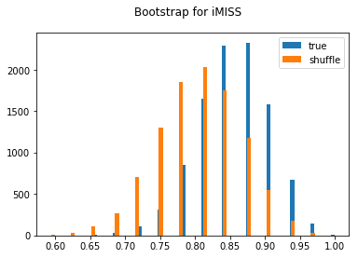
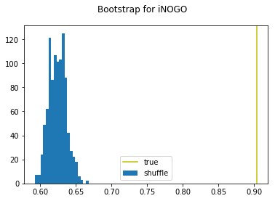
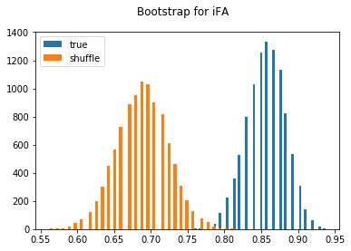
Classifiability - By Neuronal Signal
Z = 21.7
Z = 0.57
Z = 22.8
Z = 3.8

Slide 18
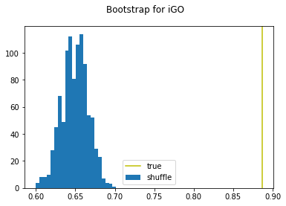
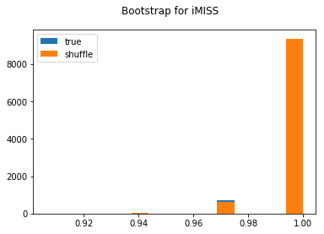
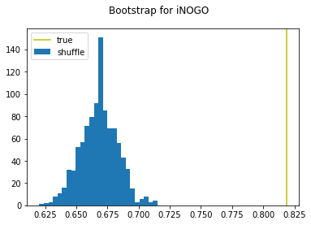
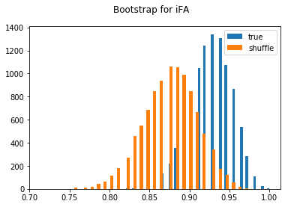
Classifiability - By Functional Connectivity
Z = 14.2
Z = 0.02
Z = 10.1
Z = 1.17

Slide 19
Desired Extensions - Possible Future Work
[Easy] Find what connections responsible for classification
[Easy] Effects of small perturbations
[Easy] Bayesian MAR with external input and suitable priors
[Hard] Bayesian MAR to optimize over all trials simultaneously
[Easy] Sparse delay (e.g. DT = [1, 20]) (Hard for SPM)
[Med] Implement MAP numerically for a Neuronal State Equation
[Med] Effect of learning on functional connectivity
[Hard] Heterogenious model selection across mice
[Hard] Hierarchical models (HGF, DCM) - fix non-additivity

Slide 20

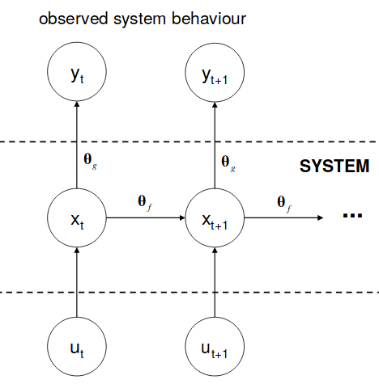

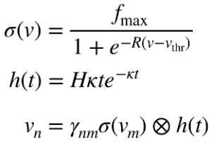

3.0 DCM

Slide 21
Time is Short
How to do Bayesian inversion of a complicated model?
Are Laplace Approx integrals of a non-linear hidden model computable?
How SPM works?
How to add new Forwards Model?
Do I need to calculate Gauss or Laplace approximation?
Do I need to calculate Jacobian or Hessian of the model?
Where do I need to plug it in?

Slide 22
Thank You

Slide 23
Hypothesis 1 - Expert Performance
Initiation
Early
Discrimination
Decision
Input
Action

Slide 24
Hypothesis 2 - Learning Stabilization
Network activity separable into task-related and task-unrelated
Trajectory of task-related activity progressively more reproducible with learning

