Slide 1
Clustering to search for a suitable place
Capstone Project - Applied Data Science Capstone by IBM/Coursera

Slide 2
Introduction: Business Problem
The goal of the project is to determine an acceptable location for the opening of an Italian restaurant within a radius of 2 kilometers from the center of Tverskaya Street, Moscow.
The criterion for determining eligibility will be the minimum number of similar restaurants.

Slide 3
Data
Based on the definition of our problem, to achieve the goal we need the following data:
coordinates of the center of Tverskaya street.
number of existing Italian restaurants in the area 2 kilometers from the center of the Tverskaya street.
Following data sources will be needed to extract/generate the required information:
to get the coordinates we will be utilize geopy library.
number of Italian restaurants will be obtained using Foursquare API

Slide 4
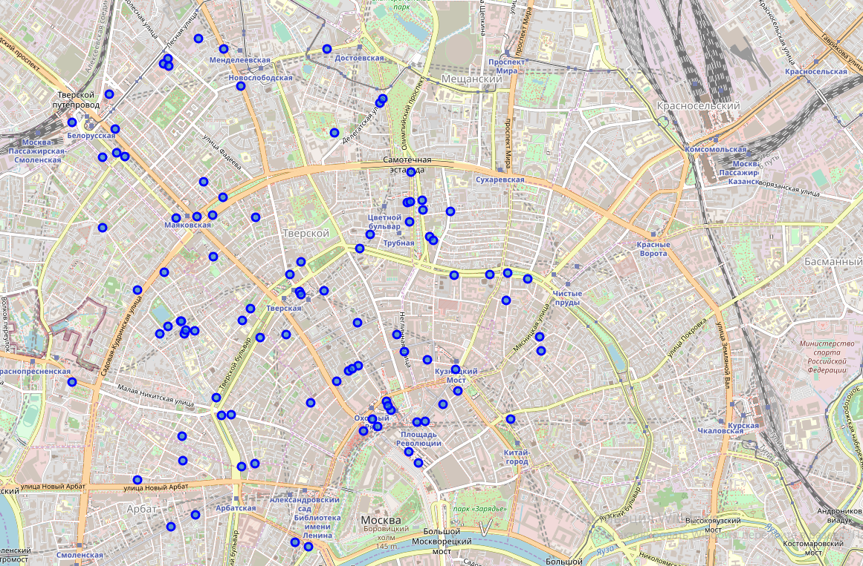
Distribution of Italian restaurants

Slide 5
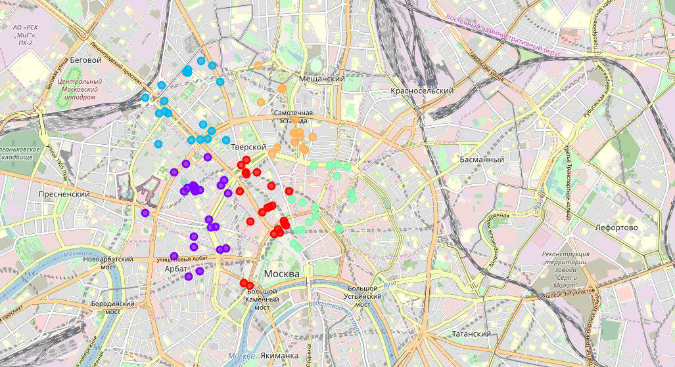
Restaurants clustering

Slide 6
Results and Discussion
According to the results of the analysis, it was found that a fairly large number of restaurants are located within a radius of 2 kilometers from the center of Tverskaya Street. Restaurants are evenly distributed, while a lower density of Italian restaurants is recorded in the northeast of the center of the street. Thus, the smallest total of restaurants of the indicated subjects are located in cluster No. 4 (orange cluster), the center of which is Tsvetnoy Boulevard 21.
In connection with the above, I would recommend opening an Italian restaurant in the area of Tsvetnoy Boulevard 21.
In addition, it should be noted that cluster No. 3 (lite green cluster) also recorded a small density of Italian restaurants, in our opinion, it is also acceptable to establish a restaurant in the area of the center of this cluster.

