Slide 1
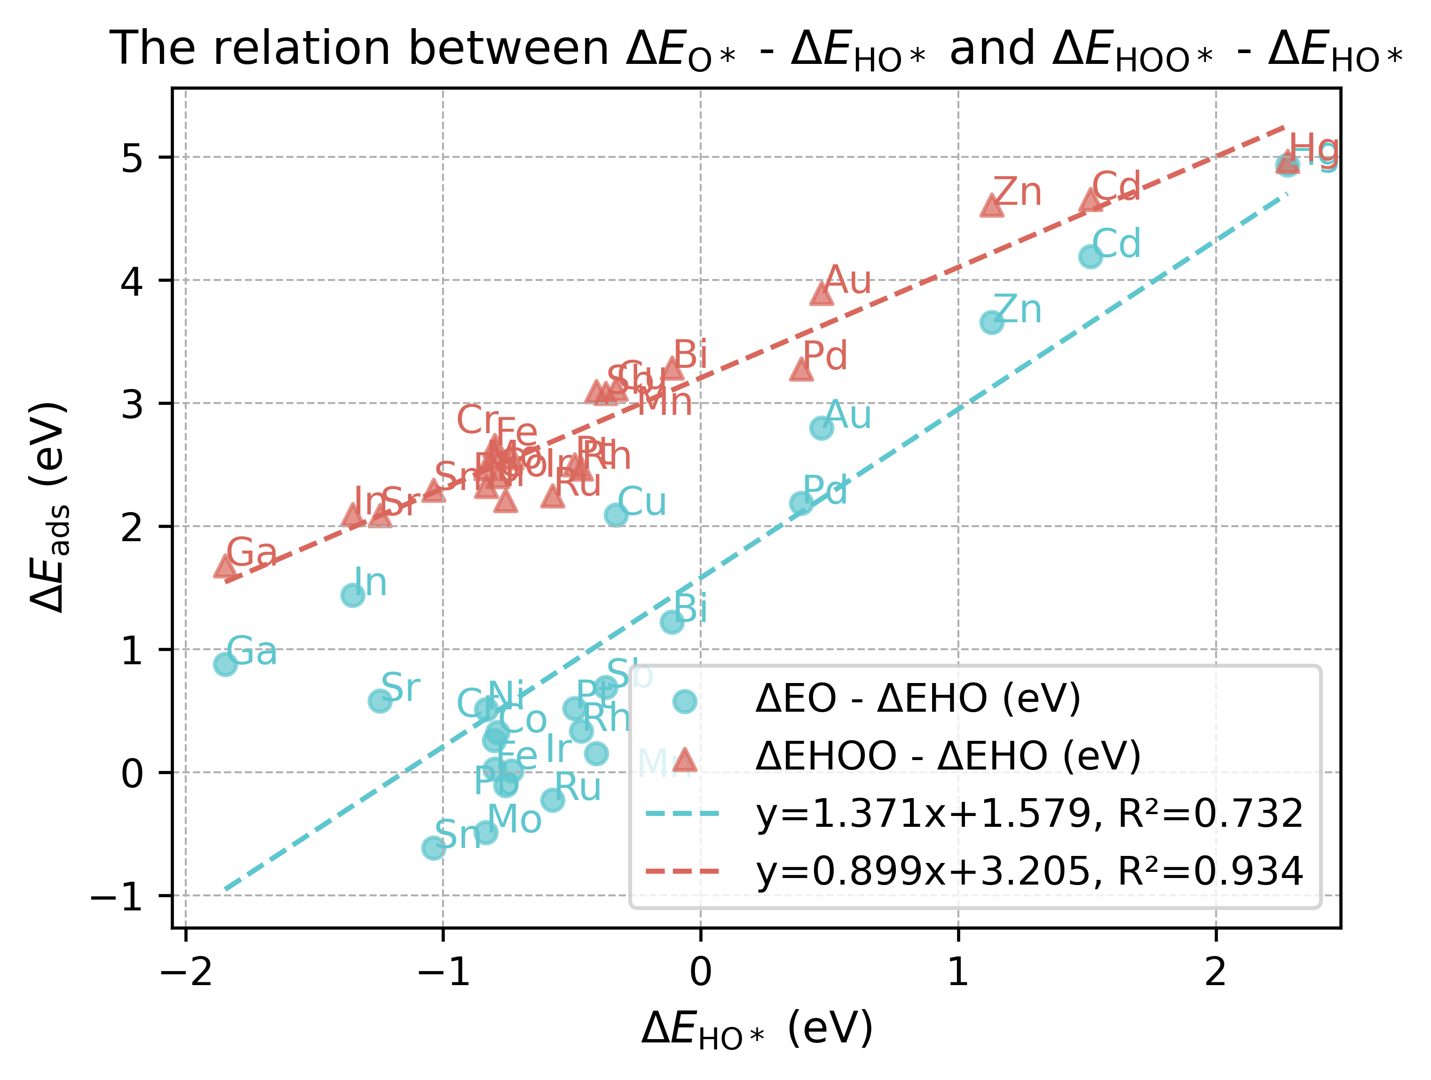
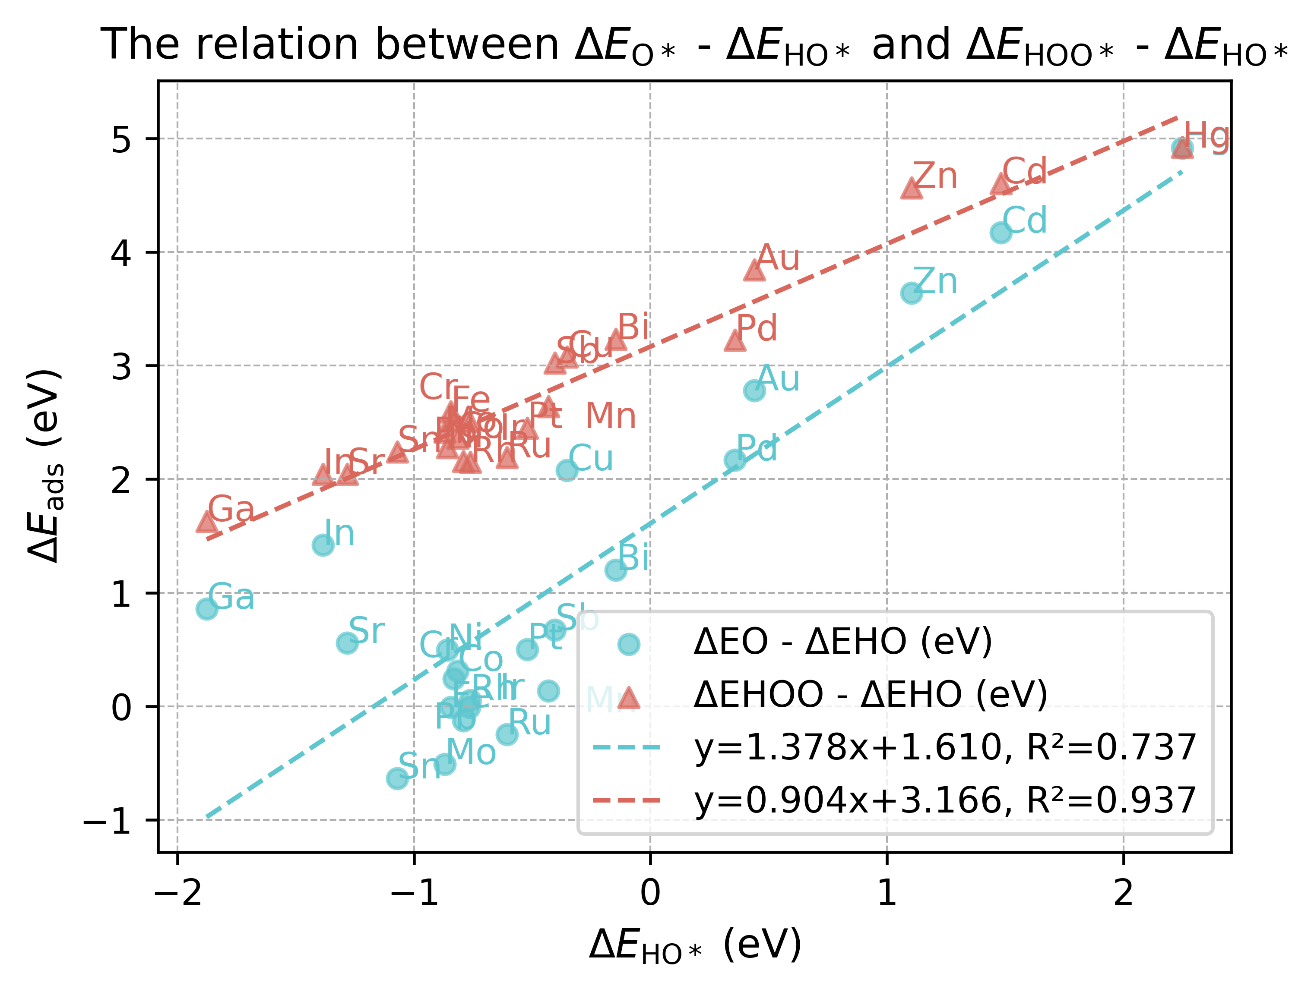
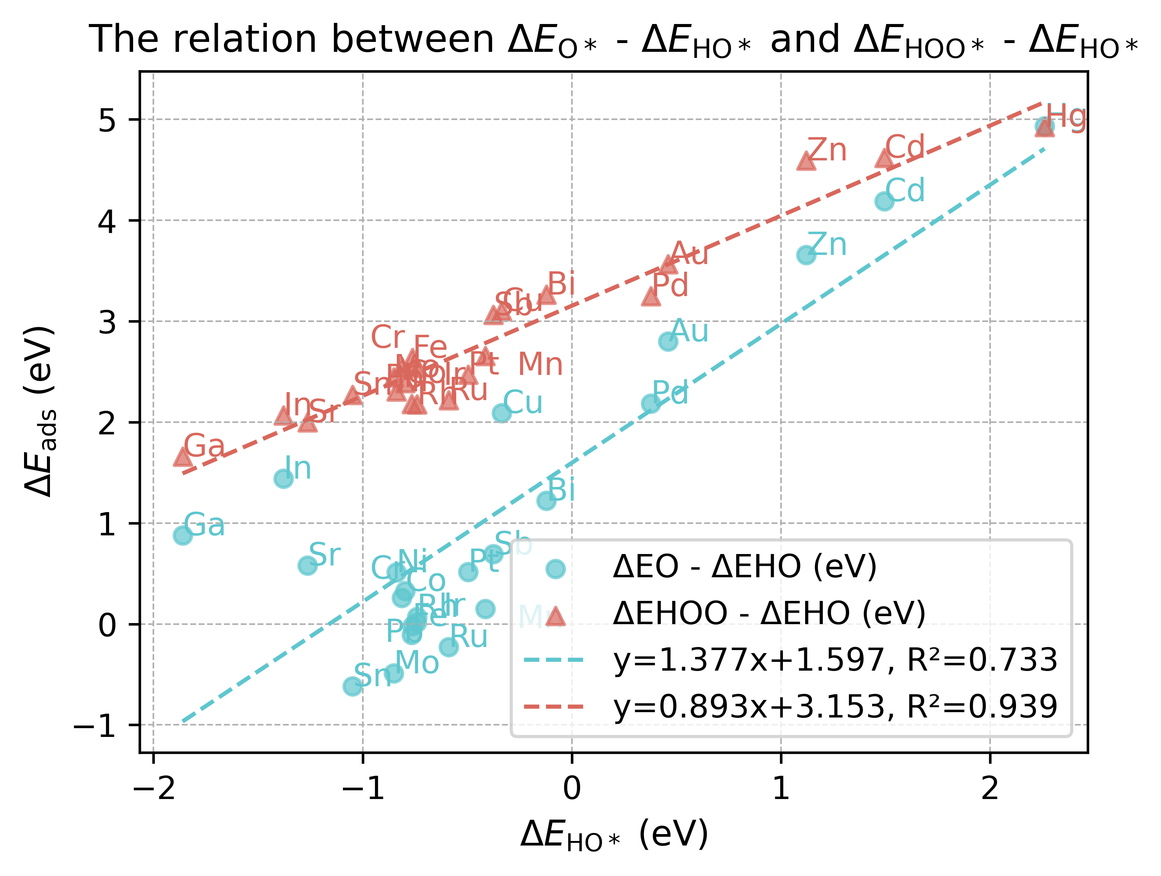
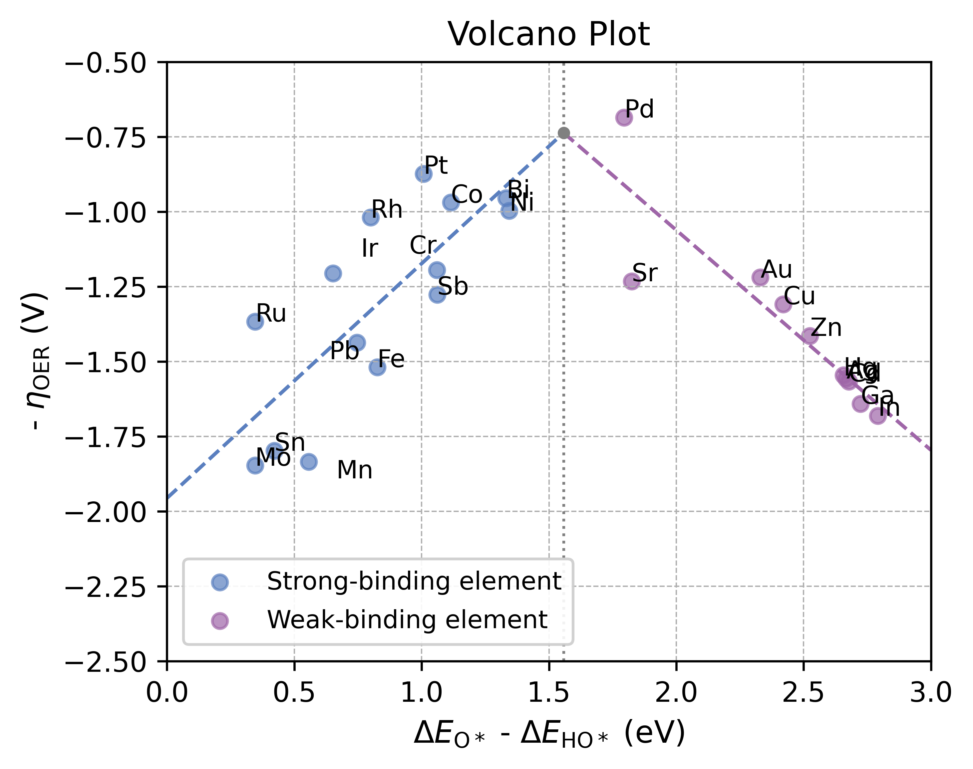
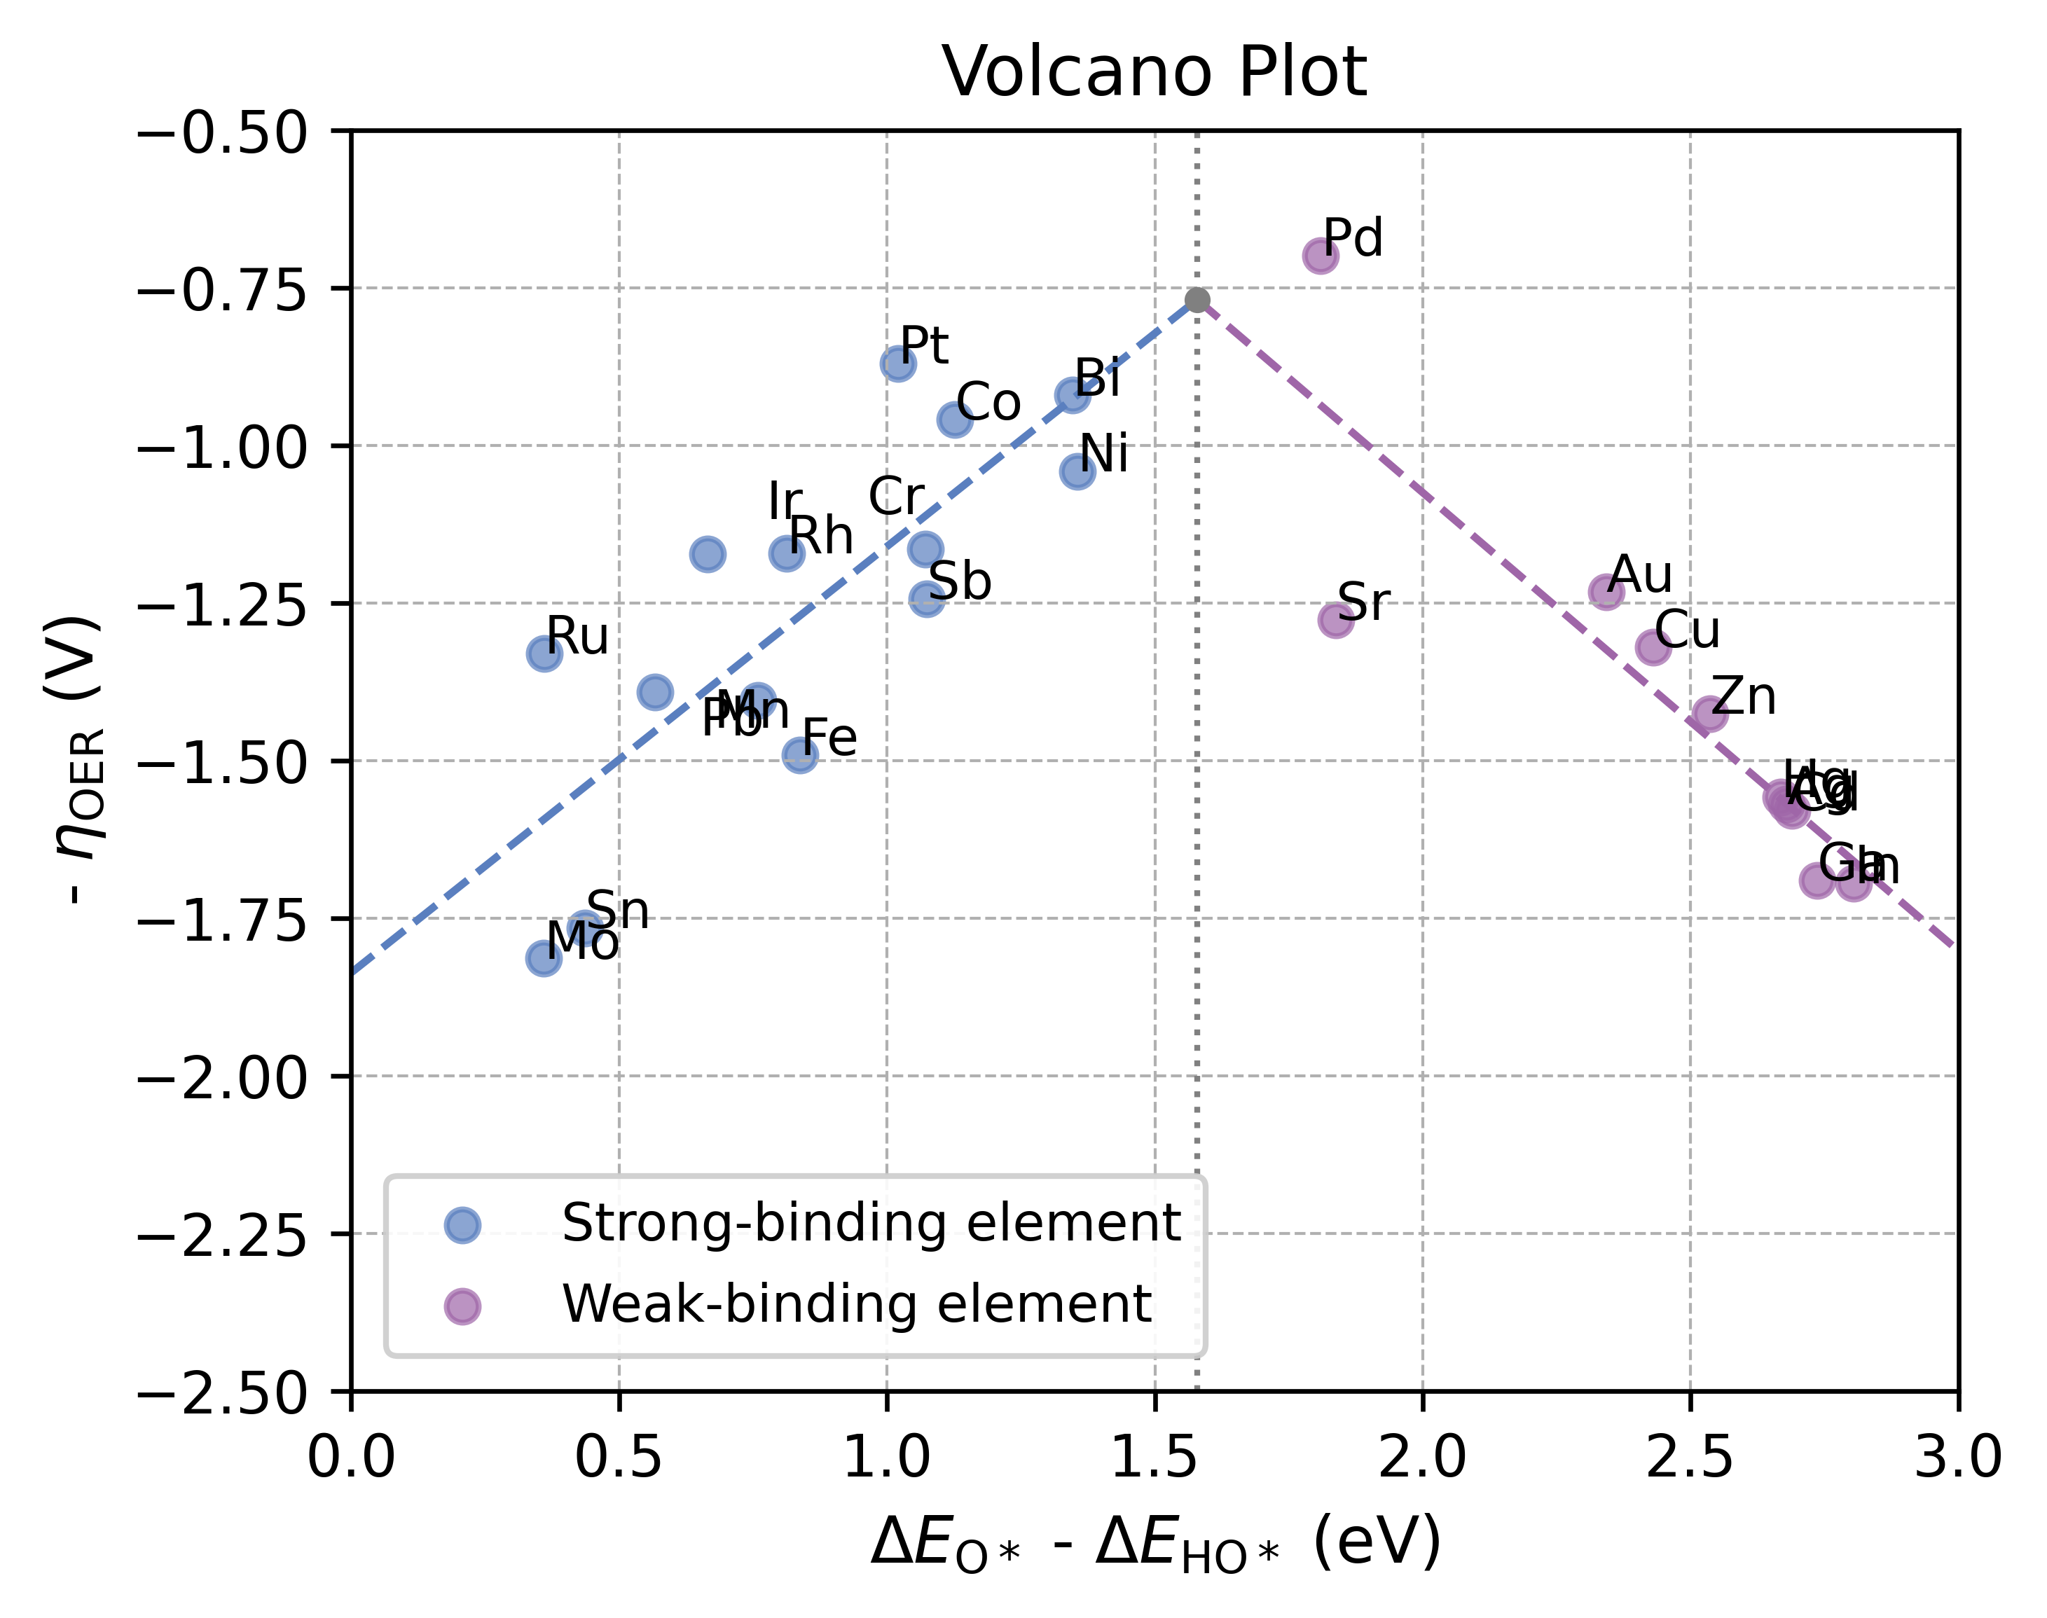
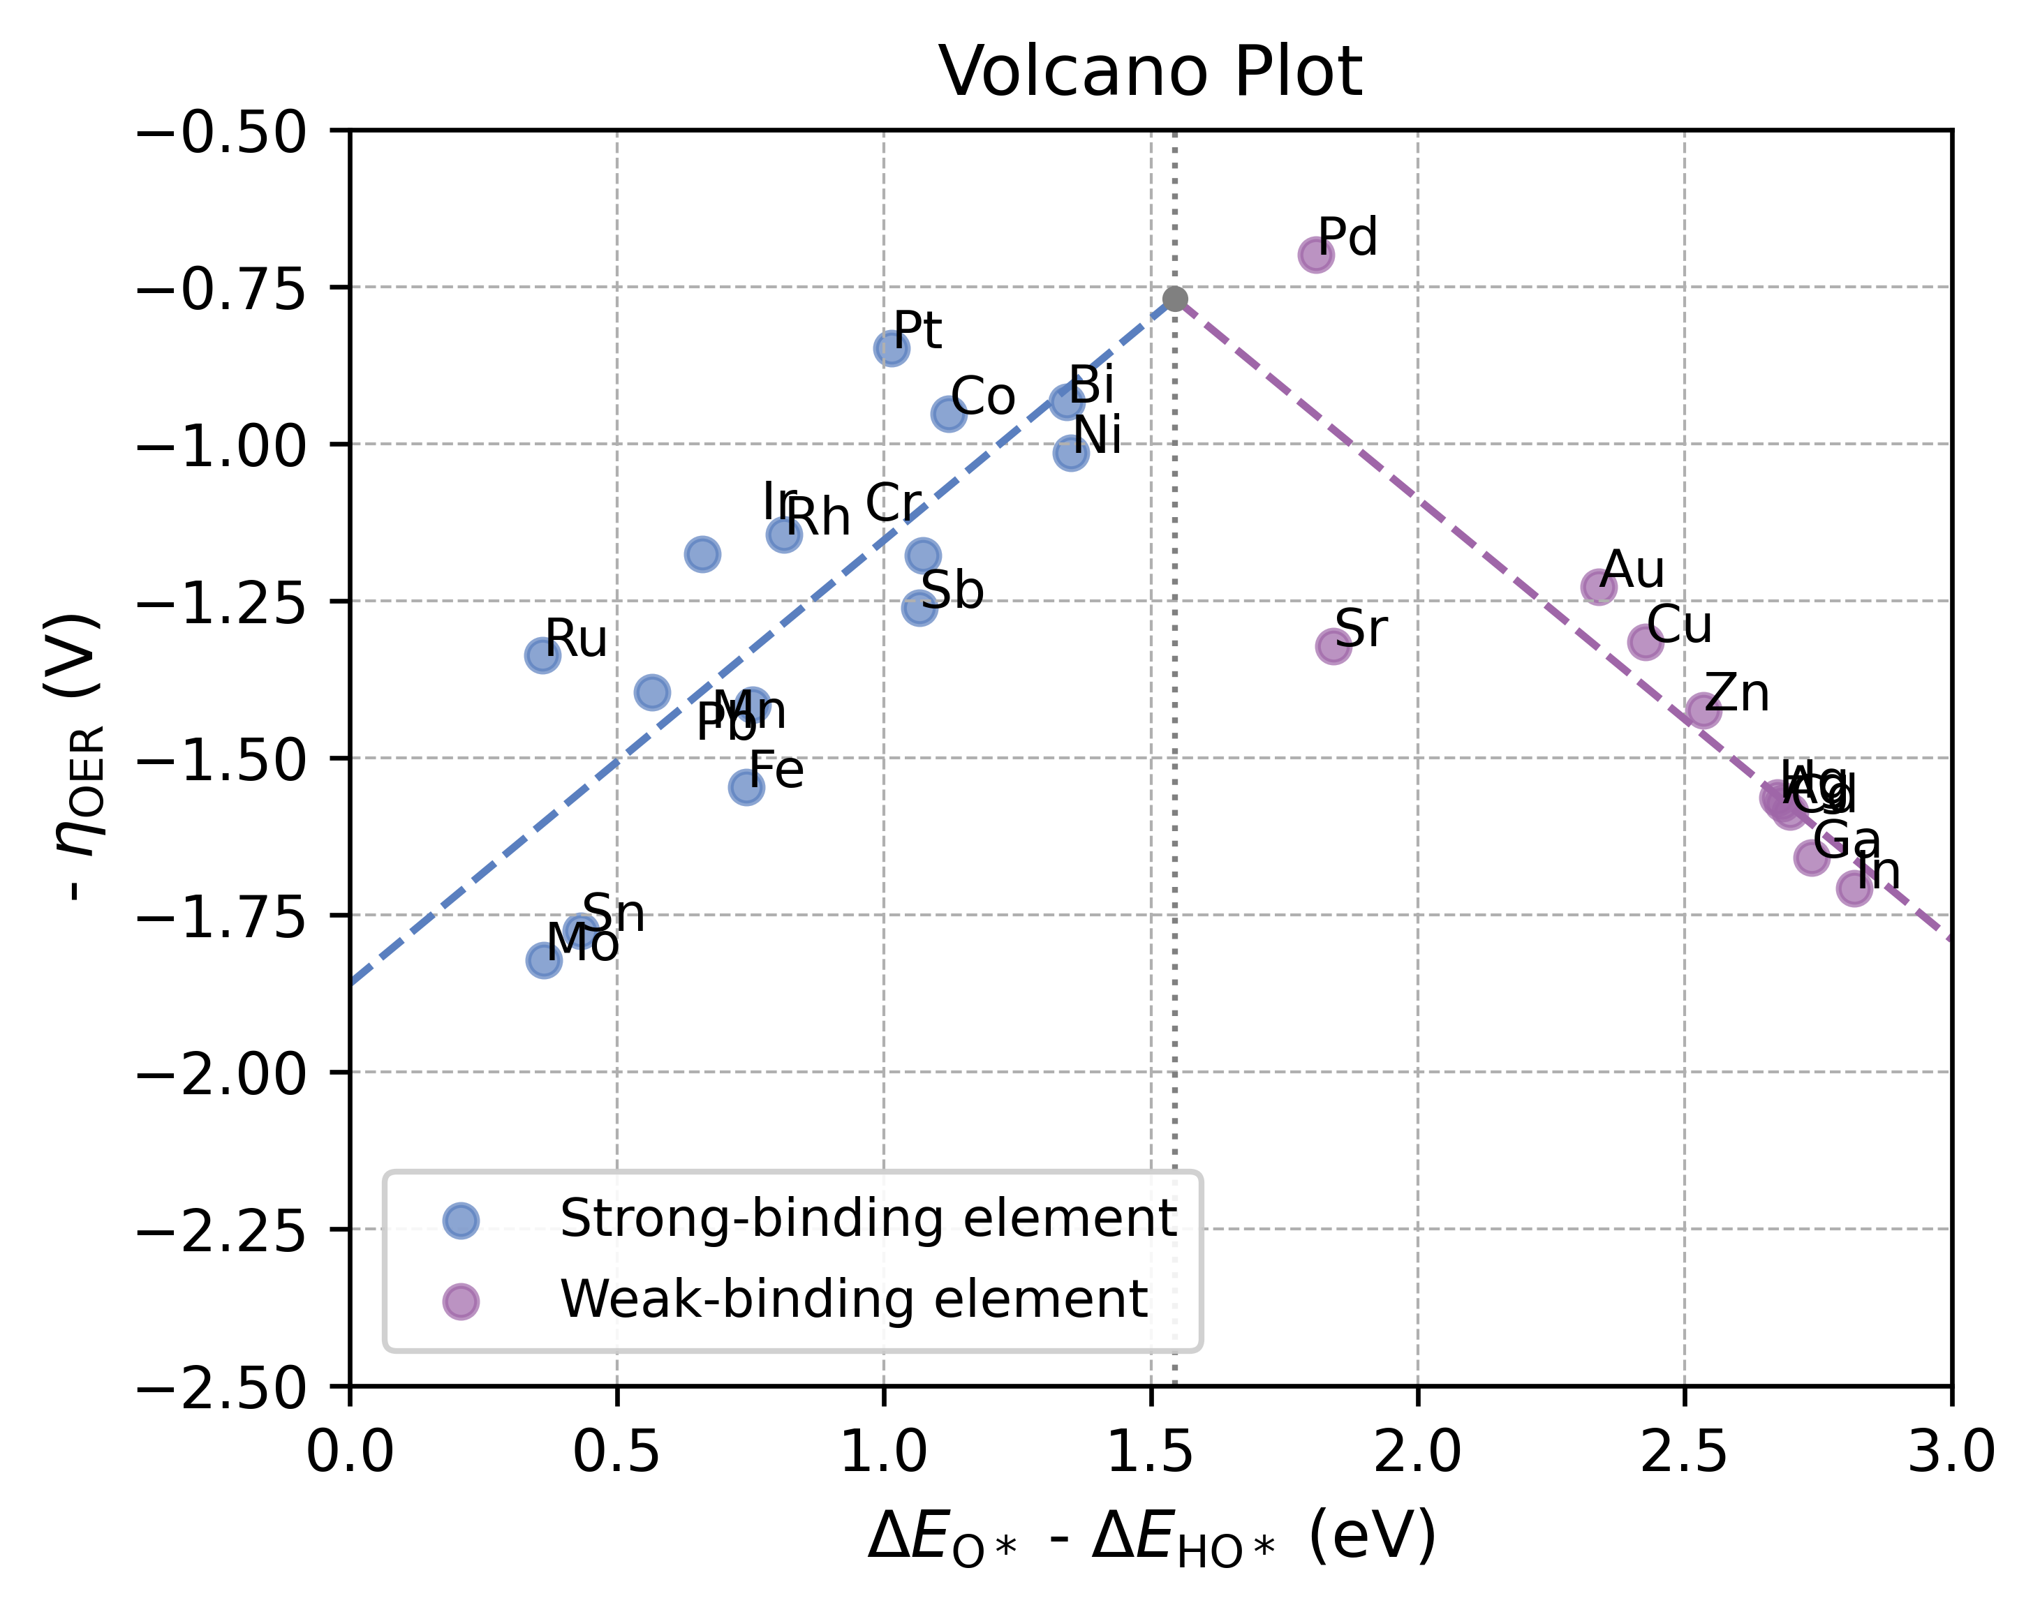
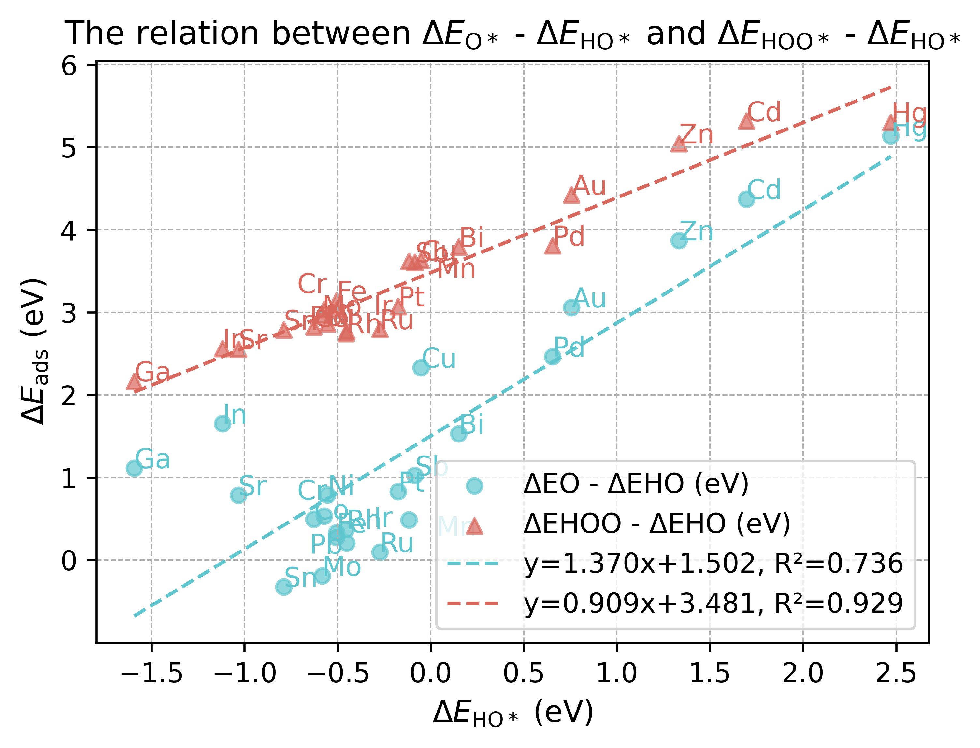
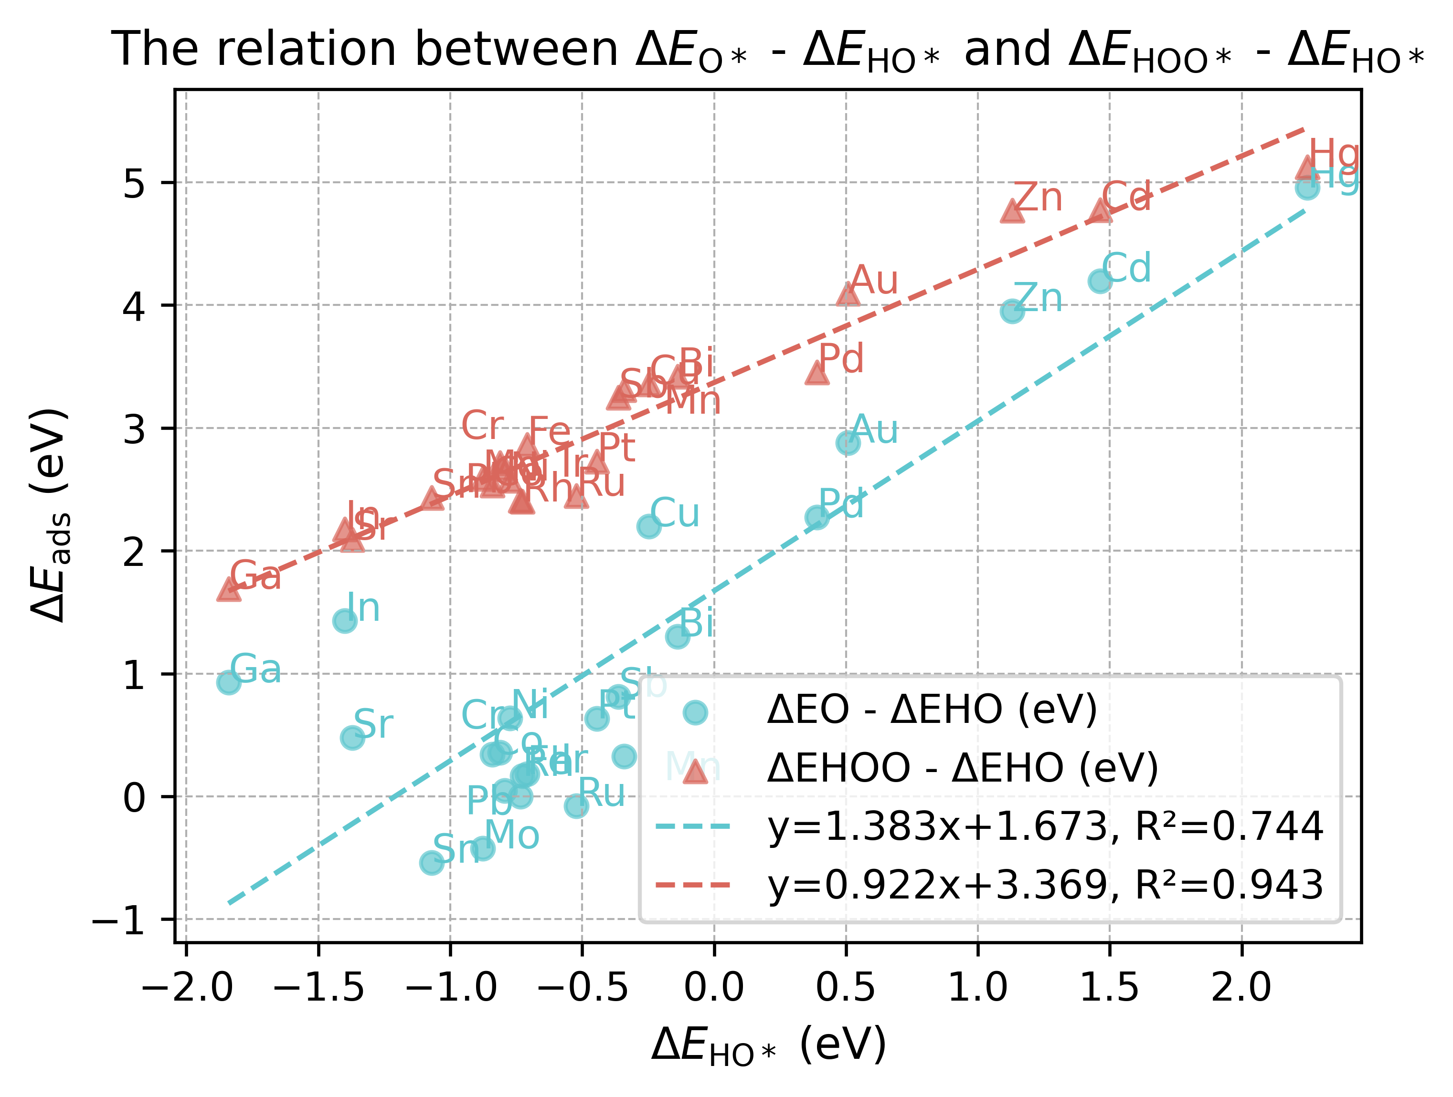
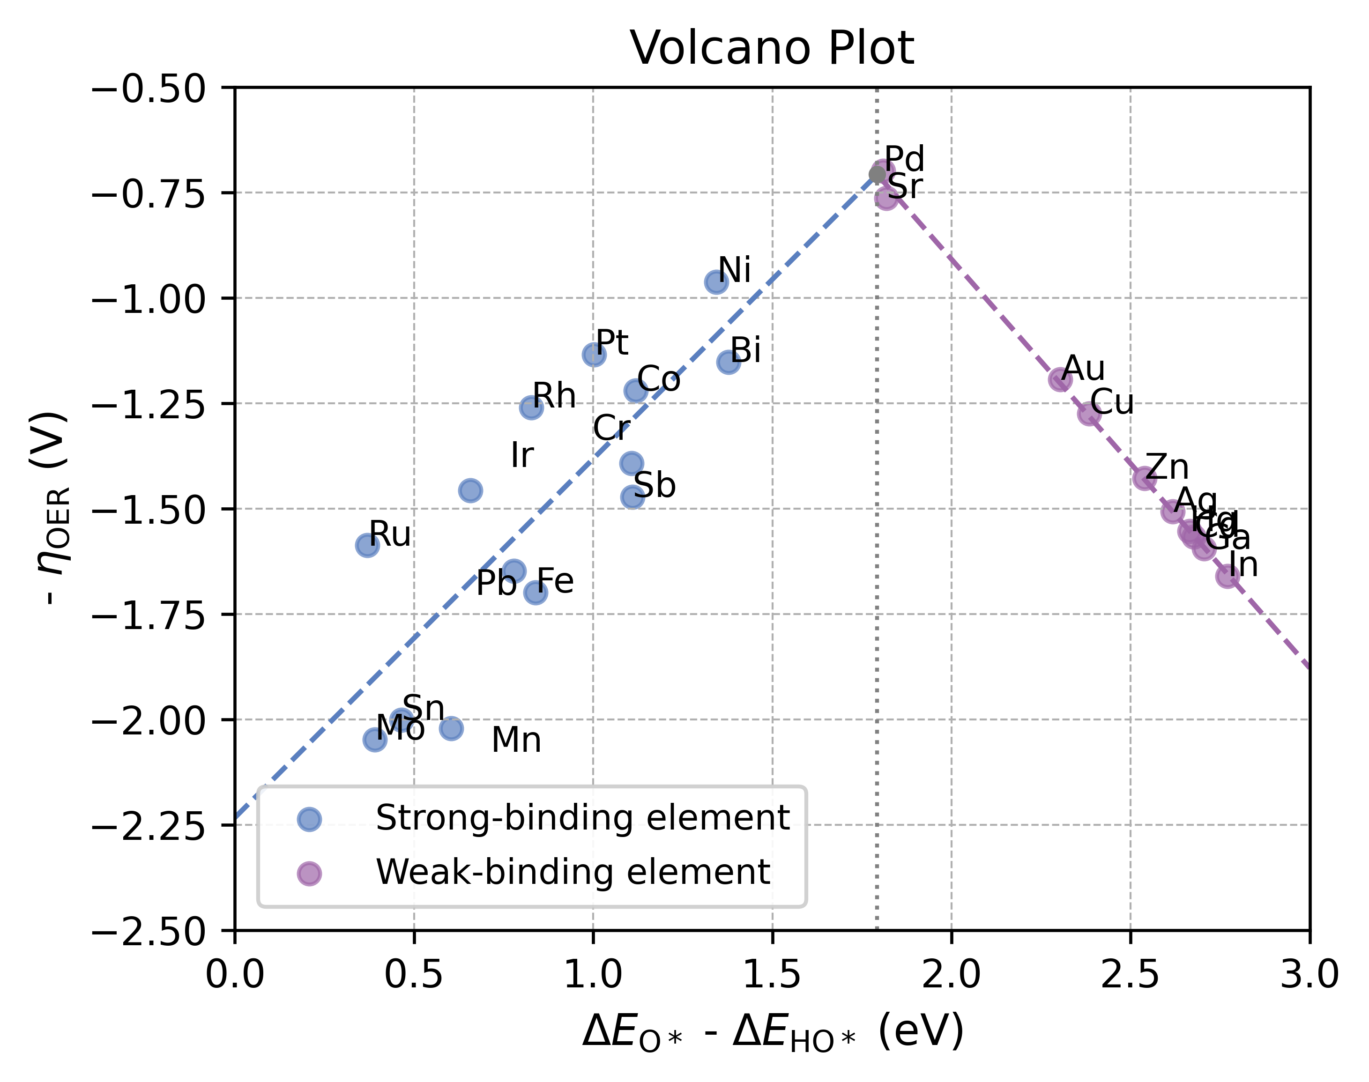
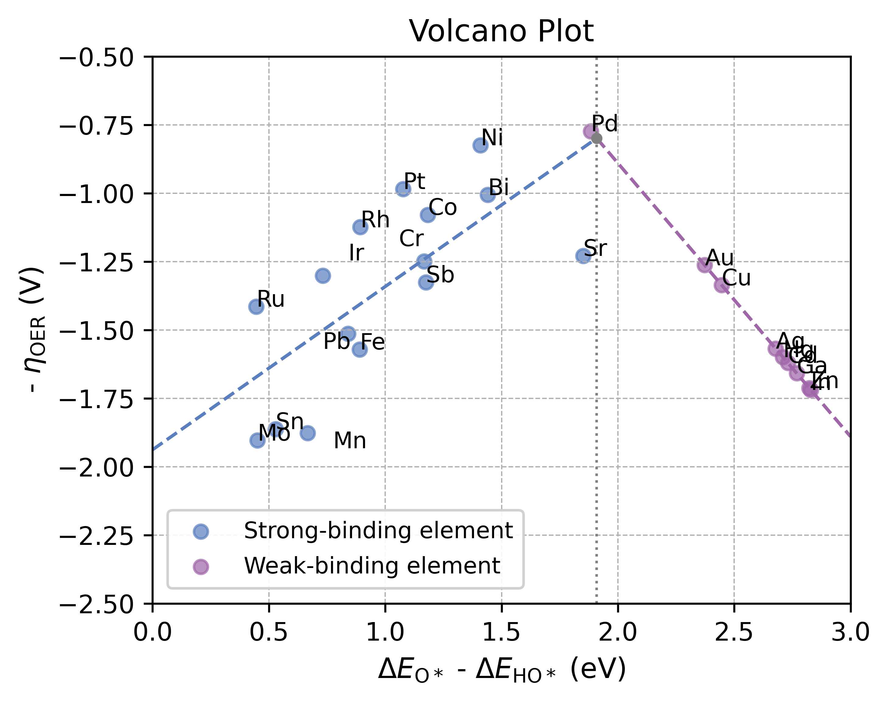
PBE
PBE +D3
PBE +D2
PBE ISPIN = 1
RPBE
RPBE + D3

Slide 3
Table 1 theory vs experiment
Elements with Single Atom | Functional | Spin | vdW dispersion | IDIPOL | DFT+U U Value | η Value of Single Atom (eV) | Theory System | η Value of Theory (eV) | Experiment System | η Value of Experiment (eV)
Ag |  |  |  |  |  |  | Ag-TiO2 | 1.23 | Ag/g-C₃N₄ | 0.8 - 1.2
Au |  |  |  |  |  |  | Au-TiO2 | 0.58 | Au-P | 0.19
Bi |  |  |  |  |  |  | Bi-Ag metal | 0.78
Cd |  |  |  |  |  |  | CdN4C0 | 0.48 | Cd | 1.7
Co |  |  |  |  |  |  | Co3O4/CoOOH | 0.76/0.78 | Co | 0.48 – 0.65
Cr |  |  |  |  |  |  | Cr in CoFeCr | 1.7 | Cr | 1.7
Cu |  |  |  |  |  |  | CuOOH | 1.26 | CuO | 1.8
Fe |  |  |  |  |  |  | FeOOH | 0.52 | Fe | 0.50 – 0.90
Ga
Hg
In
Ir |  |  |  |  |  |  |  |  | Ir | 0.33
Mn |  |  |  |  |  |  | Mn3O4 | 0.85 | Mn3O4 | 0.45
Mo |  |  |  |  |  |  | Mo-MoS2 | 0.6 | Mo-MoS2 | 0.33
Ni |  |  |  |  |  |  | NiO | 0.4 | Ni | 0.45 – 0.60
Pb
Pd |  |  |  |  |  |  | Pd | 0.65 | Pd | 0.32
Pt |  |  |  |  |  |  | Pt | 0.55 | Pt | 0.53
Rh |  |  |  |  |  |  |  |  | Rh-Rh2O3 | 0.2
Ru |  |  |  |  |  |  | RuO2 | 0.58 | Ru | 0.27
Sb |  |  |  |  |  |  |  |  | Sb/Sn ATO | 0.3
Sn |  |  |  |  |  |  | SnO2 | 1.8 | SnO2 | 1.2
Sr |  |  |  |  |  |  |  |  | SrCoO3 | 0.32
Zn |  |  |  |  |  |  | ZnO | 1.1 | ZnCo2O4 | 0.35

Slide 4
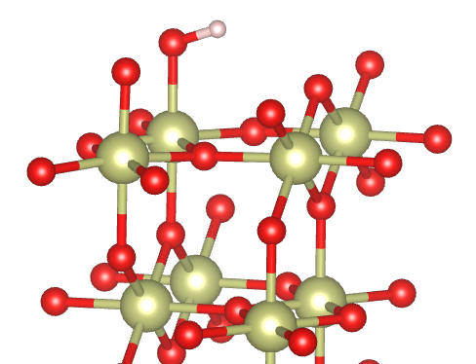
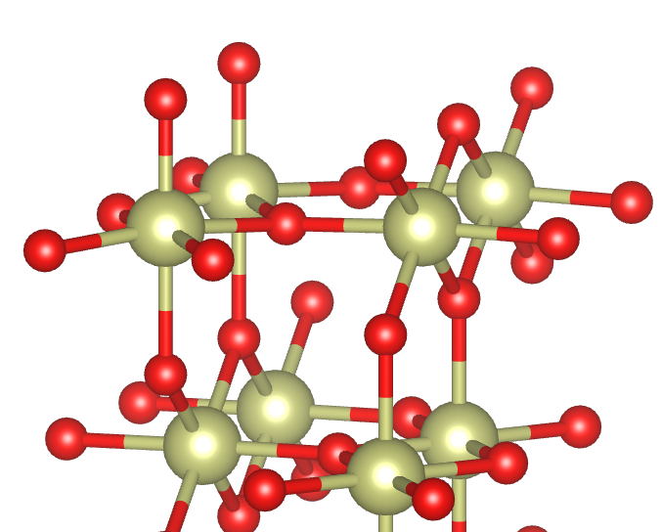
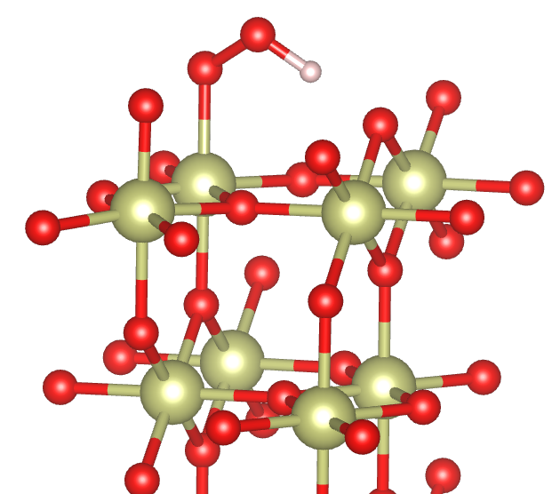
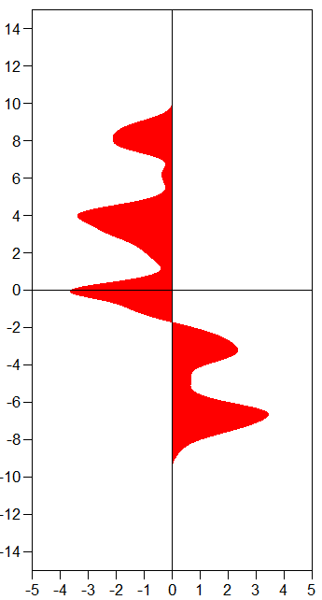
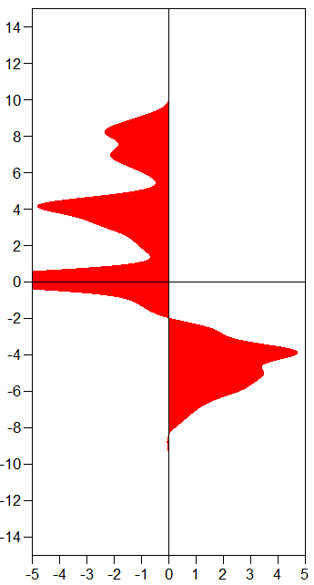
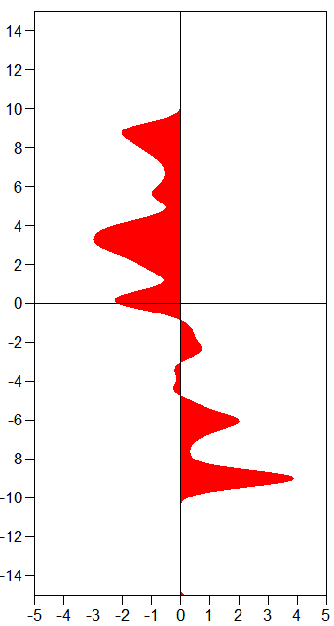
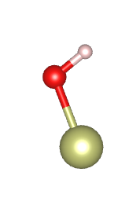
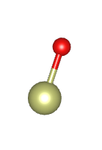
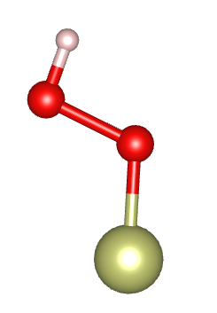
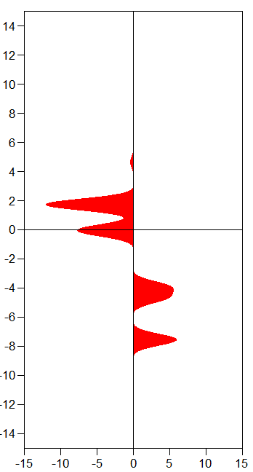
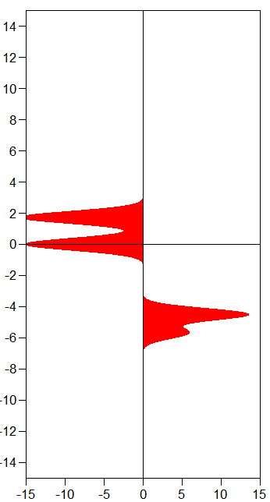
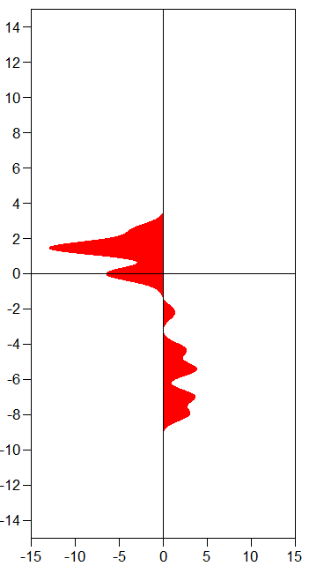
Figure 2
1.93
1.94
1.78
-IpCOHP
4.117 eV
-IpCOHP
7.040 eV
-IpCOHP
4.324 eV
Energy (eV)
Energy (eV)
Energy (eV)
E_{F}
E_{F}
E_{F}
1.87
1.74
1.80
-IpCOHP
4.676 eV
-IpCOHP
6.965 eV
-IpCOHP
5.895 eV
Energy (eV)
Energy (eV)
Energy (eV)
E_{F}
E_{F}
E_{F}

Slide 5
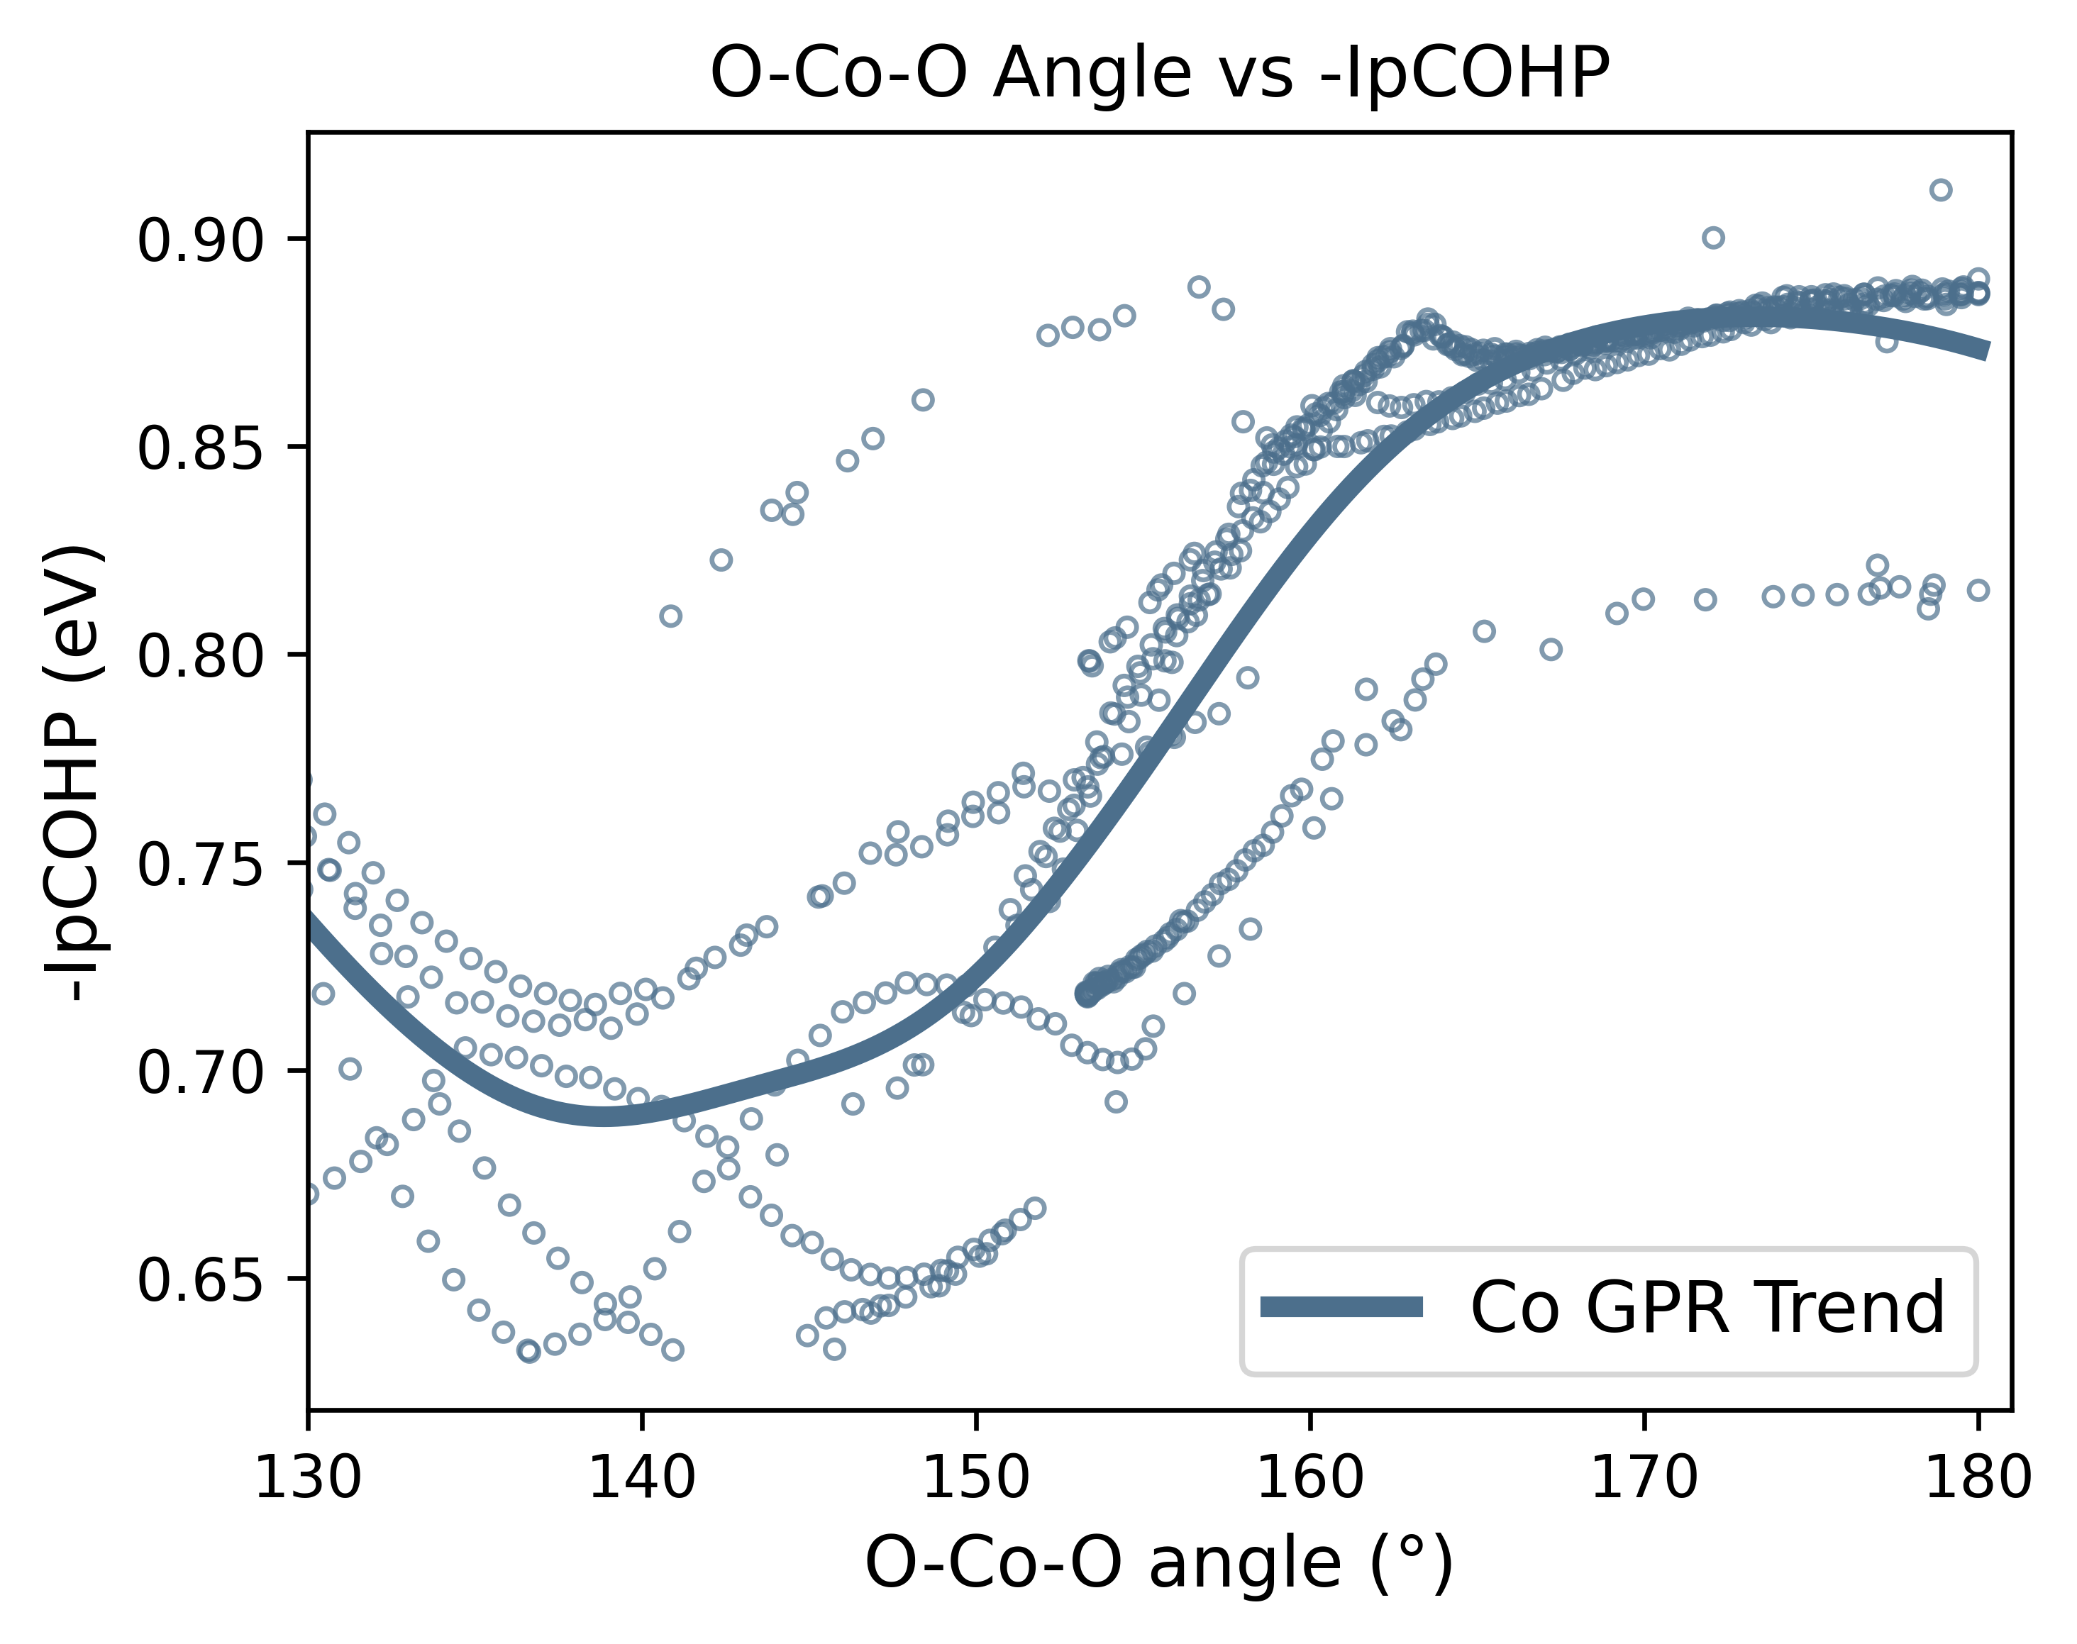
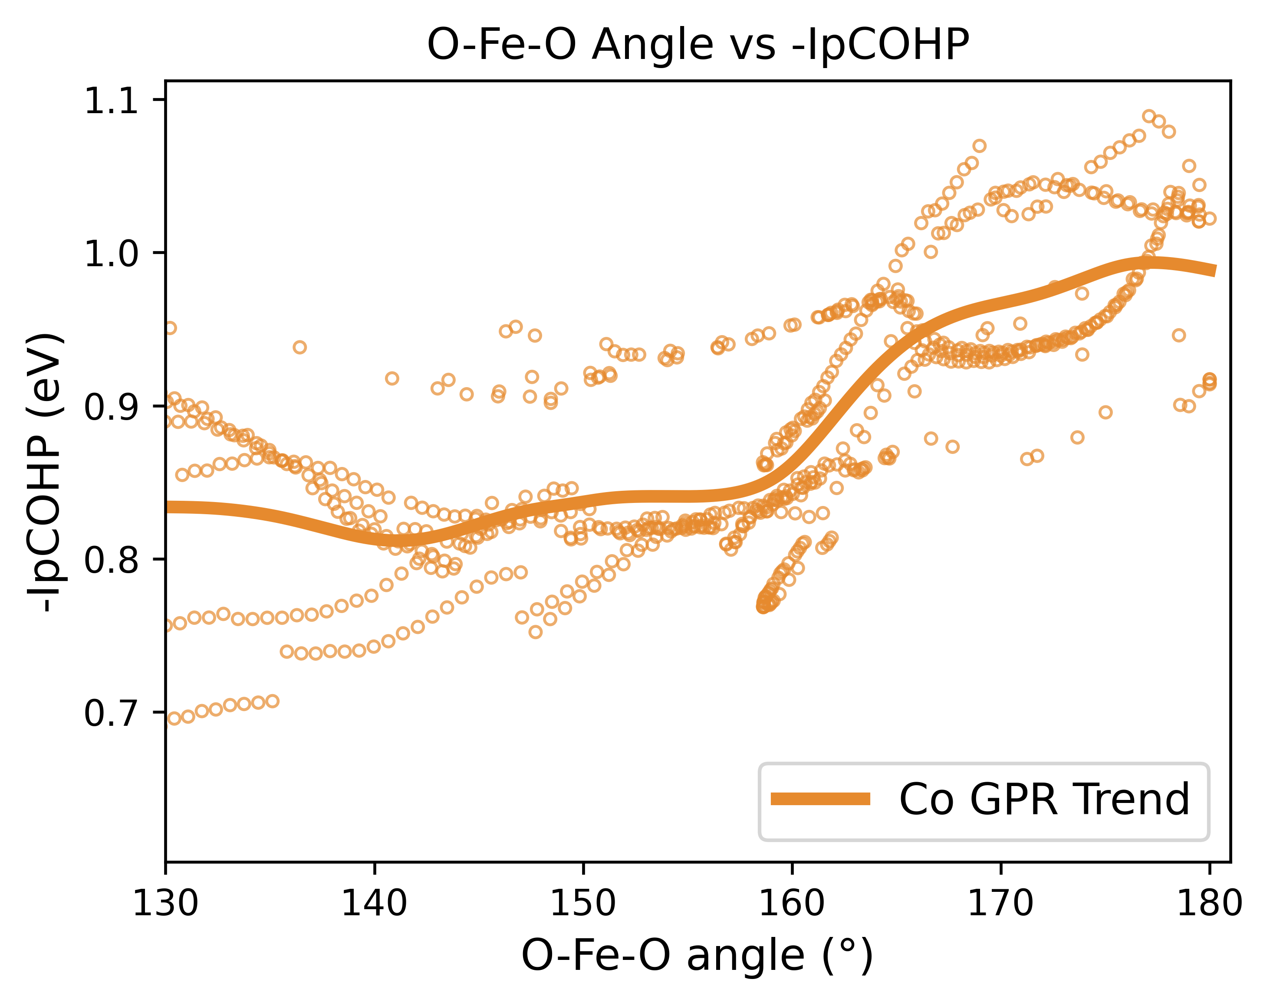
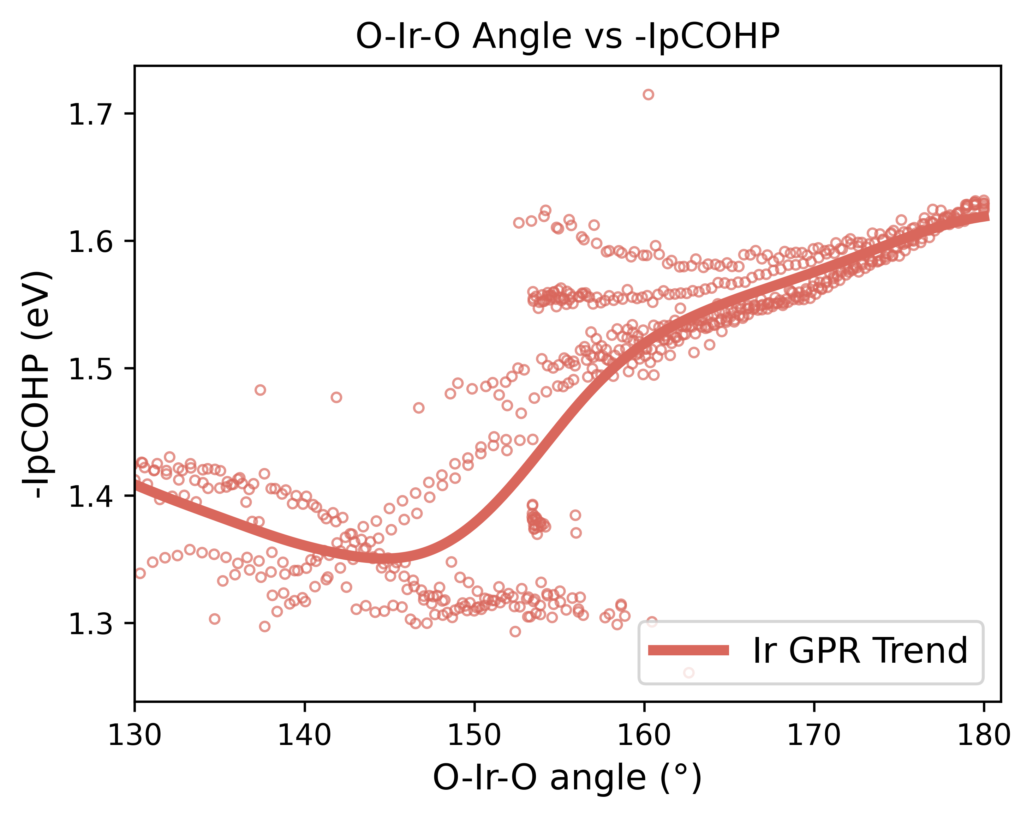
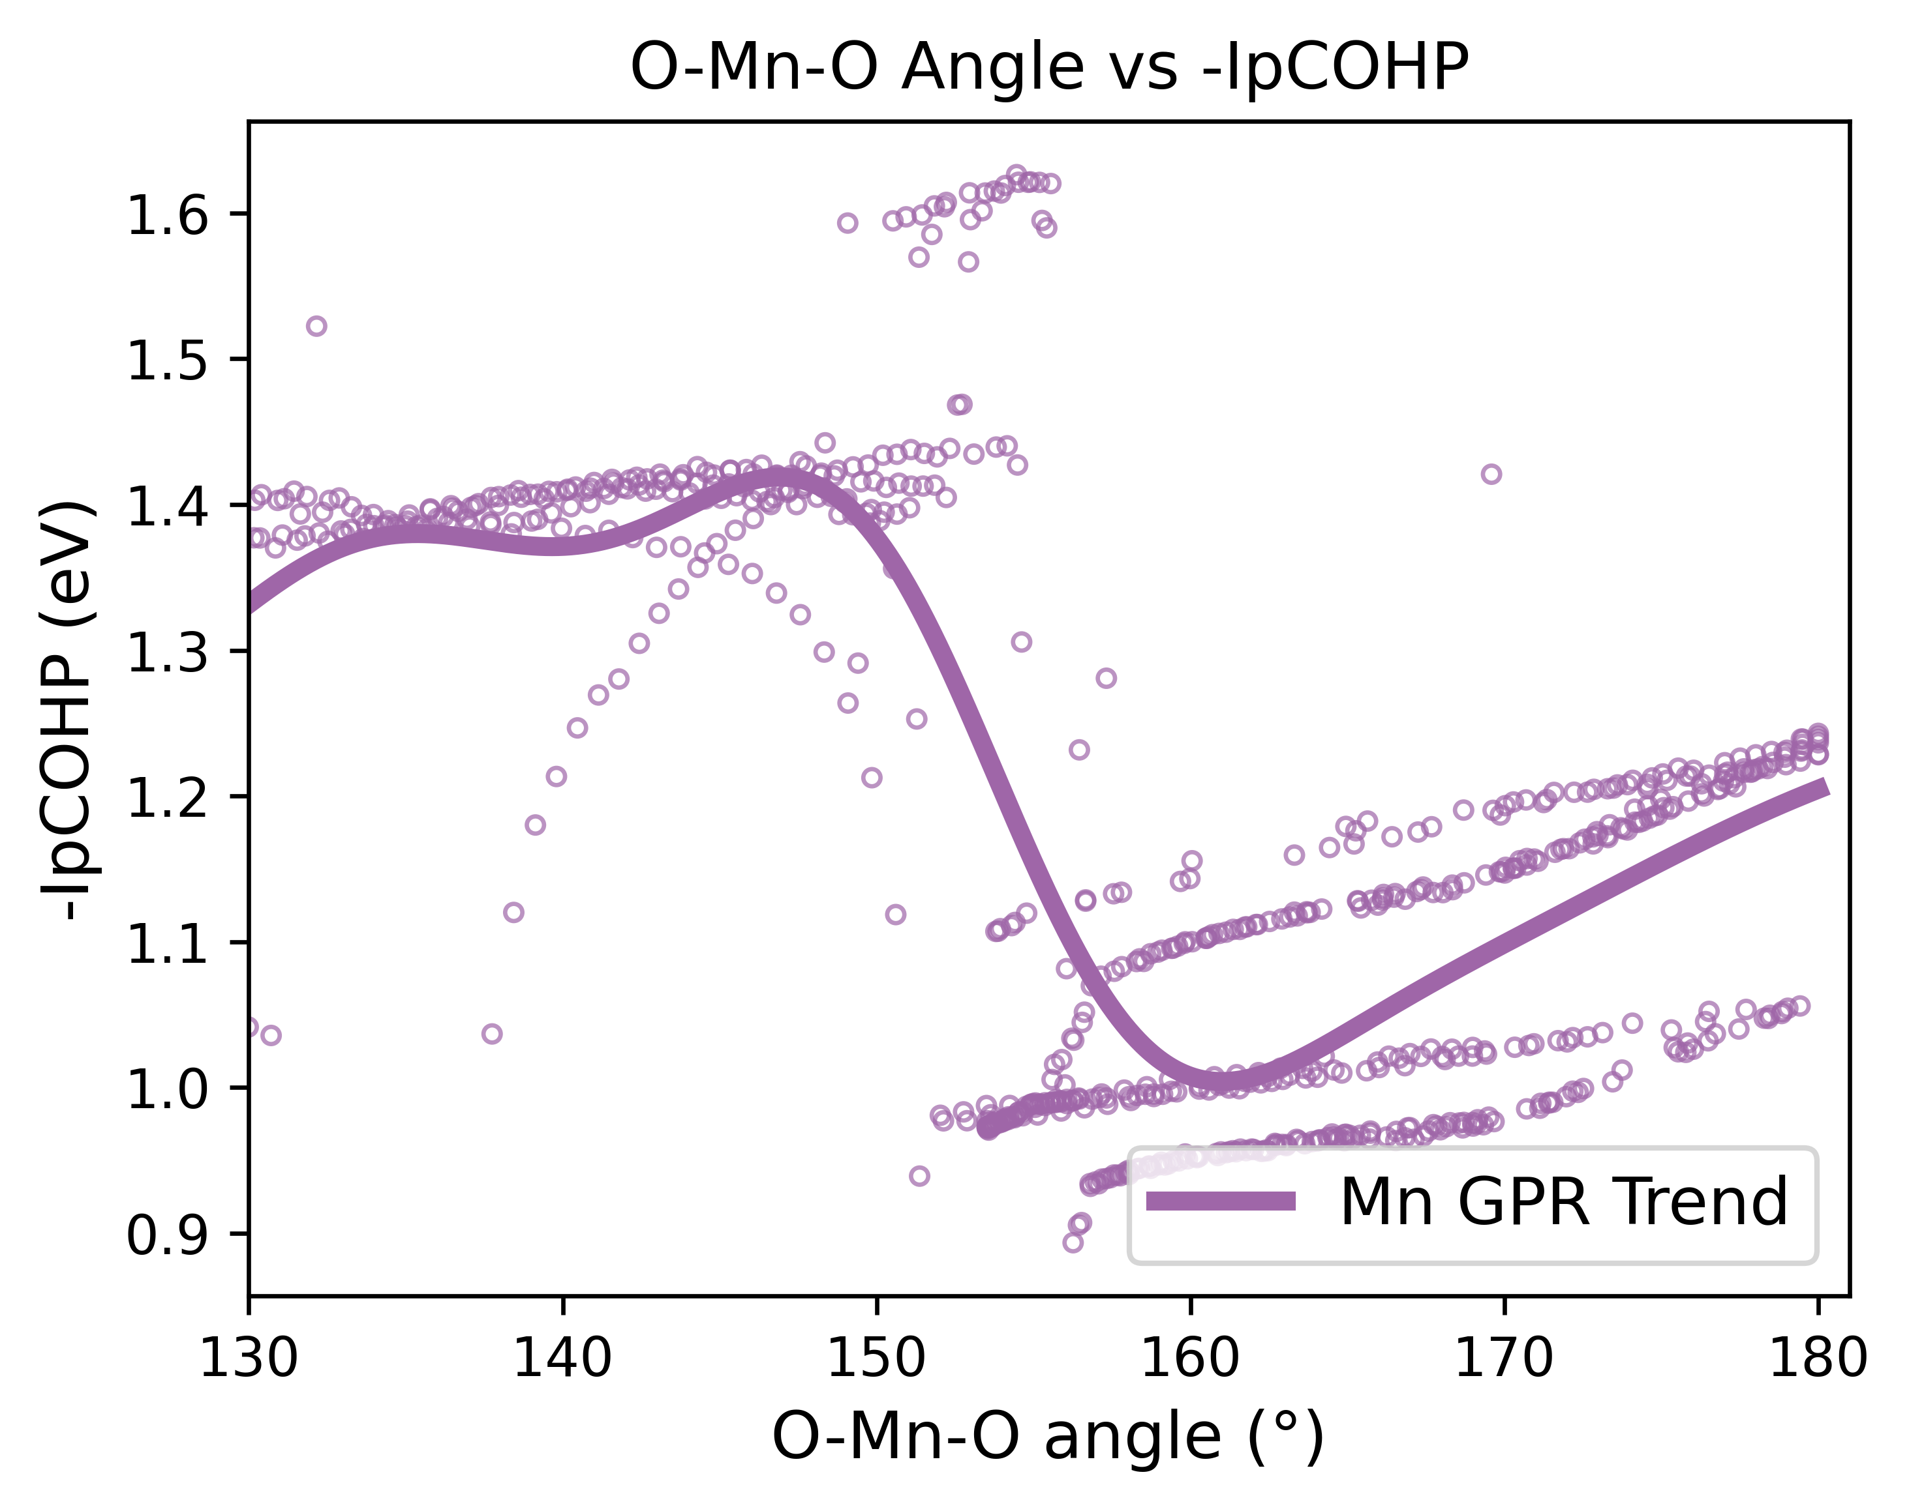
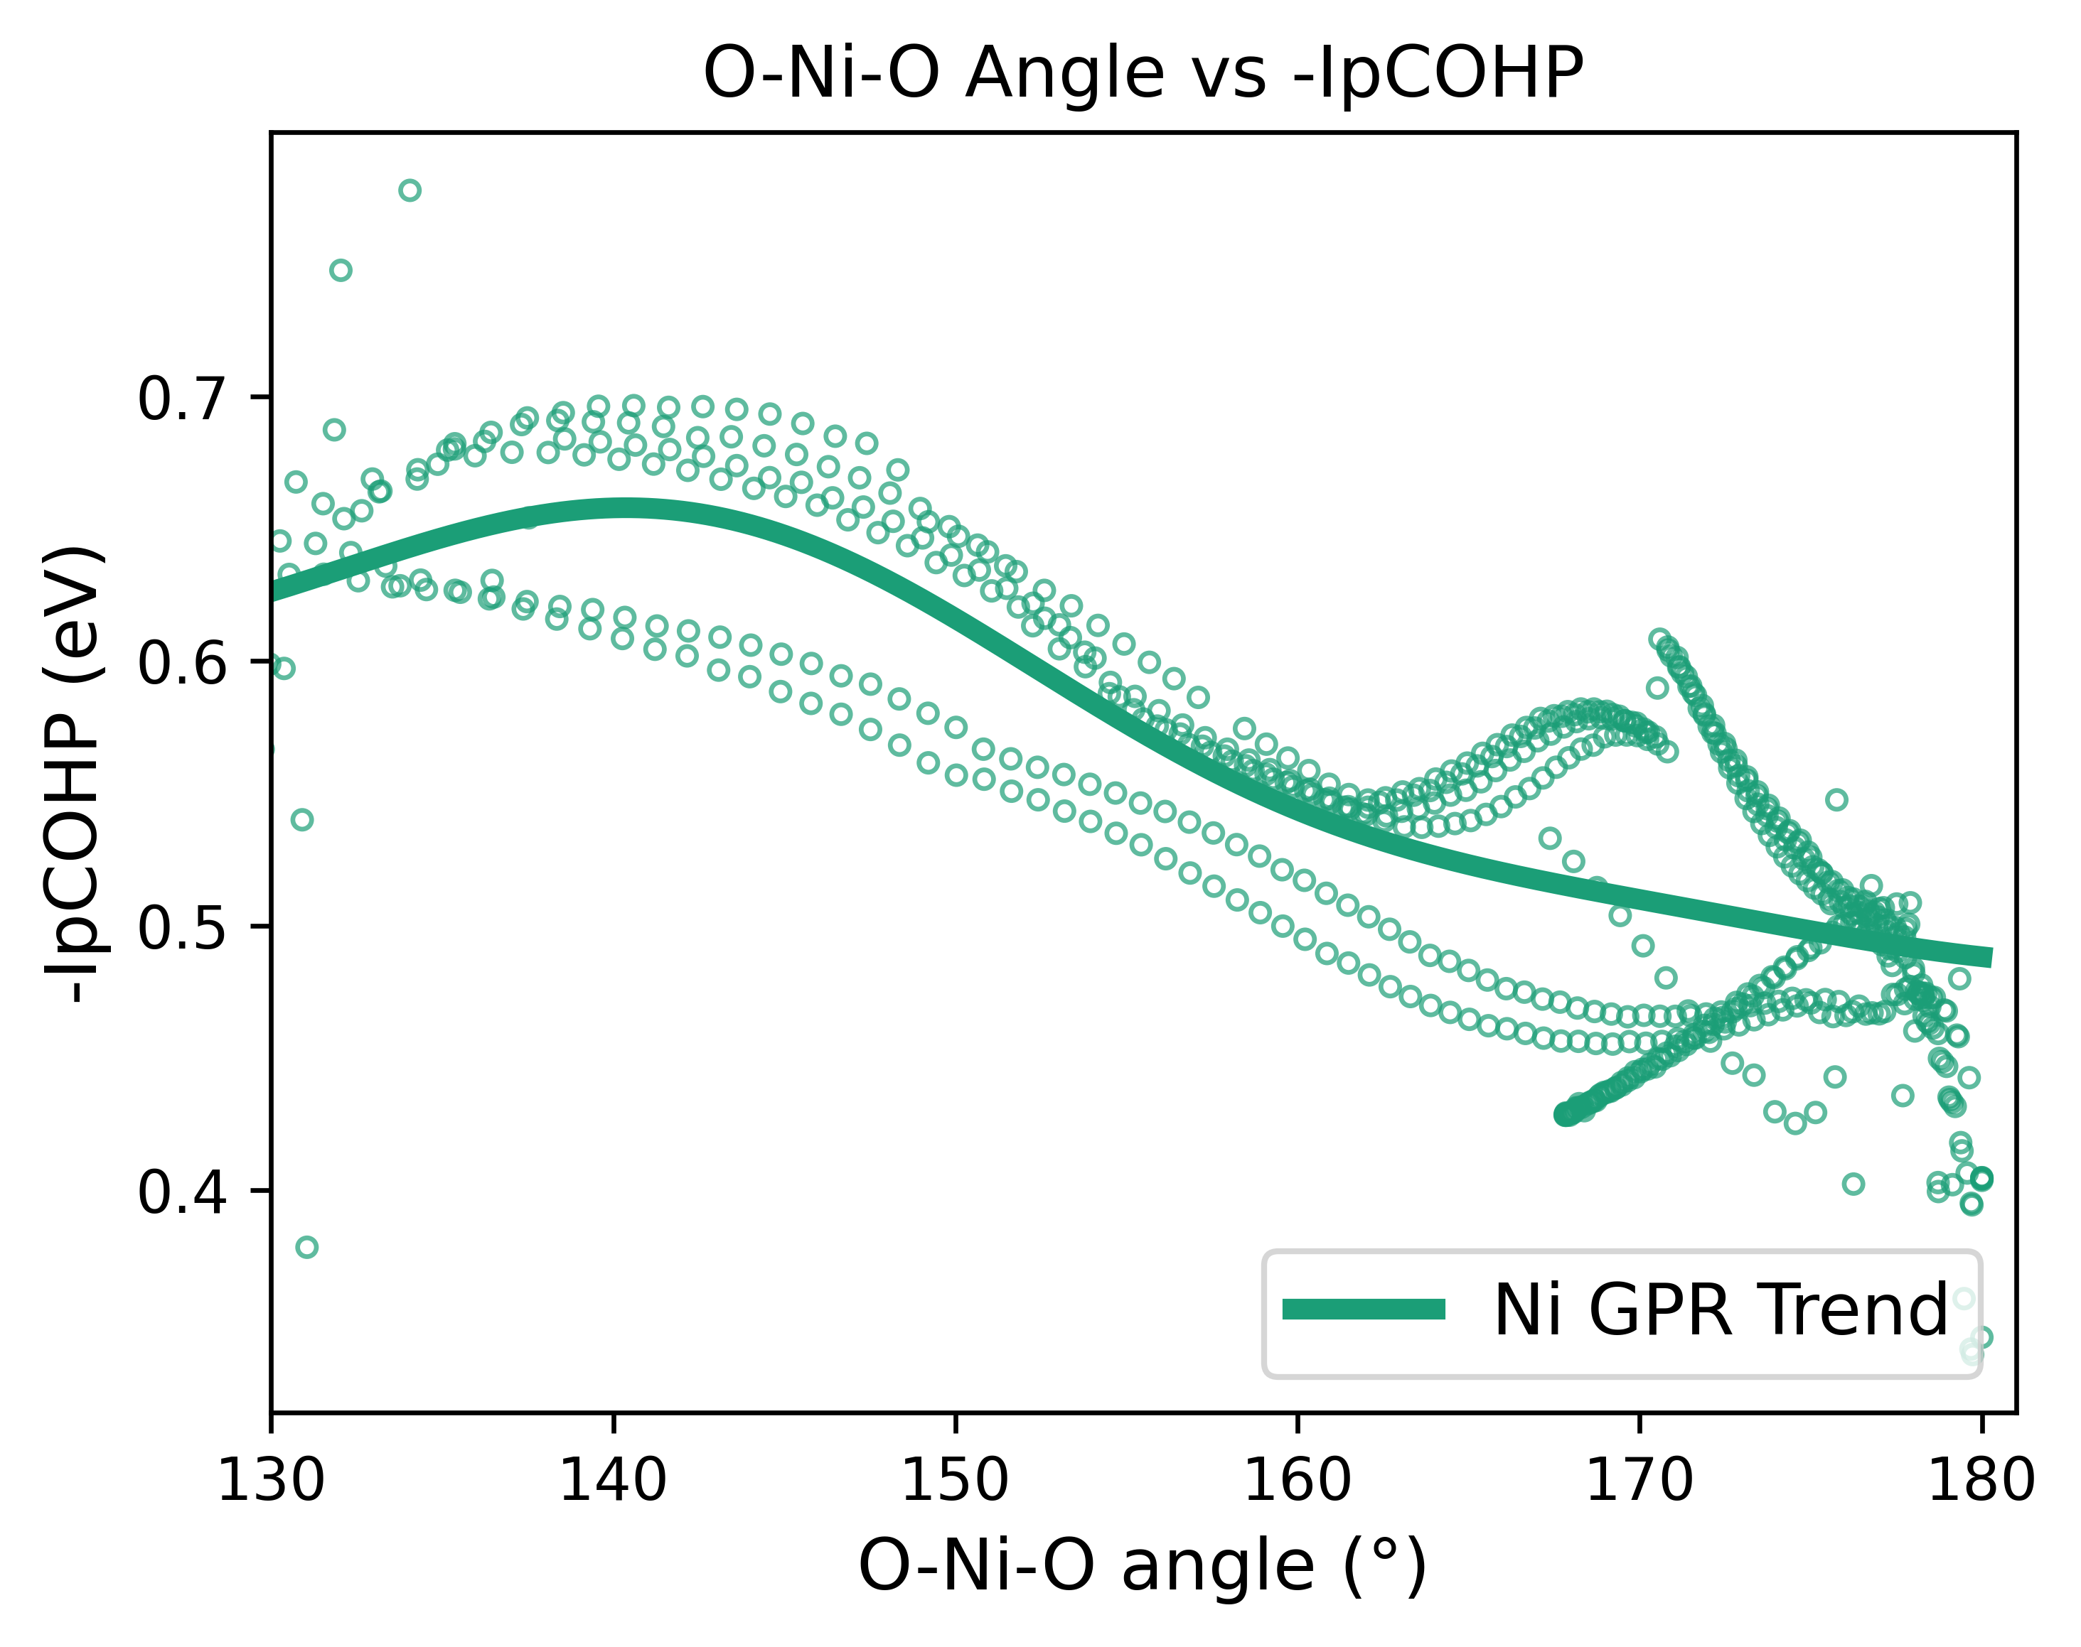
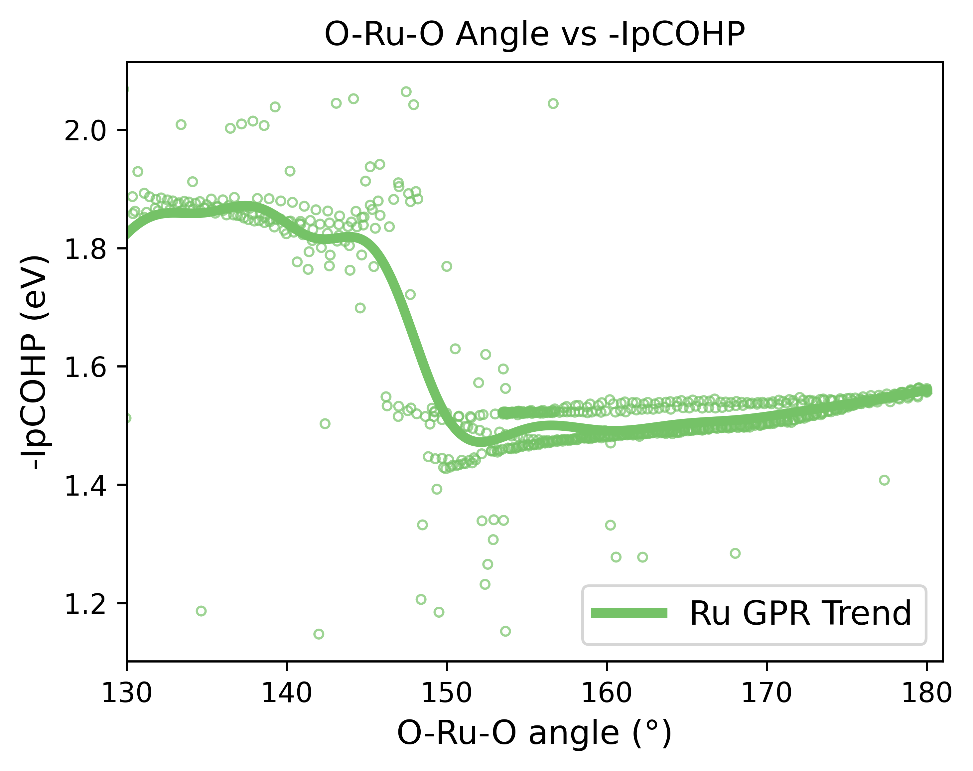
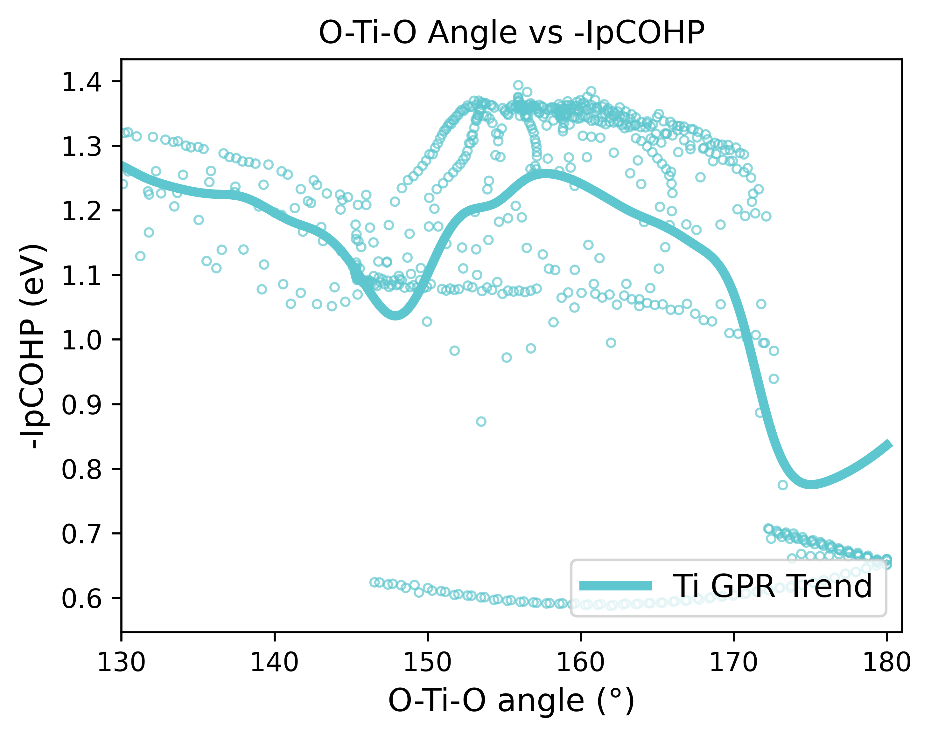
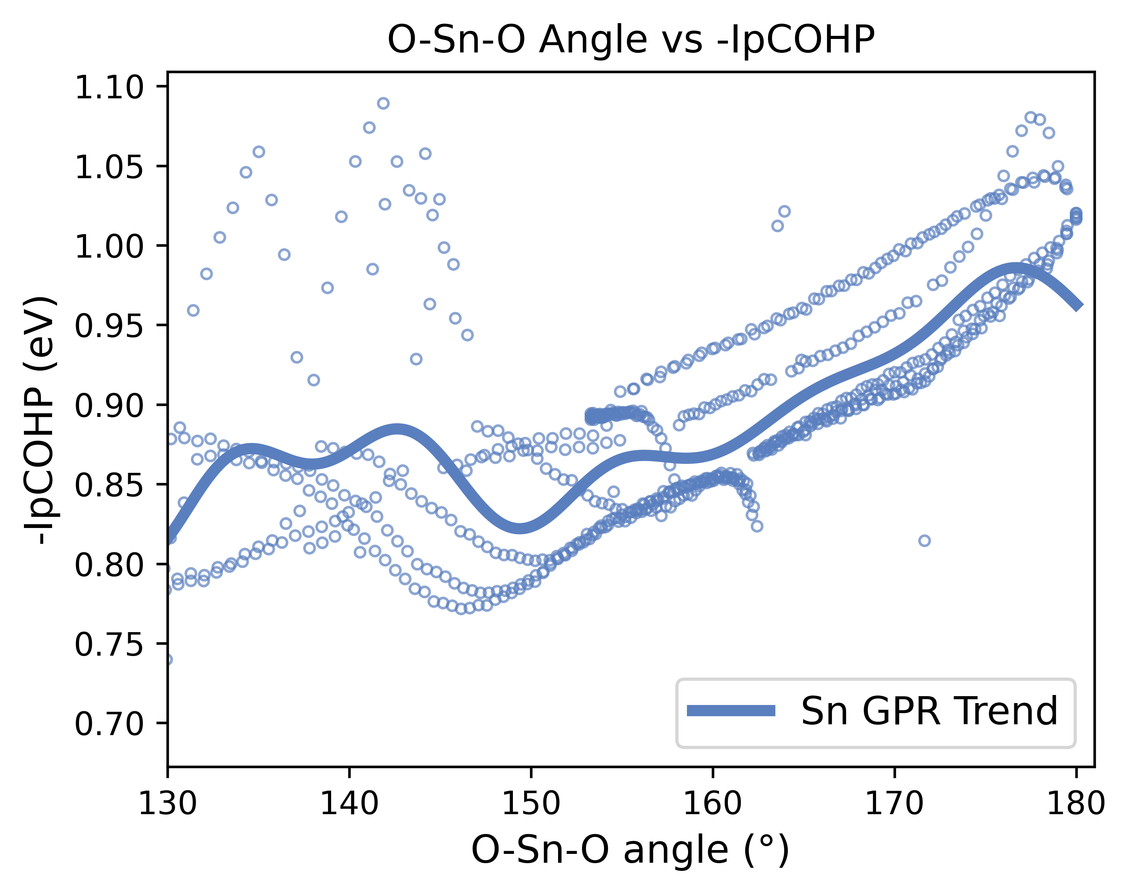
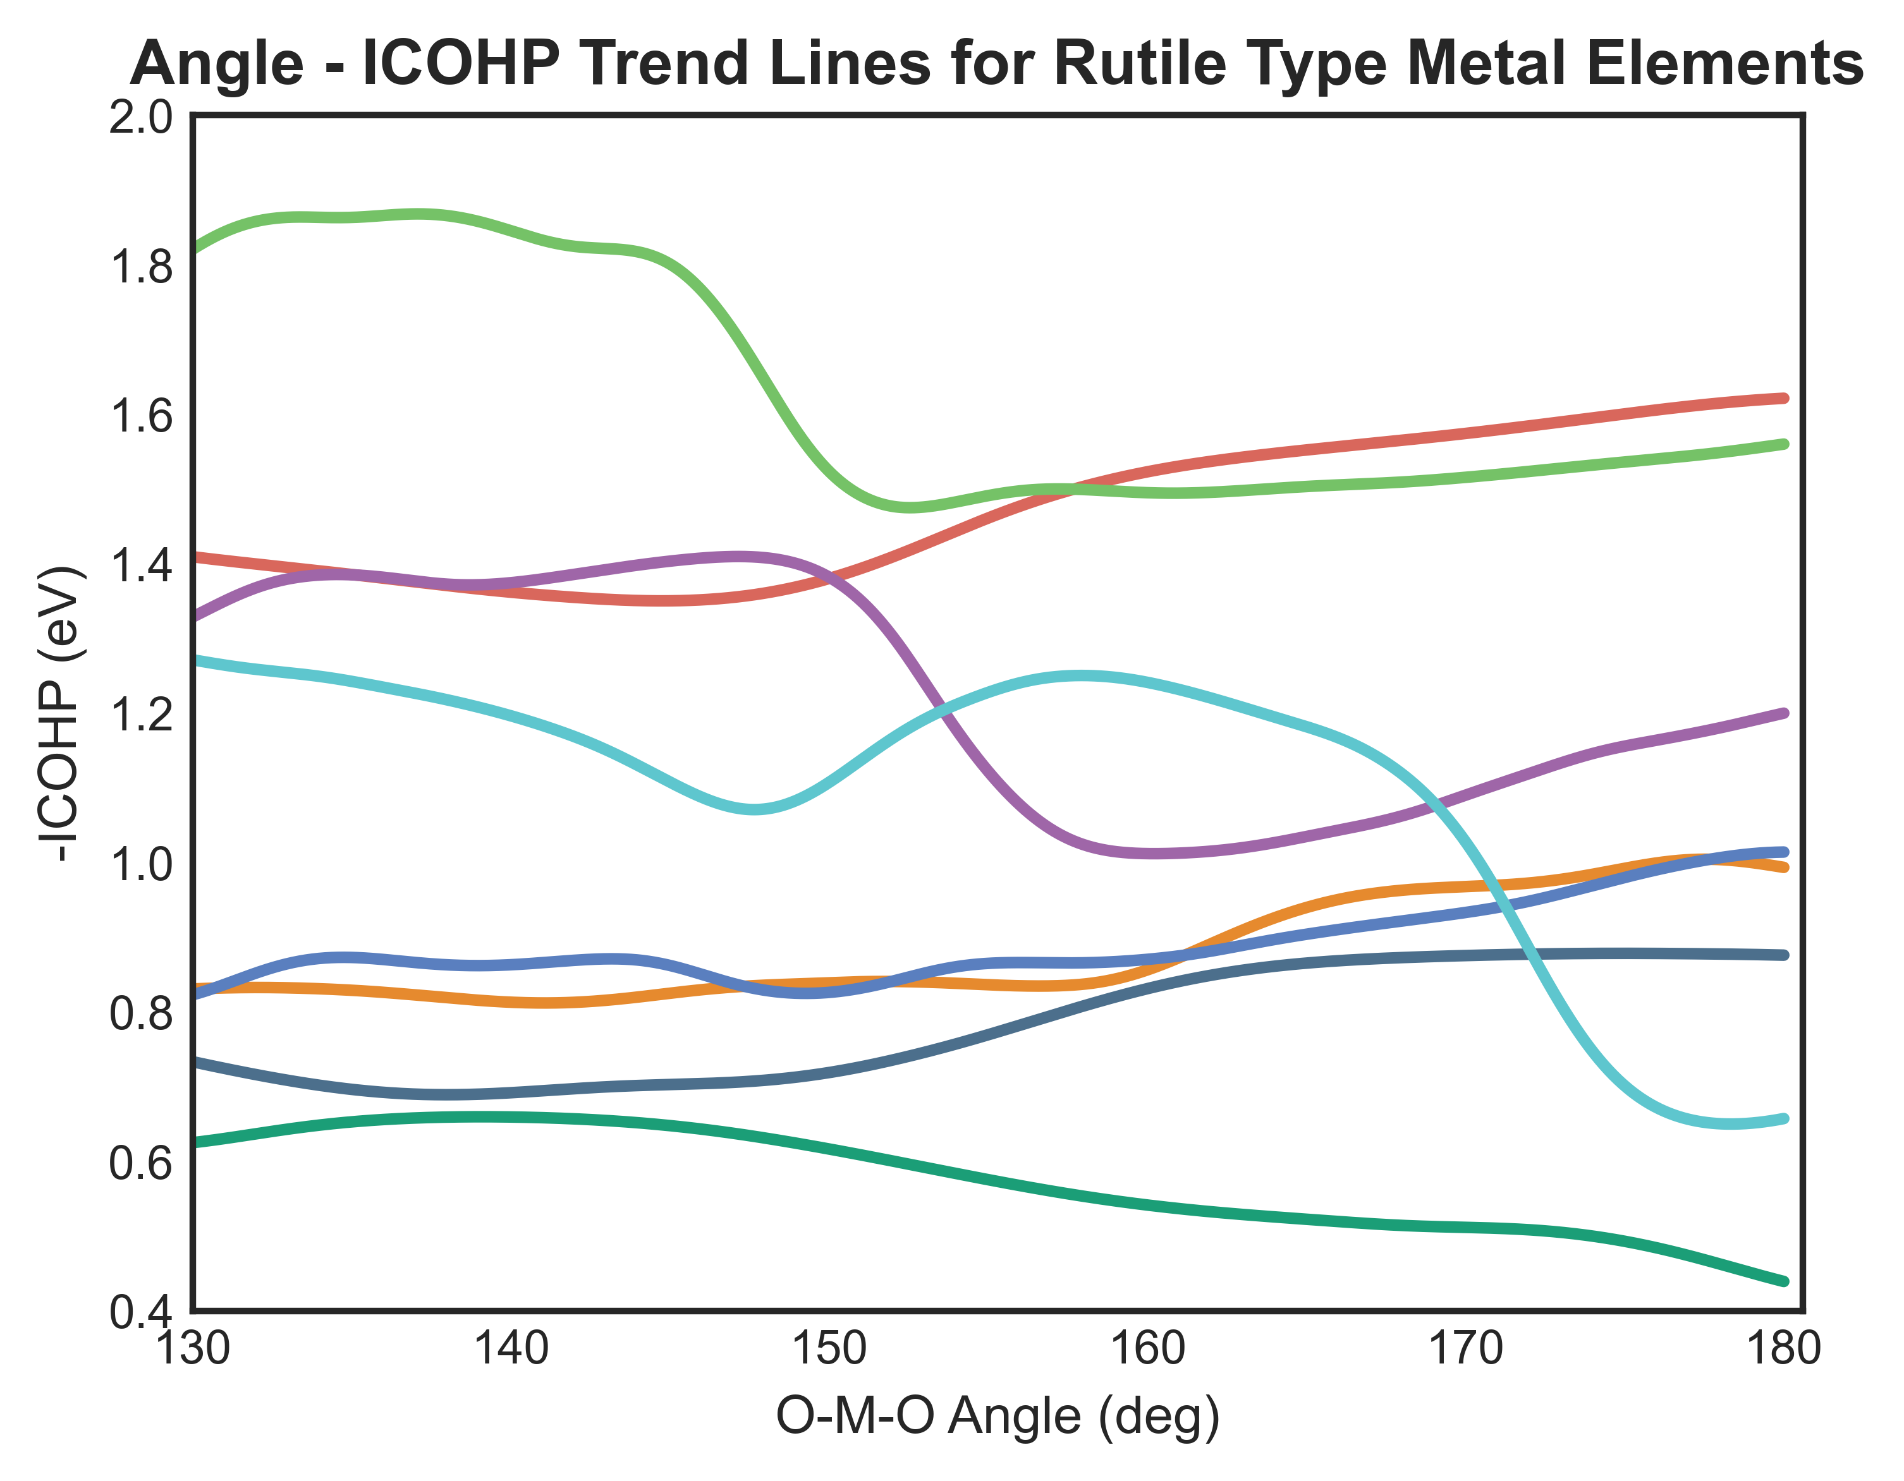
Figure 3
Ir
Ru
Mn
Sn
Fe
Co
Ti
Ni

Slide 6
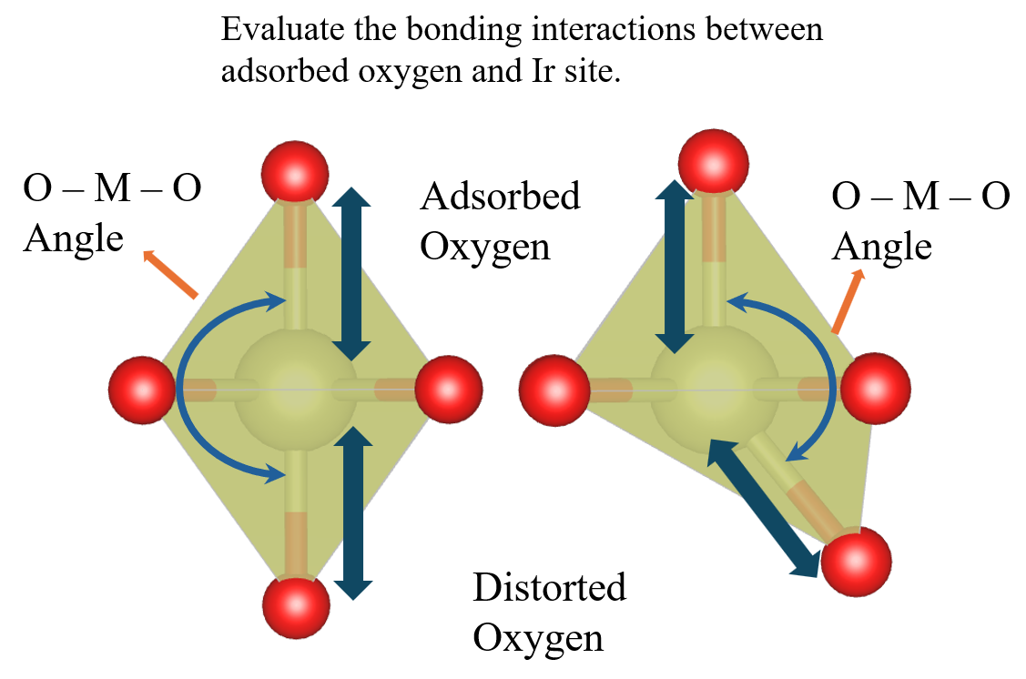

Slide 7
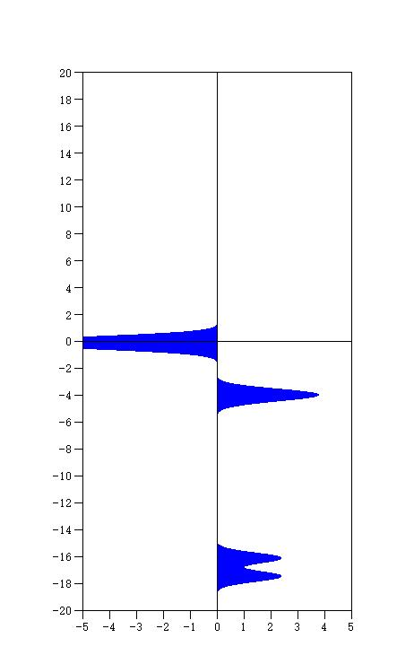
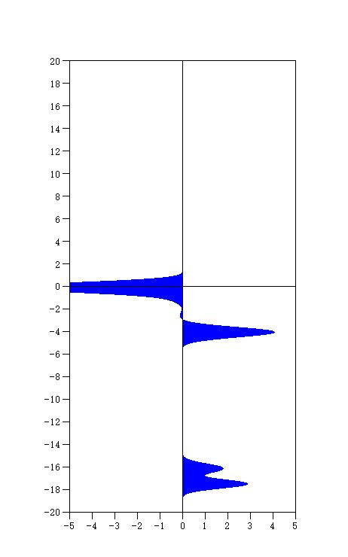
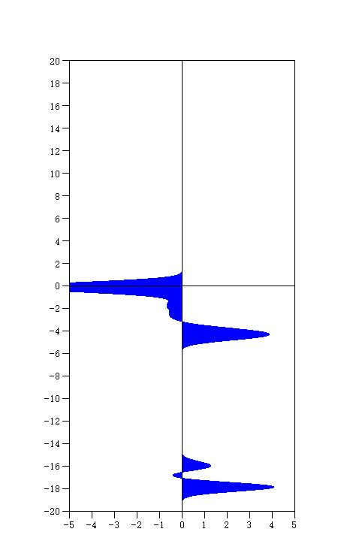
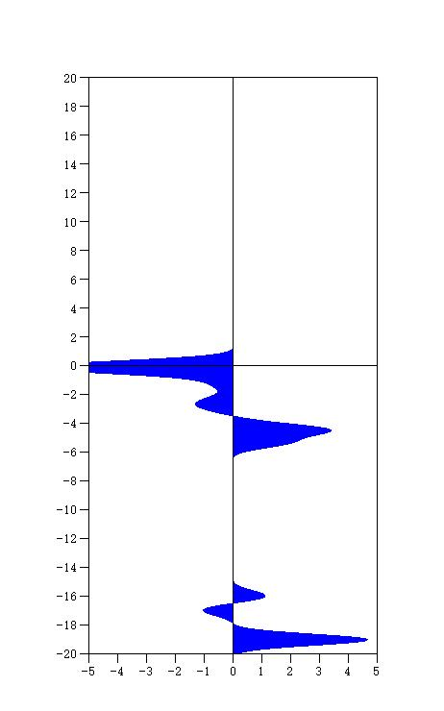
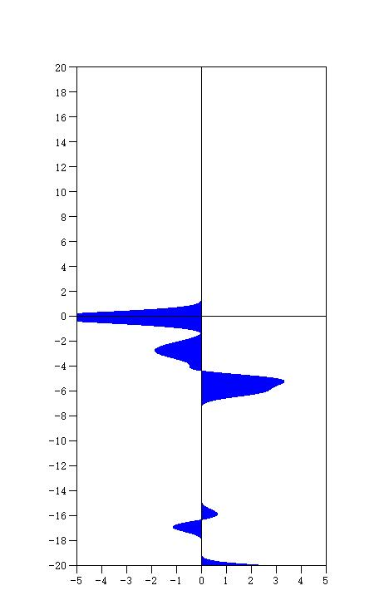
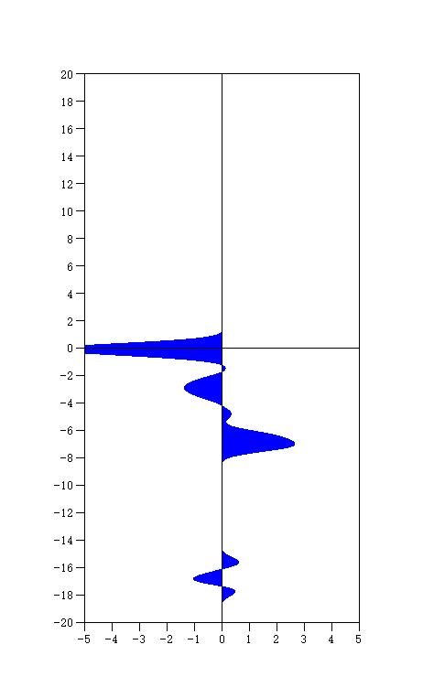
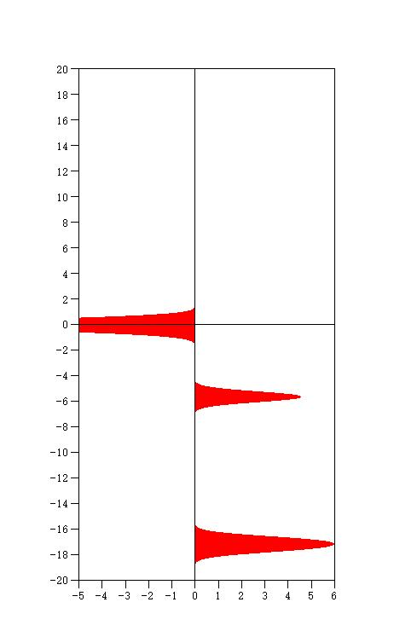

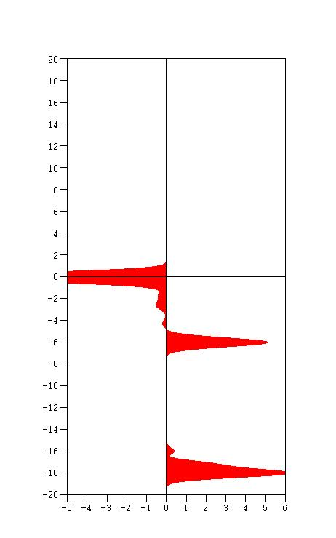
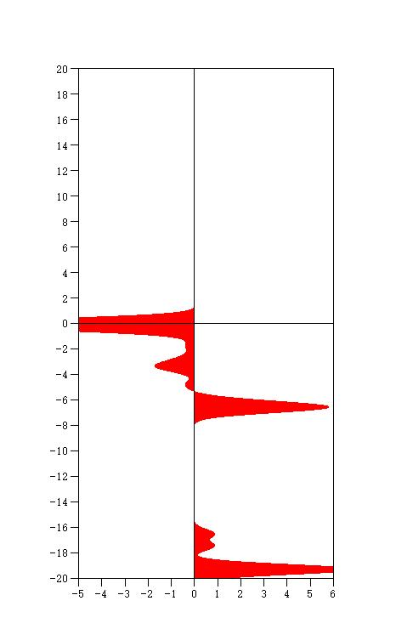
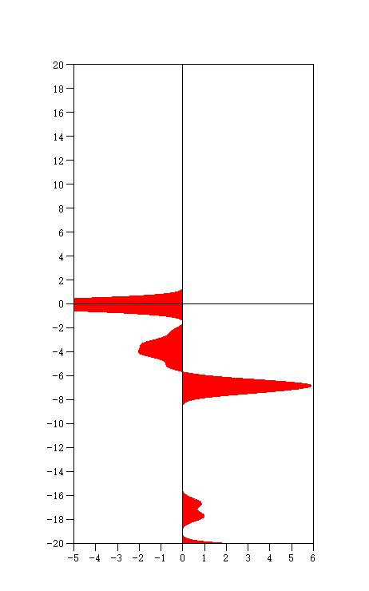
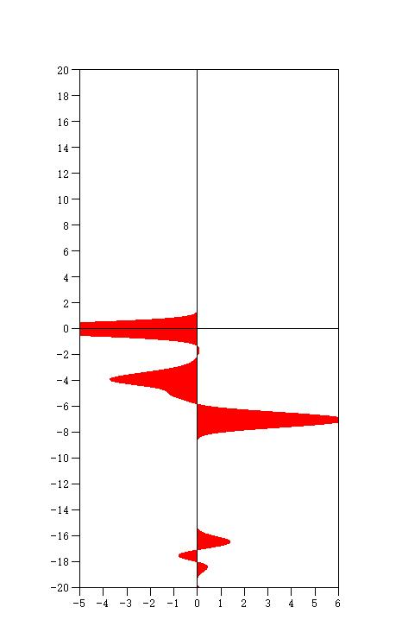
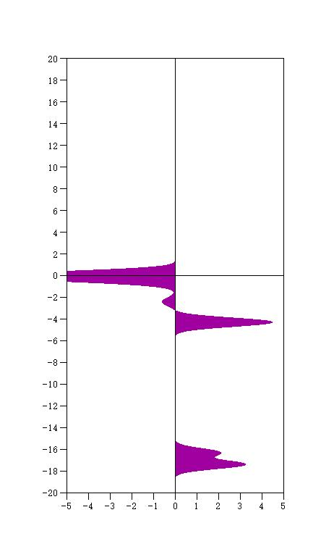
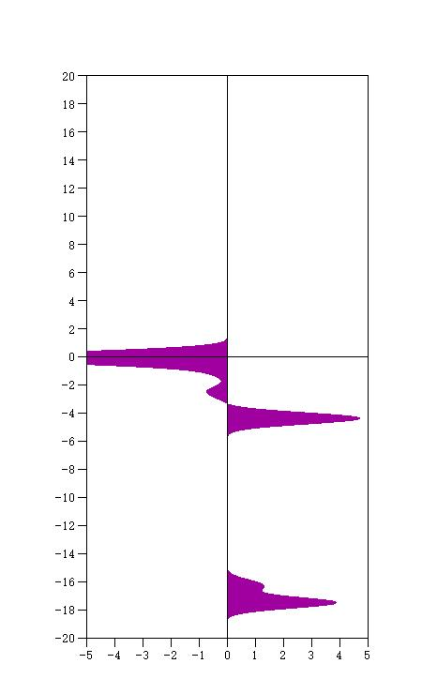
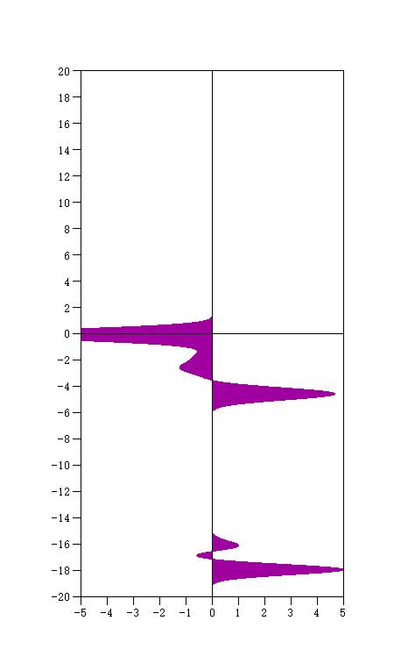
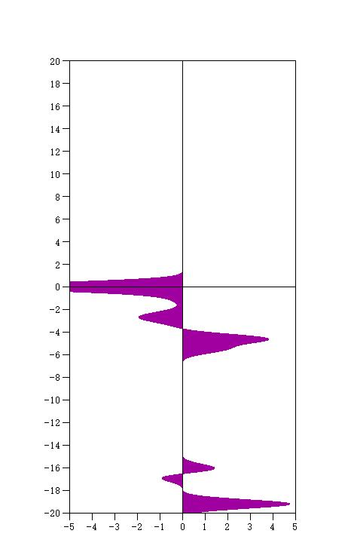
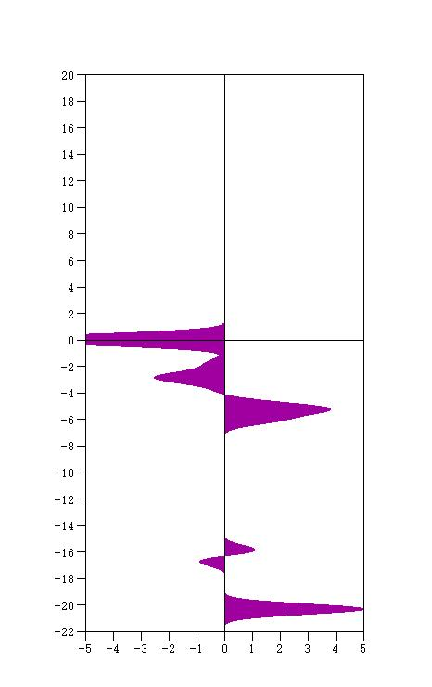
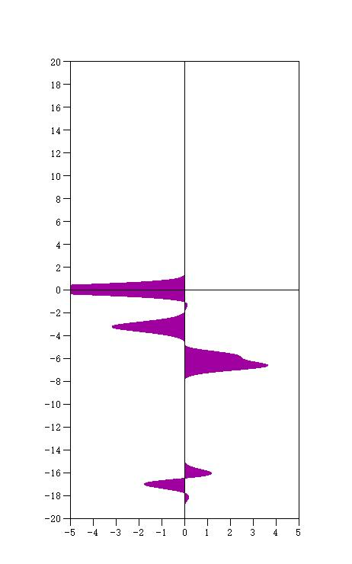
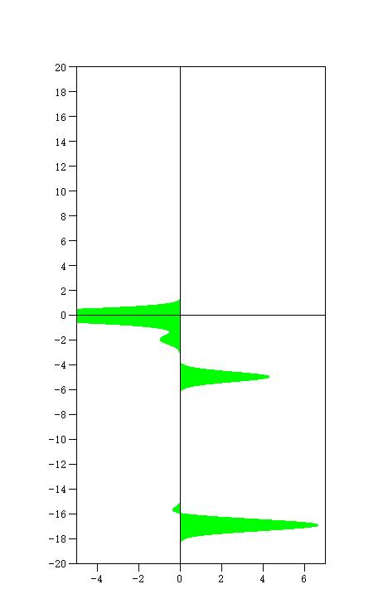





180°
170°
160°
150°
140°
130°

Slide 8


















Figure 4

