Slide 1
Measurement a position of ep-scattering with TPC
Aleksei Dziuba / PNPI NRC KI
18th of June, 2020

Slide 2
Motivation
An absolute target thickness is necessary to determine an absolute cross section of the electron-proton or muon-proton elastic scattering
This requires a Z-position measurement for each recoil candidate
The position point can be determined via two ways:
1) With incoming and outgoing leptons tracking (not a precise method)
2) Using a time information from TPC and from incoming lepton tracking (this method is more accurate, but also requires a information from the outgoing lepton tracking to get rid of pile-up). The Z position measurement is a crucial to determine lepton scattering angle, which is necessary rot the Q2-scale calibration.
A main uncertainty for the 2nd method comes from the TPC side, an accuracy of timing for the incoming lepton is assumed to be on a nanosecond level.
This report is devoted to the different aspects of the Z position measurement.

Slide 3
The method
Geant-4 simulation of the recoil proton:
Geant-4 with standard physics lists
Energy deposit at each tracking step is uniformly (not Poisson!) distributed along this step. 36,5 eV to create electron-ion pair
Ionization electrons are projected into anode plane (no loss but a diffusion is assumed!).
A signal processing includes a sigbal shaping function (see backup slides)
A data-driven method for an electronic noise simulation (see backup as well)

Slide 4
A Geant-4 Model
Recoil proton is generated within zy-plane
MC truth quantities are:
Z_{TRUE} is an initial position of the recoil
θ_{TRUE} is an angle wrt. z-axis
T_{TRUE} is a known kinetic energy
A drift velocity for the H₂ gas with a condition of experiment will be measured using a dedicated experiment
A goal is to build an effective and unbiassed time-estimator, which is independent on the scattering angle and kinetic energy of a recoil
y
H₂ (20 atm.) 400 mm
Recoil proton
z
A beam direction
0 mm
+400 mm

Slide 5
Animated figure with different θ_{TRUE}
See in a presentation mode (F5)
Flash ADC spectra for the central anode pad for the recoil proton of 5 MeV angle between 0 and 30 degrees (5 degrees step)
Noise spectra are the same
Signal amplitude is growing as path across the pad become larger
Peak position is visibly dependent on a θ_{TRUE}

Slide 6
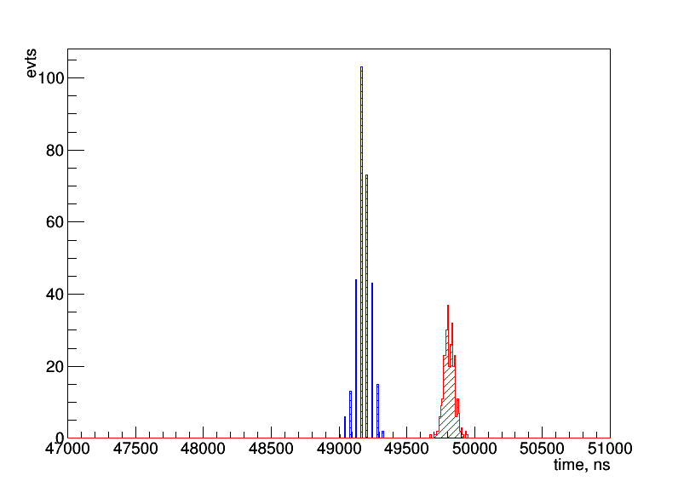
Method-1
Average signal over 3-5 channels
Find maximal slope point
Project the maximal slope from this point into a baseline
Discretization is observed
Anode-grid distance 190 mm
W₁ = 0.004 mm / ns
Time to reach grid (electrons originated in the point of scattering reach grid) = 47500 ns
Start point
(method 1)
Maximum distribution (pol2-fit)
Time to reach grid
Time to reach anode

Slide 7
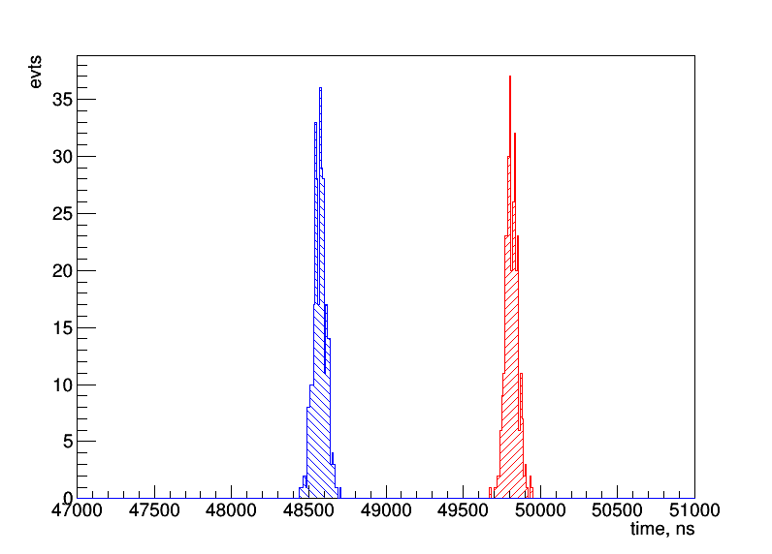
Method-2
Fit signal by a straight line for 30%-80% of signal region
Find intersect with a baseline
Resolution is similar to the maximum position resolution
Anode-grid distance 10 mm
W₂ = 0,0075 mm/ns
1333 ns of signal length (grid-anode drift time)
Maximum distribution (pol2-fit)
Start point
(method 2)
Time to reach anode
Time to reach grid
1333 ns

Slide 8
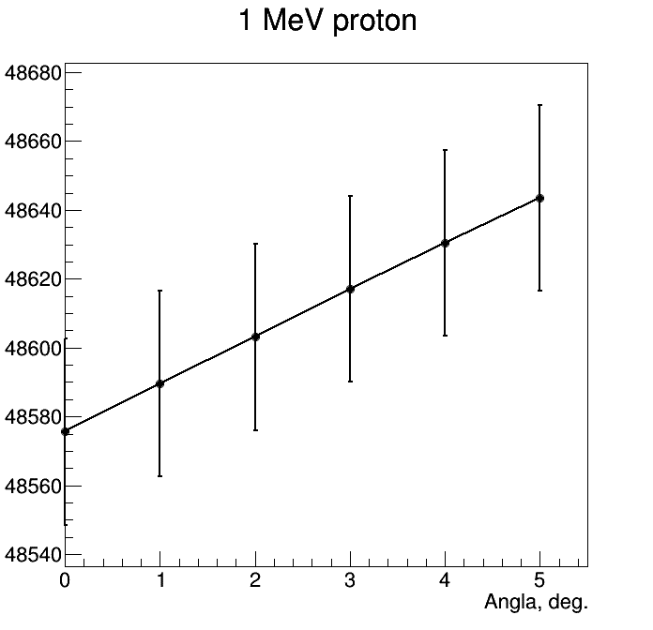
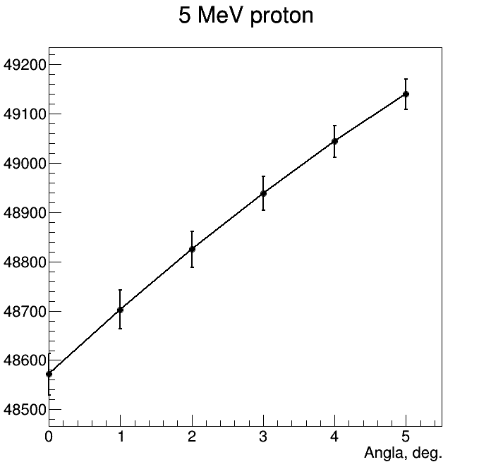
Start time-point (method-2) vs proton angle
RMS = 30-40 ns
RMS = 27 ns
1st ring
Central pad

Slide 9
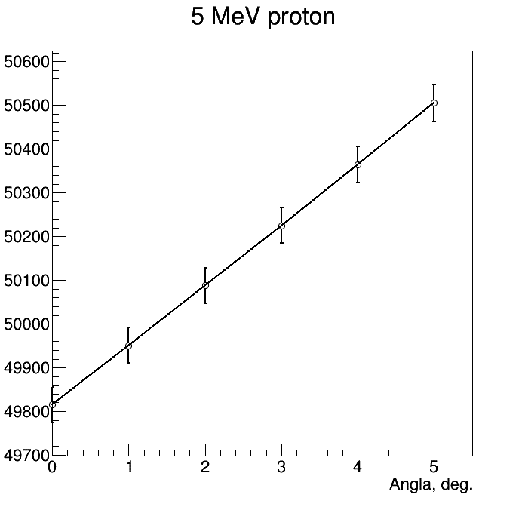
Peak position vs proton angle
RMS = 40 ns
1st ring

Slide 10
Variants of correction
MWA (BDT, Neural Networks) – could take quite a long time on realization; hard to understand by human brain
Parametrization using information about: T_{p}, angle from TPC, peak position, FWHM, a signal start and stop.
All pads at the same time / Split by fired pads
Use kinematic constrains (radiative corrections with ESEPP generator)
Some simplifications are possible (for example, use information from the 1st ring)
Change signal shaping / anode-grid distance to find better conditions
All variants require a MC verification with DATA [in future]

Slide 11
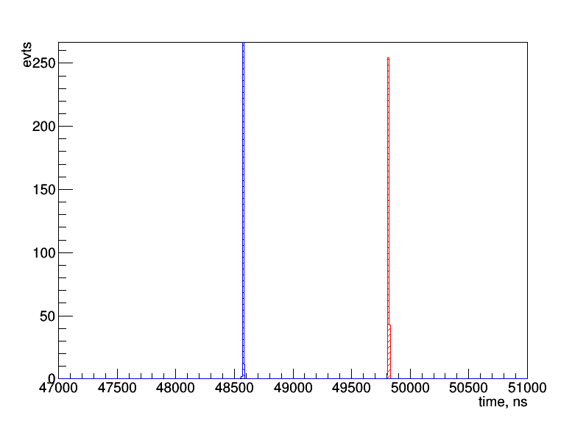
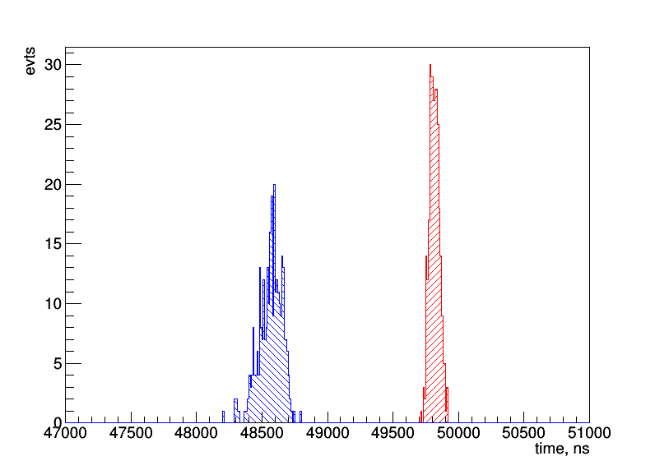
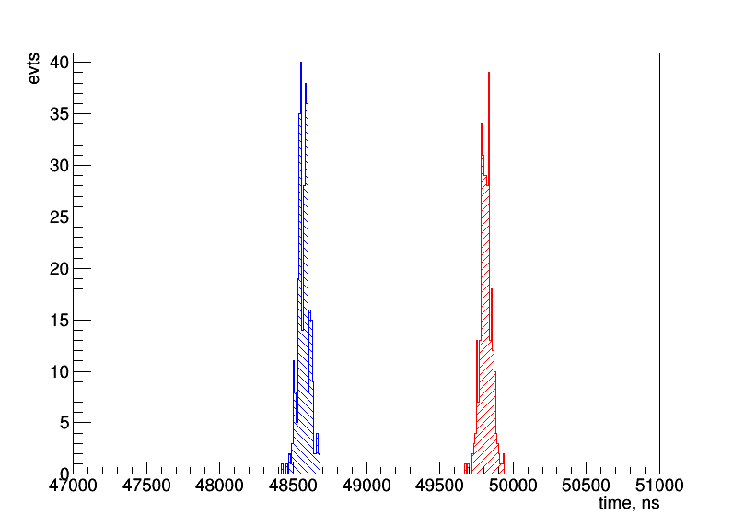
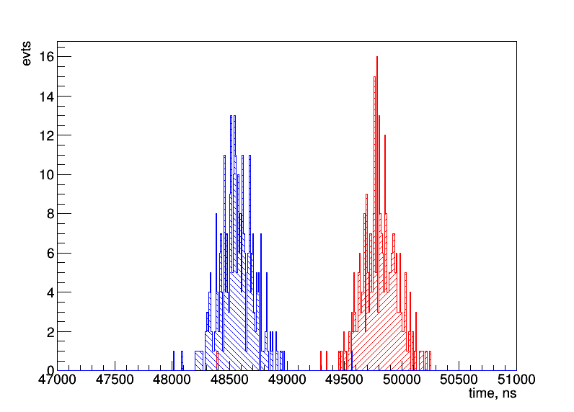
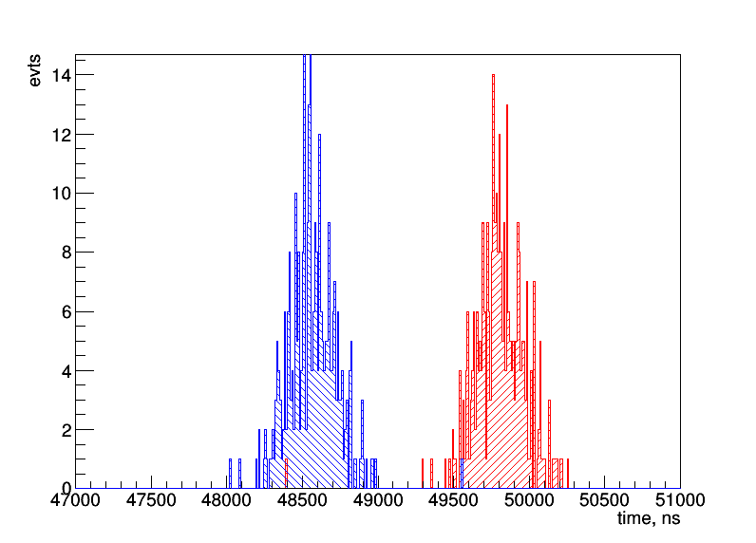
Noise OFF/ON
OFF
ON
Central pad
2.5 ns
91 ns
5 MeV proton going along Y-axis (0 deg.)
Method-2 is used
Noise affects a time information from the central pad.
Note that there is no beam-noise in consideration.
Little broadening for the 1st ring
1st ring
39 ns
42 ns
165 ns
165 ns
2nd ring

Slide 12
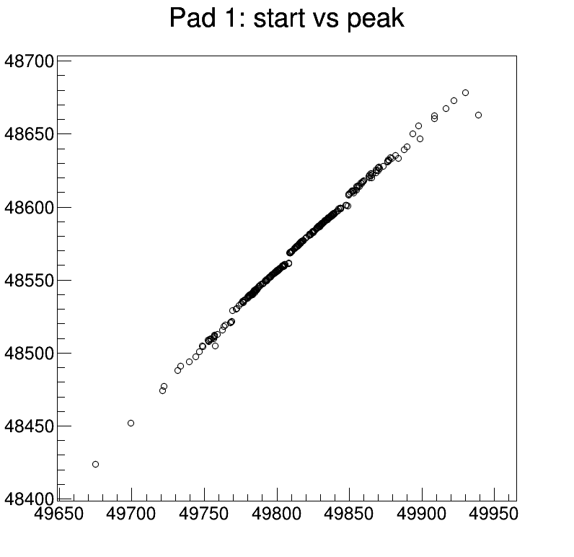
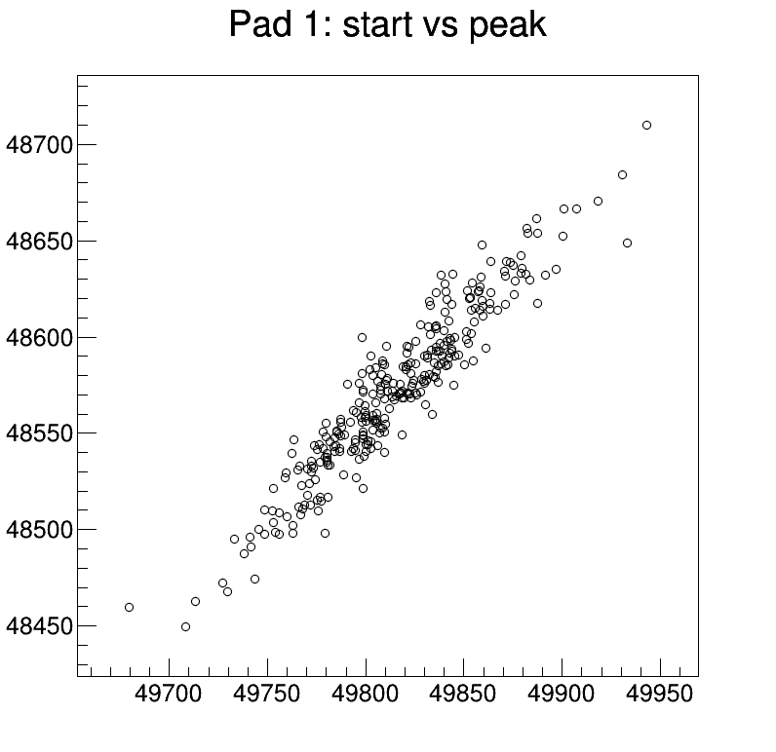
Start-peak correlation
5 MeV proton going along Y-axis (0 deg.)
Method-2 is used, 1st ring
OFF
ON

Slide 13
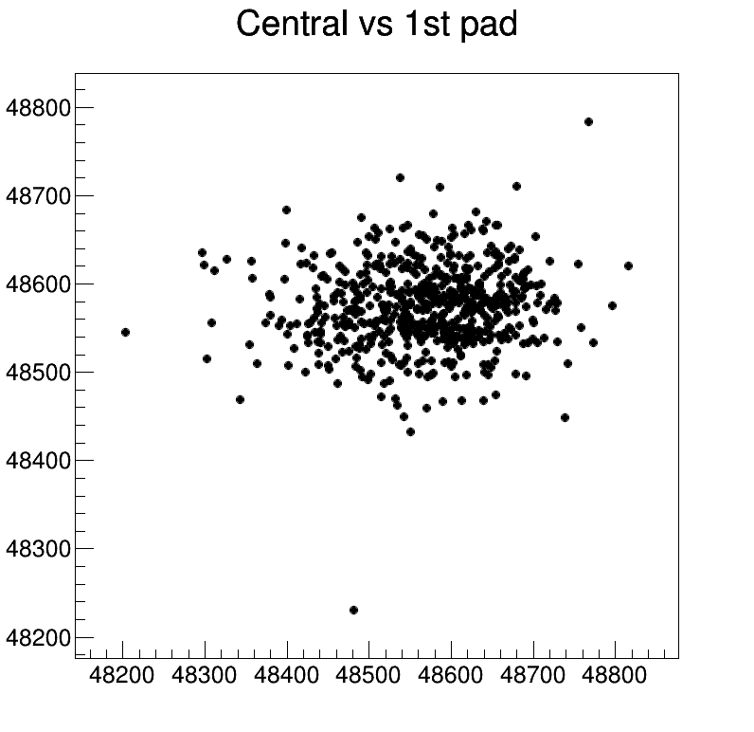
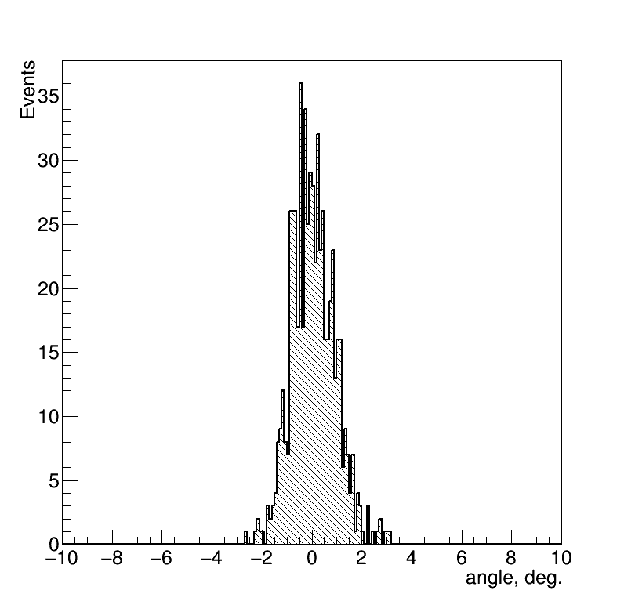
Angular resolution (central vs 1st pad)
RMS = 0,86 deg
No correlation between time from the central circle and 1st ring

Slide 14
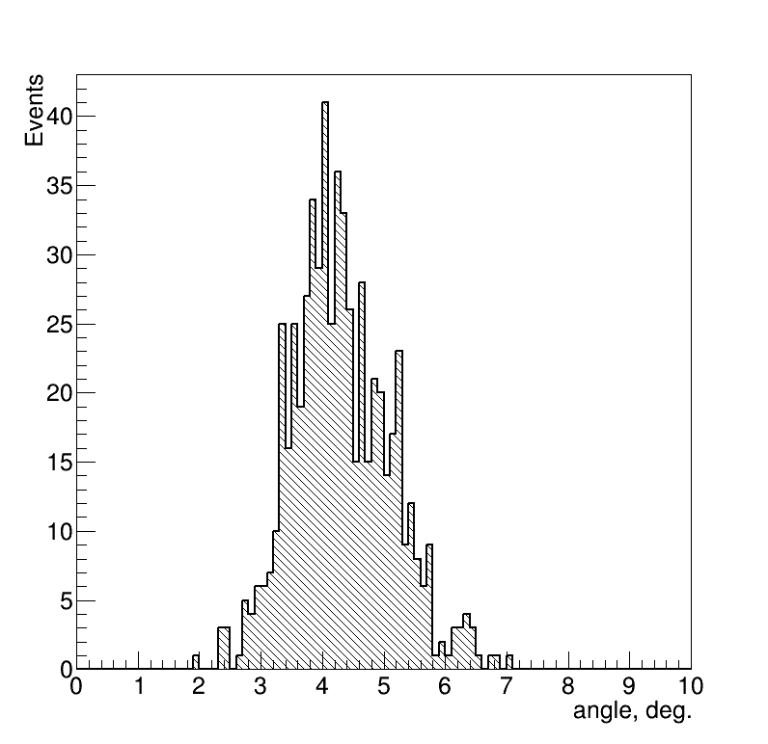
Bias for angular measurements with TPC
5 MeV proton going along with 5 deg wrt. Y-axis
Method-2 is used to reconstruct start point
Start points is considered as a proxy variables for the signals:
half of circle radius for central pad
half of the width of the 1st ring
Energy loss profile seems to be necessary to use in angular tracking
Mean = 4,3 deg
RMS = 0,8 deg

Slide 15
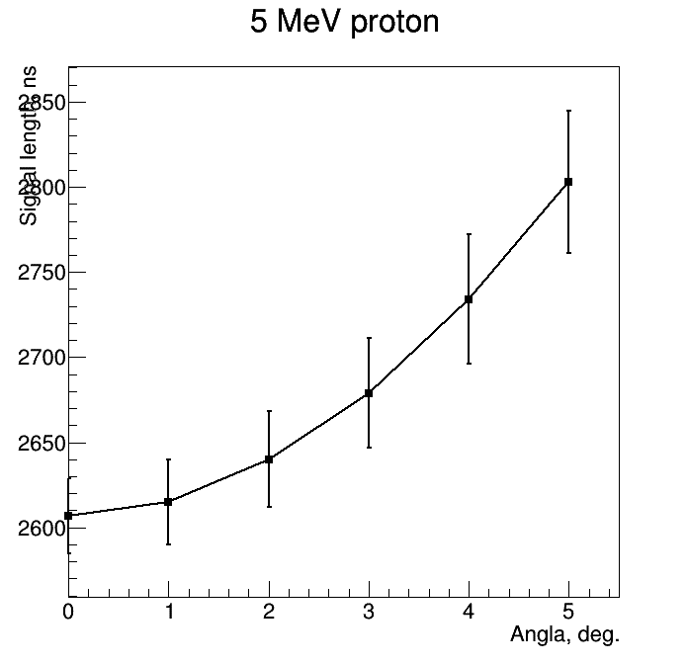
Signal length vs angle
Method-2 to determine the end of the signal.
1st ring
Lendth = End - Start
Signal become longer with larger angle. RMS grows as well.
Non-linear dependency
Could be used for correction

Slide 16
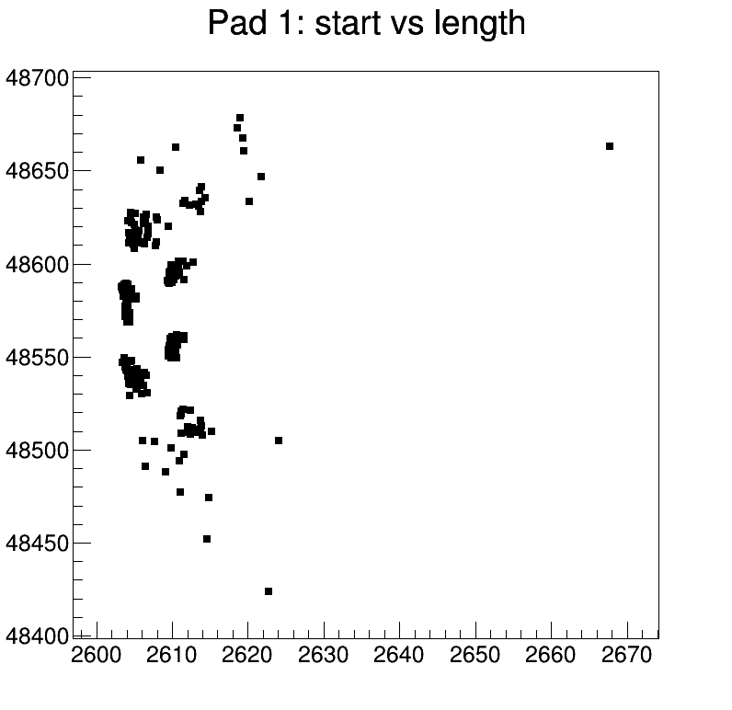
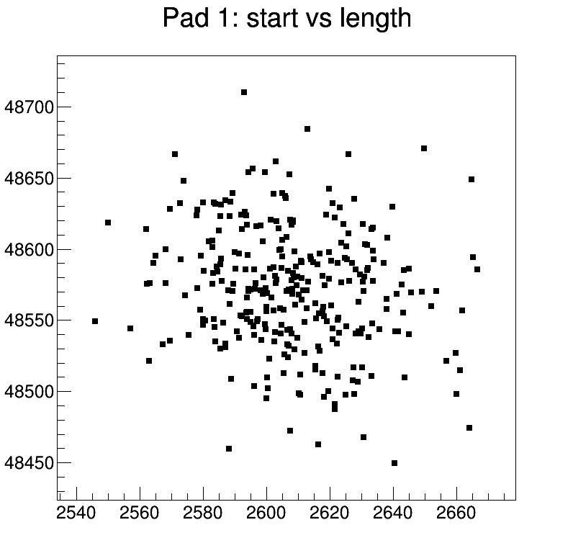
Start-length correlation
5 MeV proton going along Y-axis (0 deg.)
Method-2 is used, 1st ring
OFF
ON

Slide 17
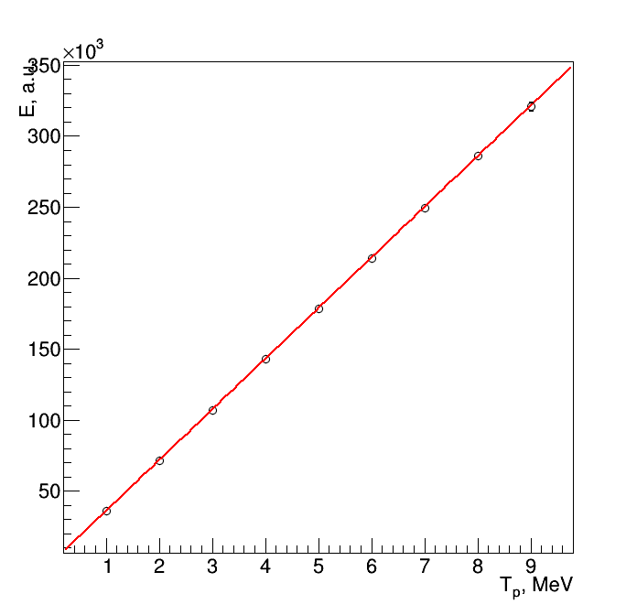
Energy deposit in TPC
Fit pol1
****************************************
Minimizer is Linear
Chi2 = 0.0845744
NDf = 7
p0 = 157.541 +/- 716.783
p1 = 35674.4 +/- 199.573
Fit C*x
C = 35710 +/- 117
Unfortunately, energy deposit on pads is not sensitive to the recoil angle (check for 5 MeV for 0 and 5 degrees)

Slide 18
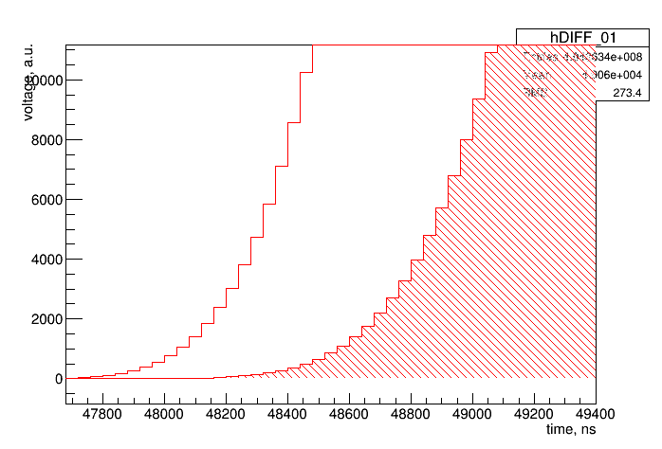
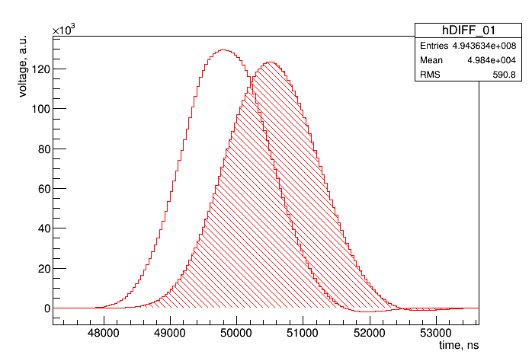
Cumulative shapes (noise OFF, 5 MeV, 1 ring).
0 deg
5 deg

Slide 19
Backup slides

Slide 20
Modification of the response functions
Grid
L _{Grid-Anode}
Anode
Current on anode appears, when an electron arrive to the grid.
It increases linearly and ends, when the electron reach anode.
T _{Grid-Anode} = L _{Grid-Anode} / W₂
An integral of the current is the charge of one electron (e = 1.602176634×10⁻¹⁹ C).
Response function of pre-amplifier must be changed according to this process
1e–
0 mm
10 mm
Current, A
2 × e × W₂ / L _{Grid-Anode}
Time, s
0
L _{Grid-Anode} / W₂

Slide 21
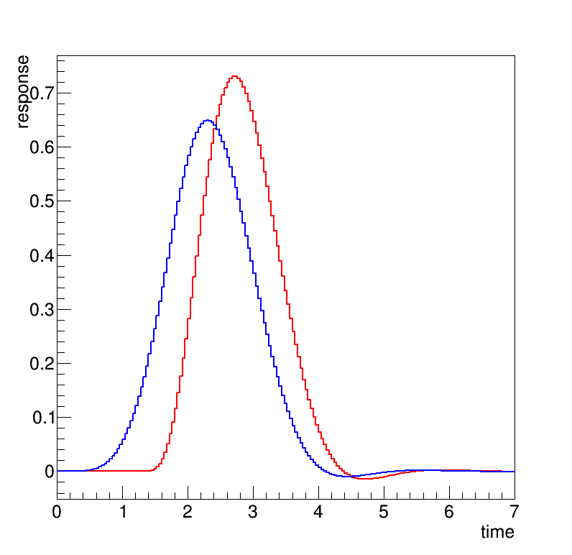
An electronic response function
For the previous simulation an electronic response appears, when an electron reach anode. Simple shift of the response function.
In a new version it starts, when an electron reach grid. Convolution with linear function (see previous slide).
Zero time – time, when electron is on the grid
L _{GridAnode} = 10 mm; W₂ = 7,5 mm/μs
Signal appears when electron reach anode
Current during Grid-Anode drift

Slide 22
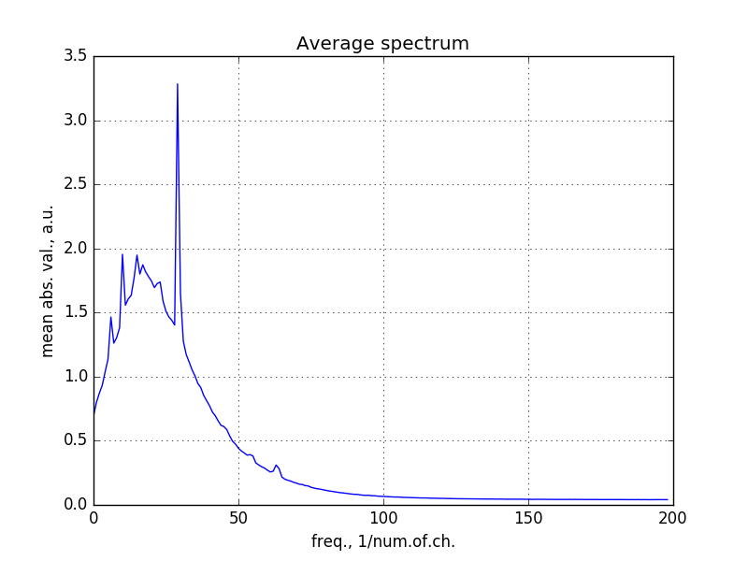
Noise studies
Done with ACTAF for a sample triggered by alpha-particles for the pads, which are far from alpha track.
Many thanks to Alexander Inglessi for the sample
Fast Fourier transformation shows that there some “featured” frequency channels
See a report: https://github.com/aleksha/electronic-noise/blob/master/docs/MC4NOISE.docx

Slide 23
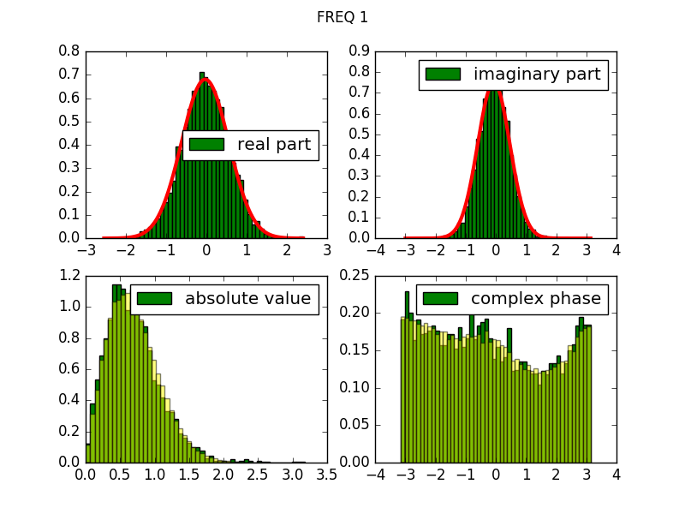
Noise generation
Example for one of frequency channel
Obtain distributions for real and imaginary part of frequency spectra using Fourier transformation;
Fit these distributions using two gaussian hypotheses;
Generate random spectrum out of these distributions;
Use inverse Fourier transformation to obtain spectrum of generated events.
Data-Model comparison

Slide 24
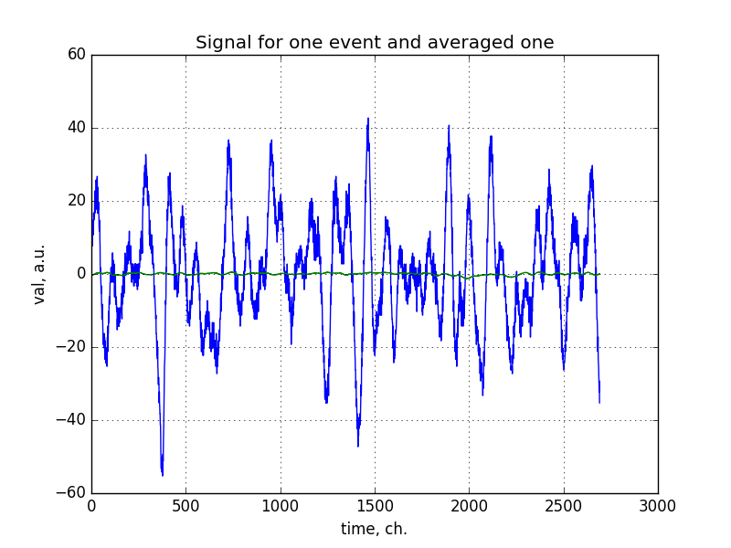
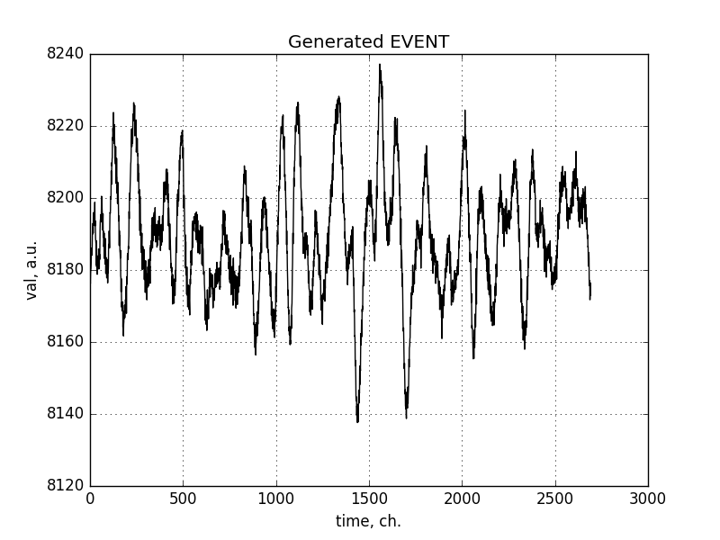
Further studies of noise + simulation
Noise in data (baseline corrected)
Generated noise
Obtain distributions for real and imaginary part of frequency spectra using Fourier transformation;
Fit these distributions using two gaussian hypotheses;
Generate random spectrum out of these distributions;
Use inverse Fourier transformation to obtain spectrum of generated events.

Slide 25
Energy calibration
Now we have 14-bit Flash ACD with 40 ns per time channel, which encode voltage in a range (-2,5, +2.5) mV
Additional calibration is needed to have same response for the signal and for the noise.
Done using alpha source.
5,5 MeV alpha-particle create a signal with integral of 200000 ADC channels (private communication with Alexander Inglessi)
A fake 1 mm track with 5,5 MeV energy deposit is created
It produces 150684 ionization electrons in a GEANT model
Integral for the Flash ADC spectrum is 152022
1 electron has “weight” = (200000 / 152022)

