Slide 1
Monte-Carlo studies for the drift velocity calibration measurement
Aleksei Dziuba / PNPI NRC KI
28th of May, 2020

Slide 2
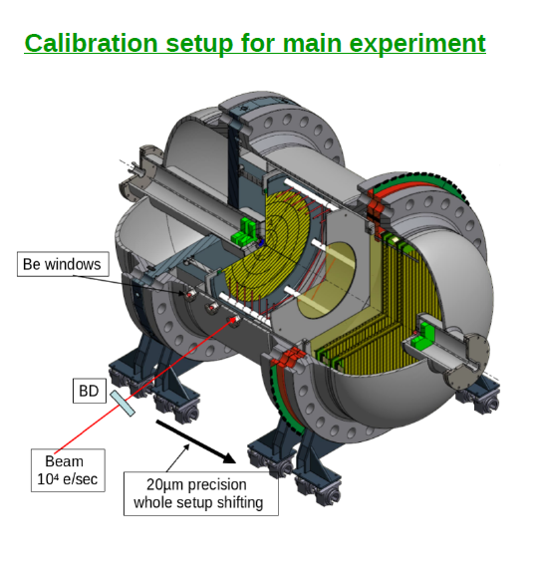
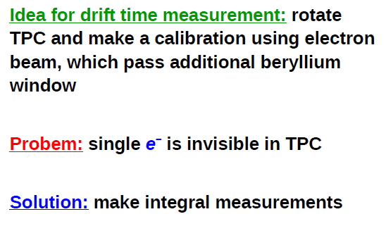
Calibration of drift velocities

Slide 3
Conditions
720 GeV electrons as a beam
Simplified model
Silicon detectors and scintillators at entrance and exit.
Be windows
H₂, 20 atm as a single volume
Geant-4 with standard physics lists
Energy deposit at each tracking step is placed into a center of this step [should be improved]

Slide 4
GEANT Model
50 mm gaps between detectors as well as between detector and berylliums
Scintillator, 10 mm (removed in last versions)
y
Be, 0.1 mm
Si, 0.25 mm
Scintillator, 10 mm
Si, 0.25 mm
H₂ (20 atm.)
700 mm
720 MeV electrons
z
This is simulation frame
-350 mm
0 mm
+350 mm

Slide 5
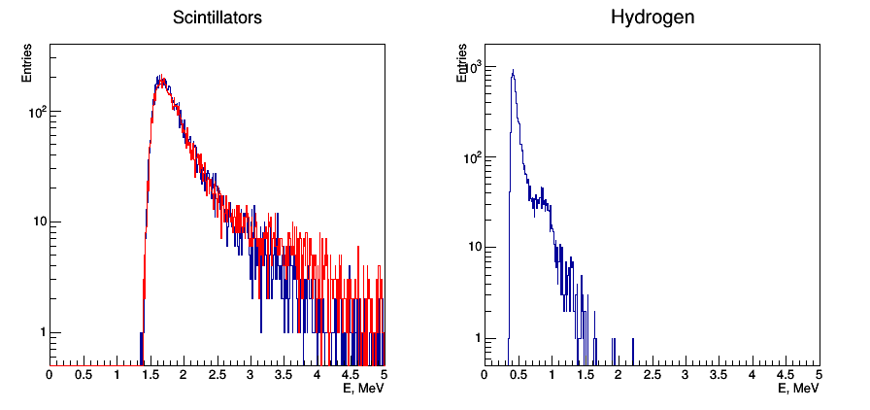
Energy deposit spectra from single electrons
Entrance scintillator
Exit scintillator
Time protections (before and after signal) is assumed! → single electrons

Slide 6
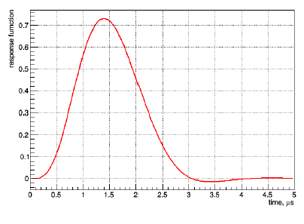
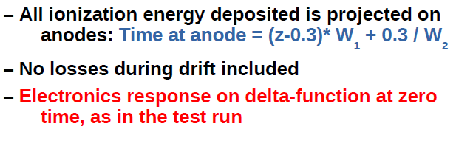
Simulation of drift process and electronics
Simulation frame (x,y,z) → Main experiment frame (X,Y,Z)
z → X; y → Y; x → Position – Z
Drift velocities:
W₁ = 3,08 mm / microsecond
W₂ = 7,50 mm / microsecond
Signal shaping as in test runs

Slide 7
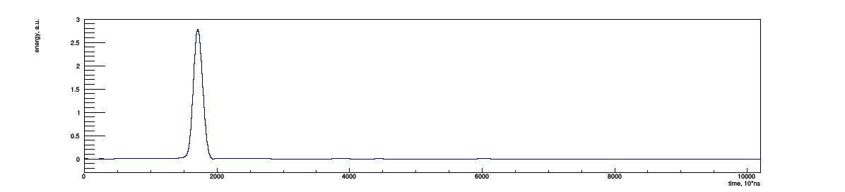
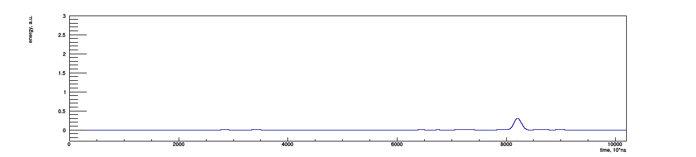
Flash ADC spectra (central anode pad, R=1cm)
Position = 50 mm; 10000 electrons
Mean = 17150.ns
Position = 250 mm; 1000 electrons
Mean = 81820. ns
Same ranges for y-axes

Slide 8
Next steps
More realistic parameters (sizes, W_{i}, etc)
Improve ionization electron distribution
Now all electrons are at the step center (DONE: Ionization along track )
Find robust estimator using toys. (CODE DONE) To check:
Mean
Mode
Median
Front
Other pads
Electronic noise
Check for different diffusion parameter in XY-plane
Use information from silicon detectors
What else ??? (New idea: Beam properties)

Slide 9
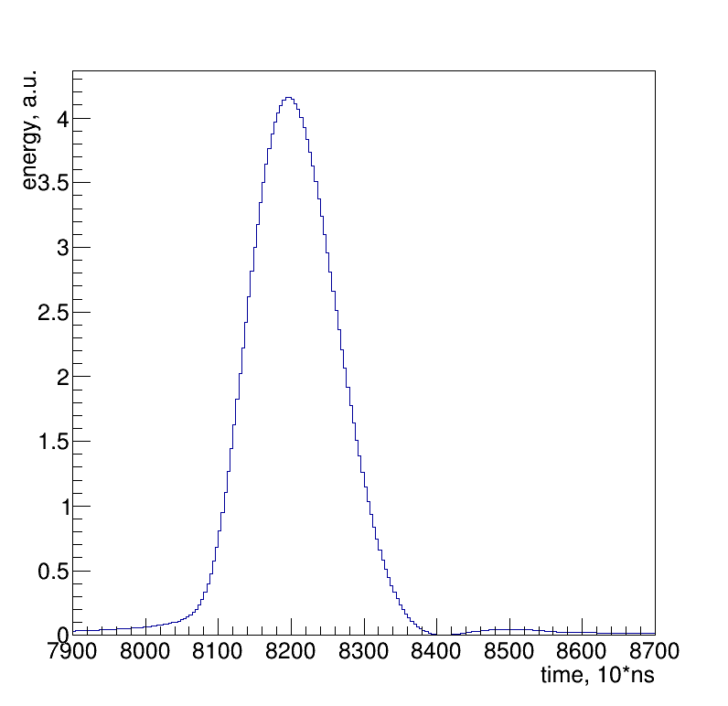
Toy studies of different estimators
Central anode pad
Position = 250; N_{e–} = 1000; N_{Toys} = 100
Resolution is an RMS of estimator distribution
Different estimators:
Mean_{Full} 82016.8 +/- 41.0 ns
Mean_{SigRegion} 81122.7 +/- 9.1 ns
Maximum 82016.8 +/- 10.8 ns
Signal region:
(Maimum-300 ch, Maximum+500 ch)
Other estimators is also possible to check

Slide 10
Modification of the response functions
Grid
L _{Grid-Anode}
Anode
Current on anode appears, when an electron arrive to the grid.
It increases linearly and ends, when the electron reach anode.
T _{Grid-Anode} = L _{Grid-Anode} / W₂
An integral of the current is the charge of one electron (e = 1.602176634×10⁻¹⁹ C).
Response function of pre-amplifier must be changed according to this process
1e–
0 mm
10 mm
Current, A
2 × e × W₂ / L _{Grid-Anode}
Time, s
0
L _{Grid-Anode} / W₂

Slide 11
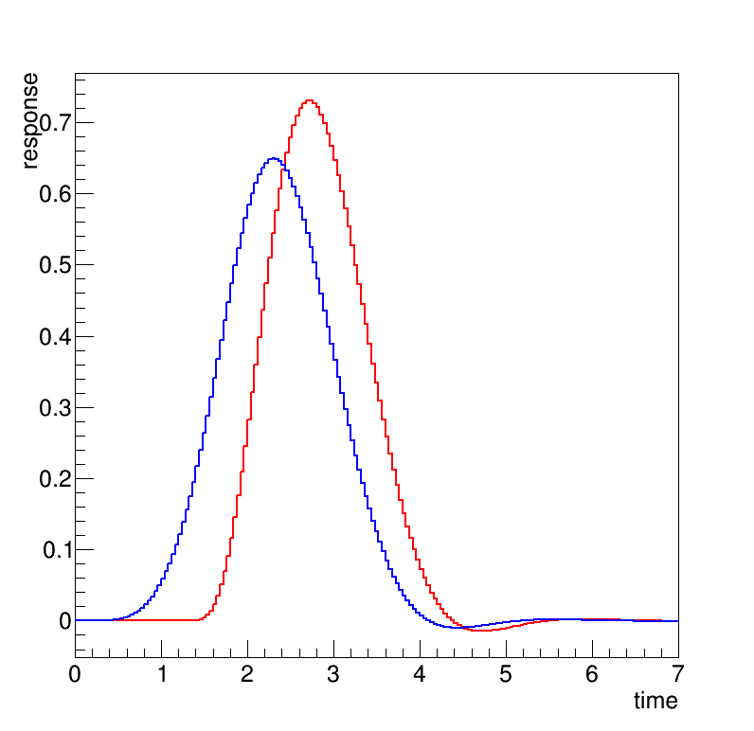
New response function
For the previous (“old”) simulation an electronic response appears, when an electron reach anode. Simple shift of the response function.
In a new version it starts, when an electron reach grid. Convolution with linear function (see previous slide).
Zero time – time, when electron is on the grid
L _{GridAnode} = 10 mm; W₂ = 7,5 mm/μs
Old
New

Slide 12
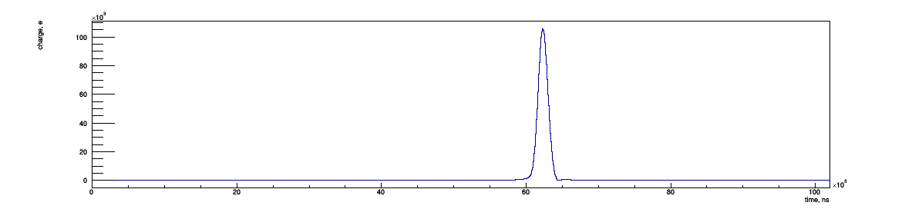
Spectrum with the new conditions
Conditions: W₁= 4 mm/μs, L _{Grid-Anode} = 10 mm
Position 250 mm, N _{Beam Electrons} = 1000

Slide 13
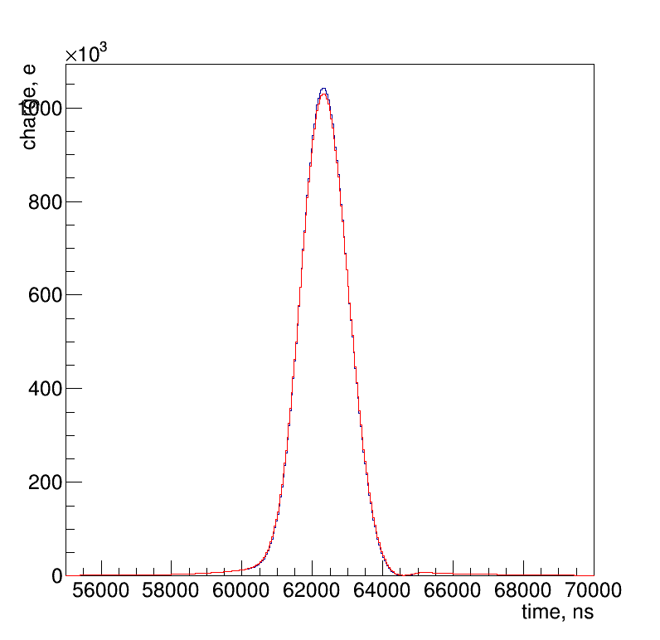
Longitudinal diffusion of electrons
σ_{Z} = 0,008 × √L_{TrackGrid}
[σ_{Z}] = [L_{TrackGrid}] = cm
Parametrization by German Korolev (private communication via Alexey Vorobyev)
Smear Z-position for each ionization electron by a Gaussian function with σ_{Z}.
L_{TrackGrid} = 25 cm
10000 of beam electrons
With longitudinal diffusion
No diffusion

Slide 14
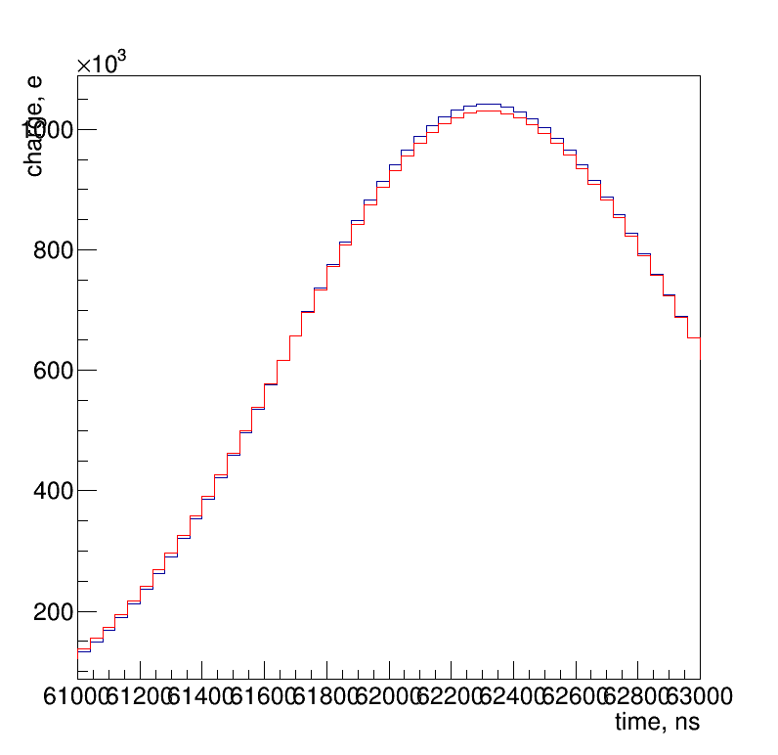
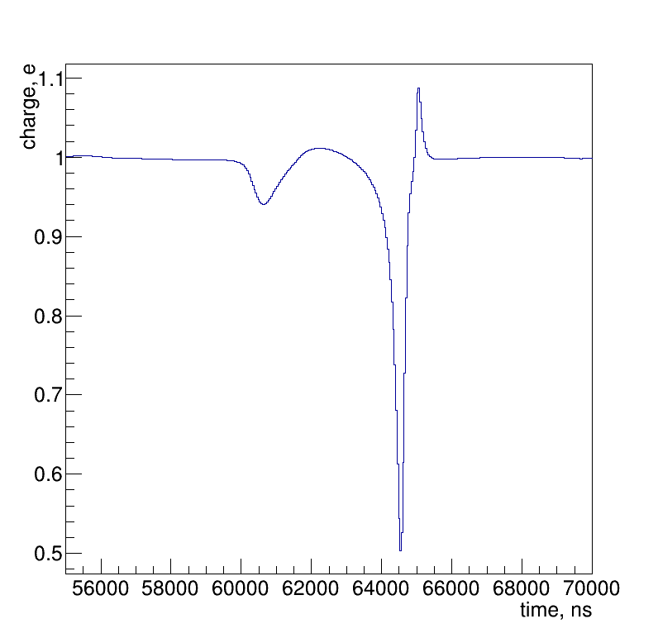
Closer look
Ratio = No diffusion / With diffusion
Maximums are quite close
Toy studies are required for a quantitative answer.

Slide 15
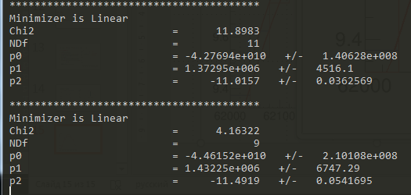
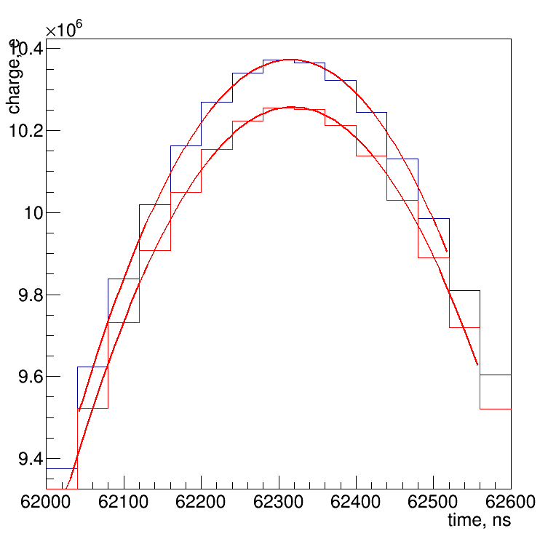
100000 events
Maximum positions
With diffusion: 62317,9 ns
No diffusion: 62315,6 ns
2,3 ns difference

Slide 16
All pads
Central pad is a circle with 1 cm radius
Others are half-rings with 4 cm width
Numbering as on sketch
Beam
14
1
3
5
7
0
16
X
2
4
8
13
9
15
6
10
12
11

Slide 17
50000 event
With and no diffusion options for all the pads
For each Flash ADC spectrum a bin of maximum as well as 10 bins to the left and 10 bins to the right are fitted with the polynomial of the 2nd order
No diffusion` With diffusion Difference
Pad 0 62318.8 62320.2 -1.43599 ns
Pad 1 62316.6 62318.2 -1.64263
Pad 2 62317.2 62318.7 -1.58292
Pad 3 62317.3 62318.8 -1.52238
Pad 4 62317.1 62318.6 -1.55779
Pad 5 62317.3 62318.9 -1.56173
Pad 6 62318.5 62320 -1.55719
Pad 7 62318.4 62320 -1.51919
Pad 8 62318.7 62320.2 -1.45737
Pad 9 62318.7 62320.2 -1.44617
Pad 10 62319.5 62321 -1.46183
Pad 11 62319.7 62321.1 -1.44189
Pad 12 62320.4 62321.8 -1.38731
Pad 13 62321.1 62322.5 -1.39093
Pad 14 62321.1 62322.4 -1.33407
Pad 15 62322.9 62324.2 -1.32674
Pad 16 62322 62323.3 -1.32055

Slide 18
Increase diffusion parameter σ_{Z} by factor 4
25000 events / Same procedure as on previous slide
Difference in increased by factor of 10
No diffusion` With diffusion Difference
Pad 0 62319.1 62335 -15.9309
Pad 1 62316.4 62333.4 -16.9878
Pad 2 62317.1 62334 -16.9145
Pad 3 62317.2 62333.9 -16.6842
Pad 4 62316.8 62333.1 -16.3286
Pad 5 62317.8 62334.1 -16.2948
Pad 6 62318.8 62335.1 -16.2893
Pad 7 62319.3 62335.4 -16.1217
Pad 8 62318.4 62334.2 -15.8083
Pad 9 62319.4 62335 -15.6423
Pad 10 62319.6 62335.3 -15.6309
Pad 11 62320 62335.4 -15.3347
Pad 12 62321.4 62336.7 -15.3024
Pad 13 62320.8 62335.8 -14.9665
Pad 14 62321.4 62335.9 -14.445
Pad 15 62322.7 62337.1 -14.4829
Pad 16 62322.4 62336.6 -14.1763

Slide 19
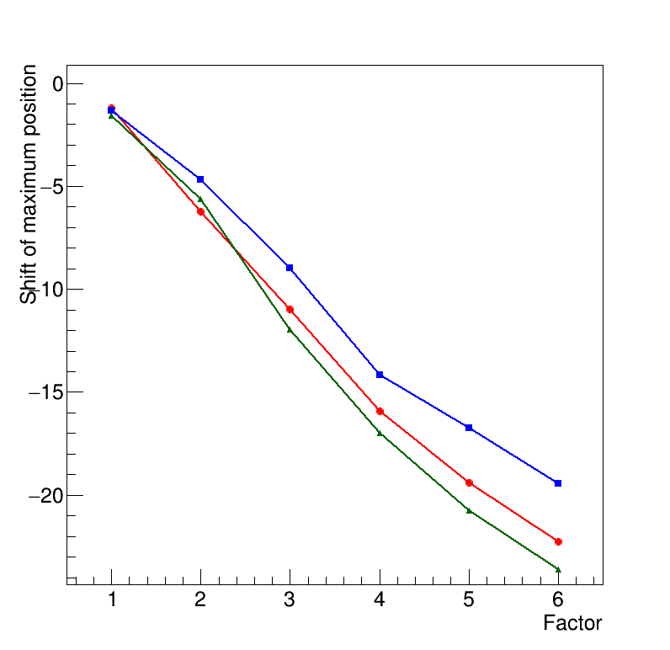
Different factors
Multiply diffusion parameter σ_{Z} by different factors
Almost linear dependence
Slope parameter is changing with the pad number
Pad 16
Pad 0 (central circle)
Pad 1

Slide 20
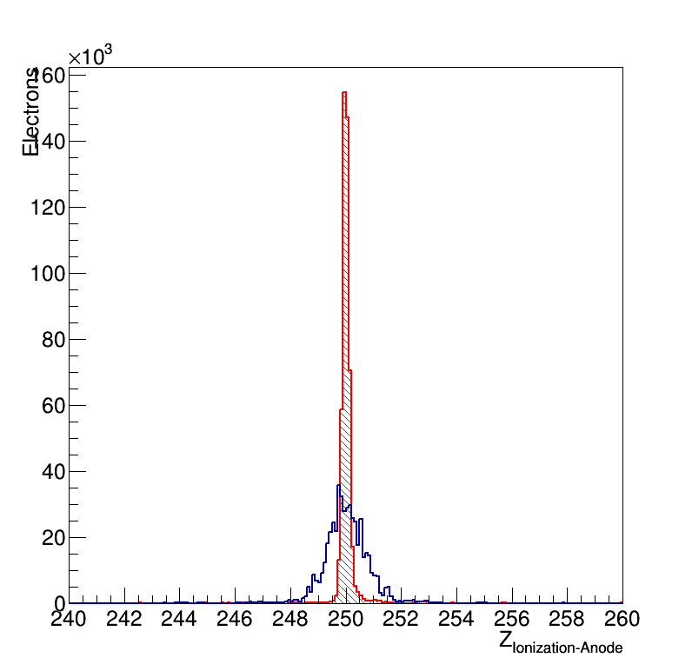
Why peak position is pad –dependent?
500 beam electrons at Z=250 mm
Distribution of the ionization on different pads
Ionization size (width) is increasing with path in the H₂
Pad 1
Pad 16

Slide 21
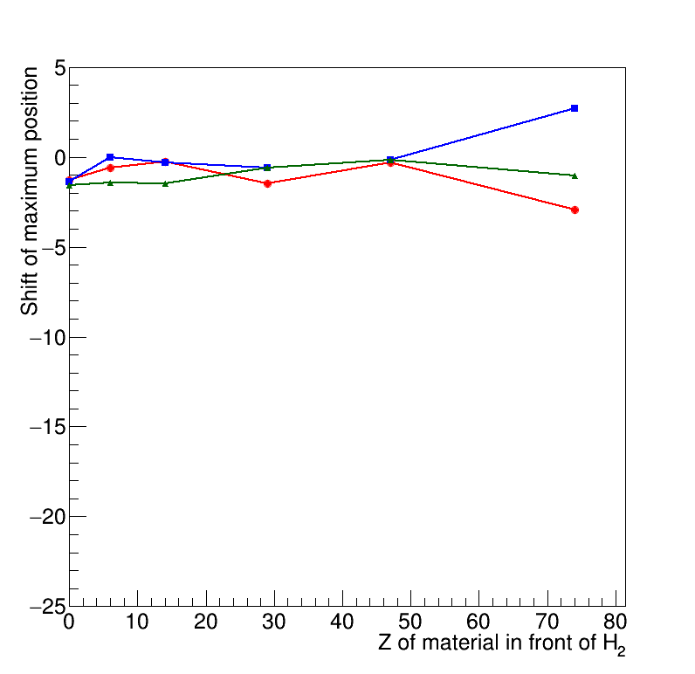
Beam smearing with different material in front
1 cm material is placed on a 1st Scintillator place
Check Z-dependence (No-material, Carbon, Silicon, Copper, Silver and Tungsten)
Ionization spot become wider. See next slides.
Beam smearing with different materials doesn’t affect shift of the peak position due to diffusion
Worser precision (larger uncertainty) with the same statistics for different Z
Pad 16
Pad 1
Pad 7

Slide 22
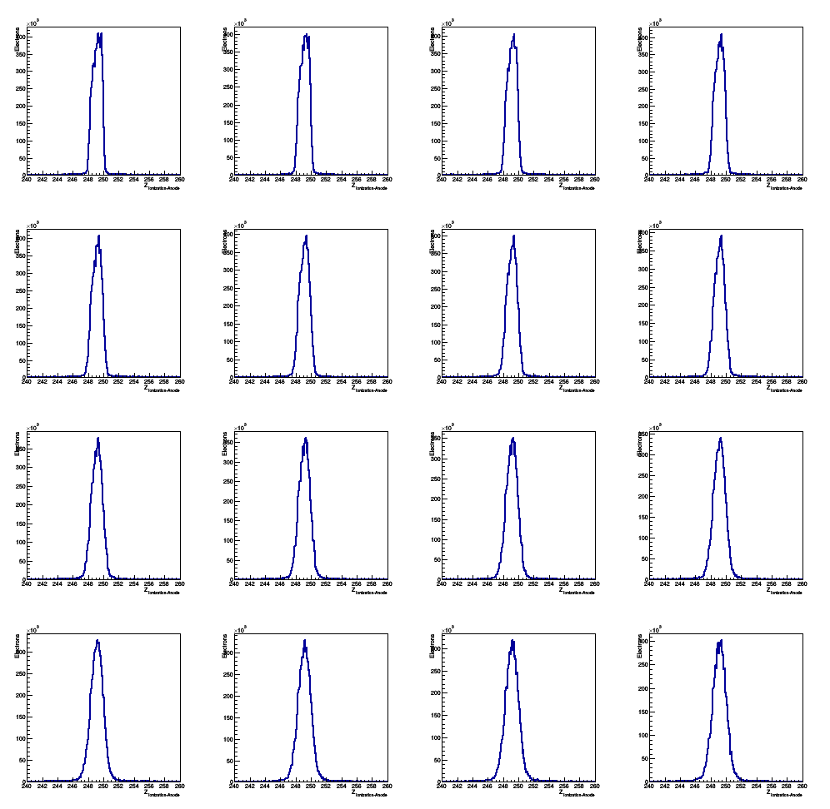
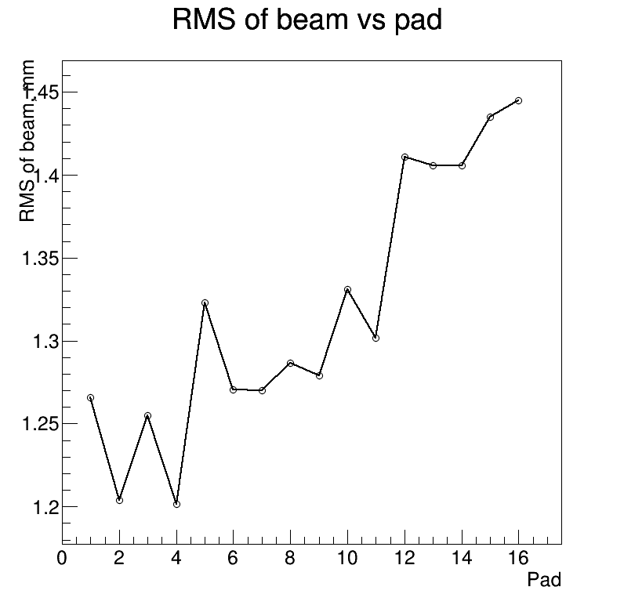
No material
1
2
15
16

Slide 23
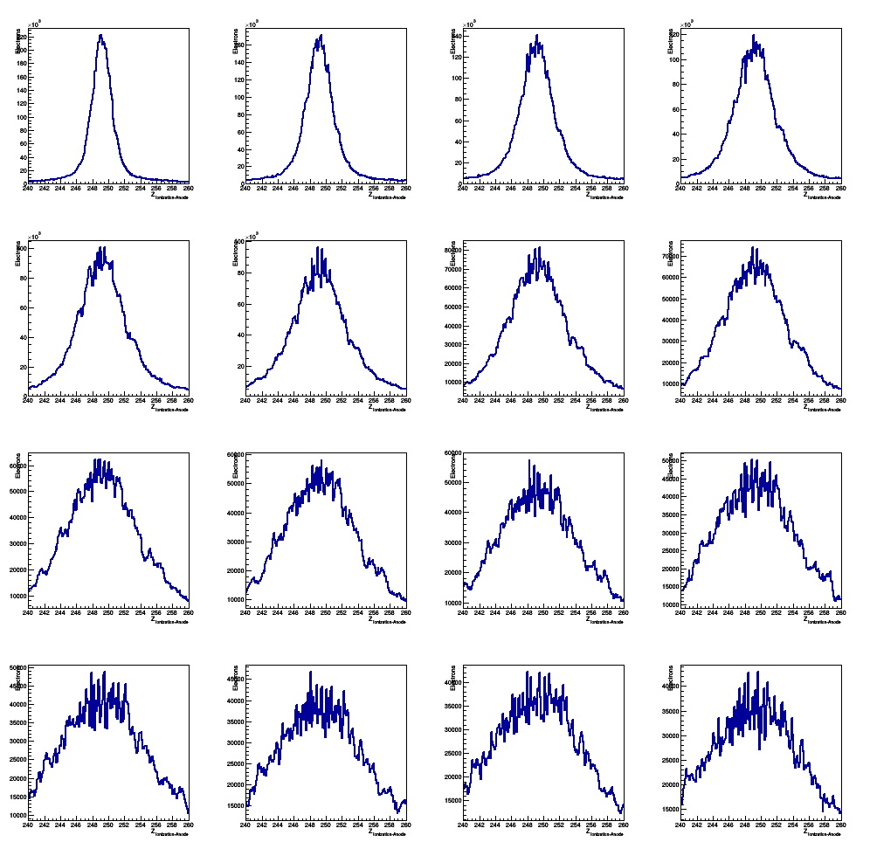
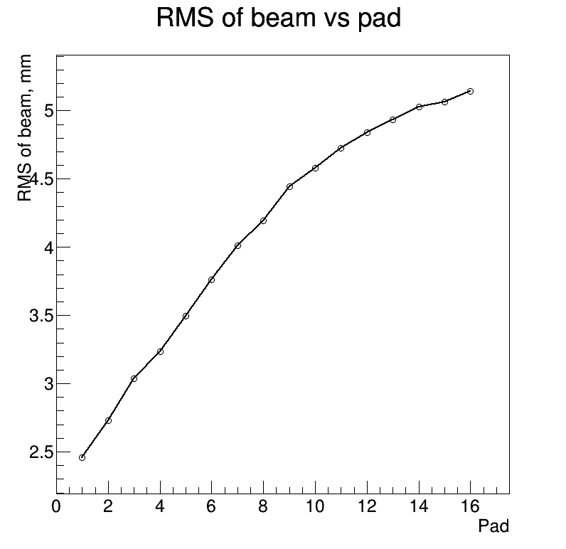
1 cm of Ti
1
2
15
16

Slide 24
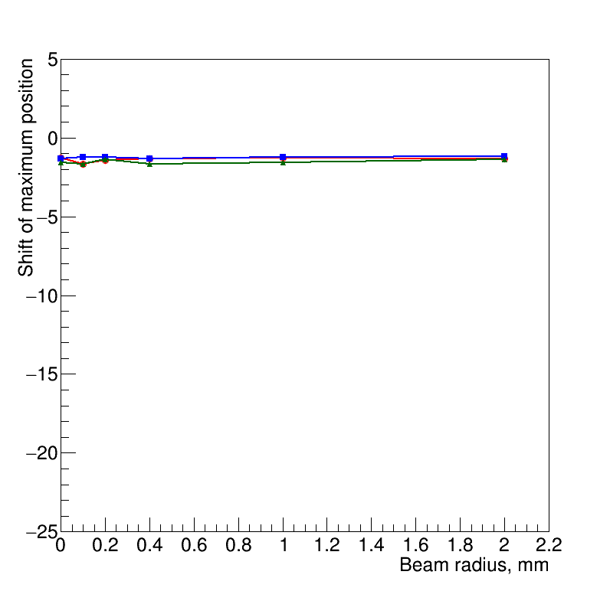
Beam smearing in simulation
Beam is distributed uniformly in a circle of different radius
No visible effect of maximum position shift for “with” and “without” diffusion simulations
Pad 1
Pad 7
Pad 16

Slide 25
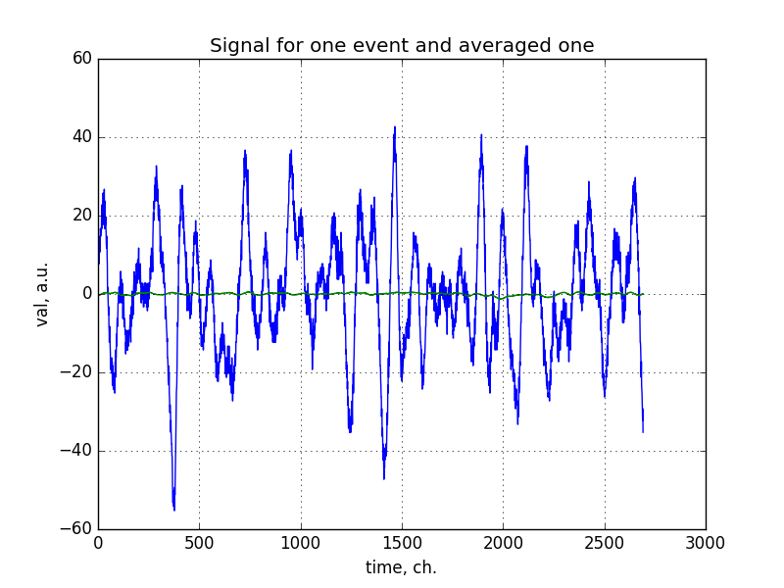
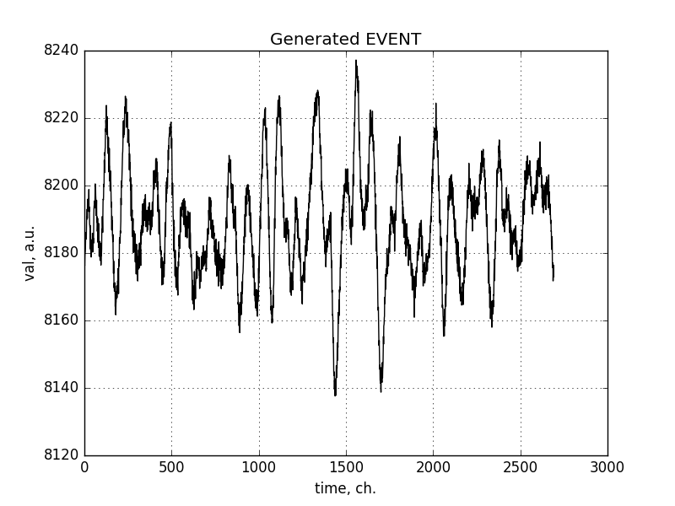
Further studies of noise + simulation
See more details https://github.com/aleksha/G4-Models/tree/master/Data/Noise
Still to be implemented
We can have noise as a function of time!
Noise in data (baseline corrected)
Generated noise
Obtain distributions for real and imaginary part of frequency spectra using Fourier transformation;
Fit these distributions using two gaussian hypotheses;
Generate random spectrum out of these distributions;
Use inverse Fourier transformation to obtain spectrum of generated events.

Slide 26
Energy calibration
5,5 MeV alpha-particle create a signal with integral of 200000 ADC channels (private communication with Alexander Inglessi)
A fake 1 mm track with 5,5 MeV energy deposit is created
It produces 150684 ionization electrons
Integral for the Flash ADC spectrum is 152022
1 electron has “weight” = (200000 / 152022)

Slide 27
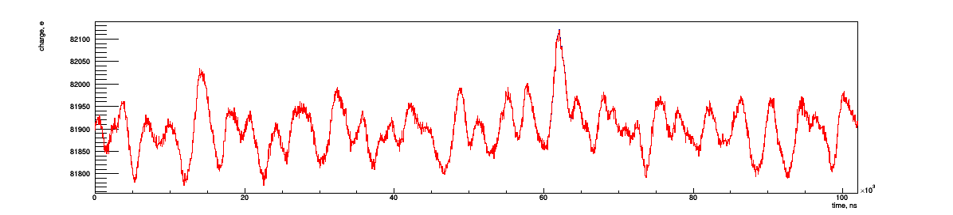
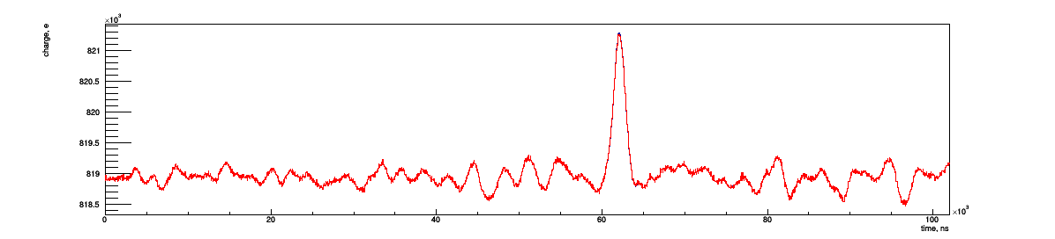
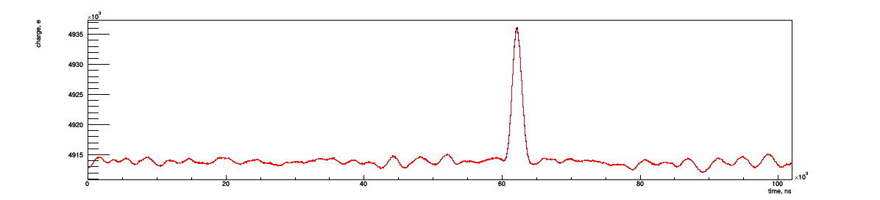
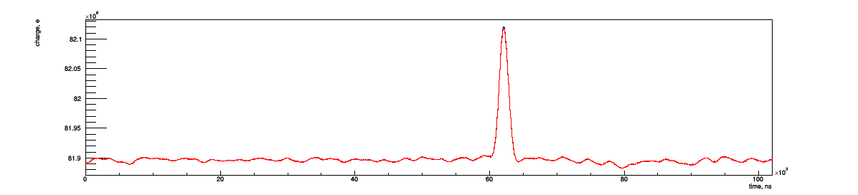
Flash ADC spectrum with noise (Pad 2)
10 beam electrons
Relative electronic noise is suppressed by an increase of the cumulative statistics
Current procedure is quite slow
½ noise event / second for one CPU core
100 beam electrons
1000 beam electrons
10000 beam electrons

Slide 28
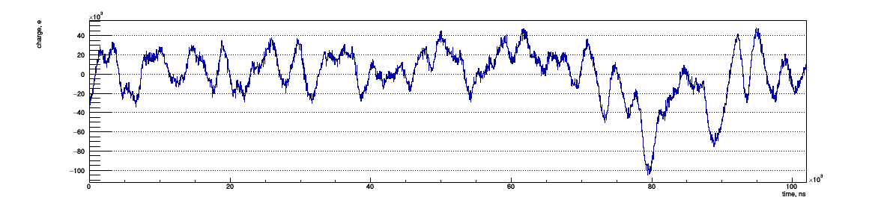
Cumulative noise baseline corrected spectrum
100k noise events
Is it a fluctuation or a problem?

Slide 29
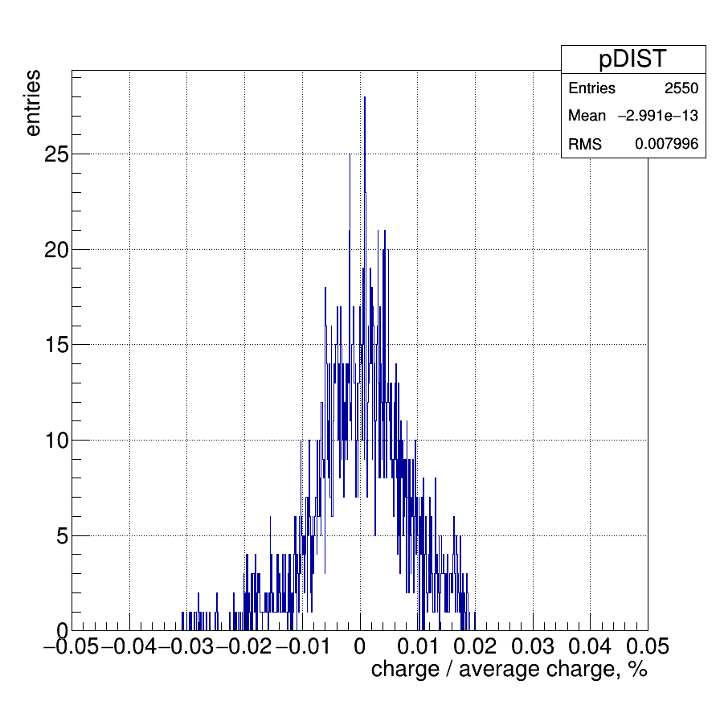
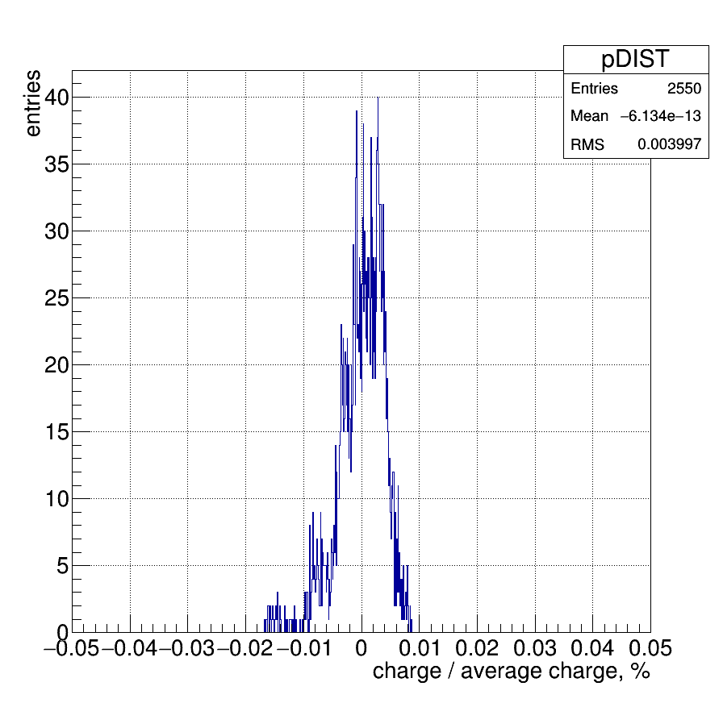
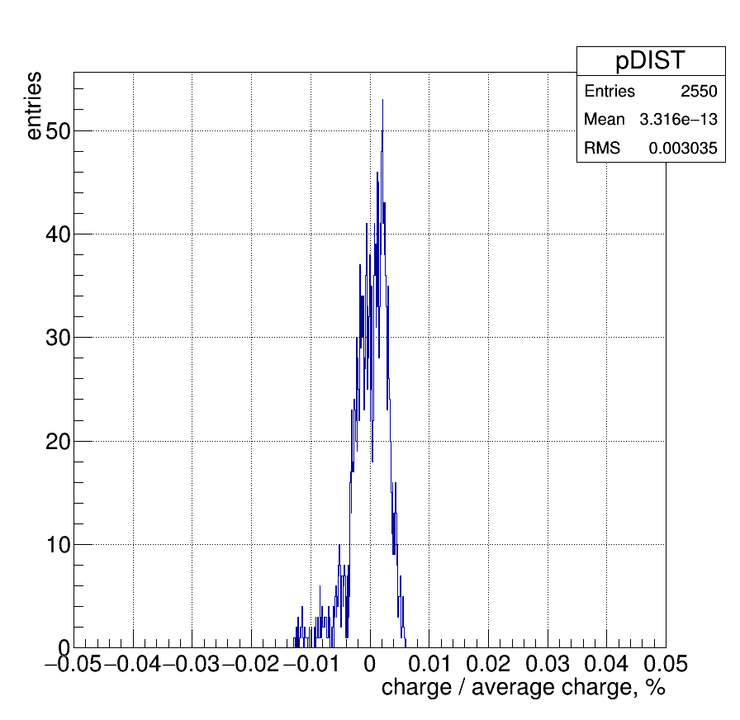
Fluctuations scales down
Project cumulative distribution on its y-axis, which is scaled to averaged number (BinVal- AvVal) / AvVal
1k noise events
10k noise events
100k noise events
RMS = 8×10^{–5}
RMS = 4×10^{–5}
RMS = 3×10^{–5}
NOTE: it isn’t and shouldn’t be a Gaussian distribution

Slide 30
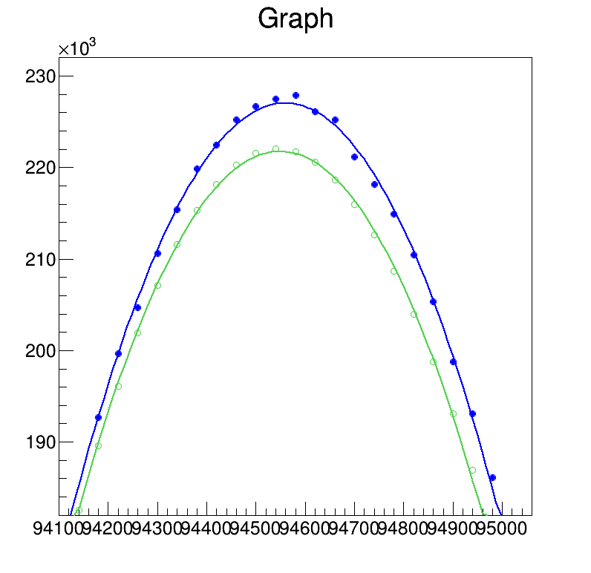
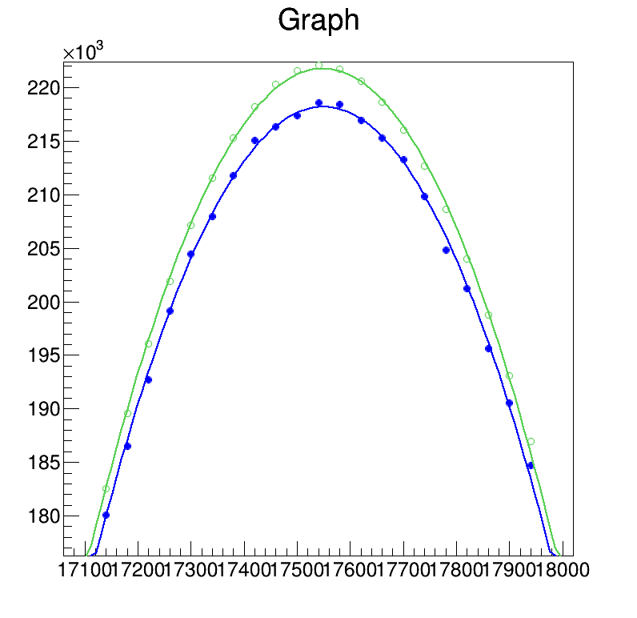
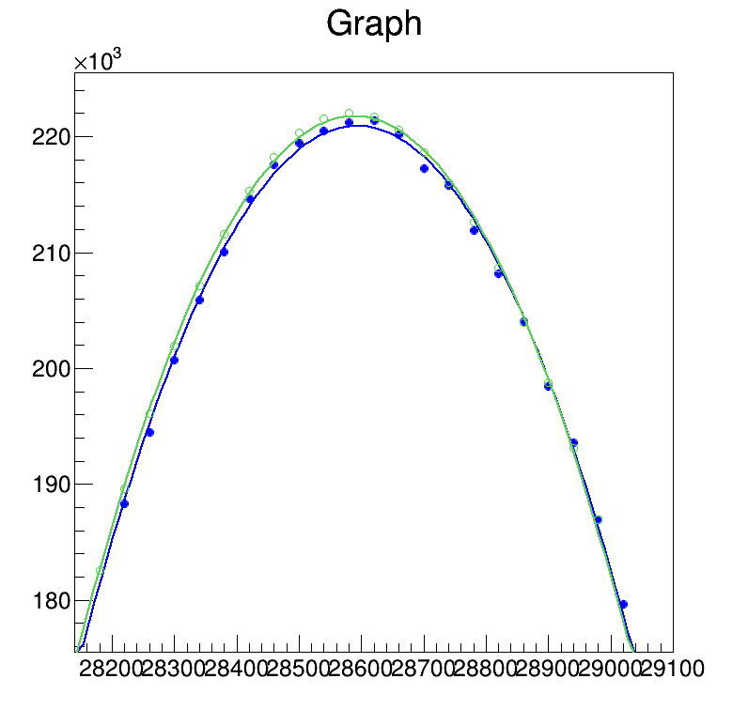
Maximum shift due to noise
Peak is placed to the random location of cumulative noise spectrum
Shift of maximum for signal + noise (blue) wrt. pure signal (green)
Some fit examples

Slide 31
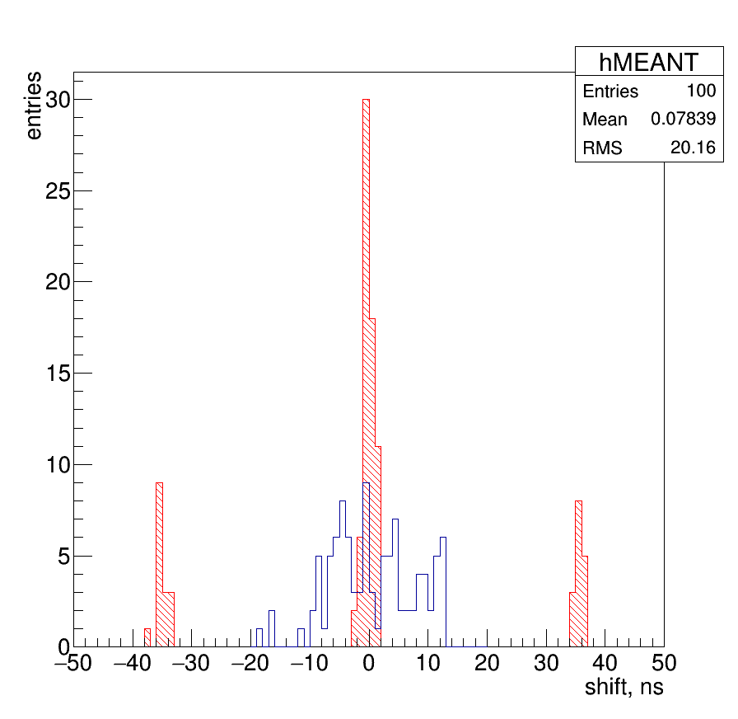
Distribution for shift for 10k events
100 random places for signal peak at the noise spectrum. Signal shape at the peak region and cumulative noise spectra are same!
RMS for maximum with peak position fitting procedure 7,3 ns
Mean value for signals in the range ( Bin of maximum +/- 10 bins) is very dangerous estimator

Slide 32
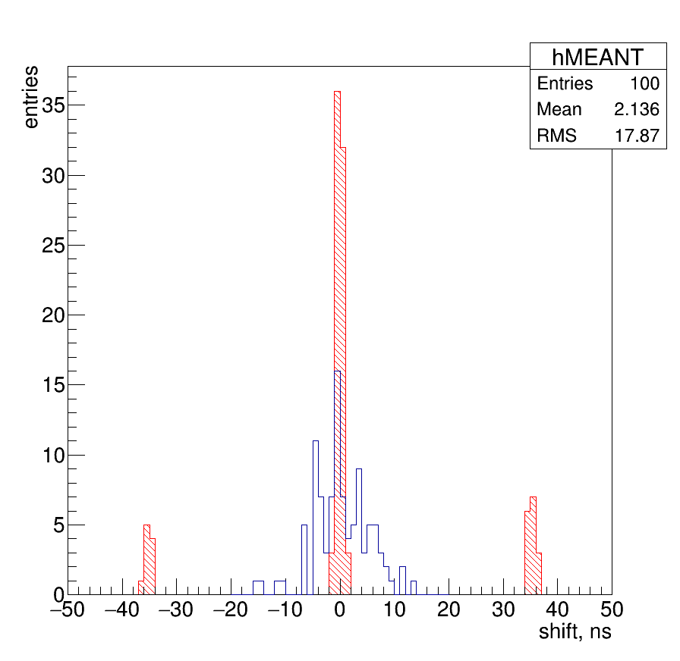
Distribution for shift for 100k events
100 random places for signal peak at the noise spectrum. Signal shape at the peak region and cumulative noise spectra are same!
RMS for maximum with peak position fitting procedure 5,1 ns
Mean value for signals in the range ( Bin of maximum +/- 10 bins) is very dangerous estimator

Slide 33
Final model

Slide 34
Final GEANT Model
50 mm gaps between detectors as well as between detector and berylliums
Scintillator, 10 mm (removed in last versions)
y
Si, 0.25 mm
Ti, 0.5 mm
Scintillator, 10 mm
Si, 0.25 mm
Ti, 0.5 mm
H₂ (20 atm.)
700 mm
720 MeV electrons
z
This is simulation frame
Beam is uniformly distributed in a circle with radius of 0,1 mm
No angular beam divergence!
-350 mm
0 mm
+350 mm

Slide 35
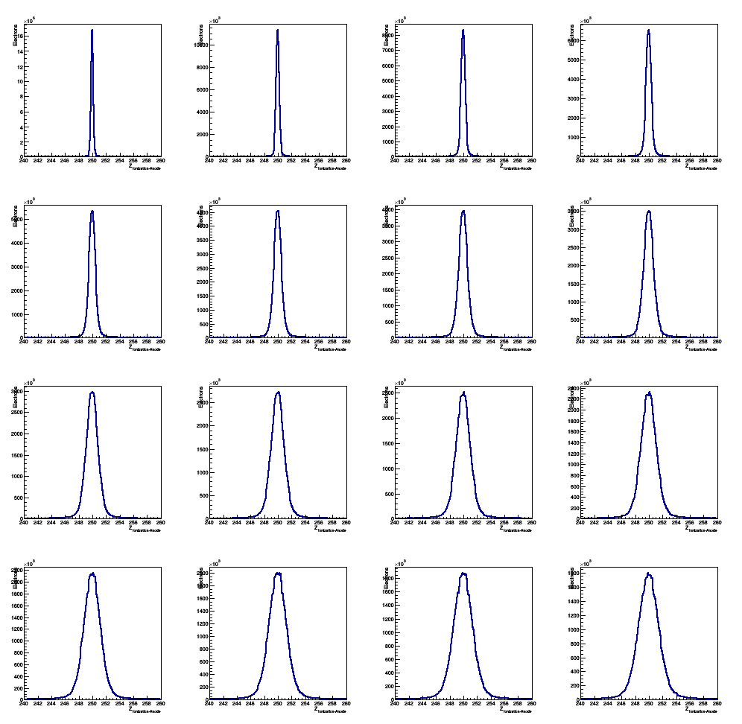
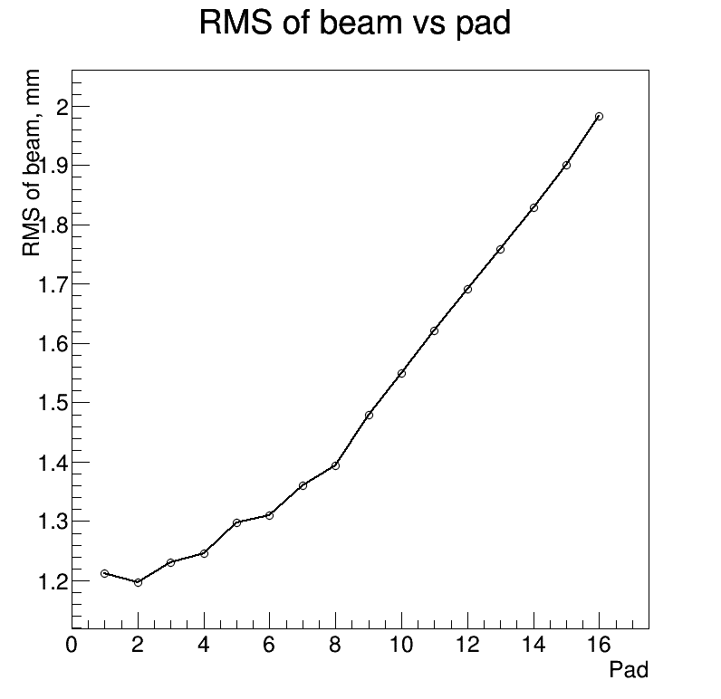
Distributions on pads
1
2
15
16

Slide 36
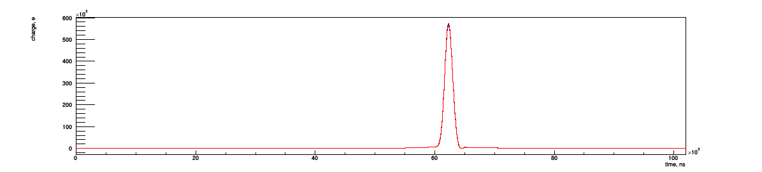
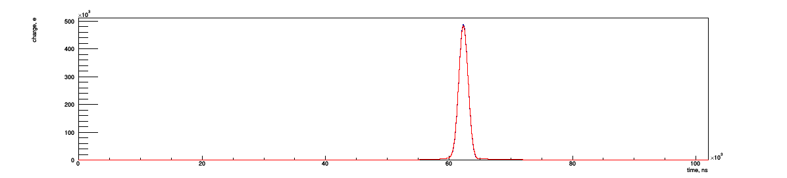
Flash ADC spectra for 25k events (no noise)
No diffusion
With longitudinal diffusion
Pad 01
Pad 16

Slide 37
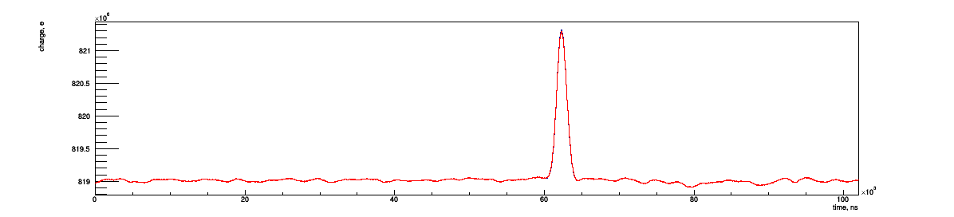
100k with noise
No diffusion
With longitudinal diffusion
Pad 02

Slide 38
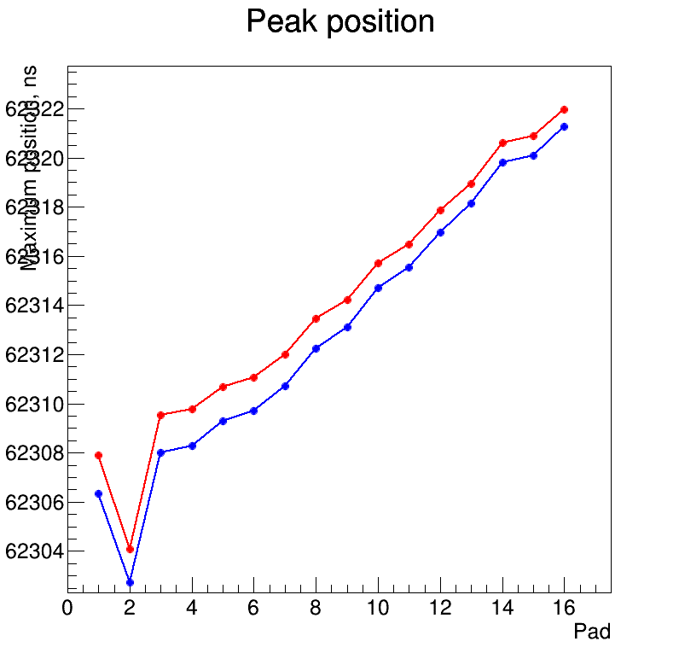
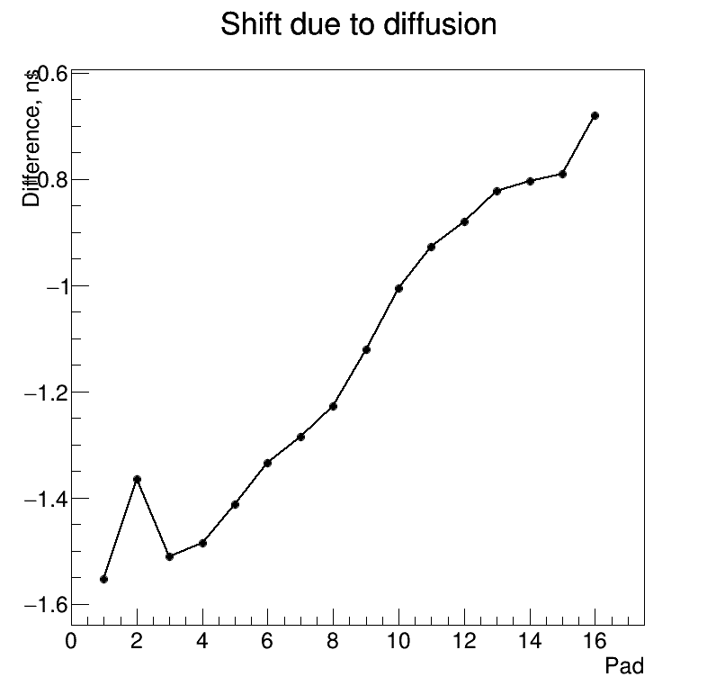
Only this pad contains electronics' noise
Only this pad contains electronics' noise
A scatter around a smooth curve indicates the accuracy of the estimate!

Slide 39
Distribution for shift for 100k events
100 random places for signal peak at the noise spectrum. Signal shape at the peak region and cumulative noise spectra are same!
RMS for maximum with peak position fitting procedure 6,7 ns
Mean value for signals in the range ( Bin of maximum +/- 10 bins) is very dangerous estimator RMS = 17,9 ns)

