Slide 1
Studies of the electronic noise and a drift velocity calibration procedure
Aleksei Dziuba (supervised by Prof. Alexey Vorobyev) / PNPI NRC KI
10th of June, 2020

Slide 2
Goals of today’s talk
To demonstrate how TPC works on the example of the drift velocity calibration, which is needed for the absolute cross section measurement.
At CERN only relative measurement is foreseen (AFAIK), but may be we have to think about absolute one.
In Mainz an absolute measurements will be done.
Show that the maximum position of the Flash ADC spectrum is quite a good time-point estimate.
Present a data-driven method and a tool to generate electronic noise on even-by-event basis.
https://github.com/aleksha/electronic-noise (Python with numpy, scipy and matplotlib)

Slide 3
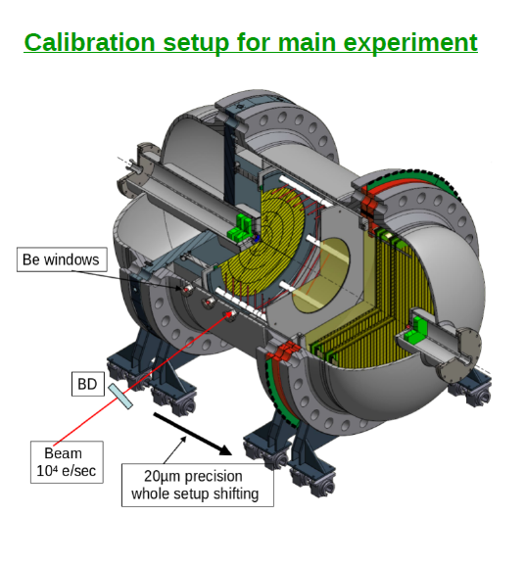
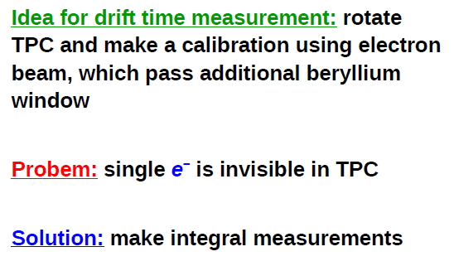
Calibration of drift velocities
titanium
Triggering from incoming beam electron. Time between beam and TPC response is known (with a precision discussed today).
MAMI has excellent beam. The ionization-anode distance is known with 0,1 mm precision.

Slide 4
Conditions
720 MeV electrons as a beam
Simplified model
Silicon detectors at entrance and exit.
Scintillator at exit
Ti windows
H₂, 20 atm as a single volume
Geant-4 with standard physics lists
Energy deposit at each tracking step is uniformly (not Poisson!) distributed along this step. 36,5 eV to create electron-ion pair
Ionization electrons are projected into anode plane (no loss assumed!).
Electronic response function + electronic noise

Slide 5
Final GEANT Model
50 mm gaps between detectors as well as between detector and berylliums
Scintillator, 10 mm (removed in last versions)
y
Si, 0.25 mm
Ti, 0.5 mm
Scintillator, 10 mm
Si, 0.25 mm
Ti, 0.5 mm
H₂ (20 atm.)
700 mm
720 MeV electrons
z
This is simulation frame. TPC frame is rotated.
Beam is uniformly distributed in a circle with radius of 0,1 mm
No angular beam divergence!
-350 mm
0 mm
+350 mm

Slide 6
All pads
Central pad is a circle with 1 cm radius
Others are half-rings with 4 cm width
Numbering as on sketch
Beam
14
1
3
5
7
0
16
X
2
4
8
13
9
15
6
10
12
11

Slide 7
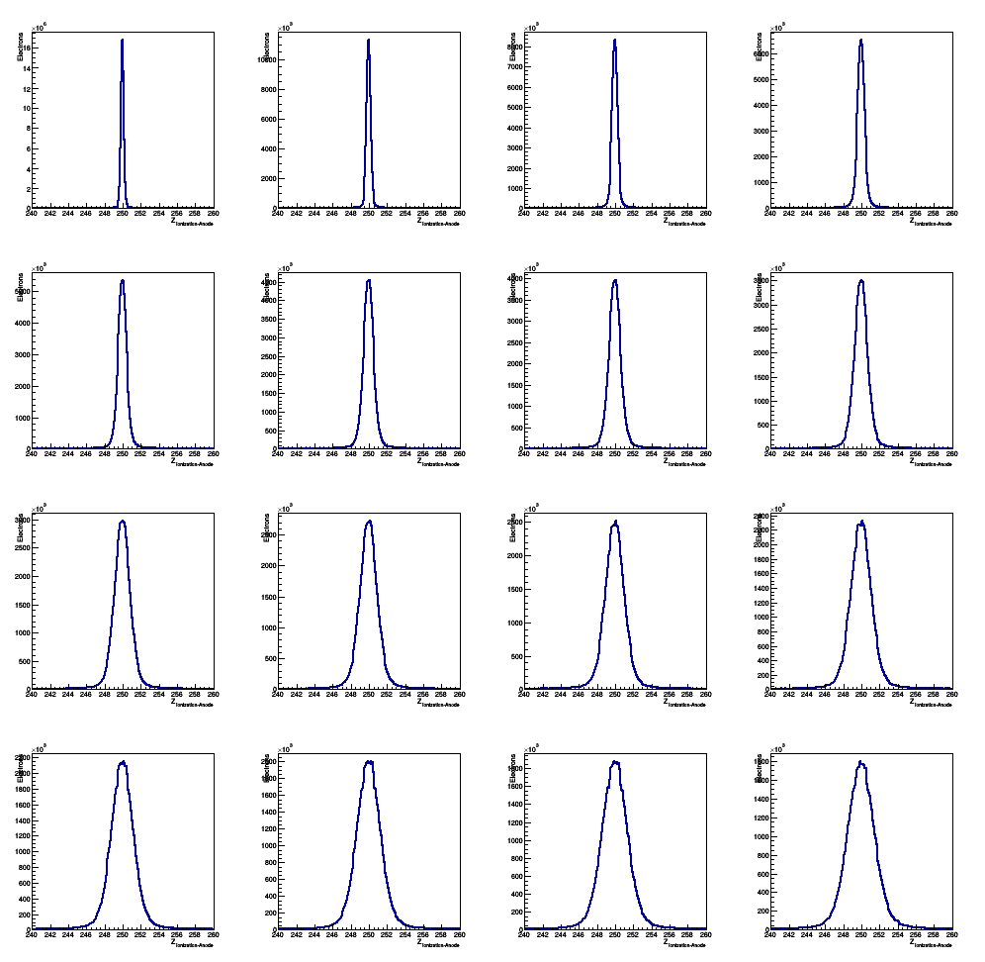
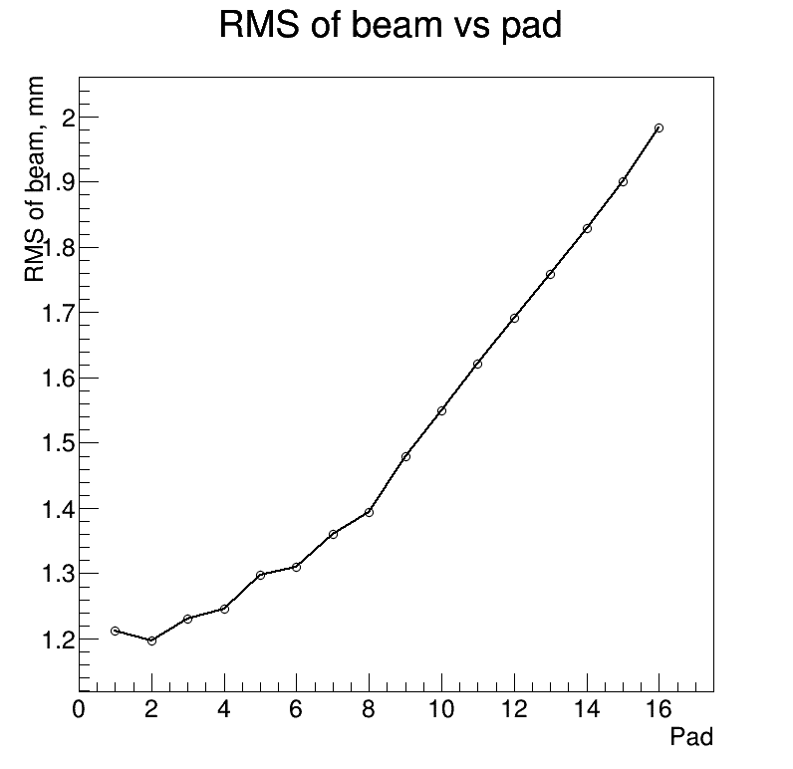
Z distributions vs pad#
1
2
15
16

Slide 8
Electron drift velocity in H₂
Known with few % accuracy, but we need 0,1% precision. We have to measure it!
Cathode-Grid
Grid-Anode

Slide 9
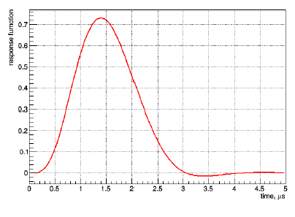
Simulation of drift process and electronics
Simulation frame (x,y,z) → Main experiment frame (X,Y,Z)
z → X; y → Y; x → Position – Z
Drift velocities:
W₁ = 4,00 mm / microsecond
[Cathode-Grid]
W₂ = 7,50 mm / microsecond
[Grid-Anode]
Signal shaping as in test runs
(provided by Gennady Petrov)

Slide 10
Modification of the response functions
Grid
L _{Grid-Anode}
Anode
Current on anode appears, when an electron arrive to the grid.
It increases linearly and ends, when the electron reach anode.
T _{Grid-Anode} = L _{Grid-Anode} / W₂
An integral of the current is the charge of one electron (e = 1.602176634×10⁻¹⁹ C).
Response function of pre-amplifier must be changed according to this process
1e–
0 mm
10 mm
Current, A
2 × e × W₂ / L _{Grid-Anode}
Time, s
0
L _{Grid-Anode} / W₂

Slide 11
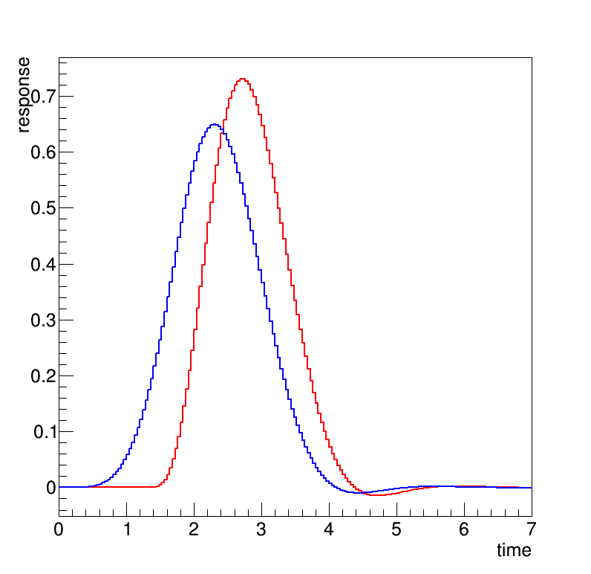
An electronic response function
For the previous simulation an electronic response appears, when an electron reach anode. Simple shift of the response function.
In a new version it starts, when an electron reach grid. Convolution with linear function (see previous slide).
Zero time – time, when electron is on the grid
L _{GridAnode} = 10 mm; W₂ = 7,5 mm/μs
Signal appears when electron reach anode
Current during Grid-Anode drift

Slide 12
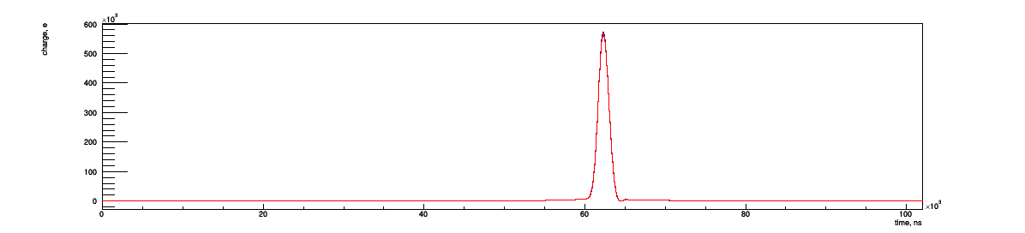
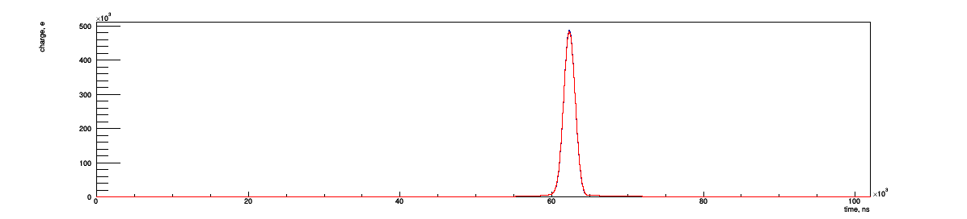
Flash ADC spectra for 25k events (no electronic noise)
No diffusion
With longitudinal diffusion
(see next slide)
Pad 01
Pad 16

Slide 13
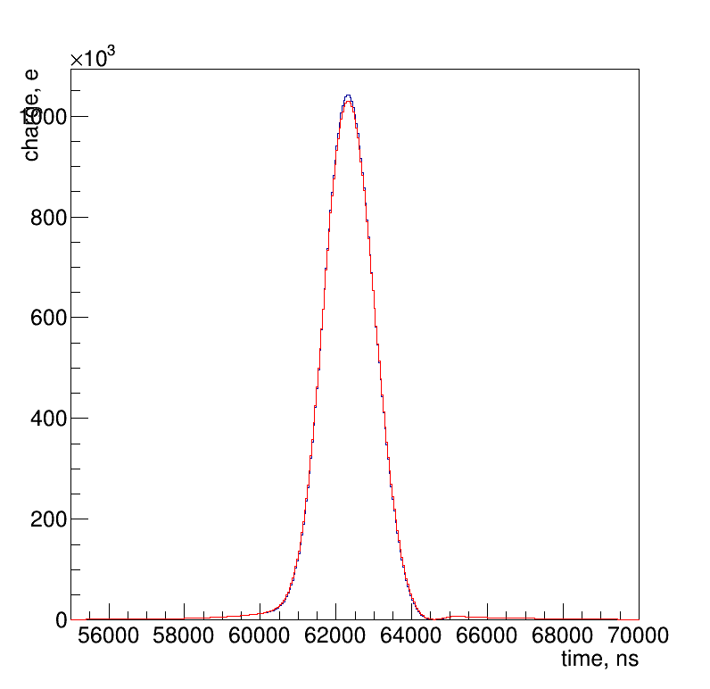
Longitudinal diffusion of electrons
σ_{Z} = 0,008 × √L_{TrackGrid}
[σ_{Z}] = [L_{TrackGrid}] = cm
Parametrization by German Korolev (private communication via Alexey Vorobyev)
Smear Z-position for each ionization electron by a Gaussian function with σ_{Z}.
L_{TrackGrid} = 25 cm
10000 of beam electrons (a part of spectrum around the peak is presented)
What should be used as a time-point estimator?
No diffusion
With longitudinal diffusion

Slide 14
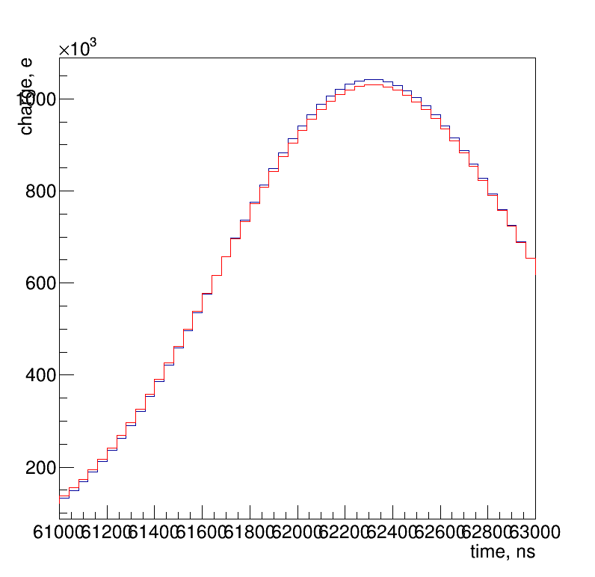
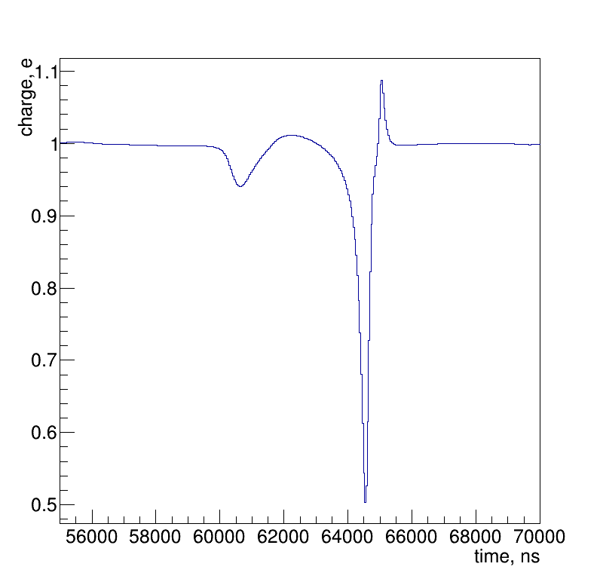
Closer look
Ratio = No diffusion / With diffusion
Maximums are quite close

Slide 15
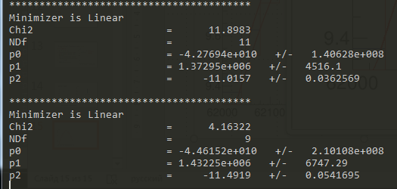
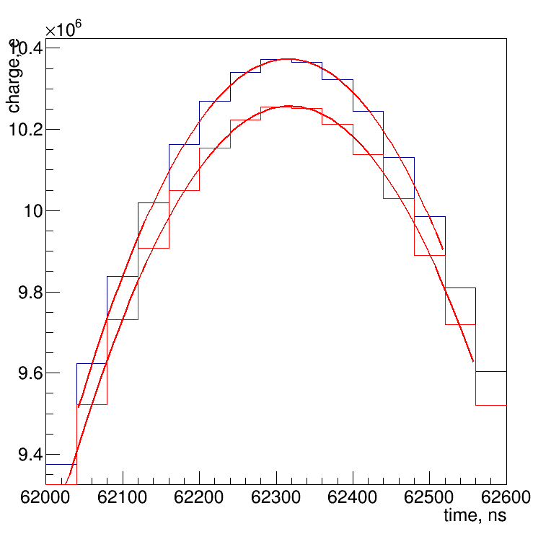
Find maximum with pol2-fit
Maximum positions
With diffusion: 62317,9 ns
No diffusion: 62315,6 ns
2,3 ns difference at central (small) pad

Slide 16
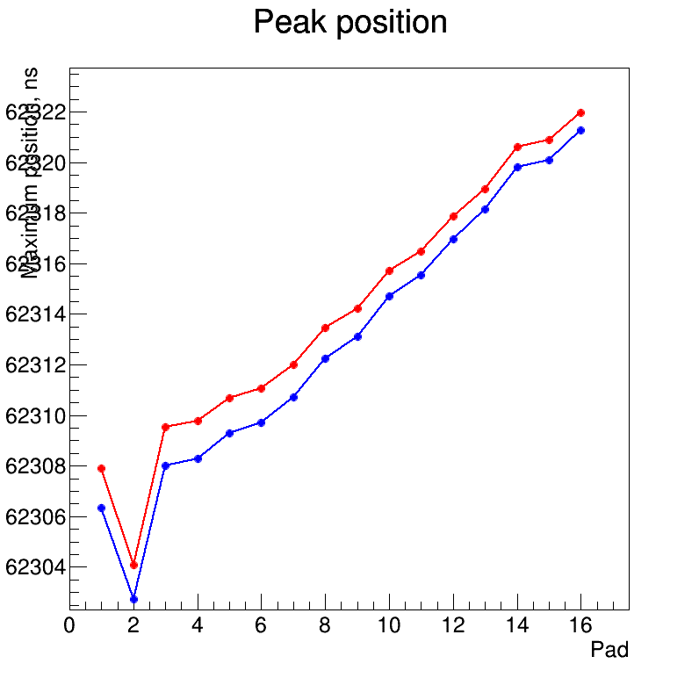
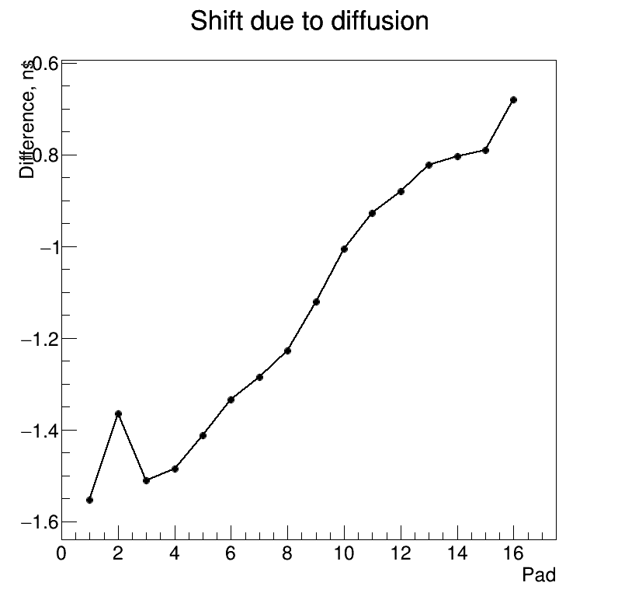
Only this pad contains electronics' noise
Only this pad contains electronics' noise
A scatter around a smooth curve indicates the accuracy of the estimate!
A bias for the maximum position estimator is on nanosecond-scale. Good enough!

Slide 17
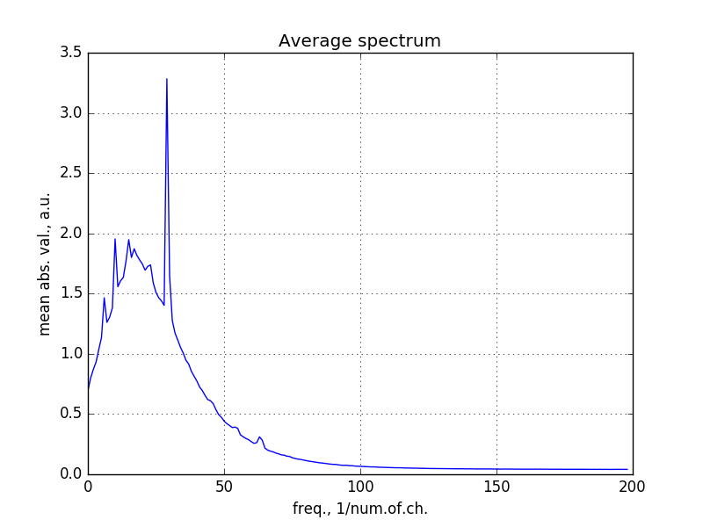
Noise studies
Done with ACTAF for a sample triggered by alpha-particles for the pads, which are far from alpha track.
Many thanks to Alexander Inglessi for the sample
Fast Fourier transformation shows that there some “featured” frequency channels
See a report: https://github.com/aleksha/electronic-noise/blob/master/docs/MC4NOISE.docx

Slide 18
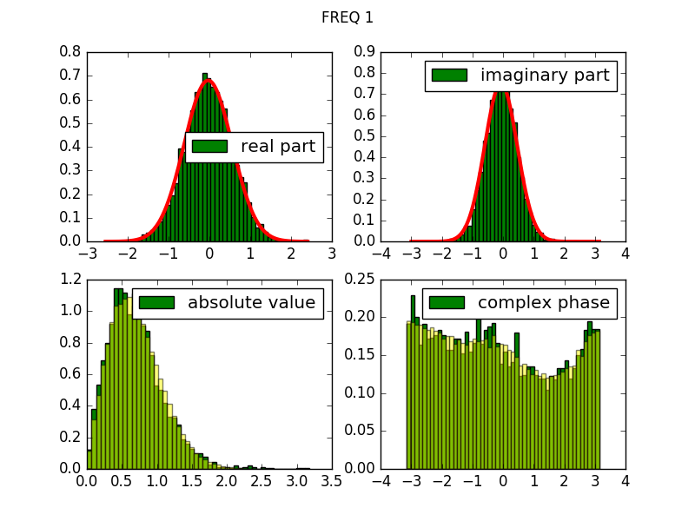
Noise generation
Example for one of frequency channel
Obtain distributions for real and imaginary part of frequency spectra using Fourier transformation;
Fit these distributions using two gaussian hypotheses;
Generate random spectrum out of these distributions;
Use inverse Fourier transformation to obtain spectrum of generated events.
Data-Model comparison

Slide 19
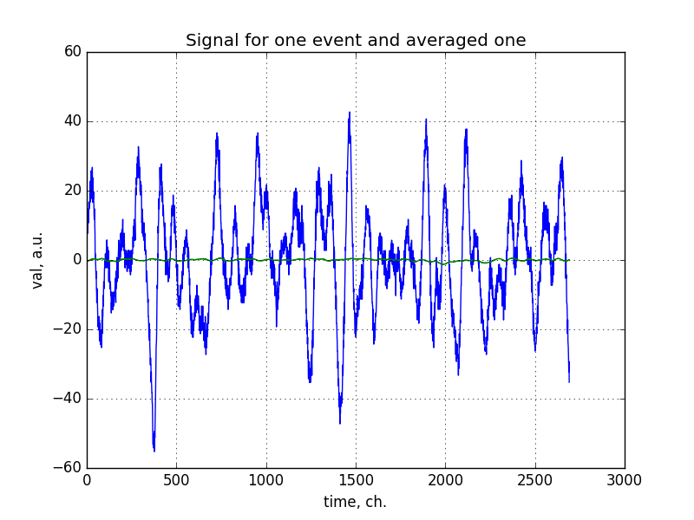
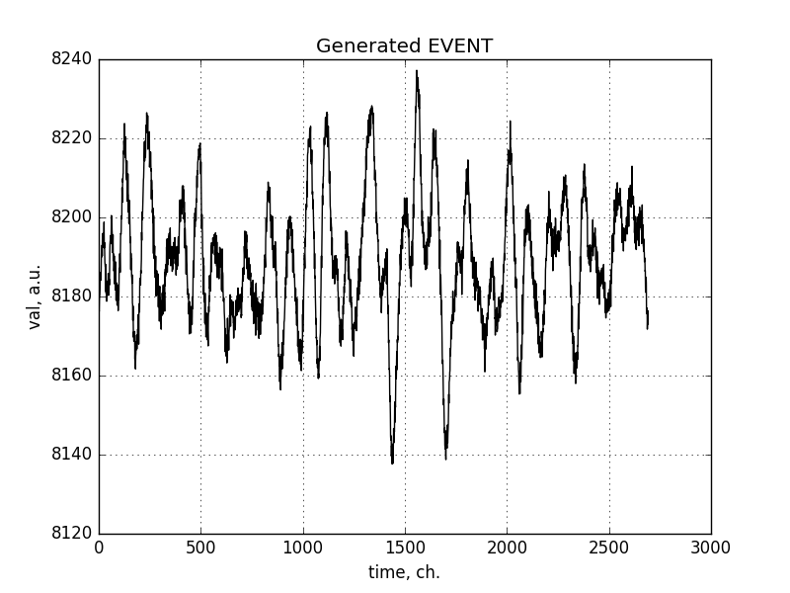
Further studies of noise + simulation
Noise in data (baseline corrected)
Generated noise
Obtain distributions for real and imaginary part of frequency spectra using Fourier transformation;
Fit these distributions using two gaussian hypotheses;
Generate random spectrum out of these distributions;
Use inverse Fourier transformation to obtain spectrum of generated events.

Slide 20
Energy calibration
Now we have 14-bit Flash ACD with 40 ns per time channel, which encode voltage in a range (-2,5, +2.5) mV
Additional calibration is needed to have same response for the signal and for the noise.
Done using alpha source.
5,5 MeV alpha-particle create a signal with integral of 200000 ADC channels (private communication with Alexander Inglessi)
A fake 1 mm track with 5,5 MeV energy deposit is created
It produces 150684 ionization electrons in a GEANT model
Integral for the Flash ADC spectrum is 152022
1 electron has “weight” = (200000 / 152022)

Slide 21
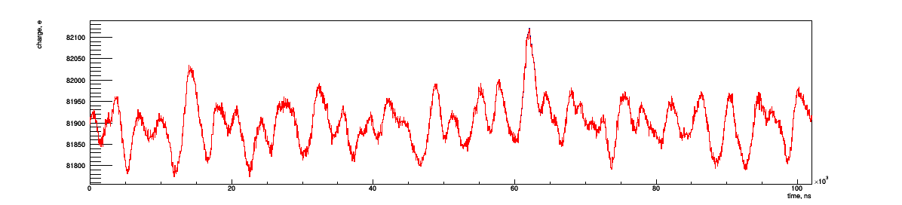
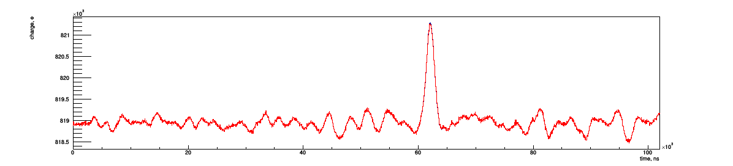
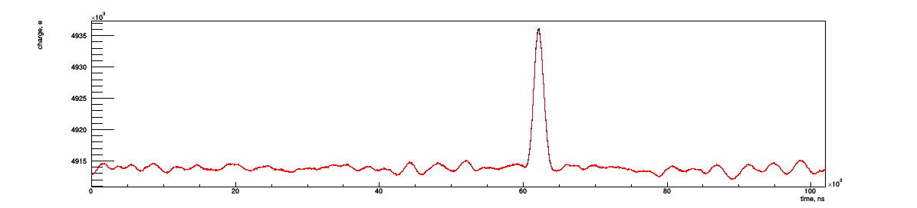
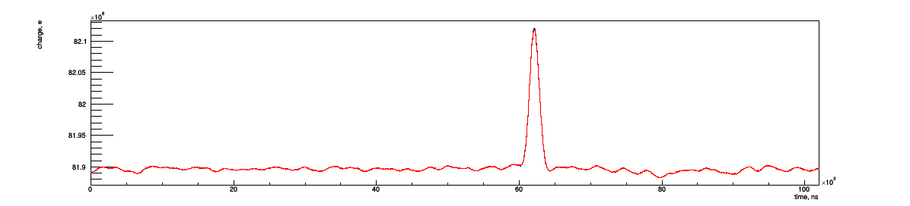
Flash ADC spectrum with noise (Pad 2)
10 beam electrons
Relative electronic noise is suppressed by an increase of the cumulative statistics
Current procedure is quite slow
½ noise event / second for one CPU core
100 beam electrons
1000 beam electrons
10000 beam electrons

Slide 22
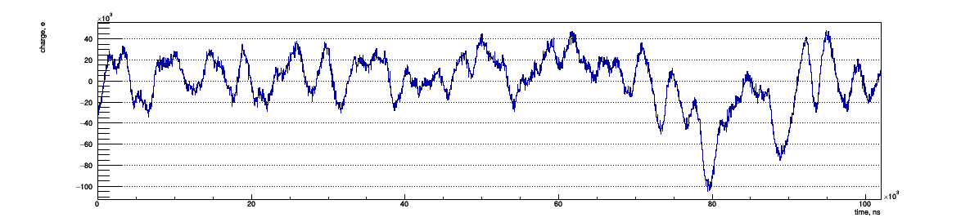
Cumulative noise baseline corrected spectrum
100k noise events
Is it a fluctuation or an issue?
No clear answer yet, but that is not important for the drift time measurements, as well as for single events!

Slide 23
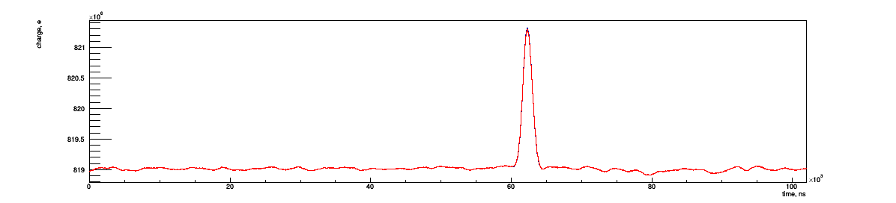
100k with noise
No diffusion
With longitudinal diffusion
Pad 02

Slide 24
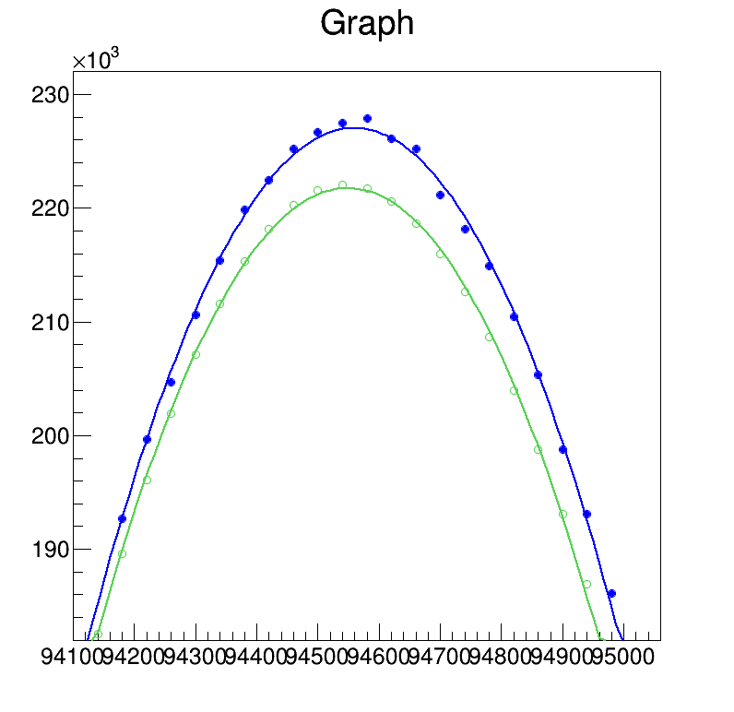
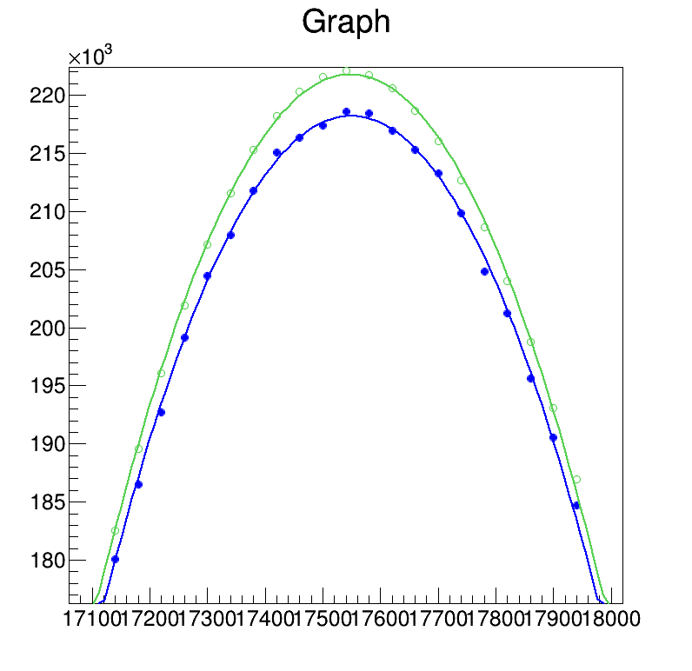
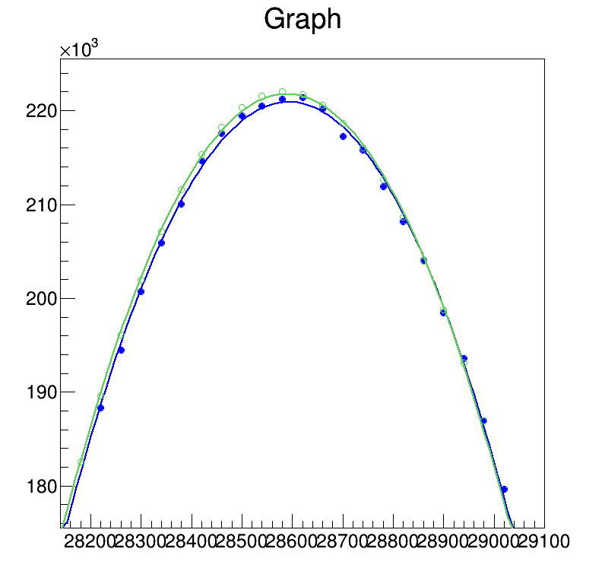
Maximum (peak position) shift due to noise
Peak is placed to the random location of cumulative noise spectrum
Shift of maximum for signal + noise (blue) wrt. pure signal (green)
Some fit examples

Slide 25
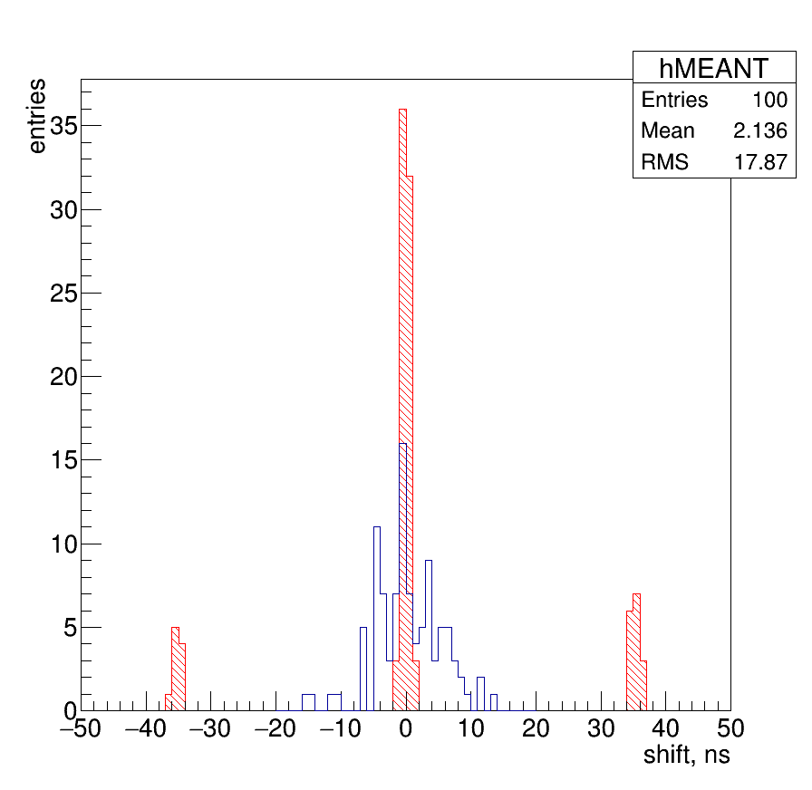
Distribution for shifts for 100k events
100 random places for signal peak at the noise spectrum. Signal shape at the peak region and cumulative noise spectra are same, but position is different!
RMS for maximum with peak position fitting procedure 6,7 ns
Mean value for signals in the range ( Bin of maximum +/- 10 bins) is very dangerous estimator RMS = 17,9 ns)

Slide 26
Summary
A drift velocity measurement is possible with several nanoseconds precision
6 ns precision / 60000 ns drift time → 10^{–4} accuracy!
There are a procedure and a tool, which allow to create an electronic noise on event-by-event basis with a data-driven method.
https://github.com/aleksha/electronic-noise (Python with numpy, scipy and matplotlib)
We can create signal with a noise now!

