Slide 1
Noise cross check
Aleksei Dziuba / PNPI NRC KI
2nd of September 2020
Many thanks to Fabian, who raised this question!

Slide 2
Noise simulation tool
Available via GitHub:
https://github.com/aleksha/electronic-noise
Fast Fourier Transformation based
Calibration sample is kindly provided by Alexander Inglessi
Do we have the same noise from the generator (20-30 keV) as we reported in the past?

Slide 3
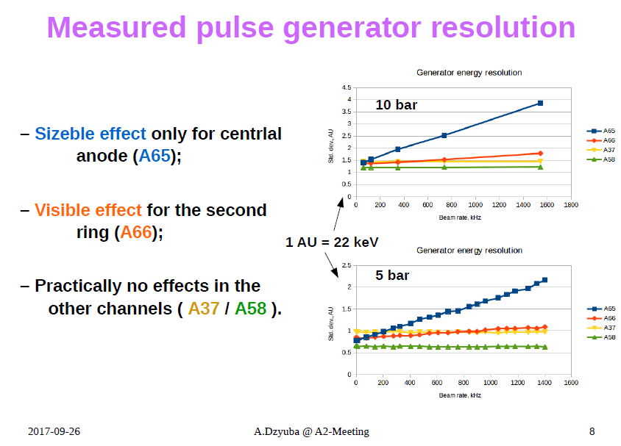
Test run in Mainz with ACTAF

Slide 4
Cross check of the tool
1 channel = 27.5 eV (if one use 5.5 MeV alpha calibration => 200000 ch.)
For the real data (calibration sample) results are:
N events = 1000 events ← ~3% uncertainty for standard deviation
GATE = 6 us (150 channels) ← Rather typical
MEAN = 1.22889e+06 a.u.
SDV. = 762.773 a.u.
RESO = 20.9763 keV ← As expected
For the simulated noise (same conditions):
MEAN = 1.22845e+06 a.u.
SDV. = 776.29 a.u.
RESO = 21.348 keV ← Reasonable agreement!

