Slide 1
Anode current calculation
Aleksei Dziuba \ NRC KI – PNPI
July-September 2020
The tool: https://github.com/aleksha/electronic-signal

Slide 2
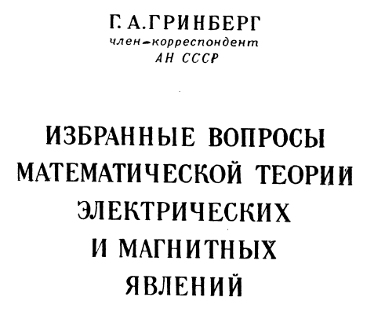

Credits
This method is suggested by Alexander Dobrovolsky (PNPI)
Добровольский Александр Владимирович
dobrovolsky_av@pnpi.nrcki.ru
Based on Grinberg’s textbook
Simulation tool uses CERN.ROOT framework
https://root.cern.ch/

Slide 3

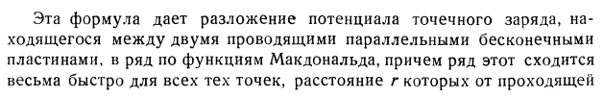
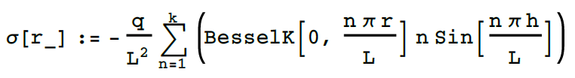
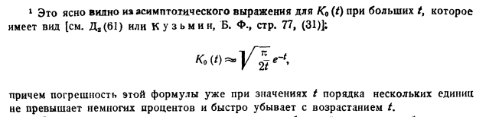
Charge between two infinite planes
From potential one can go to the induced charge using Gauss theorem
L – distance between planes
r – radial distance from a charge
h – distance between plane and charge
q – electron charge (q=-1)
pp.113

Slide 4
The method in a nutshell
Create a map of induced charge on rings with fixed width for an electron which is moving perpendicular to anode at r=0.
Calculate induced charge and induced current (as a derivative of the induced charge) with defined anode structure for an electron in point (x,y) using an overlap of the map and anodes.
Find which of anode is fired, using the largest integral of current.
Rescale currents for each of anodes with a common factor, which is evaluated to set the current integral for the fired anode to unity.

Slide 5
Parameters.h of the tool
const int N_ANODES = 9;
const int N_R = 5000; // max length for array for map (r-only)
const int N_TIME = 200; // max length of induced charge array
bool read_from_db = false ; // if database with map is prepared
double grid_anode_distance = 10. ; // mm ; Grid-Anode distance
double drift_velocity = 0.0075 ; // mm/ns ; Drift velocity
double channel_width = 40 ; // ns ; Flash ADC channel width
double r_map = 50. ; // mm, map radius <-- should fit N_R
double step_size = 0.01 ; // mm, radial step for map <-- should fit N_R

Slide 6
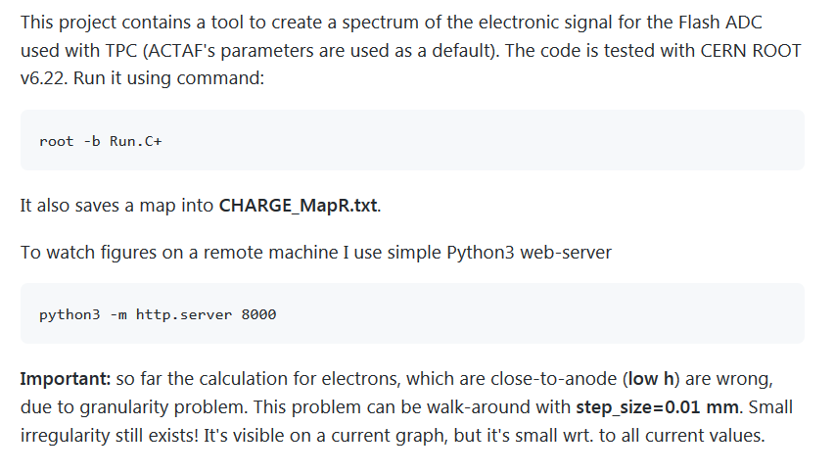
How to run

Slide 7
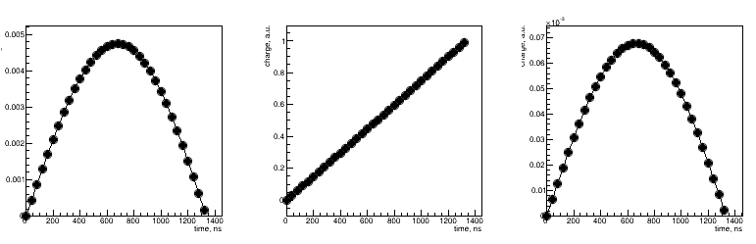
Induced charge for x=12mm, y=18mm
Central pad (r=10 mm)
1st ring (width 40 mm)
2nd ring (width 40 mm)

Slide 8
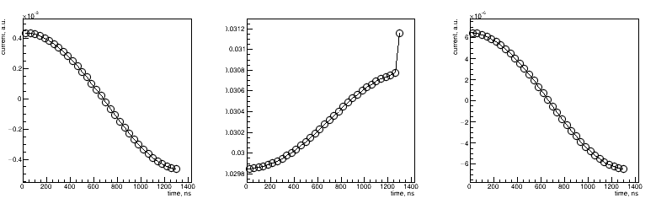
Induced charge for x=12mm, y=18mm
Central pad (r=10 mm)
1st ring (width 40 mm)
2nd ring (width 40 mm)
Numerical errors (too close r order of h)
Note that it isn’t zero!

