Slide 1

- ENIAC -
Join the game / or not?

Slide 2
Should Eniac sign a 3-year contract with Magist?
Comparison of price / orders
Delivery cost / time

Slide 3
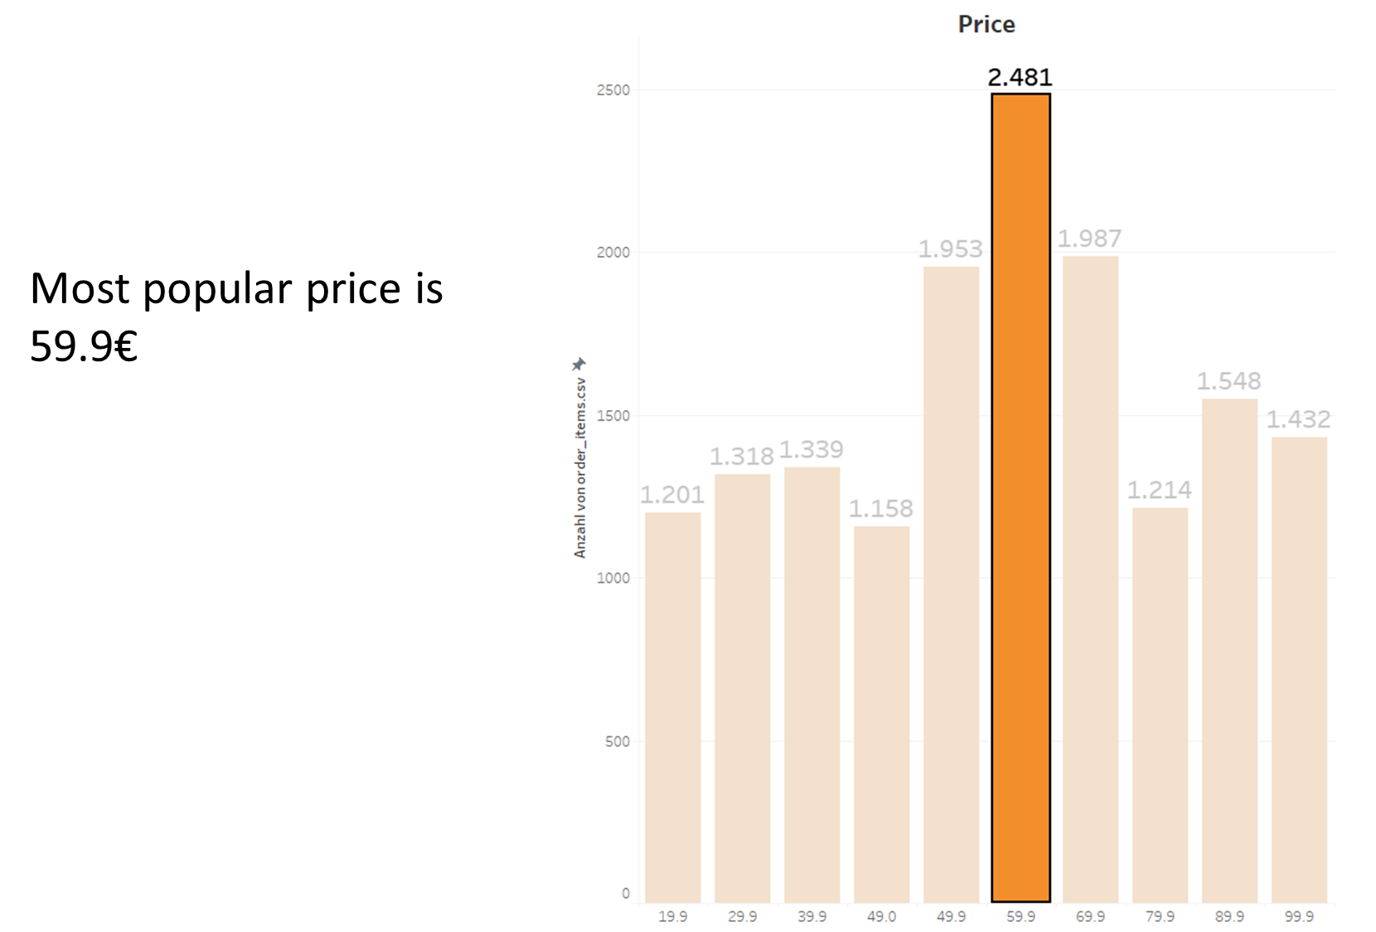

Slide 4
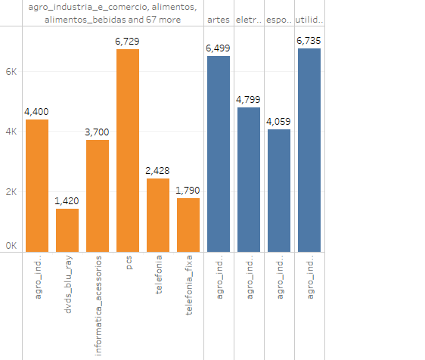
Maximum Price of Products

Slide 5
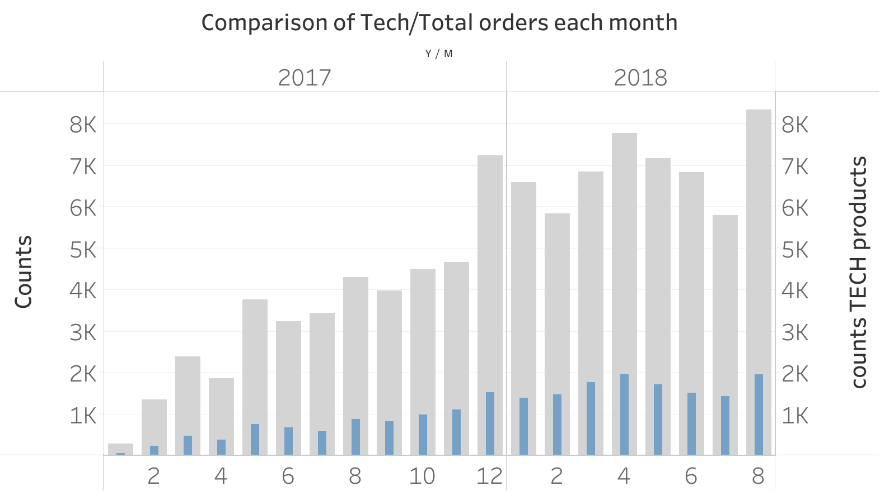

Slide 6
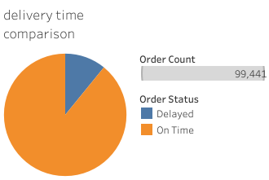
10% of the products are delayed

Slide 7
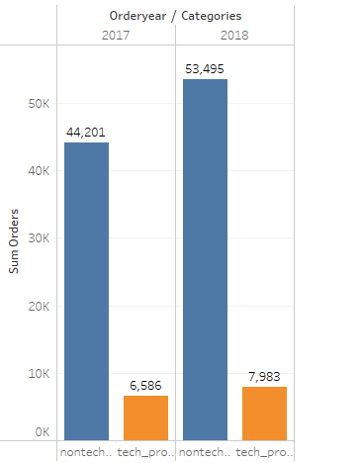
Tech&Non_Tech products Sales in Each Year

Slide 8
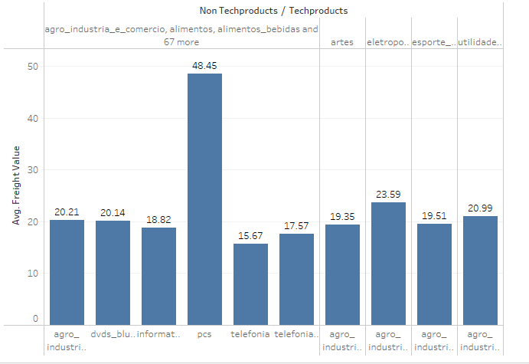
Avg Delivery cost Tech&Non_Tech Products

Slide 9
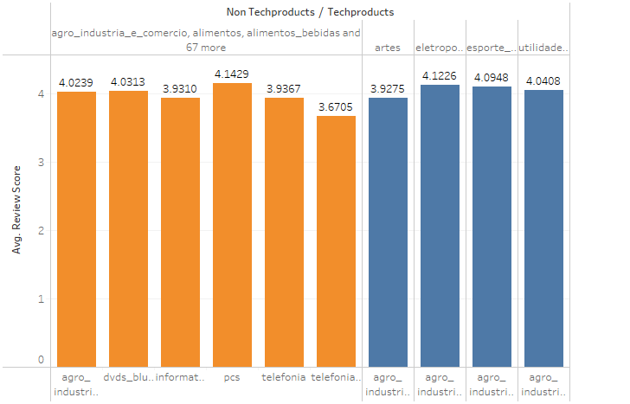
Review score of Non _Tech products&Tech_products

Slide 10
Conclusions
Only 7% are Tech sellers
Average delivery time is 9.3 days
Recommendation
Magist is not a good fit for tech products
Sales have been unstable over the years
Should Eniac sign a 3-year contract with Magist?
Yes/NO

