Slide 1


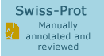
PANNZER
FRENKI

Slide 2
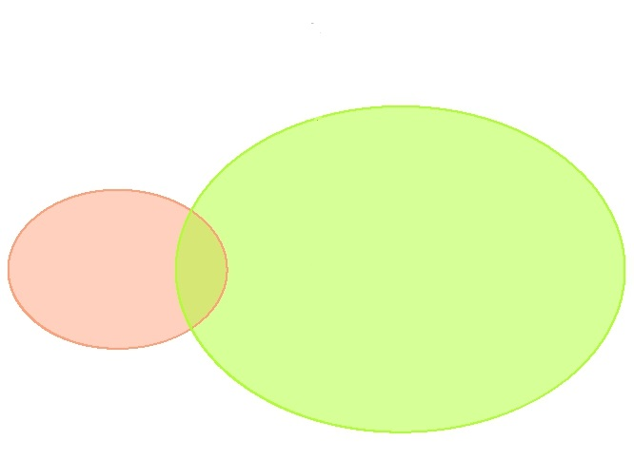
FRENKI predikcije
(2747)
Referentni set
(653)
554
99
2648
(false negatives)
(false positives)
(true positives)
draw.pairwise.venn(653, 2747, 99, scaled = TRUE, col = c("lightsalmon", "greenyellow"), inverted = T, fill = c("lightsalmon", "greenyellow"))

Slide 3
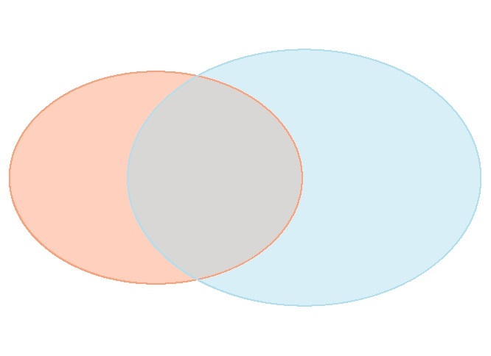
PANNZER predikcije
(951)
Referentni set
(653)
310
343
608
(false negatives)
(true positives)
(false positives)
draw.pairwise.venn(653, 951, 343, scaled = TRUE, col = c("lightsalmon", "lightblue2"), inverted = T, fill = c("lightsalmon", "lightblue2"))

