Slide 1


PRESENTED BY
TechTrek Hackathon 2026
Professional services firms are drowning in disconnected systems.
Disconnected Systems
Manual Workflows
Fragmented Communication
Each dept uses different tools
Copy-paste between Excel files
Info in emails, Teams, sticky notes
No Real-Time Visibility
Inconsistent Client Experience
Limited Strategic Insight
Managers fly blind until monthly reports
Service quality depends on who handles it
No data-driven decisions possible

Slide 2
One AI-Powered Platform
That connects every department, every client, every task, every document.
Email Hub
Task Workflow
Documents
Legal Processes
SMTP • IMAP • AI Sort • AI Reply
Kanban • Review Flow • Auto-Assign
AI Q&A • Simplify • Validation
Templates • Client Portal • Compliance
Chat
Performance
Client Portal
Notifications
Real-Time • Socket.io • File Sharing
AI Reports • Scoring • Team Analytics
Doc Upload • AI Chat • Progress
Real-Time • Bell • Task Alerts
8 AI Features • 8 Departments • 33 Users • Role-Based Access • Real-Time Everything

Slide 3
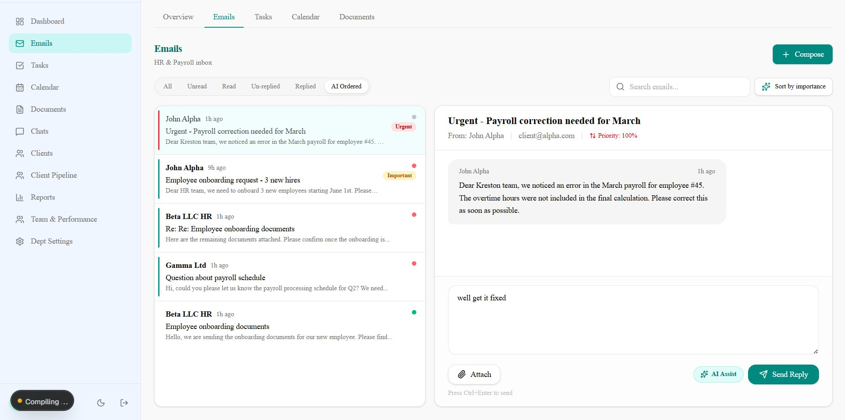
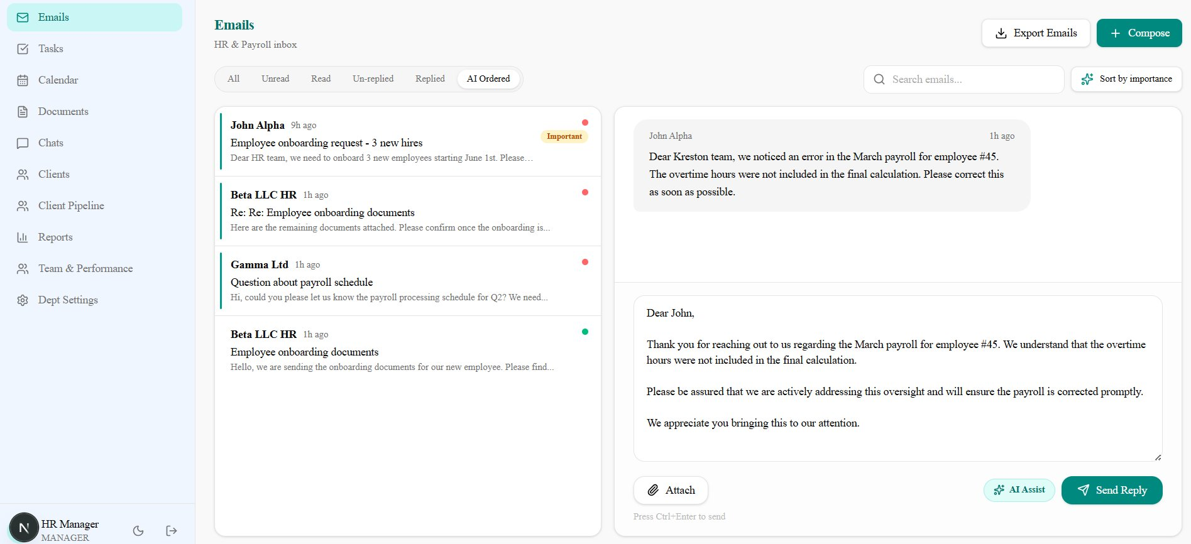
Email Hub
Centralized inbox • AI prioritization • Smart reply • Department routing
BEFORE
AFTER (AI Enhanced)
Gmail IMAP Polling
New emails appear in 10 seconds
AI Sort by Importance
One click - AI orders all unread emails
AI Enhance Reply
Type lazy draft → professional email
Smart Dept Routing
Keywords auto-route to correct dept
Attachments
PDF, Word, Excel - send and receive
Search & Pagination
Find any email instantly

Slide 4
Task Workflow Engine
TODO → In Progress → Review → Approved → Completed | Role-based permissions at every step
📸 SCREENSHOT: Task Kanban board with all 5 columns, cards visible
AI Task Assignment
AI picks best person based on workload
Review Flow
Auto-unassign → manager assigns reviewer
Auto-Assign Timer
Configurable per-dept (4h-168h)
Status Timeline
Every transition logged with timestamps
Role Permissions
Junior: work only. Manager: approve.
File Attachments
PDF/Word/Excel on every task

Slide 5
Legal Processes & Client Portal
Manager defines process → Client uploads docs → AI validates → Team produces deliverables
📸 SCREENSHOT: Process creation with template loaded, docs listed
📸 SCREENSHOT: Client portal - process with upload, AI check button
1
Create Process from Template
2
Attach Client & Required Docs
3
Client Uploads Documents
4
AI Validates & Matches
5
Team Produces Deliverables

Slide 6
8 AI Implementations
Powered by Google Gemini 2.5 Flash
1
Smart Email Sorting
2
AI Reply Enhancement
3
AI Task Assignment
4
AI Performance Reports
Reads & ranks all unread by urgency automatically
Lazy draft → professional client-facing email
Analyzes workload, picks best person for the job
Scores team daily/weekly/ monthly with manager tips
5
Document Simplifier
6
Document Q&A
7
Client Doc Validation
8
Client Document Chat
Reads PDF/Word/Excel, gives key points in seconds
Ask any question about a document, AI answers
AI matches uploads to requirements automatically
Back-and-forth guidance on what to submit & how
+ Auto-assign reviewers on timeout • AI self-coaching for employees • Smart email dept routing • PDF first-page classification

Slide 7
Performance & Team Management
AI-powered insights • Department-scoped • Historical reports • Employee self-view
📸 SCREENSHOT: Manager dashboard with KPIs, charts, department workload
📸 SCREENSHOT: AI Performance Report - employee scores with tips
📸 SCREENSHOT: Team page - member cards with task history expanded
📸 SCREENSHOT: Employee self-performance - score circle with AI coach
📸 SCREENSHOT: Client pipeline kanban - Lead/Active/Inactive

Slide 8
Business Impact
BEFORE
AFTER
✗ Emails scattered across personal inboxes
✓ Centralized inbox with AI prioritization
✗ Tasks tracked in Excel spreadsheets
✓ Kanban workflow with full audit trail
✗ Performance reviews based on gut feeling
✓ AI scores with data-backed evidence
✗ Clients wait weeks for document feedback
✓ AI validates documents in seconds
✗ Managers ask around to know what's happening
✓ Real-time dashboards and notifications
✗ Legal processes on paper templates
✓ Digital processes with client portal
"What if the system didn't just track work, but actually knew how to make your firm better?"

