Slide 1






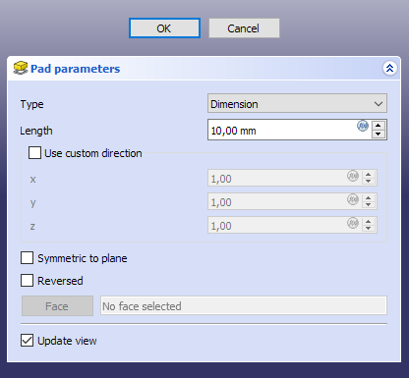
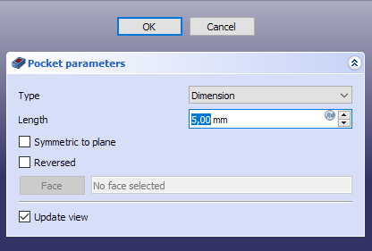
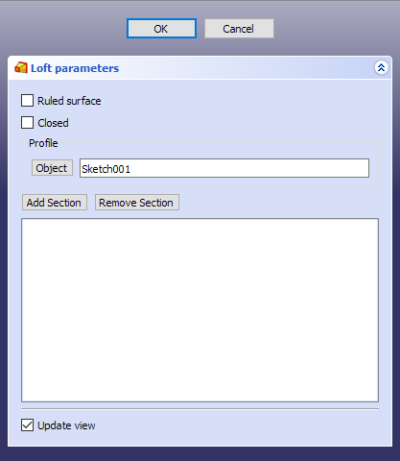
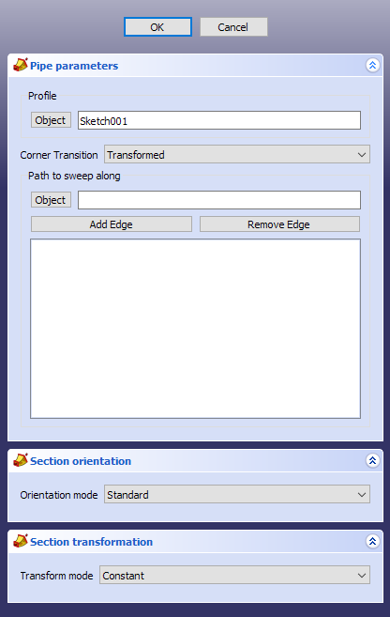
FreeCAD Command modifications
Extrusion
Extrusion
Extrusion
Mode
Add Volume
Mode
Add Volume
Mode
Add Volume
Type
Dimension
Type
Extrusion Path
Type
Multiple Faces
Face
Sketch001
Face
Sketch001
Faces
Sketch001, …
Length
10,00 mm
Extrusion Path
Not selected
Specify Extrusion Path
Reverse direction
Extrusion Path
Not selected
Symmetric to plane
Cancel
Apply
Cancel
Apply
Cancel
Apply

