Slide 1
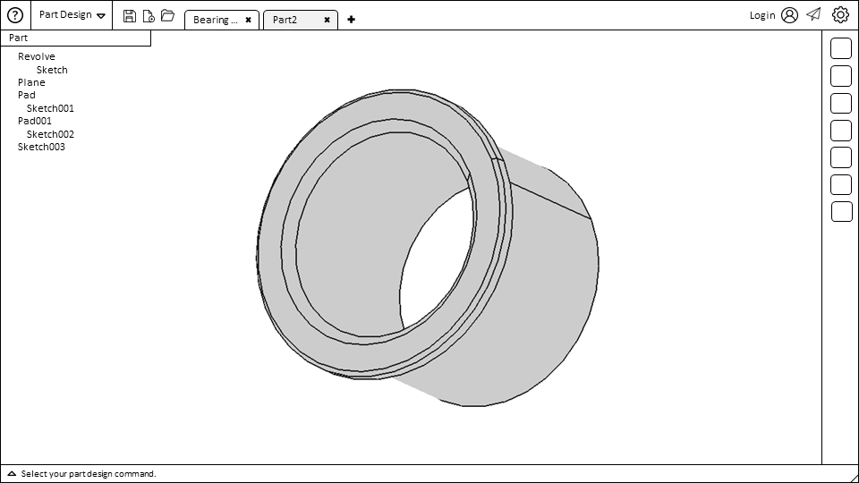
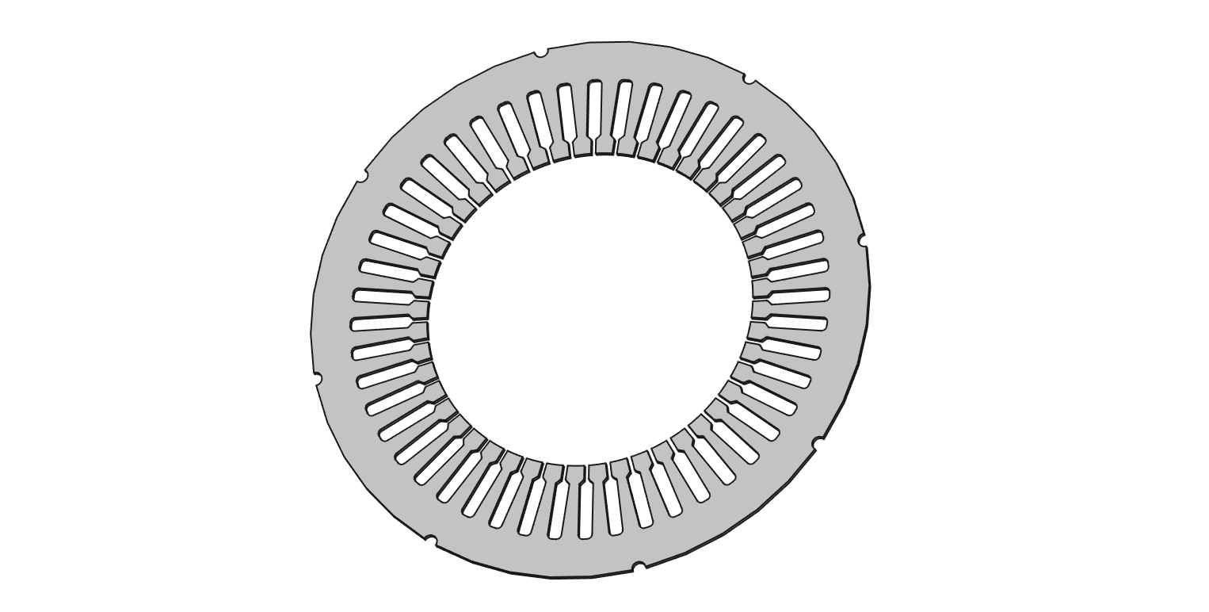
Part Design
1
2
3
4
5
6
7
8
9
0
Q
W
E
R

