Slide 1
tnnlib
Template neural network library

Slide 2
Content
A short introduction to artificial neural networks
Introduction to tnnlib
Transition to templates
Example
References

Slide 3
Goal
To understand the neural networks principles and create a library with a modern c++ interface
Having fun while doing a research

Slide 4
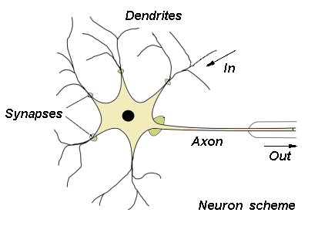
Introduction

Slide 5
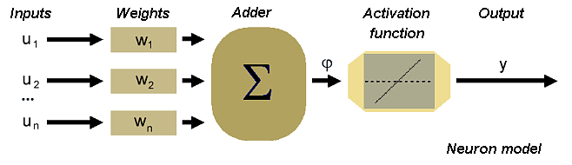
Introduction
Neuron representation

Slide 6
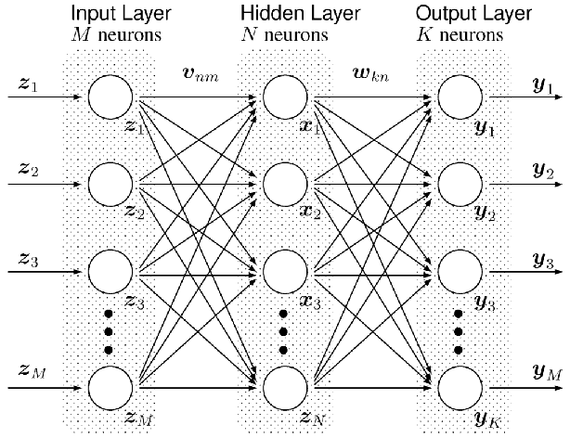
Introduction
Perceptron

Slide 7
Design
Started with the basic OOA/OOD
Define basic entities
  Neuron
  Activation Function
  NeuralLayer
  NeuronInput
  Perceptron

Slide 8
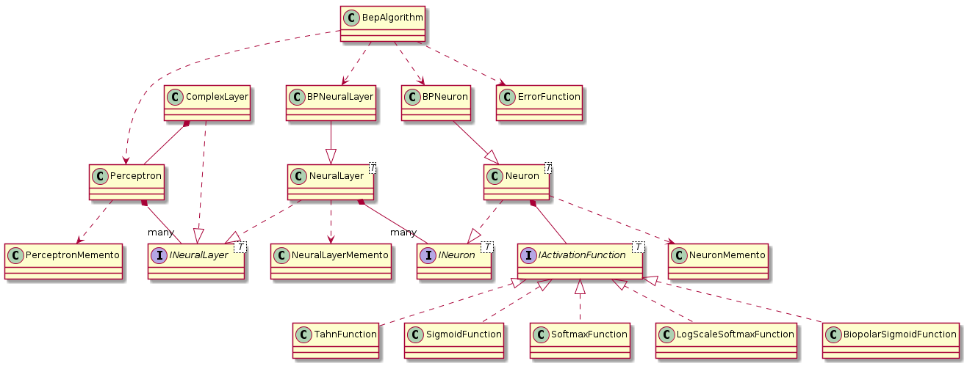
Design
UML diagram

Slide 9
Features
Gradient decent – back error propagation
Serialize, de-serialize the weights
Activation functions (Sigmoid, Softmax, Binary)
Support of OpenCL
Constructing complex network in declarative way

Slide 10
Transition to dsl
First version used dynamic memory and exceptions
The network was defined at runtime
Was slow in learning due to the memory alignment
Used a lot of error handling code (exceptions)

Slide 11
Transition to dsl
Result
  10x faster learning
  Way less code due to a luck of error management
  Easy to construct a perceptron with any number of layers and any kind of neurons - activation functions inside
  Easy to extend and create complex layers
  Code is not easy to understand by a novice c++ developer
  No support for the runtime network construction

Slide 12
Example
typedef nn::Perceptron<float,
nn::NeuralLayer<nn::Neuron, nn::SigmoidFunction, 2>,
nn::NeuralLayer<nn::Neuron, nn::TanhFunction, 20>,
nn::NeuralLayer<nn::Neuron, nn::SigmoidFunction, 1>
> Perceptron;
typedef BepAlgorithm< Perceptron > Algo;
Algo algorithm (0.09f, 0.01f );
std::array< Algo::Prototype, 4> prototypes= { Algo::Prototype{{0.f, 1.f}, {1.f}} ,
Algo::Prototype{{1.f, 0.f}, {1.f}} ,
Algo::Prototype{{1.f, 1.f}, {0.f}} ,
Algo::Prototype{{0.f, 0.f}, {0.f}}
};
Perceptron perceptron = algorithm.calculatePerceptron ( prototypes.begin(), prototypes.end(),
[] { /* you can print here*/},
numOfEpochs);

Slide 13
Example
using Memento = Perceptron::Memento;
Memento memento = perceptron.getMemento ();
Perceptron perceptron2;
{
std::stringstream strStream;
boost::archive::xml_oarchive oa (strStream);
oa << BOOST_SERIALIZATION_NVP (memento);
Memento memento2;
boost::archive::xml_iarchive ia (strStream);
ia >> BOOST_SERIALIZATION_NVP (memento2);
perceptron2.setMemento (memento);
}

Slide 14
More examples
https://github.com/alekstheod/tnnlib/tree/master/src/ocr
https://github.com/alekstheod/tnnlib/tree/master/src/Test

Slide 15
References
https://github.com/alekstheod/tnnlib
https://en.wikipedia.org/wiki/Artificial_neural_network
https://www.ianos.gr/texnita-neironika-diktia-0198875.html
https://en.wikipedia.org/wiki/Softmax_function

Slide 16
End
Thank You

