Slide 1
Sparse Multi-label Patent Classification with Deep Learning
W266 Final Project (Fall 2019)
Alexander Mueller & Kevin Stone

Slide 2


Cooperative Patent Classification (CPC) Codes
Notes:
First a little background. The Cooperative Patent Classification, CPC for short, is a patent classification system, which has been jointly developed by the European Patent Office and the United States Patent and Trademark Office.

Slide 3
CPC Label Hierarchy
Section (A - H, Y)
Class (Two Digits)
Subclass (One Letter)
Group (One to Three Digits)
Notes:
The CPC system has a defined hierarchy. The first letter is the ”section symbol” consisting of a letter from ”A”, ”Human Necessities”, followed by ”B”, ”Performing operations; transporting”, up to ”H” (”Electricity”) and then skips to “Y”, “Emerging Cross-Sectional Technologies”. The section system is followed by a two-digit number for the “class” and then a single letter for the ”subclass”. The subclass is then followed by a number of digits to indicate groups and subgroups.
In total, the CPC system has over 250,000 categories and a single patent can have from 1 to 18 CPC labels.
.

Slide 4
Example - B60W 20/00
Section B
Performing operations; transporting
Class B60
Vehicles in general
Subclass B60W
Conjoint control of vehicle sub-units
Group B60W 20/00
Control systems specially adapted for hybrid vehicles
Notes:
Here is the breakdown for ”B60W 20/00”. At the stop is Section B, “Performing operations; transporting”, down to the Group level which is ”Control systems specially adapted for hybrid vehicles”.

Slide 5
Example - B60W 20/00
Section B
Performing operations; transporting
Class B60
Vehicles in general
Subclass B60W
Conjoint control of vehicle sub-units
Group B60W 20/00
Control systems specially adapted for hybrid vehicles
Notes:
Our system classifies patents at subclass level.

Slide 6
3.3M patents filed in 2018
Notes:
Patents are a strategic resource for innovation management, but their volume, over 3.3M patents filed in 2018, and the complexity of their taxonomy are creating significant challenges for the patent system and its users. Patent classification is a core task in patent management and is typically undertaken by patent experts and patent examiners. One way to expedite the categorization and search process is to narrow down which codes apply to a new patent filing and then search for patents by code. Understanding which codes apply to a potential patent filing also allows companies to make a more informed decision on whether or not an investment in the patent is warranted.

Slide 7
Challenges of multi-label classification
Sparsity
634 subclass labels in US 2M PTO Dataset
1.3 average, up to 18 per patent
Unbalanced dataset
Precision vs. Recall Trade-off
Notes:
There are several challenges with multi-label classification. In the US 2M PTO Dataset, the dataset that we used, there are 634 subclass labels in total. One average each patent has 1.3 subclass label and the maximum number for a patent is 18. This creates a very sparse target matrix that is 634 columns by 2 M rows.
The next challenge is Imbalanced distribution — the most common CPC label in our dataset has been attached to more than 280k patents, while there is a long tail of CPC labels attached to fewer than 1000 or ½ percent of the patents in our dataset.
One final challenge to note is the precision vs. recall trade-off. For patents we felt it’s better to have higher recall to minimize the chance of “missing” a code.

Slide 8
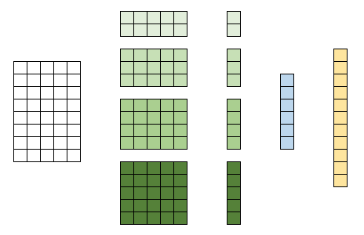

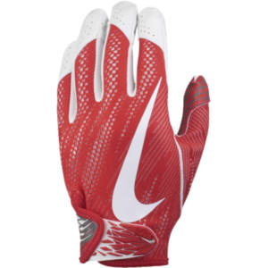
Network architecture
The
present
invention
relates
to
the
fields
of
molecular
biology
...
Embedding
Notes:
We leveraged BERT and GloVE for embeddings. Both embeddings had maximum sentence length of 250, which was calculated based on the 99% cutoff for patent abstract word count.

Slide 9
Network architecture
512 CNN filters
(2, 3, 4, 5)
Max
Pooling
512-Dim Dense
(2)
634 Classes
The
present
invention
relates
to
the
fields
of
molecular
biology
...
Embedding
Notes:
We created two different models: (1) GloVe + CNN with 23.5M parameters, and (2)BERT + CNN with 115.9M parameters.
Both models follow a similar architecture: at the input layer, the word embeddings are passed into a CNN with four parallel convolutional layers, each with 512 filters of kernel size {2, 3, 4, 5}.
We apply max pooling for each convolution.
The concatenated representations are fed into a dense layer with 512 hidden units, which are regularized with batch normalization and dropout.
The final output layer gives the independent sigmoid activations for each of the more than 600 CPC labels.

Slide 10
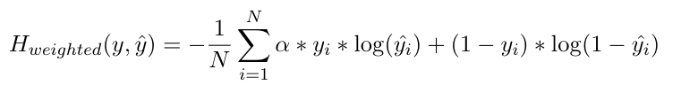
Custom loss function
Weighted binary cross-entropy loss
Multiplicative coefficient for the positive labels: 𝛂
Drives precision vs. recall tradeoff
Notes:
To address the sparsity in the label space, we implemented a weighted binary cross-entropy loss function, where y is the label and ˆy is the predicted probability for a given set of examples, and α is a multiplicative coefficient for the positive labels term in the loss expression
When α >1, the weighted binary cross-entropy loss function increases the gradient for false-negative predictions and thereby pushes more predictions towards 1. This increases recall at the cost of precision, matching our purpose to more effectively identify sparse labels.

Slide 11
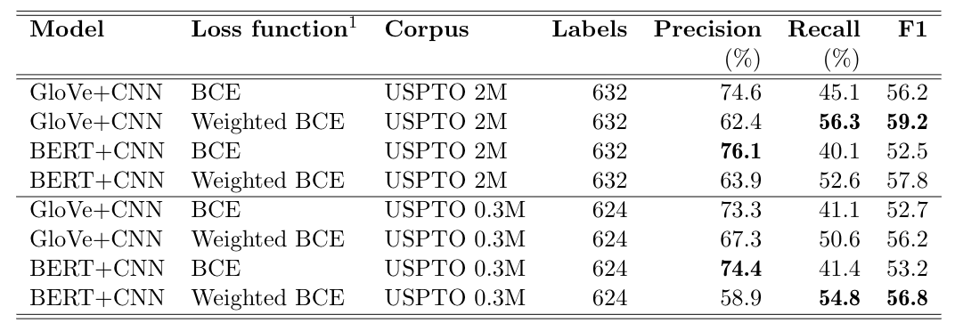
Results (1)
BCE = Binary cross-entropy
Notes:
In our best configuration GloVe+CNN with weighted binary cross-entropy loss, we achieve an F1 score of 59.2 on the USPTO 2M dataset.
While BERT+CNN achieved the highest precision (76.1%), it did not exceed the F1 score achieved by the GloVe-based model.
When working with an almost seven times smaller dataset (USPTO 0.3M), we observe an up to 4 percentage point drop in performance metrics. Here, models using BERT word embeddings scored highest.

Slide 12
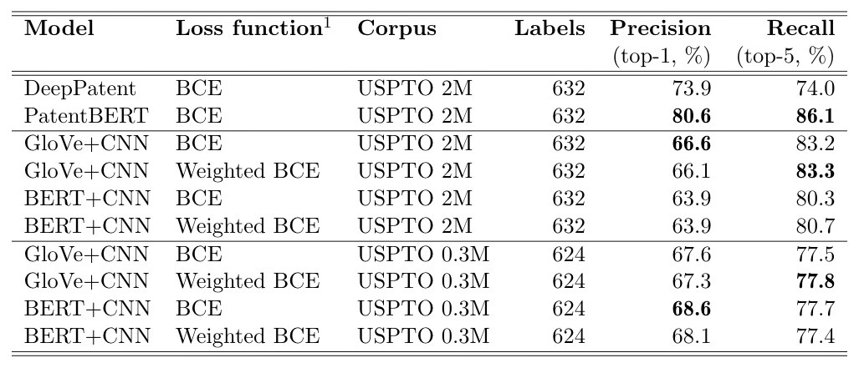
Results (2)
BCE = Binary cross-entropy
Notes:
As a reference, we include a benchmark comparison on the metrics used in two recent publications: DeepPatent (2018) andPatentBERT (2019). They used ranked retrieval metrics.
On the USPTO 2M dataset, our GloVe+CNN slightly surpassed DeepPatent (7,3%-points lower precision-1 but 9.2%-points higher recall-5).
Even when extrapolating our own BERT results with more training epochs, we were not able to exceed the baseline given by PatentBERT.

Slide 13
Interesting findings
Predictions: up to 5 labels per patent, 20% with no labels
Metrics correlate with number of examples (CPC section F1 scores range from 0.36 to 0.65)
Training time vs performance tradeoff
Notes:
We have a few interesting findings to report. The first is around the number of labels predicted. The average number of labels per patent predicted by the model was 1.04 vs. 1.3 in the dataset. Also, our model only predicted up to 5 labels vs. 18 for the dataset and there were a significant number of patents, almost 20%, with no labels predicted.
When we broken down the metrics by section, A through H, and Y, we found that the F1 scores correlated relatively well with the number of examples provided.
Lastly, we found that BERT takes approximately 60 times longer to train than GloVe.

Slide 14
Potential Areas of Exploration
Use 3M+ size patent dataset with more recent patents
Fine tuning final embedding layers
Investigating normalization and weighting of the multi-label distribution
Learning label co-occurrences
Notes:
Multi-level classification is an unsolved problem that requires more research as it applies to other areas besides patents such as image and video annotation for multimedia search or categorization of Wikipedia articles.
For future exploration, we recommend increasing the size of the dataset and tuning the final embedding layers
We also think there is opportunity for adjusting the weightings of the labels and using co-occurrence patterns as an input future.

Slide 15
Thank you!
W266 Final Project (Fall 2019)
Alexander Mueller & Kevin Stone

