Slide 1
Language Analytics
Lecture 8: Language Modelling 2
(More on RNNs)
Ross Deans Kristensen-McLachlan
rdkm@cas.au.dk

Slide 2
Course outline
1. Introductions​
2. String Processing with Python​
3. NLP for linguistic analysis​
4. Text Classification 1​
5. Text Classification 2​
6. Word embeddings​
7. Language modelling 1​
8. Language modelling 2​
9. BERT​
10. More BERT​
11. Project pitches​
12. Generative models​
13. Social impact​

Slide 3
Plan for today
Brief catchup
A recap on RNNs
Thinking about applications
Seq2seq problems
Text generation
Working on a notebook
RNNs for text generation

Slide 4
Catch-up from mid-term: The Good
18 replies, roughly two-thirds of the class
Biggest positives
Structure of classes
Notebooks
Assignments and code-along

Slide 5
Catch-up from mid-term: The Not-So-Good
UCloud, UCloud, UCloud. UCloud? UCloud UCloud! UCloooouuuudd.
Some would rather more time on independent coding; some would rather more detailed walkthrough of the notebooks
Better communication of expectations and level as we progress
Quicker feedback (I know, sorry about this!)

Slide 6
Catch-up from mid-term: Going forward
More clearer sign-posting from me
Within lectures
Throughout the semester
Quicker feedback on assignments
All existing projects will have feedback by next Friday
Find a better balance between walkthrough and free-coding
Open to suggestions here!

Slide 7
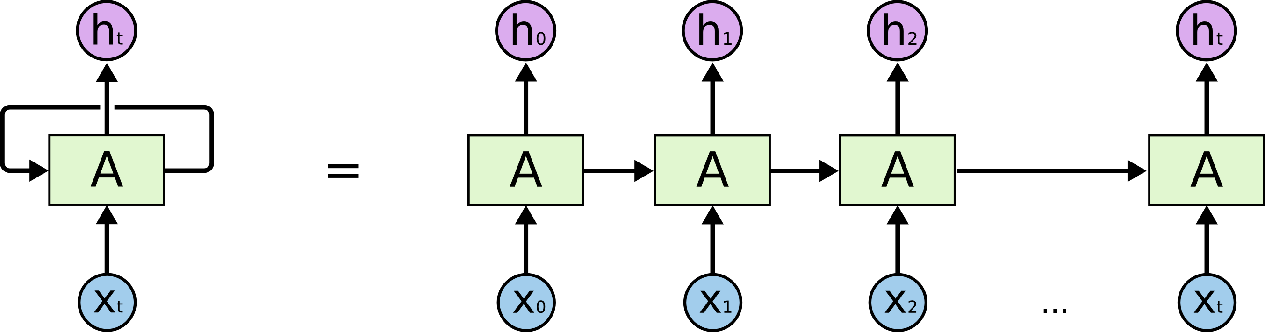
RNNs
Last week, we were introduced to recurrent neural networks
RNNs introduce hidden state which is passed on through the network, with each cell processing its own input and the preceding cell state(s)
RNNs can be really useful for language modelling but they have some fundamental and inherent problems

Slide 8

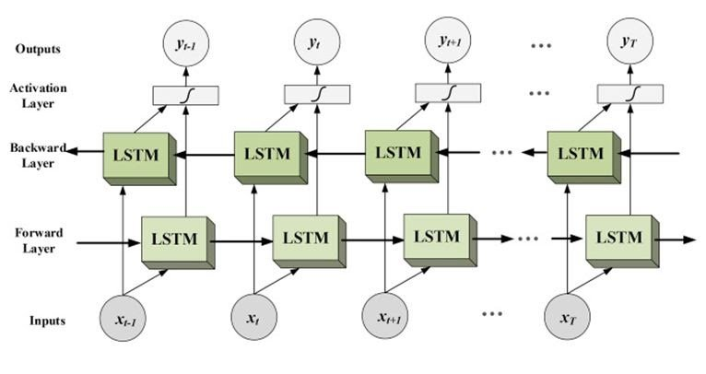
(Bi-)LSTM
Some of these problems can be solved with some additional engineering
Long Short Term Memory networks can be used to address the problem of long term dependencies in natural language
Bidirectionality can be used to address the fact that language understanding goes two ways – we sometimes update interpretations based on what comes next
Bi-LSTMs were state of the art for many language modelling tasks

Slide 9
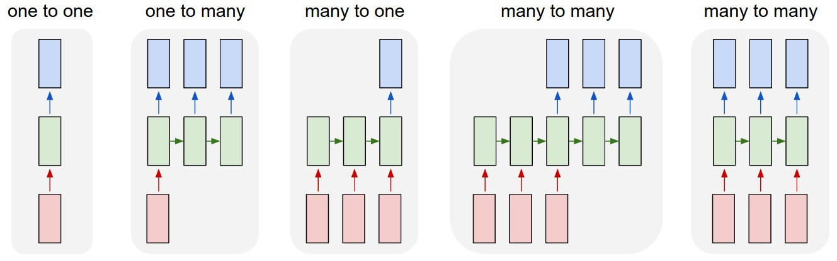
Sequence modelling
From Karpathy 2015
Notes:
(1) Vanilla mode of processing without RNN, from fixed-sized input to fixed-sized output (e.g. image classification).
(2) Sequence output (e.g. image captioning takes an image and outputs a sentence of words).
(3) Sequence input (e.g. sentiment analysis where a given sentence is classified as expressing positive or negative sentiment).
(4) Sequence input and sequence output (e.g. Machine Translation: an RNN reads a sentence in English and then outputs a sentence in French).
(5) Synced sequence input and output (e.g. video classification where we wish to label each frame of the video).

Slide 10
Seq2seq tasks
One special class of language modelling and sequence modelling tasks is the case where both the input and output are sequences
The prototypical seq2seq task is machine translation – converting from one string of natural language to an equivalent string in a different language
Question answering
Dialogue generation
This normally comprises what is known as an encoder-decoder architecture

Slide 11
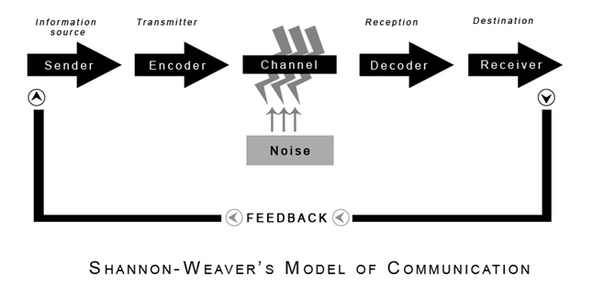
What is communication?

Slide 12
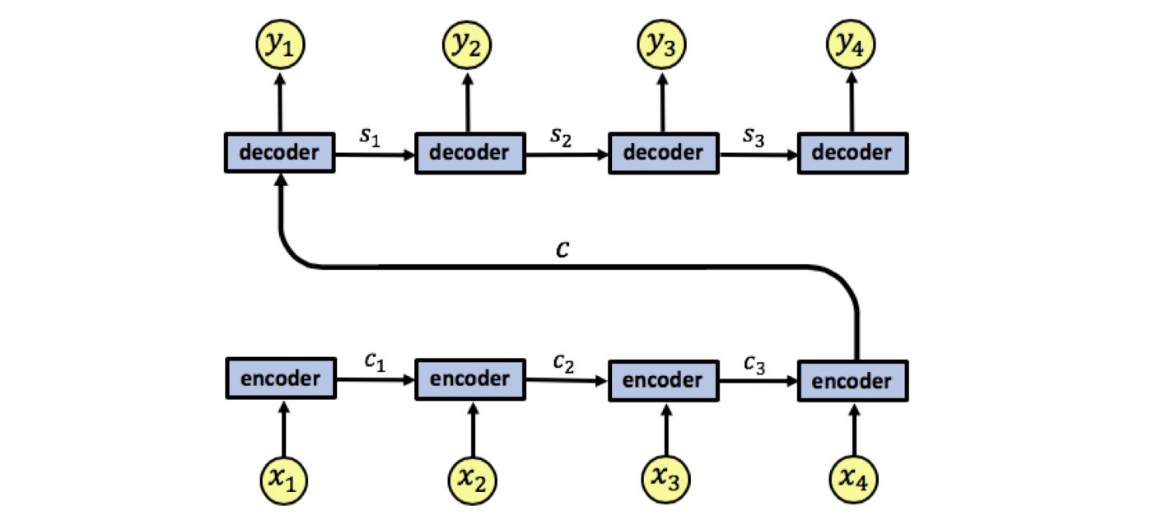
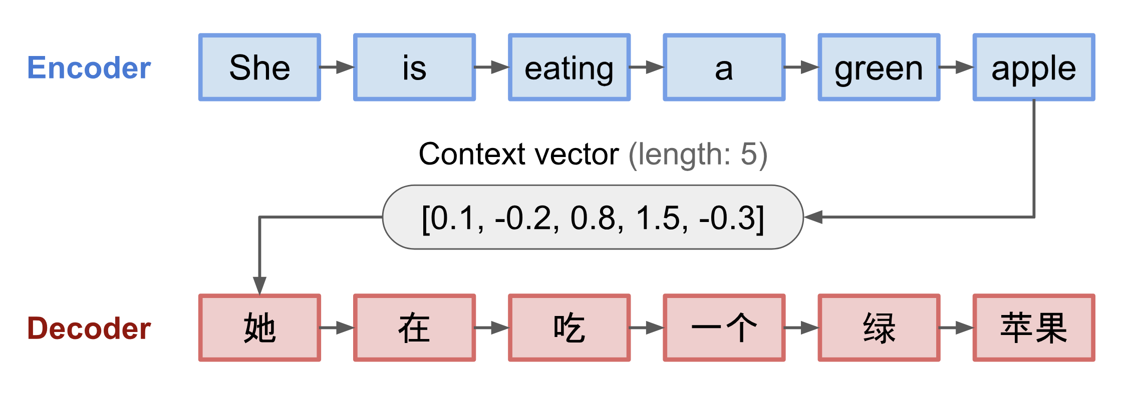
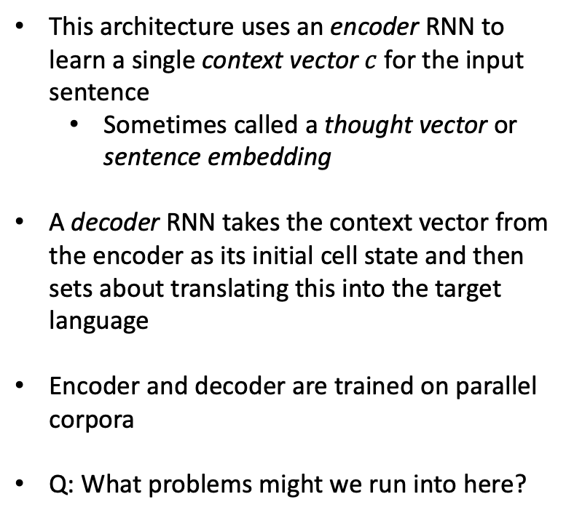
Encoder-decoder
This architecture uses an encoder RNN to learn a single context vector $c$ for the input sentence
Sometimes called a thought vector or sentence embedding
A decoder RNN takes the context vector from the encoder as its initial cell state and then sets about translating this into the target language
Encoder and decoder are trained on parallel corpora
Q: What problems might we run into here?
From Weng (2018)

Slide 13
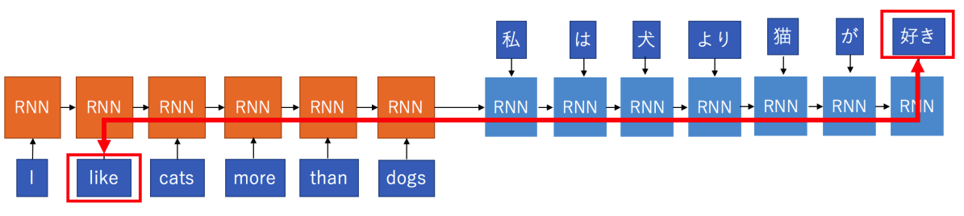
Problems
Those pesky long distance dependencies again!
Fixed-length context vector is incapable of remembering long sentences
First part is often forgotten before full input has finished processing
Particularly problematic for distant languages with very different grammar
The proposed solution to this problem is the use of what is called an attention mechanism

Slide 14
Attention – the intuition
Look again at the example we just saw and think about how the RNN passes hidden state down through the encoder network
It is true that each word is related to what comes before or after but some words are more relevant than others
For example think about eating, we expect to shortly encounter some kind of food stuff
Similarly, when we see green, we expect some sort of noun which can be a bearer of that property

Slide 15

Attention – the intuition
Look again at the example we just saw and think about how the RNN passes hidden state down through the encoder network
It is true that each word is related to what comes before or after but some words are more relevant than others
For example think about eating, we expect to shortly encounter some kind of food stuff
Similarly, when we see green, we expect some sort of noun which can be a bearer of that property
From Weng (2018)

Slide 16
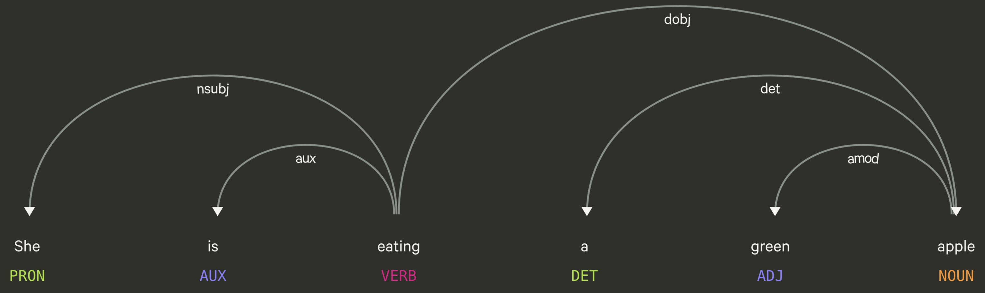
Dependency parsing

Slide 17
So what is attention?
Attention in deep learning can be broadly interpreted as a vector of importance weights
We use the attention mechanism to estimate how strongly each word is correlated with other words in a sentence
We say that words attend to one another
A large weight means that one word attends on another; low weights suggest the inverse
From Weng (2018)

Slide 18
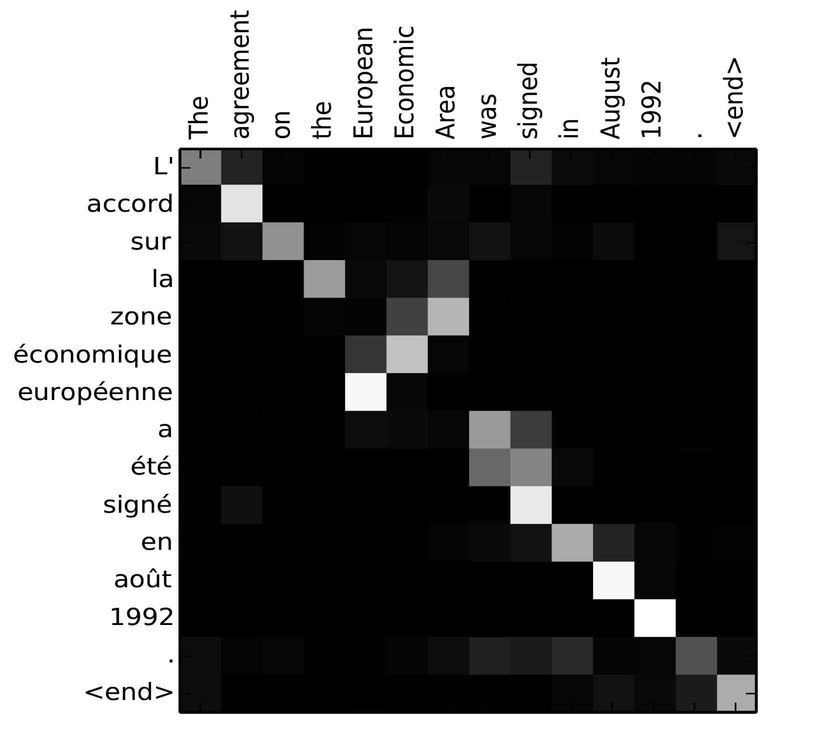
An example
The heatmap to the right shows an example of translating from English to French
It shows correlations between the input and output target words
This means we see which positions in the source sentence were considered more important when generating the translation
Notice how the correlation shows that the model has captured adjective-noun ordering differences in English and French!
European Economic Area
Zone économique européen
From Bahdanau et al., 2015

Slide 19
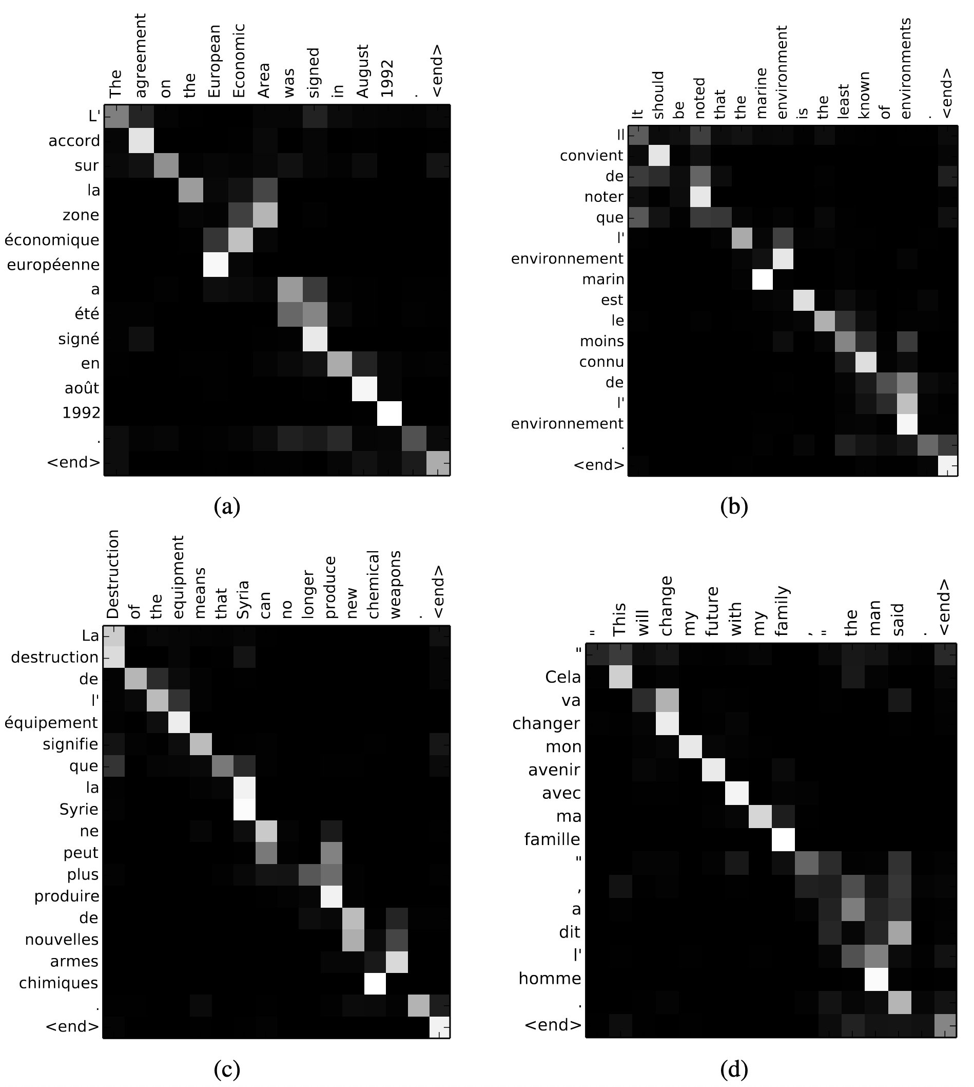

Slide 20
Summary
Seq2seq is are a class of sequence modelling problem where both input and output are strings
Encoder-decoder architectures are a kind of RNN specifically designed for seq2seq tasks like machine translation
Nevertheless, they still suffer from some problems
Long distance dependencies
Single static context vector for each input
Attention is proposed as a solution to this problem
We can use an attention mechanism to highlight which particular words a model should (or does) attend to at any given point

Slide 21
Summary… 2
Attention mechanisms are designed to approximate something like human attention
See Lindsay (2020) in the syllabus for a more detailed discussion of this
Put simply, attention is just a set of weights calculated while training a model
These weights are used to highlight which other words are being attended to at any given time
These weights are calculated using some (comparatively simple) maths combined together in increasingly complex architectures
Attention is incredibly powerful – so much so that, as we’ll see, attention is all you need

Slide 22
Additional reading
Bahdanau, D., Cho, K., & Bengio, Y. (2015). ‘Neural machine translation by jointly learning to align and translate’, ICLR 2015.
Lindsay, G. W. (2020). “Attention in Psychology, Neuroscience, and Machine Learning”, Frontiers in Computational Neuroscience, 14(29), doi: 10.3389/fncom.2020.00029.
Blogs
Arbel, N. (2019). ‘Attention in RNNs’, https://medium.datadriveninvestor.com/attention-in-rnns-321fbcd64f05
Karpathy, A. (2015). ‘The Unreasonable Effectiveness of Recurrent Neural Networks’, https://karpathy.github.io/2015/05/21/rnn-effectiveness/
Weng, L. (2018). ‘Attention? Attention!’, https://lilianweng.github.io/lil-log/2018/06/24/attention-attention.html

