Slide 1
Natural language processing
Session 6: Language Modelling 1
(Recurrent Neural Networks)
Ross Deans Kristensen-McLachlan
rdkm@cas.au.dk

Slide 2
Course outline
1. Introductions​
2. String Processing with Python​
3. NLP for linguistic analysis​
4. Text Classification 1​
5. Text Classification 2​
6. Word embeddings​
7. Language modelling 1​
8. Language modelling 2​
9. BERT​
10. More BERT​
11. Project pitches​
12. Generative models​
13. Social impact​
​

Slide 3
Plan for today
What are Recurrent Neural Networks?
Language modelling
Basic architecture
Limitations
Long Short Term Memory networks
Basic architecture
Bidirectional networks

Slide 4
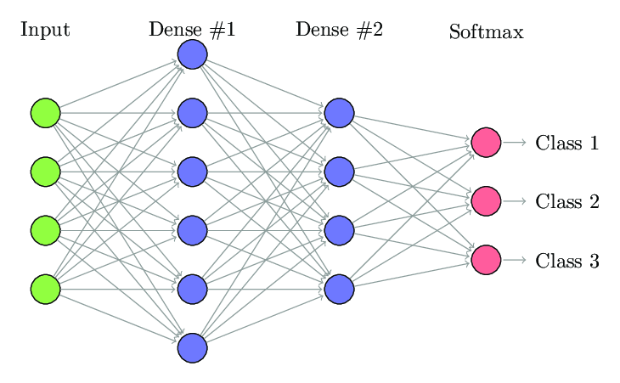
Some problems
So far, we’ve looked only at fully-connected, feed-forward neural networks
These are really good at finding mappings between some input layer and some output classes
We can use these for a bunch of similar purposes, all of which are essentially a kind of classification
Document classification
Genre, sentiment, author
Word embeddings
Context vs not-context

Slide 5
Some problems
Take five minutes to discuss the following questions in pairs
What simplifying assumptions about language do we make when using this kind of NN?
How do these assumptions relate to your intuitions (or knowledge) of how language actually works?
What kind of linguistic phenomena could be particular challenging to model? Why?

Slide 6
Main issues
Input layer needs to be of fixed dimensionality
Necessarily entails loss of information
Essentially static
Does not account for the fact that language has internal structure
Even word2vec fails here – only context vs not-context
Language is sequentially ordered – previous words are relevant for predicting next words
My favourite food is ____ but I don’t like ___

Slide 7
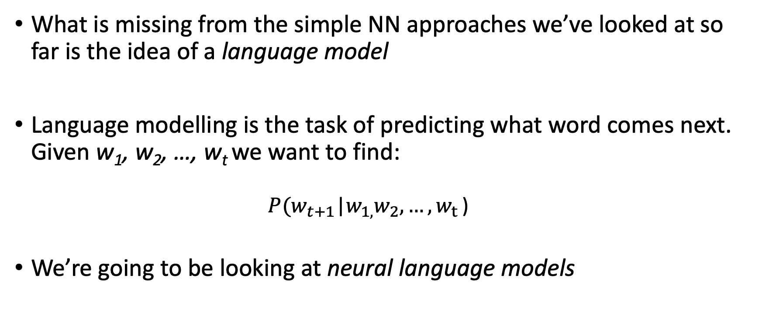
Language modelling
What is missing from the simple NN approaches we’ve looked at so far is the idea of a language model
Language modelling is the task of predicting what word comes next. Given w₁, w₂, …, w_{t} we want to find:
$$P(w_{t+1}\text{|}w_{1,}w_{2}{,…,w}_{t}\text{)}$$
We’re going to be looking at neural language models

Slide 8
Language modelling
For any domain of cognition, we never really start from scratch at any given point
Consider the previous example:
My favourite food is ____ but I don’t like ___
What kind of thing can fill the first blank? What about the second?

Slide 9
Language modelling
For any domain of cognition, we never really start from scratch at any given point
Consider the previous example:
My favourite food is ____ but I don’t like ___
What kind of thing can fill the first blank? What about the second?
My favourite food is pizza but I don’t like mushrooms ✅
My favourite food is pizza but I don’t like elephants ❌

Slide 10
Language modelling
So our knowledge of the preceding text constrains the possible options for filling the second slot
We seem have some kind of cognitive language model which allows us to make these predictions online
Check out the field of (computational) psycholinguistics for work in this area
What we need from a deep learning perspective is some way of learning from previous states in order to predict new ones

Slide 11
Who cares?
LMs are a subcomponent of many NLP tasks, especially those involving generating text or estimating the probability of text:
Named entity recognition
Part-of-speech taggers
Predictive typing and spelling/grammar correction
Text summarization
Speech recognition
Handwriting recognition
Machine translation
Text summarization
Dialogue and question answering

Slide 12
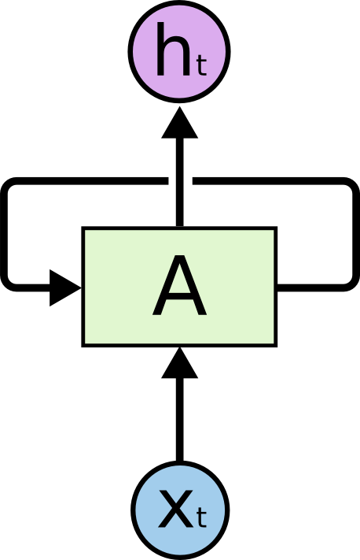
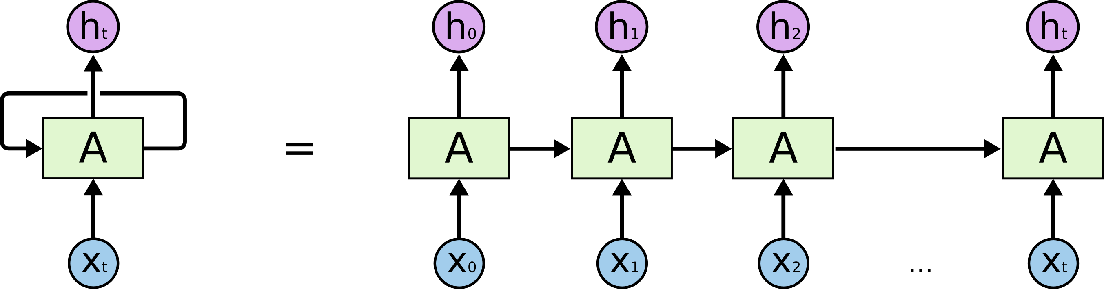
Recurrent Neural Networks
A proposed solution to the problem was what are known as recurrent neural networks
In a vanilla RNN, you can see that the network A looks at input x_{t} and outputs some value h_{t}
But it also loops the output back into the network
We can unroll the loop and get the visualisation on the bottom

Slide 13
Recurrent Neural Networks
What is happening here is that at each step the network is attending to the given input and the output from the preceding state
RNNs introduce a hidden state into the network which is passed along the chain sequentially
So RNNs =/= LM but they are a very good way to build LMs.

Slide 14
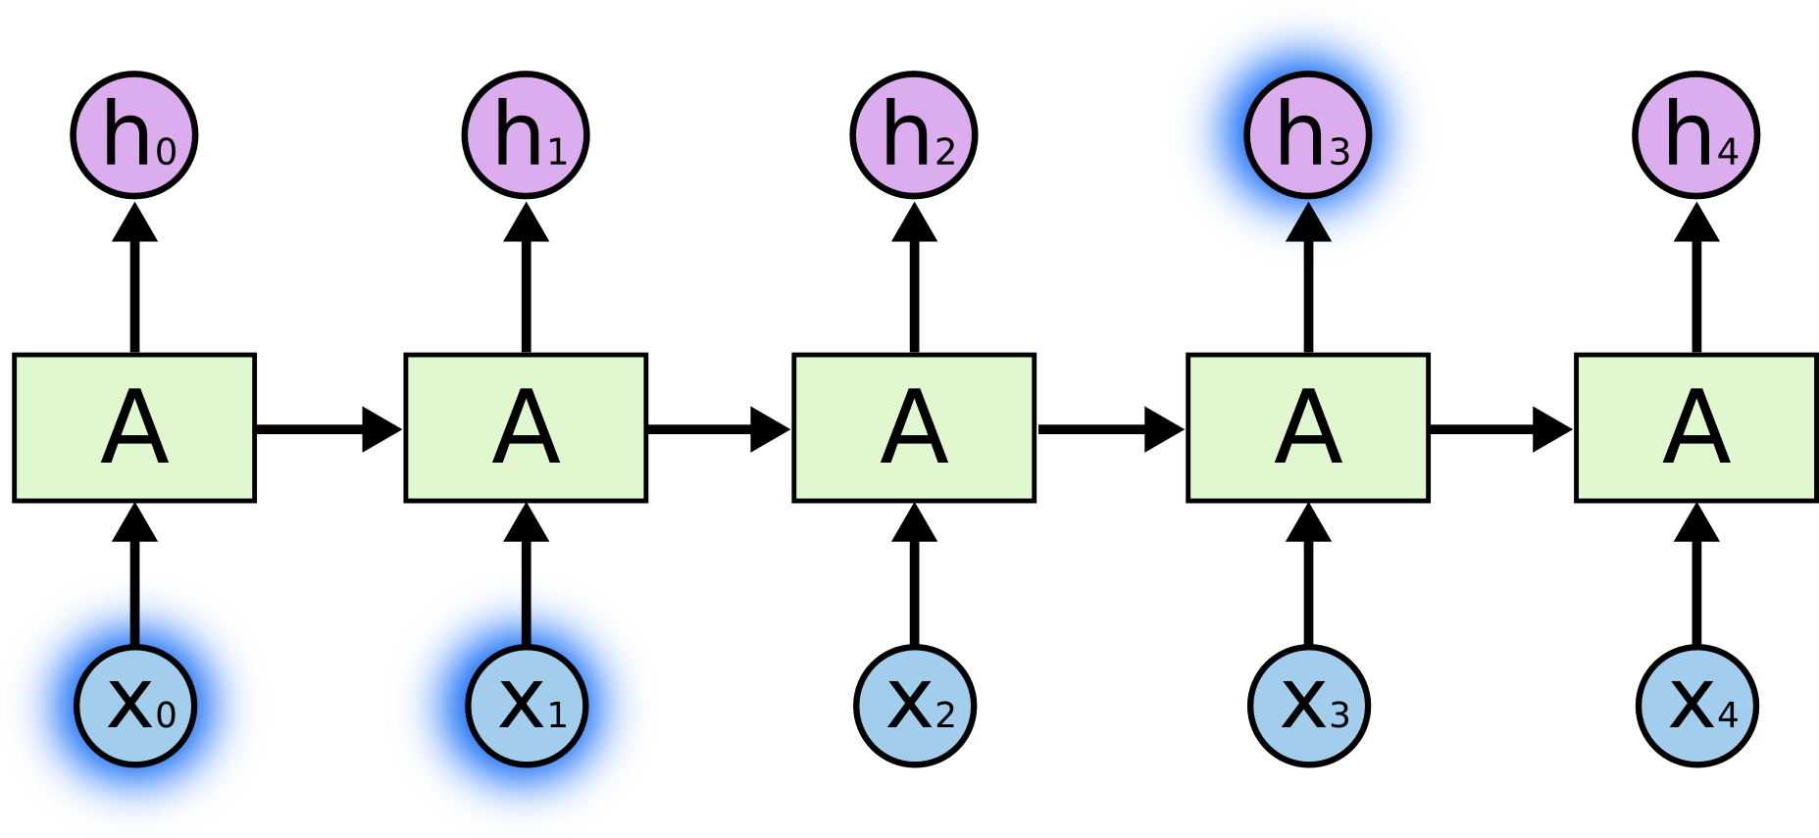
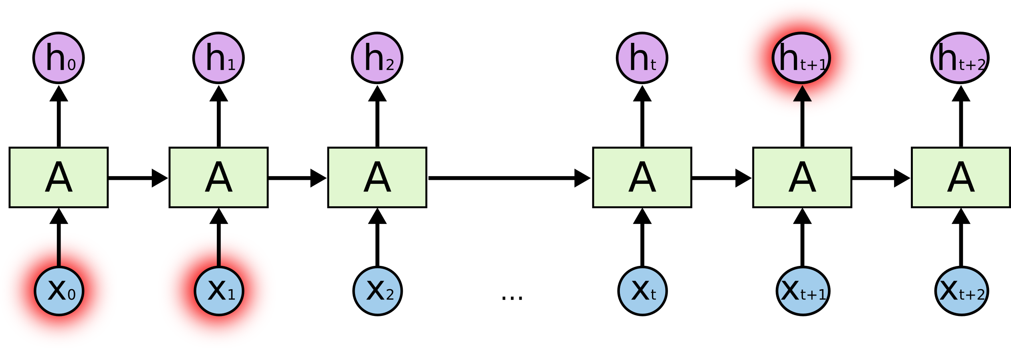
Recurrent Neural Networks
Consider this example:
There are clouds in the ____
An RNN LM would find this easy because of the short distance between the relevant information and the empty slot
But some cases are more complex:
I grew up in France. That is the reason that I speak fluent ____
In this case, the distance is much greater
In practice, as these distances grow, RNNs become less and less able to learn

Slide 15
Recurrent Neural Networks
This is a just another occurrence of the vanishing gradients problem
As errors are propagated back through time, they become increasingly small
Bengio et al (1994) showed that this is an inherent problem with the basic RNN architecture and not something which is easily solved
… but it has kind of been solved!

Slide 16
Break

Slide 17
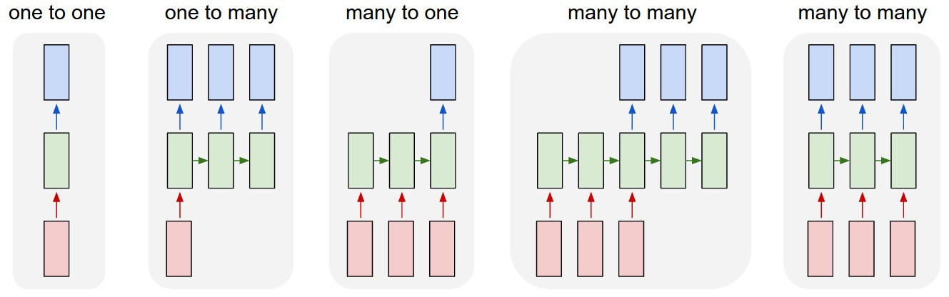
What can RNNs do?
From Karpathy 2015
Notes:
(1) Vanilla mode of processing without RNN, from fixed-sized input to fixed-sized output (e.g. image classification).
(2) Sequence output (e.g. image captioning takes an image and outputs a sentence of words).
(3) Sequence input (e.g. sentiment analysis where a given sentence is classified as expressing positive or negative sentiment).
(4) Sequence input and sequence output (e.g. Machine Translation: an RNN reads a sentence in English and then outputs a sentence in French).
(5) Synced sequence input and output (e.g. video classification where we wish to label each frame of the video).

Slide 18
Problems with RNNs
Variant of the vanishing gradient problem
Words from long ago have less of an impact
Problem - long distance dependencies which are really common in language
Unidirectional
Assumes that only the preceding words are relevant to predict a target
Problem - we often revise our interpretations of language and update our initial parse based on context that comes after a target
So RNNs seem to solve the problem of static networks by introducing sequential modelling - but this modelling has both computational and empirical flaws

Slide 19
A special kind of RNN
A special kind of RNNs capable of learning long-term dependencies is what are known as Long Short Term Memory networks
We’ll call them LSTMs
We’ll look a little at the LSTM architecture right now, primarily using visualisations
Check out the additional reading for some awesome blogs which describe LSTMs (and from whom I’ve stolen visualisations)
More detailed discussion of the maths involved can be found in the reading list

Slide 20
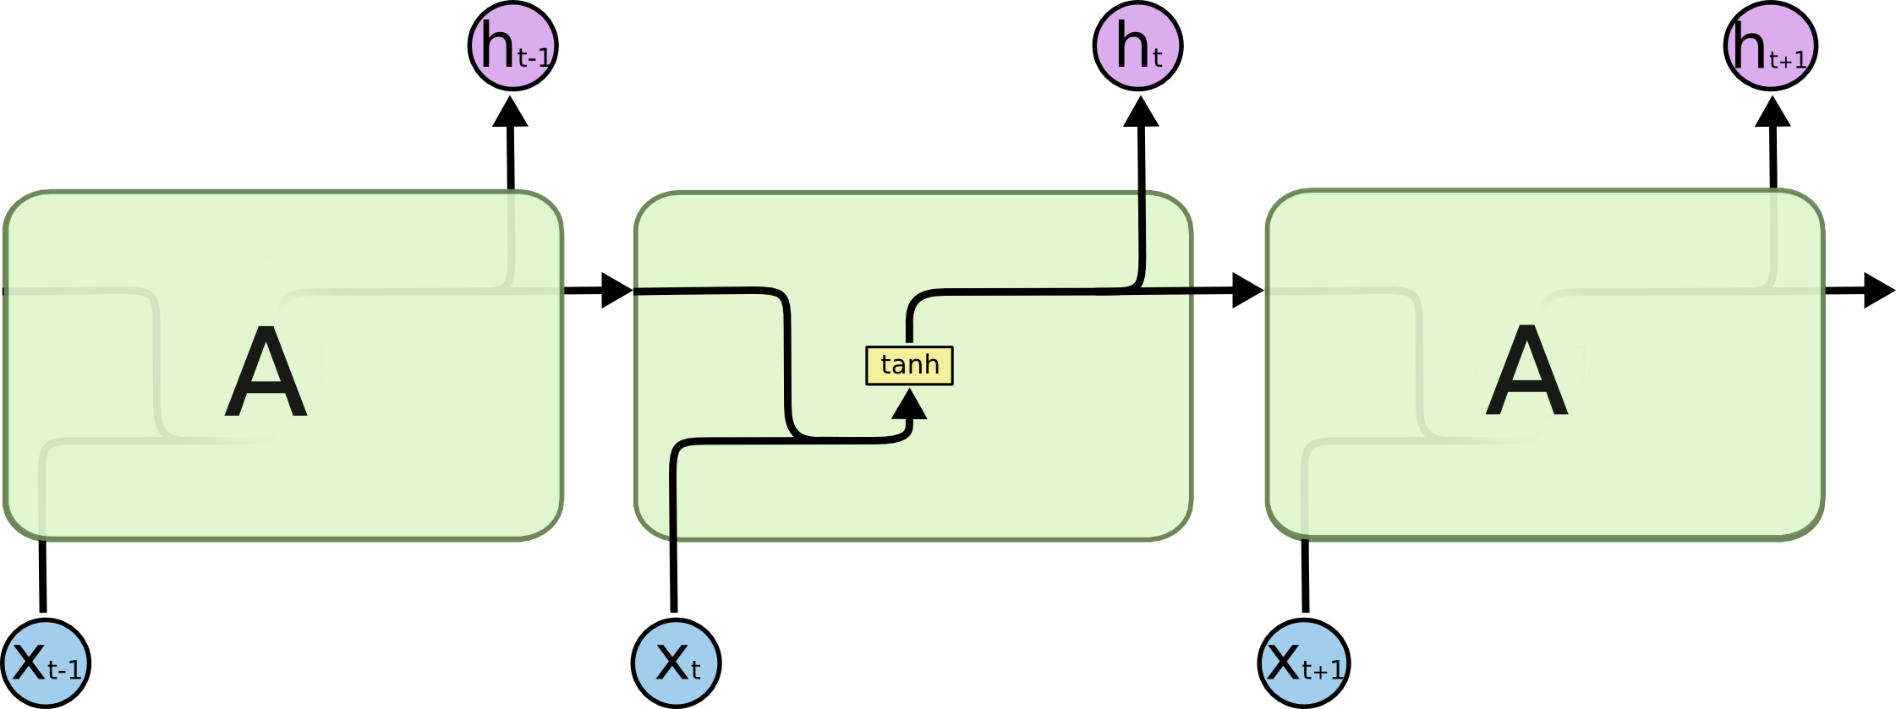
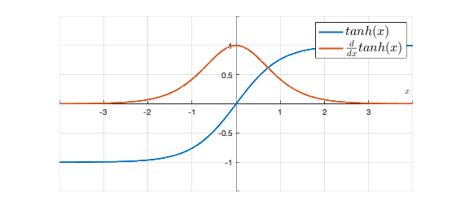
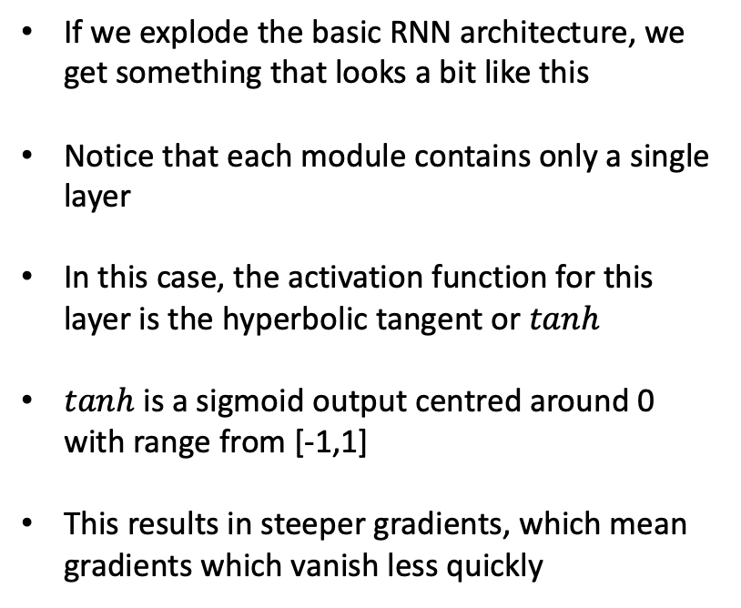
Inside an RNN
If we explode the basic RNN architecture, we get something that looks a bit like this
Notice that each module contains only a single layer
In this case, the activation function for this layer is the hyperbolic tangent or $tanh$
$tanh$ is a sigmoid output centred around 0 with range from [-1,1]
This results in steeper gradients, which mean gradients which vanish less quickly

Slide 21

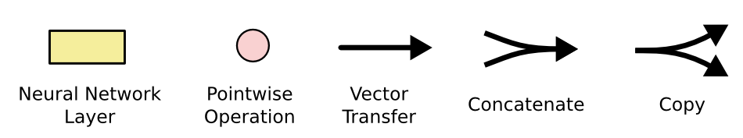
LSTMs
The basic architecture of the LSTM is essentially the same
The major difference is tthat each module now has four interacting layers
These layers define what information should be kept and what should be disregarded
Just remember it’s only a box of maths!

Slide 22
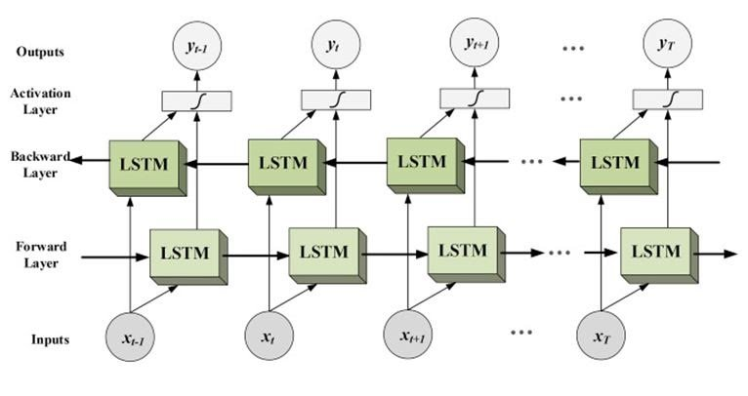
Bi-Directional LSTMs
LSTMs come in many different flavours and styles
One of the most interesting (and most performant for many tasks) are Bi-Directional LSTMs
In this case, we use two LSTM networks simultaneously – one going forward and one going backward
Think about how language works – sometimes we update out interpretations based on later information
The old man the boat
Until the police arrest the gangsters controlled the street.

Slide 23
Summary
Language is sequential and temporarily ordered. Any neural language model has to take account of this
Recurrent neural networks are a good choice for creating neural language models, insofar as they are inherently designed to model sequential data
RNNs suffer from what’s called the vanishing gradient problem and struggle with long-distance dependencies which are frequent in natural language
Long short term memory (LSTM) networks address this problem by adding a combination of different gates which regulate how information is passed along the chain of modules
Bi-directional LSTM models traverse the input data twice, once forward and once backward, with both passes being given equal weighting

Slide 24
Additional reading
Research articles
Bengio, Y., Simard, P.Y., Frasconi, P. (1994). ‘Learning long-term dependencies with gradient descent is difficult’, IEEE Transactions on Neural Networks, 5(2), 157-66.
Futrell, R. & Levy, R.P. (2019). “Do RNNs learn human-like abstract word order preferences?”, Proceedings of the Society for Computation in Linguistics (SCiL) 2019, pp. 50–59.
van Schijndel, M. & Linzen, T. (2021). "Single-stage prediction models do not explain the magnitude of syntactic disambiguation difficulty”, Cognitive Science, 45 (6): e12988. 2021.
Wilcox, E., Levy, R.P., & Futrell, R. (2019). “What Syntactic Structures Block Dependencies in RNN Language Models?”, Proceedings of the 41st Annual Meeting of the Cognitive Science Society, pp. 1199–1205.
Blog posts
Awesome and well-known blog post http://colah.github.io/posts/2015-08-Understanding-LSTMs/
Some nice animated visualisations here: https://towardsdatascience.com/illustrated-guide-to-lstms-and-gru-s-a-step-by-step-explanation-44e9eb85bf21

