Slide 1
Visual Analytics
Session 8: Convolutional Neural Networks
Ross Deans Kristensen-McLachlan
rdkm@cas.au.dk

Slide 2
Course outline
1. Introducing Visual Analytics
2. Basic image processing
3. More image processing
4. Convolutional kernels
5. Image classification 1
6. Image classification 2
7. From shallow to deep learning
8. Convolutional neural networks
9. Pretrained CNNs and transfer learning
10. Image embeddings
11. Project presentations
12. Text-to-image models
13. Project development

Slide 3
Plan for today
General catch-up (& mid-term evaluation)
1. Convolutional Neural Networks
Convolutions
Pooling
Padding and stride
2. Code-along session
CNNs for image classification
Beginning the assignment

Slide 4
Midterm feedback: The good
Pros
Focusing on Python scripting is difficult but rewarding
Code along sessions are the most helpful part of the course
People seem generally happy with the structure and content

Slide 5
Midterm feedback: The not-so-good
Often difficult to follow where things are
Slides on Brightspace
Comms on Slack
Lesson plans on Github
Assignments on Github classrooms
Class is challenging, both theory and practice

Slide 6
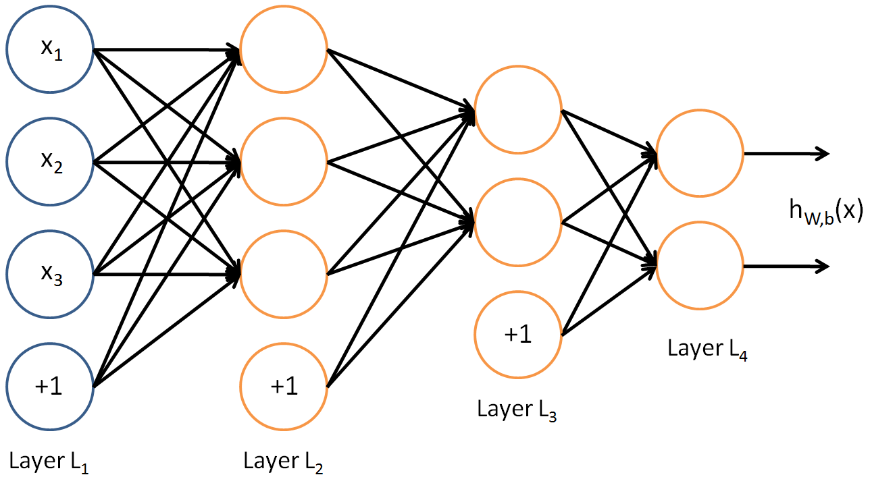
More on neural networks
So far we’ve been working with fairly simple feed-forward neural networks
We’ve seen that these networks take an input layer and pass it through a series of hidden layers
The model uses backpropagation of errors to minimise loss in the network, learning weights as it goes
These weights allow us to map the input layer onto our output (prediction) layer in a non-linear way

Slide 7
More on neural networks
These models can be unreasonably effective – we saw accuracies of around 98% on MNIST
However, in terms of image data, MNIST is pretty simple – uniform size and only 1 colour channel
This means that the images can be flattened and used as the input layer of a neural network with no issues
Why might this be a problem when we come to work with ‘real’ image data?

Slide 8
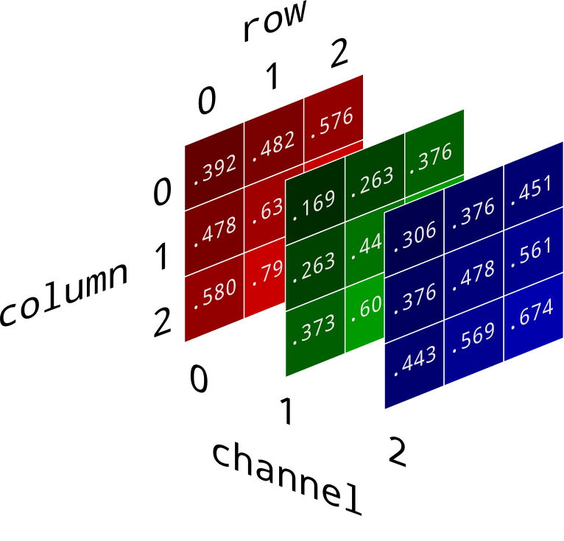
More on neural networks
Colour images do not have only 1 ‘dimension’
Instead, we have multiple colour channels, each of which encodes information
We can flatten these channels into a single greyscale colour space – think back to how we did this with histograms, for example
However, doing so necessarily results in some kind of information loss
Ideally, what we want is a deep learning model which can take into account the fact the image data has three colour channels, each of which is meaningful

Slide 9
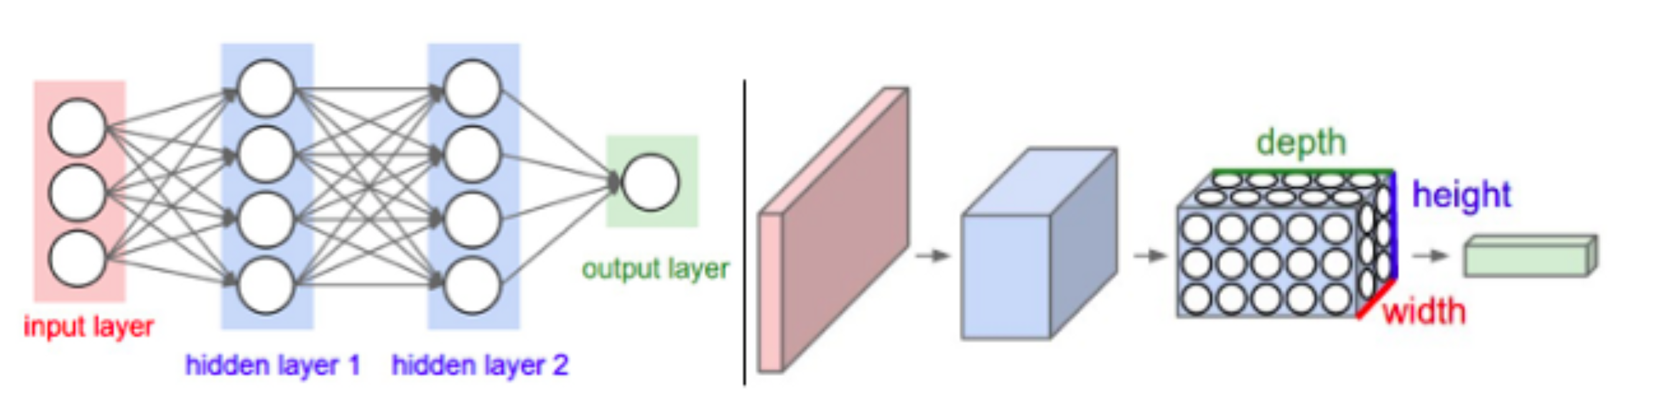
Convolutional neural networks
CNNs do exactly this!
CNNS can be designed to take advantage of the fact that the data consists of images
The architecture can then be constrained in more sensible ways
A ConvNet arranges its neurons in three dimensions (width, height, depth)
Hence a tensor of weights
Every layer of a ConvNet transforms the 3D input volume to a 3D output volume of neuron activations.

Slide 10
What actually are CNNs?
CNNs consist of layers, just like other neural networks
The layers are a little bit different to what we’ve already seen
There are four main layer types
Convolutional layer
Pooling layer
Activation layer
Fully connected layer
You might not think it but you already know how all of this works!

Slide 11
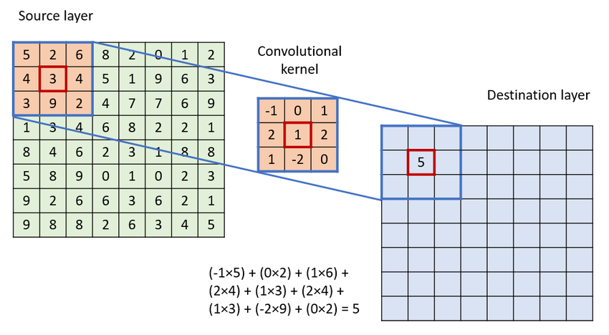
Convolutional layers
We’ve already studied convolutions when we looked at image processing
We used predefined convolutional kernels to perform operations on images
Different kernels perform different functions and extract different features
Blurring
Edge detection
Put simply, we take an input layer, pass it through a convolutional kernel, and that gets fed to the next layer

Slide 12
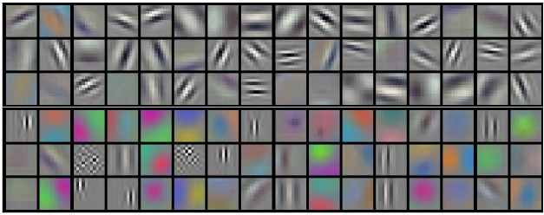
Convolutional layers
This means that CNNs are able to learn more complex kernels than the kind we are used to
More complex kernels means that the extracted features are more abstract
The image to the right shows 96 kernels of shape [11, 11, 3]
Not only the model learned things like vertical and horizontal edge detection, its also learned about specific regions of colour in the images

Slide 13
Pooling layers
In order to achieve the best results, CNNs usually comprise multiple convolutional layers
In contrast to the other kinds of neural networks we’ve looked at, CNNs actually perform substantially better the deeper they become
This means that the output from the convolved layer is fed forward into another convolutional layer through an activation layer like ReLU

Slide 14
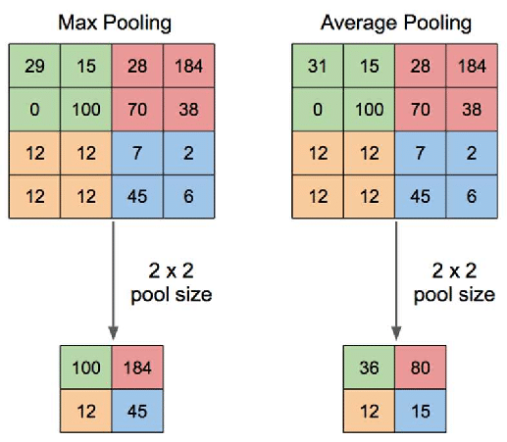
Pooling layers
In order to extract the most information from the convolutional layer, we introduce what are called pooling layers
We pool the results of our convolutional layer together and then compress the feature space further
Common ways of doing this is to take the maximum value within a defined area; or the take the average of the whole area
These pooled layers are then fed forward into the next convolutional layer

Slide 15
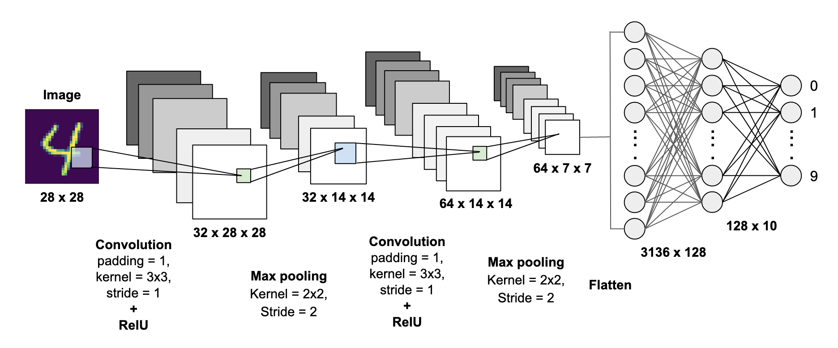
A sample architecture

Slide 16
Break

Slide 17
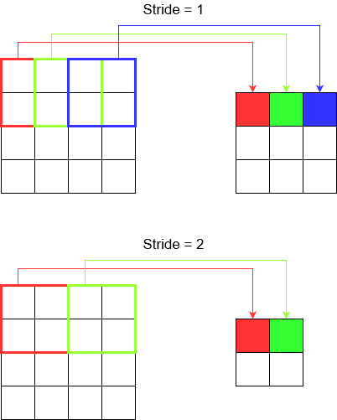
Stride and padding
We’ve looked briefly at the concepts of stride and padding previously when doing image processing –we won’t dwell too much on them here
We saw how using convolutional kernels for feature extract involved moving the kernel over the image in a stepwise manner
The size of each ‘step’ is called the stride
Q: how might different strides affect the convolved layer?

Slide 18
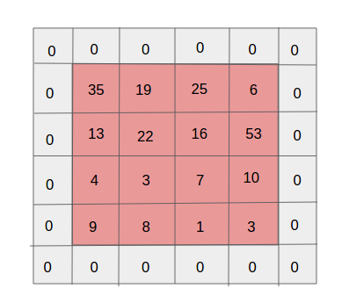
Stride and padding
Given the kernel size and stride that you choose, it might be that there is a conflict with the shape of your image
For example, if your kernel is odd numbers such as (3,3) and your image is even shape like (32,32) your kernel might ‘overshoot’ the end of the image
To get around this, we simply pad the image with an extra set of rows and columns, commonly just zeroes
This means that we can work with any kernel size and any stride, regardless of image shape
Q: why does it make sense to add zeroes?

Slide 19
Fully-connected layers
The input data works through number of convolutional layers, activation layers, and pooling layers
CNNs can be arbitrarily deep!
The end results CNN has learned a number of dense, highly informative feature kernels
If we have a classification task, our final step is to flatten the final pooling layer and use that as the input for a fully-connected, feed-forward neural network
CNNs are therefore used to perform complex, unsupervised feature extraction on image data – but the final classification layer remains familiar!

Slide 20
Putting it all together

Slide 21
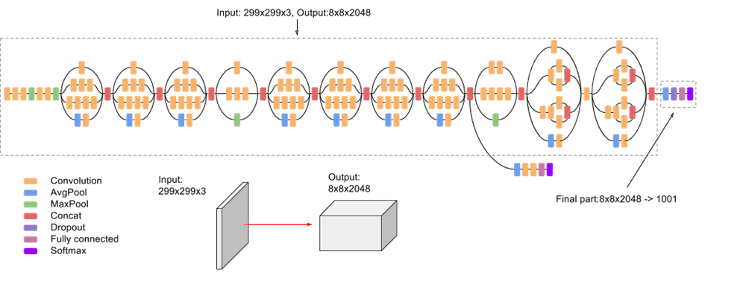
Putting it all together

Slide 22
Summary
Convolutional neural networks can take image data as an input layer without the need for flattening into a greyscale colour space
This means they can learn features that are more appropriate to the study of image data
CNNS sound complicated and their architecture can end up be quite baroque
At root, though, a CNN is a just a stack of layers each of which has a slightly different function
Before today, you already knew how each of these layers works in principle!

Slide 23
Break
And head over to UCloud

