Slide 1

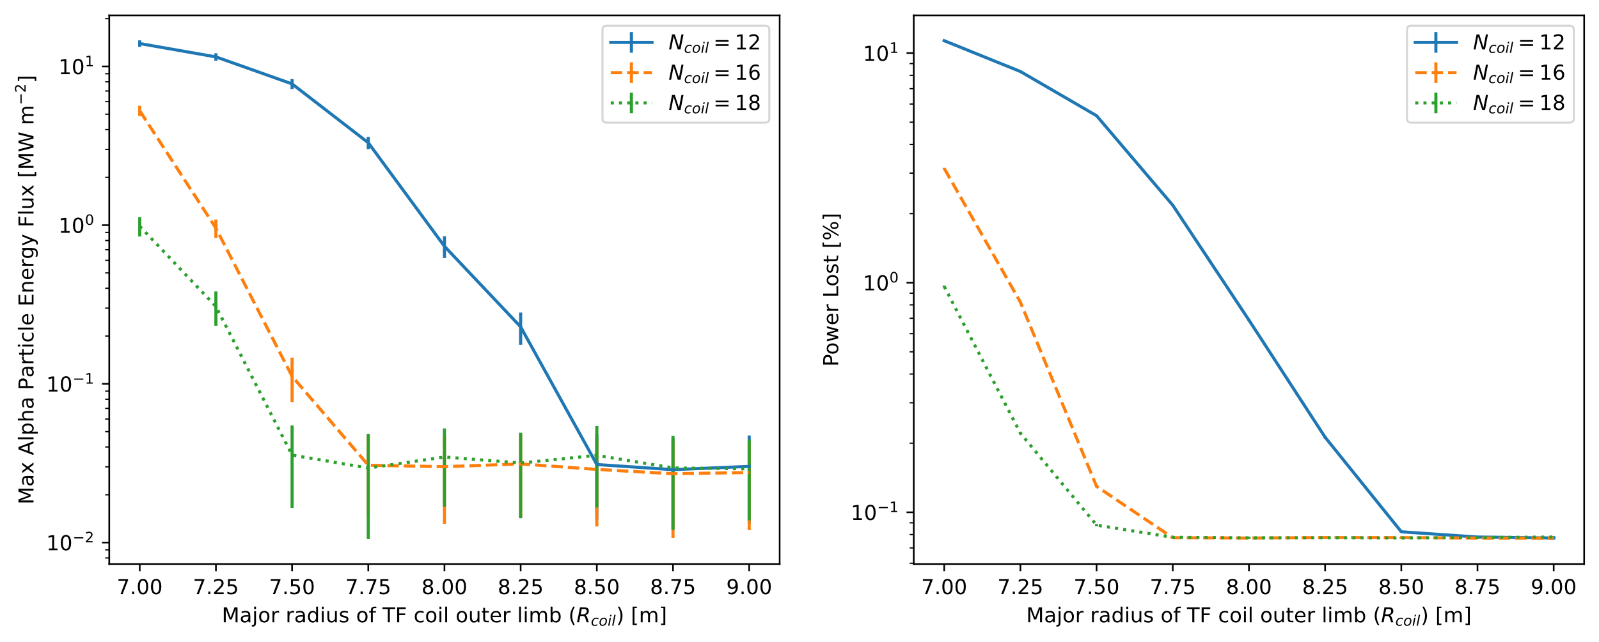
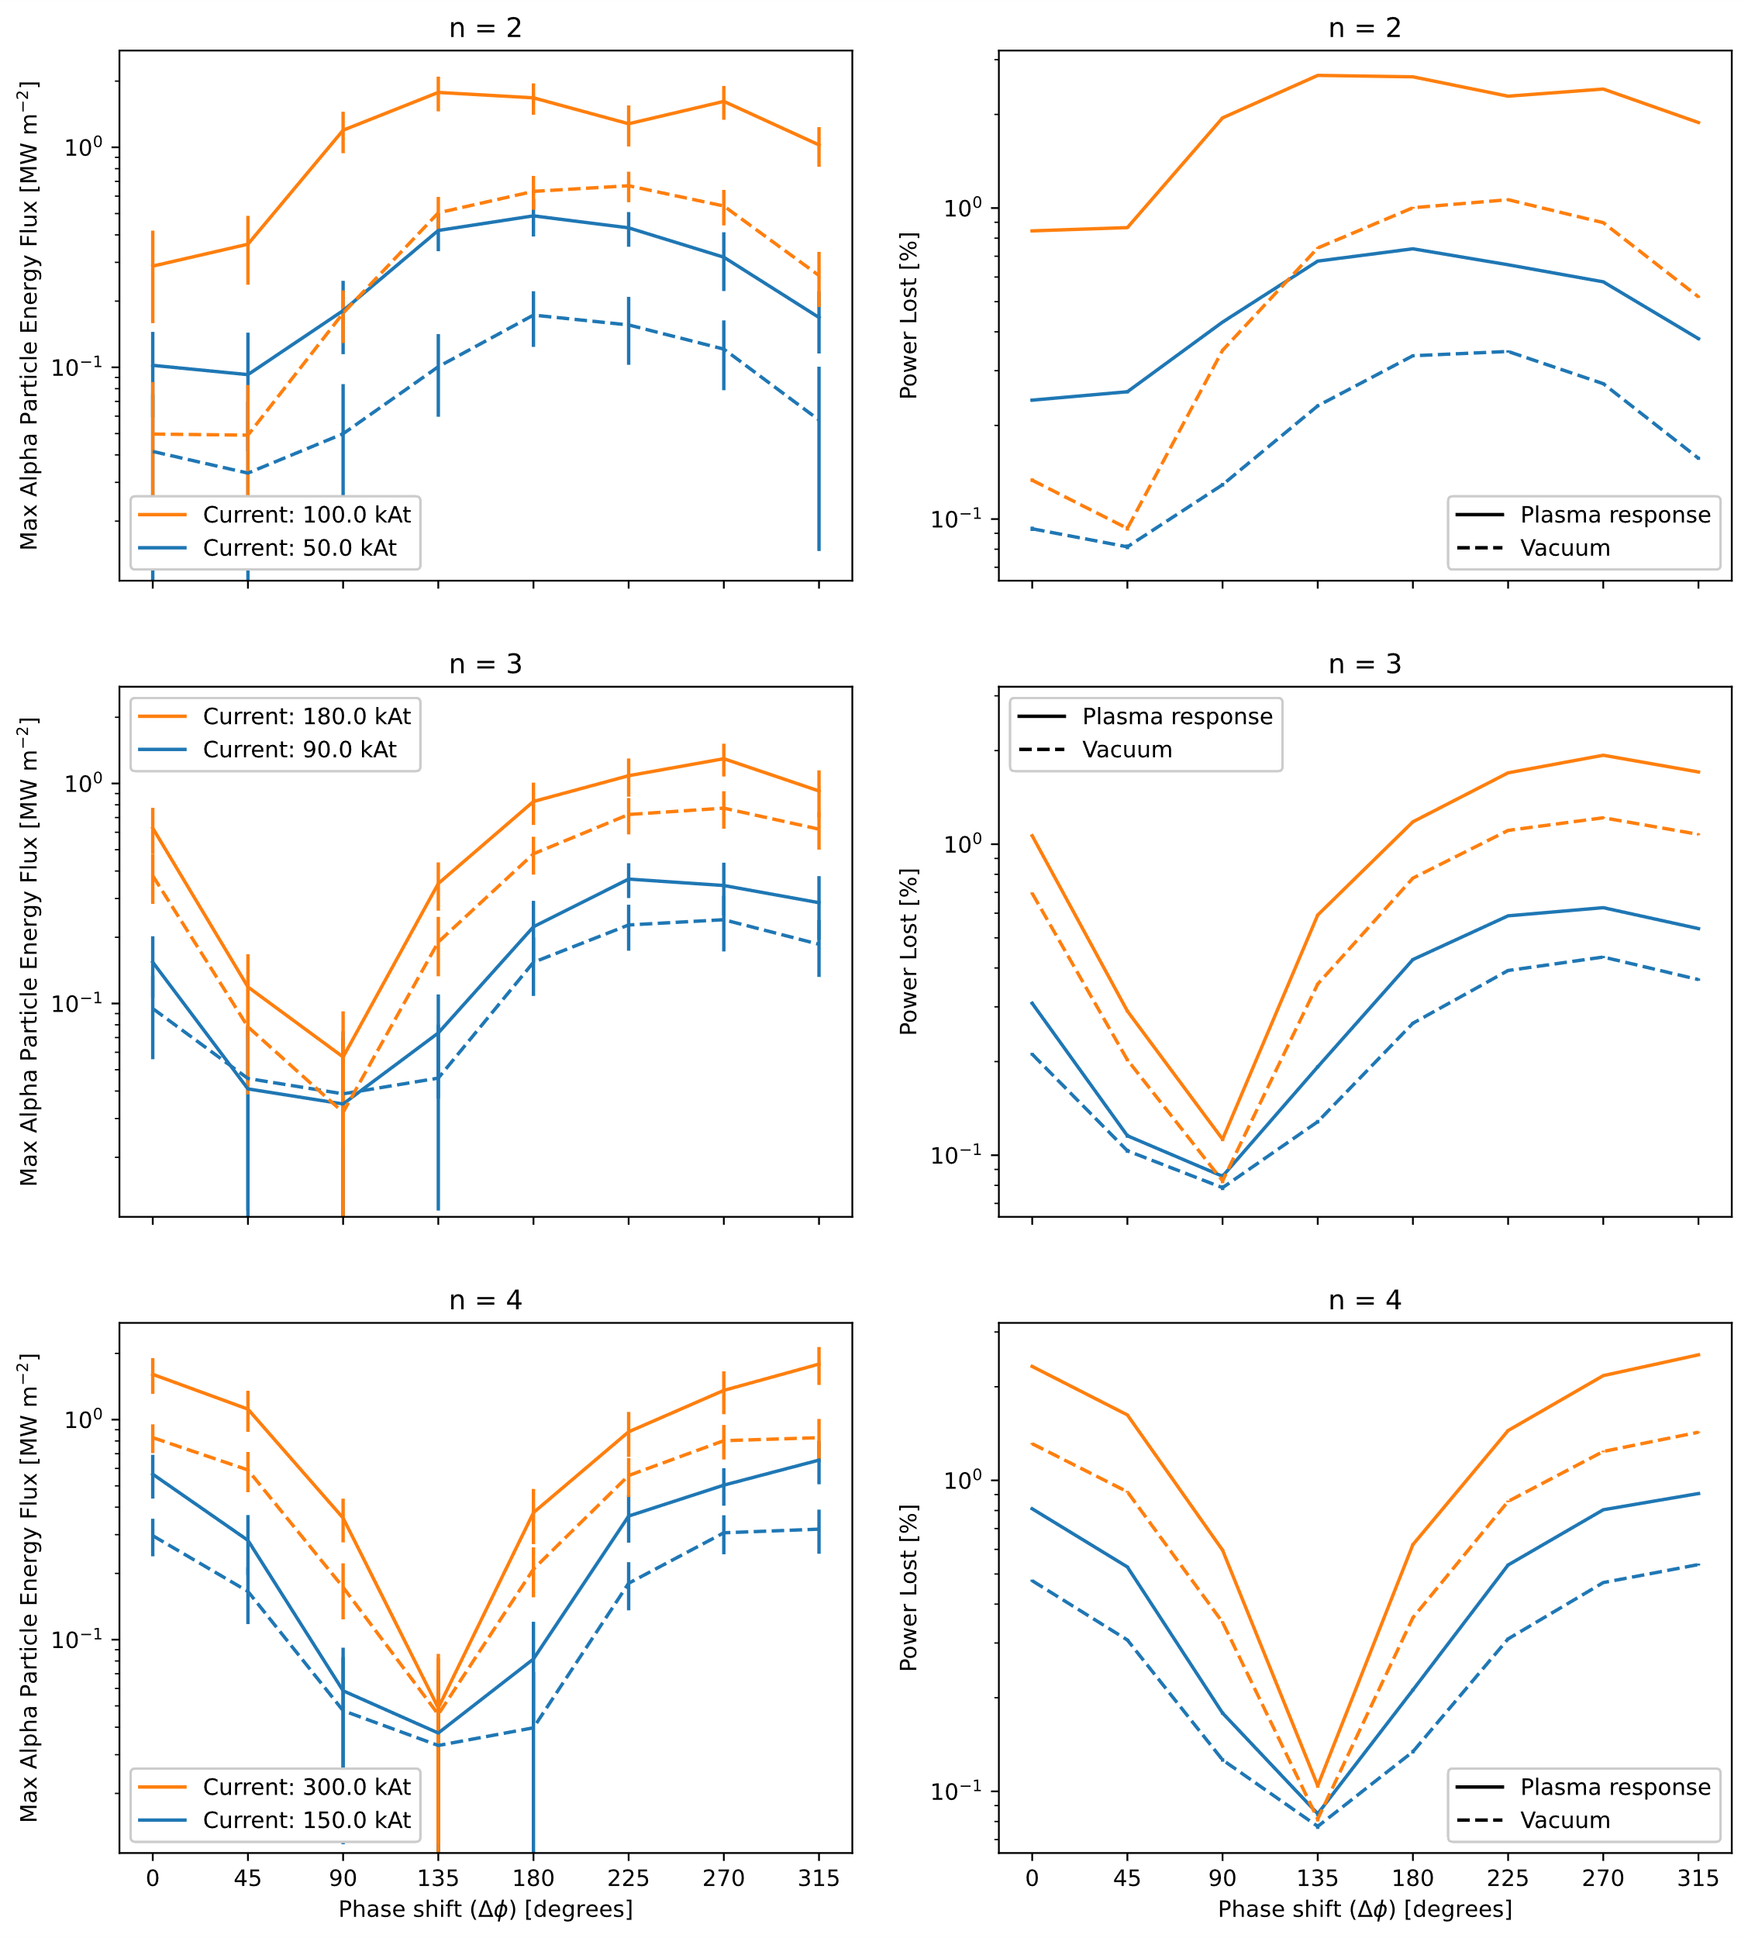
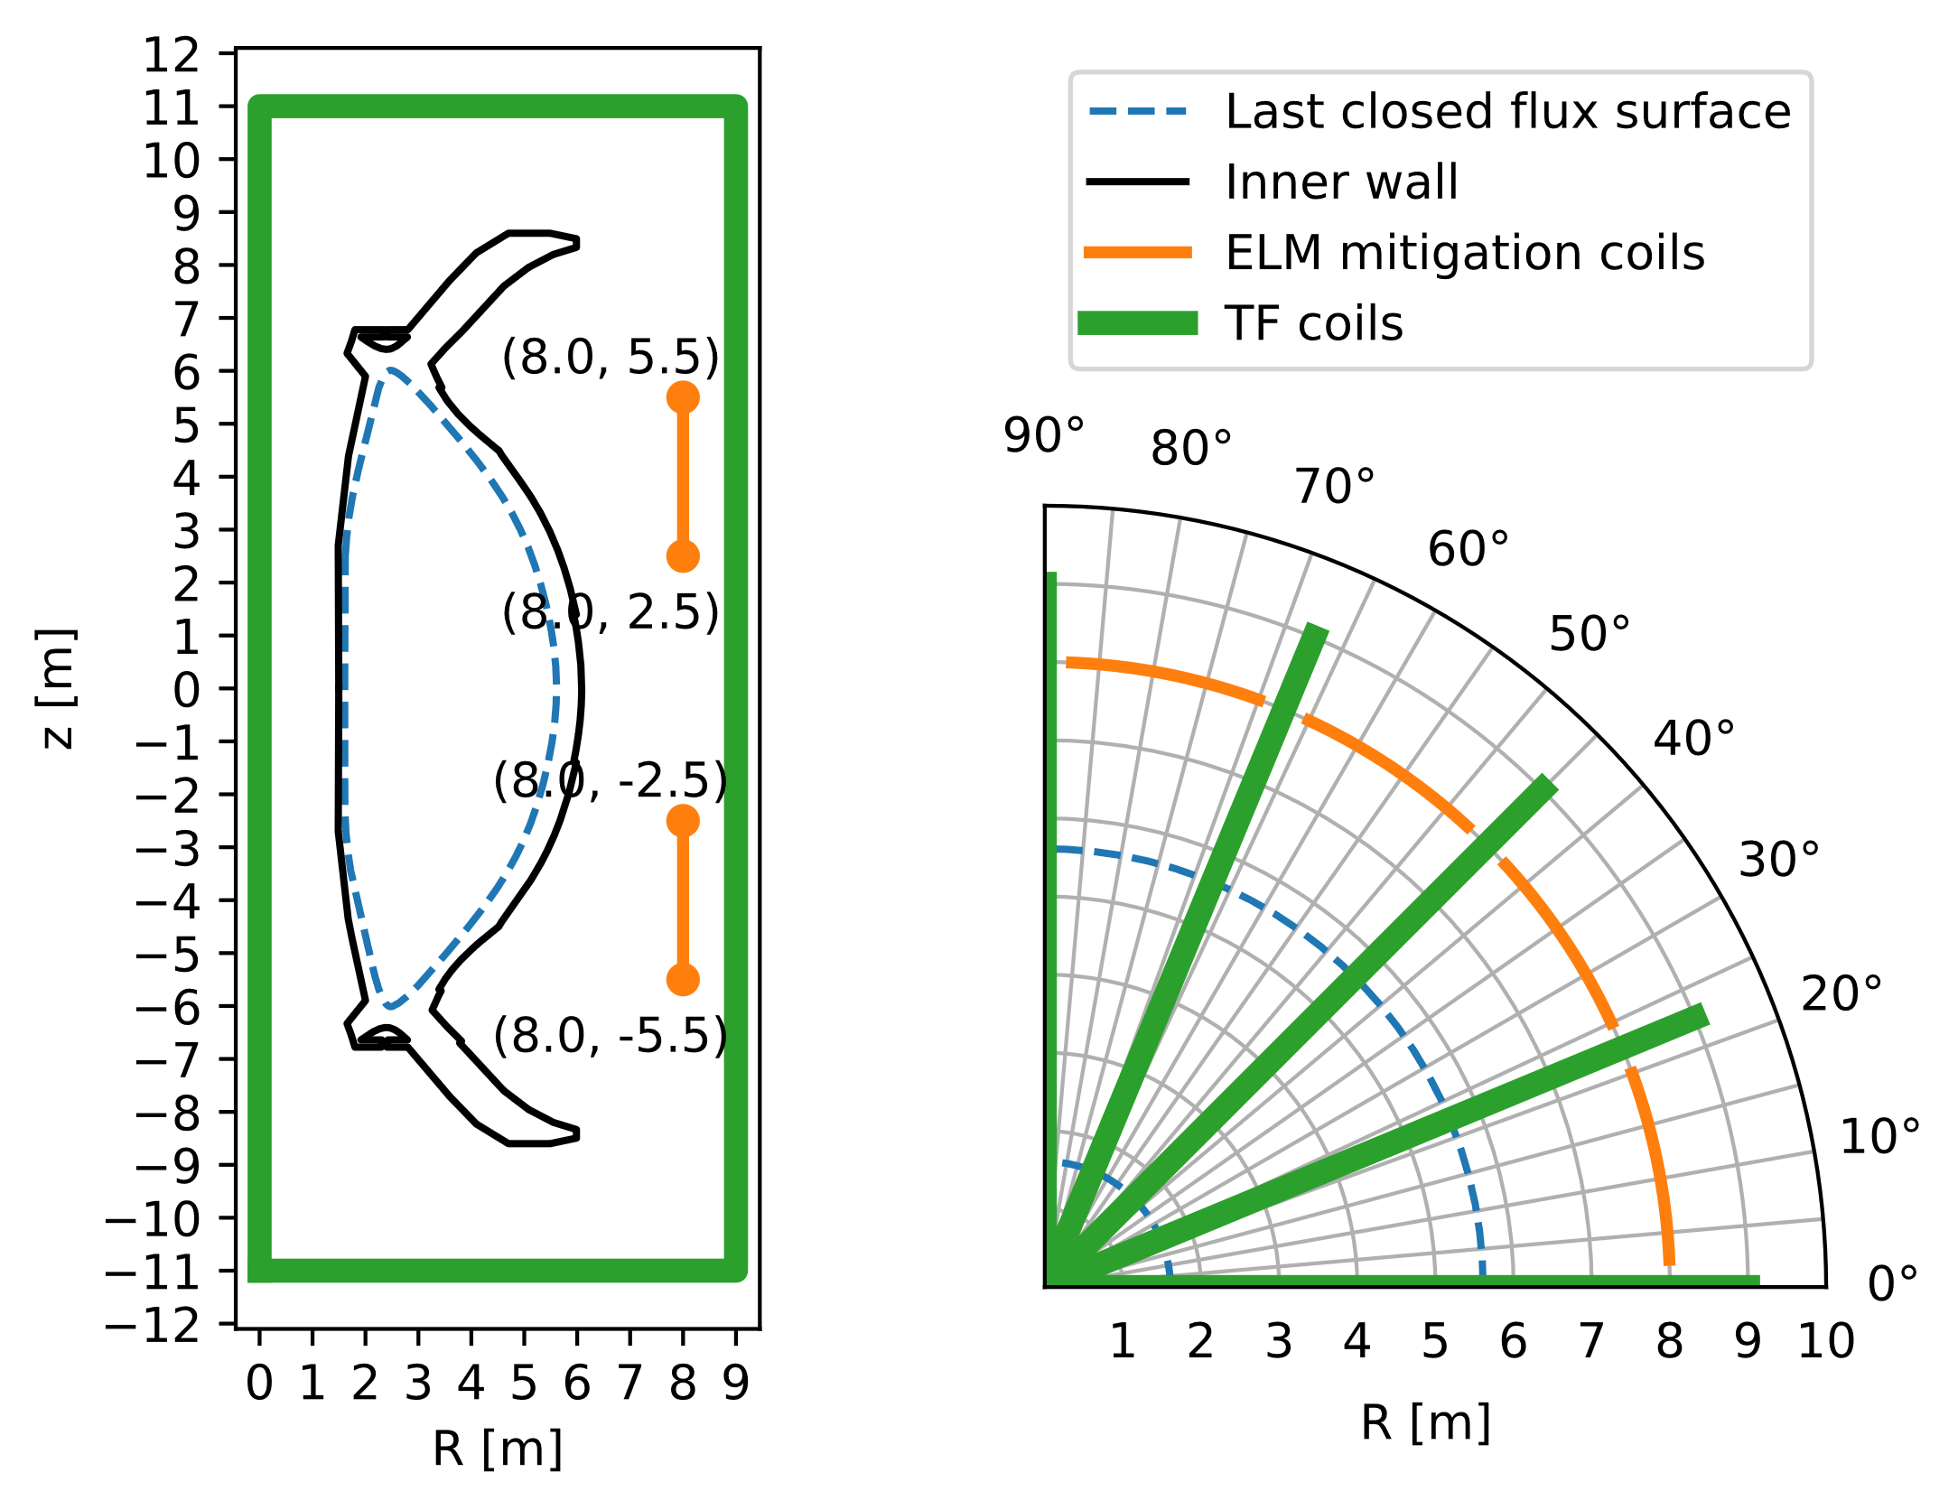
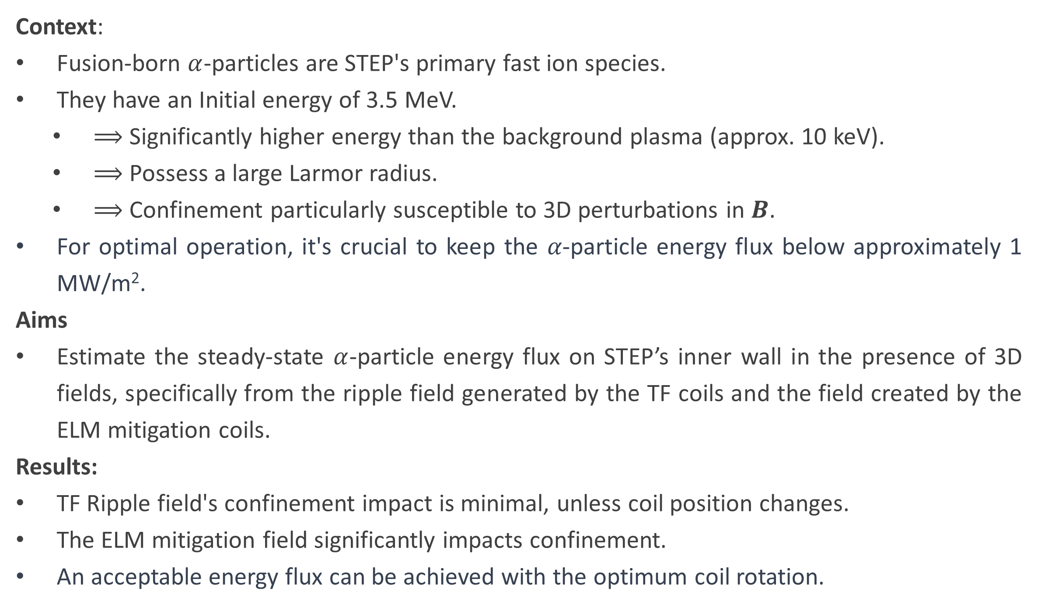
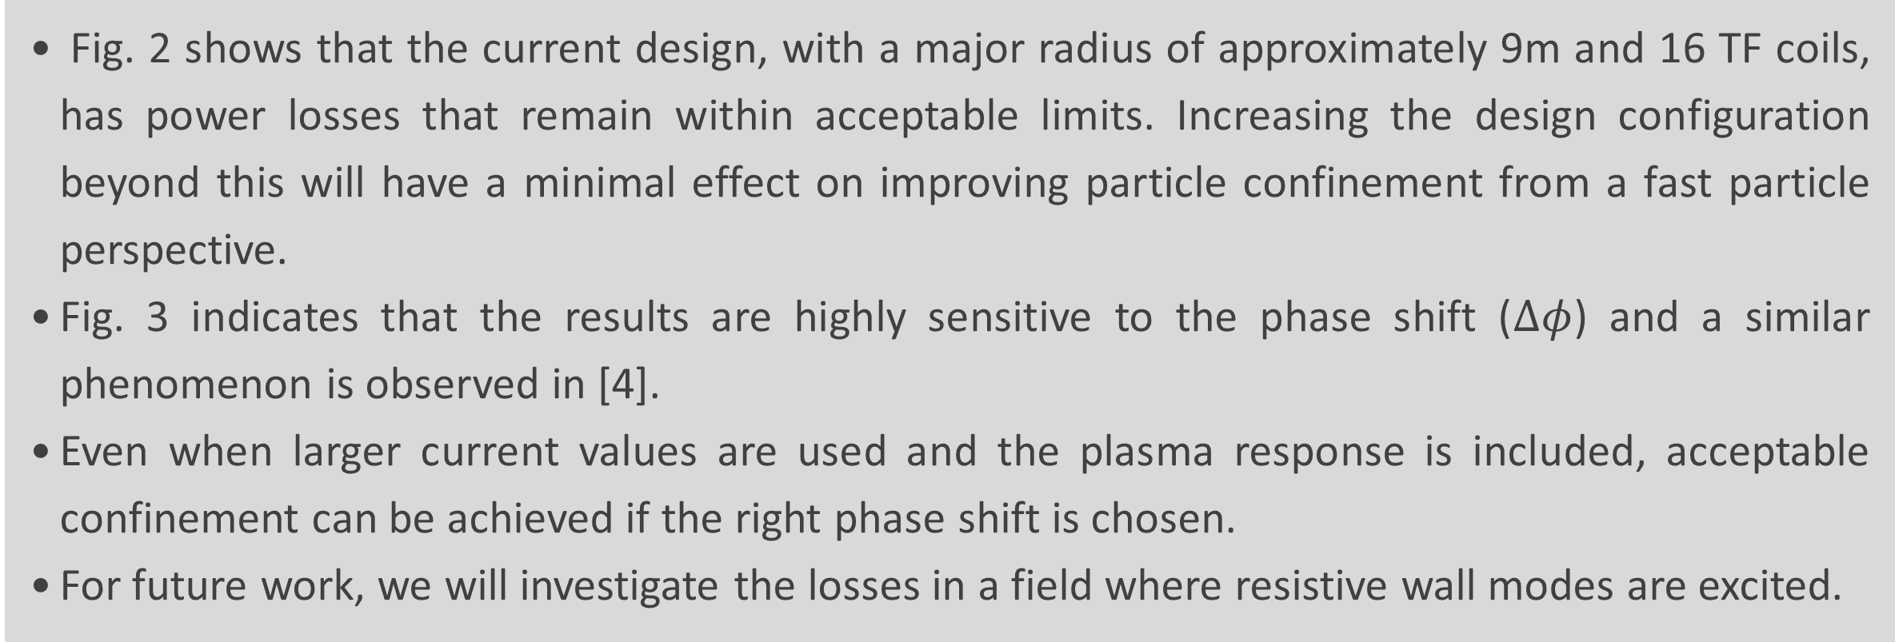
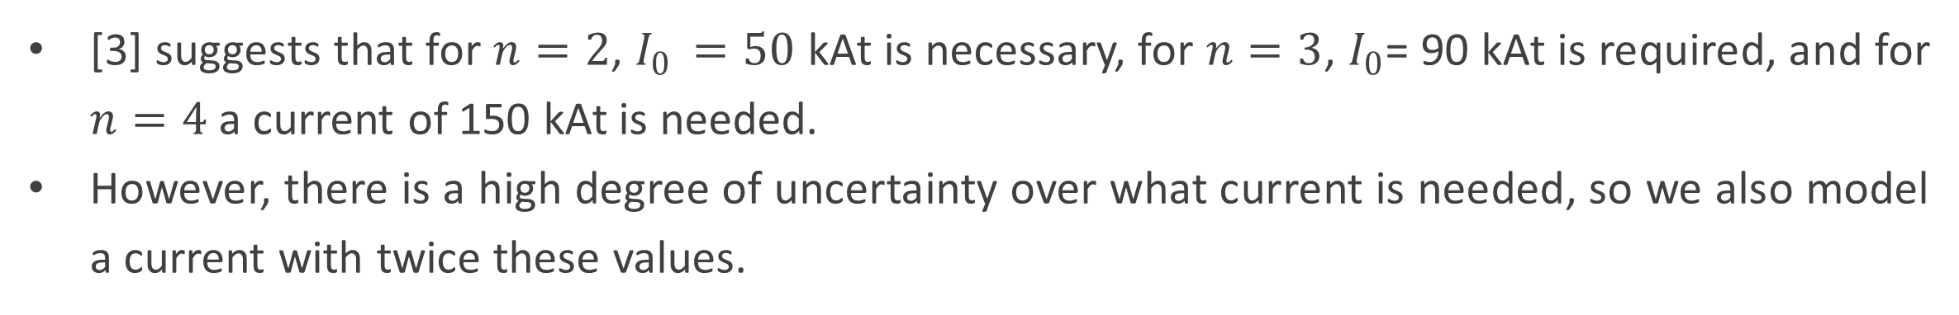
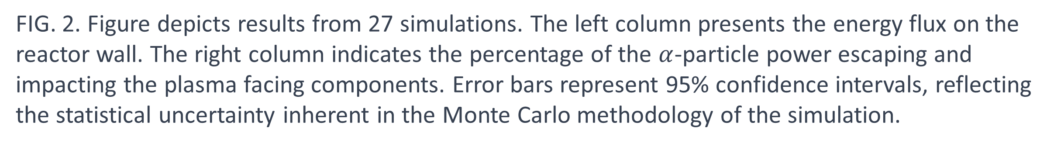
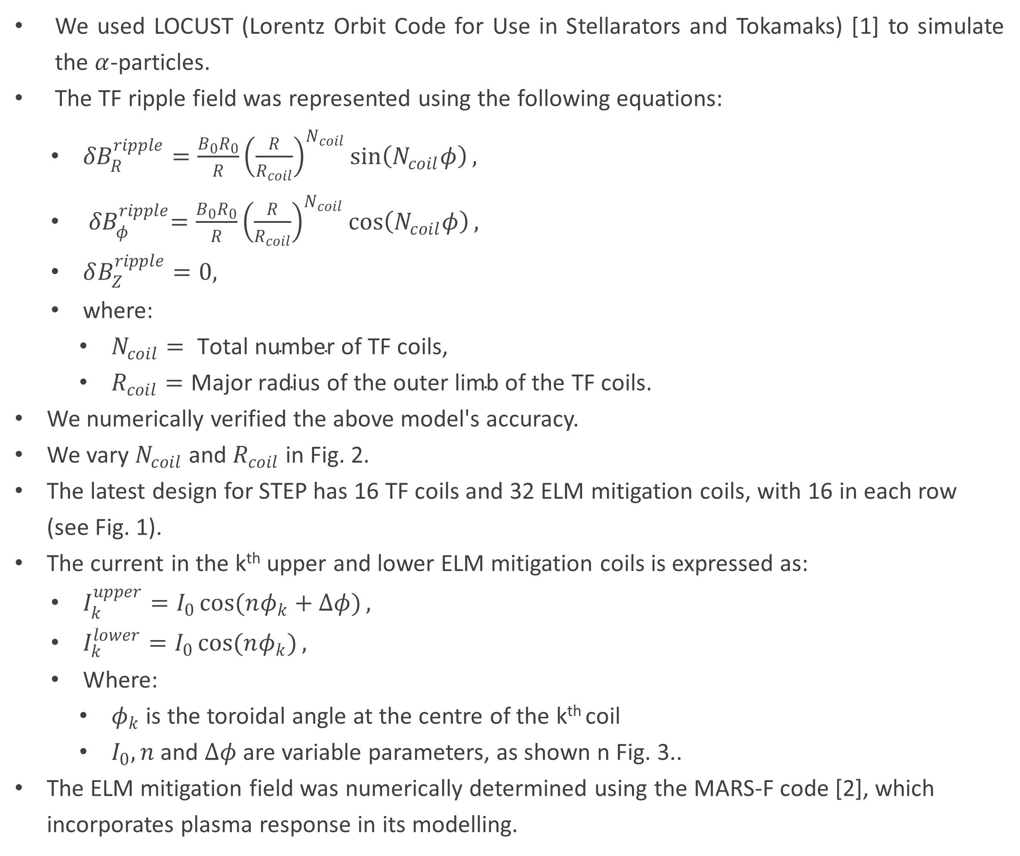
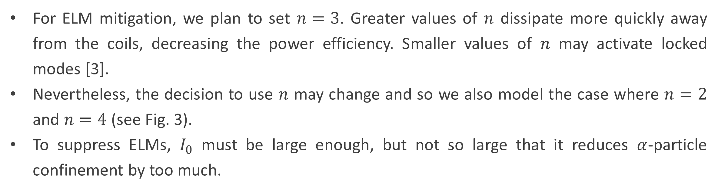
Confinement of Fusion α-Particles and Alfvén
Eigenmode Stability in STEP
A. P. K. Prokopyszyn, K. G. McClements, H. J. C. Oliver, M. Fitzgerald, D. A. Ryan, G. Xia
United Kingdom Atomic Energy Authority (UKAEA)
alex.Prokopyszyn@ukaea.uk
ID:2143
ABSTRACT
[3] suggests that for $n=2$, $I_{0 }=50$ kAt is necessary, for $n=3$, $I_{0}$= 90 kAt is required, and for $n=4$ a current of 150 kAt is needed.
However, there is a high degree of uncertainty over what current is needed, so we also model a current with twice these values.
Context:
Fusion-born $α$-particles are STEP's primary fast ion species.
They have an Initial energy of 3.5 MeV.
$⟹$ Significantly higher energy than the background plasma (approx. 10 keV).
$⟹$ Possess a large Larmor radius.
$⟹$ Confinement particularly susceptible to 3D perturbations in $B$.
For optimal operation, it's crucial to keep the 𝛼-particle energy flux below approximately 1 MW/m².
Aims
Estimate the steady-state $α$-particle energy flux on STEP’s inner wall in the presence of 3D fields, specifically from the ripple field generated by the TF coils and the field created by the ELM mitigation coils.
Results:
TF Ripple field's confinement impact is minimal, unless coil position changes.
The ELM mitigation field significantly impacts confinement.
An acceptable energy flux can be achieved with the optimum coil rotation.
FIG. 2. Figure depicts results from 27 simulations. The left column presents the energy flux on the reactor wall. The right column indicates the percentage of the $α$-particle power escaping and impacting the plasma facing components. Error bars represent 95% confidence intervals, reflecting the statistical uncertainty inherent in the Monte Carlo methodology of the simulation.
METHODS
We used LOCUST (Lorentz Orbit Code for Use in Stellarators and Tokamaks) [1] to simulate the $α$-particles.
The TF ripple field was represented using the following equations:
${δB}_{R}^{ripple}=\frac{B_{0}R_{0}}{R}{\left(\frac{R}{R_{coil}}\right)}^{N_{coil}}\sin\left(N_{coil}φ\right),$
${ δB}_{φ}^{ripple}=\frac{B_{0}R_{0}}{R}{\left(\frac{R}{R_{coil}}\right)}^{N_{coil}}\cos\left(N_{coil}φ\right),$
$δB_{Z}^{ripple}=0,$
where:
$N_{coil}= \text{Total} \text{number} \text{of} \text{TF} \text{coils}\text{,}$
$R_{coil}=\text{Major} \text{radius} \text{of} \text{the} \text{outer} \text{limb} \text{of} \text{the} \text{TF} \text{coils}$.
We numerically verified the above model's accuracy.
We vary $N_{coil}$ and $R_{coil}$ in Fig. 2.
The latest design for STEP has 16 TF coils and 32 ELM mitigation coils, with 16 in each row (see Fig. 1).
The current in the k^{th} upper and lower ELM mitigation coils is expressed as:
$I_{k}^{upper}=I_{0}\cos{(nφ_{k}+Δφ)},$
$I_{k}^{lower}=I_{0}\cos{(nφ_{k})},$
Where:
$φ_{k}$ is the toroidal angle at the centre of the k^{th} coil
$I_{0}, n$ and $Δφ$ are variable parameters, as shown n Fig. 3..
The ELM mitigation field was numerically determined using the MARS-F code [2], which incorporates plasma response in its modelling.
Title of the graphs/figures
FIG. 3. Figure illustrates outcomes from 96 simulations, comparing $α$-particle losses across different ELM mitigation coil parameters. The column arrangement mirrors that of Fig. 2.
CONCLUSION
Fig. 2 shows that the current design, with a major radius of approximately 9m and 16 TF coils, has power losses that remain within acceptable limits. Increasing the design configuration beyond this will have a minimal effect on improving particle confinement from a fast particle perspective.
Fig. 3 indicates that the results are highly sensitive to the phase shift ($Δφ$) and a similar phenomenon is observed in [4].
Even when larger current values are used and the plasma response is included, acceptable confinement can be achieved if the right phase shift is chosen.
For future work, we will investigate the losses in a field where resistive wall modes are excited.
FIG. 1. Schematic representation of STEP's inner wall, LCFS, ELM mitigation coils, and TF coils. The left side depicts a vertical cross-section, while the right provides a top-down view of a quarter section of the reactor.
RESULTS
ACKNOWLEDGEMENTS / REFERENCES
For ELM mitigation, we plan to set $n=3$. Greater values of $n$ dissipate more quickly away from the coils, decreasing the power efficiency. Smaller values of $n$ may activate locked modes [3].
Nevertheless, the decision to use $n$ may change and so we also model the case where $n=2$ and $n=4$ (see Fig. 3).
To suppress ELMs, $I_{0}$ must be large enough, but not so large that it reduces $α$-particle confinement by too much.
This work has been funded by STEP, a UKAEA program to design and build a prototype fusion energy plant and a path to commercial fusion.
[1] WARD, S, et al., Nucl. Fusion, 61 8 (2021) 086029.
[2] LIU, Y., et al., Nucl. Fusion, 55 6 (2015) 063027.
[3] RYAN, D., TD-0014685, internal report, UKAEA, 2022.
[4] SANCHIS, L., et al., Plasma Phys. Control. Fusion, 61, 1, (2018) 014038.

Slide 2
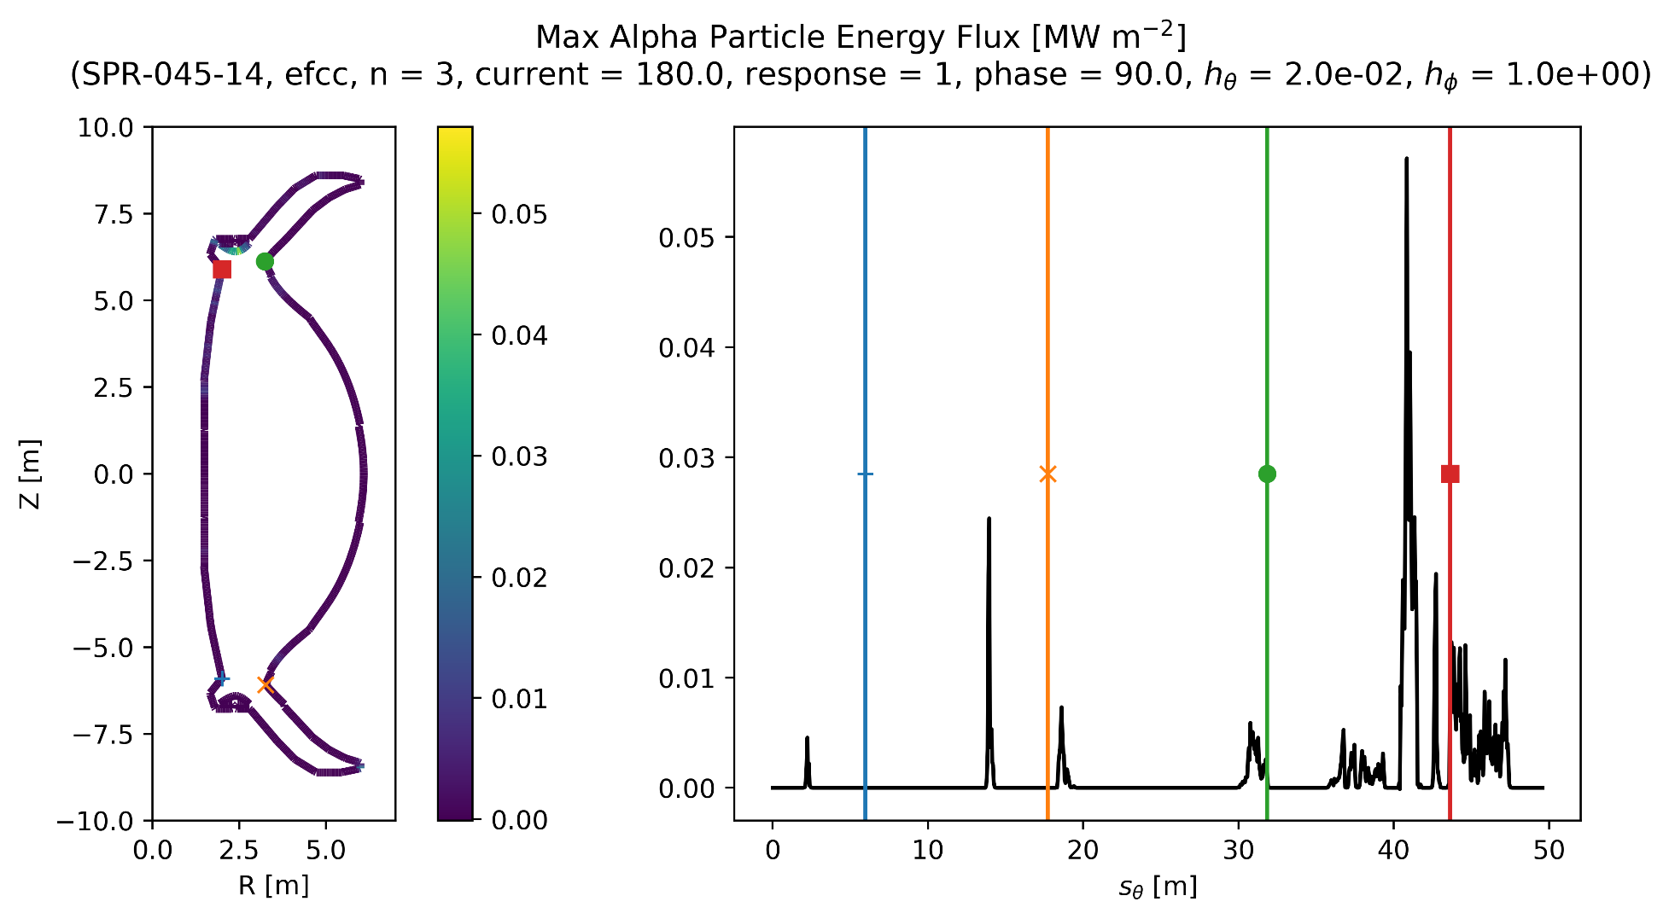
In STEP, fusion-born 𝛼-particles are the primary fast ion species, possessing an initial energy of 3.5 MeV—significantly higher than the background plasma, which has a temperature around 10 keV. Owing to their comparatively large Larmor radius, the confinement of these 𝛼-particles becomes notably vulnerable to 3D perturbations in the background magnetic field. This study examines the 3D fields from the ripple effect produced by the TF coils and the field generated by the ELM mitigation coils (refer to Fig. 1). Our analysis reveals that the ripple field's impact on confinement is minimal unless the TF coil position is altered. However, the field from the ELM mitigation coils substantially affects confinement, with variations reaching up to a factor of 10 when these coils are rotated relative to one another.

Slide 3
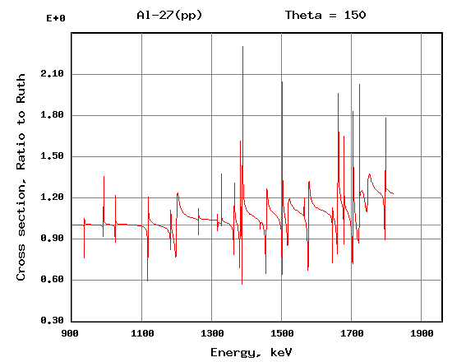
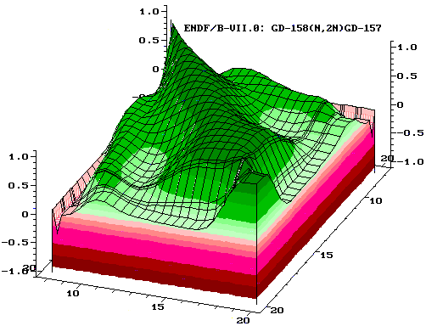
Title of Your Paper
Name of Author(s)
Name of Author(s)
Department Name and/or Institution Name
your-email@email.com
ID: xxx
Print on A0 paper size (1189x841 mm); use portrait for layout
ABSTRACT
OUTCOME
Please write summary of your paper in bullet points. Summary should only address key points of your paper.
The poster should be drafted to orient towards “Session Objectives” indicated in [ANNEX 2] sent to you in separate email.
Your primary contribution in ‘Interactive Corner’ will be to share your views and expertise during facilitated discussion. This poster will be used as basis of discussion during the Session and/or to supplement your statement.
TITLE ONE
Be sure that your outcome is clear and self-explanatory. Explain how this outcome is meaningful for the theme/topic of your Session.
TITLE TWO
Bear in mind and try to generate linkages between your outcome and three objective of the Symposium.
Innovate: Generate and explore new ideas on methods and technologies to aid the work of the Department, ‘crowdsourcing’ the collective expertise of the participants.
Partner: Mobilize partnerships to further explore the generated ideas and support the needs identified in the Department’s R&D Plan
Improve: Engage the safeguards community to identify ways to work smarter together in daily implementation, addressing both challenges and opportunities.
BACKGROUND
This section should be used to explain background of your paper. Make sure you identify objective and/or key challenges of your topic.
You should also address justification on why your theme/topic is important for International Safeguards.
The discussion should bear in mind specified Theme [CHA/TEC/NEW/SGI] of the Symposium and topics of your assigned Session.
Make sure your poster orient towards “Session Objective”, and seek to draw discussion topic or suggestion towards “Key Challenges”.
If you have any question regarding the Session, please contact Wedge Owner indicated in [ANNEX 2].
You may adjust size of these text boxes as needed. You may also change layout/colors/titles to best fit your paper.
Title of the graphs/figures
Facility | IFMIF, HF module | Fusion Power Reactor, first wall | Fast research Reactor, Petten
power (th), MW | 10 | 3400 | 45
n-Flux, 10⁺¹⁴ n/cm²/s | 7.3 | 11 | 12
max. PKA energy, MeV | 3.7 | 2.7 | 1.2
dpa (NRT), 1/fpy | 30 | 20 | 10
dpa (MD: Frankel pairs) | 9.7 | 6.7 | 3.3
dpa (MD: interst. clusters) | 5.6 | 3.8 | 1.9
CHALLENGES / METHODS / IMPLEMENTATION
TITLE ONE
This section can be adjusted to address “challenges”, “methods”, “implementation” or others depending on contents of your paper. Each point should demonstrate clear view/vision of your topic.
TITLE TWO
Using graphs/figures are recommended to provide information visually. Authors are responsible for ensuring that nothing in their papers infringes any existing copyright. Make sure to label the graph/figures clearly, and indicate source as necessary.
TITLE THREE
If you have equipment, we advise to coordinate with Wedge Owner to demonstrate during the Session. Pictures can be added to this poster if the equipment is in size unable to demonstrate.
Title of the graphs/figures
CONCLUSION
Draw conclusion which orient towards “objective” of your assigned Session/Wedge.
Raise conclusion or suggestion to “Key Challenges” identified for the Session.
Note this conclusion will be base of further discussion for the Session.
You may also raise further question or discussion topic for the Session.
ACKNOWLEDGEMENTS / REFERENCES
Title of the graphs/figures
You may add a section for acknowledgements or references

