Slide 1
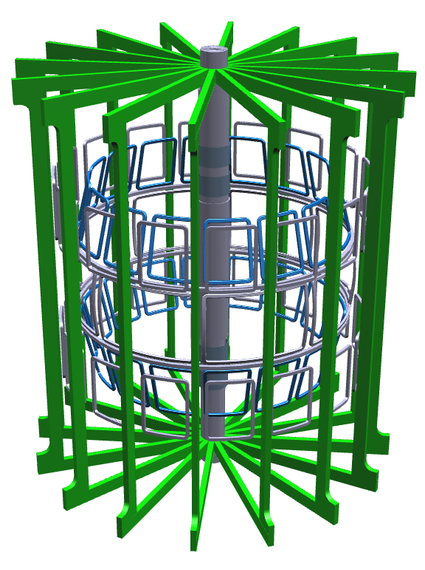
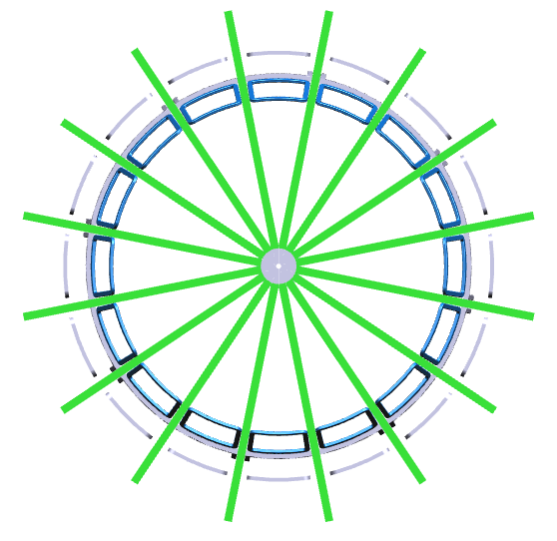
EFC/ELM mitigation coils
TF coils
RWM control coils

