Slide 1
Mode coupling at the transition region and the validity of line-tied boundary conditions
Alex Prokopyszyn, Alan Hood, Andrew Wright
Notes:
In this seminar I’m going to talk about some work that me, Alan and Andy have been doing recently. This work is closely related to a paper which was recently accepted and so I intend to put a version of the paper on ArXiv soon.
The paper paper has quite a lot of maths. In this seminar I have tried to minimise the maths as much as possible and instead show you videos and graphs.
If you want to see the maths I would recommend looking at the paper when I put it on ArXiv which should be soon.

Slide 2
Aims
Show why Fast / Alfvén waves couple at the TR
Show that polarisation of the waves changes upon reflection
Test the validity of line-tied BCs
Notes:
There are three main aims in this seminar.
The first is to show and explain why Alfven waves in the corona mode convert to fast waves when they hit the transition region and solar surface.
The second aim is to show that the Alfven waves will in general change their polarisation upon reflection with the solar surface.
Then the final aim is to test the validity of line-tied BCs. We are going to check they are still valid even for highly phase mixed Alfven waves where the transverse lengthscales can be very short.

Slide 3
Structure
Background
Model 1:
  Line-tied, pulse
Model 2:
  Line-tied, normal mode
Model 3:
  Chromosphere, normal mode
Summary and conclusions
Notes:
This slide shows the structure of this seminar.
I will start by giving a background.
Then I will discuss results from three models.
Where each model grows in complexity from the last.
Finally, I will give a summary of the key results.

Slide 4
Why study MHD waves?
Ubiquitous
Coronal heating
Coronal seismology
Tomczyk et al. (2007)
Notes:
Why study MHD waves?
I think there are three main reasons to study MHD waves.
The first is that we know that waves are ubiquitous in the corona and this has been demonstrated in papers such as the Tomczyk paper in 2007.
The second reason is that they could play an important role in coronal heating.
The final reason I have listed is that improving our understanding of MHD waves could lead to developments in coronal seismology.

Slide 5
Fast vs. Alfvén waves
Fast waves:
Propagate isotropically
Alfvén waves:
Propagate parallel to B0
Notes:
In this seminar we will focus on studying fast and Alfven waves.
We assume linear ideal MHD and assume the plasma beta is very small.
This means the slow waves are largely decoupled from the fast and Alfven waves so we can get away with ignoring them.
For beta=0 plasma the fast waves propagate isotropically, whereas the Alfven waves propagate parallel to the field.
You can see from the dispersion relation for the Alfven waves that if the frequency is real then wavenumber is guaranteed to be real.
However, for the fast waves, if the frequency is real then one of the wavenumbers could be complex. This means that the fast waves can be evanescent which means they can sometimes have a decaying exponential profile instead of a sinusoidal profile.

Slide 6
Mode conversion
Can occur via:
Non-linear effects (Verwichte et al., 1999)
Transition from β < 1 to β > 1 plasma (McLaughlin & Hood, 2006)
Gradients in vA → resonant absorption (Ionson, 1982)
Notes:
In this seminar we are going to look at one particular mechanism by which mode conversion can occur.
However, mode conversion can occur via a number of other mechanisms and I have listed some them here.
I will email these slides after this talk so you can read about more about these then if you wish.

Slide 7
Mode conversion at the TR
Studied analytically in Halberstadt & Goedbloed (1993, 1994, 1995)
Numerical approach used in Arregui et al. (2003)
Cally & Hansen (2011, 2012) suggest that mode conversion from fast waves to Alfvén waves at the transition region enables sufficient energy flux to enter the corona
Notes:
We will be looking specifically at the mode conversion which occurs at the transition region and solar surface due to the sudden change in density from the corona to the photosphere.
This problem has been studied extensively by Halberstadt and Goedbloed in the 90’s.
The work presented in this seminar can be viewed as a follow on from their work because it is very similar.
The key difference between our work and theirs is that they model closed loops whereas we will mode an open loop.
Also, they did not include the chromosphere in their model whereas later on in this seminar we will be including it.

Slide 8
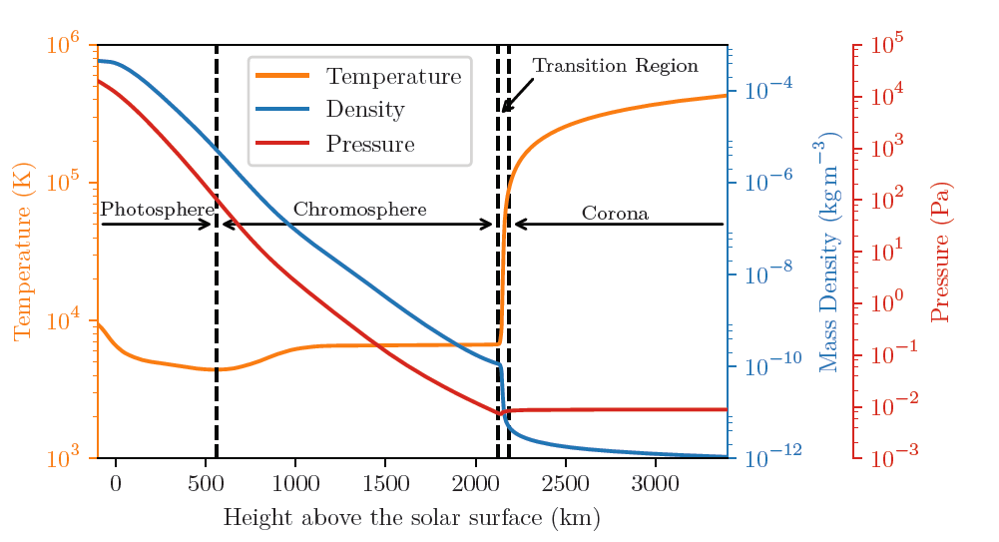
Line-tied (u=0) boundary conditions
Vernazza et al. (1981) and Williams (2018)
Notes:
For most of this seminar we will be using line-tied boundary conditions to approximate the steep jump in density from the corona to the chromosphere and photosphere.
Later on we will test the validity of these boundary conditions.
We normally justify these boundary conditions because you can see in the diagram here that over a length scale of about 5 Mm the density increases by a factor of over 100 million from the the corona to the photosphere.
You might naively expect the only thing that matters in determining the validity of line-tied boundary conditions is the lengthscales in the radial direction.
However, later on in this seminar, I will will show that the lengthscales parallel to the solar surface also matter.

Slide 9
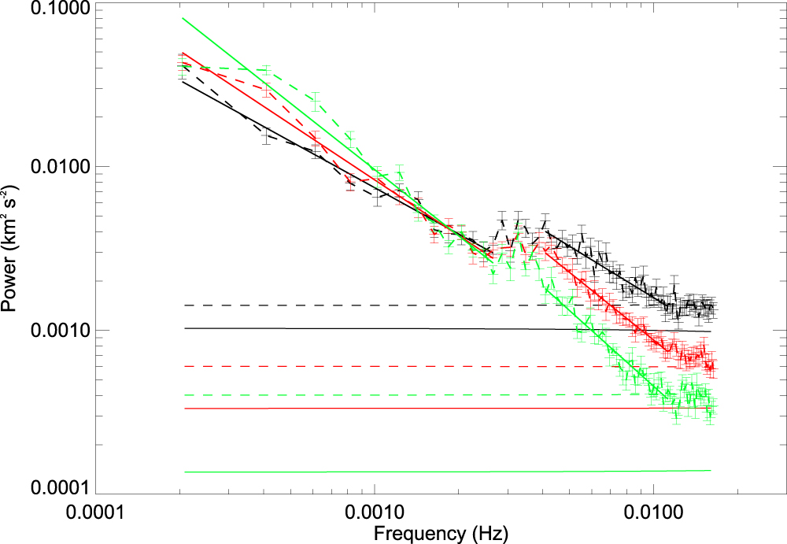
Normal mode
f(r,t) = f0(r)exp(iωt)
Morton et al. (2016)
Notes:
In most of the models in this seminar I will calculate normal mode solutions.
Where I define a normal mode solution as a solution where you assume the variables have a sinusoidal or an e^(i omega t) time dependence.
You might wonder why do I assume a sinusoidal time dependence when waves in the corona have a much more random time-dependence.
The reason is because you can think of waves in the corona as a superposition of many normal mode solutions.
The figure here shows the power spectrum for transverse waves in the solar corona.
It basically tells you how much energy is associated with each frequency.

Slide 10
Model and Equations
Background quantities:
Perturbations:
Unit vectors:
Equations:
α
Notes:
In this slide I show the model and equations we use.
We assume the background density and magnetic field are uniform. Although later on, when we include the chromosphere, the density will depend on z.
We define the z-axis as normal to the solar surface.
The y-axis is defined as the direction in which the magnetic field tilts towards at an angle alpha.
That leaves the x-direction as the remaining orthogonal direction.
We assume ideal linear MHD with a plasma beta of zero.
This means the parallel velocity is decoupled from the perpendicular velocity and so we assume the parallel velocity is zero.
Therefore, the velocity can only have a component in the x-direction and perp direction where the perp direction is defined to be both perpendicular to the background magnetic field and the x-direction.

Slide 11
Structure
Background
Model 1:
  Line-tied, pulse
Model 2:
  Line-tied, normal mode
Model 3:
  Chromosphere, normal mode
Summary and conclusions
Notes:
So that’s the background portion of the seminar over.
Now we will look at results from the first model of this seminar where we will send in an Alfven wave pulse to the solar surface and look at what happens when it reflects.
The main aim in the section is to build your intuition for what happens when waves hit the solar surface and convince you that in general mode conversion will occur and that the polarisation of the waves will change.

Slide 12
Numerical scheme
Leapfrog algorithm
Based on Zalesak (1979)
Finite-difference
Staggered grid
Second-order accurate
Notes:
The work in this section is done numerically using a leapfrog trapezoidal algorithm which is described in Zalesak (1979).
The code I use is a finite-difference scheme on a staggered grid and its second-order accurate.

Slide 13
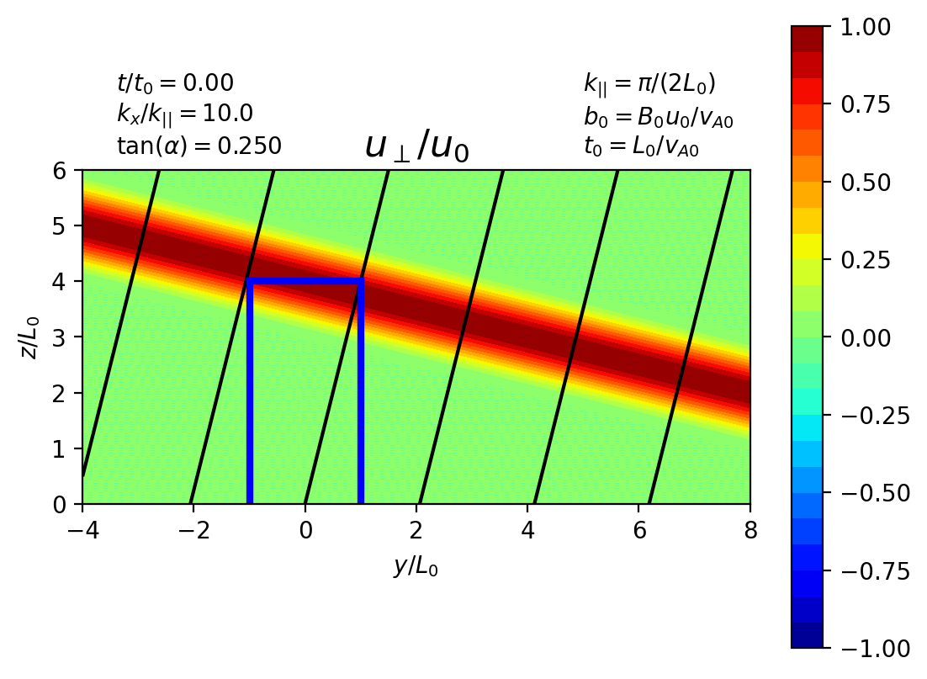
Initial / boundary conditions
Assume that
Initial conditions:
Notes:
This slide shows the initial / boundary conditions I use.
We assume that the variables have a sinusoidal x-dependence and this means the code only has to integrate in y, z and t.
I initialise the system with an Alfven wave pulse which is shown on the right here.
The boundary conditions are periodic in x, line-tied at z=0 and open in y.
In reality it’s quite hard to impose open boundaries numerically so I have made the computational domain much bigger than the domain we’re interested in.
The domain we are interested in is given by the blue box. I have extended the computational domain further as this means any noise produced by the boundary doesn’t have time to reach the domain we are interested in.

Slide 14
Notes:
In this slide I show the solution for the case where the background magnetic field is normal to the solar surface.
Before I play the video I will quickly walk you through what each plot is showing.
Going from left to right the left most plot shows the velocity in the x-direction, the next one shows the velocity in the perp direction then the last three plots show each component of the magnetic field pertubations.
Where b_|| gives the magnetic field pertubation parallel to the background magnetic field. You can think of b_|| as the magnetic pressure.
In the middle I show the time.
In the top left I show the values of kx and alpha.
The top right shows how the normalising constants are defined.
The black lines show the background magnetic field which you can see is normal to the solar surface.
Now if I play the video you can see that perhaps unsurprisingly the Alfven wave simply reflected and no mode conversion or change to the waves polarisation occurs.

Slide 15
Notes:
In this slide I will show the solution for the

Slide 16
Notes:
In this slide I show the solution for the case where the background magnetic field is oblique to the solar surface.
I’ll play the video.
The key thing is that now the field is oblique to the solar surface the Alfven wave mode converts to form fast waves
You can tell that some fast waves have been generated because the magnetic pressure is non-zero.
Also the wave has changed its polarization because it used to only oscillate in the y-z plane and now it has a component in the x-direction.

Slide 17
Notes:
It can sometimes be difficult to tell what’s going on in a contour plot so here I am running the same simulation again but this time I am plotting along z at y=0.
You can see more clearly now that a magnetic pressure component is generated suggesting we do have fast waves.

Slide 18
Notes:
This simulation is very similar to the last simulation except now I have increased the wavenumber in x by a factor of 10.
The lengthscales in the x-direction are so short now that the fast waves are evanescent.
If I play the video you may just about see an evanescent fast wave form at the boundary which then goes to zero as the Alfven wave leaves the boundary.

Slide 19
Notes:
Here I am plotting the same thing except this time along z at y=0.
If I play the video.
If you look closely at z=0 for the top right plot you may just about be able to see an evanescent fast wave form at the boundary which then goes to zero when the Alfven wave leaves the boundary.
So you can see we are left with just an Alfven wave.
It’s also interesting that at this larger value of kx we have a smaller change in polarisation.
You see the reflected Alfven wave is polarised mostly in the perp direction.

Slide 20
Notes:
In this simulation the incident Alfven wave is polarised in the x-direction instead of the perp-direction.
If I play the video
you can see that if the wave is polarised in the x-direction then no mode conversion occurs.
For this reason I am mainly going to use incident waves which are polarised in the perp direction instead of the x-direction as this polarisation gives rise to the most amount of mode conversion.
Which is what we are trying to investigate.

Slide 21
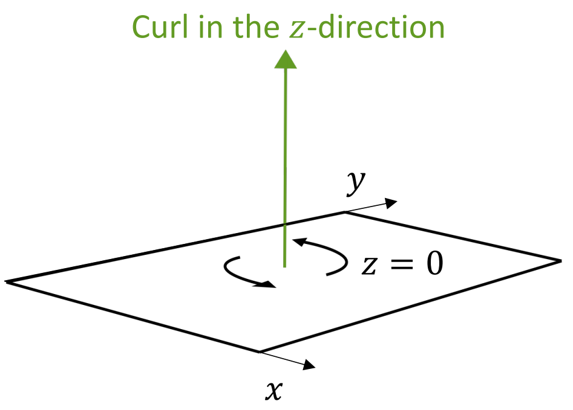
Why does the coupling occur?
bz = 0 at z = 0
bz = cos(α)b|| - sin(α)b┴
b|| = tan(α)b┴ Fast waves
Notes:
Why does the mode coupling occur?
Here I give a bit of a mathematical proof for why the mode conversion occurs.
Since the velocity is zero everywhere at z=0, then its curl in the z-direction is zero.
Therefore the magnetic field perturbation in the z-direction is zero since its initially zero.
Bz is given by a combination of b_{||} and b_perp.
Since bz is zero then we know that b_{||} is proportional to b_perp
B_{||} gives the magnetic pressure and so therefore we must have fast waves

Slide 22
Summary
At the solar surface:
Alfvén waves couple to fast waves
Change polarisation
If
then evanescent boundary layers form
Notes:
Hopefully by this point in the seminar:
You are convinced that in general Alfven wave couple to fast waves at the solar surface.
In general, their polarisation will change after they reflect at the solar surface.
Hopefully, you can also see that if the lengthscales in x are sufficiently short then fast waves will be evanescent and form boundary layers.

Slide 23
Structure
Background
Model 1:
  Line-tied, pulse
Model 2:
  Line-tied, normal mode
Model 3:
  Chromosphere, normal mode
Summary and conclusions
Notes:
So that’s all I’m going to say about the first model.
We’re now on to the next model
In this section we will calculate the normal mode solutions.
These are nice because we can calculate exact analytic solutions.
Which allows us to consider all the possible parameters very easily without having to run multiple simulations

Slide 24
Normal mode solution
Assume
Impose incident Alfvén wave
Calculate unique reflected Alfvén and fast wave which ensures u = 0
Notes:
To calculate the normal mode solution we assume the variables are of the form e^{i(kx x + ky y + omega t)}
Therefore, we only need to solve for the z-dependence.
We impose incident Alfven waves which are polarised in the perp direction.
We calculate the unique corresponding reflected Alfven and fast waves which ensure the velocity is zero at z=0.

Slide 25
Incident wave
Notes:
Now I am going to show you a few videos to help you visualise what I’m doing.
I’m basically sending in an incident Alfven wave which looks like this and is polarised in the perp direction.
This incident wave will produce a reflected Alfven wave and a reflected fast wave.

Slide 26
Reflected Alfvén wave
Notes:
The reflected Alfven wave will look something like this.
Note that it can have a different polarisation to the incident wave.
We know this is an Alfven wave because the magnetic pressure is zero.

Slide 27
Reflected Fast wave
Notes:
We also produce a reflected fast wave which can look something like this.
Here the lengthscales in x are sufficiently short that the reflected fast wave is evanescent which means it has a decaying exponential profile in z.

Slide 28
Full solution
Notes:
These waves combined gives the full solution. And the full solution is shown here.
It’s difficult to see in a contour plot, but maybe you can just about tell that the velocity does go to zero at z=0.

Slide 29
Reflected fast wave
Notes:
The reflected fast wave is quite interesting because depending on the lengthscales in the x-direction it can be either sinusoidal or evenescent.
To help build your intuition for how the solution changes with kx I have made this video.
Before I play the video I will quickly explain what it’s showing.
This video shows the reflected fast wave along z at y=0.
The real and imaginary parts are shown and you can think of the imaginary part as showing what the real part will look like a quarter of a wave cycle later.
When I play the video it will plot the solution for increasing values of kx.
k_crit gives point at which the solution transitions from being sinusoidal to evanescent
At kx = k_crit the solution is uniform in z.
Right now kx is very small and so the solution is sinusoidal in z.
So now I will play the video.
You see that the solution goes from sinusoidal to evanescent
Also, you can see that as kx gets larger the amplitude of the boundary layer stays the same however its width gets smaller.
Therefore, the energy of the fast waves decreases for increasing kx.
So the more highly phase-mixed the waves the less fast wave energy is produced.

Slide 30
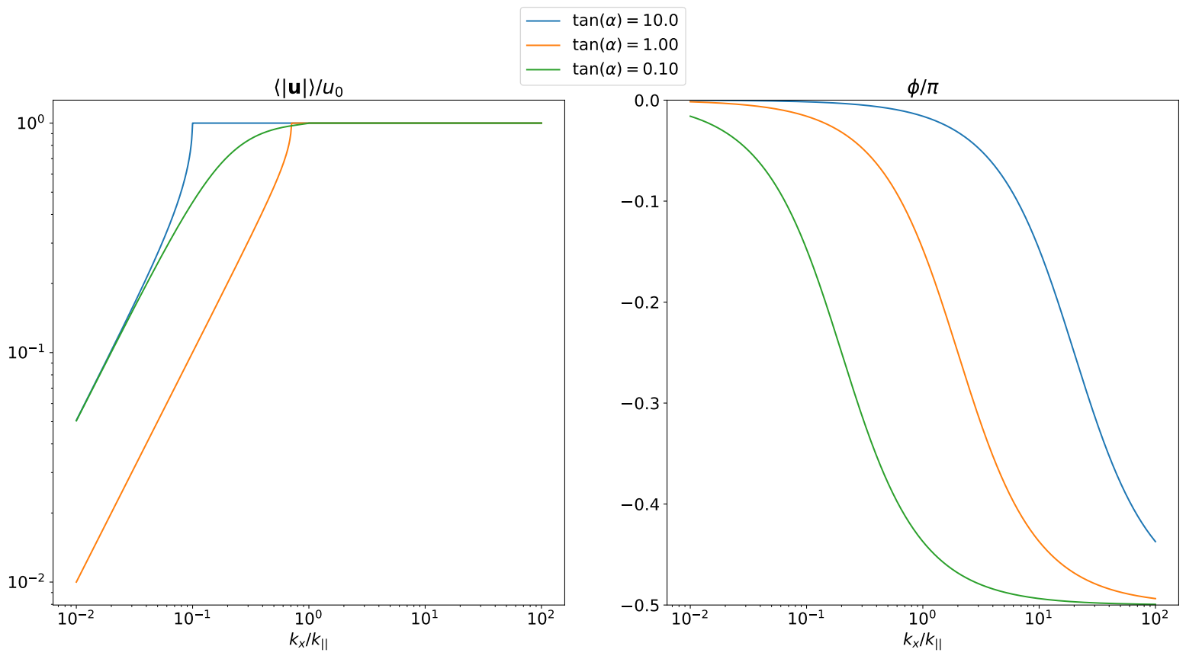
Reflected Alfvén wave
Notes:
This slide shows how the reflected Alfven wave changes with kx.
The left plot shows the amplitude of the wave as a function of kx.
Where the blue curve corresponds to the case where the background magnetic field is nearly tangential to the solar surface. The orange curve corresponds to the case where the background field is at 45 degrees to the solar surface and the green curve shows the case where the background magnetic field is nearly normal to the solar surface.
The right-hand plot shows the polarisation angle, phi, of the reflected Alfven wave as a function of kx.
I have added a key on the far right side to show you how the polarisation angle is defined.
You see that if phi is 0 then the wave is polarised in the x-direction and if it equals -pi/2 then it is polarised in the negative perp direction.
Remember that the incident wave is polarised in the perp direction. Therefore, the change in polarisation goes to zero as kx goes to infinity.
In the amplitude plot on the left you can see that if kx is large then the reflected wave amplitude is 1.
This makes sense because if the fast wave is evanescent the Alfven wave must have an amplitude of 1 to balance the incoming energy from the incident Alfven wave.
If the fast wave can propagate in z then the reflected Alfven wave can have an amplitude smaller than one and we see that an angle of 45 degrees gives the most efficient transfer of energy from Alfven waves to fast waves.
The point at which the amplitude of the Alfven wave goes from less than 1 to 1 is the point at which the fast waves go from propagating to evanescent.

Slide 31
Summary
Fast wave energy → 0 as kx → ∞
Change in polarisation → 0 as kx → ∞
∴ Boundary layers have a minimal impact on resonance absorption
Notes:
Hopefully by this point in the seminar you are convinced that as kx goes to infinity the fast wave energy goes to zero.
Also, the change in polarisation of the Alfven waves goes to zero.
This means that for resonance absorption (where kx is very large) you can somewhat get away with ignoring the mode conversion at the boundary (if all you care about is the energetics). However, you will be missing out on the boundary layers.

Slide 32
Structure
Background
Model 1:
  Line-tied, pulse
Model 2:
  Line-tied, normal mode
Model 3:
  Chromosphere, normal mode
Summary and conclusions
Notes:
So that’s all I’m going to say about the first model.
We’re now on to the next model
In this section we will calculate the normal mode solutions where we include the chromosphere in the model now instead of imposing line-tied boundary conditions.
This will allow us to test the validity of line-tying because we can compare the models with and without line-tying to check if they agree.

Slide 33
Model
Background Alfvén speed:
Where:
Impose continuity of u and b
Corona
Chromosphere
Notes:
So our model now is very similar to the last model except now we are using a piecewise constant background density
This means we have a piecewise constant background Alfven speed.
The z >= 0 region corresponds to the corona and the z<0 region corresponds to the chromosphere.
Since the corona is much more sparse than the chromosphere it has a much greater Alfven speed.
Also, for a given frequency, the lengthscales parallel to the field will be much shorter in the chromosphere.
Instead of imposing velocity=0 at z=0 we now impose that the velocity and magnetic field must be continuous at z=0.

Slide 34
Incident wave
Notes:
Like with the last model I have made a few videos to help you visualise what I’m doing.
I send in an incident Alfven wave which is polarised in the perp direction.
This produces a reflected and transmitted Alfven wave
As well as a reflected and transmitted Fast wave.

Slide 35
Reflected + Transmitted Alfvén wave
Notes:
Here I am showing the reflected and transmitted Alfven wave.
For illustrative purposes I am using a very large Alfven speed in the chromosphere.
You can see that I have set the Alfven speed in the chromosphere to be a quarter of the speed in the corona
This ensures the wavelength is not too short to see what’s happening in the chromosphere at this lengthscale.
You can see that the velocity does go to zero in the chromosphere as expected due to the higher density there.

Slide 36
Reflected + Transmitted Fast wave
Notes:
Here I am showing the reflected and transmitted fast waves.
You can see that for this kx value the fast wave is evanescent in the corona but sinusoidal in the chromosphere
We need a much greater value of kx for the fast waves to become evanescent in the chromosphere as well

Slide 37
Full solution
Notes:
Here I am showing the full solution with all the components added together.

Slide 38
Chromosphere vs. Line-tied model
Notes:
In this slide I am showing the magnetic pressure pertubation along z.
Remember that the magnetic pressure is associated with the fast wave.
Before I play the video I will just quickly explain what the plots are showing.
The top row shows the real part of b_{||} and the bottom row shows the imaginary part.
The blue curve shows the solution from the chromosphere model while the orange curve shows the solution from the line-tied model.
This is why the blue curve extends below z=0 while the orange curve stops at z=0.
The plots on the left show the solutions at the much shorter chromospheric lengthscales while the plots on the right show the solution on the much longer coronal lengthscales.
Right now you can see the solution is sinusoidal in both the corona and chromosphere
As I increase kx we can expect the solution to go from sinusoidal to evanescent in the corona then from sinusoidal to evanescent in the chromosphere.
Right now we can see that the solutions are in pretty good agreement (the blue curve mostly agrees with the orange curve)
But we will see that eventually as we increase kx the solutions will diverge.
Now I’ll play the video.
So hopefully you can see that once the wave starts to become evanescent in the chromosphere the line-tied model and the chromosphere model start to disagree
The amplitude of the fast wave goes to zero in the chromosphere model while the amplitude remains fixed in the line-tied model.
This is interesting because it shows that the validity of the line-tied boundary conditions is sensitive to the lengthscales tangential to the solar surface as well as the lengthscales normal to the solar surface.
The reason the tangential lengthscales matter is that they determine if the fast wave can propagate or is evanescent in the chromosphere.

Slide 39
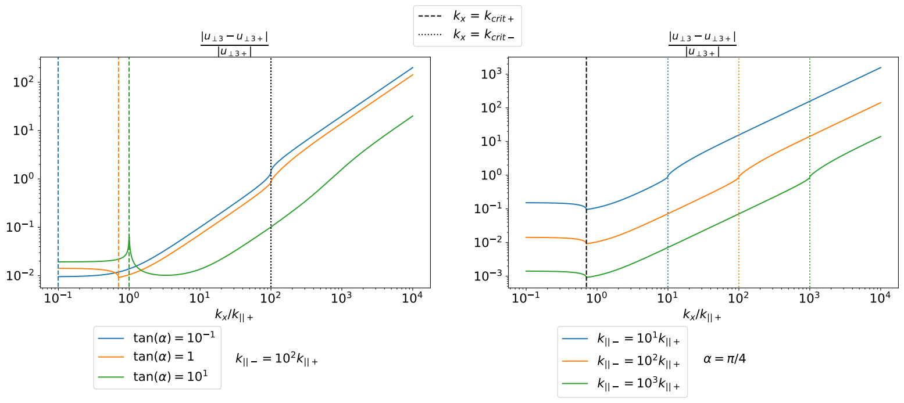
Reflected fast wave error
Notes:
In this slide I am showing the reflected fast wave relative error as function of kx.
Here u_perp3 denotes the amplitude of the fast wave in the line-tied model and u_perp3+ denotes the amplitude in the model which includes the chromosphere.
If your wondering where the 3 comes from its just the naming convention I use in the paper where u_perp1 is the incident wave amplitude and u_perp2 is the reflected Alfven wave amplitude.
In the left-hand plot, the Alfven speed in the chromosphere is set to be 100 times smaller than the Alfven speed in the corona
The different colours correspond to different values of alpha, where the blue curve gives the case where the background field is nearly normal to the solar surface, the orange curves corresponds to 45 degrees and the green curve shows the solution where the background field is nearly parallel to the solar surface.
Wheras in the right-hand plot, the angle is fixed at 45 degrees and the different colours corresponds to different Alfven speeds in the chromosphere.
The blue curve corresponds to the case where the Alfven speed is 10 times smaller in the chromosphere, the orange curve is where its 100 times smaller and the green curve is where its 1000 times smaller.
You can see that the green curve on the right has the smallest error because this corresponds to the model with the highest density in the chromosphere.
The vertical dashed lines show the the critical point where the fast waves go from sinusoidal to evanescent in the corona and the vertical dotted lines show the critical point in the chromosphere.
You can see in the right-hand plot that that the error if of order unity around the critical point in the chromosphere.
In other words the error approaches unity around the vertical dotted line.
You can see this is mostly true in the left-hand plot for the case where the background field is mostly normal to the solar surface or at 45 degrees.
Annoyingly this pattern doesn’t continue that well to the case where the magnetic field is nearly tangential to the solar surface.
You can see the green curve is not of order unity at the dotted line.
However, if the field is within 45 degrees or so of normal to the solar surface then this pattern is mostly true.

Slide 40
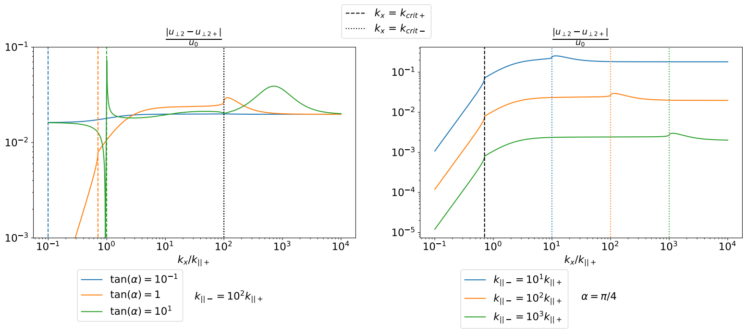
Reflected Alfvén wave error
Notes:
This slide is very similar to the last slide except it shows the reflected Alfven wave error.
You can see I am plotting u_perp2 – u_perp2+ now instead of u_perp3 - u_perp3+
It shows that the error for the Alfven waves is always small regardless of kx.
In the right-hand plot it shows that this error is smaller for larger densities in the chromosphere
This is demonstrated by the fact that the green curve is below the orange curve which below the blue curve on the right.
These plots show that line-tied boundary conditions do a good job with the predicting the reflected Alfven wave amplitude its just with the reflected fast wave amplitudes that the line tied model starts to struggle for large kx.

Slide 41
Summary + conclusions
Alfvén waves couple to fast waves at the TR
They change polarisation upon reflection
Line-tied BC’s are usually a good approximation
However, they generate unphysically large BL’s if:
Notes:
So we’re now pretty much at the end of the seminar.
The key points are that the Alfven waves will in general couple to fast waves at the transition region and solar surface.
They change polarisation upon reflection with the solar surface.
Line-tied BCs are usually a good approximation to use in coronal models.
However, for the case with highly phase-mixed Alfven waves where the transverse lengthscales are shorter than the parallel lengthscales in the chromosphere, the line-tied boundary model can generate unphysically large boundary layers.

Slide 42
The paper
Includes model where
Confirms BL’s → 0 in RA model

Slide 43
Future work
Investigate different incident polarisations
Use incident fast waves
Model an exponential density profile instead of piecewise constant
Let ρ = ρ(x, z)
Notes:
Here I have listed some ideas for future work.
In this seminar we only really looked at incident waves which are polarised in the perp direction.
I did briefly show that if the waves are polarised in the x-direction then no mode conversion occurs.
However, it would be interesting to look at polarisations in between these two extremes.
I always used an incident Alfven wave but it might be interesting to see if there are any major differences for incident fast waves.
I used a piecewise constant density profile in z but it would be nice if we could find a way to study the problem with a hydrostatic background density.
Finally, I have listed that we could let the density depend on x as well as z. The last section of the paper investigates this. But I’ll leave that for another time.

Slide 44
References
Arregui, I., R. Oliver, and J. L. Ballester. "Coupling of fast and Alfvén waves in a straight bounded magnetic field with density stratification." Astronomy & Astrophysics 402, no. 3 (2003): 1129-1143.
Cally, Paul S., and Shelley C. Hansen. "Benchmarking fast-to-Alfvén mode conversion in a cold magnetohydrodynamic plasma." The Astrophysical Journal 738, no. 2 (2011): 119.
Goedbloed, J. P., and G. Halberstadt. "Magnetohydrodynamic waves in coronal flux tubes." Astronomy and Astrophysics 286 (1994): 275-301.
Halberstadt, G., and J. P. Goedbloed. "The continuous Alfvén spectrum of line-tied coronal loops." Astronomy and Astrophysics 280 (1993): 647-660.
Halberstadt, G., and J. P. Goedbloed. "Alfven wave heating of coronal loops: photospheric excitation." Astronomy and Astrophysics 301 (1995): 559.
Hansen, Shelley C., and Paul S. Cally. "Benchmarking fast-to-Alfvén mode conversion in a cold MHD plasma. II. how to get Alfvén waves through the solar transition region." The Astrophysical Journal 751, no. 1 (2012): 31.
Ionson, J.A., 1982. Resonant electrodynamic heating of stellar coronal loops-an LRC circuit analog. The Astrophysical Journal, 254, pp.318-334.
McLaughlin, J.A. and Hood, A.W., 2006. MHD mode coupling in the neighbourhood of a 2D null point. Astronomy & Astrophysics, 459(2), pp.641-649.
Morton, R. J., Steve Tomczyk, and R. F. Pinto. "A global view of velocity fluctuations in the corona below 1.3 R⊙ with CoMP." The Astrophysical Journal 828, no. 2 (2016): 89.
Tomczyk, S., McIntosh, S.W., Keil, S.L., Judge, P.G., Schad, T., Seeley, D.H. and Edmondson, J., 2007. Alfvén waves in the solar corona. Science, 317(5842), pp.1192-1196.
Vernazza, J. E., E. H. Avrett, and R. Loeser. "Structure of the solar chromosphere. III-Models of the EUV brightness components of the quiet-sun." The Astrophysical Journal Supplement Series 45 (1981): 635-725.
Verwichte, E., V. M. Nakariakov, and A. W. Longbottom. "On the evolution of a nonlinear Alfvén pulse." Journal of plasma physics 62, no. 2 (1999): 219-232.
Williams, Benjamin Matthew. "The dynamic topology of the solar corona: mapping the Sun’s three dimensional magnetic skeleton." PhD diss., University of St Andrews, 2018.
Zalesak, Steven T. "Fully multidimensional flux-corrected transport algorithms for fluids." Journal of computational physics 31, no. 3 (1979): 335-362.
Notes:
That’s the end of the seminar and thank you for listening.

Slide 45
Aside
A consequence of the fast and Alfven waves being coupled is that this changes the natural frequency of the loop.
The natural frequencies are not given by what you would naively expect

