Slide 1
Mode coupling at the transition region and the validity of line-tied boundary conditions
Alex Prokopyszyn, Alan Hood, Andrew Wright

Slide 2
Aims
Show why Fast / Alfvén waves couple at the TR
Test the validity of line-tied BCs
Show they can be invalid for highly phase-mixed waves
Notes:
The third aim here is the most important. The key take-away from this seminar is that if the waves become highly phase mixed then this can cause the line-tied boundary condition to become invalid. Or give rise to very large boundary conditions when it shouldn’t.

Slide 3
Structure
Background
Model 1:
  Line-tied, pulse
Model 2:
  Line-tied, normal mode
Model 3:
  Chromosphere, normal mode
Summary and conclusions
Notes:
In this section we will calculate the normal mode solutions. These are nice because we can calculate exact analytic solutions. Which allows us to consider all the possible parameters very easily without having to run multiple simulations

Slide 4
Why study MHD waves?
Ubiquitous
Coronal heating
Seismology
Notes:
Why should we study waves?
I think there are three main reasons to study MHD waves. The first is that we know that waves ubiqutous.

Slide 5
Fast vs. Alfvén waves
Fast waves:
Propagate isotropically
Alfvén waves:
Propagate parallel to B0

Slide 6
Mode conversion
Can occur via non-linear effects see e.g. verwichte, high beta to low beta see e.g. mclaughlin, gradients in background in Alfven speed → resonant absorption

Slide 7
Mode conversion at the TR
Studied extensively by Halberstadt & Goedbloed analytically closed loops
Arregui 2003 studied numerically
Cally & Hansen (2011); Hansen & Cally (2012) suggest that mode conversion from fast waves to Alfv´en waves at the transition region enables sufficient energy flux to enter the corona

Slide 8
Line-tied boundary conditions
Add VAL
U = 0
Usually valid
Might naively expect the only thing that matters is the lengthscale in the radial direction

Slide 9
Normal mode
f(r,t) = f0(r)exp(iωt)
Add Morton power spectrum

Slide 10
Model and Equations
Background quantities:
Perturbations:
Unit vectors:
Equations:
α
Notes:
We define the z-axis as normal to the solar surface.
The y-axis is defined as the direction in which the magnetic field tilts towards
That leaves the x-direction as the remaining orthogonal direction.

Slide 11
Structure
Background
Model 1:
  Line-tied, pulse
Model 2:
  Line-tied, normal mode
Model 3:
  Chromosphere, normal mode
Summary and conclusions
Notes:
The main goal in this section is to convince you that Alfven waves do indeed couple to fast waves at the transition.

Slide 12
Numerical scheme
Leapfrog algorithm
Based on Rickard and Wright (1994)
Finite-difference
Staggered grid
Second-order accurate

Slide 13
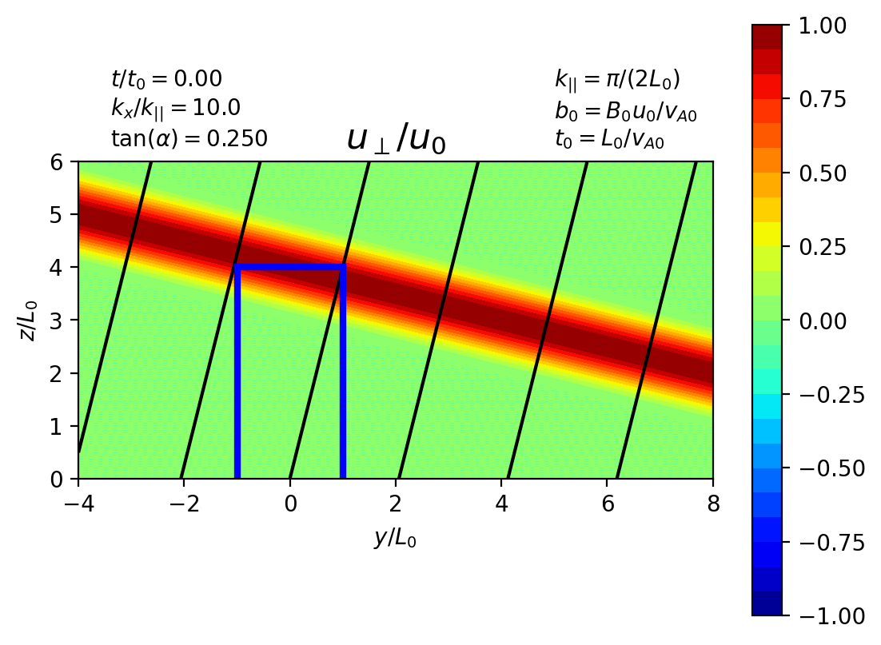
Initial / boundary conditions
Assume that
Initial conditions:
Notes:
The boundary conditions are open in y. Periodic in x. Line-tied at z=0 and open for z > 0.

Slide 16
Add video with ux blob

Slide 20
Notes:
The Alfven wave has changed polarisation

Slide 21
Why does the coupling occur?

Slide 22
Summary
At the solar surface:
Alfvén waves couple to fast waves
Change polarisation
If
then evanescent boundary layers form

Slide 23
Structure
Background
Model 1:
  Line-tied, pulse
Model 2:
  Line-tied, normal mode
Model 3:
  Chromosphere, normal mode
Summary and conclusions
Notes:
In this section we will calculate the normal mode solutions. These are nice because we can calculate exact analytic solutions. Which allows us to consider all the possible parameters very easily without having to run multiple simulations

Slide 24
Normal mode solution
Assume
Impose incident Alfvén wave
Calculate unique reflected Alfvén and fast wave which ensures u = 0

Slide 25
Incident wave

Slide 26
Reflected Alfvén wave

Slide 27
Reflected Fast wave

Slide 28
Full solution

Slide 29
Reflected fast wave

Slide 30
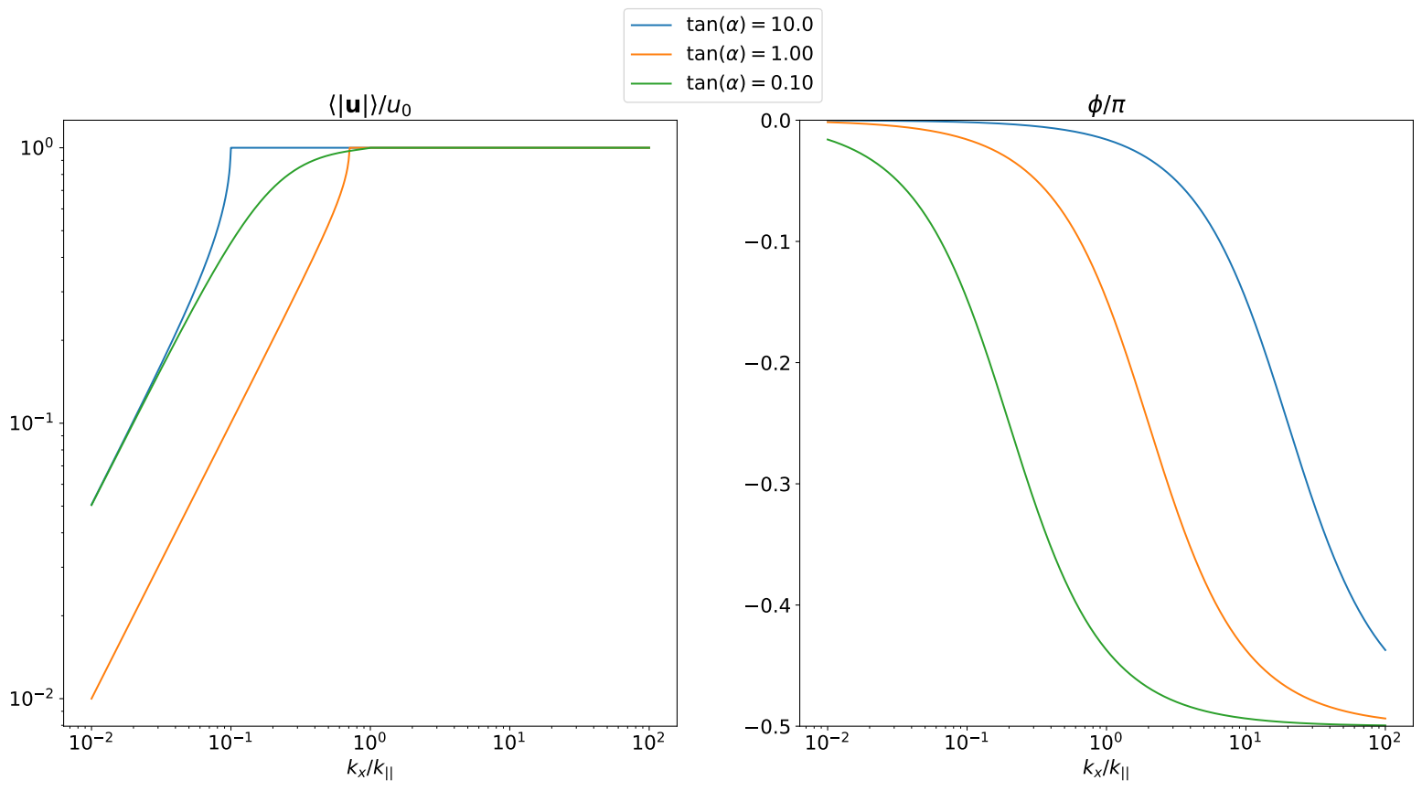
Reflected Alfvén wave
Notes:
In the blue curve the background magnetic field is nearly parallel to the solar surface.
For the orange curve the background field is at 45 degrees to the solar surface.
For the green curve the background field is nearly normal to the solar surface.
The amplitude of the wave is 1 when the fast waves are evanescent This makes sense because if the fast waves are evanescent then the incoming Poynting flux from the Alfven waves must be balanced entirely by the outward poynting flux from the reflected Alfven wave.

Slide 31
Summary
Fast wave energy → 0 as kx → ∞
Change in polarisation → 0 as kx → ∞
∴ Boundary layers have a minimal impact on resonance absorption
Notes:
The change to the natural frequency also decrease as kx goes to infinity. This means that the mode conversion at the boundary should have a limited
This means that for resonance absorption you can somewhat get away with ignoring the mode conversion at the boundary. However, you will be missing out on the boundary layers.
Hopefully you appreciate that the behaviour of the solution is very much dependent on whether the fast waves can propagate or are evenescent.

Slide 32
Structure
Background
Model 1:
  Line-tied, pulse
Model 2:
  Line-tied, normal mode
Model 3:
  Chromosphere, normal mode
Summary and conclusions
Notes:
In this section we will calculate the normal mode solutions. These are nice because we can calculate exact analytic solutions. Which allows us to consider all the possible parameters very easily without having to run multiple simulations

Slide 33
Omega ^ 2 / vA^2 = kx ^ 2 + ky ^2 + kz ^ 2
Therefore, assumign line-tied boundary conditions forces the waves in the chromospehre to be chromospheric.

Slide 34
Model
Va = (va+ z > 0 and va- z < 0)
Implies k_par- >> k_par+
Implies k_crit- >> k_crit+
Impose continuity of u and b

Slide 35
Incident wave

Slide 36
Reflected + Transmitted Alfvén wave

Slide 37
Reflected + Transmitted Fast wave

Slide 38
Full solution

Slide 39
Chromosphere vs. Line-tied model

Slide 40
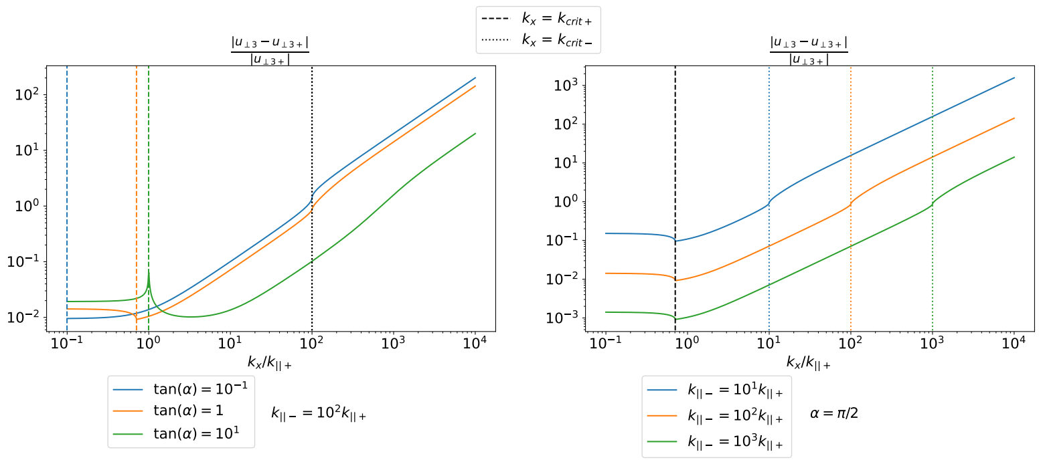
Fast wave error

Slide 41
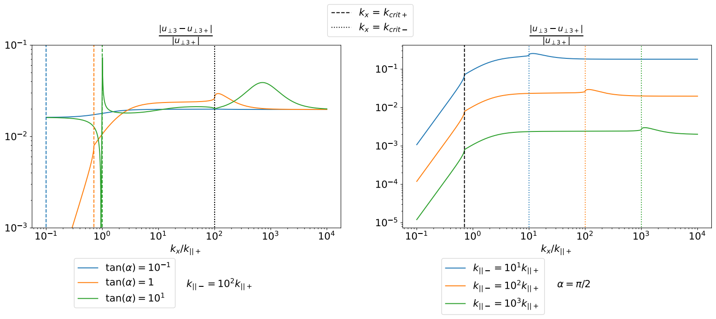
Alfvén wave error

Slide 42
Summary + conclusions
Alfvén waves couple to fast waves at TR
Alfén waves change polarsation when they reflect
Line-tied BC’s are usually a good approximation
However, they generate non-physically large BL’s if kx >~ k_{||-}

Slide 43
Aside
A consequence of the fast and Alfven waves being coupled is that this changes the natural frequency of the loop.
The natural frequencies are not given by what you would naively expect

