Slide 1
Thesis Overview
Alex Prokopyszyn

Slide 2
Chapter 1: Introduction
Solar atmosphere
Coronal heating problem
MHD equations & assumptions
MHD waves: dispersion relation
MHD waves: power spectrum

Slide 3
Chapter 2: Ideal footpoint driven Alfven waves
The main goal here is to introduce concepts relevant for the rest of the thesis.
Still has elements of original research. For example I am not aware of anyone using the D’Alambert’s formula.
Useful for numerical as people often drive with a sinusoidal footpoint driver.

Slide 4
Closed loop: General solution
Uses d’Alambert’s formula instead of Fourier analysis.

Slide 5
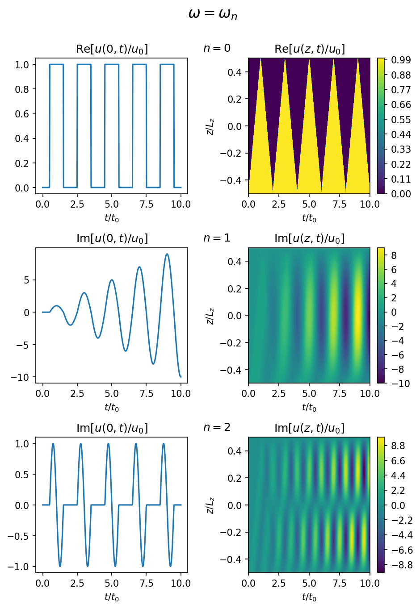
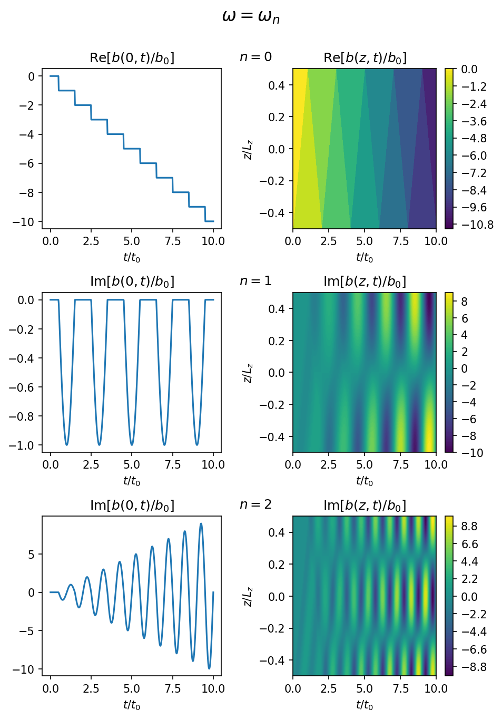
Closed loop: resonant
Figures 2.1 and 2.2 show clearly that slow motions can build-up the magnetic field for a small kinetic energy.
Notes:
The main points I was trying to get across here is that at the resonant frequencies the energy grows linearly with time.
I also showed these graphs because I think they clearly illustrate the difference between a slow driver where the driving frequency is lower than than the fundamental frequency of the field line and there the driver freuqncy is greater than or equal to the

Slide 6
Closed loop: Nearly resonant
Amplitude given by sec(omega lz / va0)
Beating frequency given by (omega – omega_n) / 2

Slide 7
Closed loop: Antiresonant case
Interesting interference pattern

Slide 8
Closed loop: broadband driver
Goal here is to tie the results to observations.
Will the energy of a randomly driven loop grow to infinity or oscillate about a finite value?
Check white noise result agrees with Fourier result.

