Slide 1
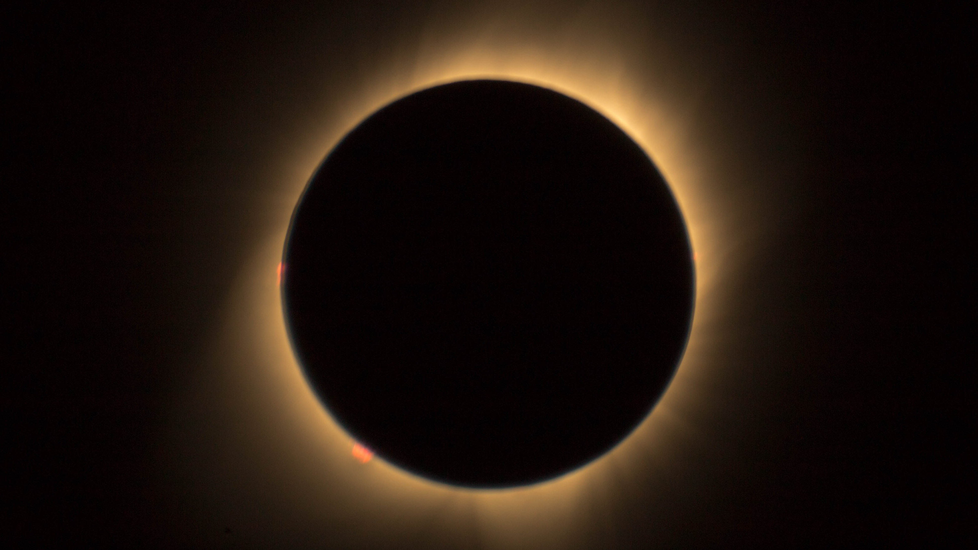
Thesis overview
Alex Prokopyszyn
Notes:
In this talk, my goal is to give an overview of the thesis, and I will focus on explaining my aims and how I went about trying to achieve these aims.
Feel free to stop me at any point if you want to ask a question or if you want me to slow down or explain something in more detail.

Slide 2
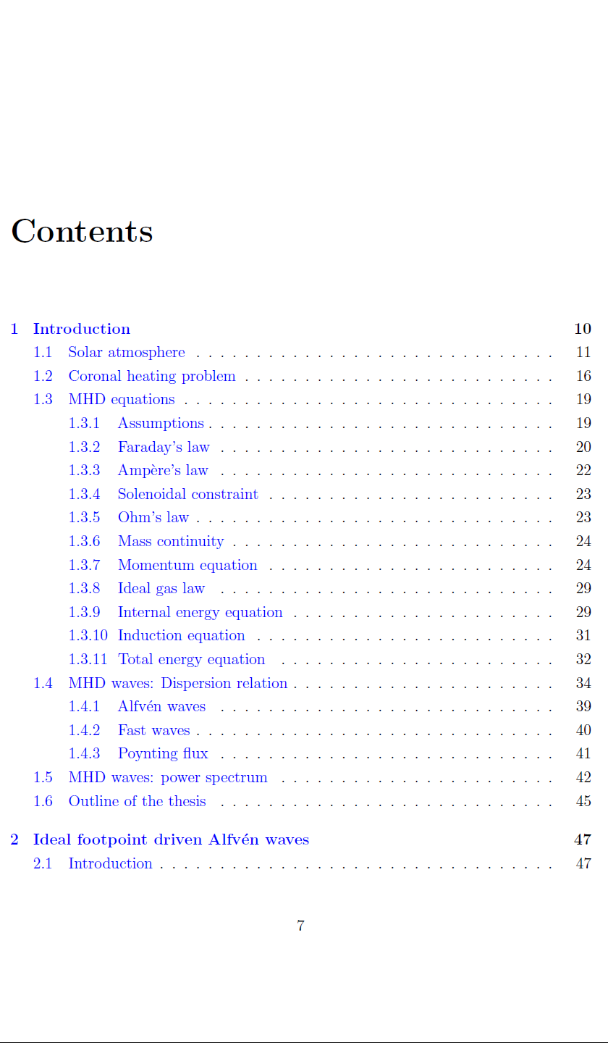
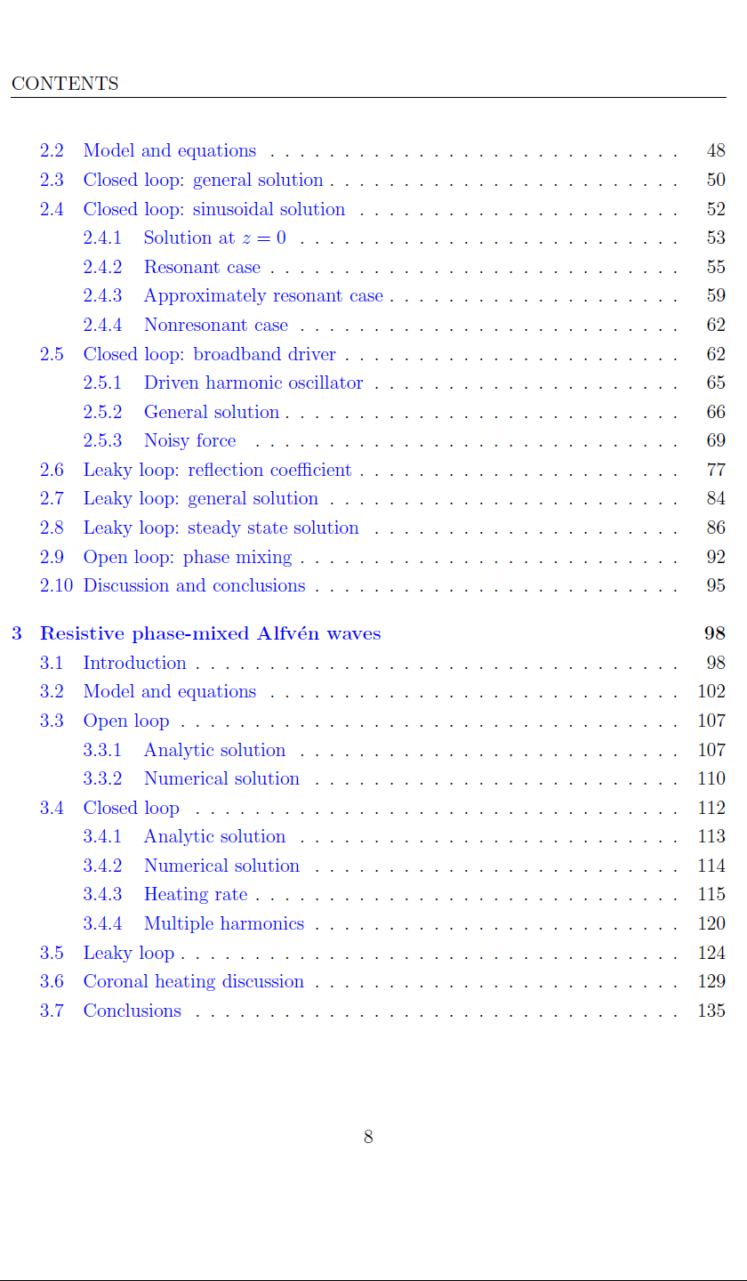
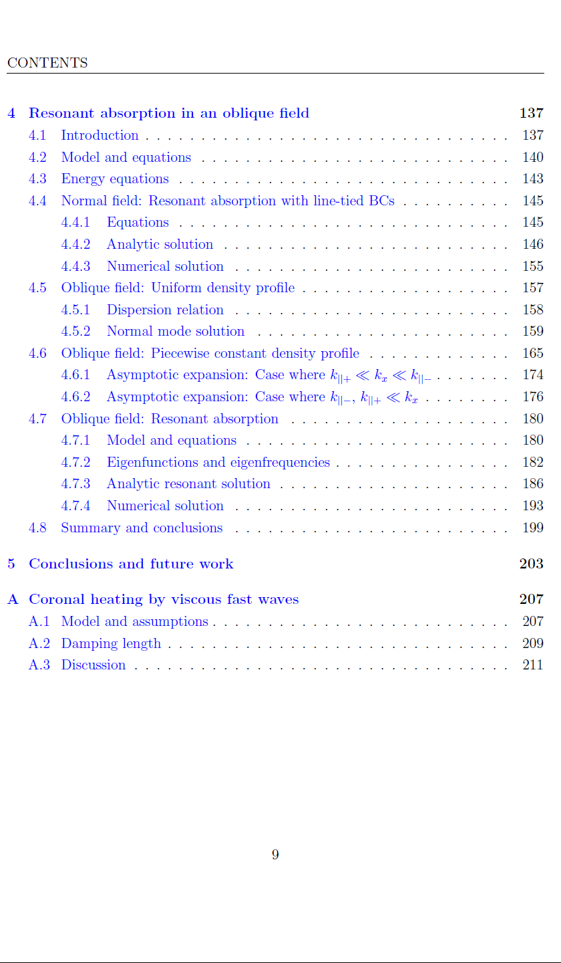
Notes:
This slide shows the contents page in the thesis.
Given that this is only a 20 minute talk I don’t have time to go into much detail about any particular topic. However, hopefully this talk will be sufficient to give a rough idea of what the thesis is about and then we can go into more detail about particular topics later on in this viva.
You can see that this thesis has 5 chapters and 1 appendix. The chapters can be split into 1 introductory chapter, 3ish research chapters (depending on whether you class chapter 2 as a research or an introductory chapter) and 1 conclusion chapter.
I will start by giving a brief overview of the thesis as a whole, then I will go through chapter by chapter explaining the main aims and results from each section.
This thesis mainly investigates MHD waves in the solar corona with a big focus on phase mixing and resonant absorption. It’s heavily theoretical as opposed to observational. A lot of time is spent calculating analytic solutions and then verifying these solutions numerically.
I think the two most important results from this thesis are shown in chapter 3 and chapter 4. I think the key result from chapter 3, is that I show that phase mixing is not a viable standalone coronal heating mechanism. The key results from chapter 4 is that I show that, counterintuitively, the length scales parallel to the solar surface play a role in determining the validity of line–tied boundary conditions. I think there are other interesting results from this thesis, but these two stand out because I think they are original as well as interesting.

Slide 3
Notes:
In the interest of time I will skip the introduction. I think it’s fairly similar to the sort of thing you’d find in lots of other solar physics theses.

Slide 4
Notes:
In chapter 2, my goal is to introduce some of the most relevant facts about footpoint driven Alfven waves for this thesis.
I think this chapter reads like a cross between an introductory chapter and a research chapter. I talk about lots of results that are already quite well known, so I think I would struggle to write a paper based on this content. However, I think I the way I derive many of the results is original so it could perhaps make it in to some sort of review paper.

Slide 5
Notes:
I start this chapter by giving a very brief introduction.

Slide 6
Notes:
I then present the model and linearised equations we use.

Slide 7
Notes:
In the third section my goal is to calculate the general solution for linear Alfven waves in a closed uniform field line. By using a method of images approach combined with d'Alembert's formula. The main reason I derive this solution is that I make use of it in Chapter 3 when we calculate the solution for resistive phase-mixed Alfven waves in a leaky loop. It’s really easy to include leakage with this formula. It also comes in handy in the next section when we look at the case where the driver is sinusoidal.

Slide 8
Notes:
In the fourth section my aim is to calculate the solution for the case where the driver is sinusoidal. The reason I consider a sinusoidal driver is that I think it’s the simplest case to consider. In reality the footpoint driver on the Sun will be much more random but you can model this as a superposition of many sinusoidal drivers.
After calculating the solution, I use it to introduce some key concepts like resonance and the beating effect. I produced lots of graphs as I thought this is really useful for building intuition for how the solution changes depending on the frequency of the driver.

Slide 9
Notes:
In the fifth section my aim is to calculate the solution for the case where a broadband or noisy driver is used.
Throughout this thesis I mainly use sinusoidal drivers but I thought it would be good to at least once consider the case where a noisy driver is used as this more closely resembles what the driver on the sun actually behaves like.
I basically had two aims in this section.
The first was to see if the energy will grow to infinity or oscillate about a finite value if a random driver is used. I thought this was an interesting question to answer and until I did the calculation I actually had no idea if it would grow to infinity or not. It turns out, that for a white noise driver, the energy grows linearly with time, and for a resonant driver, the energy grows as t squared.
The second aim was to check that a true white noise driver which excites all frequencies with a given amount of energy gives the same results as an approximate white noise signal which only excites the frequencies over a finite range. It turns out, that provided the resonant frequency is excited then the true white noise signal and approximate white noise signal give approximately the same answer. The reason I wanted to check this is because a true white noise signal isn’t actually physical because it has a variance of infinity whereas an approximate white noise signal has a finite variance so it is physical. So its reassuring to know that although true white noise isn’t physical it is still a useful tool for making predictions.

Slide 10
Notes:
The sixth sections aims to estimate the reflection coefficient, R. This is important as to simulate the leakage I model that a fraction R of the waves reflects each time the waves hit each of the boundaries. To estimate the reflection coefficient I use a method which is similar to what Joe Hollweg uses in a paper he wrote in 1984.

Slide 11
Notes:
In seventh section I show how the general solution derived in the third section can be modified to include leakage. Or in other words, modified to ensure that only a fraction R of the waves reflects each time the waves hits one of the boundaries.

Slide 12
Notes:
In the eight section, I have two main aims.
The first aim here is to introduce the idea of a steady-state. In other words, that for a leaky loop or resistive loop the system will go through a transient phase where the system can oscillate at different frequencies to the driver frequency but will always eventually reach a steady-state, where the whole system oscillates at the driver frequency.
The second aim is to convince the reader that the formula we derived is indeed accurate. I do this by calculating both a numeric and analytic solution and checking they agree. Confirming this formula is accurate is also useful in Chapter 3 when we look at resistive phase mixed Alfven waves in a leaky loop.

Slide 13
Notes:
In section 9 the goal is to introduce phase mixing so the reader is ready for the more in-depth discussion of phase mixing in the next chapter. I do this by illustrating phase mixing using graphs in the simplest setup I could think of.

Slide 14
Notes:
Finally, section 10 gives a summary of the main results from the chapter.

Slide 15
Notes:
So that’s all I’m going to say about chapter 2.
Chapter 3 is closely related to a paper I published in 2019. The main goal of this chapter is to show that phase mixing is not a viable standalone heating mechanism in the closed solar corona. I still think its possible that phase mixing could play an indirect role in coronal heating. For example, it could trigger the Kelvin-Helmholtz instability which then causes energy to be dissipated due to gradients parallel to the velocity and magnetic field. But I don’t think the direct dissipation of the transverse gradients produced by phase mixing plays a significant role in coronal heating.
I structure this chapter by starting simple with an open loop. Then I keep adding complexity to the model in each subsequent section.

Slide 16
Notes:
In the first section I give an introduction.
The most important thing I introduce in this section is something I call the heating rate per unit of wave energy which I denote with the symbol gamma.
I then estimate that we need a heating rate per unit of wave energy of about 10^-1 s-^-1 to the heat the corona. This comes from estimating the heating rate required per unit volume and dividing by observed wave energy density in the corona.
This quantity is really important later on in this chapter because I use it to show that phase mixing is not viable standalone heating mechanism because you can’t produce enough heat with observed wave amplitudes via the viscous and resistive dissipation of the gradients produced by phase mixing..

Slide 17
Notes:
In the second section I introduce the model and equations I will use in this chapter.

Slide 18
Notes:
The main goal in the third section is to rederive the equations which Heyvearts and Priest derived in their 1983 paper for phase-mixed Alfven waves in an open field. I then check it’s accurate by comparing the analytic formula with numerical solutions.
This formula is useful because I combine this formula with the method of images formula I derived in section 2 to calculate the solution in a closed loop and leaky loop.

Slide 19
Notes:
In the fourth section I calculate the solution in a closed loop and then verify it numerically.
But the main goal here is to calculate an expression for the heating rate per unit of wave energy as I use this to show that phase mixing is not a viable standalone heating mechanism.
I also investigate how adding multiple harmonics affects the heating rate per unit of wave energy and how changing the slope of the power spectrum effects it.

Slide 20
Notes:
In the fifth section the main goal is to investigate how leakage effects the heating rate per unit of wave energy. It turns out that leakage further acts to decrease the heating rate per unit of wave energy.
So this further strengthens the idea that phase mixing is not a viable standalone heating mechanism.
But even if we don’t include leakage in the model we still find that that phase mixing is not a viable standalone heating mechanism.

Slide 21
Notes:
In the sixth section I bring together results from the chapter and from the literature to make the case that phase mixing is not a viable standalone heating mechanism. There’s lots of physics which I neglect in my model but in this discussion I try to make the argument that ignoring this physics causes my model to overestimate the heating rate per unit of wave energy. Therefore, my estimate serves as an upper bound. If my upper bound can’t give enough heat then we know a more physical model will also not give enough heat.

Slide 22
Notes:
Finally, I end the chapter by summarising the results in a conclusion section.

Slide 23
Notes:
So that’s all I will say about the third chapter.
The fourth chapter is very similar to a paper I submitted to ApJ this year. The paper been approved by the referee I’m just wating to get the proofs.
This chapter has three main aims:
The first is to show that Alfven waves couple to fast waves at the transition region if the background field is oblique to the solar surface.
The second is to show that the polarisation of an Alfven wave changes upon reflection at the transition region.
The third aim is to show that the validity of line-tied boundary conditions is dependent, counterintuitively, on the length scales tangential to the solar surface. This is relevant to resonant absorption where the length scales across the magnetic field can be very short.

Slide 24
Notes:
The first 4 sections of this chapter are all basically introductory sections so I won’t go into them much here. The fourth section here aims to introduce resonant resonant absorption and show some of its key features.

Slide 25
Notes:
In the fifth section the goal is show that if the background field is oblique to the solar surface then the Alfven waves couple to fast waves upon reflection with the solar surface. I do this by imposing an incident Alfven wave then calculating the unique solution which keeps the velocity equal to zero at the boundary

Slide 26
Notes:
In the sixth section, the goal is to check the validity of line-tied boundary conditions. I do this by using a piecewise constant background density and imposing continuity of the velocity and magnetic field at the interface. I then compare the results from this section with the previous section to see if they agree. We should see that the solutions agree if I make the density in the chromosphere very large. We do indeed find that the solutions mostly agree. However, if the length scales tangential to the solar surface are sufficiently short then the solutions start to disagree.
We find that if kx is very large then the lintied model gives very steep boundary layers, however, in the piecewise constant model, the boundary layers go away.
Given that the boundary layers go away for large kx.
This means that they should not appear in an ideal resonant absorption experiment at the resonant location, provided a piecewise constant background density is used. This is because a singularity develops at the the resonant location which is equivalent to having an infinite wavenumber.

Slide 27
Notes:
In the seventh section, the goal is to to test this hypothesis.
I do this by first calculating an analytic approximation.
I then verify the analytic solution via a numerical approach.
This section is probably the most involved section, but at the end of it we do indeed confirm that near the singularity in a resonant absorption experiment, the boundary layers are not present.

Slide 28
Notes:
In the final section I give a summary and conclusion.

Slide 29
Notes:
That’s all I’ll say about chapter 4.
I then give a conclusion and discussion of future work. One of the ideas I had for future work is the possibility of cotonal heating by fast waves or compressive waves.

Slide 30
Notes:
That’s all I’ll say about chapter 4.
I then give a conclusion and discussion of future work.

Slide 31
Notes:
Finally, in the appendix, I follow-up one of the ideas I have for further study. Which is the possibility that the viscous dissipation of compressive waves could play a significant role in coronal heating. The reason I think further study could be interesting, is because the viscosity dissipates compressive gradients and gradients parallel to the magnetic field of the order 10^10 more efficiently than transverse gradients.

Slide 32
Notes:
Now I will go through the thesis chapter by chapter starting with the introduction chapter.
My goal with this chapter is to introduce the main equations and terminology I will use throughout the thesis.

Slide 33
Notes:
The first section aims to introduce some basic facts about the solar atmosphere. I want to make sure the reader knows what I mean when I say words like photosphere, transition region, quiet sun, active region etc

Slide 34
Notes:
The second section aims to give an introduction to the coronal heating. I thought it would be good to introduce the coronal heating problem here because I go in to a lot of detail about a specific coronal heating mechanism, namely, phase mixing in chapter 3. I also talk about coronal heating in the appendix.

Slide 35
Notes:
The third section aims to introduce the MHD equations and some of the critical assumptions. .
I thought it was important to show when the length scales are too short for the plasma to be modelled as collisional because, in the later chapters, very short length scales form due to phase mixing. I think most PhD students in this field have a section in their introduction very similar to this.
I go into more detail about the viscosity tensor than I think most other PhD students would. I do this because, in chapter 3, I make strong claims about phase mixing as a coronal heating mechanism. I also propose the dissipation of fast waves as a possible heating mechanism in the appendix. My claims are heavily reliant on modelling the resistivity and viscosity correctly. So I thought it was worth spending a bit of extra time clearly defining how I model the viscosity.

Slide 36
Notes:
The fourth section aims to introduce some basic facts about linear fast and Alfven waves. I do this by deriving the dispersion relation and then using this to show basic facts like that linear Alfven waves are incompressible and fast waves propagate isotropically. I don’t talk much about slow waves as I model the plasma beta equal to zero throughout most of this thesis.

Slide 37
Notes:
The fifth section aims to introduce the observed power spectra of waves on the sun. I thought it would be good to introduce it here because I refer to it later in chapter 2 when we look at footpoint driven waves where the driver is noisy. I also use it in chapter 3 to calculate the heat produced by multiple harmonics of standing phase-mixed Alfven waves.
In this section I also go into the maths of how power spectra are calculated in a lot more detail than I would in say a paper. The reason is because in a paper you would normally assume the reader already knows this but for this thesis I wanted to make sure the reader knows precisely how the power spectrum is defined.

Slide 38
Notes:
Finally section 6 gives a brief outline of the thesis.

