Slide 1
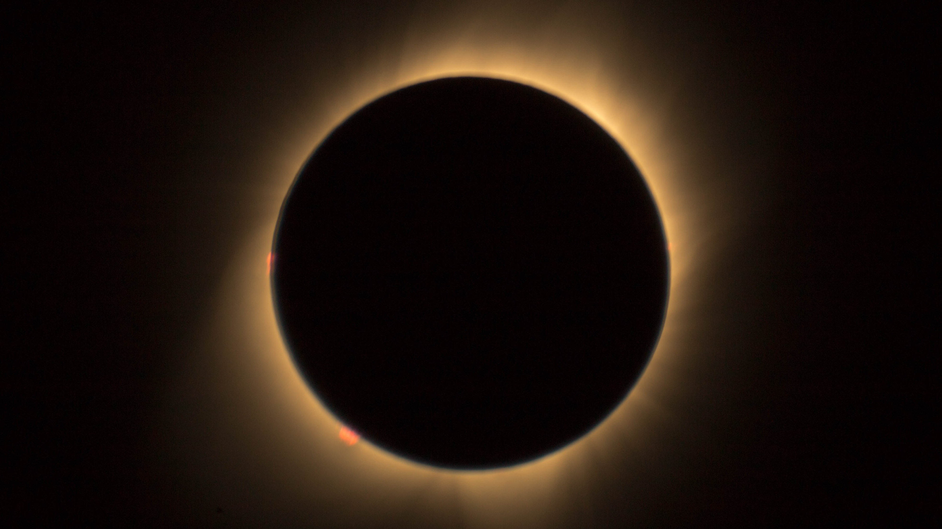
Thesis overview
Alex Prokopyszyn
Notes:
My goal in this presentation is to give an overview of the thesis, and I will focus on explaining my aims and how I went about trying to achieve these aims.
Feel free to stop me at any point if you want to ask a question or if you want me to slow down or explain something in more detail.

Slide 2
Structure
Chapter 1: Introduction
Chapter 2: Ideal footpoint driven Alfvén waves
Chapter 3: Resistive phase-mixed Alfvén waves
Chapter 4: Resonant absorption in an oblique field
Chapter 5: Conclusions and future work
Appendix A: Coronal heating by viscous fast waves
Notes:
In this talk I intend to summarise the thesis chapter by chapter. The thesis has 5 chapters and 1 appendix. The chapters can be split into 1 introductory chapter, 3ish research chapters (depending on whether you class chapter 2 as a research or an introductory chapter) and 1 conclusion chapter. I will talk about each chapter (excluding the conclusion chapter) in order.

Slide 3
Chap 1: Introduction
Notes:
In the introductory chapter, my goal is to introduce the main equations and terminology I use throughout the thesis.

Slide 4
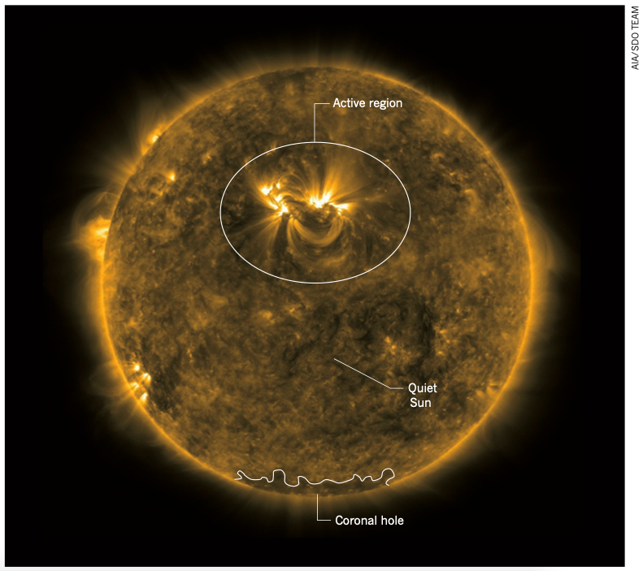
Chap 1: Introduction
Solar atmosphere
Notes:
More specifically, my first goal is to introduce:
The terminology which relates to the solar atmosphere. I want to make sure the reader knows what I mean when I say words like chromosphere, active region, quiet sun etc.

Slide 5
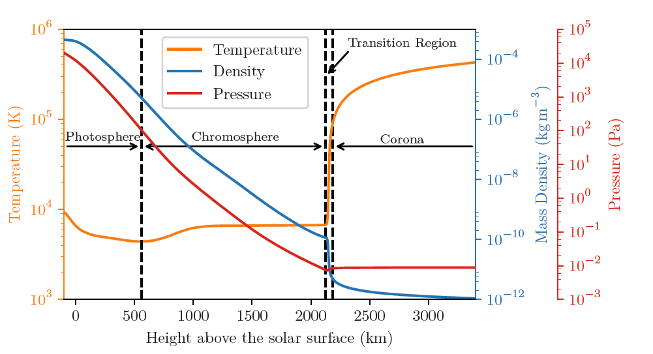
Chap 1: Introduction
Solar atmosphere
Coronal heating problem
Notes:
My second aim is to introduce the coronal heating problem because later on in the thesis I go in to a lot more detail about a specific coronal heating mechanism, namely, phase mixing, so I thought it would be good here to have a brief overview of the coronal heating problem, so we’re ready to go into more detail in the third chapter.

Slide 6

Chap 1: Introduction
Solar atmosphere
Coronal heating problem
MHD equations & assumptions
$$L_{∥}≫λ_{Te}, λ_{Ti}$$
$$L_{⊥}≫\sqrt{λ_{Te}r_{e}}, \sqrt{λ_{Ti}r_{e}}$$
Notes:
My third goal is to introduce the MHD equations and some of the critical assumptions needed for the plasma to be modelled as collisional. I thought it was important to show when the length scales are too short for the plasma to be modelled as collisional because, in the later chapters, very short length scales form due to phase mixing.

Slide 7
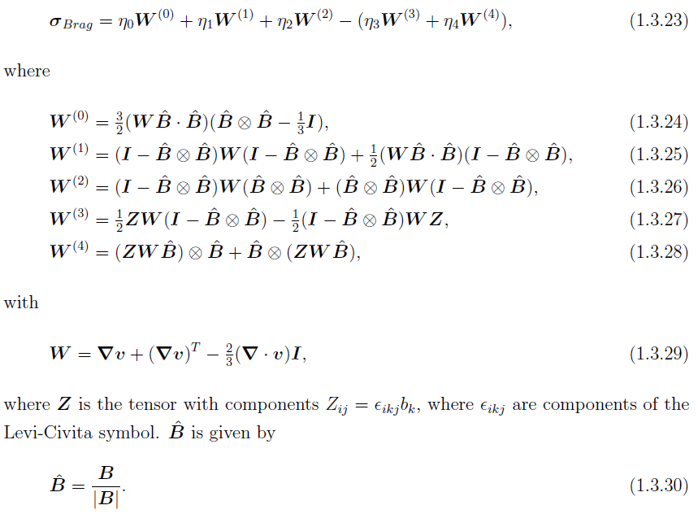
Chap 1: Introduction
Solar atmosphere
Coronal heating problem
MHD equations & assumptions
Viscosity tensor
Notes:
My fourth goal is go into quite a lot of detail describing the viscosity tensor, in probably more detail than most other theses would. I do this because, in chapter 3, I make strong claims about phase mixing as a coronal heating mechanism. I also propose the dissipation of fast waves as a possible heating mechanism in the appendix. My claims are heavily reliant on modelling the resistivity and viscosity correctly. So I thought it was worth spending a bit of extra time clearly defining how I model the viscosity.

Slide 8
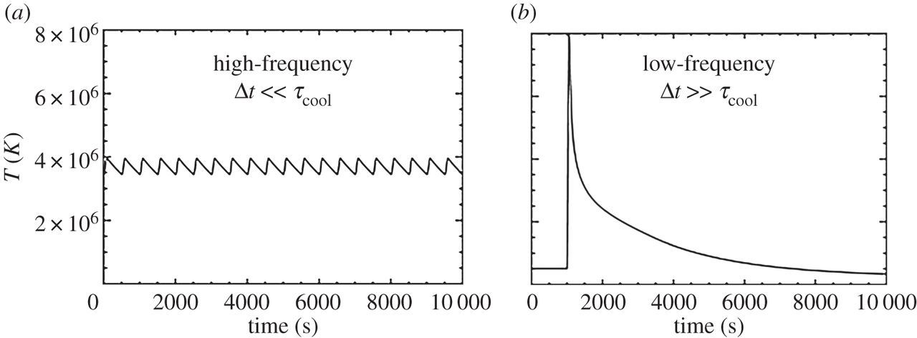
Chap 1: Introduction
Solar atmosphere
Coronal heating problem
MHD equations & assumptions
Viscosity tensor
Thermodynamics
Notes:
My fifth aim is to briefly introduce the thermodynamic terms in the MHD equations. This thesis mostly ignores the thermodynamics for simplicity, and I usually model the loops as isothermal. My goal here is to clarify that I don’t think modelling the loop as isothermal is necessarily a good approximation, but it makes the calculations significantly easier. I think the only other time I really mention the thermodynamics is in the discussion section of chapter 3.

Slide 9

Chap 1: Introduction
Solar atmosphere
Coronal heating problem
MHD equations & assumptions
Viscosity tensor
Thermodynamics
Dispersion relation
$$ω^{2}−v_{A0}^{2}k_{z}^{2}=0$$
$$ω^{2}−v_{A0}^{2}\left(k_{x}^{2}+k_{y}^{2}+k_{z}^{2}\right)=0$$
Notes:
My sixth aim is to derive the dispersion relation for linear fast waves and Alfven waves in a uniform domain. My goal here is to introduce the terminology and point out some basic facts about linear fast waves and Alfven waves. I don’t talk much about slow waves as I model the plasma beta equal to zero throughout most of this thesis.

Slide 10
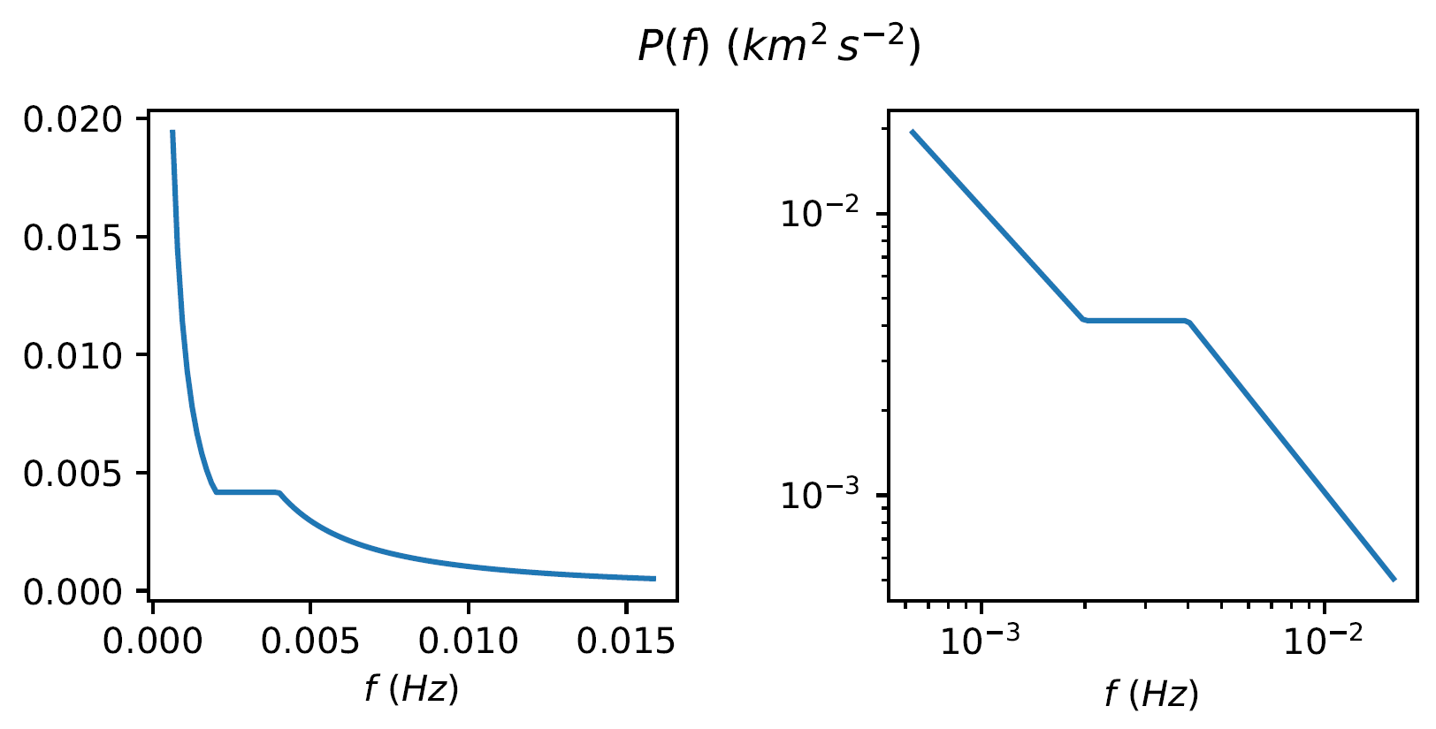
Chap 1: Introduction
Solar atmosphere
Coronal heating problem
MHD equations & assumptions
Viscosity tensor
Thermodynamics
Dispersion relation
Power spectrum
Notes:
Finally, I talk about the observed power spectra of waves in the corona and how power spectra, in general, is calculated. I introduce the power spectrum here because I refer to it later in Chapter 2 when I look at footpoint driven waves where the driver is noisy. I also use it in Chapter 3 to calculate the heat produced by multiple harmonics of standing phase-mixed Alfven waves. In this section I also go into the maths of how power spectra are calculated in a lot more detail than I would in say a paper. The reason is because in a paper you would normally assume the reader already knows this but for this thesis I wanted to make sure the reader knows precisely how the power spectrum is defined.

Slide 11
Chap 2: Ideal footpoint driven Alfvén waves
Notes:
So that’s the introduction part of this talk over.
In chapter 2, my goal is to introduce some of the most relevant facts about footpoint driven Alfven waves for this thesis. I think this chapter reads like a cross between an introductory chapter and a research chapter. I talk about lots of results that are already quite well known, so I think I would struggle to write a paper based on this content. However, I think I the way I derive many of the results is original so it could perhaps make it in to some sort of review paper.

Slide 12
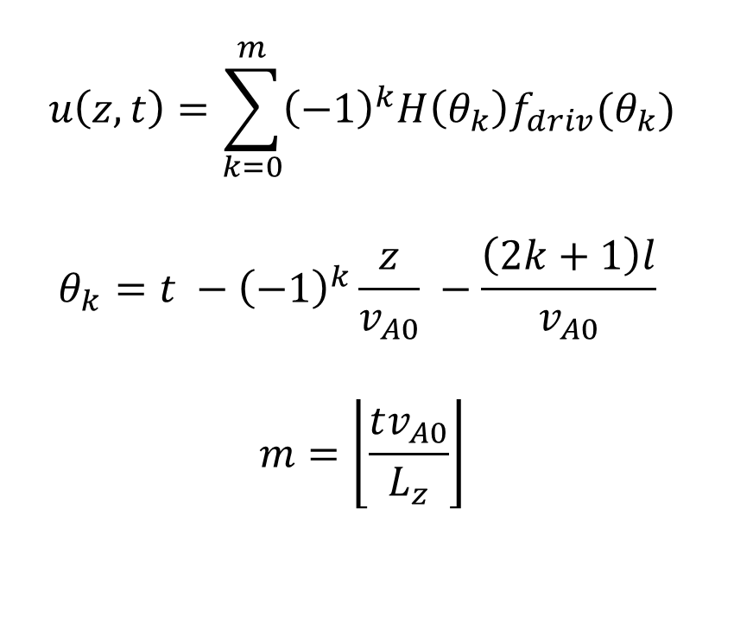
Chap 2: Ideal footpoint driven Alfvén waves
Closed loop: general solution
$$u\left(z,t\right)=\sum_{k=0}^{m}{{\left(−1\right)}^{k}H\left(θ_{k}\right)f_{driv}(θ_{k})}$$
$$θ_{k}=t −{\left(−1\right)}^{k}\frac{z}{v_{A0}} −\frac{\left(2k+1\right)l}{v_{A0}}$$
$$m=\left\lfloor \frac{tv_{A0}}{L_{z}}\right\rfloor$$
Notes:
More specifically, my first goal in this chapter is to calculate:
The general solution for linear Alfven waves in a closed uniform field line using a method of images approach combined with d'Alembert's formula. The main reason I derive this formula is that I make use of it in Chapter 3 when we calculate the solution for linear, resistive phase-mixed Alfven waves in a leaky loop. It’s really easy to include leakage with this formula. It also comes in handy in the next section when we look at the case where the driver is sinusoidal.

Slide 13
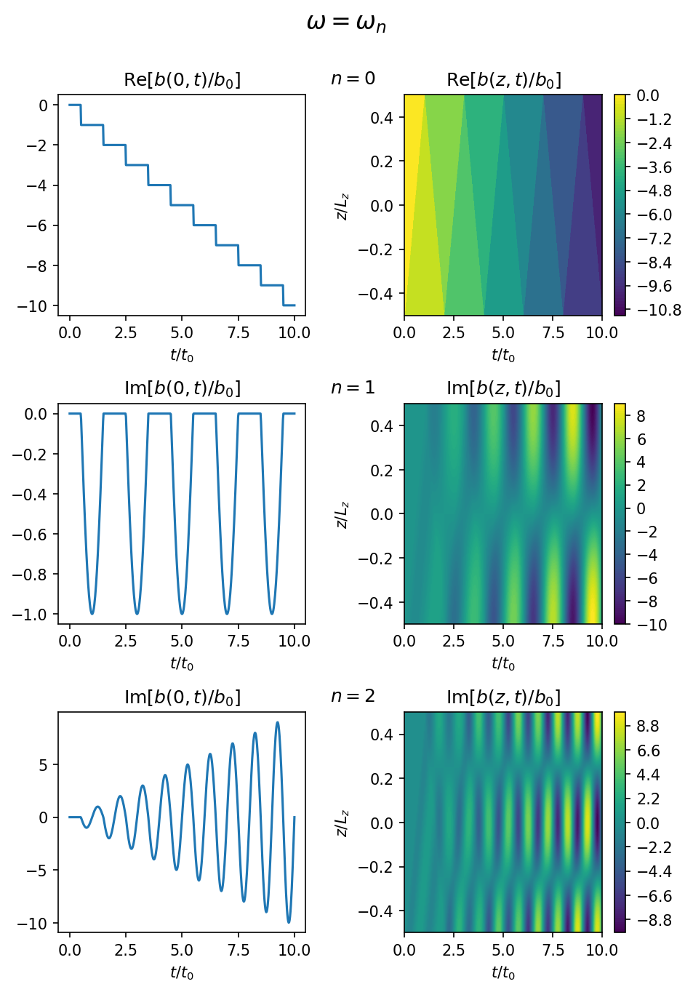
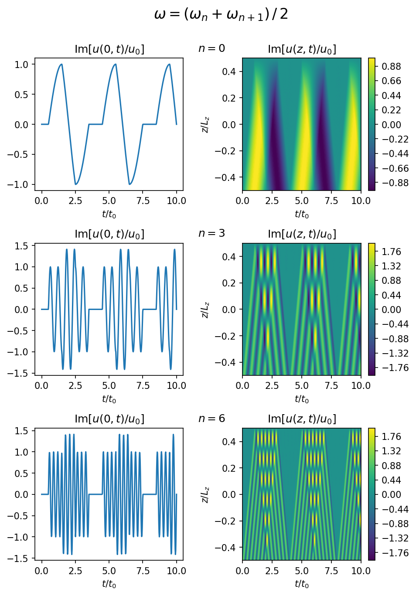
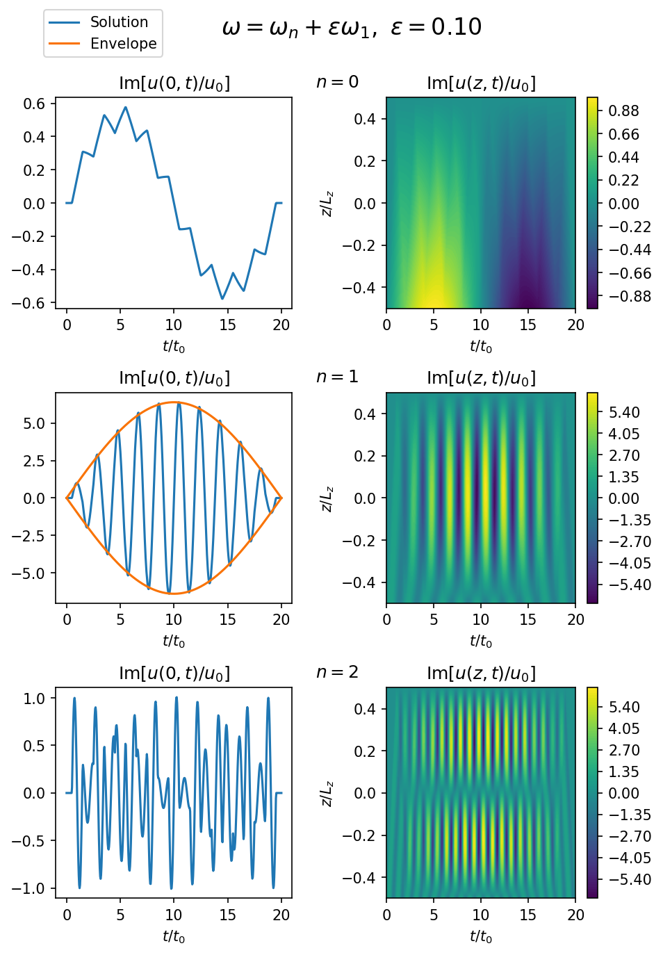
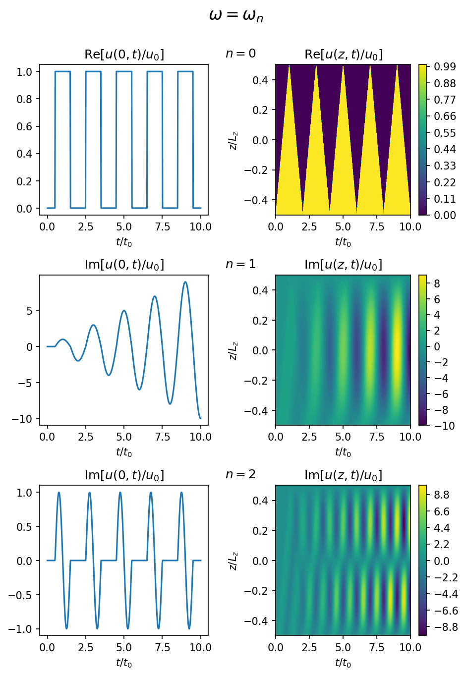
Chap 2: Ideal footpoint driven Alfvén waves
Closed loop: general solution
Closed loop: sinusoidal solution
Notes:
This leads nicely into my second aim which is to calculate the solution for the case where the driver is sinusoidal. The reason I consider a sinusoidal driver is that I think it’s the simplest case to consider. In reality the footpoint driver on the Sun will be much more random but you can model this as a superposition of many sinusoidal drivers. In this section my goal was to introduce some key concepts like resonance and the beating effect. I produced lots of graphs like the ones shown here as I thought this is really useful for building intuition for how the solution changes depending on the frequency of the driver. If the driver is equal to one of the resonant frequencies then the amplitude grows linearly and you can see this in the middle row of the graph here. (change graph) If the driver is close to one of the resonant frequencies then the amplitude oscillates with an approximately sinusoidal envelope shown in orange in the middle row here. The frequency of this envelope is the beating frequency which is given by half of the difference between the driver frequency and natural frequency. (change graph) Finally if the driver frequency is far away from any of the natural frequencies then you get an interference pattern which looks like this. I thought it was worth showing this as I know lots of authors use sinusoidal drivers in their simulations. So if they ever see an interference pattern which looks something like this they will know that there’s a good chance that a phenomenon similar to this is going on in their simulation. (change graph) I also thought this was good opportunity to explain how a slow (or in other words DC) driver where the driver frequency is less than the fundamental frequency of a field line gives different results to a fast (or in other words AC) driver where the driver frequency is greater than the fundamental frequency of the loop. You can see here in the top row a driver frequency of zero is used and this represents a DC driver. You can see the magnetic energy continually builds up but if we look at the velocity graph again (change graph) You can see the velocity amplitude in the top row oscillates about a finite value and does not grow linearly like the magnetic field does. This shows one of the key difference between DC drivers is that they generate a large build-up in magnetic energy and a relatively small build-up in kinetic energy. Whereas AC drivers generate approximately equal magnetic and kinetic energy.

Slide 14
Chap 2: Ideal footpoint driven Alfvén waves
Closed loop: general solution
Closed loop: sinusoidal solution
Notes:
This leads nicely into my second aim which is to calculate the solution for the case where the driver is sinusoidal. The reason I consider a sinusoidal driver is that I think it’s the simplest case to consider. In reality the footpoint driver on the Sun will be much more random but you can model this as a superposition of many sinusoidal drivers. In this section my goal was to introduce some key concepts like resonance and the beating effect. I produced lots of graphs like the ones shown here as I thought this is really useful for building intuition for how the solution changes depending on the frequency of the driver. If the driver is equal to one of the resonant frequencies then the amplitude grows linearly and you can see this in the middle row of the graph here.
I also thought this was good opportunity to explain how a slow (or in other words DC) driver where the driver frequency is less than the fundamental frequency of a field line gives different results to a fast (or in other words AC) driver where the driver frequency is greater than the fundamental frequency of the loop. You can see here in the top row a driver frequency of zero is used and this represents a DC driver. You can see the magnetic energy continually builds up but if we look at the top row of the velocity graphs (change graph) You can see the velocity amplitude in the top row oscillates about a finite value and does not grow linearly like the magnetic field does. This shows one of the key difference between DC drivers is that they generate a large build-up in magnetic energy and a relatively small build-up in kinetic energy. Whereas AC drivers generate approximately equal magnetic and kinetic energy.

Slide 15
Chap 2: Ideal footpoint driven Alfvén waves
Closed loop: general solution
Closed loop: sinusoidal solution
Notes:
This leads nicely into my second aim which is to calculate the solution for the case where the driver is sinusoidal. The reason I consider a sinusoidal driver is that I think it’s the simplest case to consider. In reality the footpoint driver on the Sun will be much more random but you can model this as a superposition of many sinusoidal drivers. In this section my goal was to introduce some key concepts like resonance and the beating effect. I produced lots of graphs like the ones shown here as I thought this is really useful for building intuition for how the solution changes depending on the frequency of the driver.

Slide 16
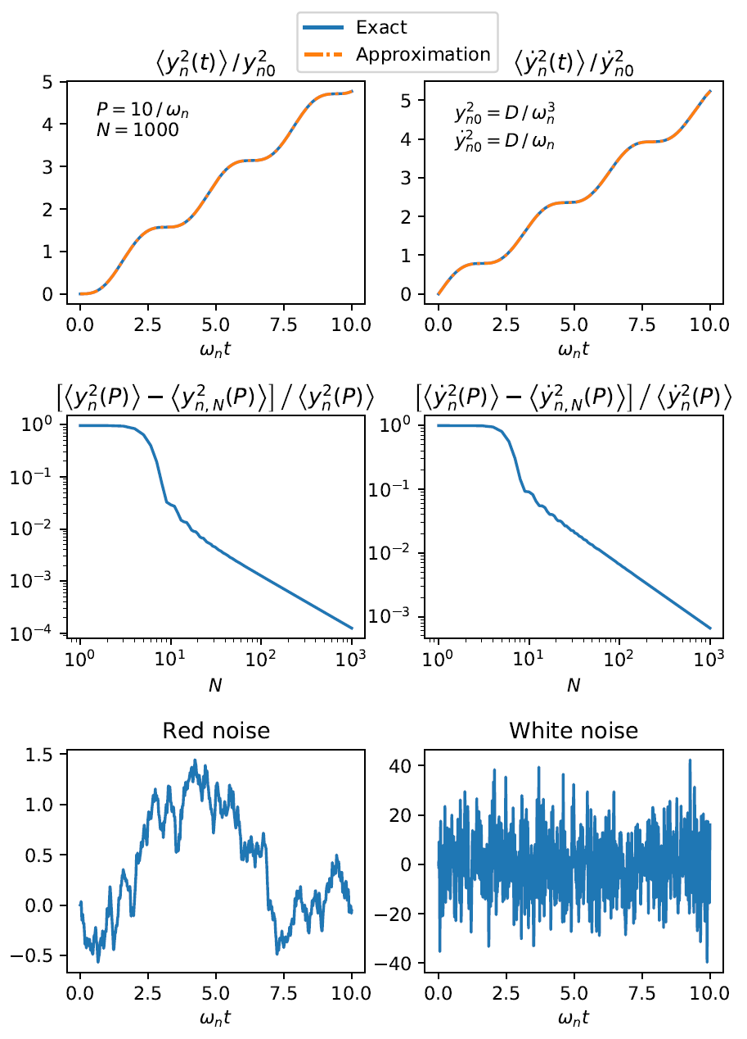
Chap 2: Ideal footpoint driven Alfvén waves
Closed loop: general solution
Closed loop: sinusoidal solution
Closed loop: broadband driver
Notes:
My third aim is to calculate the solution for the case where a broadband or noisy driver is used. Throughout this thesis I mainly use sinusoidal drivers but I thought it would be good to at least once consider the case where a noisy driver is used as this more closely resembles what the driver on the sun actually behaves like.
I was also curious if the energy will grow to infinity or oscillate about a finite value. Before I did these calculations I actually had no idea what would happen because I knew from the sinusoidal solutions that the energy only grows to infinity if the resonant frequency is excited. It turns out that for a resonant loop the energy grows quadratically with time and for a noisy loop the variance (which you can think of as the energy) grows linearly with time. You can see this linear growth in the top row here.
Another aim I had in this section was to show off the power of some of the ideas from stochastic calculus. You can see in the legend of the graph here I have an exact solution shown in blue and an approximation shown in orange. The exact solution was calculated by modelling the driver as a white noise signal. The orange curve was calculated using an approximate white noise signal which excites all frequencies over a finite range with a constant amount of energy. True white noise excites all frequencies from 0 to infinity with a constant amount of energy, this means it has a variance of infinity. The signal in the bottom right here is actually only approximately a white noise signal as it only excites frequencies over a finite range with a constant amount of energy. True white noise would have a variance of infinity.
Before I did these calculations I was a bit sceptical of the idea of using a white noise signal because it obviously isn’t physical to have a force with a variance of infinity. But it turns out that provided the approximate signal excites the resonant frequency then you get very good agreement between an approximate white noise signal and true white noise. In the middle row here I show the error between the exact and approximate signal and the steep drop in error occurs when the approximate solution includes the resonant frequency in it’s range of frequencies it excites. This shows that although true white noise isn’t physical it still serves as useful concept for making predictions.
You can see in the thesis that it takes significantly less effort/algebra to calculate the solution when a true white noise driver is used compared with an approximate white noise driver.

Slide 17
Chap 2: Ideal footpoint driven Alfvén waves
Closed loop: general solution
Closed loop: sinusoidal solution
Closed loop: broadband driver
Notes:
My third aim is to calculate the solution for the case where a broadband or noisy driver is used. Throughout this thesis I mainly use sinusoidal drivers but I thought it would be good to at least once consider the case where a noisy driver is used as this more closely resembles what the driver on the sun actually behaves like.
I basically had two aims in this section.
The first was to see if the energy will grow to infinity or oscillate about a finite value. As I thought this was an interesting question to answer and until I did the calculation I actually had no idea if it would grow to infinity or not. You can see here that the variance which, you can think of the energy grows linearly with time. I think its interesting that for a randomly driven loop the energy grows approximately linearly with time but for a resonant loop the energy grows quadratically with time.
The second aim was to check that a true white noise driver which excites all frequencies with a given amount of energy gives the same results as an approximate white noise signal which only excites the frequencies over a finite range. It turns out that provided the resonant frequency is excited then the true white noise signal and approximate white noise signal give approximately the same answer. The reason I wanted to check this is that a true white noise signal isn’t actually physical because it has a variance of infinity whereas an approximate white noise singal has a finite variance so is physical. So its reassuring to know that although true white noise isn’t physical it is still a useful tool for making predictions.

Slide 18
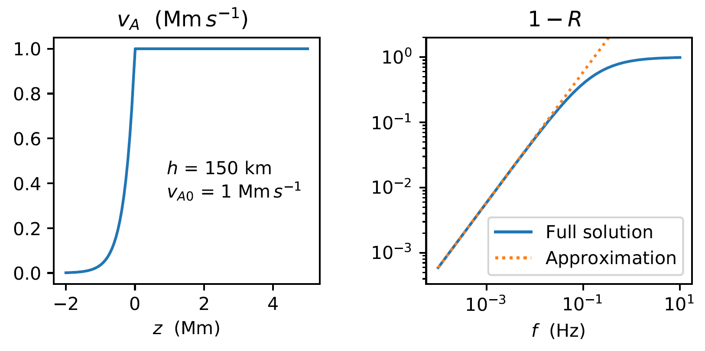
Chap 2: Ideal footpoint driven Alfvén waves
Closed loop: general solution
Closed loop: sinusoidal solution
Closed loop: broadband driver
Leaky loop: reflection coefficient
Notes:
My fourth aim in chapter 2 is to calculate an estimate for the reflection coefficient, R. This is important as to simulate the leakage I model that a fraction R of the waves reflects each time the waves hit each of the boundaries. To estimate the reflection coefficient I use a method which is similar to what Joe Hollweg uses in a in a paper he wrote in 1984.

Slide 19

Chap 2: Ideal footpoint driven Alfvén waves
Closed loop: general solution
Closed loop: sinusoidal solution
Closed loop: broadband driver
Leaky loop: reflection coefficient
Leaky loop: steady state solution
$$u\left(z,t\right)= \sum_{k=0}^{∞}{{\left(−1\right)}^{k}R^{k}H\left(θ_{k}\right)f_{driv}(θ_{k})}$$
Notes:
My final aim in chapter 2 is to calculate the steady-state solution for a sinusoidal driver in a leaky loop.
One of the major aims here is to introduce the idea of a steady-state. In other words, that for a leaky loop or resistive loop the system will go through a transient phase where the system can oscillate at different frequencies to the driver frequency but at steady-state the whole system oscillates at the driver frequency.
Another aim is to convince the reader that to introduce leakage you simply need to modify the formula a little bit by introducing an R to the k factor which is shown in red here. I do this by calculating both a numeric and analytic solution and checking they agree. Confirming this formula is accurate is useful in Chapter 3 when we look at resistive phase mixed Alfven waves in a leaky loop.

Slide 20
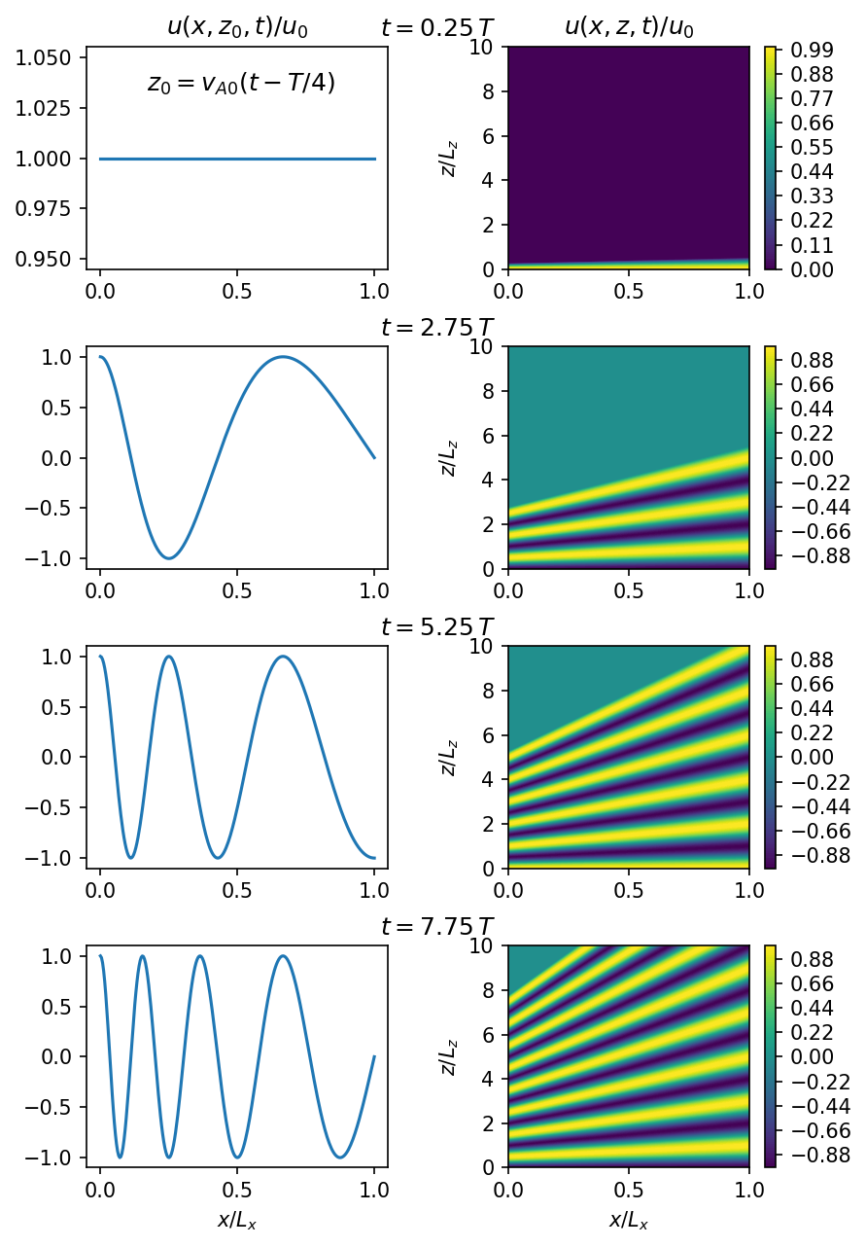
Chap 2: Ideal footpoint driven Alfvén waves
Closed loop: general solution
Closed loop: sinusoidal solution
Closed loop: broadband driver
Leaky loop: reflection coefficient
Leaky loop: steady state solution
Open loop: phase mixing
Notes:
My final aim in chapter 2 is to introduce phase mixing. I do this by calculating the solution

Slide 21
Chap 3: Resistive phase-mixed Alfvén waves
Notes:
So that’s all I’m going to say about chapter 2.
Chapter 3 is closely related to a paper I published in 2019. The main goal of this chapter is to rule out phase mixing as a potential heating mechanism in the closed corona. I still think its possible that phase mixing could play an indirect role in coronal heating. For example, it could trigger the Kelvin-Helmholtz instability which then causes energy to be dissipated due to gradients parallel to the velocity and magnetic field. But I don’t think the direct dissipation of the transverse gradients produced by phase mixing plays a significant role in coronal heating.
I structure this chapter by starting simple with an open loop. Then I keep adding complexity to the model in each subsequent section.

Slide 22


Chap 3: Resistive phase-mixed Alfvén waves
$γ=\frac{\text{Heating} \text{rate}}{\text{Wave} \text{energy}}$
We require:
$$γ=\frac{H_{c}}{E_{wave}} \\ ≈{10}^{−1}s^{−1}$$
Notes:
I start this chapter by introducing something I call the heating rate per unit of wave energy which I denote with gamma.
I then estimate that we need a gamma of about 10^-1 s-^-1 for something to be a viable coronal heating mechanism. This comes from estimating the heating rate required per unit volume in the corona and dividing by observed wave energy density in the corona.
In this chapter I try to show that phase mixing cannot give a high enough gamma and therefore cannot explain coronal heating on its own.

Slide 23
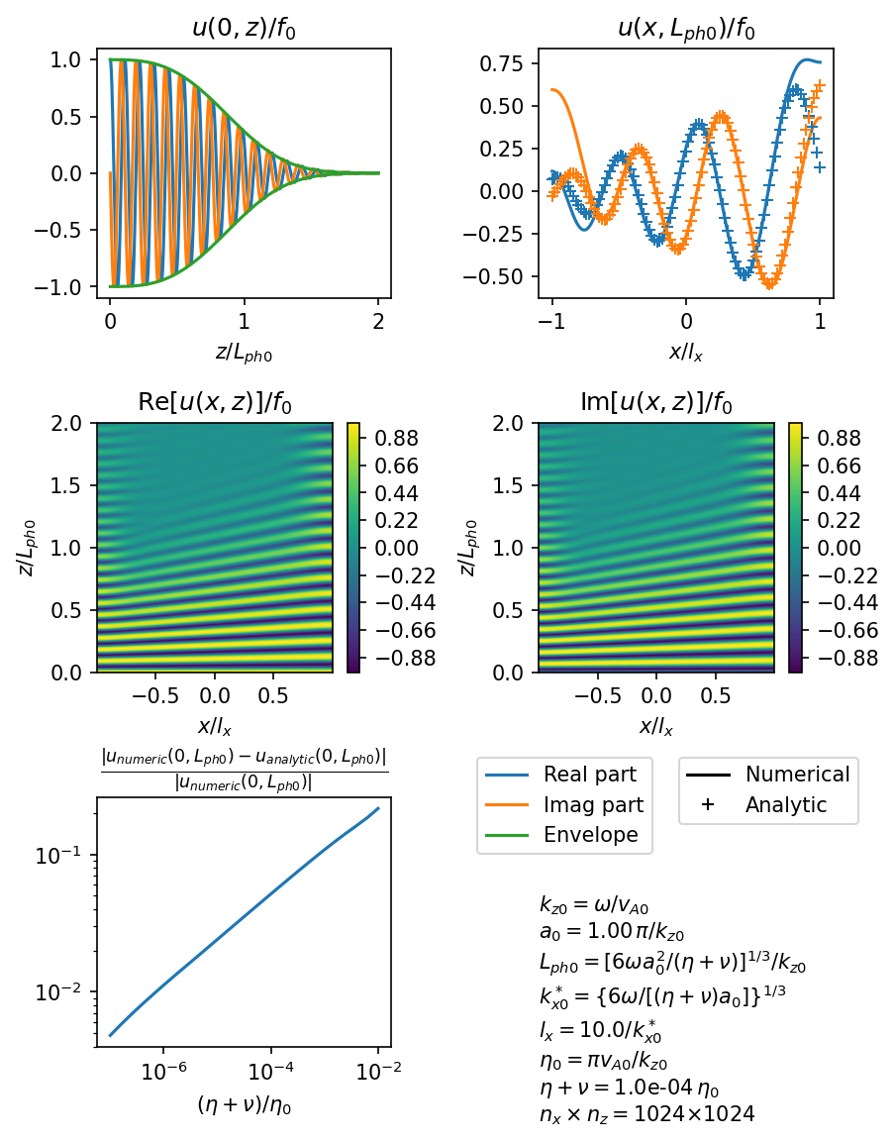

Chap 3: Resistive phase-mixed Alfvén waves
$γ=\frac{\text{Heating} \text{rate}}{\text{Wave} \text{energy}}$
Open loop
Notes:
In the next section my goal is to introduce phase mixing. To do this I rederive the formulas that were derived in Heyvearts and Priest (1983). I then confirm that the analytic approximation agrees with the numerical solution.

Slide 24
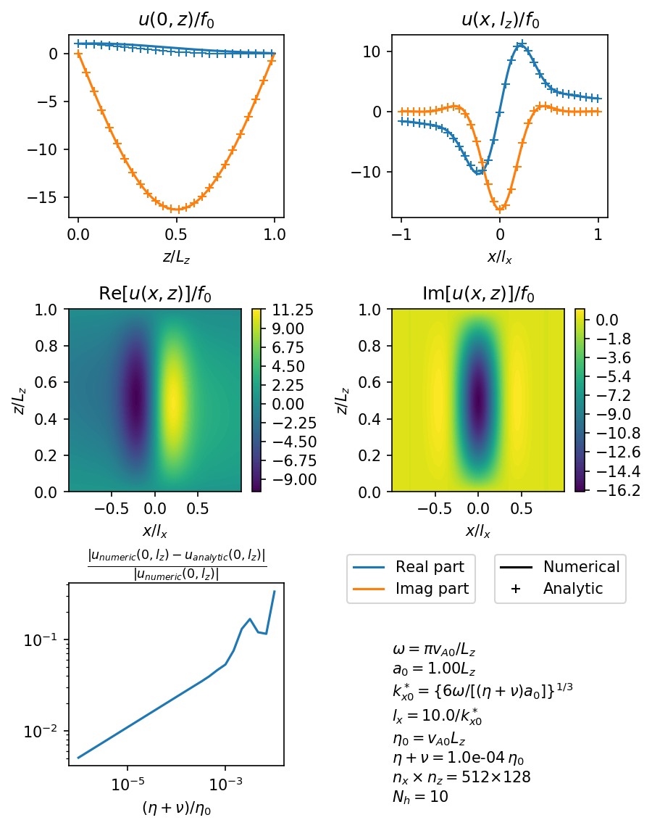

Chap 3: Resistive phase-mixed Alfvén waves
$γ=\frac{\text{Heating} \text{rate}}{\text{Wave} \text{energy}}$
Open loop
Closed loop: single harmonic
Notes:
In this next section my goal was to extend the open loop solution to work for closed loop. I did this by combining the Heyvearts and Priest (1983) solution with the d’Alembert solution I derived in the previous chapter. I then confirmed it was accurate by calculating the solution numerically.

Slide 25
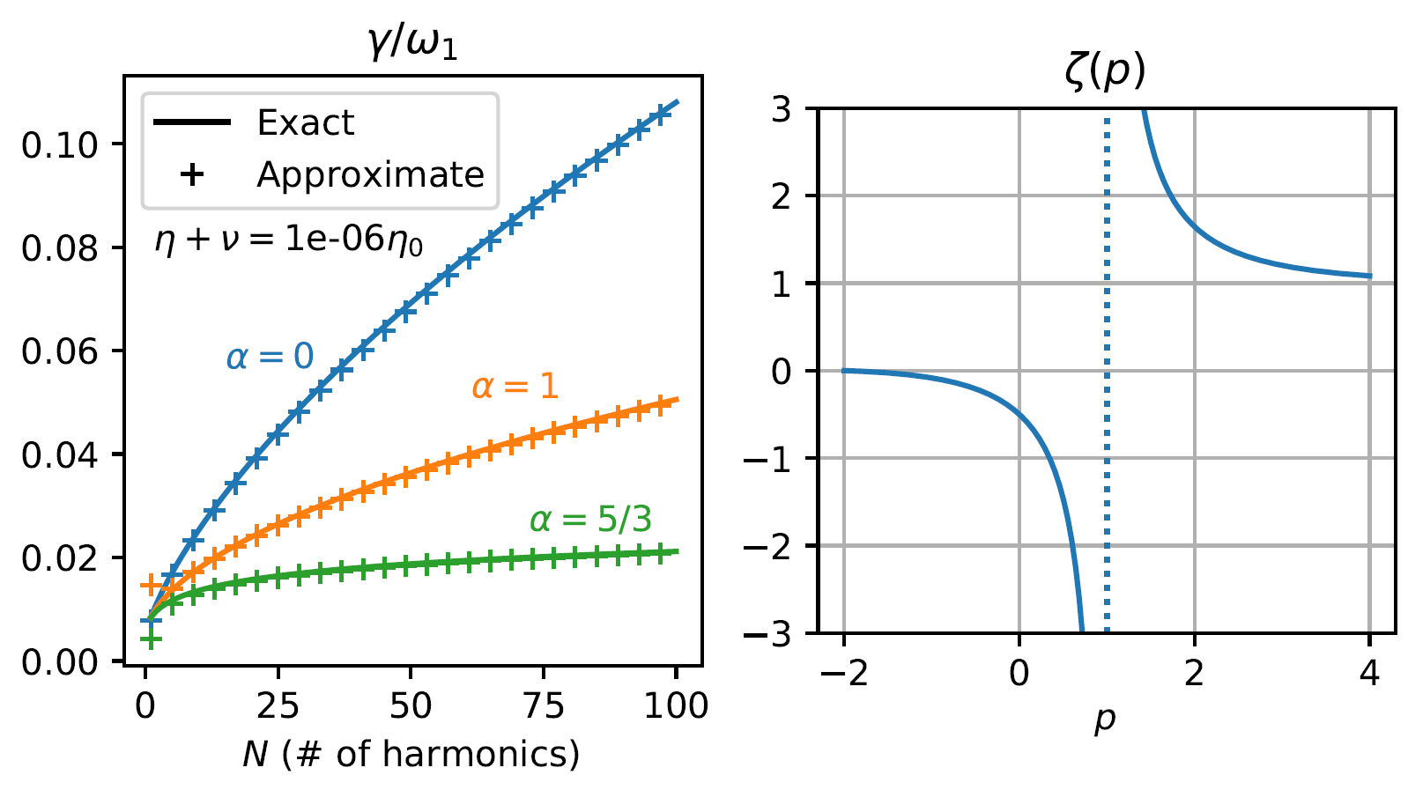
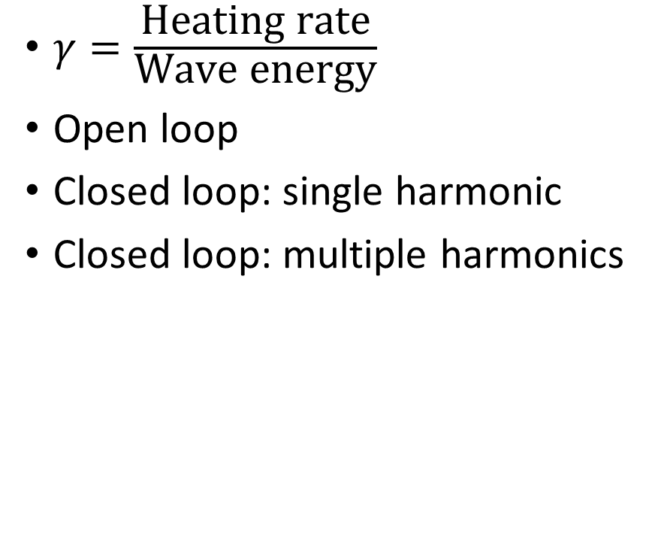
Chap 3: Resistive phase-mixed Alfvén waves
$γ=\frac{\text{Heating} \text{rate}}{\text{Wave} \text{energy}}$
Open loop
Closed loop: single harmonic
Closed loop: multiple harmonics
Notes:
In this next section I increase the complexity of the model by considering the case where multiple harmonics are excited. I look at how the heating rate per unit of wave energy changes depending on how many harmonics I excite and the slope of the of the power spectrum.

Slide 26
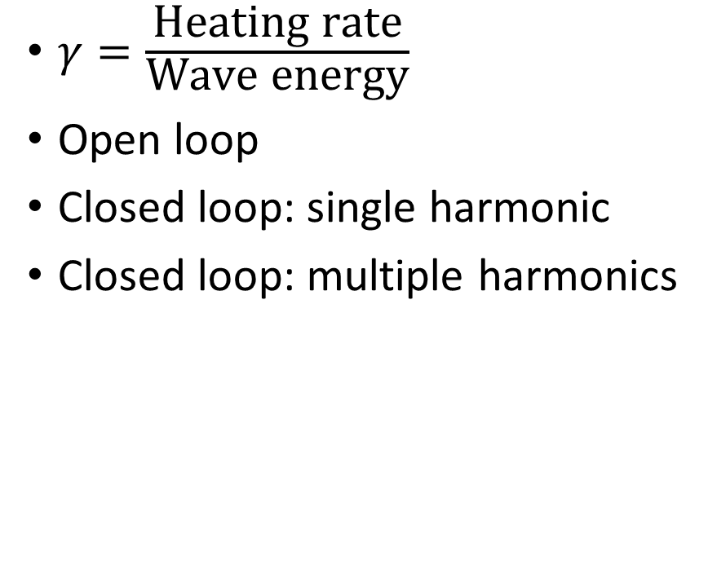
Chap 3: Resistive phase-mixed Alfvén waves
$γ=\frac{\text{Heating} \text{rate}}{\text{Wave} \text{energy}}$
Open loop
Closed loop: single harmonic
Closed loop: multiple harmonics
Notes:
In this next section I increase the complexity of the model by considering the case where multiple harmonics are excited. I look at how the heating rate per unit of wave energy changes depending on how many harmonics I excite and the slope of the of the power spectrum.

Slide 27
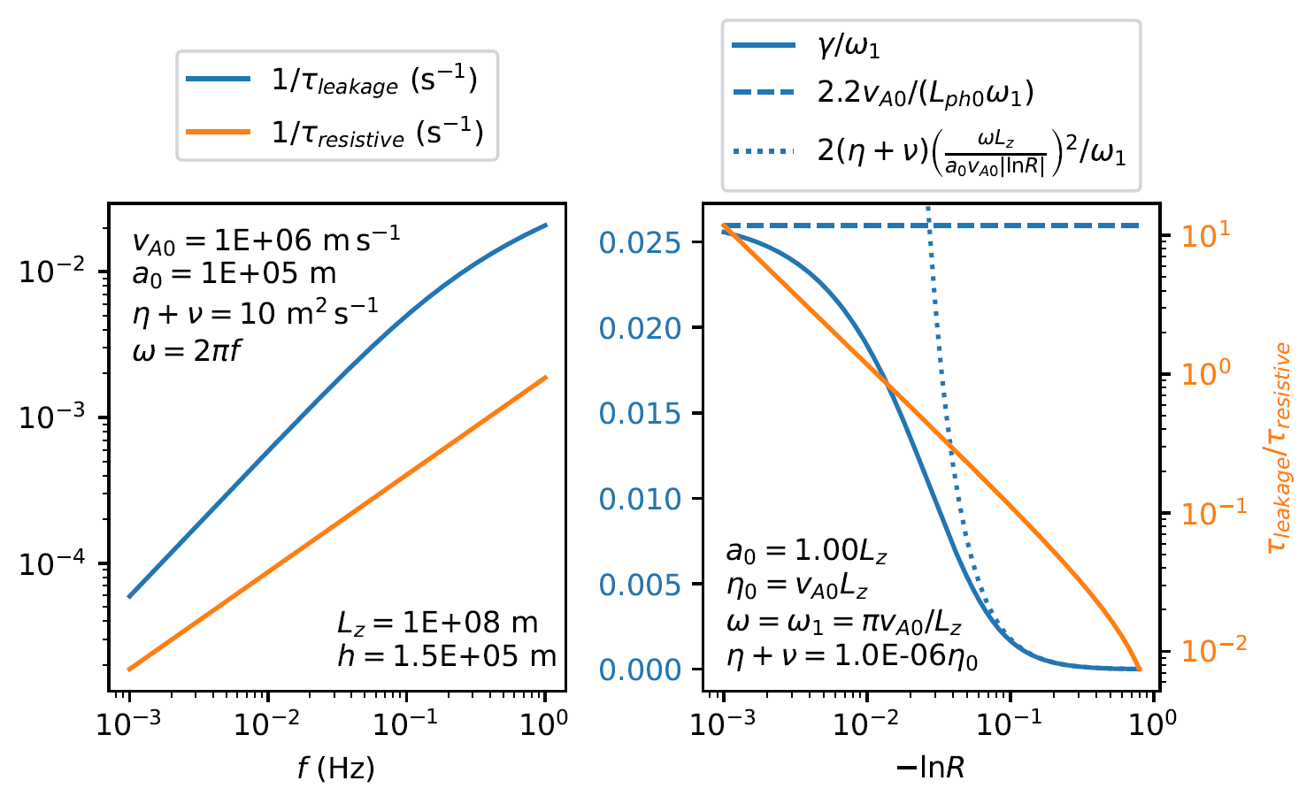
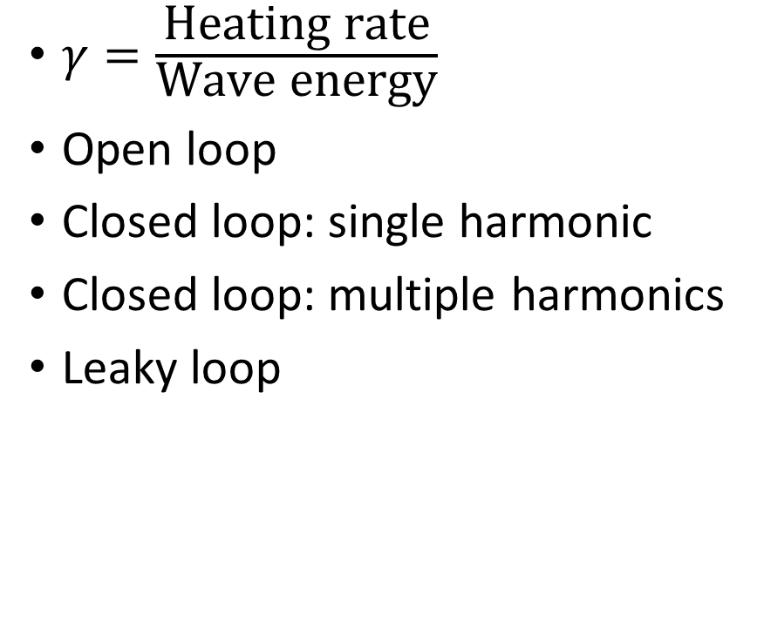
Chap 3: Resistive phase-mixed Alfvén waves
$γ=\frac{\text{Heating} \text{rate}}{\text{Wave} \text{energy}}$
Open loop
Closed loop: single harmonic
Closed loop: multiple harmonics
Leaky loop

Slide 28
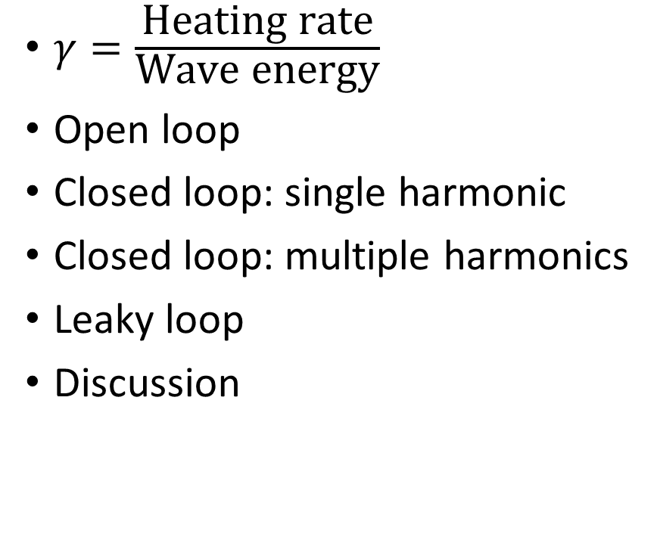
Chap 3: Resistive phase-mixed Alfvén waves
$γ=\frac{\text{Heating} \text{rate}}{\text{Wave} \text{energy}}$
Open loop
Closed loop: single harmonic
Closed loop: multiple harmonics
Leaky loop
Discussion

