Slide 1
Thesis Overview
Alex Prokopyszyn

Slide 2
Chapter 1: Introduction

Slide 3
Chapter 1 aims:
1.1: Introduce

Slide 4
Chapter 1: Introduction
Solar atmosphere
Coronal heating problem
MHD equations & assumptions
MHD waves: dispersion relation
MHD waves: power spectrum

Slide 5
Chapter 2: Ideal footpoint driven Alfven waves
The main goal here is to introduce concepts relevant for the rest of the thesis.
Still has elements of original research. For example I am not aware of anyone using the D’Alambert’s formula.
Useful for numerical as people often drive with a sinusoidal footpoint driver.

Slide 6
Chapter 2: Ideal footpoint driven Alfven waves
Aim 1:
Still has elements of original research. For example I am not aware of anyone using the D’Alambert’s formula.
Useful for numerical as people often drive with a sinusoidal footpoint driver.
Notes:
The

Slide 7
Closed loop: General solution
Uses d’Alambert’s formula instead of Fourier analysis.

Slide 8
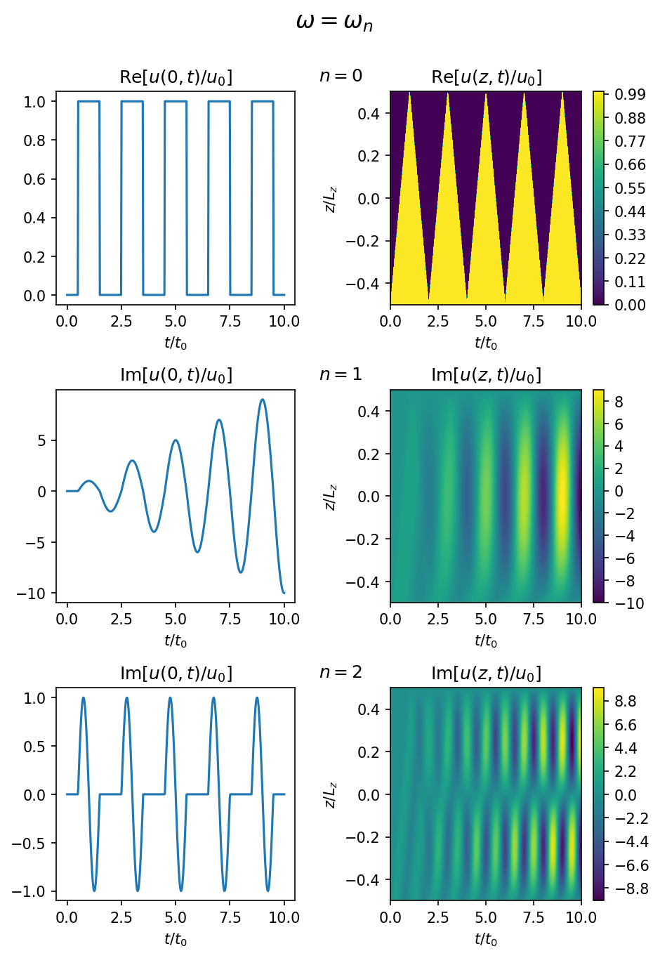
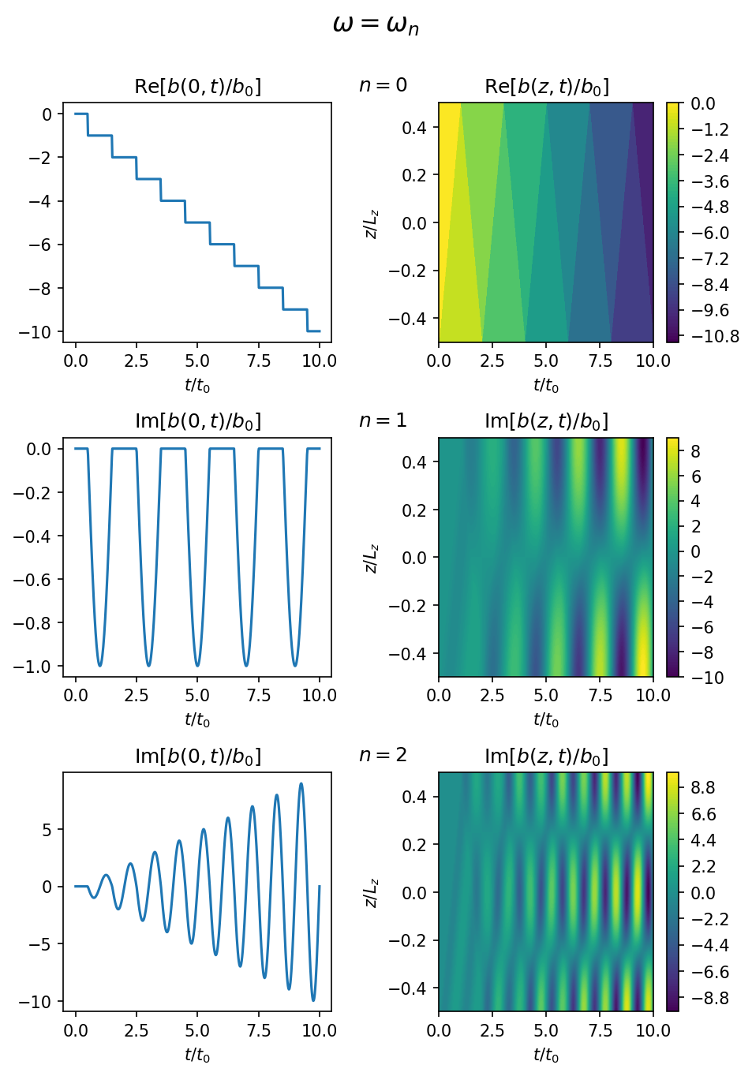
Closed loop: resonant
Figures 2.1 and 2.2 show clearly that slow motions can build-up the magnetic field for a small kinetic energy.
Notes:
The main points I was trying to get across here is that at the resonant frequencies the energy grows linearly with time.
I also showed these graphs because I think they clearly illustrate the difference between a slow driver where the driving frequency is lower than than the fundamental frequency of the field line and there the driver freuqncy is greater than or equal to the

Slide 9
Closed loop: Nearly resonant
Amplitude given by sec(omega lz / va0)
Beating frequency given by (omega – omega_n) / 2

Slide 10
Closed loop: Antiresonant case
Interesting interference pattern

Slide 11
Closed loop: broadband driver
Goal here is to tie the results to observations.
Will the energy of a randomly driven loop grow to infinity or oscillate about a finite value?
Check white noise result agrees with Fourier result.
The most natural way to do this gives you a Langevin equation.
The Langevin equation with white noise we can calculate a nice analytic solution precisely. However, it quite confusing because we have a white noise force that excites all frequencies equally.

Slide 12
Leaky loop: reflection coefficent

Slide 13
Leaky loop: general solution

Slide 14
Leaky loop: steady state solution

Slide 15
Chapter 3: Resistive phase-mixed Alfven waves
Show that the steep gradients produced by phase mixing play a negligible direct role in coronal heating. However, it is possible that they trigger a turbulent cascade which then results in dissipation due to gradients formed parallel to the magnetic field or velocity field.
To do this I showed that the heating rate per unit of wave energy, γ, is too small

