Slide 1
BASIC ELECTRONICS (CENG 102)
J. OWUSU
Assisted by:
Dean P. Agbodjan
Enoch K.D. Viewu

Slide 2
INFO:
Reading material: Grob Basic Electronics (11 th Edition) pp 838
Other reading material: Electronic Devices and Circuit Theory (7 Edition) ROBERT BOYLESTAD, LOUIS NASHELSKY
I am available for live and call session on weekends.
You can schedule a personal online meeting on week days between 6 and 8pm.
You can contact my T.A.s for assistance
Contact (WhatsApp) : 0560741222
Contact (Call) : 0541371094
Contact (Zoom) : meeting ID 851 489 4811 Password 0M248c

Slide 3
ASSIGNMENT
Electronic Devices and Circuit Theory end of chapter 2 exercises;
3,5,6,10,21,26, 27,42,43,45,47,48.
Multisim Assignment: Design and simulate a 5v power supply using a transformer, full wave rectifier, capacitors and a voltage regulator.
1. Use an oscilloscope to determine the:
i. AC voltage source waveform
ii. Waveform of the voltage after the rectifier
iii. Waveform of the voltage after the capacitor
iv. Change the capacitance and determine its waveform
v. What is the purpose of the capacitor in a power supply
iv. What difference did you notice in the waveform before and after the
capacitance was changed.
v. What is the purpose of the volage regulator
2. Add a light emitting diode as a load to the power supply you designed.

Slide 4
Diode Applications
A semiconductor is a material that is neither a good conductor nor a good insulator. In their purest form, semiconductors have few applications in electronics. However, when the characteristics of a pure semiconductor are altered through a process known as doping, many useful electronic devices can be developed. The most basic semiconductor device is the diode,
Diode is a device that allows current to pass through it in only one direction. This characteristic of a diode has many useful applications in electronics. One of the most useful applications is converting an ac voltage into a dc voltage.

Slide 5
Diode Applications
When used for this purpose, diodes are typically referred to as rectifier diodes.
We will consider the basic construction and operation of a semiconductor diode. You will learn how a diode can be turned on or off by applying the proper polarity of voltage across the diode terminals.
You will also be introduced to half-wave and full-wave rectifiers which use diodes to convert an ac voltage into a dc voltage.
Also we will consider to two special-purpose diodes
the light-emitting diode (LED) and
the zener diode.

Slide 6
Important Terminology
barrier potential, V B
bias
breakdown voltage, V BR
bulk resistance, r B
covalent bonding
depletion zone
diode
doping
electron-hole pair
extrinsic
Semiconductor
avalanche
forward bias
full-wave rectifier
half-wave rectifier
hole
intrinsic semiconductor
leakage current
light-emitting diode
(LED)
majority current carrier
minority current carrier
n -type semiconductor
p -type semiconductor
peak inverse voltage
(PIV)
pentavalent atom
reverse bias
trivalent atom
valence electrons
zener current, I z
zener diode

Slide 7
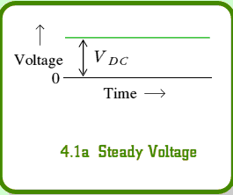
Direct Current and its Voltage Waveform
Circuits that are powered by battery sources are termed direct current circuits.
This is because the battery maintains the same polarity of output voltage. The plus and minus sides remain constant.

Slide 8
Characteristics of DC
It is the flow of charges in just one direction.
The fixed polarity of the applied voltage which are characteristics of DC circuits

Slide 9
Alternating Current (AC)
An alternating voltage source periodically alternates or reverses in polarity.
The resulting current, therefore, periodically reverses in direction.
The power outlet in your home is 60 cycle ac - meaning the voltage polarity and current direction go through 60 cycles of reversal per second.
All audio signals are AC also.

Slide 10
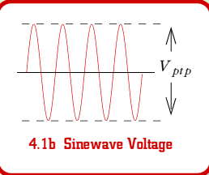
Waveform of AC Voltage

Slide 11
Comparison of DC & AC
DC Voltage | AC Voltage
Fixed polarity | Reverses polarity
Can be steady or vary in magnitude | Varies in magnitude between reversals in polarity
Steady value cannot be stepped up or down by a transformer | Used for electrical power distribution
Electrode voltage for tube and transistor amps | I/O signal for tube and transistor amps
Easier to measure | Easier to amplify
Heating Effects the same for both AC and DC current

Slide 12
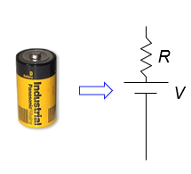
DC power supply: Batteries
A power supply (battery) is characterized by a voltage (V) and an output impedance (R), sometimes called source impedance.
Hooking up to load (R_{load}), we form a voltage divider, so that the voltage applied by the battery terminal is actually V_{out} = V(R_{load}/(R+R_{load}))
thus the smaller R is, the “stiffer” the power supply
when V_{out} sags with higher load current, we call this “droop”
Example: If 10.0 V power supply droops by 1% (0.1 V) when loaded to 1 Amp (10 Ω load):
internal resistance is 0.1 Ω
called output impedance or source impedance
may vary with load, though (not a real resistor)
D-cell example: 6A
out of 1.5 V battery
indicates 0.25 Ω output
impedance

Slide 13
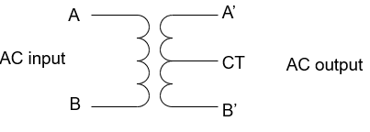
Power Supplies and Regulation
A power supply typically starts with a transformer, to knock down the 240 V peak-to-peak (120 V AC) to something reasonable/manageable
We will be using a center-tap transformer
(A’ − B’) = (winding ratio)×(A − B), when A > B, so is A’ > B’
geometry of center tap (CT) guarantees it is midway between A’ and B’ (frequently tie this to ground so that A’ = −B’)
note that secondary side floats: no ground reference built-in

Slide 14
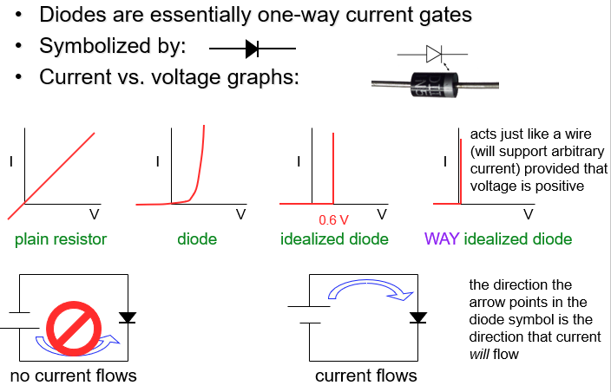
Diodes

Slide 15
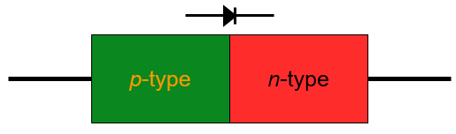
Diode Makeup
Diodes are made of semiconductors (usually silicon)
Essentially a stack of p-doped and n-doped silicon to form a p-n junction
NB: doping means deliberate impurities that contribute extra
electrons (n-doped) or “holes” for electrons (p-doped).

Slide 16
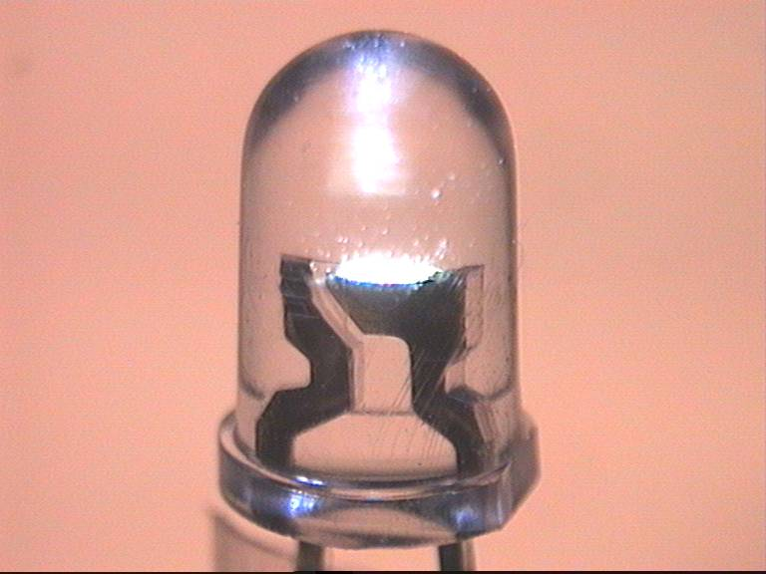
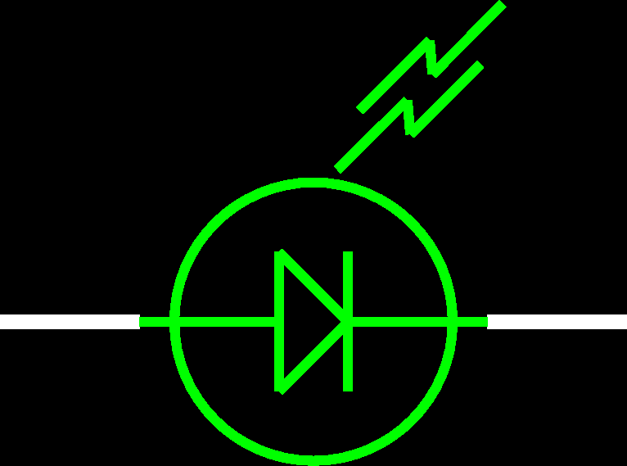
LEDs: Light-Emitting Diodes
Main difference is, material is more exotic than silicon used in ordinary diodes/transistors (typically 2-volt drop instead of 0.6 V drop)
When electron flows through LED, loses energy by emitting a photon of light rather than vibrating lattice (heat)
LED efficiency is 30% (compare to incandescent bulb at 10%)
Must connect current-limiting resistor in series:

Slide 17
Getting DC back out of AC
AC provides a means for us to distribute electrical power, but most devices actually want DC. Electrical devices such bulbs, toasters, heaters, fans don’t care: plug straight in.
Sophisticated devices care because they have diodes and transistors that require a certain polarity.
−rather than oscillating polarity derived from AC
−this is why battery orientation matters in most electronics
Use diodes to “rectify” AC signal
Simplest (half-wave) rectifier uses one diode:
input voltage
AC source
load
diode only conducts
when input voltage is positive
voltage seen by load

Slide 18
Doing Better: Full-wave Diode Bridge
The diode in the rectifying circuit simply prevented the negative swing of voltage from conducting
but this wastes half the available cycle
also very irregular (bumpy): far from a “good” DC source
By using four diodes, you can recover the negative swing:
B & C conduct
input voltage
A
B
AC source
A & D conduct
C
load
D
voltage seen by load

Slide 19
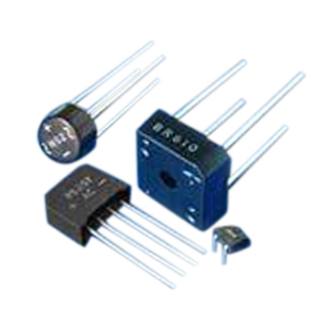
Full-Wave Dual-Supply
By grounding the center tap, we have two opposite AC sources
the diode bridge now presents + and − voltages relative to ground
each can be separately smoothed/regulated
cutting out diodes A and D makes a half-wave rectifier
can buy pre-packaged diode bridges
A
B
AC source
+ load
voltages seen by loads
D
C
− load

Slide 20
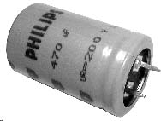
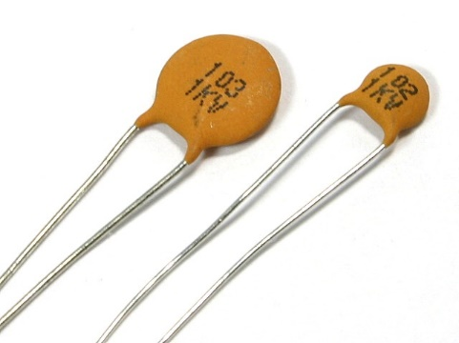
Smoothing out the Bumps
Still a bumpy ride, but we can smooth this out with a capacitor
capacitors have capacity for storing charge
acts like a reservoir to supply current during low spots
voltage regulator smoothes out remaining ripple
electrolytic capacitor
A
B
capacitor
ceremaic capacitor
AC source
C
D
load

Slide 21

How smooth is smooth?
An RC circuit has a time constant τ = RC
because dV/dt = I/C, and I = V/R → dV/dt = V/RC
so V is V₀exp(±t/τ)
Any exponential function starts out with slope = Amplitude/τ
So if you want < 10% ripple over 120 Hz (8.3 ms) timescale
must have τ = RC > 83 ms
if R = 100 Ω, C > 830 μF
τ

Slide 22
Regulating the Voltage
The unregulated, supply voltage may not be at the value you want
depends on transformer, etc.
suppose you want 5.0 V
You could use a voltage divider to set the voltage
But it would droop under load
output impedance → R₁ || R₂
need to have very small R₁, R₂ to make “stiff”
the divider will draw a lot of current
perhaps straining the source
power expended in divider >> power in load
Not a “real” solution
Important note: a “big load” means a small resistor value: 1 Ω demands more current than 1 MΩ
V_{in}
R₁
V_{out}
1
R_{load}
R₂
3
2

Slide 23
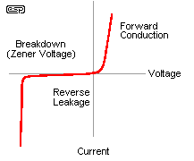
The Zener Regulator
Zener diodes break down at some reverse voltage
can buy at specific breakdown voltages
as long as some current goes through zener, it’ll work
good for rough regulation
Conditions for working:
let’s maintain some minimal current, I_{z} through zener (say a few mA)
then (V_{in} − V_{out})/R₁ = I_{z} + V_{out}/R_{load} sets the requirement on R₁
because presumably all else is known
if load current increases too much, zener shuts off (node drops below breakdown) and you just have a voltage divider with the load
zener voltage
high slope is what makes the
zener a decent voltage regulator
V_{in}
R₁
V_{out} = V_{z}
R_{load}
Z

Slide 24
Zener diodes as voltage regulators
A Circuit diagram symbol for a zener diode.
Zener diodes are used in circuits to maintain a fixed voltage across a load. A zener diode is a diode that breaks down at a specific voltage when it is reverse biased.
This means that a zener diode will stop a reverse current from flowing through it until the reverse voltage applied across it reaches a fixed value known as the breakdown voltage (VZ).
They are designed to ‘breakdown’ in a reliable and non-destructive way so that they can be used in reverse to maintain a fixed voltage across their terminals.

Slide 25
Zener diodes can be distinguished from ordinary diodes by their code and breakdown voltage which are printed on them.
Zener diode codes begin BZX ... or BZY ... Their breakdown voltage is printed with V in place of a decimal point, so 4V7 means 4.7V.
The diagram below shows the voltage versus current characteristic for a zener diode and how they are connected, with a resistor in series to limit the current.

Slide 26
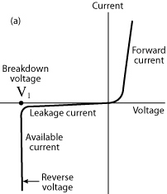

Diagram
The transfer characteristic of a zener diode
A zener diode in series with a current limiting resistor.

Slide 27
Key points
A zener diode is a diode that breaks down at a specific voltage when it is reverse biased. A zener diode can maintain the voltage at its breakdown voltage as long as the supply voltage is above this value.
When a zener diode is forward biased it behaves like an ordinary silicon diode.
When the zener diode is reverse biased with a voltage less than VZ it blocks the current, like an ordinary silicon diode.
When the reverse bias voltage reaches VZ the voltage is limited to around this value, but it can conduct very large currents.

Slide 28
Key points
If a zener diode is placed in parallel with one of the resistors in a voltage divider circuit, no current flows through the zener diode when the voltage across the resistor is less than the breakdown voltage.
When the voltage is equal to the breakdown voltage, some current passes through the resistor, the rest passes through the diode. The result is that the voltage across the diode and the resistor remains constant.
If the input voltage increases, the current through the voltage divider increases and any increase in voltage happens across the other resistor.

Slide 29
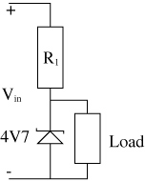
A zener diode regulates the voltage drop across a load resistor at 4.7 V as long as Vin is greater than 4.7 V.

Slide 30
Sample problem
A 4V7 zener diode is used as a voltage regulator as shown in the diagram below. The input voltage comes from a rectifier and has a ripple that ranges between 8.5 V and 9.3 V. The resistor R1 has a resistance of 100 Ω.
Calculate the peak to peak value of the ripple voltage.
What is the value of the voltage drop across the load for this input voltage signal?
What happens to the magnitude of the current through resistor R1?

Slide 31
Solution
Vr(p-p) = Vmax – Vmin
= 9.3 V – 8.5 V
= 0.8 V
4.7 V
The voltage drop across the zener diode and the load remains constant at 4.7 V. The voltage drop across resistor R1 varies between 3.8 V and 4.6 V.
I =V/R, so the current varies between 0.038 A and 0.046 A.

Slide 32
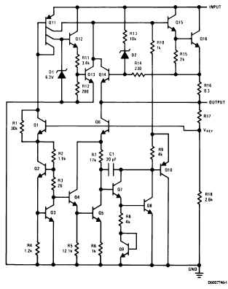
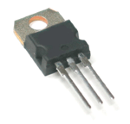
Voltage Regulator IC
Can trim down ripply voltage to precise, rock-steady value
Now things get complicated!
We are now in the realm of integrated circuits (ICs)
ICs are whole circuits in small packages
ICs contain resistors, capacitors, diodes, transistors, etc.
note zeners

Slide 33
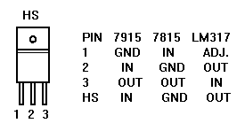
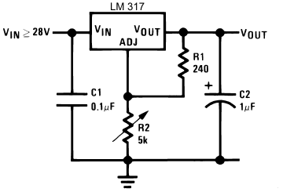
Voltage Regulators
The most common voltage regulators are the LM78XX (+ voltages) and LM79XX (− voltages)
XX represents the voltage
7815 is +15; 7915 is −15; 7805 is +5, etc
typically needs input > 3 volts above output (reg.) voltage
A versatile regulator is the LM317 (+) or LM337 (−)
1.2–37 V output
V_{out} = 1.25(1+R₂/R₁) + I_{adj}R₂
Up to 1.5 A
picture at right can go to 25 V
datasheetcatalog.com for details
beware that housing is not always ground

Slide 34
ASSIGNMENT 2
Is uploaded on the E-learning

