Slide 1
MECH 106: BASIC MECHANICS

Slide 2
APPLICATION OF STATICS OF PARTICLES

Slide 3
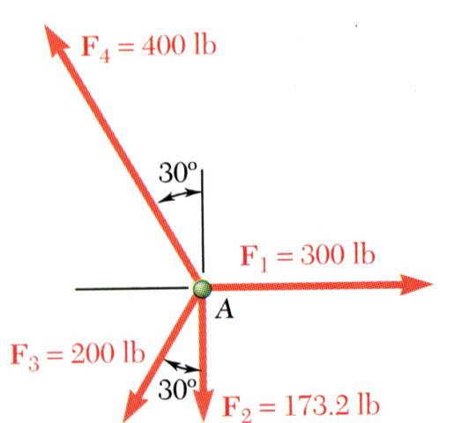
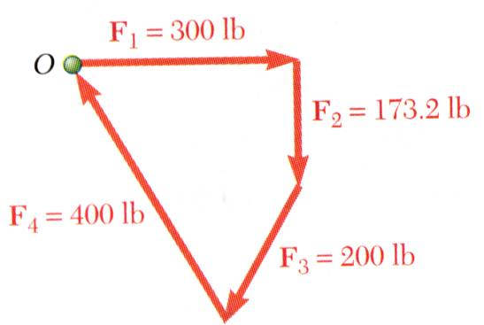
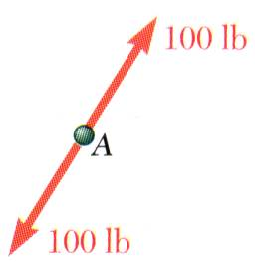
Equilibrium of a Particle
When the resultant of all forces acting on a particle is zero, the particle is in equilibrium.
Particle acted upon by two forces:
equal magnitude
same line of action
opposite sense
Particle acted upon by three or more forces:
graphical solution yields a closed polygon
algebraic solution
Notes:
A particle is said to be at equilibrium when the resultant of all the forces acting on it is zero. If two forces are involved on a body in equilibrium, then the forces are equal and opposite. If there are three forces, when resolving, the triangle of forces will close, if they are in equilibrium. If there are more than three forces, the polygon of forces will be closed if the particle is in equilibrium.
Newton’s First Law: If the resultant force on a particle is zero, the particle will remain at rest or will continue at constant speed in a straight line.

Slide 4
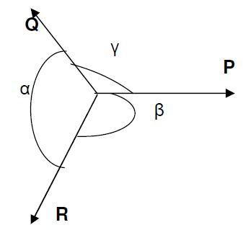
Lami’s Theorem
Suppose the three forces P, Q and R are acting at a point O and they are in equilibrium as shown.
If a body is in equilibrium under the action of three forces, each force is proportional to the sine of the angle between other two forces.
According to Lami’s theorem,
P/sinα = Q/sinβ = R/sinγ

Slide 5
Example
Determine the resultant of the three forces below.
y
600 N
800 N
350 N
45º
60º
25º
x

Slide 6
Solution
600 N
y
800 N
350 N
45º
60º
25º
x

Slide 7
Example
A hoist trolley is subjected to the three forces shown. Knowing that = 40º , determine (a) the magnitude of force, P for which the resultant of the three forces is vertical (b) the corresponding magnitude of the resultant.
P
2000 N
1000 N

Slide 8
Solution
P
40º
40º
2000 N
1000 N

Slide 9
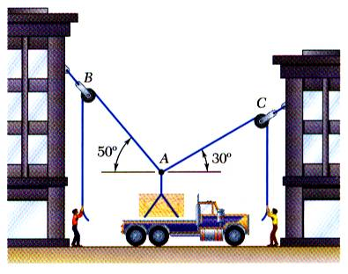
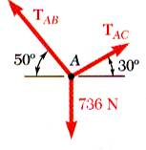
Free-Body Diagrams
Space Diagram: A sketch showing the physical conditions of the problem.
Free-Body Diagram: A sketch showing only the forces on the selected particle.

Slide 10
FREE BODY DIAGRAMS:
Steps:
Imagine the particle to be isolated or cut free from its surroundings. Draw or sketch its outlined shape.
2. Indicate on this sketch all the forces
that act on the particle.
3. Label known forces with their magnitudes and directions. use letters to represent magnitudes and directions of unknown forces.
Notes:
#1: These include active forces - tend to set the particle in motion e.g. from cables and weights and reactive forces caused by constraints or supports that prevent motion.
#3: Assume direction of force which may be corrected later.

Slide 11
Example
The crate below has a weight of 50 kg. Draw a free body diagram of the crate, the cord BD and the ring at B.
A
B ring
C
45º
D
CRATE

Slide 12
Solution
A
B
C
45º
D
CRATE

Slide 13
Solution Contd.

Slide 14
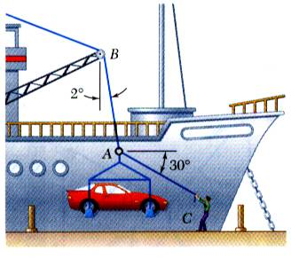
Example
SOLUTION:
Construct a free-body diagram for the particle at the junction of the rope and cable.
Apply the conditions for equilibrium by creating a closed polygon from the forces applied to the particle.
In a ship-unloading operation, a 3500-lb automobile is supported by a cable. A rope is tied to the cable and pulled to center the automobile over its intended position. What is the tension in the rope?
Apply trigonometric relations to determine the unknown force magnitudes.

Slide 15
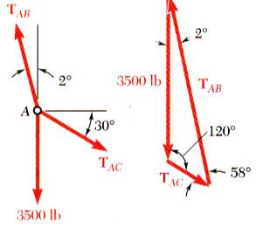
Example contd
SOLUTION:
Construct a free-body diagram for the particle at A.
Apply the conditions for equilibrium.
Solve for the unknown force magnitudes.

Slide 16
STATICS OF RIGID BODIES

Slide 17
Introduction
Treatment of a body as a single particle is not always possible. In general, the size of the body and the specific points of application of the forces must be considered.
Most bodies in mechanics are assumed to be rigid, i.e., the actual deformations are small and do not affect the conditions of equilibrium or motion of the body.
We will consider:
moment of a force about a point
moment due to a couple

Slide 18
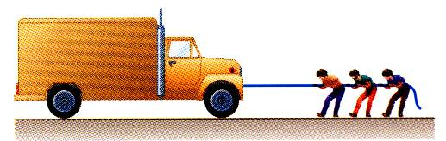
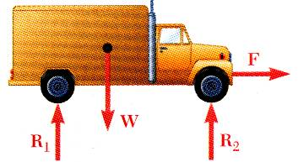
External and Internal Forces
Forces acting on rigid bodies are divided into two groups:
External forces
Internal forces
External forces are shown in a free-body diagram.
If unopposed, each external force can impart a motion of translation or rotation, or both.

Slide 19
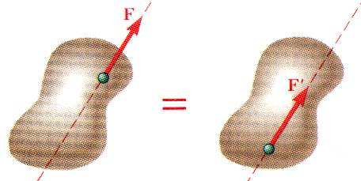
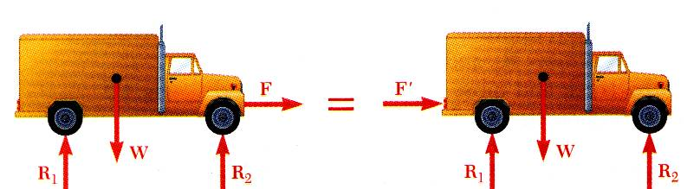
Principle of Transmissibility: Equivalent Forces
Principle of Transmissibility - Conditions of equilibrium or motion are not affected by transmitting a force along its line of action.
NOTE: F and F’ are equivalent forces.
Moving the point of application of the force F to the rear bumper does not affect the motion or the other forces acting on the truck.

Slide 20
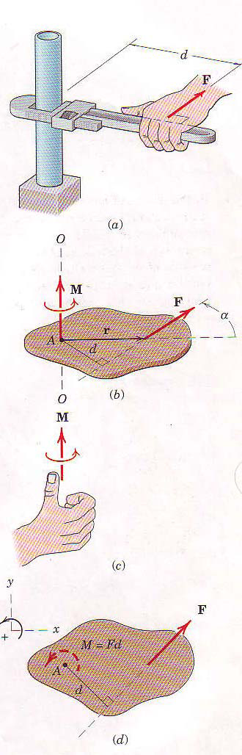
Moment of a Force
In addition to the tendency to move a body in the direction of its application, a force can also tend to rotate a body about an axis.
This rotational tendency is known as the moment M of the force (or torque).
M = Fd, F = magnitude of force
d = perpendicular distance from the axis to the line of action of the force (moment arm).
Notes:
The sense of M depends on the direction in which F tends to rotate the body The right-hand rule, Fig.1c, is used to identify this sense. The moment of F about O-O is represented as a vector pointing in the direction of the thumb, with the finger curled in the direction of the rotational tendency.
Moment directions may be accounted for by using a stated sign convention. such as a plus sign (+) for counterclockwise moment and a minus sign! (+) for clockwise moments, or vice versa. Sign consistency within a given problem is essential. For the sign convention of Fig.d, the moment of F about point A (or about the z-axis passing through point A) is positive. The curved arrow of the figure is a convenient way to represent moments in two-dimensional analysis.

Slide 21
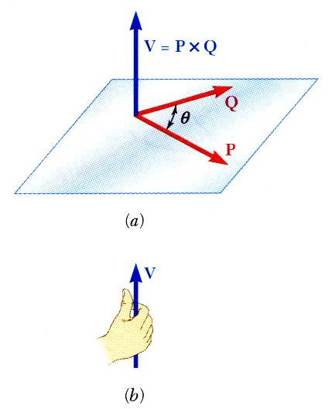
Vector Product of Two Vectors
Concept of the moment of a force about a point is more easily understood through applications of the vector product or cross product.
Vector product of two vectors P and Q is defined as the vector V which satisfies the following conditions:
Line of action of V is perpendicular to plane containing P and Q.
Magnitude of V is V = PQ sin θ
Direction of V is obtained from the right-hand rule.

Slide 22
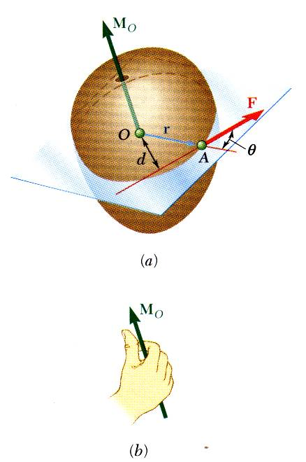
Moment of a Force About a Point
A force vector is defined by its magnitude and direction. Its effect on the rigid body also depends on its point of application.
The moment of F about O is defined as
The moment vector M_{O} is perpendicular to the plane containing O and the force F.
Magnitude of M_{O} measures the tendency of the force to cause rotation of the body about an axis along M_{O}.
The sense of the moment may be determined by the right-hand rule.
Any force F’ that has the same magnitude and direction as F, is equivalent if it also has the same line of action and therefore, produces the same moment.

Slide 23
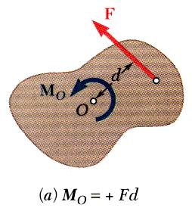
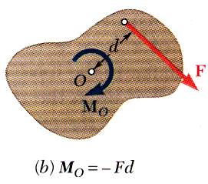
Moment of a Force About a Point
Two-dimensional structures have length and breadth but negligible depth and are subjected to forces contained in the plane of the structure.
The plane of the structure contains the point O and the force F. M_{O}, the moment of the force about O is perpendicular to the plane.
If the force tends to rotate the structure clockwise, the sense of the moment vector is out of the plane of the structure and the magnitude of the moment is positive.
If the force tends to rotate the structure counterclockwise, the sense of the moment vector is into the plane of the structure and the magnitude of the moment is negative.

Slide 24
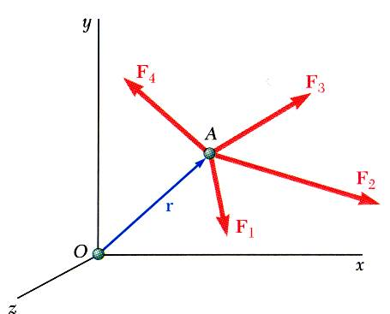
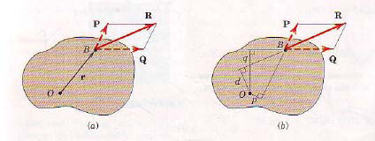
Varignon’s Theorem
The moment of a force about a given point O is equal to the sum of the moment of the components of the force about the same point O.
Varignon’s Theorem makes it possible to replace the direct determination of the moment of a force F
by the moments of two or
more component forces
of F.

Slide 25
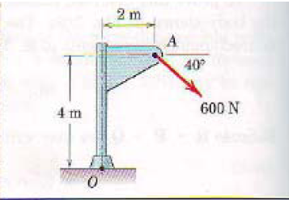
Examples
Calculate the magnitude of the moment about the base point O of the 600N force in four different ways.

Slide 26
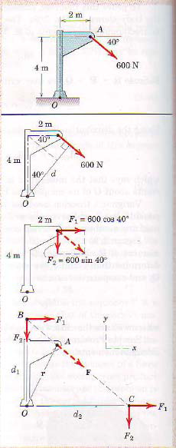
Solution
(I) The moment arm to the 600-N force is
d = 4 cos 40° + 2 sin 40° = 4.35 m
(1) By M = Fd the moment is clockwise and has the magnitude
Mo = 600(4. 35) = 2610 N.m
(II) Replace the force by its rectangular components at A
F1= 600 cos 40° = 460 N
F2 = 600 sin 40°= 386N

Slide 27
d1 = 4 + 2 tan 40° = 5.68 m
and the moment is
Mo = 460(5.68) = 2610 N.m
(4) Moving the force to point C eliminates the moment of the component F1. The moment arm of F2 becomes
d2 = 2 + 4 cos40° = 6.77 m
and the moment is
Mo = 386(6.77) + 2610 N.m
(2)By Varignon's theorem, the moment becomes
Mo = 460(4) + 386(2) = 2610N
(III) By the principle of transmissibility,
(3) Move the 600-N force along its line of action to point B, which eliminates the moment of the component F2. The moment arm of F1 becomes

Slide 28
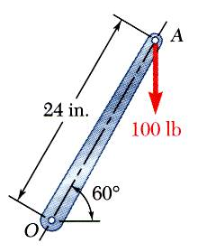
Example
A 100-lb vertical force is applied to the end of a lever which is attached to a shaft at O.
Determine:
moment about O,
horizontal force at A which creates the same moment,
smallest force at A which produces the same moment,
location for a 240-lb vertical force to produce the same moment,
e) whether any of the forces from b, c, and d is equivalent to the original force.

Slide 29
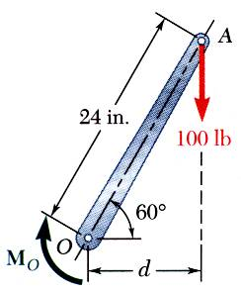
Solution
a) Moment about O is equal to the product of the force and the perpendicular distance between the line of action of the force and O. Since the force tends to rotate the lever clockwise, the moment vector is into the plane of the paper.

Slide 30
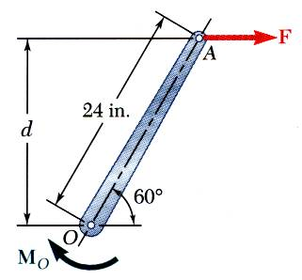
Solution contd
c) Horizontal force at A that produces the same moment,

Slide 31
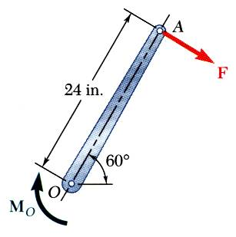
Solution contd
c) The smallest force A to produce the same moment occurs when the perpendicular distance is a maximum or when F is perpendicular to OA.

Slide 32
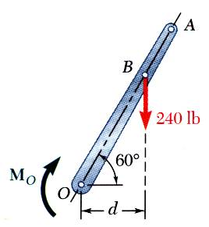
Solution contd
d) To determine the point of application of a 240 lb force to produce the same moment,

Slide 33
Solution contd
e) Although each of the forces in parts b), c), and d) produces the same moment as the 100 lb force, none are of the same magnitude and sense, or on the same line of action. None of the forces is equivalent to the 100 lb force.

Slide 34
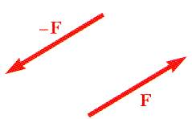
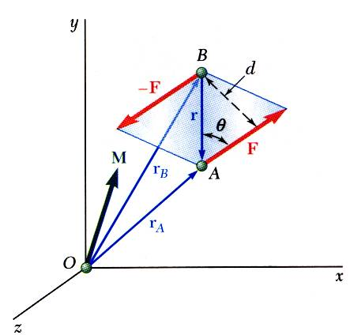
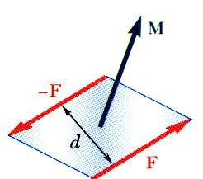
Moment of a Couple
Two forces F and -F having the same magnitude, parallel lines of action, and opposite sense are said to form a couple.
Moment of the couple,
The only effect that a couple can have on a body is too ten to cause it to rotate. A couple has no tendency to cause translation in any direction.

Slide 35
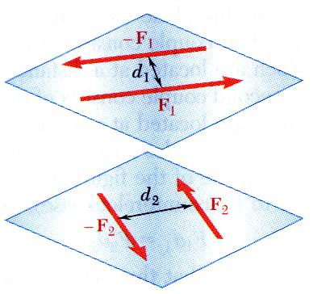
Moment of a Couple
Two couples will have equal moments if
the two couples lie in parallel planes, and
the two couples have the same sense or the tendency to cause rotation in the same direction.

Slide 36
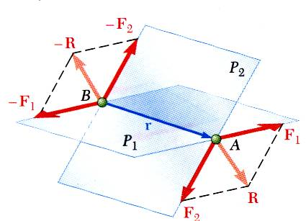
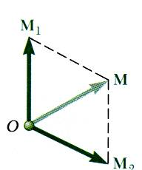
Addition of Couples
Consider two intersecting planes P₁ and P₂ with each containing a couple
Resultants of the vectors also form a couple
By Varigon’s theorem
Sum of two couples is also a couple that is equal to the vector sum of the two couples

Slide 37
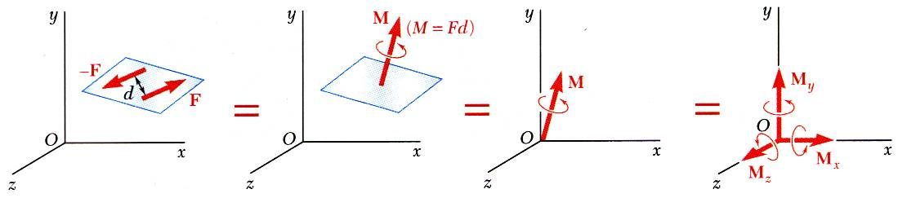
Couples Can Be Represented by Vectors
A couple can be represented by a vector with magnitude and direction equal to the moment of the couple.
Couple vectors obey the law of addition of vectors.
Couple vectors are free vectors, i.e., the point of application is not significant.
Couple vectors may be resolved into component vectors.

Slide 38
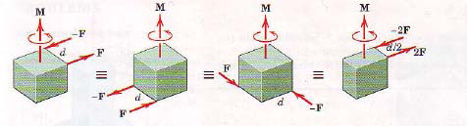
Equivalent Couples
Two couples are said to be equivalent if they have the same moment.
The forces of equivalent couples must lie either in the same plane or in planes that are parallel to each other.

Slide 39
EQUILIBRIUM OF RIGID BODIES

Slide 40
Introduction
For a rigid body in static equilibrium, the external forces and moments are balanced and will impart no translational or rotational motion to the body.
The necessary and sufficient condition for the static equilibrium of a body are that the resultant force and couple from all external forces form a system equivalent to zero,
Resolving each force and moment into its rectangular components leads to 6 scalar equations which also express the conditions for static equilibrium,

Slide 41
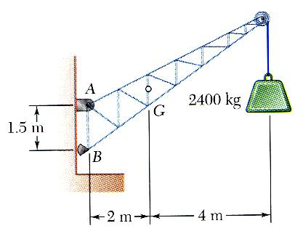
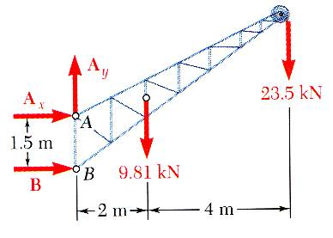
Free-Body Diagram
First step in the static equilibrium analysis of a rigid body is identification of all forces acting on the body with a free-body diagram.
Select the extent of the free-body and detach it from the ground and all other bodies.
Indicate point of application, magnitude, and direction of external forces, including the rigid body weight.
Indicate point of application and assumed direction of unknown applied forces. These usually consist of reactions through which the ground and other bodies oppose the possible motion of the rigid body.
Include the dimensions necessary to compute the moments of the forces.

Slide 42
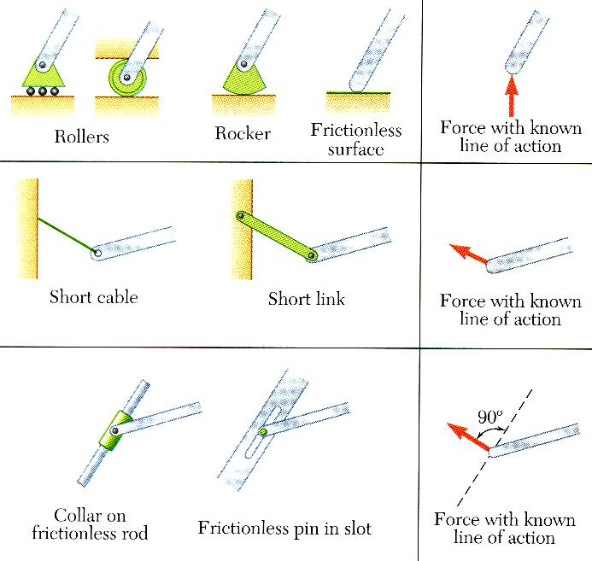
Reactions at Supports and Connections for a Two-Dimensional Structure
Reactions equivalent to a force with known line of action.

Slide 43
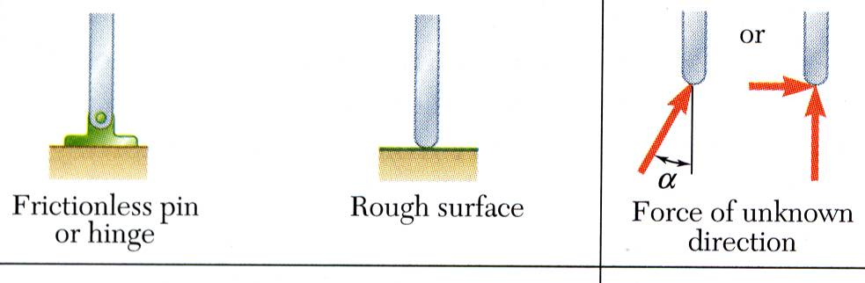
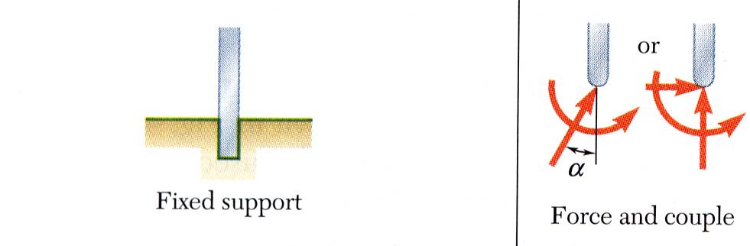
Reactions at Supports and Connections for a Two-Dimensional Structure
Reactions equivalent to a force of unknown direction and magnitude.
Reactions equivalent to a force of unknown direction and magnitude and a couple.of unknown magnitude

Slide 44
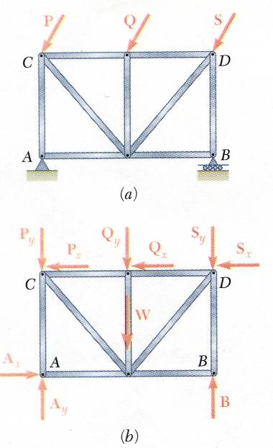
Equilibrium of a Rigid Body in Two Dimensions
For all forces and moments acting on a two-dimensional structure,
Equations of equilibrium become
where A is any point in the plane of the structure.
The 3 equations can be solved for no more than 3 unknowns.
The 3 equations can not be augmented with additional equations, but they can be replaced

Slide 45
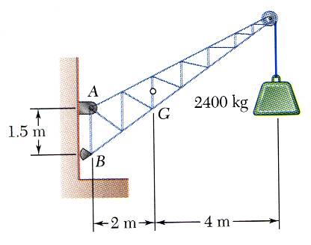
Exmple
SOLUTION:
Create a free-body diagram for the crane.
Determine B by solving the equation for the sum of the moments of all forces about A. Note there will be no contribution from the unknown reactions at A.
Determine the reactions at A by solving the equations for the sum of all horizontal force components and all vertical force components.
A fixed crane has a mass of 1000 kg and is used to lift a 2400 kg crate. It is held in place by a pin at A and a rocker at B. The center of gravity of the crane is located at G.
Determine the components of the reactions at A and B.
Check the values obtained for the reactions by verifying that the sum of the moments about B of all forces is zero.

Slide 46
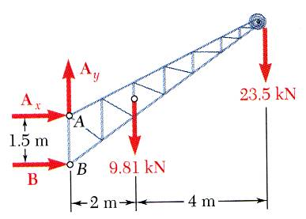
Solution
Determine B by solving the equation for the sum of the moments of all forces about A.
Determine the reactions at A by solving the equations for the sum of all horizontal forces and all vertical forces.
Create the free-body diagram.
Check the values obtained.

Slide 47
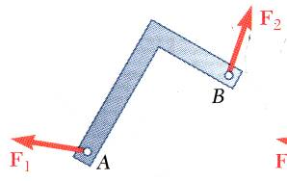
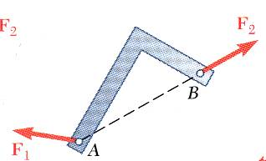
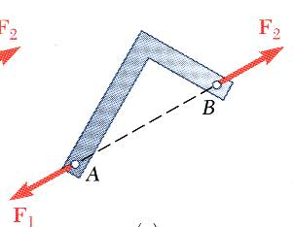
Equilibrium of a Two-Force Body
Consider a plate subjected to two forces F₁ and F₂
For static equilibrium, the sum of moments about A must be zero. The moment of F₂ must be zero. It follows that the line of action of F₂ must pass through A.
Similarly, the line of action of F₁ must pass through B for the sum of moments about B to be zero.
Requiring that the sum of forces in any direction be zero leads to the conclusion that F₁ and F₂ must have equal magnitude but opposite sense.

Slide 48
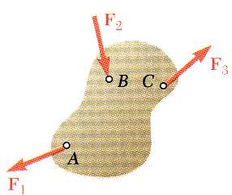
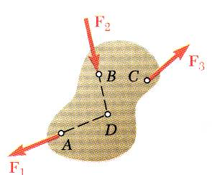
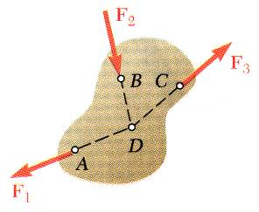
Equilibrium of a Three-Force Body
Consider a rigid body subjected to forces acting at only 3 points.
Assuming that their lines of action intersect, the moment of F₁ and F₂ about the point of intersection represented by D is zero.
Since the rigid body is in equilibrium, the sum of the moments of F₁, F₂, and F₃ about any axis must be zero. It follows that the moment of F₃ about D must be zero as well and that the line of action of F₃ must pass through D.
The lines of action of the three forces must be concurrent or parallel.

Slide 49
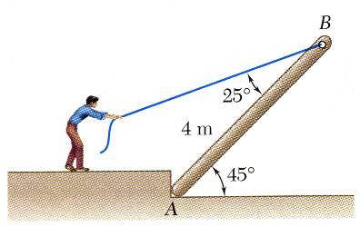
Example
SOLUTION:
Create a free-body diagram of the joist. Note that the joist is a 3 force body acted upon by the rope, its weight, and the reaction at A.
The three forces must be concurrent for static equilibrium. Therefore, the reaction R must pass through the intersection of the lines of action of the weight and rope forces. Determine the direction of the reaction force R.
A man raises a 10 kg joist, of length 4 m, by pulling on a rope.
Find the tension in the rope and the reaction at A.
Utilize a force triangle to determine the magnitude of the reaction force R.

Slide 50
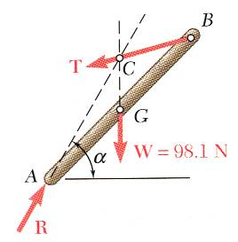

Solution
Create a free-body diagram of the joist.
Determine the direction of the reaction force R.

Slide 51

Solution contd
Determine the magnitude of the reaction force R.

Slide 52
Equilibrium of a Rigid Body in Three Dimensions
Six scalar equations are required to express the conditions for the equilibrium of a rigid body in the general three dimensional case.
These equations can be solved for no more than 6 unknowns which generally represent reactions at supports or connections.
The scalar equations are conveniently obtained by applying the vector forms of the conditions for equilibrium,

Slide 53

Reactions at Supports and Connections for a Three-Dimensional Structure

Slide 54

Reactions at Supports and Connections for a Three-Dimensional Structure

Slide 55

Example
SOLUTION:
Create a free-body diagram for the sign.
Apply the conditions for static equilibrium to develop equations for the unknown reactions.
A sign of uniform density weighs 270 lb and is supported by a ball-and-socket joint at A and by two cables.
Determine the tension in each cable and the reaction at A.

Slide 56

Solution contd
Create a free-body diagram for the sign.
Since there are only 5 unknowns, the sign is partially constrain. It is free to rotate about the x axis. It is, however, in equilibrium for the given loading.

Slide 57
Solution contd
Apply the conditions for static equilibrium to develop equations for the unknown reactions.
Solve the 5 equations for the 5 unknowns,

