Slide 1
Using Convex optimization to control linear systems with disturbances
Oladapo Afolabi, Sarah Seko, Alek Williams
EE227BT
December 1st, 2015

Slide 2
Affine Recourse
An optimization technique used to manage uncertainty by making the decision variables a linear function of the uncertainty, i.e. linear feedback.
Gain matrix, K can be computed using convex optimization and uncertainties can be modeled in expectation or robustly
More concretely, in our case we seek to:

Slide 3
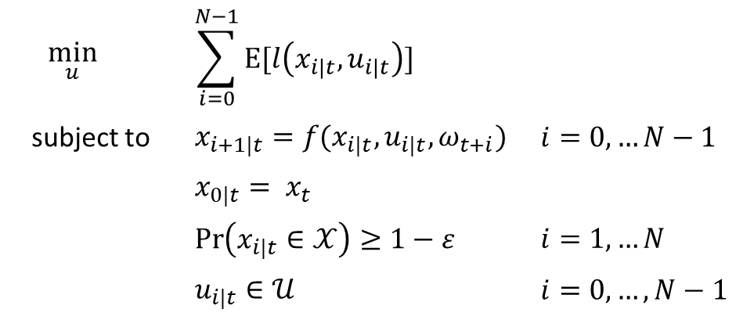
Model Predictive Control
A control technique that uses numerical optimization to solve for the input, subject to state and input constraints
Apply the first input, measure the state, and solve the problem again
Stochastic version:
$$\min_{u}{}$$ | $$\sum_{i=0}^{N−1}{\text{E}[l\left(x_{i|t},u_{i|t}\right)]}$$
subject to | $$x_{i+1|t}=f(x_{i|t},u_{i|t},ω_{t+i})$$ | $$i=0,…N−1$$
 | $$x_{0|t}= x_{t}$$
 | $$\operatorname{Pr}\left(x_{i|t}∈𝒳\right)≥1−ε$$ | $$i=1,…N$$
 | $$u_{i|t}∈𝒰$$ | $$i=0,…,N−1$$

Slide 4
Tube-based MPC
Uncertain system is decomposed into independent nominal and error systems:
LTI system with disturbance:
Closed-loop decomposed system:
Solve the nominal optimization problem (QP) over c_{k} (online)
Bound the error within robust positively invariant set (computed offline)
Uncertain system evolves in a tube around the nominal system

Slide 5
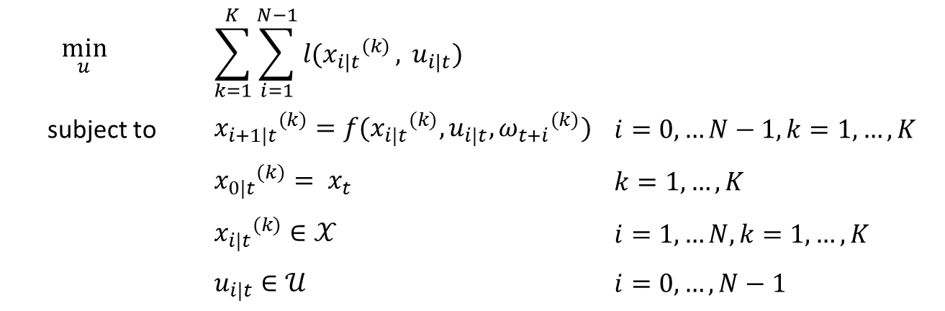
Scenario MPC
Turn the stochastic problem into a deterministic one by sampling the uncertainty
The solution is required to satisfy the constraints for all full-horizon samples, also called scenarios
Bounds exist on the number of scenarios to guarantee chance constraint satisfaction
$$\min_{u}{}$$ | $$\sum_{k=1}^{K}{\sum_{i=1}^{N−1}{l({x_{i|t}}_{}^{(k)}},} u_{i|t})$$
subject to | $${x_{i+1|t}}_{}^{(k)}=f({x_{i|t}}_{}^{(k)},u_{i|t},{ω_{t+i}}_{}^{(k)})$$ | $$i=0,…N−1,k=1, …, K$$
 | $${x_{0|t}}_{}^{(k)}= x_{t}$$ | $$k=1, …, K$$
 | $${x_{i|t}}_{}^{(k)}∈𝒳$$ | $$i=1,…N,k=1, …, K$$
 | $$u_{i|t}∈𝒰$$ | $$i=0,…,N−1$$

Slide 6
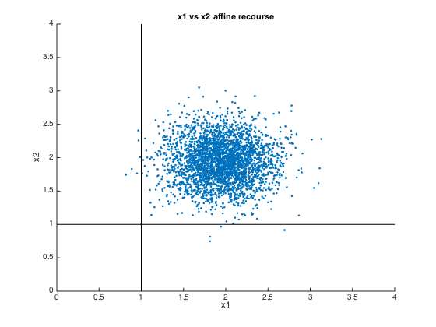
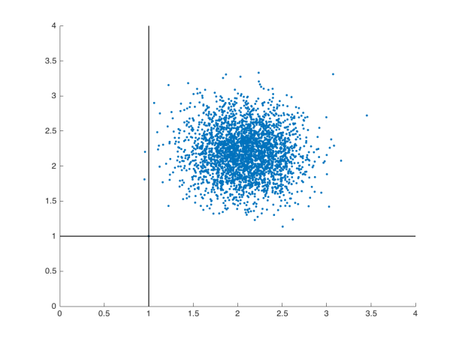
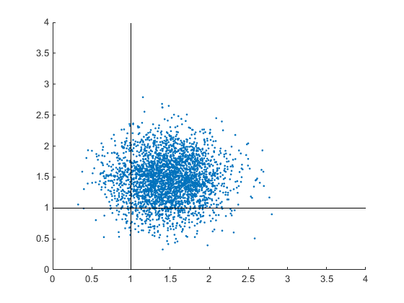
Simulation Results
Affine Recourse
Tube MPC
Scenario MPC
Single realization, 3000 time steps
0.20%, 0.13% constraint violation
Cost: 2.8476 *10⁴
200 trials, 6 time steps
All % violation/time step = 0%
Average cost = 35.99
Single realization, 3000 time steps
0.07%, 0% constraint violation
Cost: 3.3757 *10⁴
200 trials, 6 time steps
Highest % violation/time step = 0.5% t= 1; 0 %
Average cost = 63.04
Single realization, 3000 time steps
9.87%, 10% constraint violation
Cost: 1.7117 *10⁴
200 trials, 6 time steps
Highest % violation/time step = 10%, t = 6; 15.5%, t = 2
Average cost = 32.73

Slide 7
References
Cannon, M.; Kouvaritakis, B.’ Rakovic, S.V.; Qifeng Cheng, “Stochastic tubes in model predictive control with probabalistic constraints,” in American Control Conference( (ACC), 2010, vol., no., pp 6274-6279, June 30 2010- July 2 2010
Schildbach, G., Fagiano, L., Frei, C., & Morari, M. (2014) The scenario approach for Stochastic Model Predictive Control with bounds on closed-loop constraint violations. Automatica, 50, 3009-3018.
Skaf, J.; Boyd, S.P., "Design of Affine Controllers via Convex Optimization," in Automatic Control, IEEE Transactions on , vol.55, no.11, pp.2476-2487, Nov. 2010.

