Slide 1
Integrating Microsoft PlayFab Services into Vanguard-Outrider Demo Game for Enhanced Player Experience

Slide 2
About PlayFab:
Microsoft PlayFab is a cloud-based backend platform for games that provides a range of services such as player authentication, data storage, matchmaking, and analytics.
PlayFab is scalable and flexible, making it suitable for games of all sizes and genres.
PlayFab includes features such as leaderboards, achievements, and player inventory management, which can help developers create engaging experiences for their players.
PlayFab is integrated with Microsoft Azure, which provides additional services such as machine learning and IoT that can be used to enhance games.

Slide 3
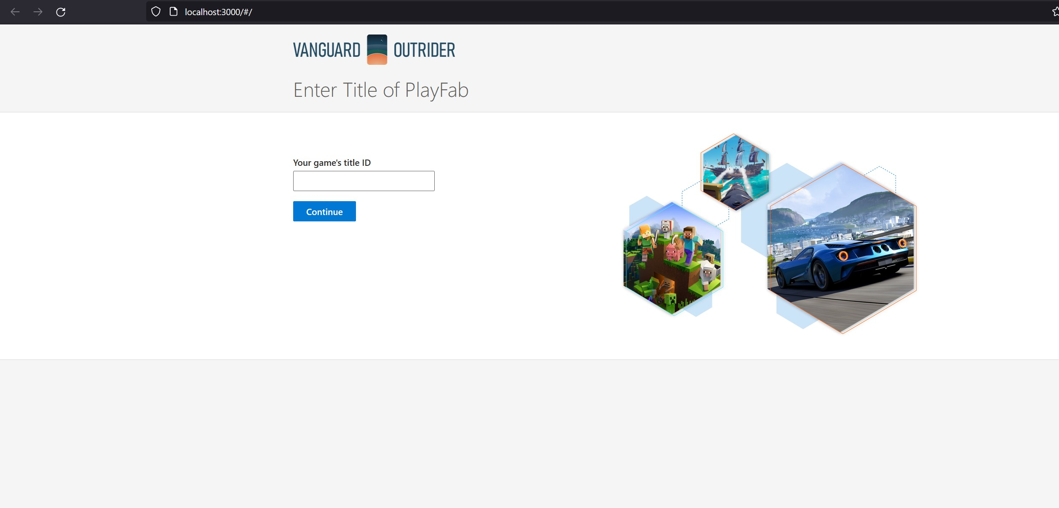
Index Page:
In the index page we should give the Title id of the title we have crated in MS PlayFab and should click continue.

Slide 4
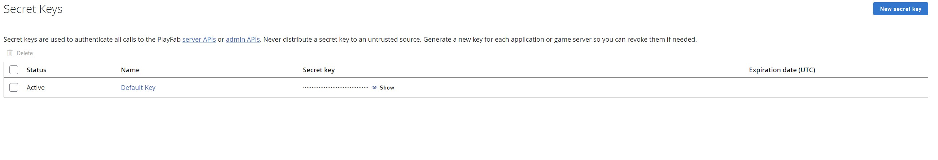
Secret Key of Title:
1.Secret keys are a security feature in Microsoft PlayFab that are used to authenticate requests to the PlayFab API.
2.Secret keys are long, random strings of characters that are generated by PlayFab and are associated with a specific game title.
3.Secret keys are used in conjunction with the title ID of a game to generate a hashed signature that is included in API requests to PlayFab.
4.Secret keys should be kept private and not shared with anyone outside of the development team, as they provide full access to the PlayFab API.

Slide 5
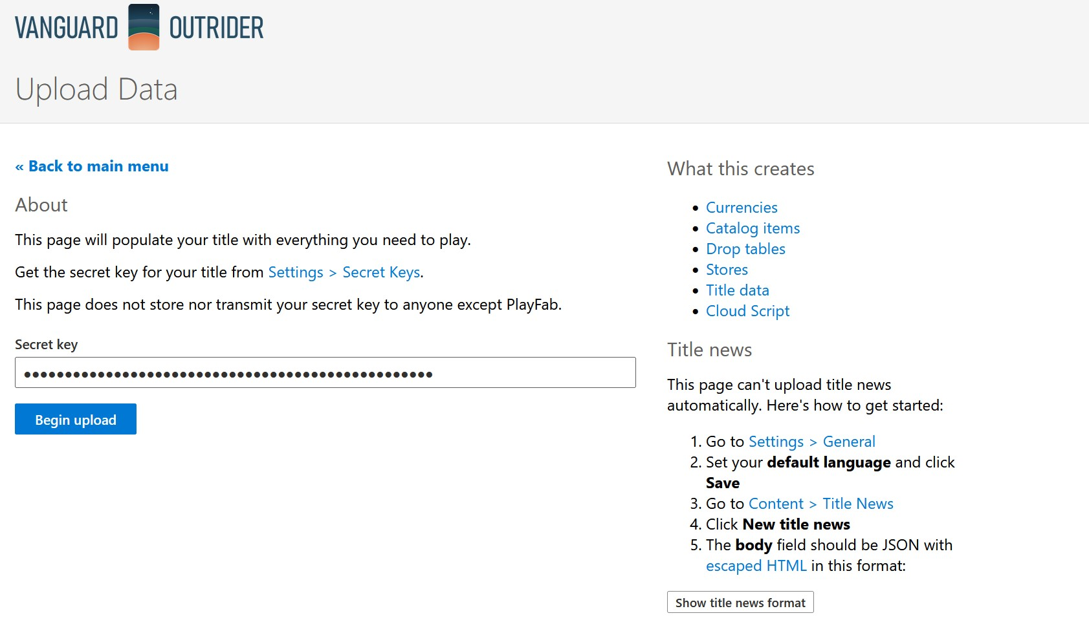
Upload Game Data:
We should upload the game data at the first time Once the game data is uploaded successfully it will redirect to regiset or login page.

Slide 6
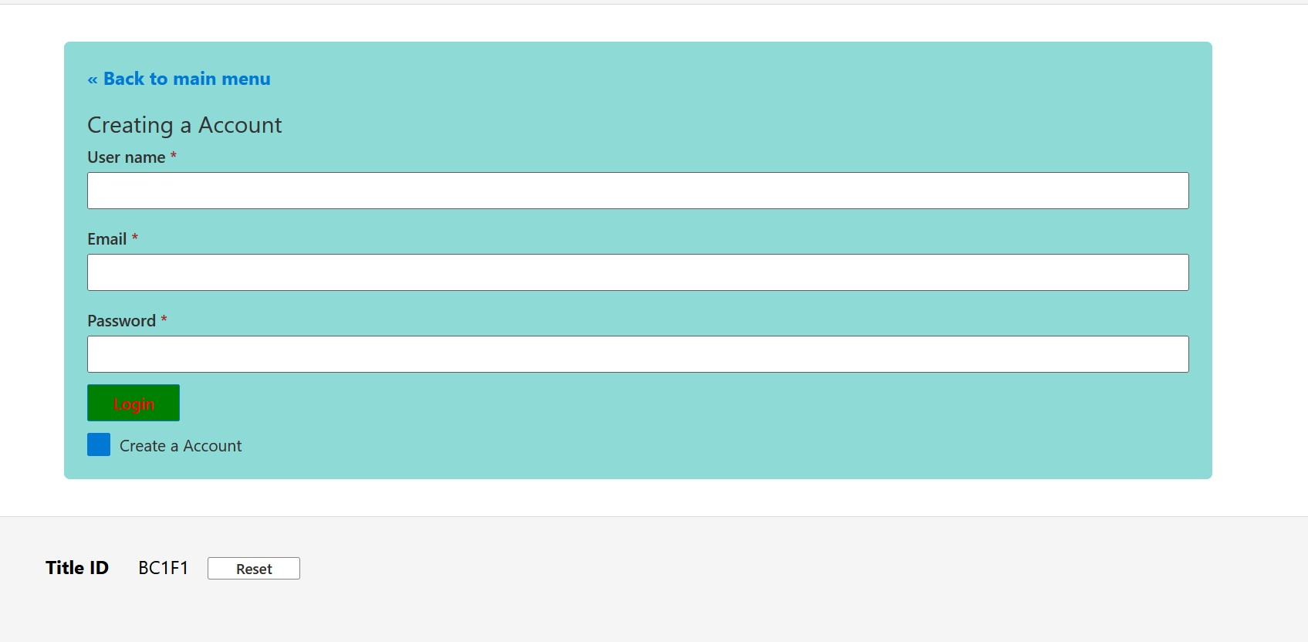
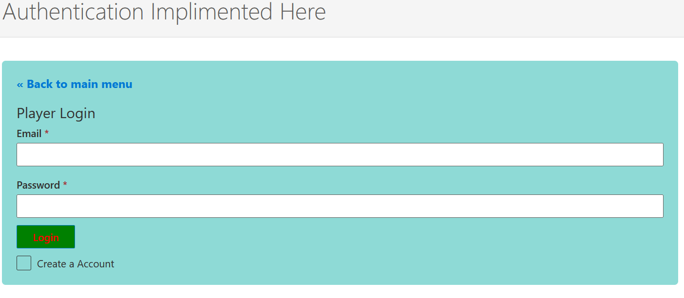
Login/Registration:
Registration page
Login Page
The above Pages are added to the game to implement Authentication and login feature.

Slide 7
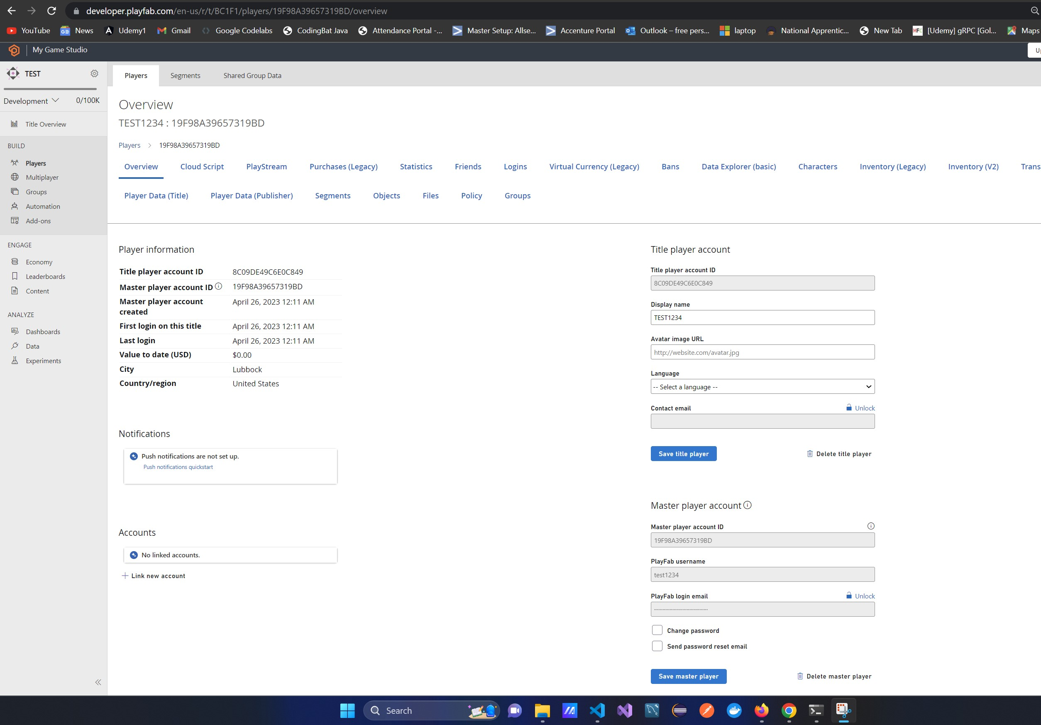
Login/Authentication success:
When the player is registered we can see the details of the registered player in the developer.playfab.com so we can say that the authentication and registration is success

Slide 8
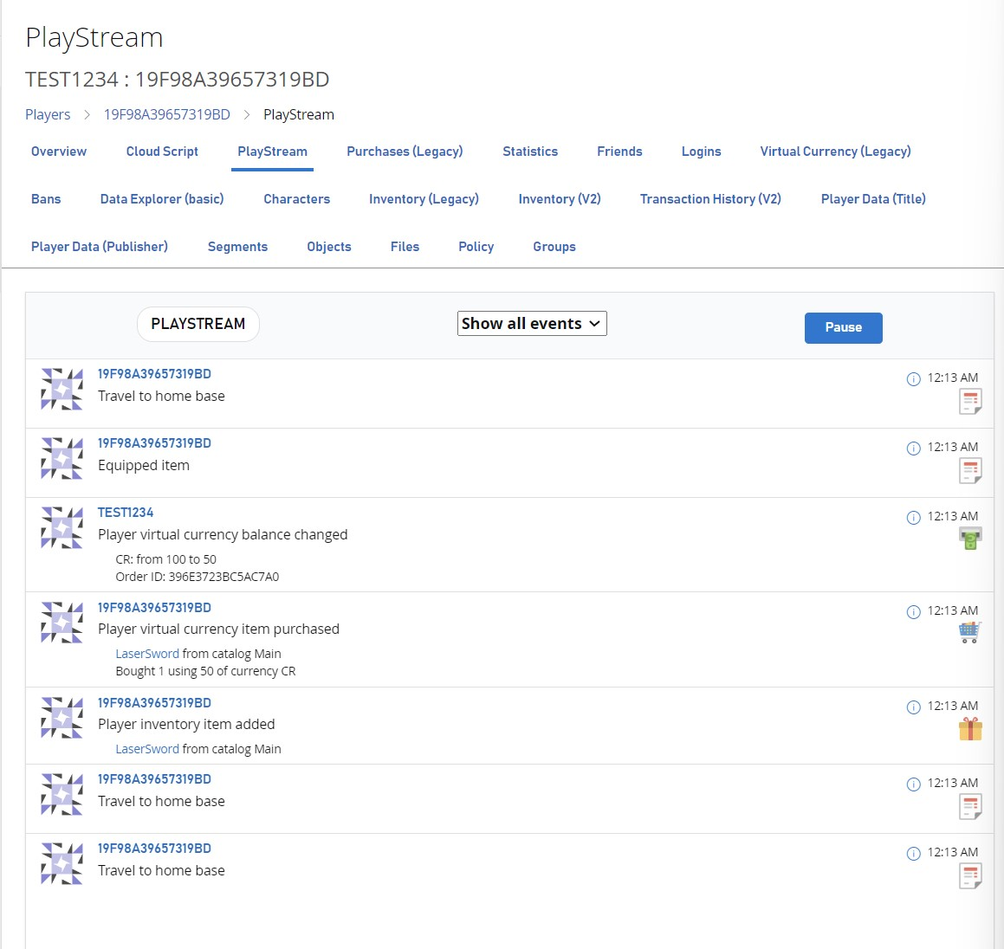
PlayStream:
Used for the behaviour and analytics of the Player

Slide 9
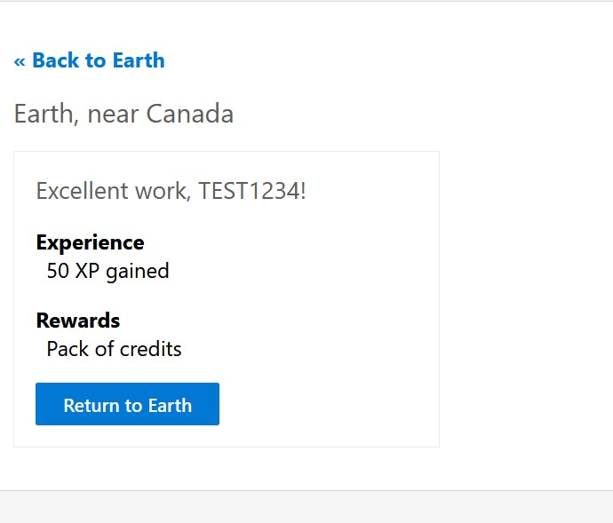
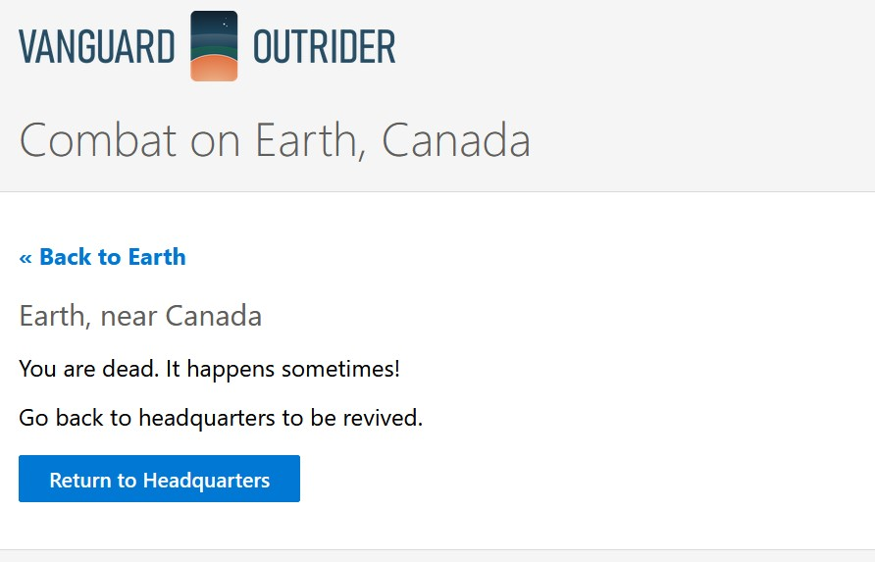
Game Play:

Slide 10
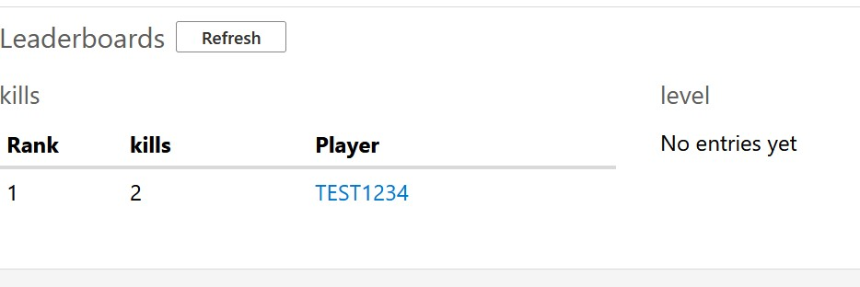
Leader Board:
Leaderboards are a popular feature in games that allow players to compete with each other and see who has achieved the highest scores or fastest times.
PlayFab provides a leaderboard service that makes it easy for developers to add leaderboards to their games.
Developers can create and manage leaderboards in the PlayFab Game Manager dashboard, specifying the name of the leaderboard, the scoring criteria, and other settings.
Leaderboard data is stored in PlayFab's backend, making it easy to access and update from within the game client or server.
PlayFab provides APIs and SDKs that allow developers to interact with leaderboards and retrieve data such as player scores and rankings.

Slide 11
Thank you

