Slide 1
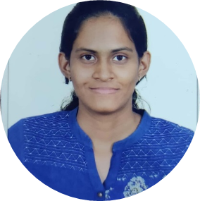
Alekya Kunadharaju
Software Engineer
2014-2018:
Bachelor of Technology in CSE | SRM University
2018
Freshers Learning Program
Career
2018-Present:
Capgemini
Skills
HTML5
C,Java Programming,SQL
Oracle,MySQL
Analyst / A4
Hyderabad
Indian
English, Hindi,Telugu
I have been introduced to programming language in 2008. We used BASIC to develop few primitive programs. My first programming language was C and then Java. I have always had an interest towards programming.
Hence I have chosen computers as my subject learnt C ,Java SQL in detail and internet tools such as HTML and CSS.
I am a very quick learner and responsible towards my work.I assure you to give my best in professional pursuit for overall benefit and growth of the company.
13/06/2018 - at Capgemini as Trainee
A trainee in a Fresher's Learning Program.

