Slide 1
ECE 18-649
Final Project Report
December 02, 2013
Group # 18
Sairam Krishnan (sbkrishn)
Yi Huo (yhuo)
Mustafa Bilgen (mbilgen)
Abhijit Lele (alele)
MUSTAFA BILGEN

Slide 2
Overview
Project statistics
  GitHub Commit Trends
  Now vs. Midsemester
Door Control
  Design
  Implementation
Lessons learned
Open issues
Suggestions
MUSTAFA BILGEN

Slide 3
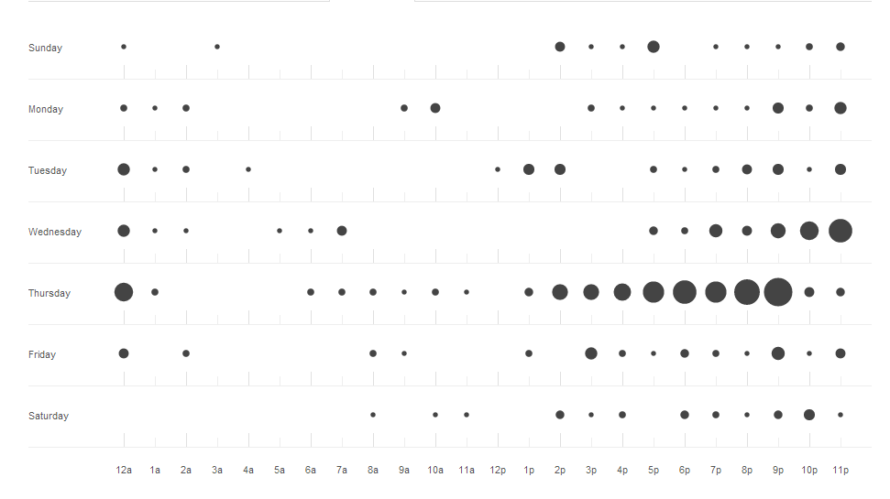
Project Statistics
MUSTAFA BILGEN

Slide 4
Project Statistics
 | Midsemester | Now
(# of sequence diagrams; # of arcs) | (18; 146) | (19; 163)
# of lines of requirements | 58 | 75
(# of state charts; # of states; # of arcs) | (7; 31; 24) | (7; 48; 30)
# of lines of non-comment code | 1302 | 1798
# of test files written (incl. “.cf” files and the custom acceptance test for P8) | 54 | 60
# of peer reviews | 52 | 81
total # of defects found & fixed via peer reviews | 40 | 64
total # of defects found & fixed via test & other | 12 | 20
# of revisions | 20 | 48
# of GitHub commits | 308 | 453
MUSTAFA BILGEN

Slide 5
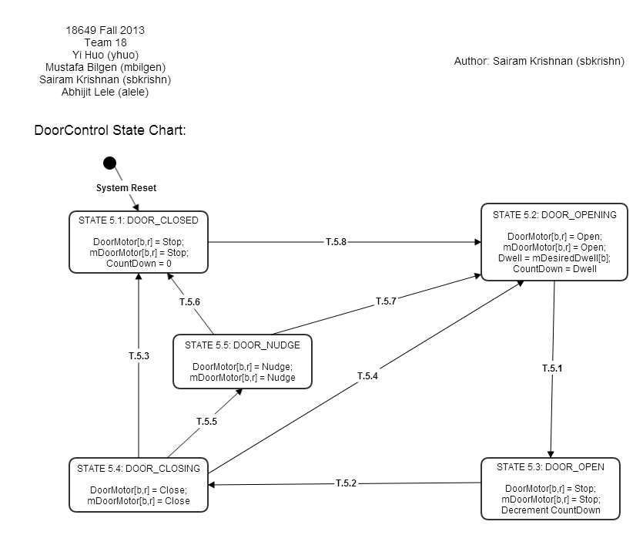
Design of Door Control - Old
S.5.1 –
DOOR_CLOSED
S.5.2 –
DOOR_OPENING
T.5.8
T.5.6
T.5.7
S.5.5 –
DOOR_NUDGE
T.5.3
T.5.4
T.5.1
T.5.5
S.5.4 –
DOOR_CLOSING
S.5.3 –
DOOR_OPEN
T.5.2
SAIRAM KRISHNAN

Slide 6
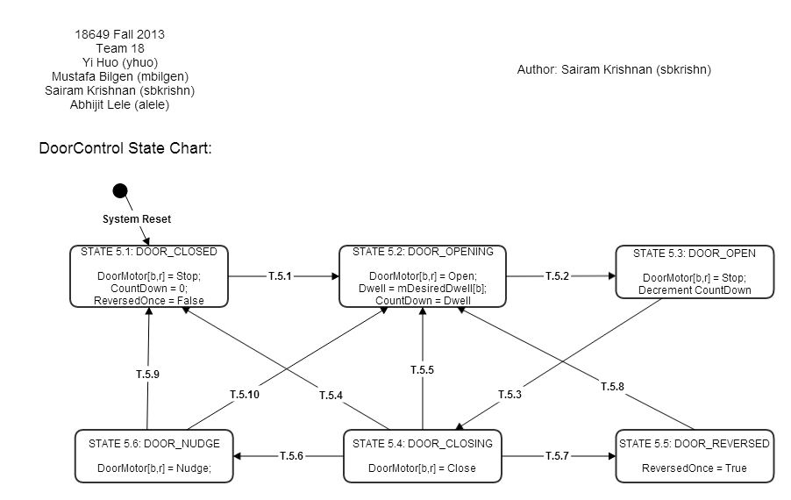
Design of Door Control – New
S.5.1 –
DOOR_CLOSED
S.5.2 –
DOOR_OPENING
S.5.3 –
DOOR_OPEN
T.5.1
T.5.2
T.5.9
T.5.5
T.5.10
T.5.4
T.5.3
T.5.8
S.5.6 –
DOOR_NUDGE
S.5.4 –
DOOR_CLOSING
S.5.5 –
DOOR_REVERSED
T.5.6
T.5.7
SAIRAM KRISHNAN

Slide 7
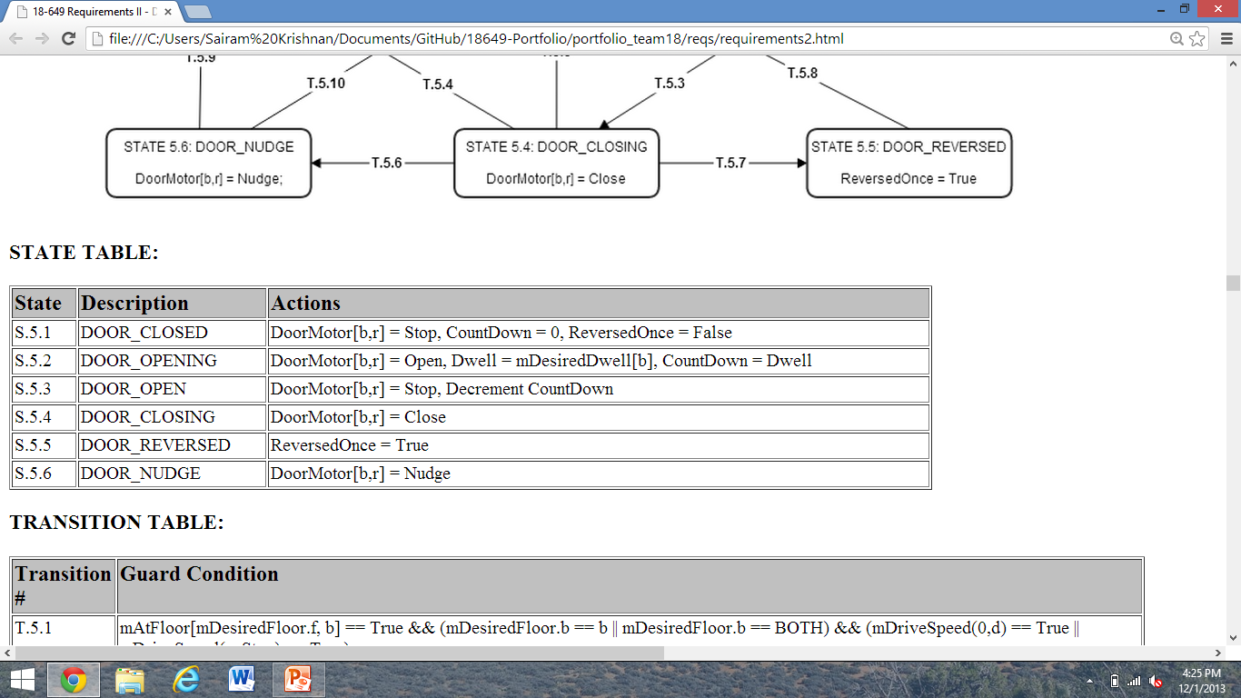
Design of Door Control - New
SAIRAM KRISHNAN

Slide 8
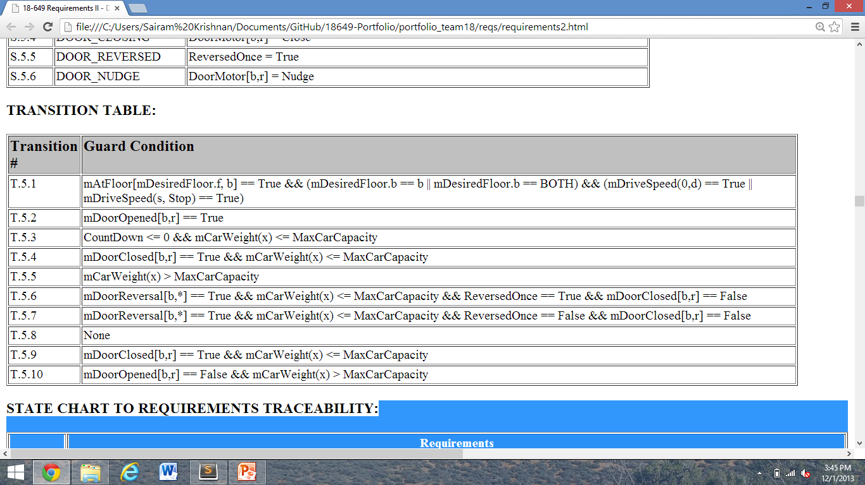
Design of Door Control
SAIRAM KRISHNAN

Slide 9
Door Control Implementation
switch (state) {
//#state '5.1'
case DOOR_CLOSED:
//#state '5.1' actions
localDoorMotor.set(DoorCommand.STOP);
countDown = SimTime.ZERO;
reversedOnce = false;
int desiredFloor = mDesiredFloor.getFloor();
if (desiredFloor == 0) { break; }
//#transition 'T.5.1'
Hallway desiredHallway = mDesiredFloor.getHallway();
boolean atFloor = mAtFloor.isAtFloor(desiredFloor, hallway) &&
(desiredHallway == hallway || desiredHallway == Hallway.BOTH);
if (atFloor && (mDriveSpeed.getSpeed() == 0.0 || DriveSpeed.getDirection()
== Direction.STOP)) {
newState = State.DOOR_OPENING;
}
else { newState = state; }
break;
ABHIJIT LELE

Slide 10
Design of Door Control
case DOOR_OPENING:
localDoorMotor.set(DoorCommand.OPEN);
countDown = Dwell;
if (mDoorOpened.getValue() == true) {
newState = State.DOOR_OPEN;
}
case DOOR_OPEN:
localDoorMotor.set(DoorCommand.STOP);
countDown = SimTime.subtract(countDown, period);
if (countDown.isLessThanOrEqual(SimTime.ZERO) &&
mCarWeight.getWeight() <= Elevator.MaxCarCapacity) {
newState = State.DOOR_CLOSING;
}
case DOOR_CLOSING:
localDoorMotor.set(DoorCommand.CLOSE);
//#transition 'T.5.4'
if (mDoorClosed.getValue() == true &&
mCarWeight.getWeight() <= Elevator.MaxCarCapacity) {
newState = State.DOOR_CLOSED;
}
ABHIJIT LELE

Slide 11
Design of Door Control
//#transition 'T.5.5'
else if (mDoorOpened.getValue() == false &&
mCarWeight.getWeight() > Elevator.MaxCarCapacity) {
newState = State.DOOR_OPENING;
}
//#transition 'T.5.6'
else if (mDoorReversal.getEitherReversed() == true &&
reversedOnce ==true && mCarWeight.getWeight() <=
Elevator.MaxCarCapacity)
{
newState = State.DOOR_NUDGE;
}
//#transition 'T.5.7'
else if (mDoorReversal.getEitherReversed() == true &&
reversedOnce == false && mCarWeight.getWeight() <=
Elevator.MaxCarCapacity)
{
newState = State.DOOR_REVERSED;
}
case DOOR_REVERSED:
reversedOnce = true;
ABHIJIT LELE

Slide 12
Design of Door Control
case DOOR_NUDGE:
localDoorMotor.set(DoorCommand.NUDGE);
//#transition 'T.5.9'
if(mDoorClosed.getValue() == true &&
mCarWeight.getWeight() <= Elevator.MaxCarCapacity) {
newState = State.DOOR_CLOSED;
}
//#transition 'T.5.10'
else if(mDoorOpened.getValue() == false &&
mCarWeight.getWeight() > Elevator.MaxCarCapacity) {
newState = State.DOOR_OPENING;
}
ABHIJIT LELE

Slide 13
Unit Testing – Door Control
Unit Test Files – 3
Total Assertions passed – 244
Failing Assertions – 0
ABHIJIT LELE

Slide 14
Lessons Learned
Version control is your friend
Consistency facilitates communication
  Use a single naming/style convention
  Use same software for state charts and sequence diagrams
Most of your time should be spent on design rather than on implementation and testing
YI HUO

Slide 15
Lessons Learned
Rerun all tests after changing code
What worked well
  Peer reviews
    Helped catch almost all the major bugs, made sure we had a solid design
  State charts
    Great guide to implementation
  Scenarios and Use Cases
    Helped us visualize different elevator behaviors
YI HUO

Slide 16
Lessons Learned
Use checklists
What didn’t work well
  Unit and Integration tests
    Most errors were due to timing rather than implementation
YI HUO

Slide 17
Open Issues
Even smarter Dispatcher design
  Considered skipping HallCalls when car is overweight
  Too complex, current version works well, not enough time
YI HUO

Slide 18
Open Issues
Controllers assume all other controllers work perfectly
  Network faults could cause very unpredictable behavior
  Would need to redesign for reliability
  Can’t be added on
YI HUO

Slide 19
Suggestions
Run a script that runs acceptance tests
  Run them overnight, check for any RT warnings/exceptions/stranded passengers
  Great for figuring out weird, rare bugs
Found a bug during acceptance testing?
  Replace super(“name”, verbose) with super(“name”, true)
  Easy way to get all log() outputs without adding in a bunch of System.out.println()
  Make sure you undo this before handin!
MUSTAFA BILGEN

Slide 20
Suggestions
For simulator:
  Add timing information in .stats outputs
  Makes it possible to run all tests in bulk instead of running them one by one and checking stdout output
MUSTAFA BILGEN

