Slide 1
ECE 18-649
Midterm Project Report
November 1, 2013
Group # 18
Yi Huo
Mustafa Bilgen
Sairam Krishnan
Abhijit Lele
Yi Huo

Slide 2
Overview
Content
  Project statistics
  Complete design of Dispatcher
  Lessons learned
Yi Huo

Slide 3
Project Statistics
18 sequence diagrams and 146 arcs
58 lines of requirements
7 state charts, 24 states, 31 arcs
1302 lines of non-comment code
54 test files
52 peer reviews, 40 defects found, 40 defects fixed
11 revisions
Yi Huo

Slide 4
Scenario
Scenario 9A: Dispatcher computes
next desired floor just as doors open.
Pre-Conditions:
Car is stopped.
AtFloor[f,b] was last received as True.
All doors are closed.
Scenario:
Doors[b,r] open.
CarLantern[d] is turned on.
Doors[b,r] close.
CarLantern[d] is turned off.
Yi Huo

Slide 5
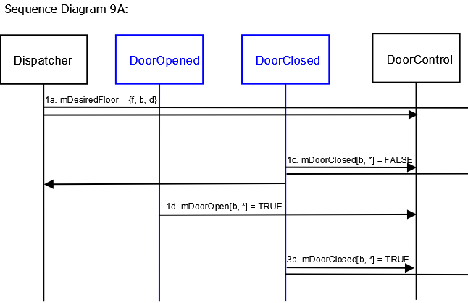
Sequence Diagram
Yi Huo

Slide 6
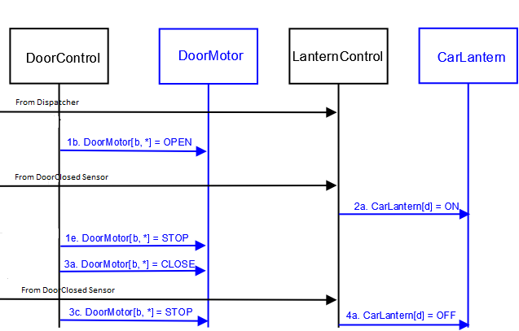
Sequence Diagram
Yi Huo

Slide 7
Dispatcher Requirements
We have a dispatcher that goes up and down, instead of just up.
11.4 mDesiredFloor.f shall always be set to Target.
11.5 If Target == 8 and all mDoorClosed[*, *] are TRUE, mDesiredFloor.d shall be set to DOWN.
11.6 If Target == 1 and all mDoorClosed[*, *] are TRUE, mDesiredFloor.d shall be set to UP.
11.7 Whenever any mDoorClosed [b, r] is False and at least one mAtFloor[*, *] is True, then
  11.7.1 If mDesiredFloor.d is UP, Target shall be set equal to (f + 1), where f whichever mAtFloor[f, *] is True
  11.7.2 If mDesiredFloor.d is DOWN, Target shall be set equal to (f - 1), where f is whichever mAtFloor[f, *] is True
  11.7.3 mDesiredFloor.b shall be set to b, where b is whichever AtFloor[Target, b] exists.
Abhijit Lele

Slide 8
Dispatcher Requirements
We have a dispatcher that goes up and down, instead of just up.
11.8 If all mAtFloor[f, b] are False AND any mDoorClosed [b, r] is False (which means doors are not closed between floors!); then
  11.8.1 Target shall be set to 1
  11.8.2 mDesiredFloor.b shall be set to None
11.9 If two AtFloor[Target, b] sensors exist, then mDesiredFloor.b shall be set to Both.
11.10 mDesiredDwell shall always be set to a constant appropriate value for door open dwell.
Abhijit Lele

Slide 9
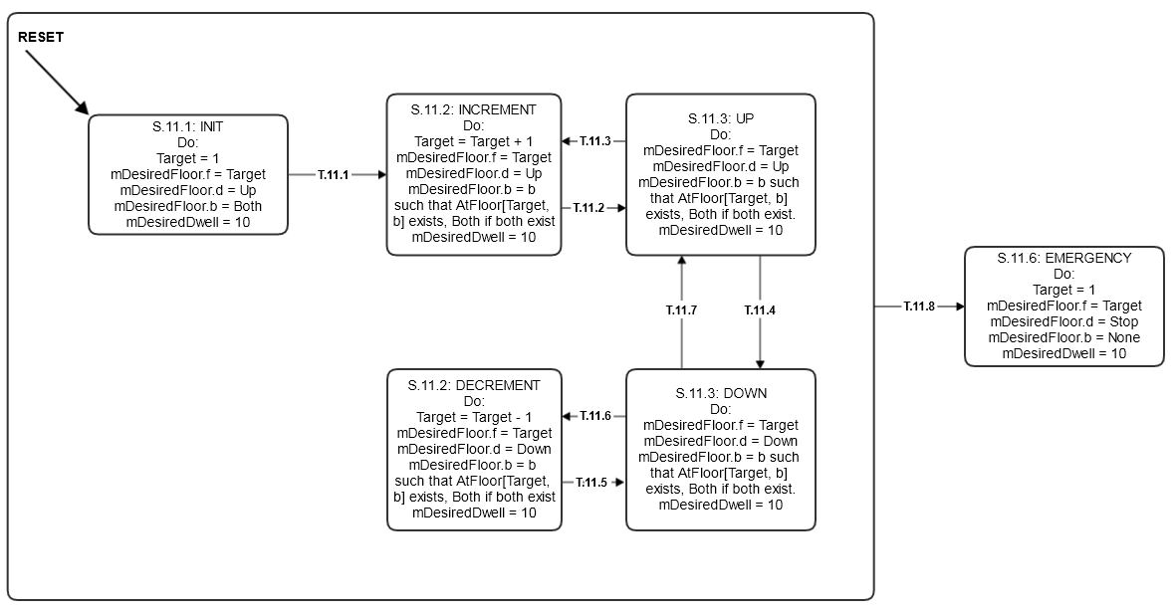
Dispatcher State Chart
Abhijit Lele

Slide 10
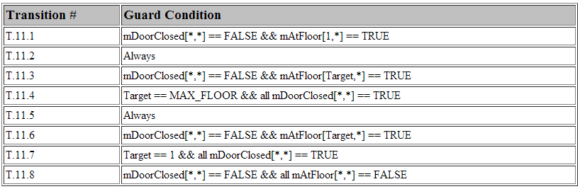
Dispatcher Transition Table
Abhijit Lele

Slide 11
Dispatcher Code
case STATE_INIT:
//State actions for INIT
target = 1;
mDesiredFloor.set(target, Direction.UP, Hallway.BOTH);
mDesiredDwell[Hallway.FRONT.ordinal()].set(DEFAULT_DWELL);
mDesiredDwell[Hallway.BACK.ordinal()].set(DEFAULT_DWELL);
//Transitions
if(T.11.1) {
newState = State.STATE_INCREMENT;
}
case STATE_INCREMENT:
//State actions for INCREMENT
if (Elevator.hasLand ing())
{
Assign h to landing sides : FRONT/ BACK / BOTH
}
mDesiredFloor.set(target, Direction.UP, h);
mDesiredDwell[Hallway.FRONT.ordinal()].set(DEFAULT_DWELL);
mDesiredDwell[Hallway.BACK.ordinal()].set(DEFAULT_DWELL);
//#transition 'T.11.2'
newState = State.STATE_UP;
Mustafa Bilgen

Slide 12
Dispatcher Code
case STATE_UP:
if (Elevator.hasLand ing())
{
Assign h to landing sides : FRONT/ BACK / BOTH
}
mDesiredDwell[Hallway.FRONT.ordinal()].set(DEFAULT_DWELL);
mDesiredDwell[Hallway.BACK.ordinal()].set(DEFAULT_DWELL);
if (T.11.3) {
newState = State.STATE_INCREMENT;
}
else if (T.11.4){
newState = State.STATE_DOWN;
}
case STATE_DECREMENT:
//State actions for DECREMENT
target--;
if (Elevator.hasLand ing())
{
Assign h to landing sides : FRONT/ BACK / BOTH;
}
mDesiredFloor.set(target, Direction.DOWN, h);
mDesiredDwell[Hallway.FRONT.ordinal()].set(DEFAULT_DWELL);
mDesiredDwell[Hallway.BACK.ordinal()].set(DEFAULT_DWELL);
//#transition 'T.11.5'
newState = State.STATE_DOWN;
Mustafa Bilgen

Slide 13
Dispatcher Code
case STATE_DOWN:
if (Elevator.hasLand ing())
{
Assign h to landing sides : FRONT/ BACK / BOTH
}
mDesiredFloor.set(target, Direction.DOWN, h);
mDesiredDwell[Hallway.FRONT.ordinal()].set(DEFAULT_DWELL);
mDesiredDwell[Hallway.BACK.ordinal()].set(DEFAULT_DWELL);
if (T.11.6){
newState = State.STATE_DECREMENT;
}
else if (T.11.7){
newState = State.STATE_UP;
}
case STATE_EMERGENCY:
target = 1;
mDesiredFloor.set(target, Direction.STOP, Hallway.NONE);
mDesiredDwell[Hallway.FRONT.ordinal()].set(DEFAULT_DWELL);
mDesiredDwell[Hallway.BACK.ordinal()].set(DEFAULT_DWELL);
newState = state;
break;
Mustafa Bilgen

Slide 14
Dispatcher Testing
Single unit test:
Simulates one cycle of going up and down
7.73 simulation seconds
129 assertions, all passed
Three integration tests:
Simulates arriving at floor, emergency condition, and setting mDesiredDwell
31 total assertions, all passed
Mustafa Bilgen

Slide 15
Lessons Learned
Consistency facilitates communication of ideas.
  Use same software for sequence diagrams and state charts.
  Use a single naming/style convention.
Version control is your friend.
  Great way of keeping track of changes to your project and reverting to previous versions in emergencies.
Coordinate interactions with GitHub, especially at the last minute!
  Can accidentally merge or override changes.
Sairam Krishnan

Slide 16
Lessons Learned
Most of your time should be spent on design and architecture rather than on implementation and testing.
  If you have a solid design, then you should only have minor errors in implementation.
Distributed embedded systems based on the concept of specialization of labor
  Dispatcher does not have to do everything.
Leveling
  Can’t directly transition the Drive from Slow to Level; must stop the car first.
Sairam Krishnan

Slide 17
Lessons Learned
What Worked Well
  Scenarios & Use Cases
    Helped us visualize different elevator behaviors
  State Charts
    Great guide to implementation
  Unit Tests and Integration Tests
    Great way to test state charts and sequence diagrams
  Acceptance Tests
What Didn’t Work Well
  Unit and Integration Tests
    More errors due to timing issues within the tests themselves rather than with the implementation.
Sairam Krishnan

