Slide 1

Visiting Professor Gasko
MsCIS, CCNA, MCTS, MCP, MCDBA

Slide 2

Given the Windows WSH Scripting language VBScript, demonstrate the ability to:
  Read data from an existing text file
  Write data to a new text file
  After determining the file does not currently exist in the target directory.

Slide 3

In order to manipulate files and folders we have to access the File System Object(FSO)
To do this you must declare a variable and then set it to the File System Object
Dim objFSO
Set objFSO = WScript.CreateObject(“Scripting.FileSystemObject”)

Slide 4

Files and folders are two different things
Have similar properties and methods
  Think of properties as nouns
  Think of methods as verbs

Slide 5
Does file or folder exist?
File:
  Dim objFSO
  Set objFSO = CreateObject(“Scripting.FileSystemObject”)
  If objFSO.FileExists(“C:\windows\notepad.exe”) then…

Slide 6
Does file or folder exist?
Folder
  Dim objFSO
  Set objFSO = CreateObject(“Scripting.FileSystemObject”)
  If objFSO.FolderExists(“C:\ windows”) then …

Slide 7
There are many things you can do with files and folders: rename, move, copy, etc.
Read the leesson for proper syntax to complete other file and folder management tasks

Slide 8

File
  If it doesn’t exist we must create it.

Slide 9
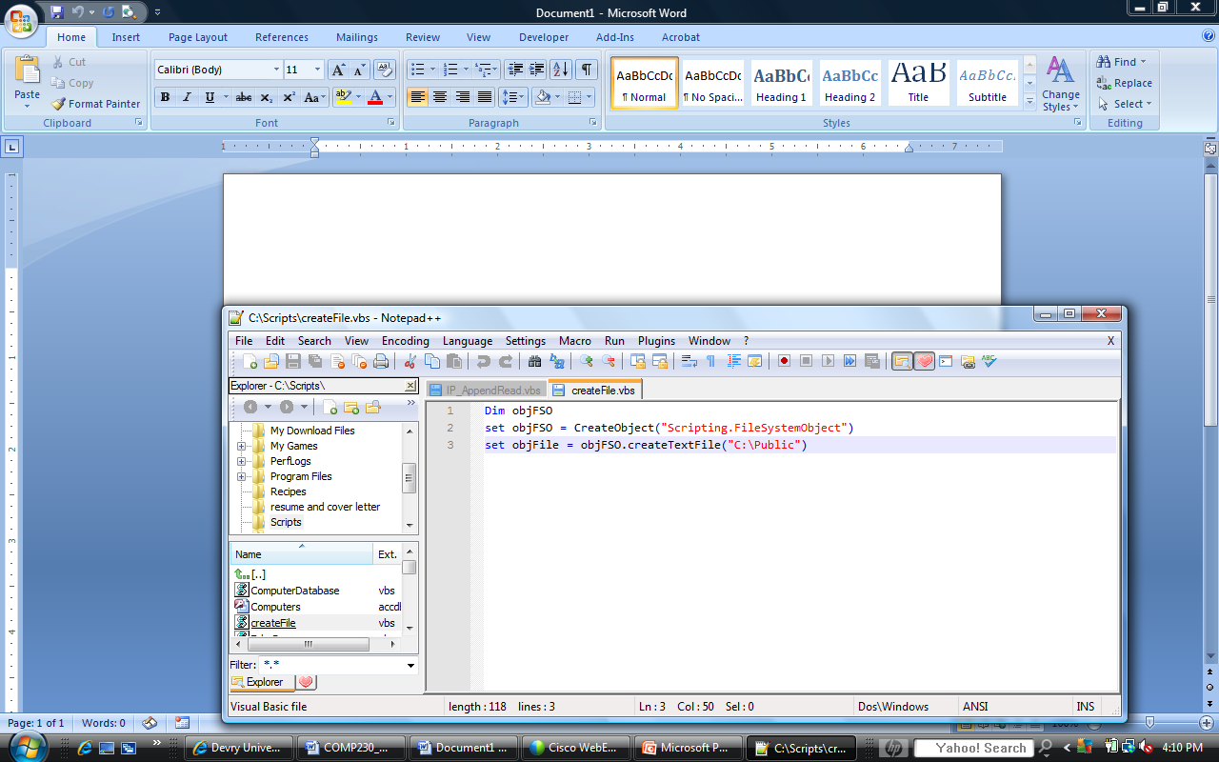
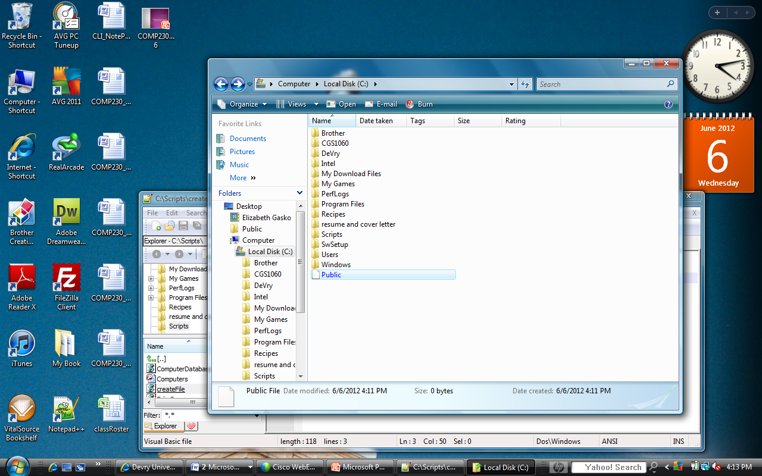
Create a File

Slide 10
Access Modes
    1: Opens a file for reading.
    2: Opens a file for writing to the beginning of the file.
    8: Opens a file for appending (writing to the end of the file).
    (Stanek 182)
Stanek. Microsoft PowerShell, VBScript & JScript Bible. John Wiley & Sons (P&T). <vbk:9781118170908#outline(9.3.1)>.

Slide 11
Access Modes Syntax
Const READ = 1
Const WRITE = 2
Const APPEND = 8

Slide 12
File Format Mode
Const ASCII = 0
Book uses TriStateFalse instead.
  Const TriStateFalse = 0
  Just another way to write it

Slide 13

Instructions
Write IP Addresses to a .csv (Excel-type file)
Append(add lines to) the Excel-type file
Open and Read the appended file

Slide 14
Task 1: Download the file (In Skillsoft the file is located in the comp230 folder).
  Review week 4 iConnect Live Lecture if you have trouble with this step
  It is the same array you used in week 4 lab assignment

Slide 15

  Task 1
    Lab Instructions Page 4: Typo:
    Says:
    Use ipFileOjb to close the file
    Should read:
    Use ipFileObj to close the file

Slide 16

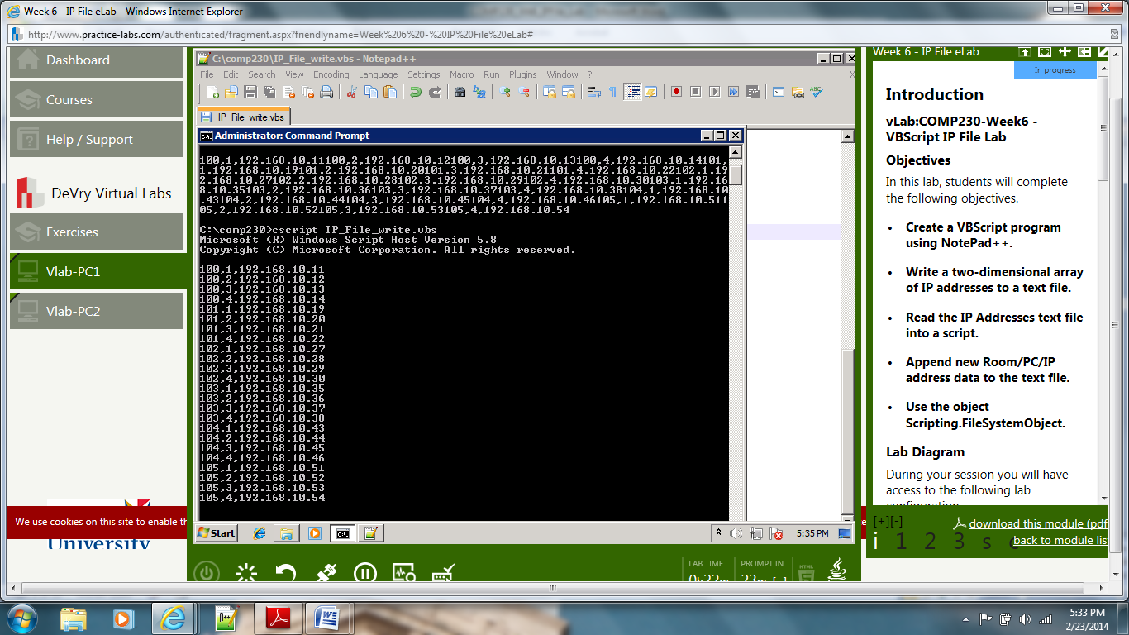
When you run the program your results will look like this

Slide 17
For nicer results add: & vbCrLf to your code inside the loop
For room = 0 to 5
For computer = 0 to 3
ipAddrStr = CStr(room+100) & "," & CStr(computer+1) _
& "," & ipAddress(room,computer) & vbCrLf
Use ipFileObj to WriteLine(IpAddrStr)
Next
Next
Your results will then match the lab instructions and be readable

Slide 18

Task 2: Append File
  Write new script. Do not copy and paste. Causes errors.
Page 8: Pseudocode
If file identified by fileName does not exist Then
Beep Speaker Twice
Display Message:
"File Does Not Exist!!!" & newline & "You Must Create the File Before You can Read the File!!")
Code
  If Not fso.FileExists…

Slide 19
Task 2 Page 11: Append File
Pseudocode
Do Until ipAddrFile is at EndOfStream
room = ipAddrFile.Read 3 characters
ipAddrFile.Skip 1 character
computer = ipAddrFile.Read 1 character
ipAddrFile.Skip 1 character
ipAddress = ipAddrFile.Read 13 characters
ipAddrFile.Skip newline
Display Message:
"The IP Address in Room " & room & " for Computer "
& computer & " is " & ipAddress
End Loop

Slide 20
Task 2 Page 11: Append File
Code Syntax (partial)
Do Until ipFileObj.AtEndOfStream
room = ipFileObj.Read(3)
ipFileObj.Skip(1)
.
.
.
ipFileObj.SkipLine()

Slide 21

Every time you run IP_AppendRead.vbs you will add the four lines to the end of the .csv file.
  Don’t be surprised if your appended lines of code appear several times.
  Please fix this before you turn in your lab report.

Slide 22
If you receive an error message saying:
  Past End of File
  Add:
  & vbCrLf
  to the line of code to display the message:
  WScript.Echo "The IP Address in Room " & room & " for Computer " & computer & " is " & ipAddress & vbCrLf

