Slide 1
COMP230
Week 4
VISITING PROFESSOR GASKO
MSCIS, CCNA, MCTS, MCP, MCDBA

Slide 2
TCO 4
Given the Windows WSH Scripting language VBScript, implement a program that incorporates using loop structures for error-handling and the processing of arrays; loop structures may include For/Next, For/Each, Do/While/Loops and Do/Until Loops.

Slide 3
While Loop
Requirements
Loop control variable
Primed
Counter
Repeats as long as condition is true(May not execute at all)

Slide 4
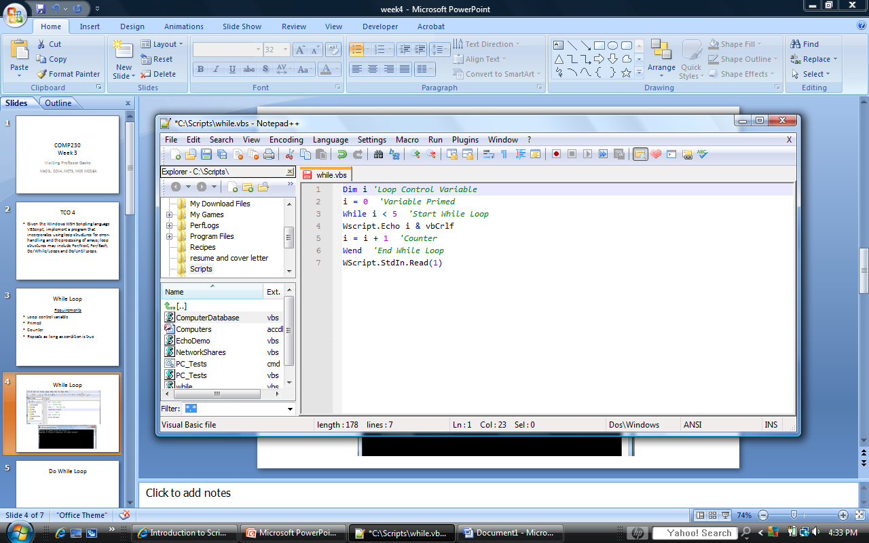
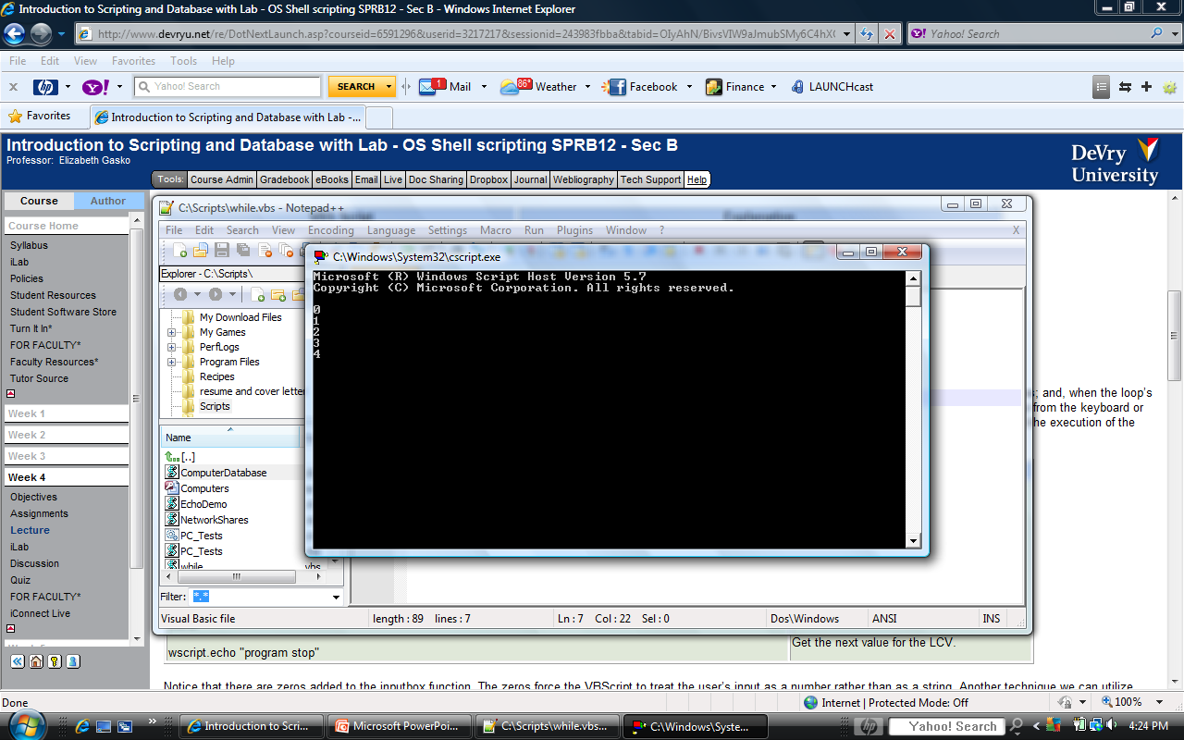
While Loop

Slide 5
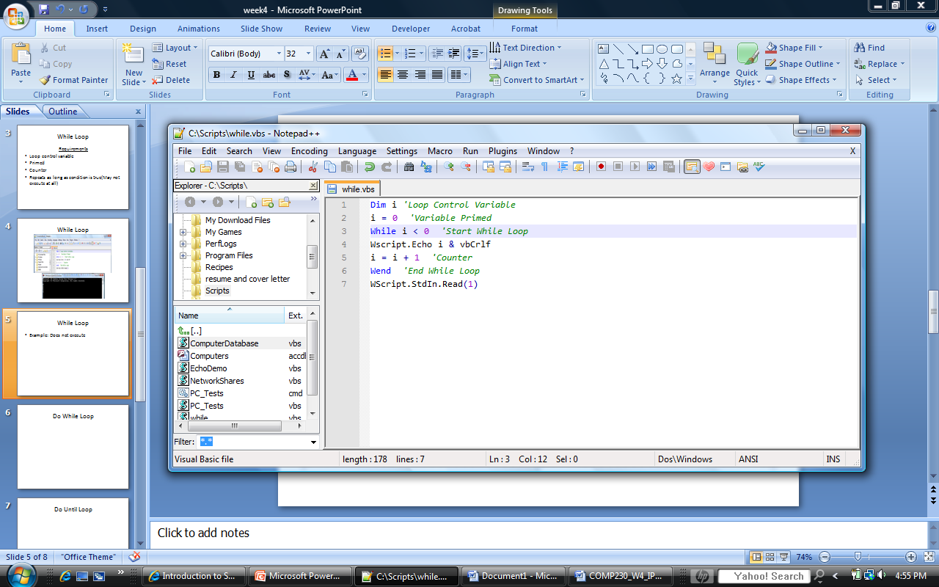
While Loop
Example: Does not execute

Slide 6
Do Until Loop
Executes at least one time
Use when you don’t know how many repetitions you want
Loops until the condition is true

Slide 7
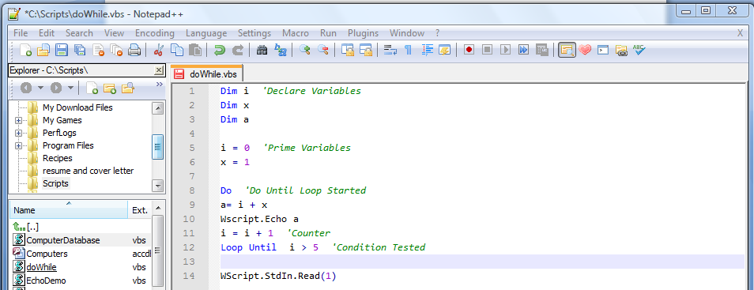
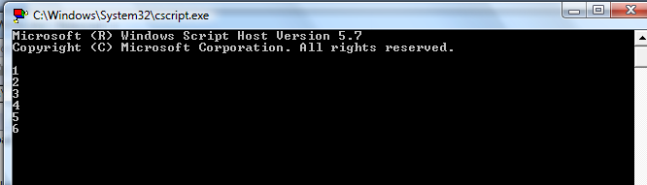
Do Until Loop

Slide 8
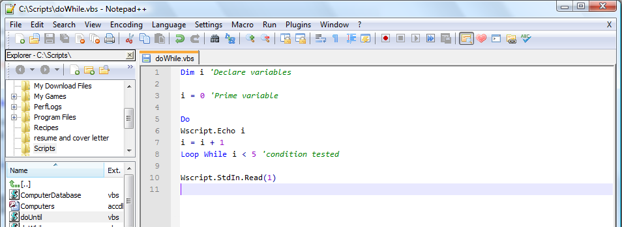
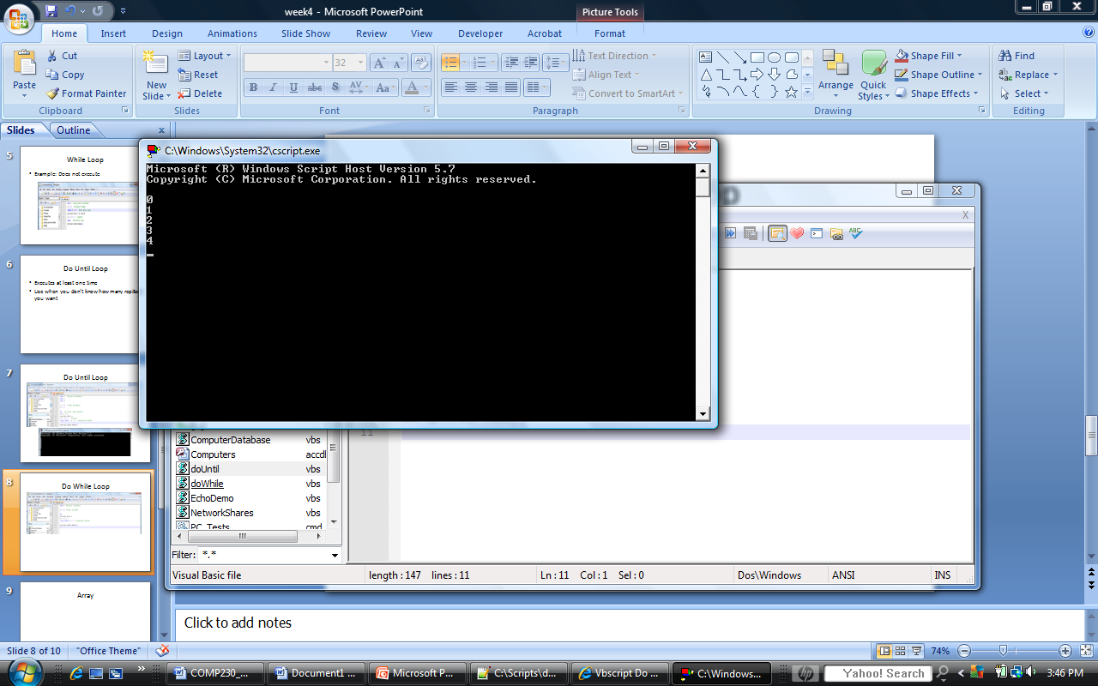
Do While Loop
Loops while the condition is true

Slide 9
Array
Allows you to store multiple values in one variable
Looks like a list
Format: Array(argument)
Argument is one more then index because index starts at zero
Example: State Array(3)
State(0) = Florida
State(1) = New York
State(2) = California

Slide 10
Two-Dimensional Array
Looks like a grid or matrix
Example:
Dim StateBird(1,3)
StateBird(0,0) = Florida, Mockingbird
StateBird(0,1) = New York, Bluebird
StateBird(0,2) = California, Valley Quail

Slide 11
Lab Objective
chr(7): Causes computer to beep
Windows 7: Your computer may not beep

Slide 12
Lab Assignment: Task 1
Download and Open file from the Doc Sharing tab
  If you cannot open the file:
    Download and Save the folder on your desktop
      Right click the zipped folder
      Click Extract All
      Click Extract
      Drag the file to your desktop
      Right click file
      Click Edit with Notepad++
      Save to your Scripts folder

Slide 13
Lab Assignment: Task 2
Interpret pseudocode
Doc Sharing Document: Flowcharts and Pseudocode
Real code is in bold. Type that as it is. All other code must be changed to real code that you have used over the past 2 weeks.

Slide 14
Lab Assignment Task 2
Pg 5: While loops end with the word:
Wend
not End While

Slide 15
Lab Assignment: Hints
Look at your previous labs for help writing the code.
You learned most of this lab’s lessons in the previous two weeks. New this week are the loops and the beep.

Slide 16
Lab Assignment Hints
DO NOT copy and paste results from the lab instructions

