Slide 1

Visiting Professor Gasko
MsCIS, CCNA, MCTS, MCP, MCDBA

Slide 2

Given the Windows WSH Scripting language VBScript, demonstrate the use of functions and procedures to modularize your script. Have separate procedures perform different separate logical tasks such as user input, calculations and displayed output. Show the use of functions for user input or processing of data.

Slide 3

Breaks programs down into smaller blocks of code
Basically small programs inside a big program
  Easier to program
  Code is reusable
  In business world
    Work can be done by teams
    Several teams can work on one program at one time
    Cost effective

Slide 4

Module that:
  returns a value
Example:
  processRecords( )
  read record
  while not eof
  if contactState = "ca" then
  print contactName ‘Returns a value
  endif
  read record
  endwhile
  return

Slide 5

Module that:
  Performs a task
  Does not return a value
Example:
openFiles( )
open file personalContacts
return

Slide 6
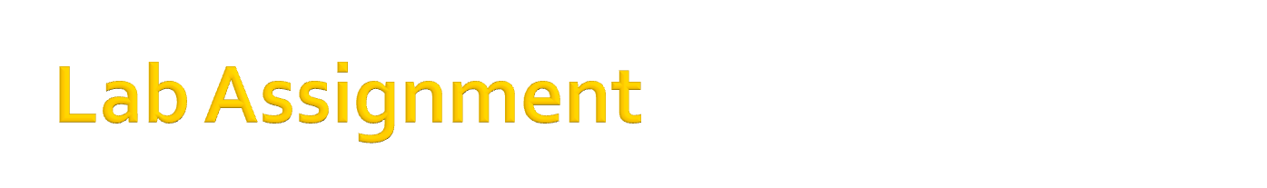
Task 1: Download the file (Open from the comp230 folder in Skillsoft) and Analyze the Batch file.
  If you can’t open the file: review last week’s live lecture

Slide 7
Task 2:
  Read the code and Analyze the Script File
  View the run results in the lab instructions for each code block

Slide 8
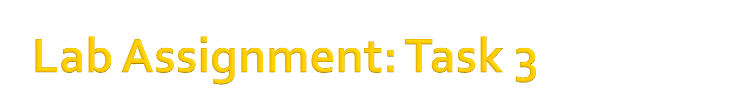
Number 1
  Case 1 is given to you
  Change the other choices so it is similar to the first one. Read the lecture.
  Create all the 5 cases

Slide 9
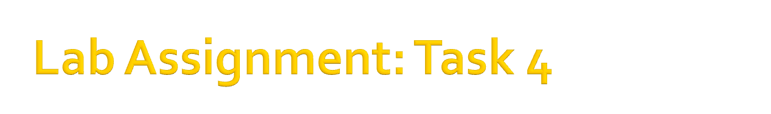
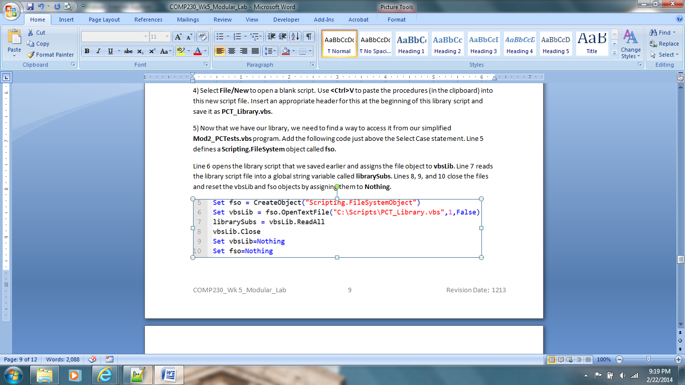
Number 5: Be aware of line 6 file location
C:\Scripts - if using your own computer
C:\comp230 – if using Skillsoft

Slide 10
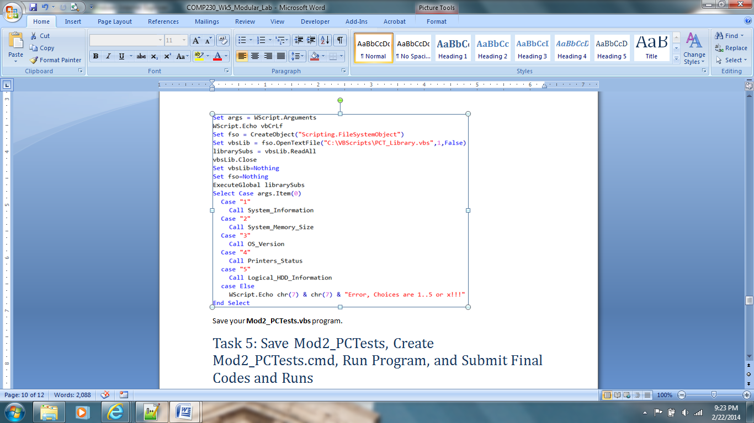
Number 7 – be aware of file location
C:\Scripts – if using your own computer
C:\comp230 – if using Skillsoft

Slide 11

  When you run the script
  You might get the error message:
    Subscript Out of Range

Slide 12

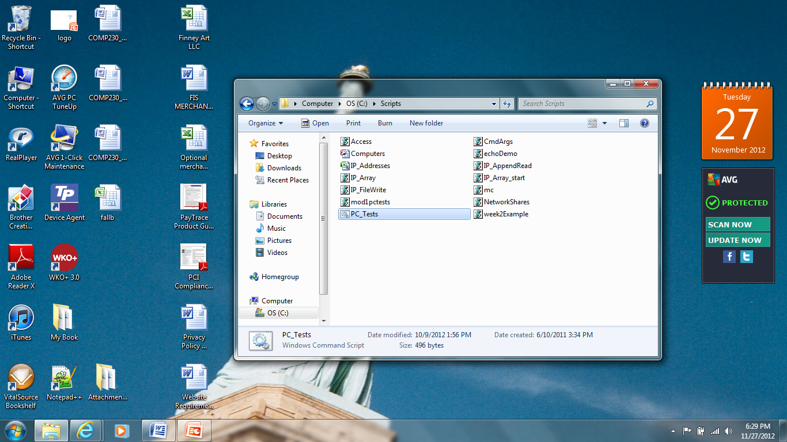
To run without error:
  Navigate to the location of your saved files and double click the batch file (gear icon)

Slide 13

Has the same instructions.
Follow my suggestion to double click the gear icon

Slide 14
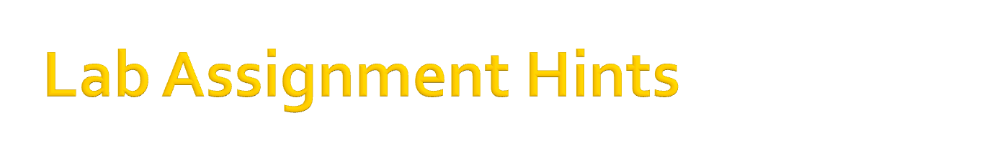
Keep it simple (In my opinion this is the easiest lab assignment of the semester)
Lecture very helpful this week
Enjoy the easy week!

