Slide 1
COMP230
Week 7
Visiting Professor Elizabeth (Lisa) Gasko, MSCIS, CCNA, MCTS, MCDBA, MCP

Slide 2
TCO 7
Given an existing database with one or two tables:
  define the terms: relational database, table, record and field
  write the SQL statements needed to extract specific information from this database

Slide 3
TCO 7
Key Concepts
Explain the commands that are necessary for a VBScript to make a connection to an Access database.
Implement an SQL query of an existing database using the SELECT, FROM, WHERE, and ORDER BY clauses.
Show the loop structure necessary to sequence through a database looking for query matches.

Slide 4
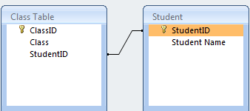
TCO 7: Terminology
Relational Database: Database consisting of tables that are related together by common fields.

Slide 5
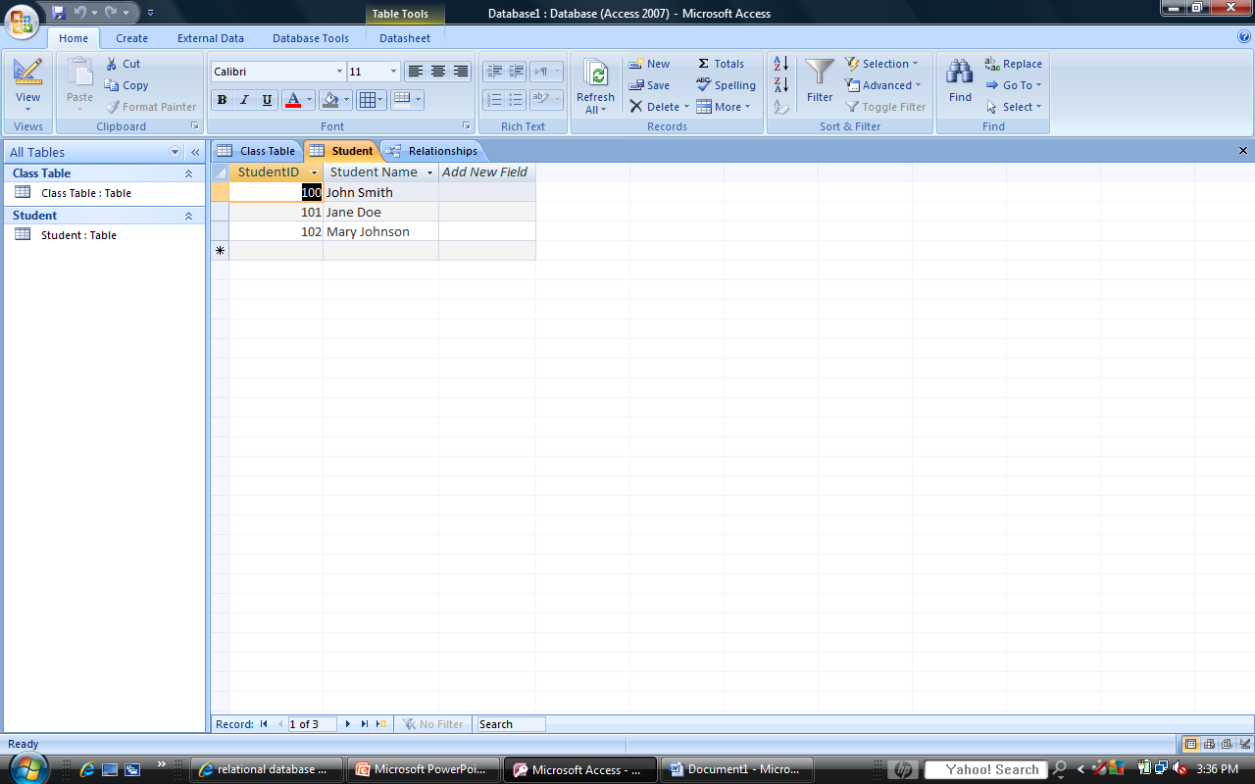
TCO 7: Terminology
Table: Where data is stored. Looks similar to a spreadsheet.
Example: Student Table

Slide 6
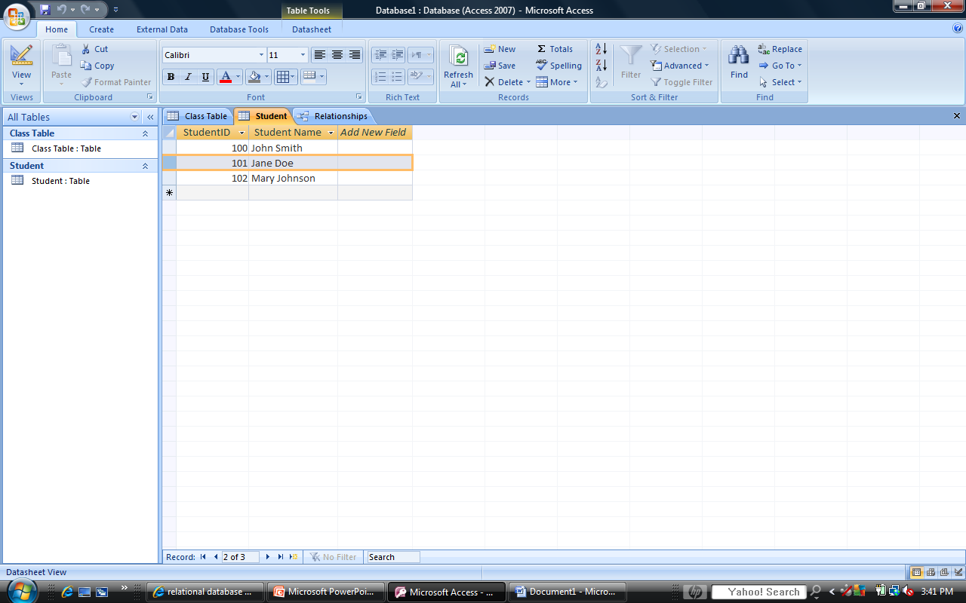
TCO 7: Terminology
Record: One row of a database table
(Attribute: One column of a database table)

Slide 7
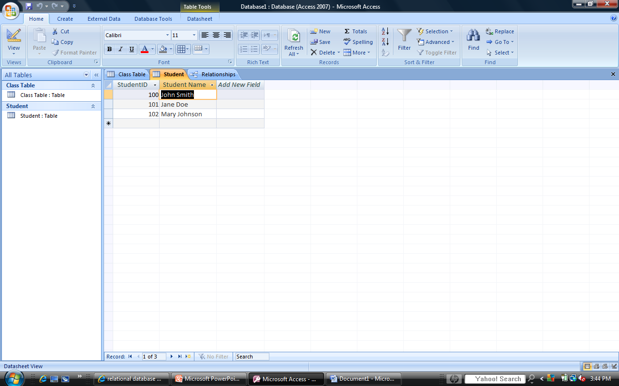
TCO 7: Terminology
Field: One piece of data in a database table. (Called a cell in Excel)

Slide 8
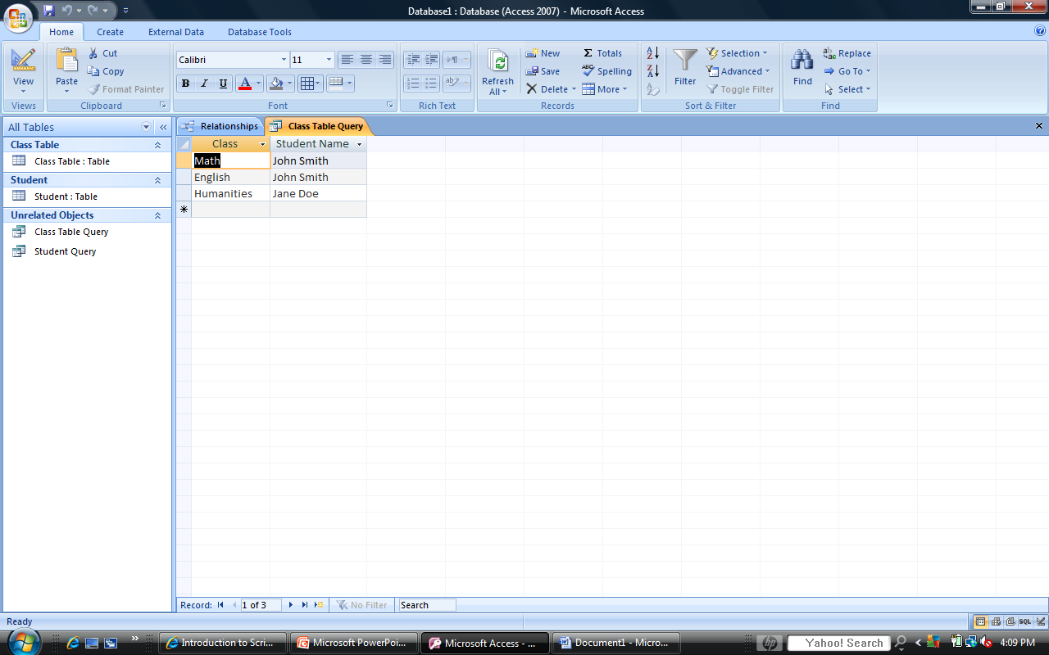
TCO 7: Terminology
  Query: SQL statement needed to extract specific information from a database
  TCO 7: Key Concepts
  SELECT [Class Table].Class, Student.[Student Name]
  FROM Student INNER JOIN [Class Table] ON Student.[StudentID] = [Class Table].[StudentID];

Slide 9
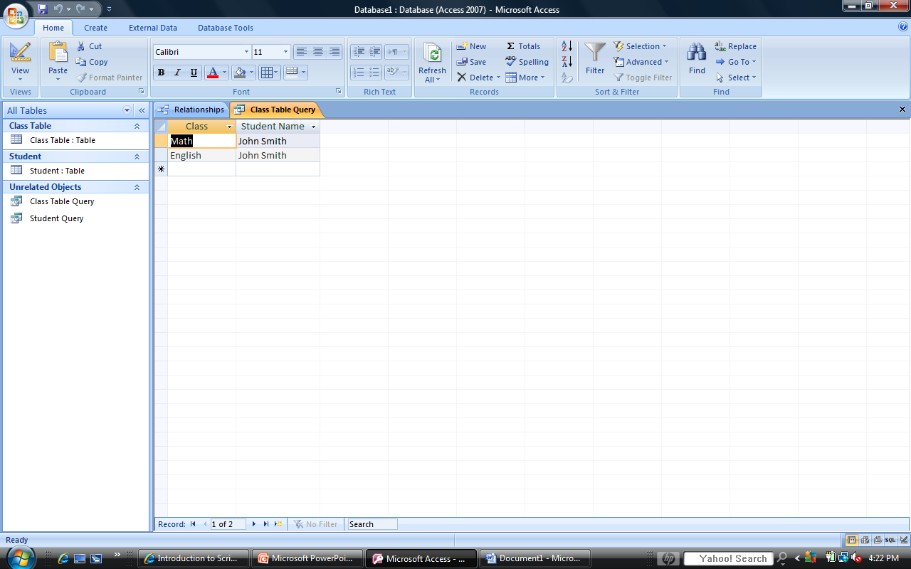
TCO 7: Key Concepts
SELECT [Class Table].Class, Student.[Student Name]
FROM Student INNER JOIN [Class Table] ON Student.[StudentID] = [Class Table].[StudentID]
WHERE Student.[StudentID] = 100;

Slide 10

TCO 7: Key Concepts
SELECT [Class Table].Class, Student.[Student Name]
FROM Student INNER JOIN [Class Table] ON Student.[StudentID] = [Class Table].[StudentID]
WHERE Student.[StudentID] = 100
ORDER BY [Class Table].Class ASC;

Slide 11
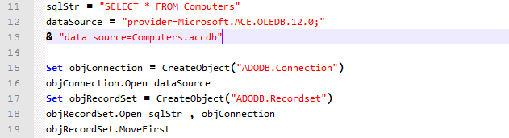
Lab Assignment Tasks 4 and 5
1. Change sqlStr
Notice the Quotation marks

Slide 12
Lab Assignment Tasks 4 and 5
In Week 2 you learned that:
  Strings = Text
    Require Quotation Marks
    Integers = Numbers
    Does Not Require Quotation Marks

Slide 13
Lab Assignment Tasks 4 and 5
Example: cmdArgs.vbs
c:\comp230>cscript cmdargs.vbs "Clark Kent" 25
Microsoft (R) Windows Script Host Version 5.8
Copyright (C) Microsoft Corporation. All rights reserved.
Your name is Clark Kent
Your age is 25
Your age in 10 years is .....35

Slide 14
Lab Assignment Tasks 4 and 5
How do you figure out what fields need to be inside quotation marks?
  Answer: Look at the table in Design View

Slide 15
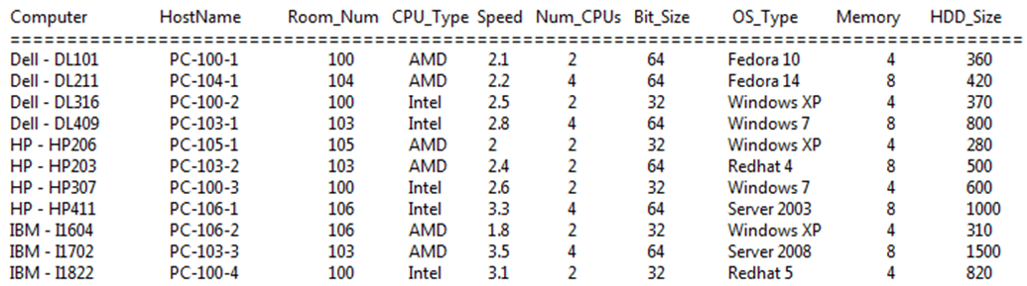
Lab Assignment
  Page 2 of Lab Assignment Instructions: Table in Datasheet View

Slide 16
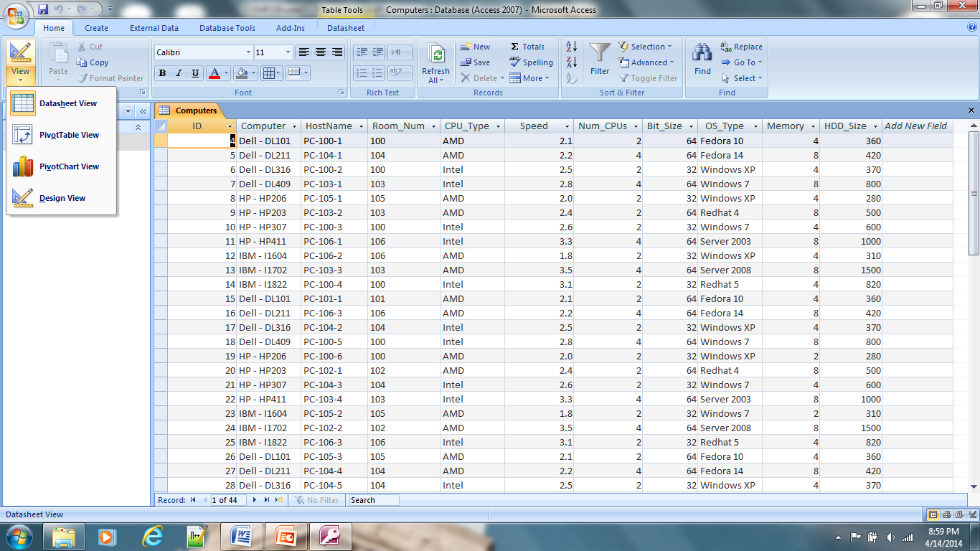
Lab Assignment
Change Datasheet View to Design View

Slide 17
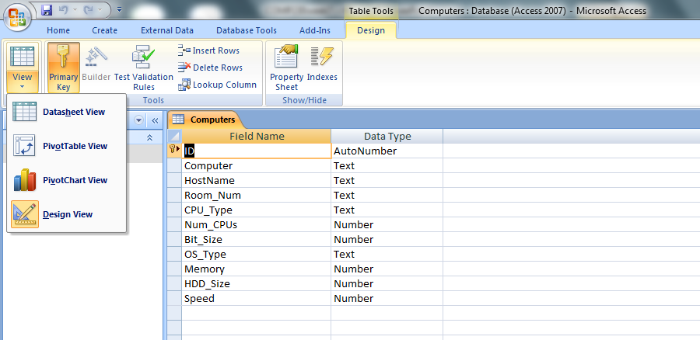
Lab Assignment
Text fields require quotation marks
Notice: you are going to have quotation marks inside of quotation marks or nested quotation marks

Slide 18
Lab Assignment Tasks 4 and 5
How do you write nested quotation marks?
  Answer: You learned this in your week 2 readings
  Textbook Page 135
var = ″SELECT * FROM Object WHERE Prop = ′Value′″
  Jones, Don. VBScript, WMI, and ADSI Unleashed, 2nd Edition. Pearson Learning Solutions, 05/2007. VitalBook file.

Slide 19
Lab Assignment Tasks 4 and 5
2. Modify recordStr to display the given headers only

Slide 20
Lab Assignment Tasks 4 and 5
  3. Modify the Do Until loop to include only the fields being displayed. Use the pad( ) function as needed to make the header and field values line up.
  Example: vbTab & pad(objRecordSet.Fields.Item(“HostName”),12)
  However, you can change the spacing in recordsStr.
  Example: recordsStr = “Computer HostName Room_Num & _

Slide 21
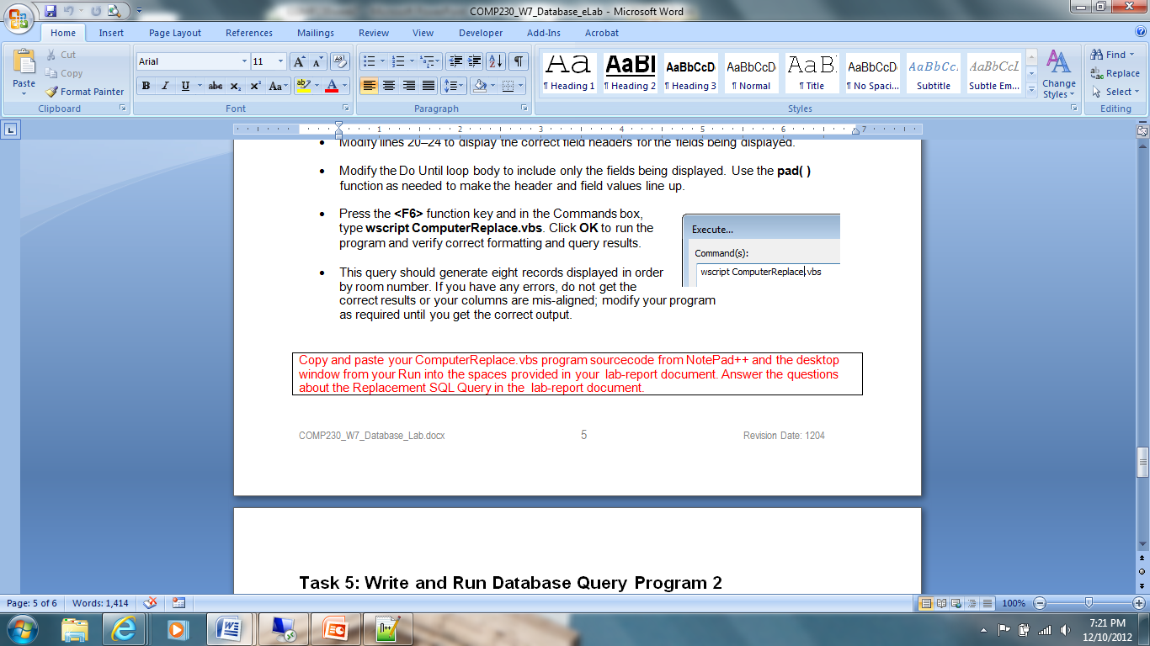
Lab Assignment
  Tasks 4 and 5
  Questions are worth a lot of points

Slide 22
Lab Assignment Hints
Do one step at a time – SELECT, FROM, WHERE, ORDER BY
Be very careful – there is an Internet assignment that runs, but has a flaw in it. The Academic Integrity Committee has ruled this assignment violates the Academic Integrity Policy and you will receive a grade of ZERO if you turn this in.

