Slide 1
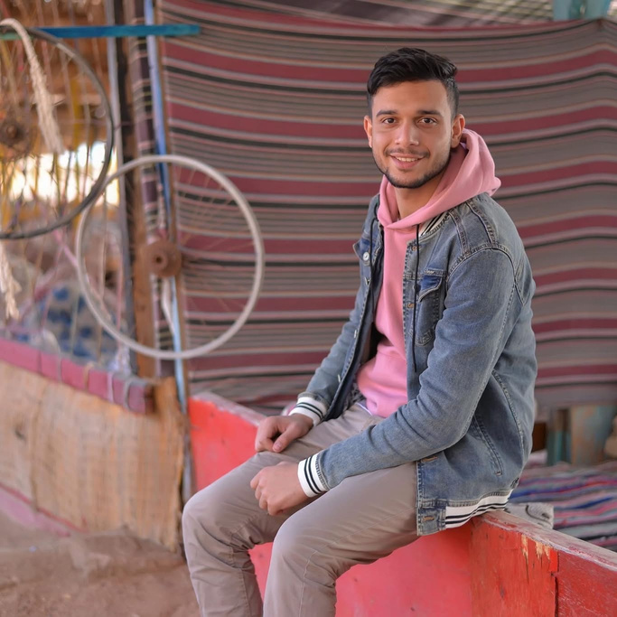
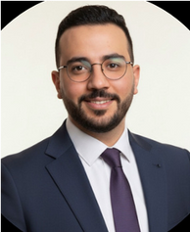
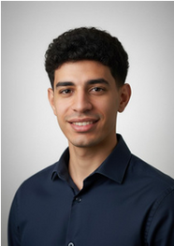
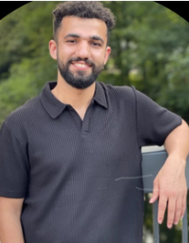
FINAL PRESENTATION
FROM PHOTO TO SOLVED CROSSWORD
Structure Understanding, OCR, and Hybrid Solving
Mohamed Ibrahim
Moustafa Elmehy
Ali Elshafey
Mustafa Hussein
1

Slide 2


Project Goal
TAKE A PHOTO OF A CROSSWORD PUZZLE AND SOLVE IT DIRECTLY
Photo
Preprocessed Image
Structure Extraction
Answers
• OCR alone is not enough
• We must understand the puzzle structure
2

Slide 3


From CamScanner to Real Mobile Photos
At first, we used CamScanner images
Mobile photos include skew, perspective distortion, shadows, and noise
We wanted a fully automatic system
So we removed the dependency on external apps
All image preprocessing is now done inside our pipeline
Images were clean and easy to process
This was not realistic. In real use, a user simply takes a photo with a mobile phone.
3

Slide 4
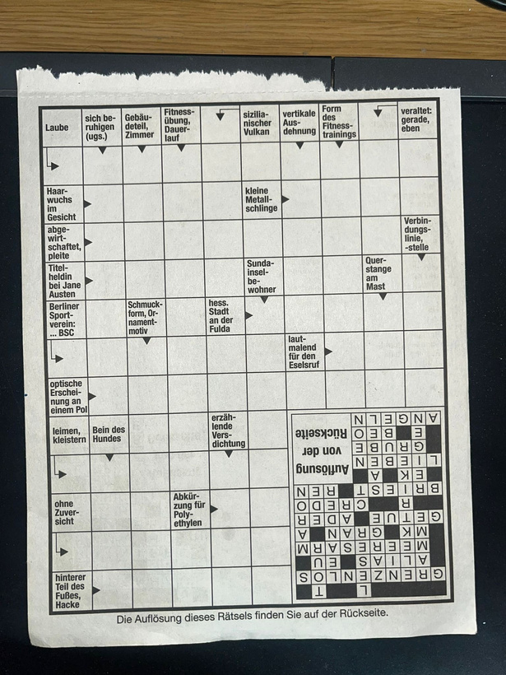
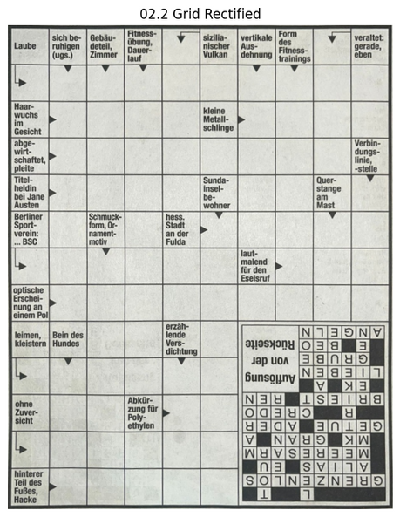
Image Preprocessing
Our solution:
Skew correction and auto-warp
• Perspective rectification
Grid Rectification Problem
Perspective distortion in scanned images.
Solution
Detect grid contour + perspective unwarp.
Result &impact
Clean, rectangular grid.
Stable grid, better OCR & solving.
4

Slide 5
Pipeline to build the structured puzzle
WE CONVERT THE PHOTO INTO
Clean Gird
Mask
Detected Questions Cell
Detected Arrows
Libraries used:
  NumPy
  OpenCV
  Matplotlib
  Pathlib
5

Slide 6
Clean Gird
Image enhancement & binarization
Uniform grid reconstruction
Improves image quality and converts it into a clean black-and-white representation.
Reconstructs a regular grid with consistent cell spacing.
Grid line detection
cell extraction (13 × 10)
Detects horizontal and vertical lines that form the table structure.
Extracts table cells with a fixed 13×10 layout.
Grid refinement & intersection filtering
Refines detected lines and keeps only valid grid intersection points.
6

Slide 7

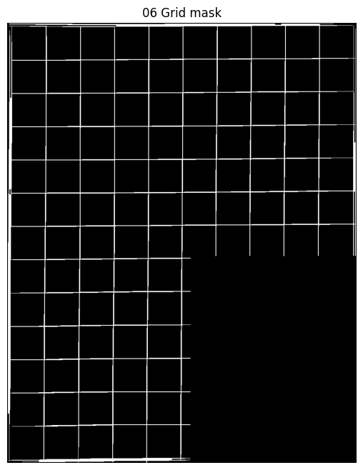
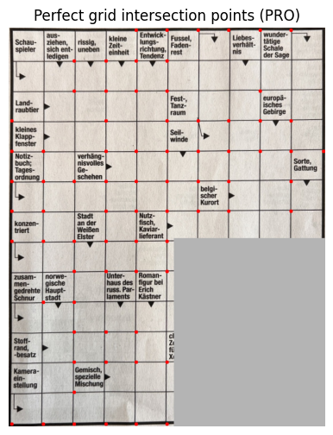
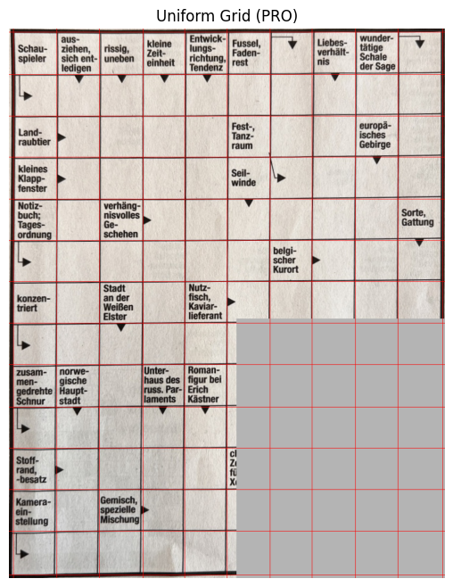
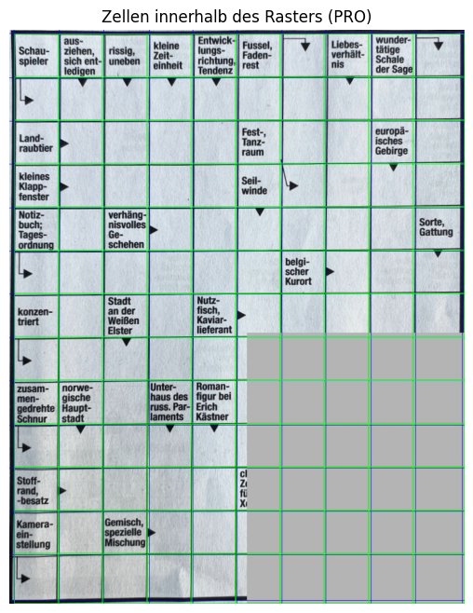
THE LINKING PROBLEM
7

Slide 8
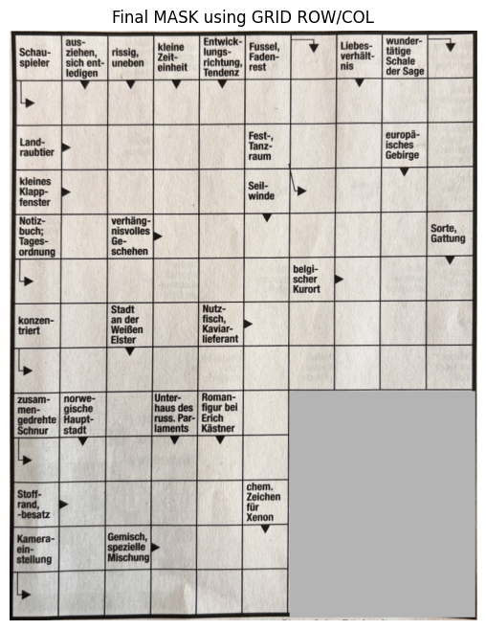
Grid-basiertes Masking
Questions and arrows detected correctly
Use the warped image and the grid coordinates to mask a specific table area
Libraries: OpenCV, NumPy, Matplotlib, Pathlib.
8

Slide 9
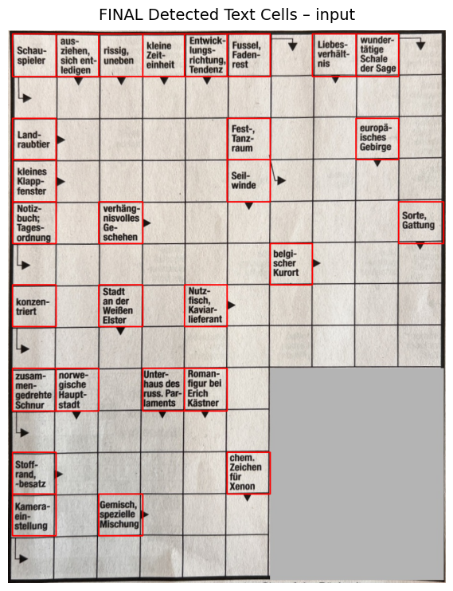
Detected Questions Cell
Divide the page into cells
The page is split into individual grid cells using the detected row and column coordinates.
Measure ink amount (text density)
For each cell, the amount of ink is measured by calculating the ratio of black pixels using OpenCV and NumPy.
Decide using a threshold
If the ink is higher than a defined threshold, the cell is marked as a text cell; otherwise, it is considered empty.
9

Slide 10
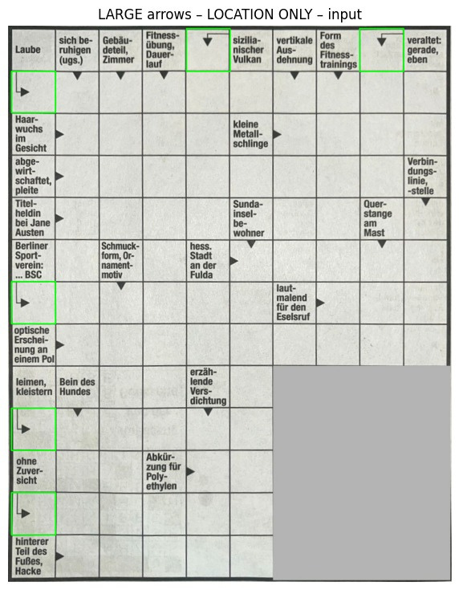
1st stage Detected Arrows
Large Arrow Detected
The code scans all table cells except text cells, removes noise, measures the ink amount, and uses template matching to detect the locations of large arrows, preparing for small arrow detection in the next stage.
10

Slide 11
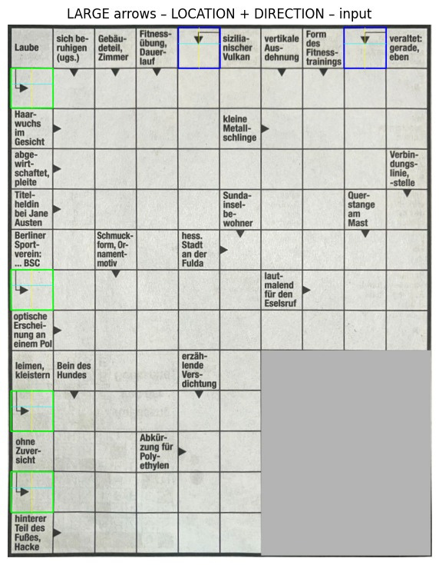
Large Arrows direction
11

Slide 12
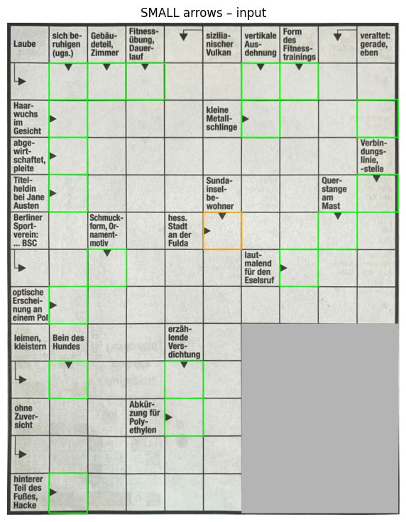
2nd Stage Detected Arrows
Small Arrow Detection
The code scans all table cells except text cells and previously detected large arrows, measures the ink amount, and uses template matching to detect small arrow heads and determine their direction.
12

Slide 13
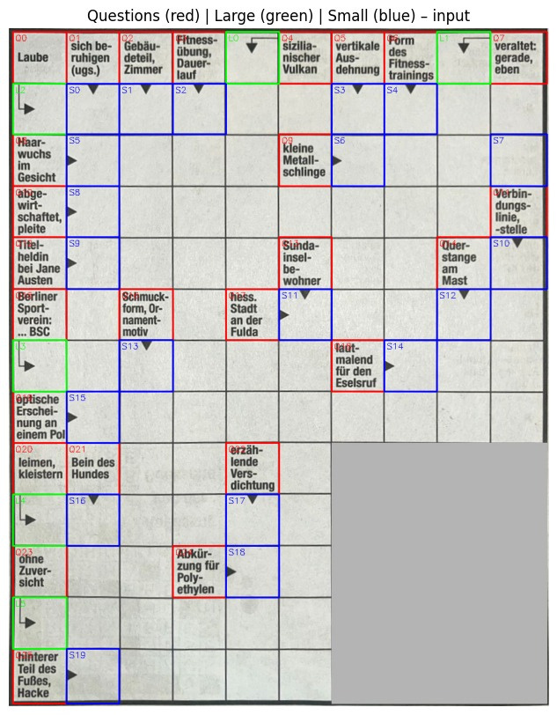
Detected Arrows
13

Slide 14
THE LINKING PROBLEM
Questions and arrows detected correctly
Individual detection stages produced accurate question cells and correct arrow directions across the grid.
Linking between them still unreliable
Correct detection of questions and arrows alone did not guarantee correct question–answer associations.
Core challenge: structural ambiguity
Multiple valid-looking relations exist inside the grid without explicit structural rules defining the correct linkage.
14

Slide 15
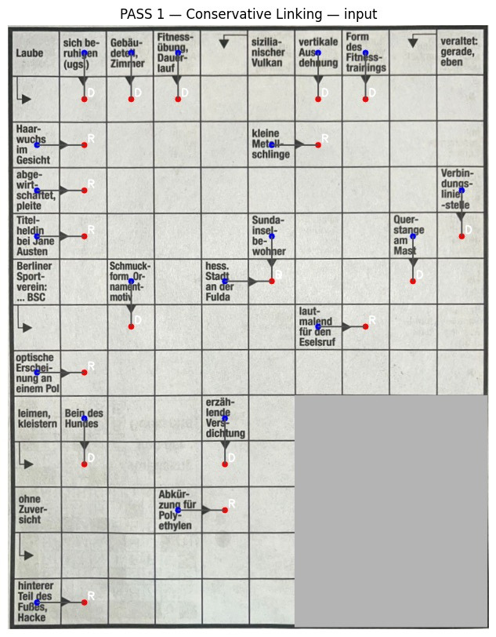
PASS 1: CONSERVATION DIRECT LINKING
Link only arrows directly adjacent to a question
Only arrows in immediately neighboring cells were considered as candidates.
Direction must match the question position
Arrow orientation was validated to ensure logical answer flow.
High precision, but many cases remain unlinked
The strict rules reduced errors but excluded valid non-local cases.
15

Slide 16
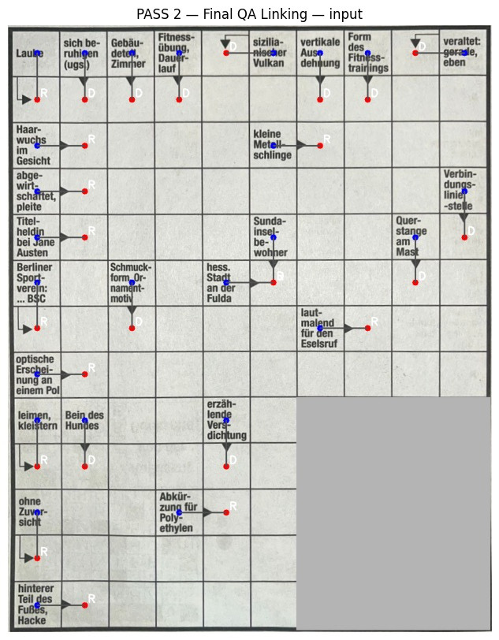
PASS 2: GRID-BASED RECOVERY
Second pass over the grid
The grid was traversed again to re-evaluate unresolved elements.
Recover unlinked questions and arrows
Remaining free questions and arrows were matched using spatial proximity.
Structure-aware, deterministic strategy
Linking decisions followed a simple, rule-based grid logic.
16

Slide 17
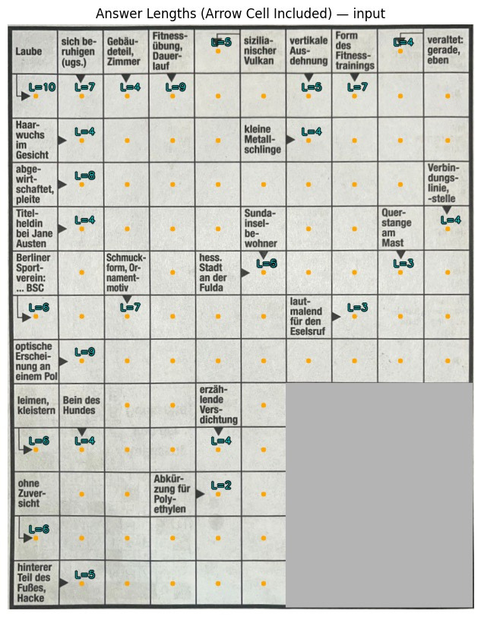
ANSWER LENGTH & FINAL OUTPUT
Answer length computed by grid walk
Each answer length was calculated by stepping through the grid cells.
Clear stopping conditions
Traversal stopped at boundaries, question cells, or masked regions.
Final structured output for the solver
The result is a clean representation ready for downstream solving.
17

Slide 18
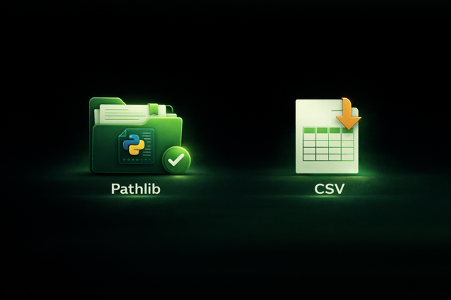

LIBRARIES USED IN THIS PART
In this part, We mainly used NumPy for grid logic, OpenCV and Matplotlib for visualization, and simple file utilities for structured outputs.
18

Slide 19
OCR & Text Extraction
Cell-level OCR
OCR is applied per question cell, not on the full image.
Libraries used:
  base64
  openai
OpenAI Vision-based OCR (GPT-4.1)
More stable than classical OCR for German crossword text.
Clean input for solver
Produces structured text used by all solvers.
19

Slide 20
Solver Input Representation
Question metadata
Text, start cell, direction, and answer length.
Libraries used:
  ast
  re
Grid-based constraints
Shared letters at intersections
Goal
Assign one valid word per question.
20

Slide 21
Solver 1 — Website based Solver
Candidate generation
Words fetched from wort-suchen.de (German crossword database).
Libraries used:
  requests
  beautifulsoup4
  urllib.parse
  time
Backtracking search
Try words and backtrack on conflicts.
Baseline approach
Used as a reference solution.
21

Slide 22
Solver 2 — Hybrid Solver
Candidate generation (Website&GPT)
Words fetched from a crossword website (wort-suchen.de).
Semantic candidates from an LLM.
Merging & weighting
Website > GPT > fallback.
Never-empty rule
Each clue always has candidates.
22

Slide 23
Solver 2 — Hybrid Solver
CSP formulation
Clues = variables, list of candidate words= domains,grid intersections=constraints .
Seeding
  Start with a constrained anchor word.
  Fewer candidates or longer length
Propagation & pruning
Once a word is placed, its letters become fixed and remove words that do not fit in intersecting clues.
Backtracking search
Backtracking is used only after the grid is constrained and we have some remaining options .
23

Slide 24

LIVE DEMO
24

Slide 25
THANK YOU
FOR YOUR ATTENTION
24

