Slide 1
RNA Sequencing
Molecular and Genomics Informatics Core
By Alexander Lemenze, PhD
Notes:
Hi Everyone, and welcome to the session on RNA sequencing

Slide 2
Our Journey Today
MEETING AGENDA
Library Prep
Analysis Steps
Tertiary Steps
Post- Sequencing QC
Alignment and Mapping
Secondary QC
Differential Gene Expression
Intake QC
Library Prep Methods
Library QC
Pathway Analysis
De novo transcriptome
Splice Variants
Notes:
So our journey today for the ins and outs of RNA-sequencing- in this case bulk short reads. Like WGS, we will start with the upstream library prep options and QC, then to the analysis with both alignment and mapping, some secondary QC that goes into RNA-seq, then differential gene expression, and a spot on some tertiary steps like pathway analysis, de novo transcriptomes, and splice variants.

Slide 3
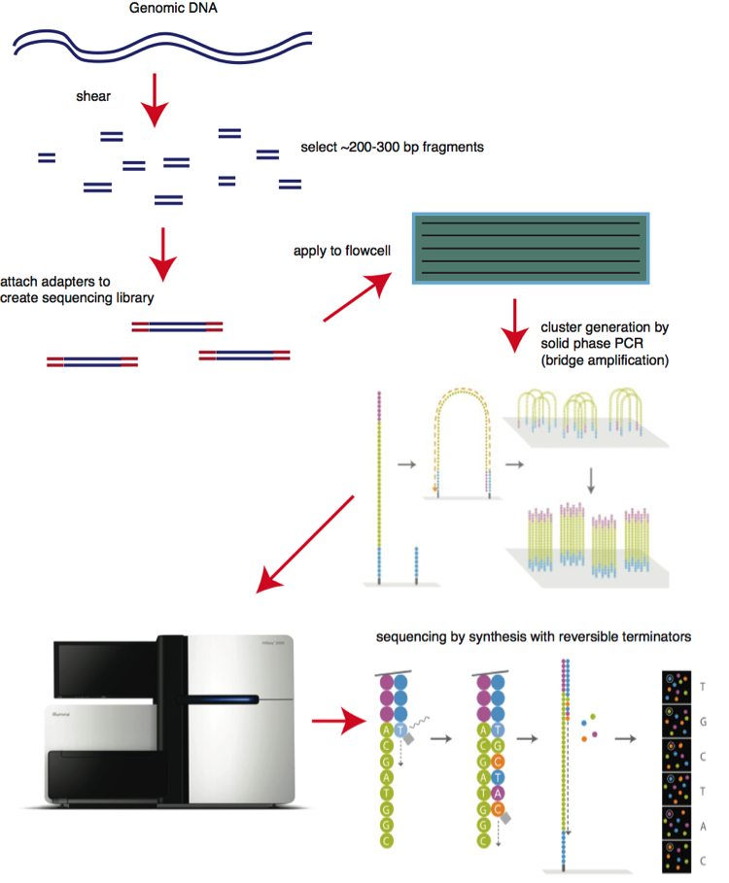
Recap
1
Short read NGS Basics
3
1
Fragment DNA/cDNA
2
2
Add Adapter
3
Generate Clusters on Flowcells
4
Sequence by Synthesis
4
https://bitesizebio.com/13546/sequencing-by-synthesis-explaining-the-illumina-sequencing-technology/
Notes:
But the real quick recap! Just to refresh how NGS works again- Ill keep bringing this up every time to illustrate just how the sequencing part is all the same- it’s the getting to your fragments of nucleic acid that are critical for the experiments. But in this case, you convert RNA to cDNA, fragment you cDNA, add adapter, generate clusters, and do your sequencing by synthesis yah? So that’s a lot of what we will touch on today is the how to make your library for the sequencer, and then the downstream analysis.

Slide 4
Library Prep

Slide 5
Intake QC

Slide 6
Library Prep Methods
PolyA

Slide 7
Library Prep Methods
rRNA depletion

Slide 8
Library Prep Methods
Ultra Low

Slide 9
Library Prep Methods
Small RNA

Slide 10
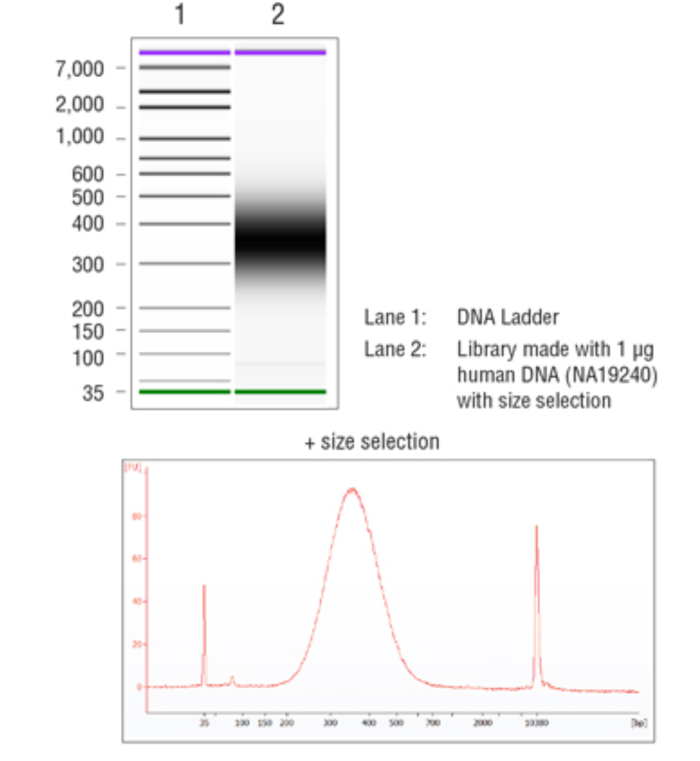
Library QC
Good libraries
Narrow band ~200-400bp in size target
Depends upon sequencing length for final insert size if you want overlap or not
Illumina machines minimum is ~100bp
Illumina machine maximum is ~700bp
Watch out for primer dimer peaks!!
Notes:
So just to re-hash a good library- it should look like this. We went over this in depth for WGS, but just again watch out from primers and primer dimers!

Slide 11
Analysis Steps

Slide 12
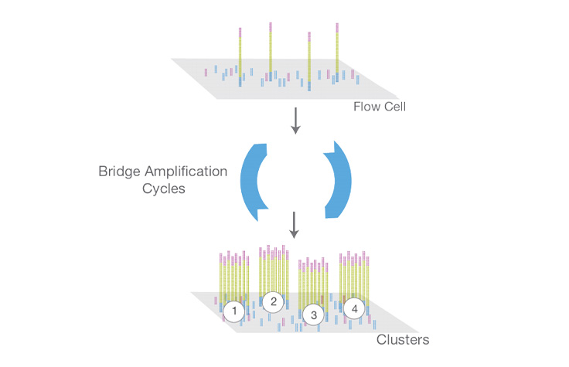
During Sequencing QC
Cluster generation
MiSeq optimal range:
1200-1400 k/mm²
NextSeq optimal range:
170-220 k/mm²
%PhiX mapping
Spike in control, make sure its mapping well!
%Phasing/prephasing
Percent of molecules in a cluster that may be ahead or behind of the cycles
Should be <0.5%
% Passing filter
Notes:
Now this is all just a refresher from the WGS 101- If you need this in depth we can go back to there, but just remember some of the things to look for during sequencing.

Slide 13
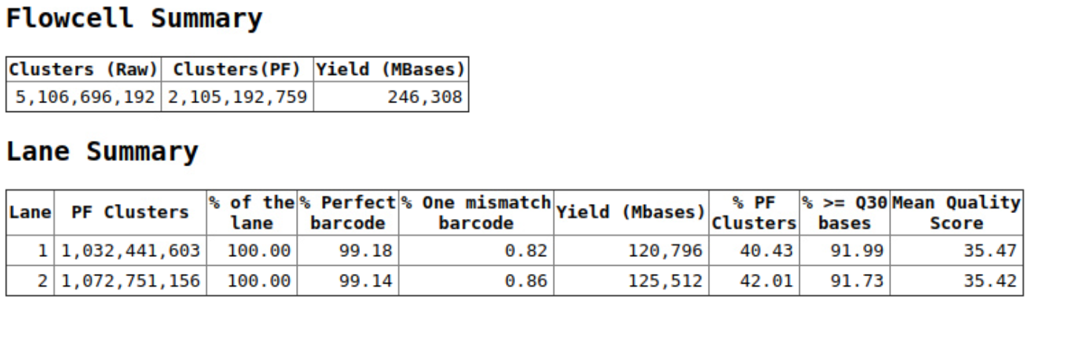
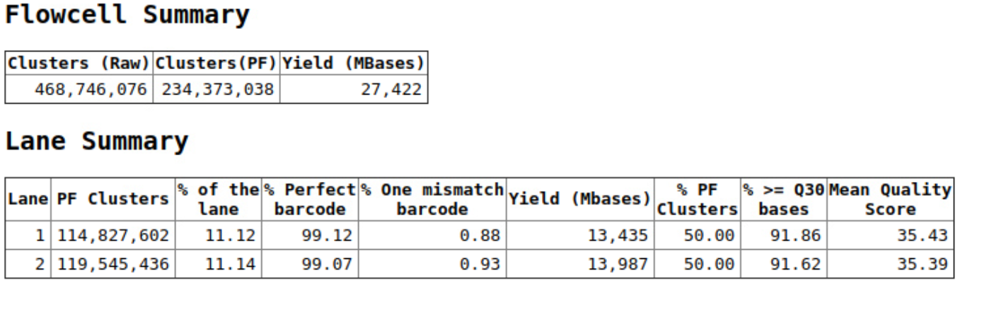
Post-Sequencing QC
Whole flowcell
Single sample
Notes:
Likewise for demultiplexing- same key points- make sure your indices are good.

Slide 14
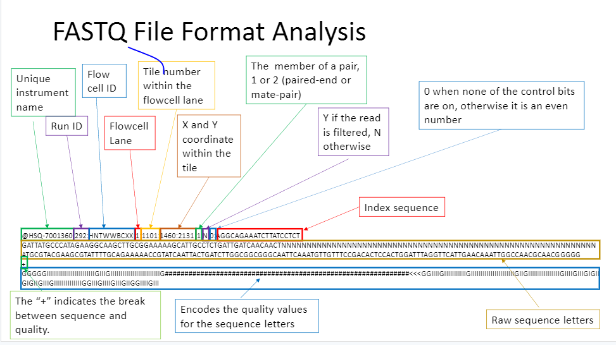
Fastq format
https://kscbioinformatics.wordpress.com/category/bioinformatics-resources/
Notes:
And the fastq format in case you forgot- so far it’s the same as WGS.

Slide 15

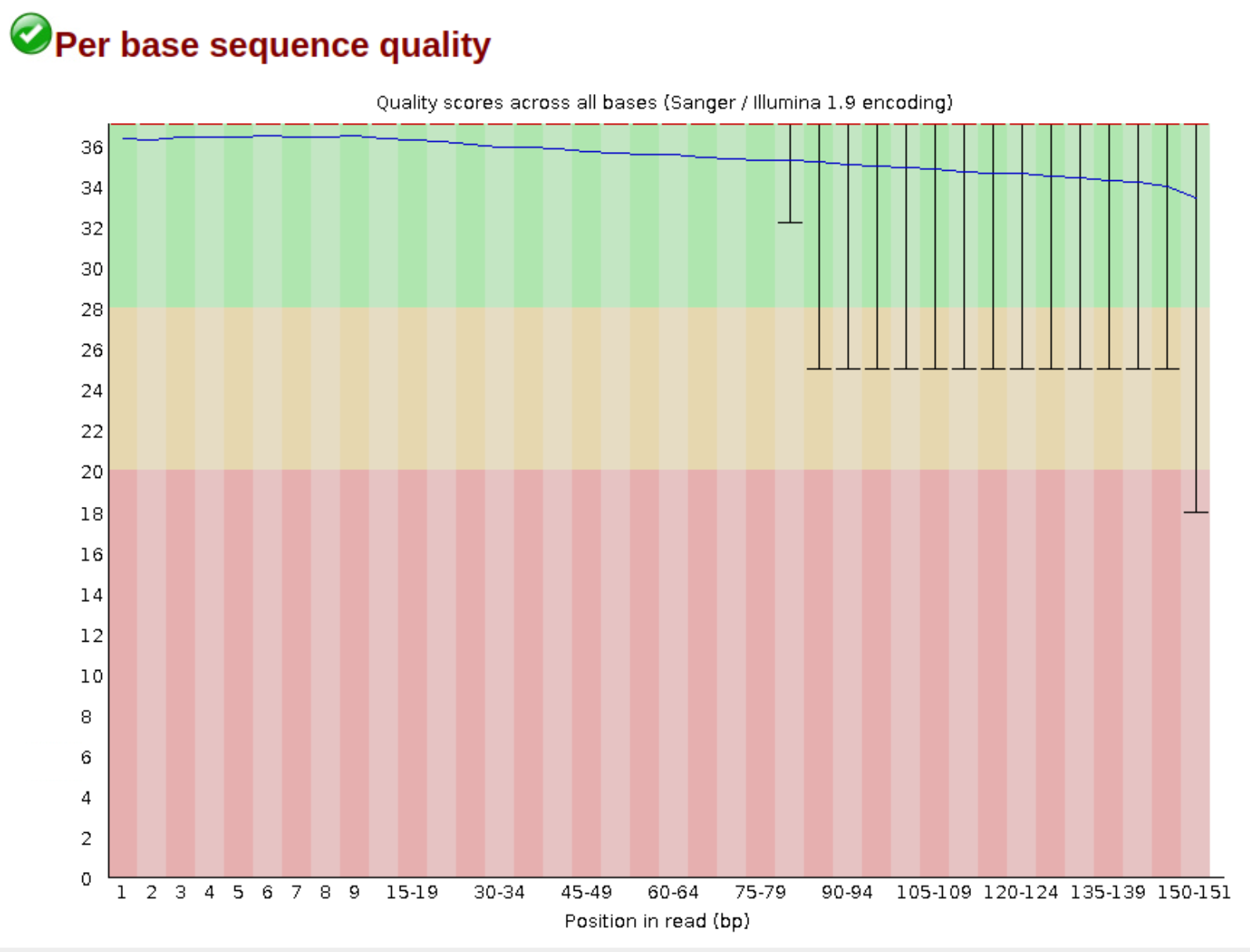
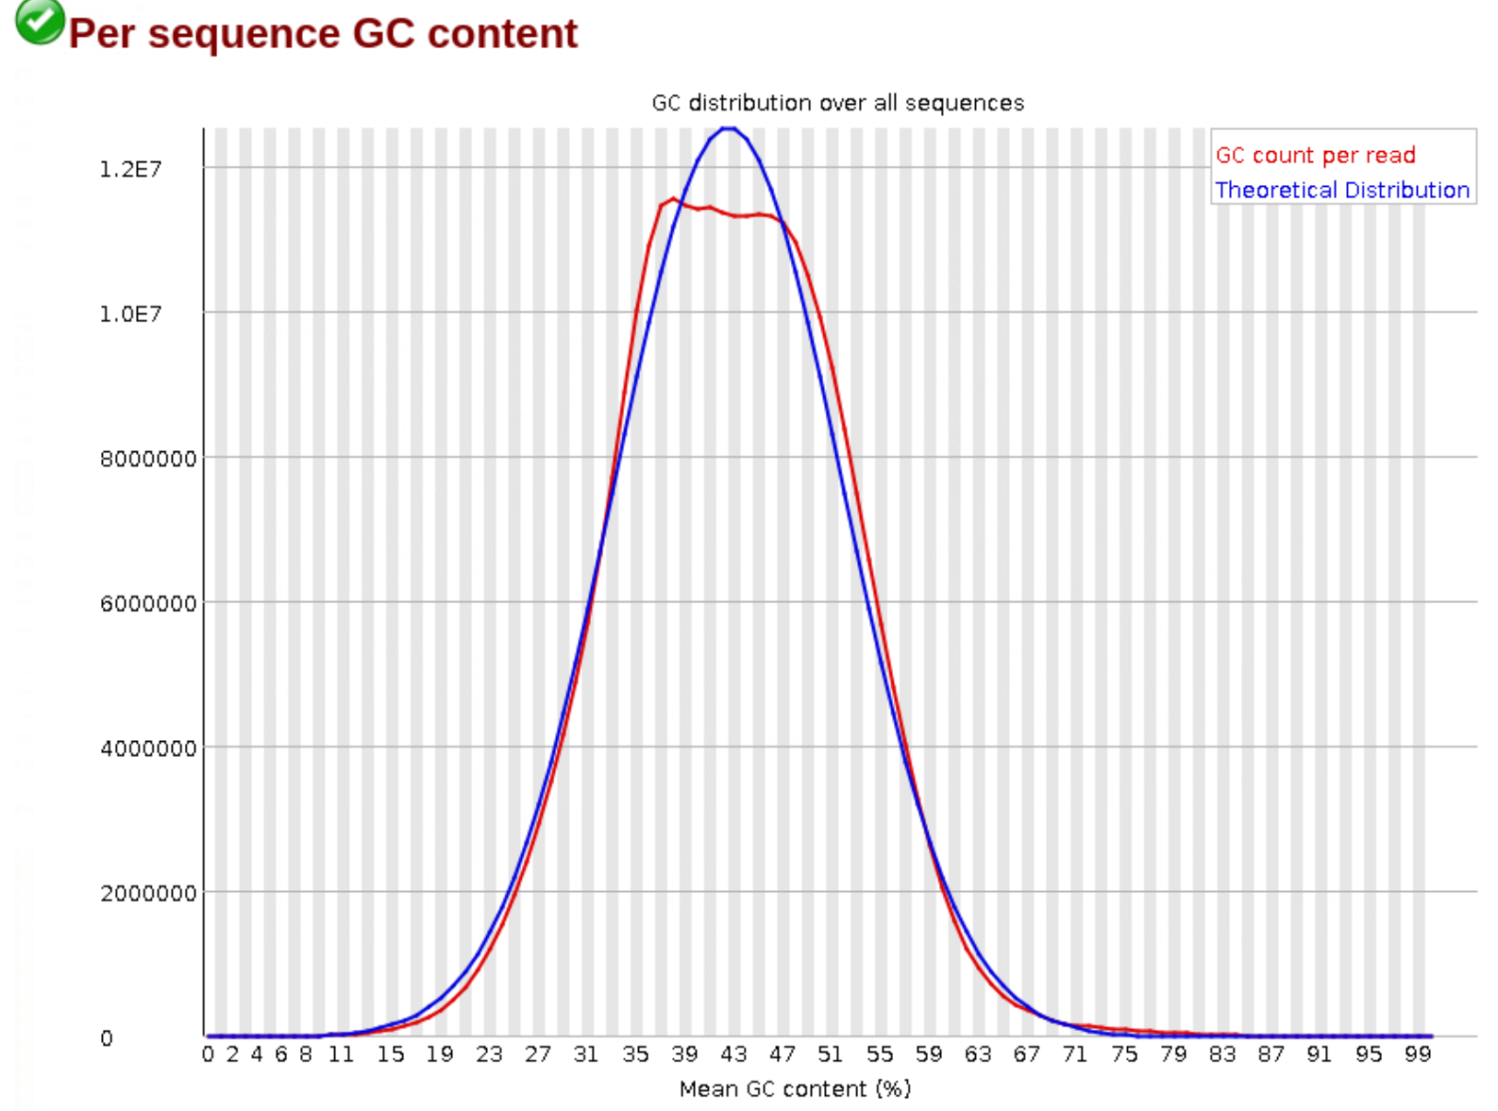
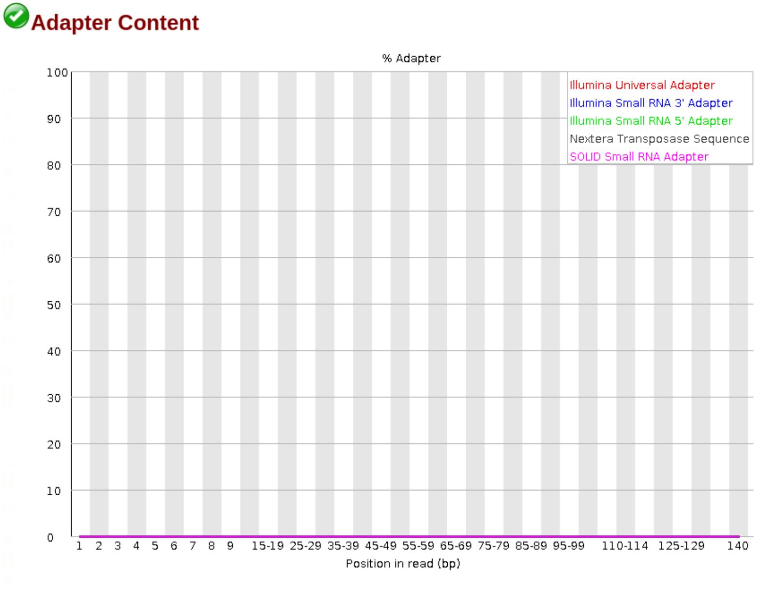
FASTQC
Notes:
And once again, output fastq quality is another important facet. Sounds like Im on repeat from the last class eh?

Slide 16
Mapping/Alignment
Basis of algorithms
Mapping= where does my read look like it came from
This read is in the beta-actin gene
Alignment= exact matching location
This read is base 1-20, has a 3bp insertion, then bases 21-50 of the beta-actin gene
Similar and often used interchangeably, but slightly different.
Notes:
But here is where Im going to start mixing it up. Remember back to when I harped on how mapping and alignment are often used interchangeably but are slightly different? Well here we are going to get into that. First we will review alignment for RNA-seq since that is the more traditional route, and then we will go into mapping for RNA-seq.

Slide 17
Smith waterman refresher?

Slide 18
Alignment

Slide 19
Mapping

Slide 20
Mapping/Alignment QC

Slide 21
Differential Gene Expression
Algorithms

Slide 22
Differential Gene Expression
Tools

Slide 23
Tertiary Steps

Slide 24
Pathway Analysis

Slide 26
De novo transcriptome

Slide 27
Splice Variants

Slide 28
THANK YOU

