Slide 1
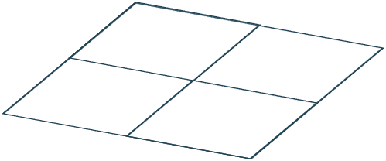
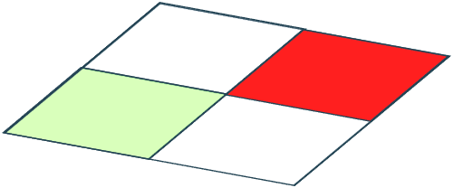
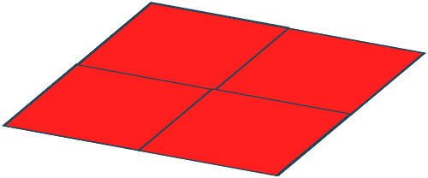
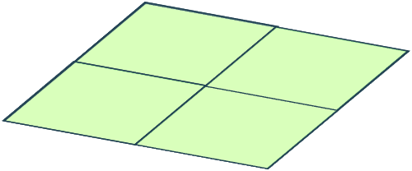

Slide 2
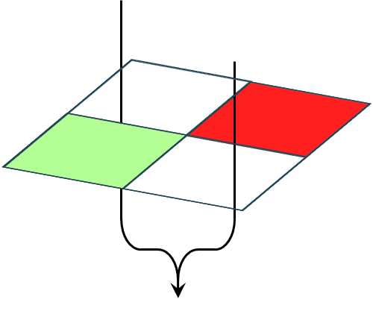
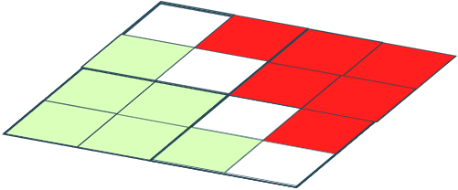
Favour Dose B

Slide 3
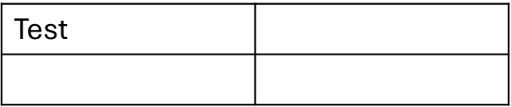
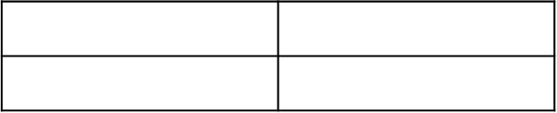
test
Test

Slide 4
 |  | Dose B
 |  | DLT | No DLT
Dose A | DLT
 | No DLT

Slide 5
 |  | Dose B
 |  | No response | Response
Dose A | No response
 | Response

Slide 6
 |  | Dose B
 |  | Insufficient intensity | Sufficient intensity
Dose A | Insufficient intensity
 | Sufficient intensity

Slide 7
 |  |  | Dose B
 |  |  | FACT-GP5 score of…
 |  |  | 4 | 3 | 2 | 1 | 0
Dose A | FACT-GP5 score of… | 4
 |  | 3
 |  | 2
 |  | 1
 |  | 0

Slide 8
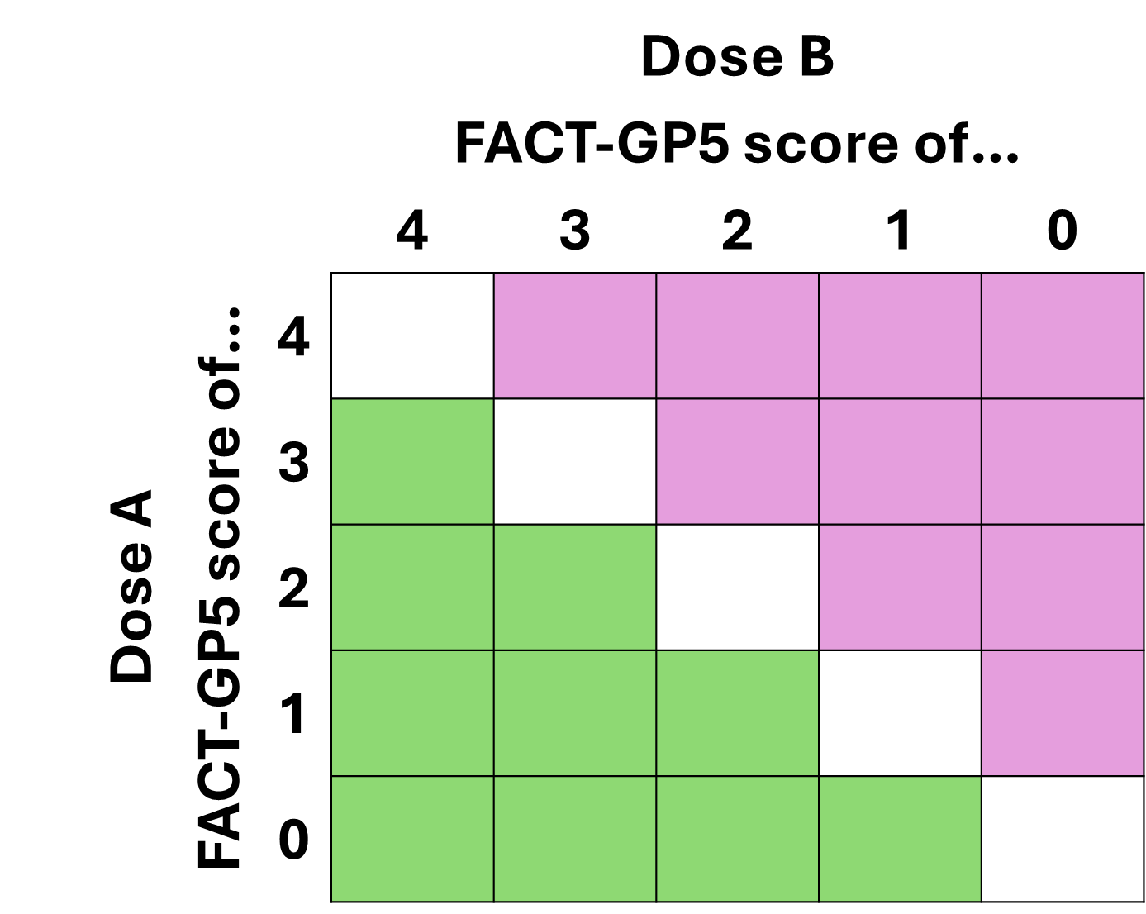
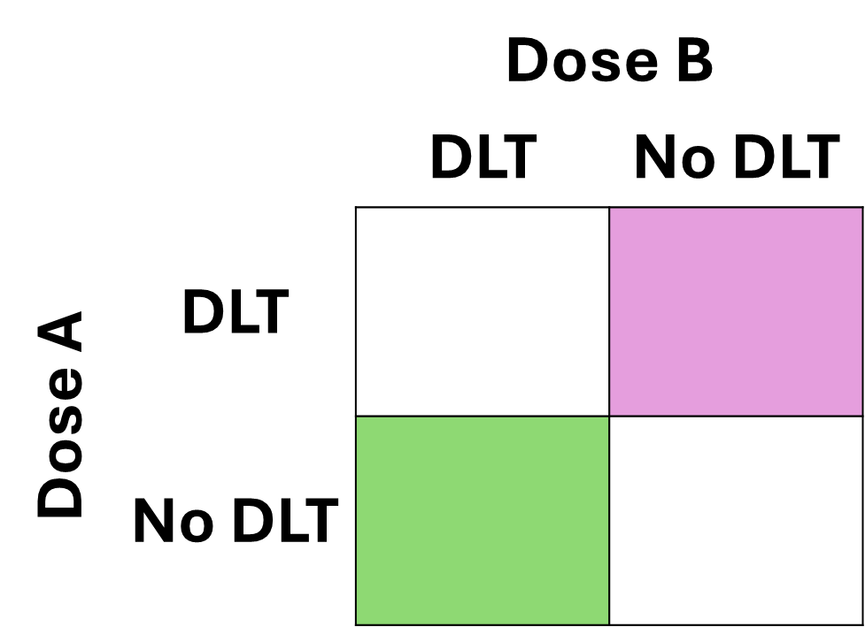

Slide 9
