Slide 1
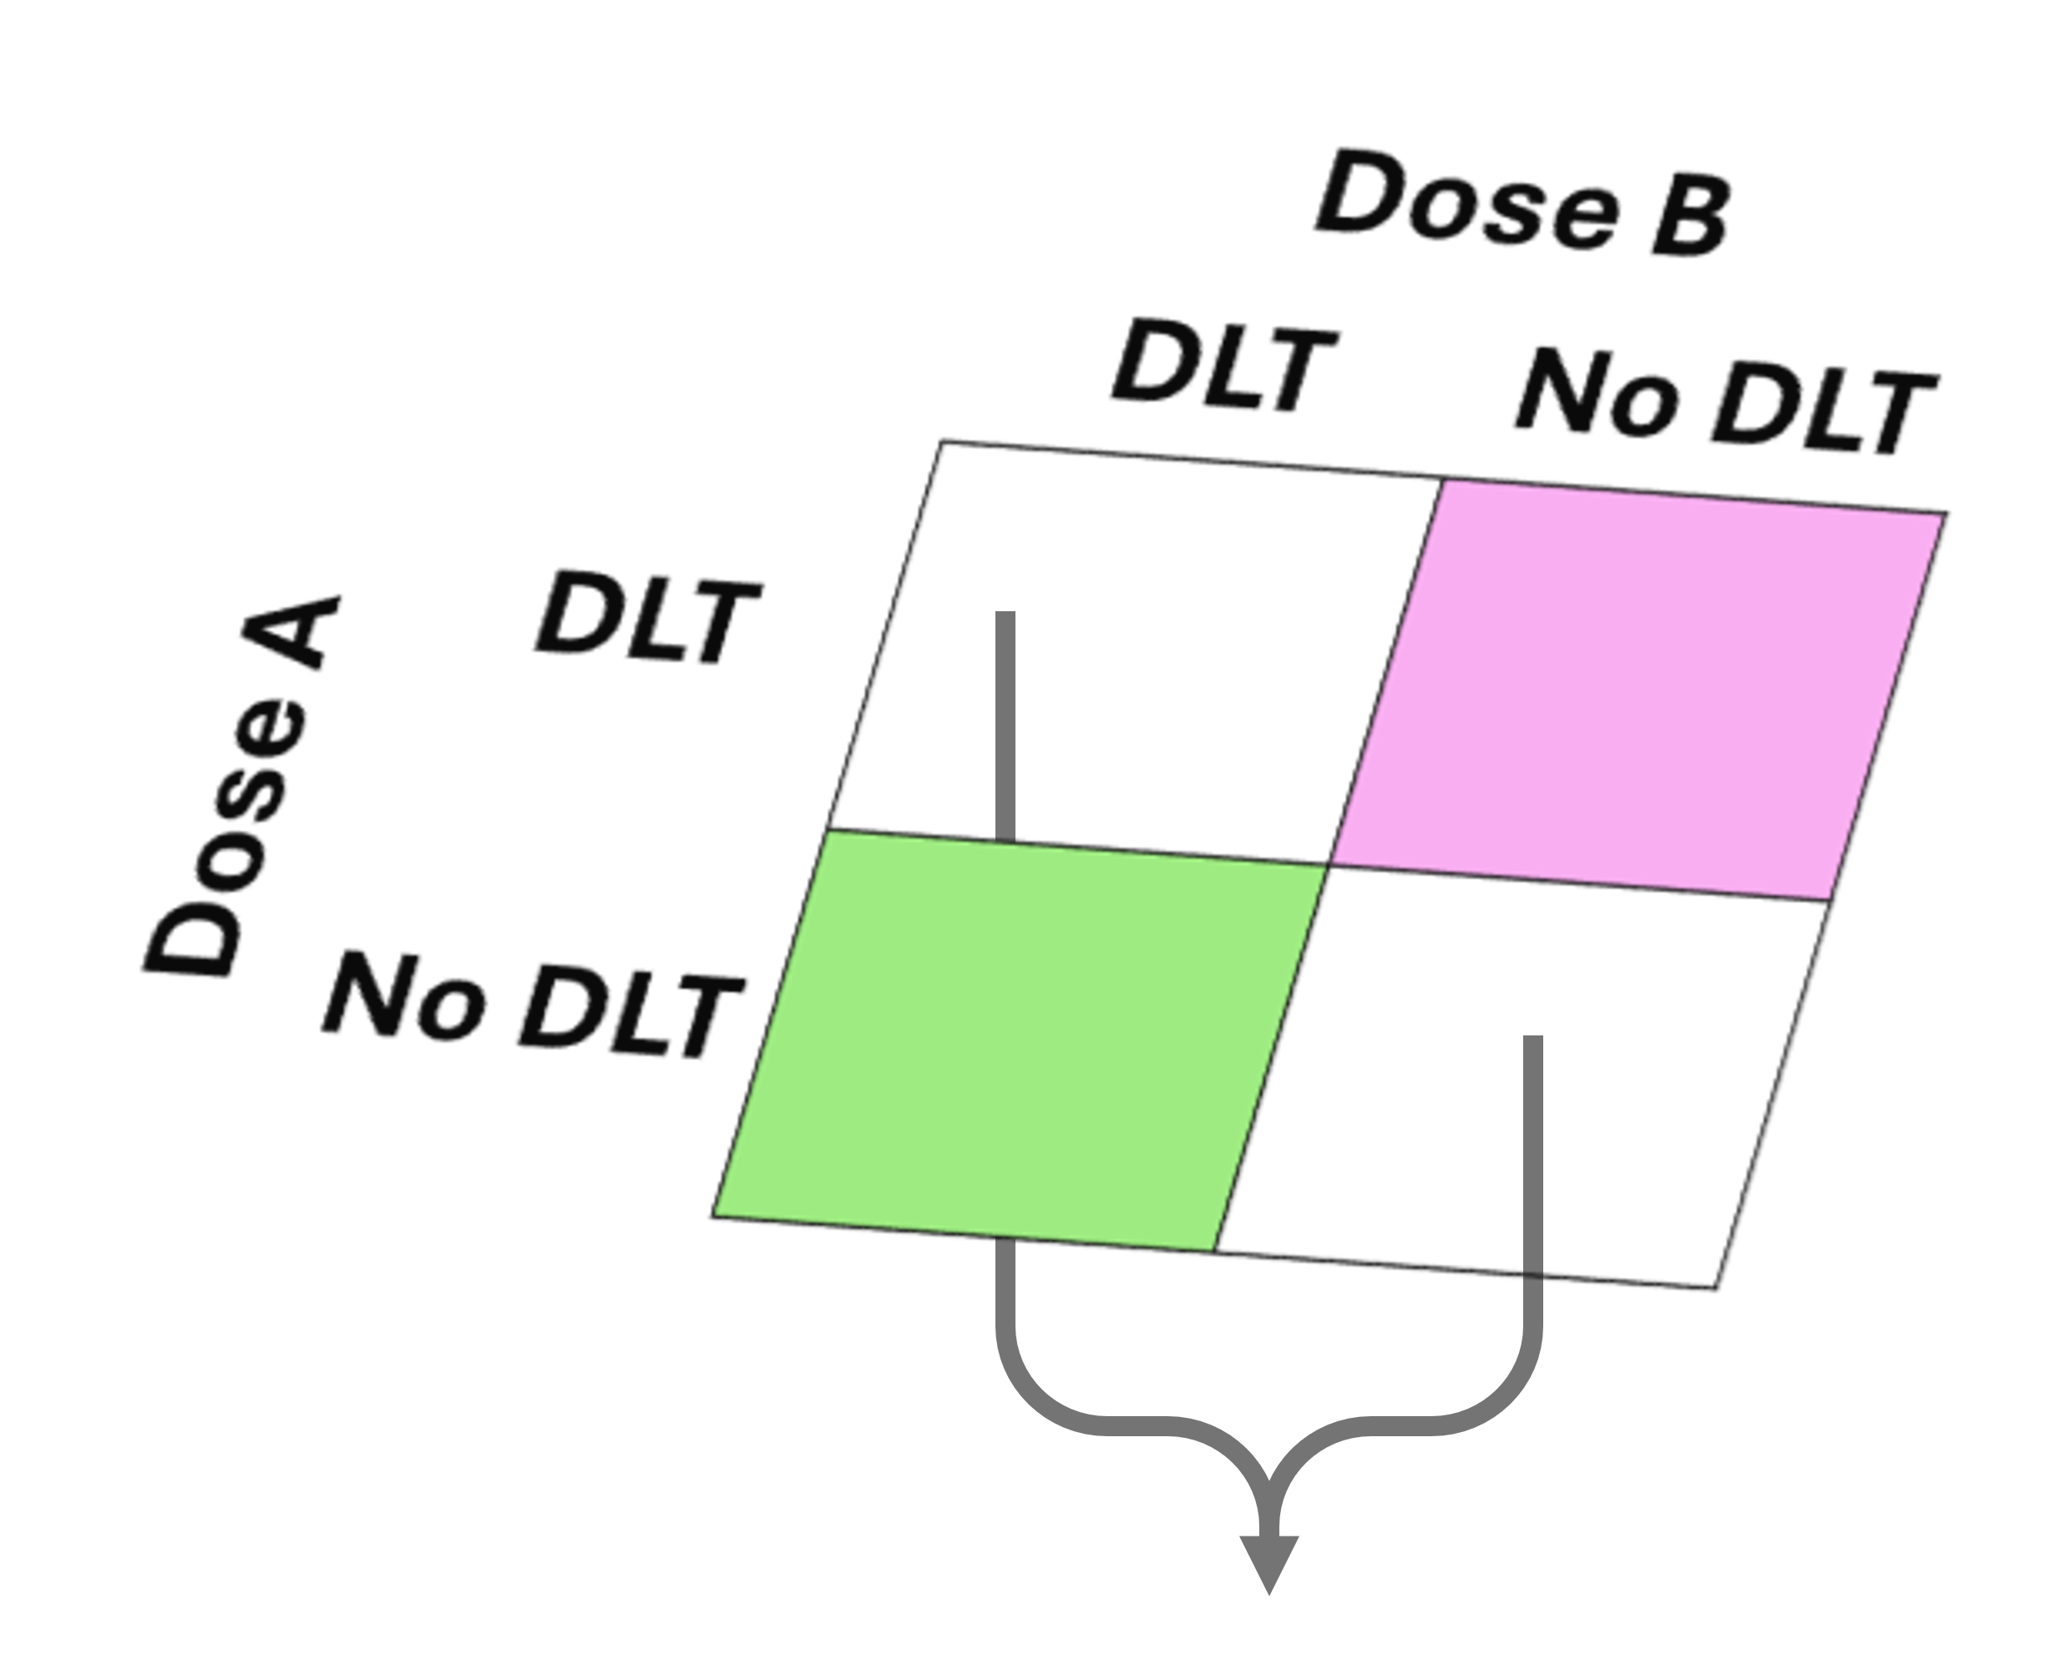
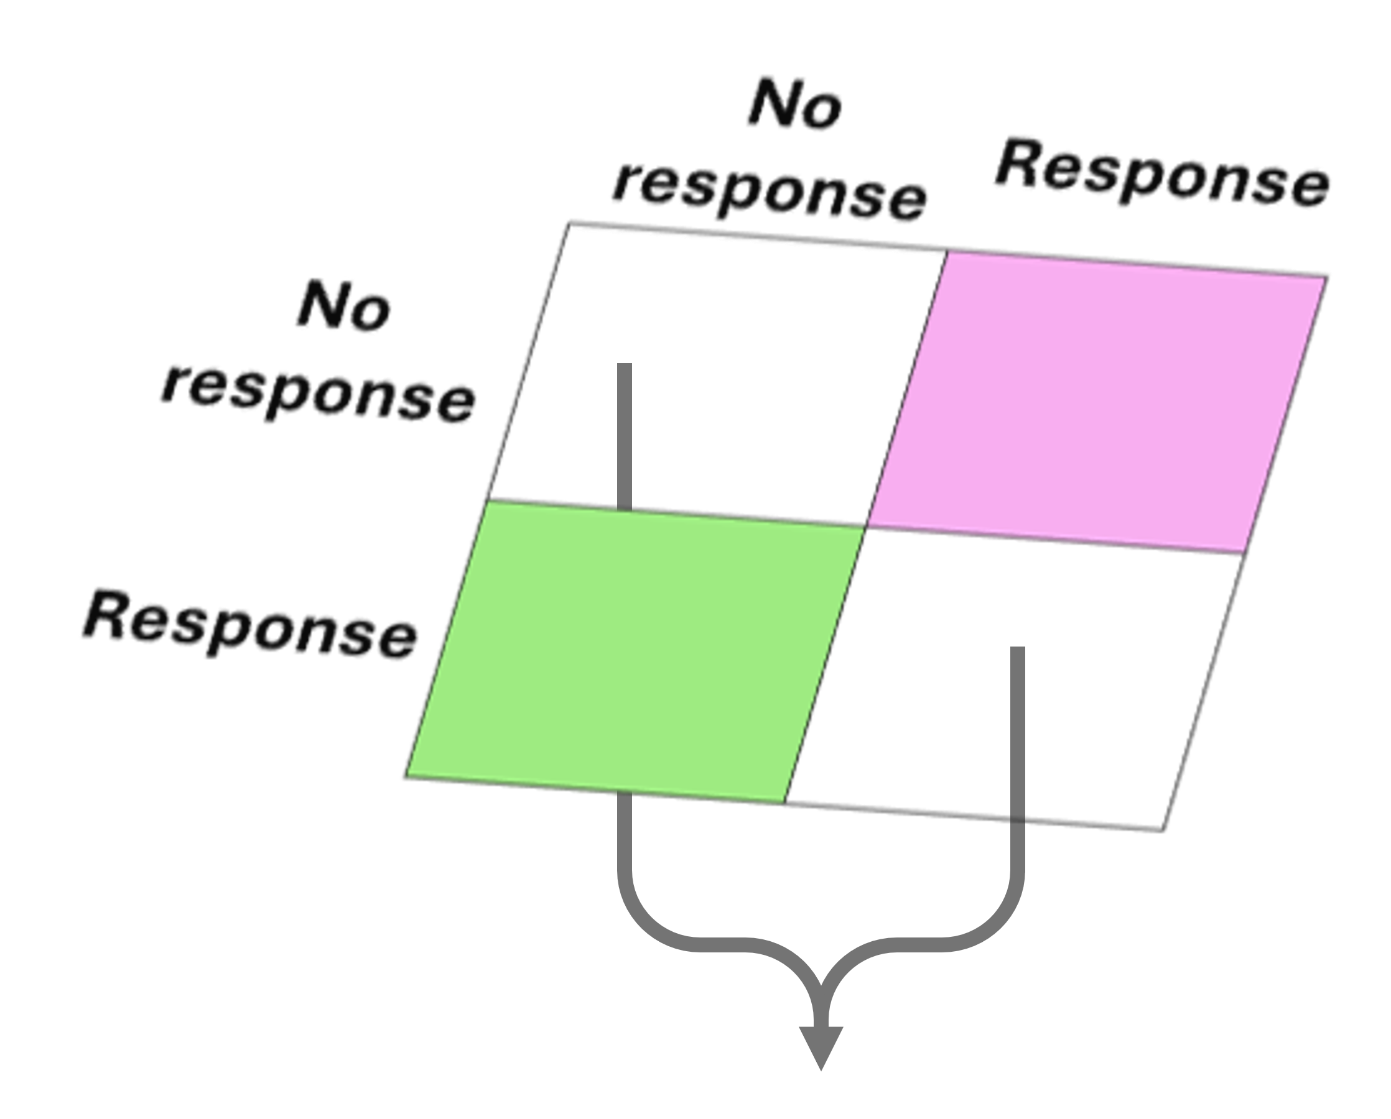
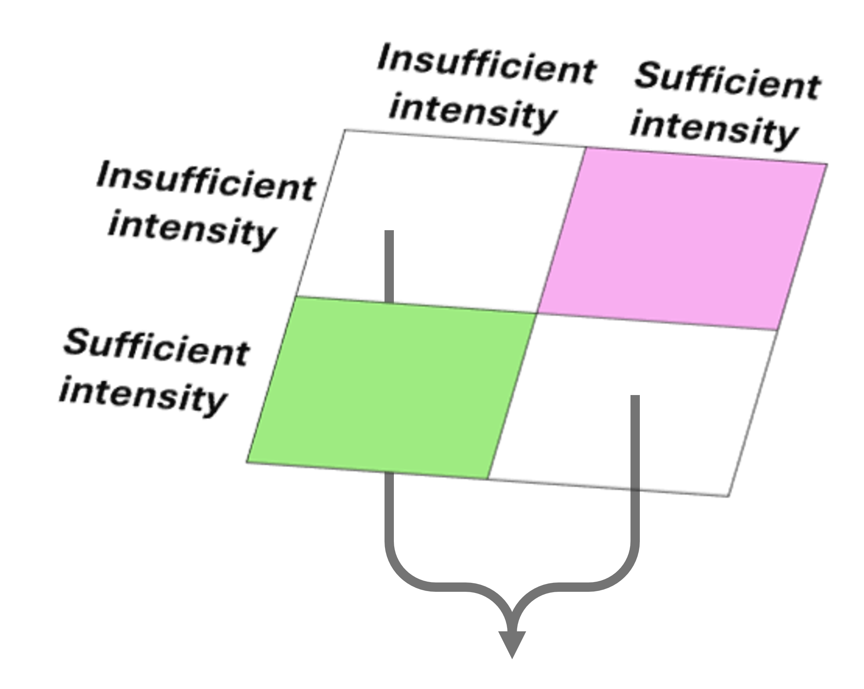
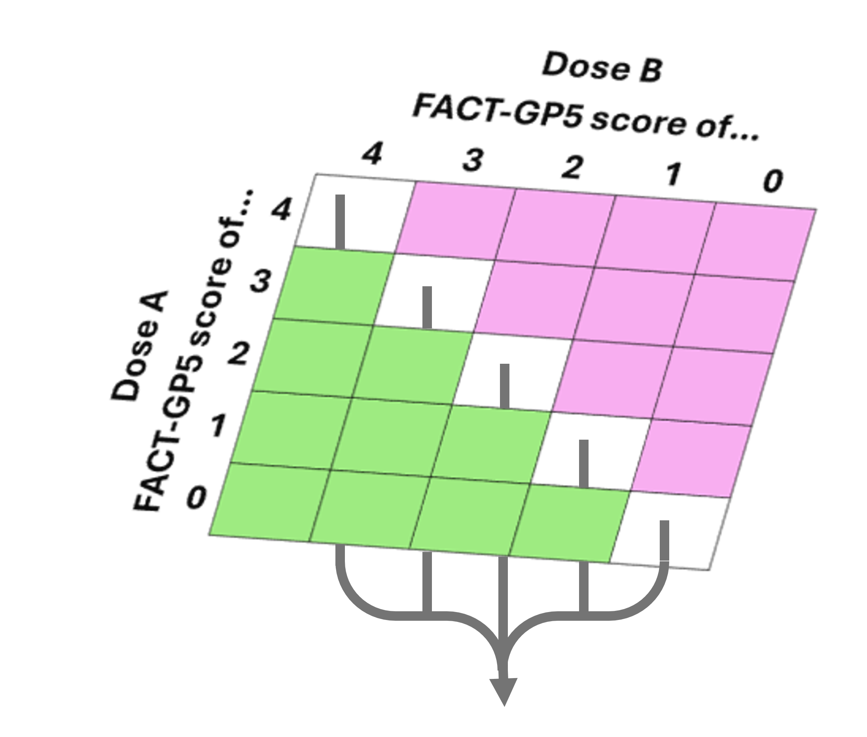
Pairs favouring
Dose A
Pairs favouring
Dose B
(1) Safety
264
114
Ties: 522
(2) Preliminary response
37
133
Ties: 352
(3a) Dose intensity
136
32
Ties: 184
(3b) PROs
92
56
WR = 0.63
95% CI [0.34, 1.18] , p=0.15
N_{A} = 529
N_{T} = 36
N_{B} = 335

