Slide 1


Effective Vaccine Management Training
E7: Distribution
Presenter:……………….
EVM—setting a standard for the vaccine supply chain

Slide 2

E7: Global requirement
E7 : Distribution between supply chain levels is effective

Slide 3
Distribution system: Why is this important?
In-country transport of vaccine is a key supply chain link but often the weakest one.
Studies show that 35% of vaccines are inadequately exposed to freezing temperatures during transportation*.
Distribution between each level in the supply chain is not always effective. Some observations:
Distribution according to a scheduled plan is not done.
Packing practices for transport puts vaccines at risk.
Temperature monitoring not done during transport.
Information systems not tracking vaccine status on arrival.
* Matthias, D.M., et al., 2007. Freezing temperatures in the vaccine cold chain: A systematic literature review. Vaccine 25, 3980-3986.

Slide 4
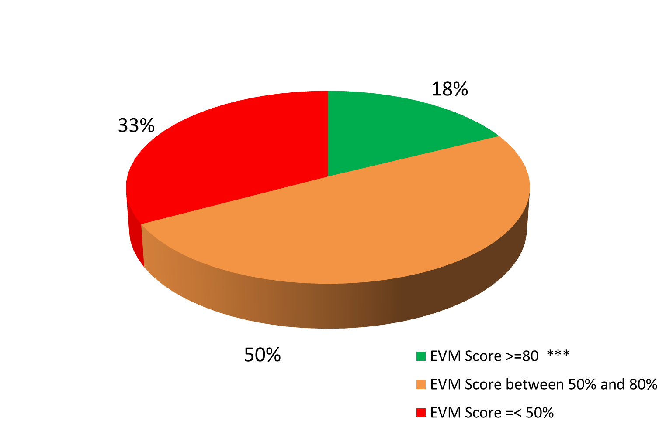
Distribution system: Evidence from 50 countries**
E7 Criterion*: % of countries by grouping of distribution scores
* Criteria score aggregated for national, sub-national, district and health center level
** WHO analysis based on 2010 and 2011 EVM data from 50 countries
*** Minimum score recommended by WHO is 80%

Slide 5
Distribution system: Main areas of investigation
Planned distribution system
Is there a planned distribution schedule?
is it being followed regularly?
Unplanned distribution system
Have there been instances of deliveries outside the planned schedule?
What were the reasons?
Were these managed effectively?
Vaccine packing for distribution
Not using a refrigerated truck:
Are cold boxes and vaccines carriers properly used?
Are the frozen water packs (if used) conditioned adequately?
Is the packing of vaccines done according to standards?
Using a refrigerated truck:
Are refrigerated vehicles correctly used?
Is there an SOP for packing?
Is the SOP followed?

Slide 6
Distribution system: Main areas for verification
Requisition and issues
Verify if the right form being used correctly.
Verify if VVM and freeze indicator* status recorded upon reception.
Vaccine damage and losses during transport
Verify if freeze and heat damage has occurred during transport.
Transport contingency planning
Verify that a written plan and SOP exists.
Verify that drivers understand emergency procedures.
Photos can tell 1000 words……………….

Slide 7
Distribution system: Key principles - 1
Planned distribution system:
Essential for achieving 3 of the 6 rights of a supply chain:
Right Product, Right Quantities, Right Place, Right Time, Right Condition, Right Cost.
Each vaccine store at all levels of the system needs:
A distribution plan based on efficient route planning/delivery circuits.
A distribution schedule that is respected and monitored.
To ensure the distribution plan is followed as closely as possible.
A plan with some flexibility, but it must be planned flexibility.
Distribution plan and schedule is based on the knowledge of:
When vaccine will arrive in the store and when it will leave.
How much vaccine will arrive in the store and how much will leave.

Slide 8
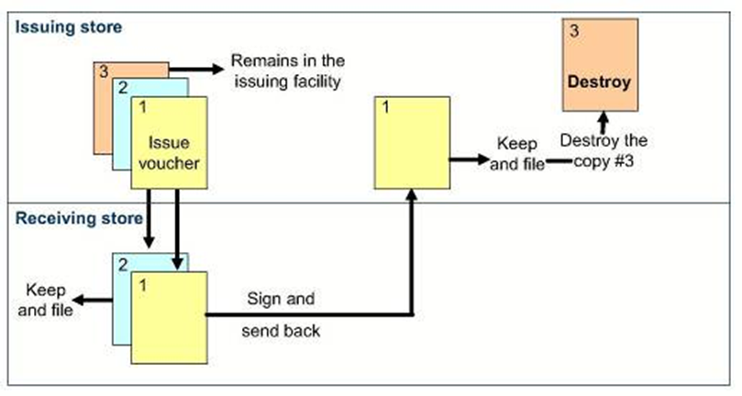
Distribution system: Key principles - 2
Correctly designed issue voucher system:
To ensure traceability of vaccines, monitoring of physical damage and VVM and freeze indicator status.

Slide 9
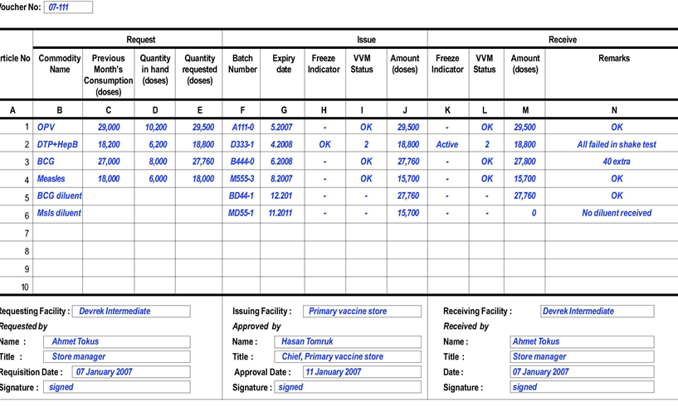
Distribution system: Key principles - 3
Ideal reporting system design:

Slide 10
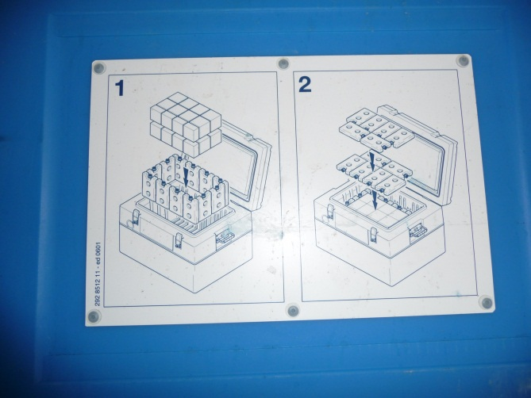
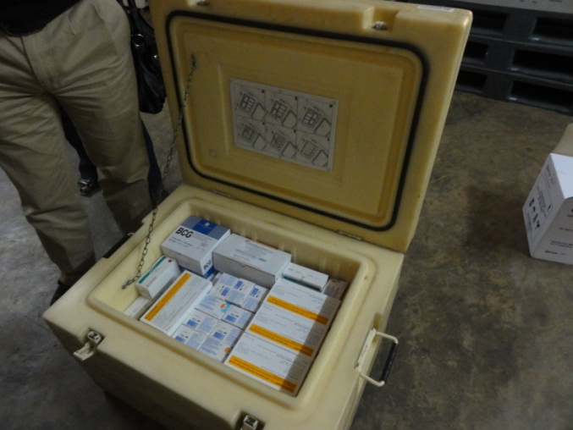
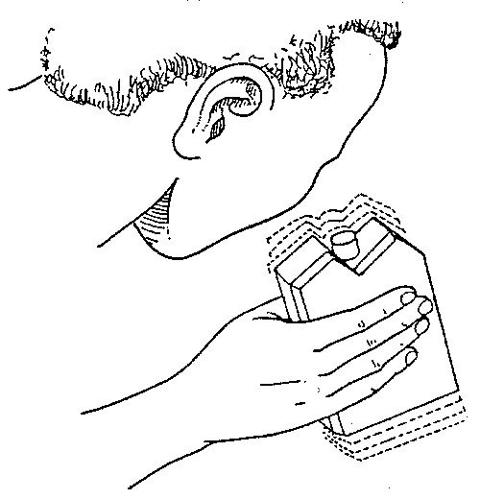
Distribution system: Key principles - 4
Correct vaccine packing practices (cold boxes):
Cold boxes need to be packed as shown in the manufacturer's instructions, or national SOPs.
Frozen water-packs need to be conditioned before packing in the cold box, unless PCM or cool water-packs are used for vaccine transport.

Slide 11
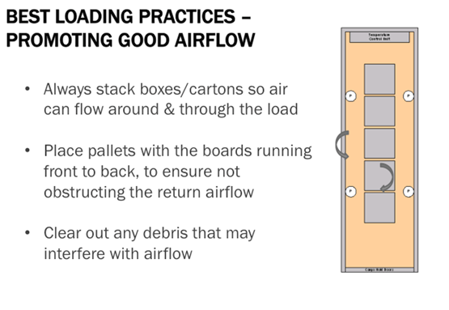
Distribution system: Key principles - 5
Correct vaccine packing practices (refrigerated truck):
Vaccines need to be packed to allow good air flow and circulation.

Slide 12
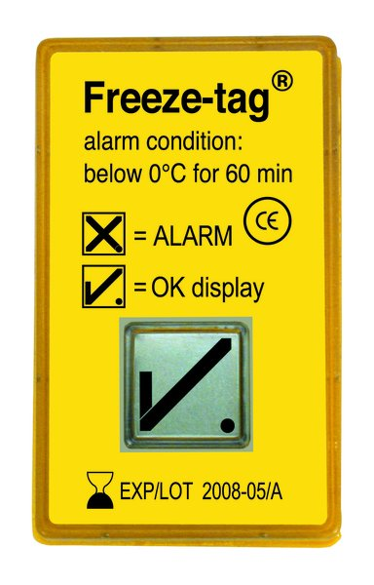
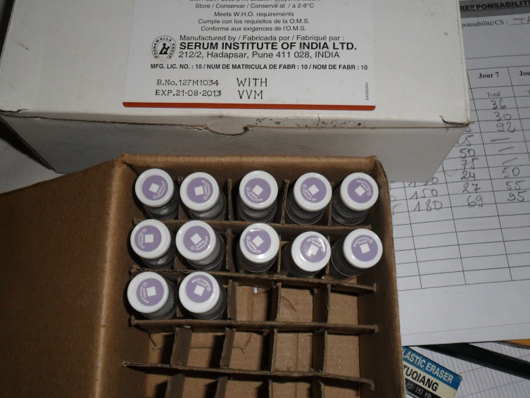
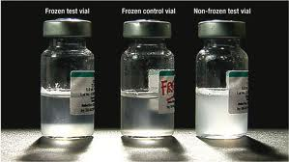
Distribution system: Key principles - 6
Temperature monitoring during transport:
If freezing is a risk, freeze watch indicators need to be used and correctly placed.
If a freeze event has occurred, the shake test needs to be done.
VVM status need to be recorded on arrival.
Assessment of vaccine losses during distribution.

Slide 13

Distribution system: Key resources
EVM SOPs:
E7-01.1 –Transport temperature
E7-02.1 – Pack cold boxes
E7-03.1 – Pack vaccine carriers
E7-04.1 – Conditioning ice-packs
E7-05.1 – Refrigerated vehicles
E7-06.1 – Transport emergencies
WHO guidelines:
Study protocol on temperature monitoring in the vaccine cold chain (including during transport)

Slide 14
E7: Questionnaire sections - 1
In groups of 3:
Review the questions;
Write down and queries and points of clarification;
Discuss practical challenges of collecting the information.

Slide 15
E7: Questionnaire sections - 2
7.1: Distribution reports comply with planned delivery schedule
7.1.1 – Compliance with vaccine distribution schedule from the issuing store to the each receiving store.
7.1.2 – Vaccine distribution reporting and monitoring system is effective.
7.2: Managing orders outside of the planned delivery schedule
7.2.1 – System for managing short shipments to receiving stores is effective
7.3: Vaccine packing is done according to standards for each equipment
7.3.1 – Transport vaccine in passive containers which have a cold-life (or in cold climates, a warm-life) sufficient for the longest expected journey.
7.3.2 – Pack vaccine into refrigerated vehicles in accordance with the standard operating procedure for the vehicle.

Slide 16
E7: Questionnaire sections - 3
7.4 – Temperature monitoring during transport is done effectively
7.4.1 – Dispatch: is the VVM status recorded for each batch of vaccine? If a freezing risk is identified, are freeze indicator used in every shipment of freeze-sensitive vaccine?
7.4.2 – Arrival: Does the receiving store return the arrival section of the issue voucher with recorded VVM and freeze indicator status (where applicable) at the time of arrival?
7.5 – Contingency plans for cold chain failure during distribution
7.5.2 – Are there contingency plans designed to deal with foreseeable emergencies on each and every distribution route.

Slide 17
Thank you

