Slide 1
Data Incubator Capstone project
Project Title:
Identifying the race of an individual involved in stop incident by using a statistical model
Prepared by
Aklilu z Welegebrael

Slide 2
Objective
Constructing a model which classify the race of an individual involved in stop incident, stop and frisk incidence
Identifying the trend of incidents a long the years
To identify the distribution of incidents a long with Gender, Ethnicity group and different Districts

Slide 3
Introduction
Washington Dc is the capital city of US which is one of the populous city.
Based on 2019 population estimation, there are a bout 711,571 population living in DC.
One of the highest crime rate area in US with crime rate of 60 per one thousand residents
The distribution of crime is not uniformly distributed throughout the city
As it is one of the populous city, the DC police has a lot of burden in maintaining the safety of the communities.
Even though most officers doing a great job on maintaining the community safety, there is a claim as some officers abuse their position

Slide 4
Data structure
A bout 27,559 individuals involved in stop incidence(i.e. stop and frisk) from 2010 to 2017 in Washington dc
Exploratory Data Analysis
Table 1.1: Distribution of races
Race | Observations | Percentage
Black | 22589 | 83.4991%
white | 1656 | 6.1213%
Asian | 97 | 0.3586%
American Indian or Alaska Native | 13 | 0.0481%
Native Hawaiian or Other Pacific Islander | 11 | 0.0407%
Unknown | 2687 | 9.9324%

Slide 5
From Table 1.1:distribution of races
A bout 83% of the individuals are black
A bout 13(0.0481%) are American Indian or Alaska Native
A bout 11(0.0407%) are Native Hawaiian or other Pacific Islander
About 10% of individuals their race is not identified
Table 1.2: Distribution of incidents along Dc districts
District | Observations | Percentage
1D | 4320 | 15.8637%
2D | 2424 | 8.9013%
3D | 3986 | 14.6372%
4D | 3771 | 13.8477%
5D | 3843 | 14.1121%
6D | 4474 | 16.4292%
7D | 4414 | 16.2089%
From Table 1.2: Distribution of incidents a long the different Washington dc districts,
District two has a minimum number of stop and frisk incidents from 2010 to 2017, about 8.9% , however the other districts have higher incidents

Slide 6
Table 1.3: Distribution of incidents along gender
Gender | Observations | Percentage
Male | 23259 | 85.9757%
Female | 2413 | 8.9196%
Unknown | 1381 | 5.1048%
Most of the incidented individuals are males, about 23,259(86%).
The male incidents are about ten times those of female.

Slide 7
Table 1.4: Distribution of incidents along Ethnicity groups
Ethnicity | Observations | Percentage
Not Hispanic or Latino | 17571 | 64.9503%
Unknown | 8058 | 29.7860%
Hispanic or Latino | 1424 | 5.2637%
A bout 65% of the incidents are happened on Not Hispanic or Latino
About 5.00% are belong to Hipanic or Latino ethnicity group.
A bout 30% of the individuals were not known their ethnicity group.

Slide 8
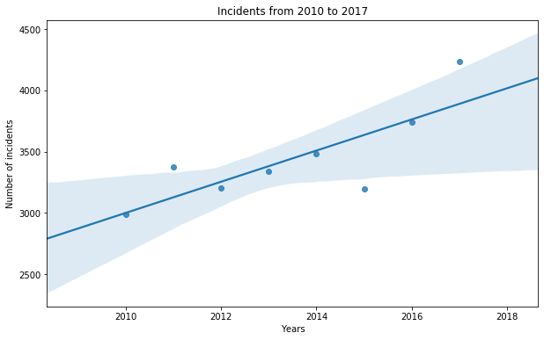
Figure 1.0 describes the trend of the incidents from 2010 to 2017
As we can see from the figure incident looks like increasing from year to year except in 2011( more increase) and 2015 ( decrease).
From the fitted line we can say that there is an increasing trend of incidents from 2010 to 2017

Slide 9
Statistical Methods
Logistic regression, Decision tree and SVM will be used to classify an arbitrary incidented individual to the different race groups such as:
white
Black
Asian
Alaskan Native or American Indian
Native Hawaiian or other Pacific islander race

