Slide 1
CHAPTER ONE
Introduction
Background of the organization.
Civil case
Criminal case
Constitution
Mahiberawi fird shengo.
Statement of the problem

Slide 2
Objective
General objective
To develop web based court management system for Bahir dar around First instance court .
Specific objective
Analyze the existing system.
Collect information related to the system.
Preparing needed materials which used for developing the project.
Select appropriate language.
Design and developed a user friendly system to handle data insertion, updating, deletion, retrieving on the database.
Develop a secured Data base system.
Develop suitable system to give appointment and assign cases.
Develop suitable and fast intercommunication between offices.

Slide 3
Cont…
Methodology
Requirement gathering methodology
Interview
Observation
Document Analysis
Analysis and design Methodology
The team plan to use the Object Oriented Software Development Methodology (OOSD) for the development of the system
Because it is better way to construct, manage and assemble objects that are implemented in our system.

Slide 4
Cont…
We used OOSD because of the following important features:
Increase reusability
Increased extensibility
Improved quality
Financial benefits
Reduced maintenance cost
Object oriented design methodology has two phases
OOA
OOD
Implementation Methodology
Hardware tools
Software tools

Slide 5
Cont…
Feasibility
Economic feasibility
Technical feasibility
Time feasibility
Benefits
Benefits for court
Benefits for customers
Benefits for team members
Limitations of the project
does not include such as human resource and finance information.
not including other sector offices like police and jail.
don’t supports decisions and mitigating by it.

Slide 6
Cont…
Scope of the project
Register new cases, completed cases and decisions.
View assigned cases that law officers are assign to Judges
Register any customer
Register any Advocator with full address
Register appointment
Update employee’s information.
Generate reports
Accept comment from customers

Slide 7
CHAPTER TWO
What look like the existing system?
cybersoft software company (ccims)
Actors
Administrator
Judge
Law officer
Civil law officer
Criminal law officer
Customer
Advocator

Slide 8
Cont…
Problem of Existing System
Performance
Security and Controls
Economic
Data storage problem
Strength, weakness, opportunity, threat (SWOT) analysis
Strength
Weakness
Opportunity
Threat

Slide 9
Proposed System
New features of proposed system
Requirement Analysis
Functional requirement
Assign the cases to the judges.
Record final decision and evidences.
The system would able to search the file within short time.
Register the details of accuser, accused, and advocator properly.
Giving appointments for the customers.
Handle the data properly

Slide 10
Functional requirement
Generate reports
Adding new user account; modifying recent users account and delete user account.
View information for customers
Giving privileges to each user
Giving comment online to administrators.
Changing their password.

Slide 11
System Use case
Use cases contained in our system
Login
Manage account
Generate report
New case registration
Advocator registration
View appointment
Give appointment
Record decision
View assigned case
View decision
Give comment
Search Customer Information
View information

Slide 12
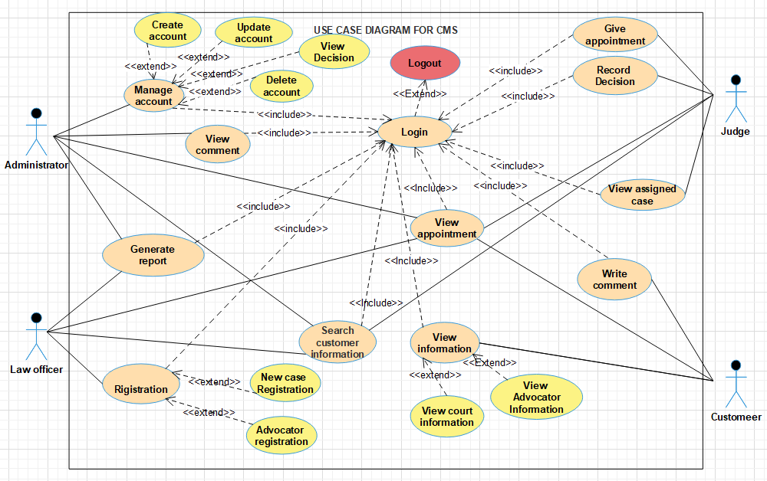
Use case diagram

Slide 13
Business Rule of the Organization
The client must be come to the office on the appointment day.
The judge assigned for one case does not changed from that case.
Any appointed case can see within 10 up to 15 days.
Civil cases must see by civil law Judge.
Criminal cases must see by criminal law Judge.
If accuser, accused, advocator or public prosecutor does not satisfied to the decision judges, he/she can ask appeal to the upper court.
Seeing active case except the judge assigned is impossible for others.
If any accused or accuser can’t defend by himself , they can represent advocator.
All employees must come on time and obey regulation of the court.
Administrator has responsibility to manage all the system in court.

Slide 14
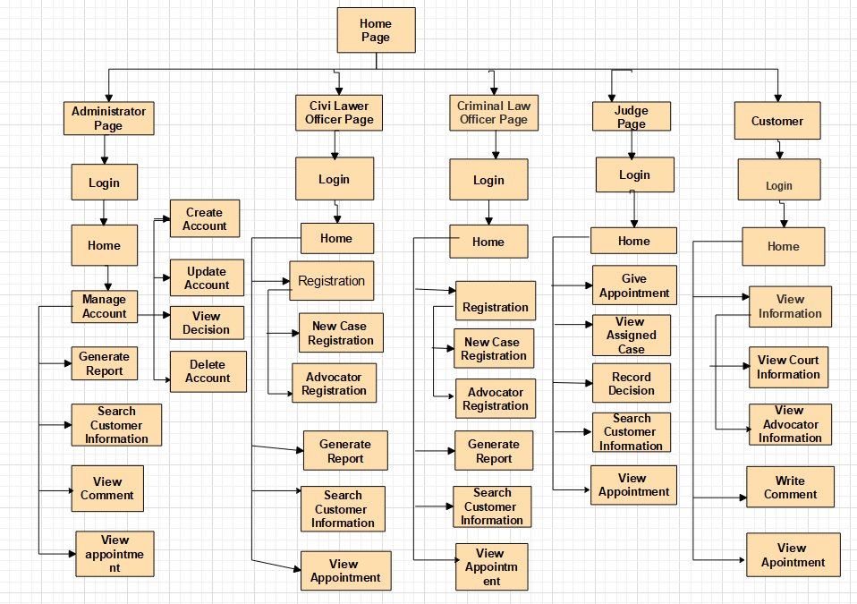
User Interface prototype

Slide 15
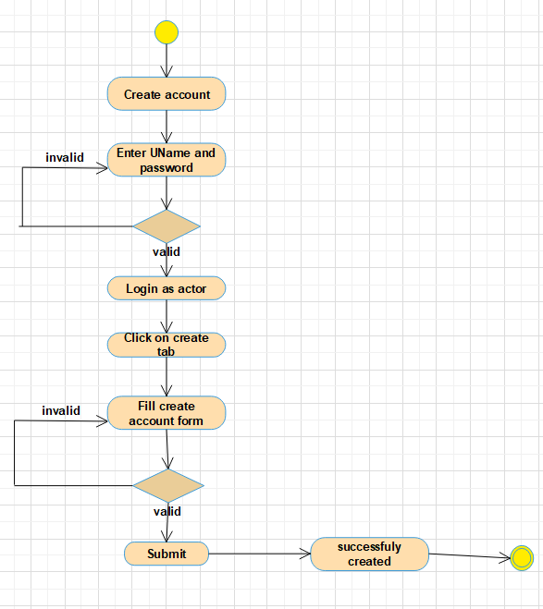
State chart diagram
State chart diagram shows the machine that depicts the control flows of the objects from one state to another state.
State diagram for create account

Slide 16
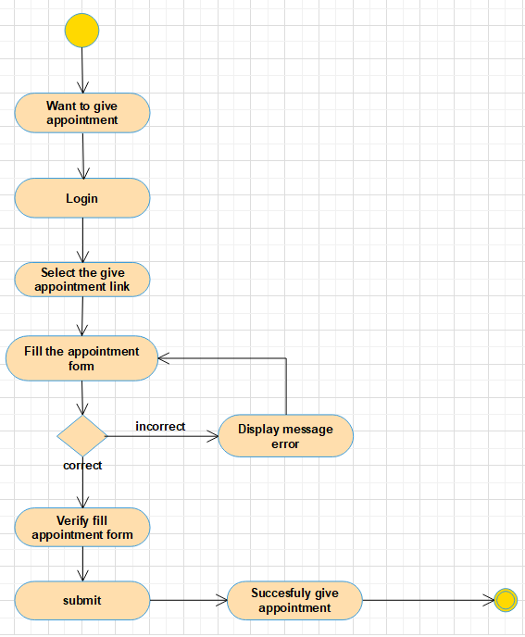
Activity Diagram
Activity diagram focuses on the flow of activities involved in a single process.
Activity Diagram for New Case Registration

Slide 17
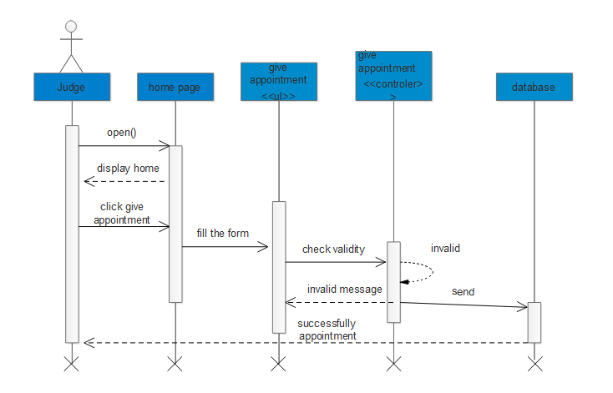
Sequence diagram
A sequence diagram shows object interactions arranged in time sequence.
sequence diagram for Give appointment

Slide 18
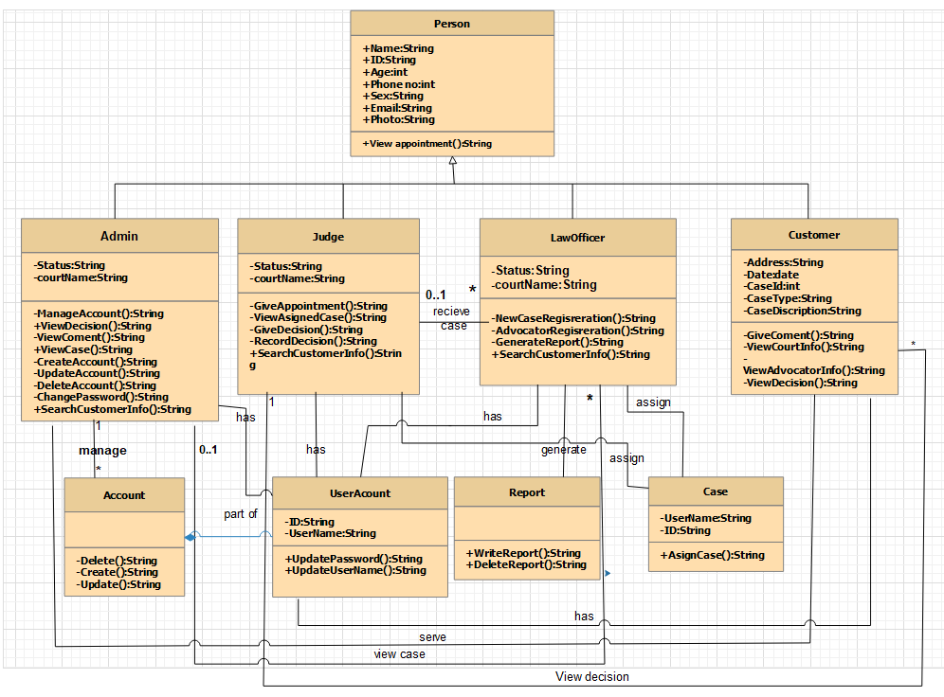
Class model
class model

Slide 19
Non functional requirement
Accuracy
Performance
Reliability
No Redundancy
Availability
Efficiency
User friendly Interface
Security
Usability
Error handling

Slide 20
Key abstraction with CRC analysis
A Class Responsibility Collaborator (CRC) model is a collection of standard index Cards that have been divided into three sections; this is class name, responsibility and collaborator.
A class represents a collection of similar objects
a responsibility is something that a class knows or does
a collaborator is another class that a class interacts with to fulfill its responsibilities.
Login
Username Password Login() | Administrator Judge Law officer Customer

Slide 21
CHAPTER THREE
System Design
System design is the transformation of the analysis model into a system design model.
Court management works in a networked environment and is going to be a web based application.
Users of the system can access it from a local area network or from anywhere over the Internet.
While developing Court Management System, there are a lot of design goals to be taken.
The design goals are based on standard software design methodologies
User friendly
Performance
Development cost
Portability

Slide 22
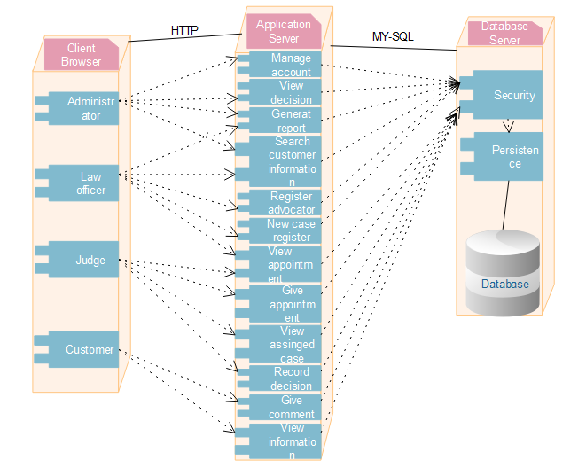
Deployment Modeling
The deployment design used to show the hardware of the system and the software that is installed in the hardware.
It also shows how the software and the hardware components work together

Slide 23
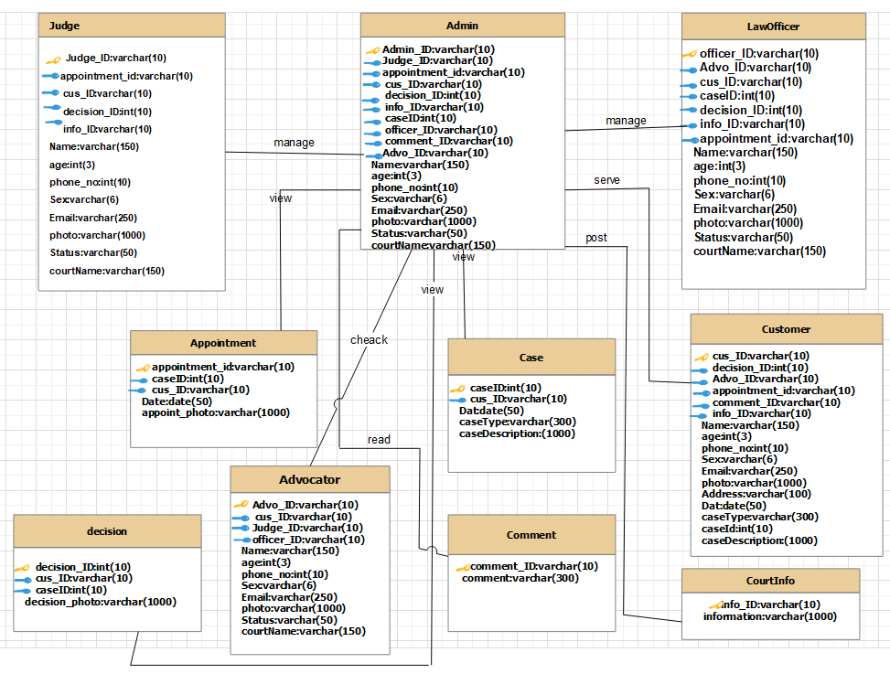
Persistent model
Persistent model deals with how the persistent data (file, database) are stored and managed and it outlives a single execution of the system.

Slide 24
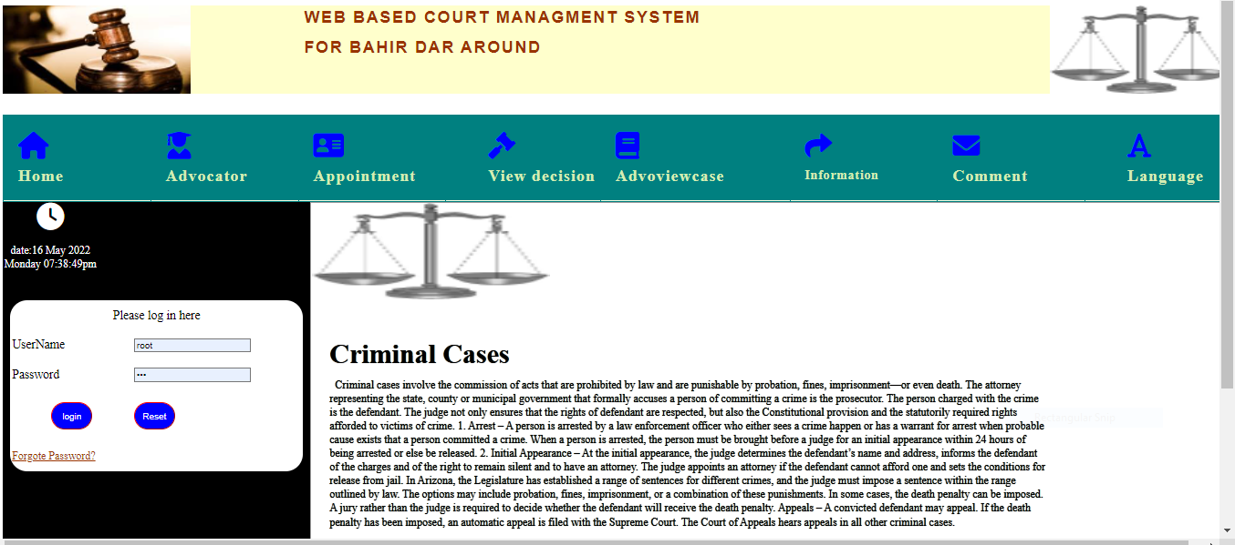
User Interface Design
User interface prototype is to indicate the surface that can be used by user and the system to communicate to each other, but, not actual work area.
Login and customer home page

Slide 25
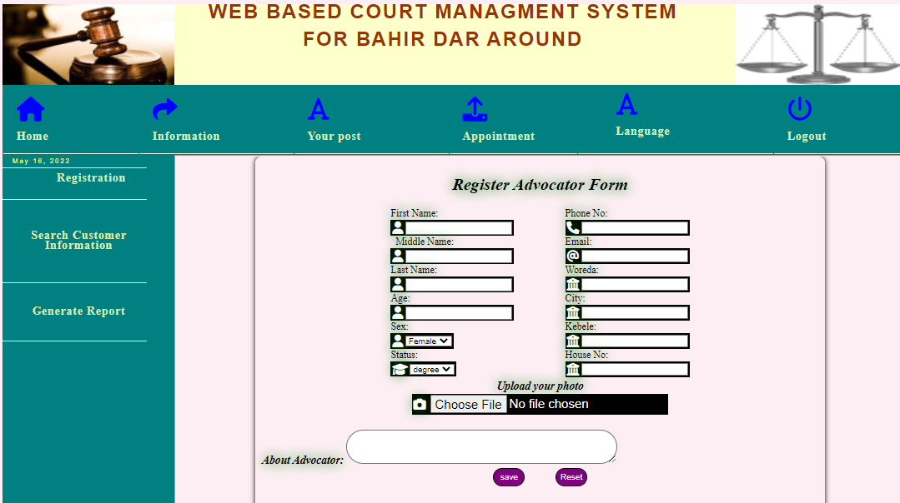
Cont…
User interface for law officer

Slide 26
THE END!!!
THANK YOU FOR GIVING YOUR ATTENTION

