Slide 1
CS FINAL PROJECT
VOTING APP-The purpose of this application is to facilitate a simple voting process.
Allen Kurien

Slide 2
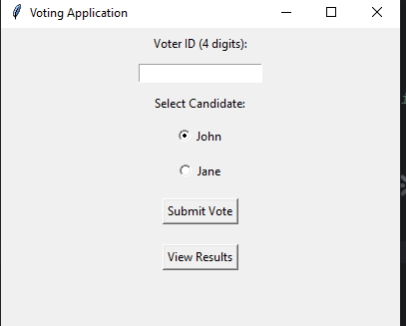
INTRODUCTION
Voting: Allows users to vote for "John" or "Jane" with a 4-digit ID, ensuring each voter can only vote once.
Vote Tracking: Counts and stores votes for each candidate, with data saved across sessions.
Duplicate Prevention: Checks that each voter ID is unique.
History Recording: Logs votes in an Excel file for tracking.
Results Display: Provides functionality to view current vote counts.

Slide 3
Conclusion
It is very important to test your programs at each progress you make.
Suggestion to add a view results was implemented successfully .
Was able to learn to finish a project at a specific time.

